Slide 1




Gaining insight from inpatient falls
and linking with PSIRF
Presenter: Lucy Winstanley
Helen Dockerill
West Suffolk NHS Foundation Trust

Slide 2

Objectives
Gaining insight from inpatient falls
Reporting and investigation of inpatient falls – changes with the introduction of PSIRF
Participation in the national audit of inpatient falls at a local level
Falls investigation: learning from falls
Implementation of safety improvement practice: our experience as a PSIRF pilot site

Slide 3

Our story - WSFT falls position
December 2022 data
Total trust falls figure – 113
Of these 113 falls 102 occurred in acute beds and 11 occurring in community beds
14 patients were classed as frequent fallers – 12 fell twice, 1 three times and 1 six times during the reporting month
Year to date data
The average number of falls per month is 100, including acute and community beds

Slide 4
Case Study
Fall with fractured neck of femur
What happened?
Admission with back pain and urinary incontinence
Treatment given for UTI
Declined to mobilise due to back pain and feeling unwell
Mobilised with a frame and supervision and completed stairs assessment
Discharge planned for the afternoon
Unwitnessed fall within the bay and sustained a fractured neck of femur.
Why did it happen?
Background of dementia
Patient awareness that not at home and wanting to return home
Deconditioning
Reduced insight into abilities
Call buzzer not used
Staff attending to another patient and not in the bay when patient mobilised
Bed space has reduced visibility from ward corridor

Slide 5
Case Study
What have we learned?
Patient awareness and understanding of discussions and discharge plans
Manual Handling technique to assist patient off the floor
Lying/ standing blood pressure
What are we doing about it?
Education to staff ensuring close observation when patient sat out for first time
Identifying how we support patients unable to use call bell system
Education to staff regarding the covid curtains being rolled up between bed spaces
What did we do well?
Documentation regarding post fall assessment and patient refusing observations, patient monitored closely for any other signs of deterioration

Slide 6
National Patient Safety Strategy
Three strategic aims
INSIGHT - improving understanding of safety by drawing intelligence from multiple sources of patient safety information
INVOLVEMNT - equipping patients, staff and partners with the skills and opportunities to improve patient safety throughout the whole system
IMPROVEMENT - designing and supporting programmes that deliver effective and sustainable change in the most important areas

Slide 7
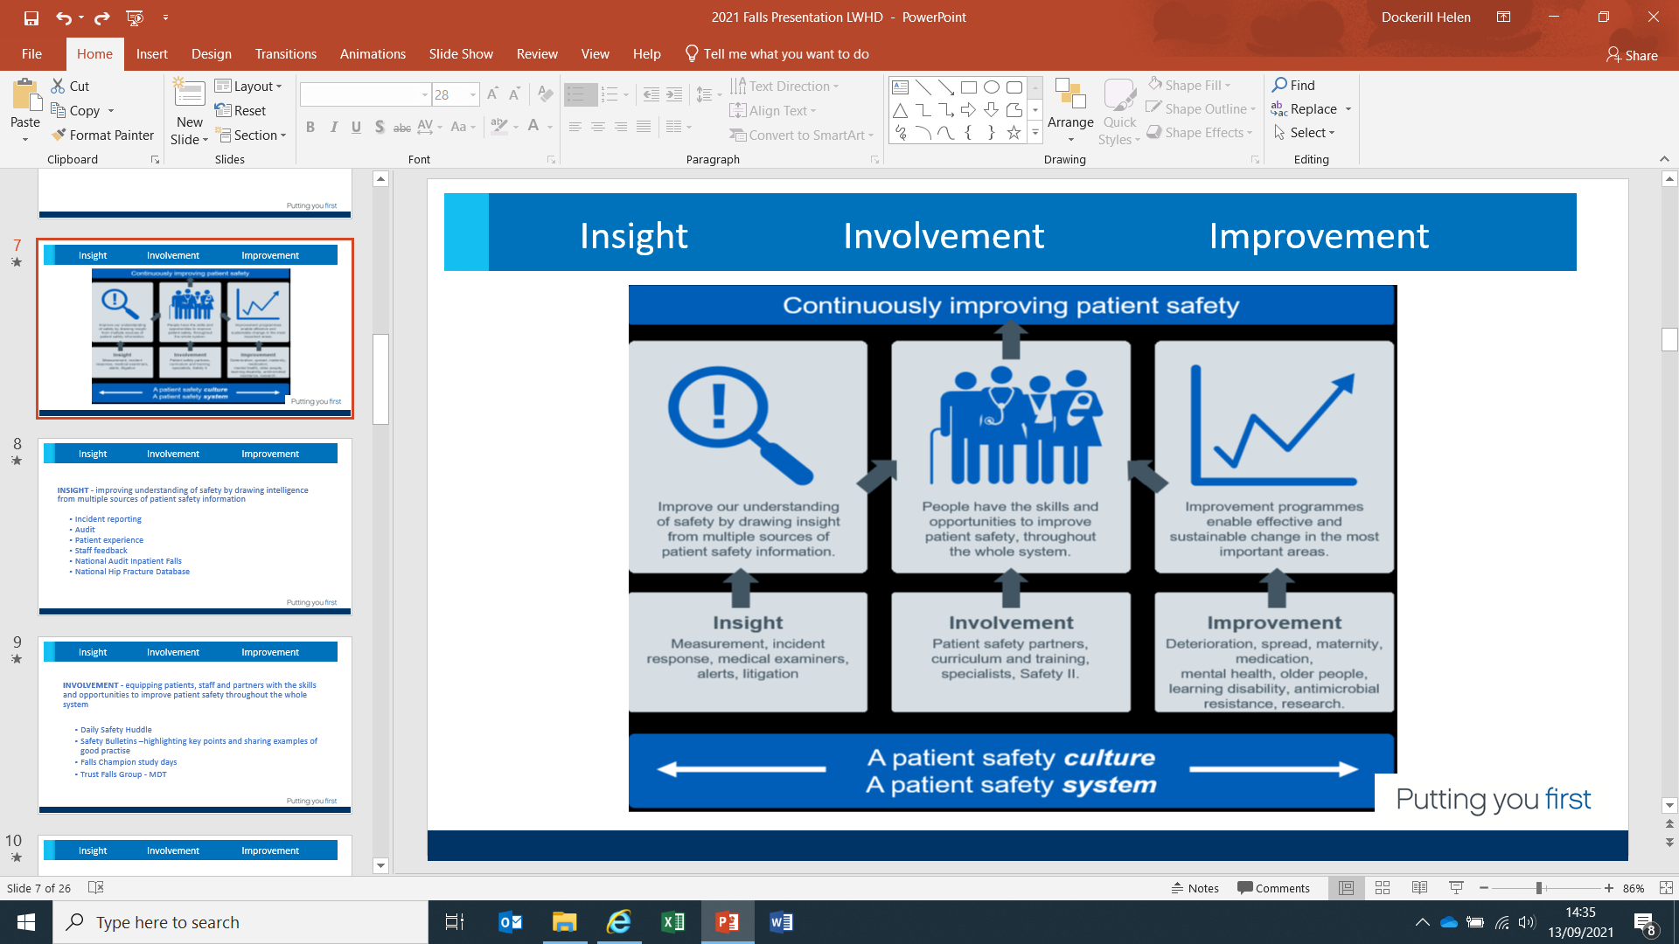
Insight Involvement Improvement
INSIGHT
  Incidents
  Greatix
  Complaints
  Staff feedback
  Safety Dashboard
  National Audit Inpatient Falls
  National Hip Database
  Daily falls reviews

Slide 8

Insight Involvement Improvement
INVOLVEMENT
  Daily Safety Huddle
  Safety Bulletins –highlighting key points
  and sharing examples of good practise
  Falls Champion study days
  Trust Falls Group – MDT
  Engagement with the patient/ family

Slide 9
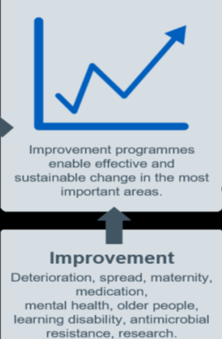
Insight Involvement Improvement
IMPROVEMENT
  NAIF –pilot of the new process including
  hot debriefs and after action reviews
  Continuous review of falls to identify themes
  Monthly quick wins
  Targeted QI approach, use of Life QI

Slide 10
Patient Safety Incident Response Framework
Key part of the NHS patient Safety Strategy
Aim to help the NHS to improve its understanding of safety by drawing insight from patient safety incidents.
Early adopter site
Opportunity to use alternative method to safety investigation
Collaborated with the National Audit Inpatient Falls for investigating inpatient falls with ‘hot debrief’ and ‘After Action Reviews’.

Slide 11
PSIRF at WSFT – Developing our PSIRP
Included in our local predefined patient safety priorities which meet PSII
Failed discharges related to medicines management
Shared care (between specialties) where management of care resulted in extended length of stay requiring additional treatment/ surgery
Diabetes management leading to deterioration requiring interventional treatment at higher level of care 9level 2/3)
Out of hours delayed recognition of deterioration and/or not escalated appropriately
Falls – inpatient falls resulting in a major bone fracture

Slide 12
PSIRF at WSFT- Investigation tools
Patient Safety Audit (PSA)
Medication incidents
Pressure ulcers developed in our care
Patient safety Review (PSR)
Maternity incidents, adverse outcomes and externally reportable events that do not meet the threshold requirement for completion of a PSII
All incidents which meet moderate or major harm

Slide 13
Inpatient falls - what we did before
Completed a root cause analysis* for each fall resulting in major harm
Completed a concise RCA** on our Datix system for other falls resulting in harm
Added narrative to all green (no harm) falls incidents on Datix
Also
Participated in the National Audit of Inpatient Falls
Produced monthly data on falls parameters from our electronic patient record (e-Care)
Reported monthly falls data (absolute numbers and per 1,000 bed days) to the Trust board

Slide 14
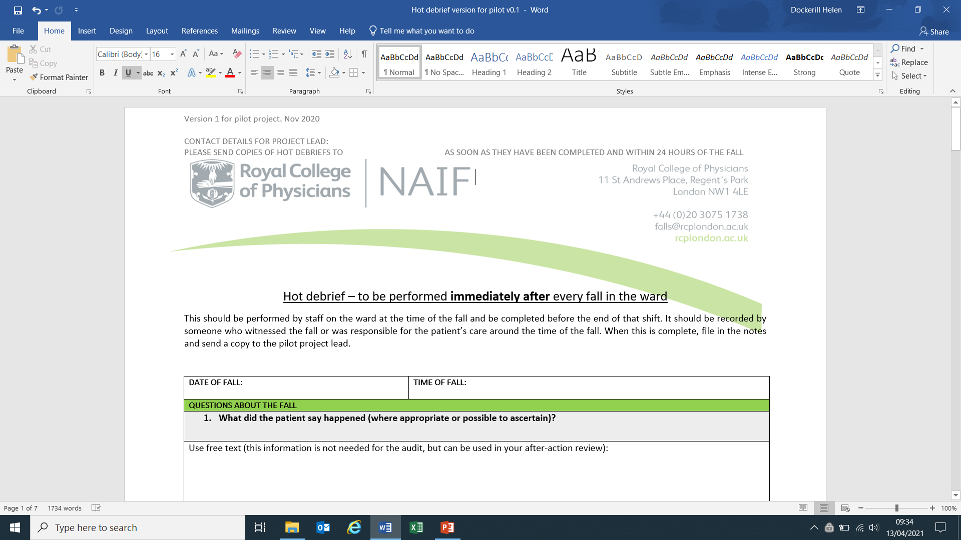
Hot Debrief

Slide 15
Hot Debrief
To ensure the patient and those involved in the patient’s care are given the opportunity to provide their account of the fall.
To collect the information about the circumstances surrounding the fall to inform the after-action review.
To improve record keeping relating to the fall
To support data collection for the National Audit of inpatient Falls for falls that lead to hip fracture (NAIF)

Slide 16
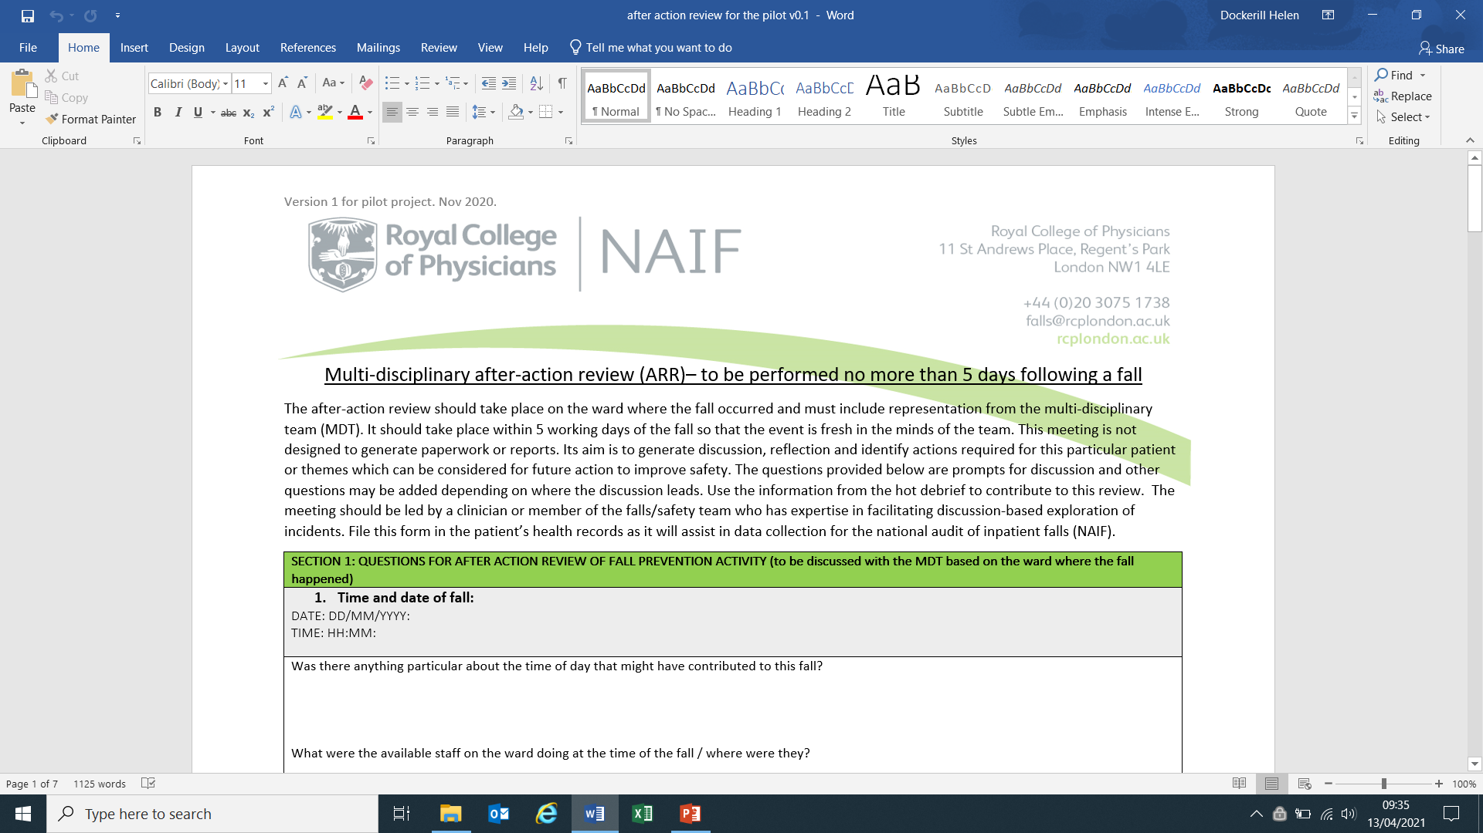
After Action Review

Slide 17
After Action Review
For the multi-disciplinary team to participate in open discussion about the circumstances leading to and the management of the fall.
To develop insights into how patient safety might be improved as a result of the discussion.
To share the outcome of discussions more widely to allow others within the organisation to benefit from the insights.
To be used to identify patterns that might require further investigation and provide an information base to support a PSII

Slide 18
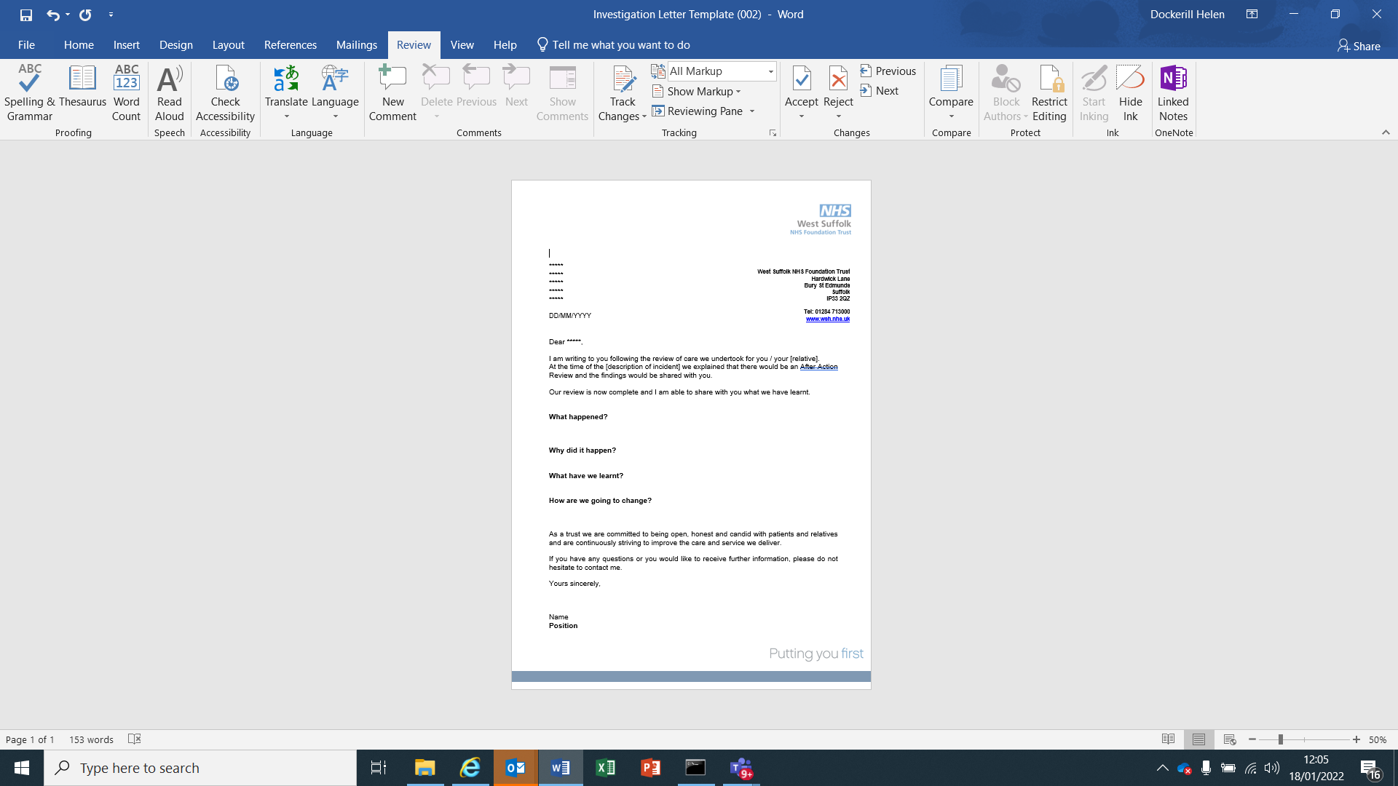
What happened?
How did it happen?
How are we going to change?
Investigation Findings Letter

Slide 19
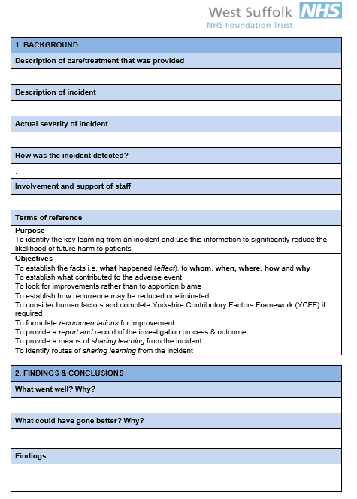
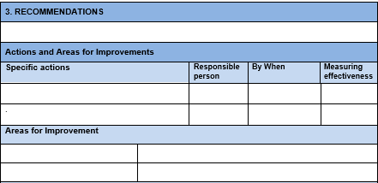
What happened?
How did it happen?
Findings
Actions and Recommendations
Patient Safety Review Template

Slide 20
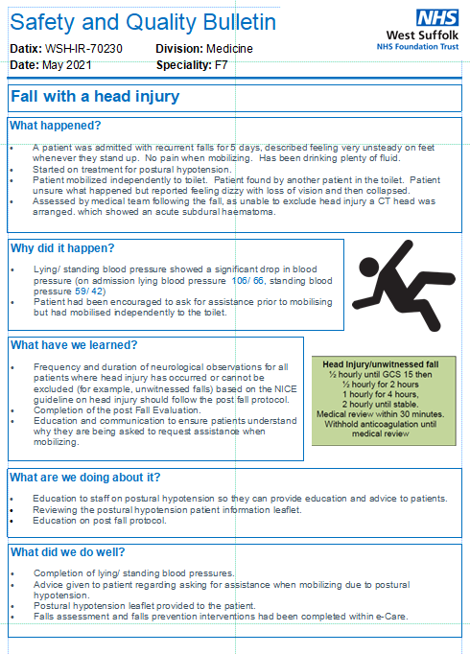
Safety Bulletins

Slide 21
Evaluation – Local and National
LOCAL
  Earlier identification of learning outcomes
  Earlier identification of themes across falls and therefore improvement plans to address these
  Opportunity for MDT involvement
NATIONAL
  Participated in national evaluation
  Awaiting results

Slide 22
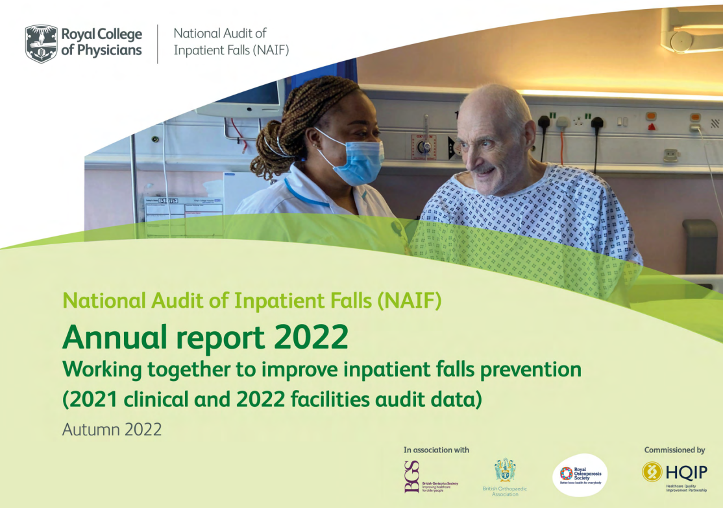
Learning from the national audit of inpatient falls at a local level

Slide 23
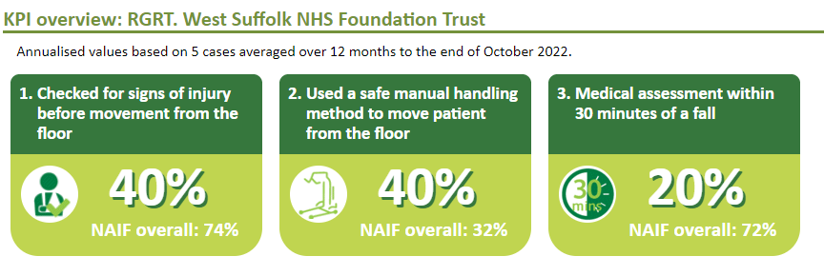
Learning from the national audit of inpatient falls at a local level

Slide 24
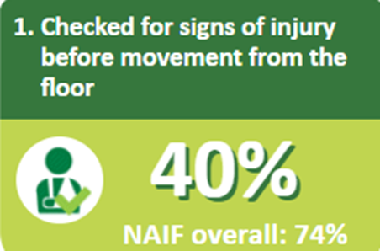
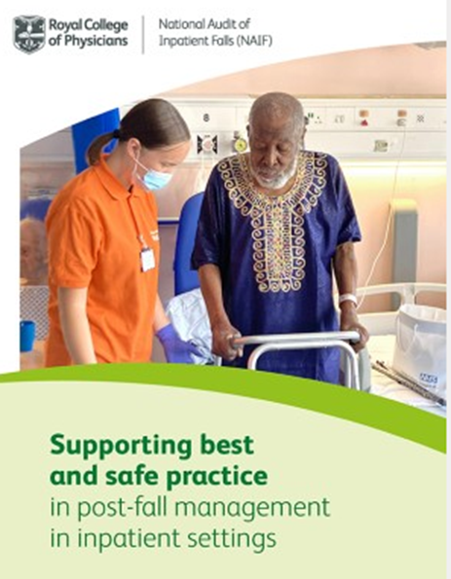
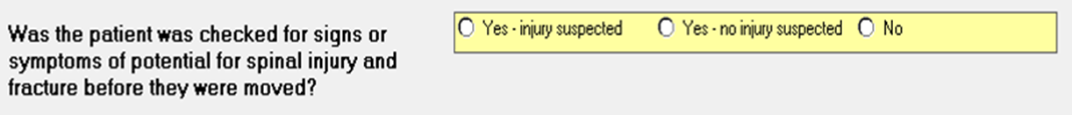
Documentation- not always clearly stated that patient checked for injury prior to being moved
Changed the post fall documentation to support this
Education and training to staff
Falls to be included within staff induction

Slide 25
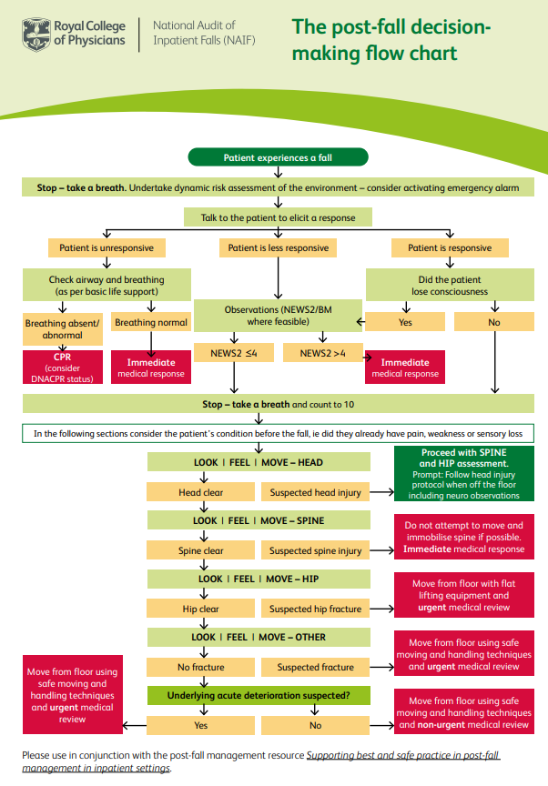

Slide 26
Hoverjack
Assessment of injuries prior to moving
Purchasing of additional scoops so more accessible and visible to ward staff
Education and training
QI project focusing on manual handling method to move patient from the floor

Slide 27
Electronic documentation
Not recorded time patient was assessed
Review of the medical post fall documentation

Slide 28
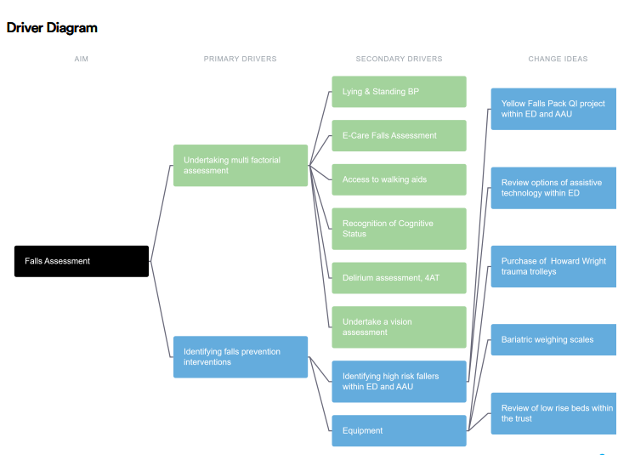
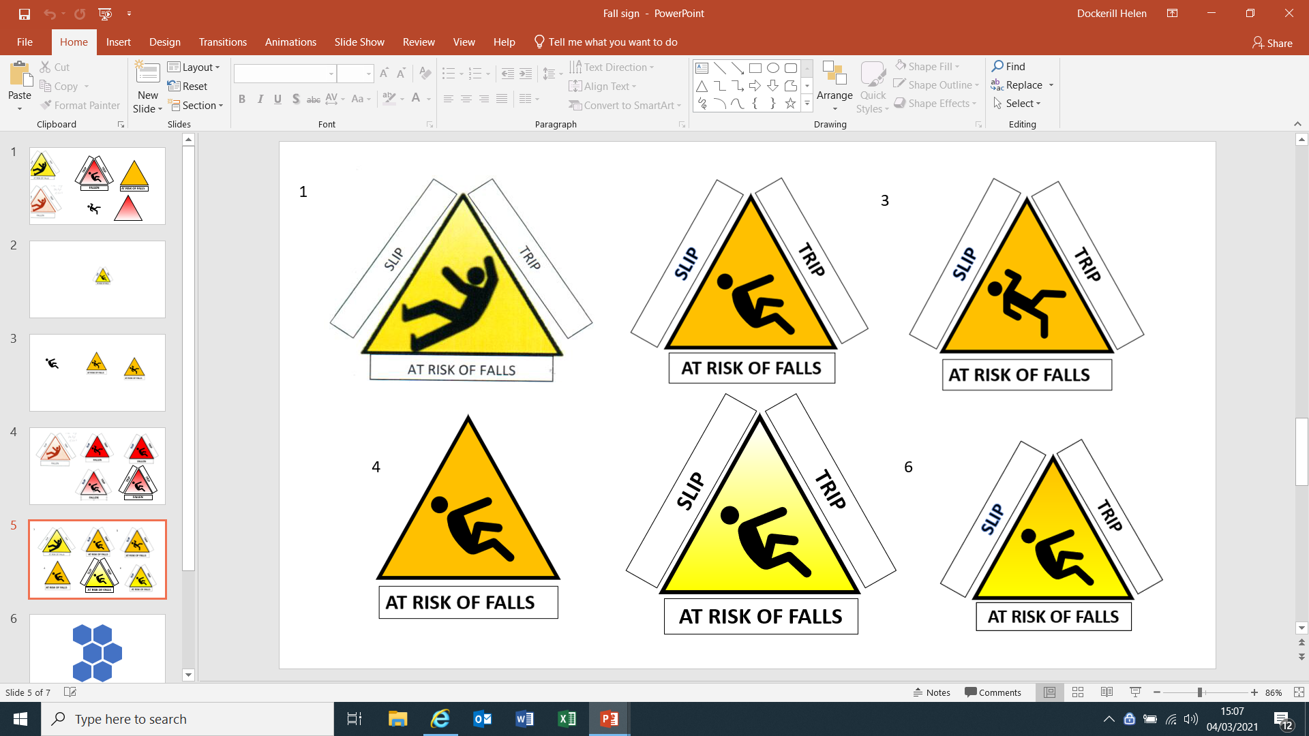
Using Life QI to map falls improvement

Slide 29
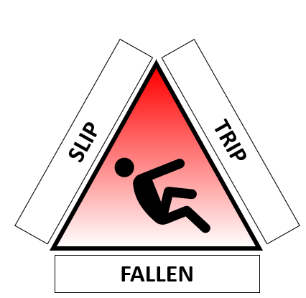
Examples Frequent Fallers
Escalated at safety huddle to matron of the area
Ensuring all falls prevention strategies are in place
Communication within the MDT to ensure frequent fallers identified
Timely patient and environmental safety reviews

Slide 30
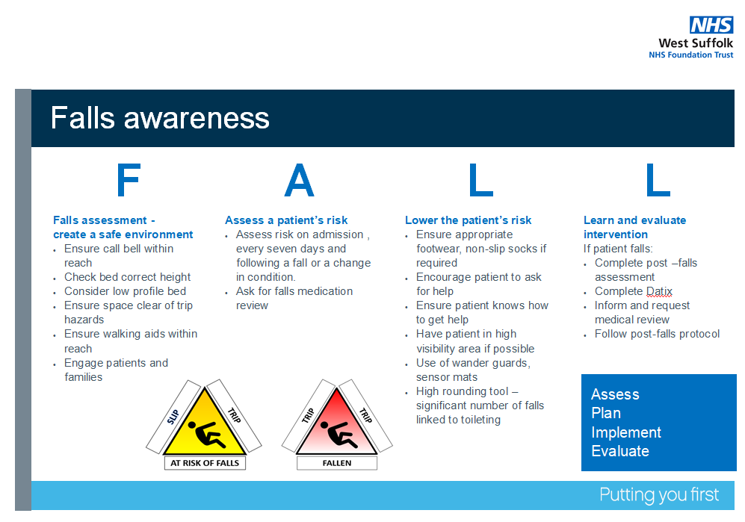

Slide 31
PSIRF – working well so far..
Insight
Dedicated Falls lead who is able to continuously review and interpret data on a regular basis
Participation in National Falls Audit
Triangulate data
Involvement
Daily safety huddle
Involve staff at the time of the fall to support through de-brief and AAR
Share good practice and bad at time of fall for enriched learning
Improvement
Use QI method to plan and test project work for frequent fallers and patients who have been admitted as a result of a fall
Measure again improvement plan

Slide 32
PSIRF – What we plan to do next..
Continue to use debrief and AAR to investigate falls with moderate harm and above
Continue to use thematic analysis for all falls
The Falls group will receive and review
  Output of the Debrief + AARs
  All falls data presented within a falls dashboard
  Reports / publications from the national audit
  Plan safety improvement work accordingly

Slide 33
Our take home messages
Trust focus on falls but accept there is still lots to do!
Insight
Invest in Falls - Trust Falls role
Utilising different investigation methods to learn
Involvement
Trust falls group with MDT input and Executive sponsor
Falls champions
Improvement
Qi projects

Slide 34

Thank you for listening.
Any Questions?

