Slide 1
THE NEW NICE GUIDELINE FOR SELF HARM dr Gemma Trainor
Senior lecturer in mental health nursing
Liverpool john moores university and nice SELF HARM guideline development COMMITTEE MEMBER, 2019-2022

Slide 2
OUTLINE OF TALK
PART 1 Guideline development process
Overview of the NICE Guideline process, the 15 topic areas covered, the evidence base, the recommendations, the rationale for them and impact upon practice
PART 2 Specific Recommendations
This presentation will cover 4 specific topic areas and recommendations covering …
  Compassionate approaches
  Information and support
  Consent and confidentiality
  Safeguarding
  Involving Families and Carers
Remaining NICE GL topic areas and recommendations (eg interventions) will be addressed by other speakers

Slide 3
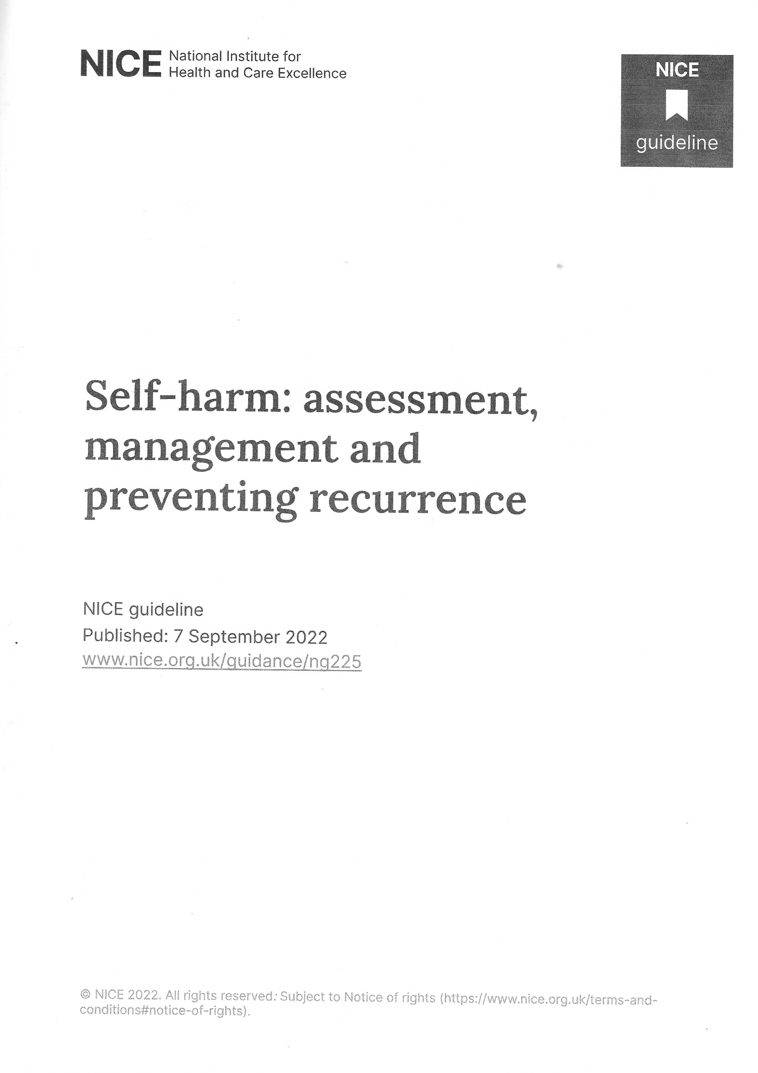
PART 1 – NICE GUIDELINE OVERVIEW

Slide 4
GUIDELINE DEVELOPMENT PROCESS
Existing 2 guidelines over 10 years old - in need of updating into single GL encompassing both short and long term care and management for children, young people and adults
Recommendations drafted by GL development committee following review of published evidence carried out by researchers at the National Guidance Alliance (NGA) – systematic reviews/PICO approaches etc
Committee chaired by Dr Jeremy Isaacs (Consultant Neurologist) with Prof Nav Kapur as advisor
17 members (including 3 lay members) and also 7 co-optees.
Specialists in psychiatry, psychotherapy, mental health nursing, emergency medicine, social work, general practice etc along with co-opted members eg police and prison service.
Committee meetings took place on line between 2019 and 2022

Slide 5
GUIDELINE DEVELOPMENT PROCESS –EVIDENCE REVIEW
Over 20 Expert Topic Groups formed from membership who identified specific questions to be addressed in the GL
eg “ What is the most effective approach to obtain consent, ensure confidentiality and promote safeguarding when people have self-harmed?”
NGA scientists (systematic reviewers, economists etc) collected relevant published evidence – both quantitative (ideally from RCTs) and qualitative - from UK and abroad – to address the posed question.
Produced 20 detailed Evidence Review reports

Slide 6
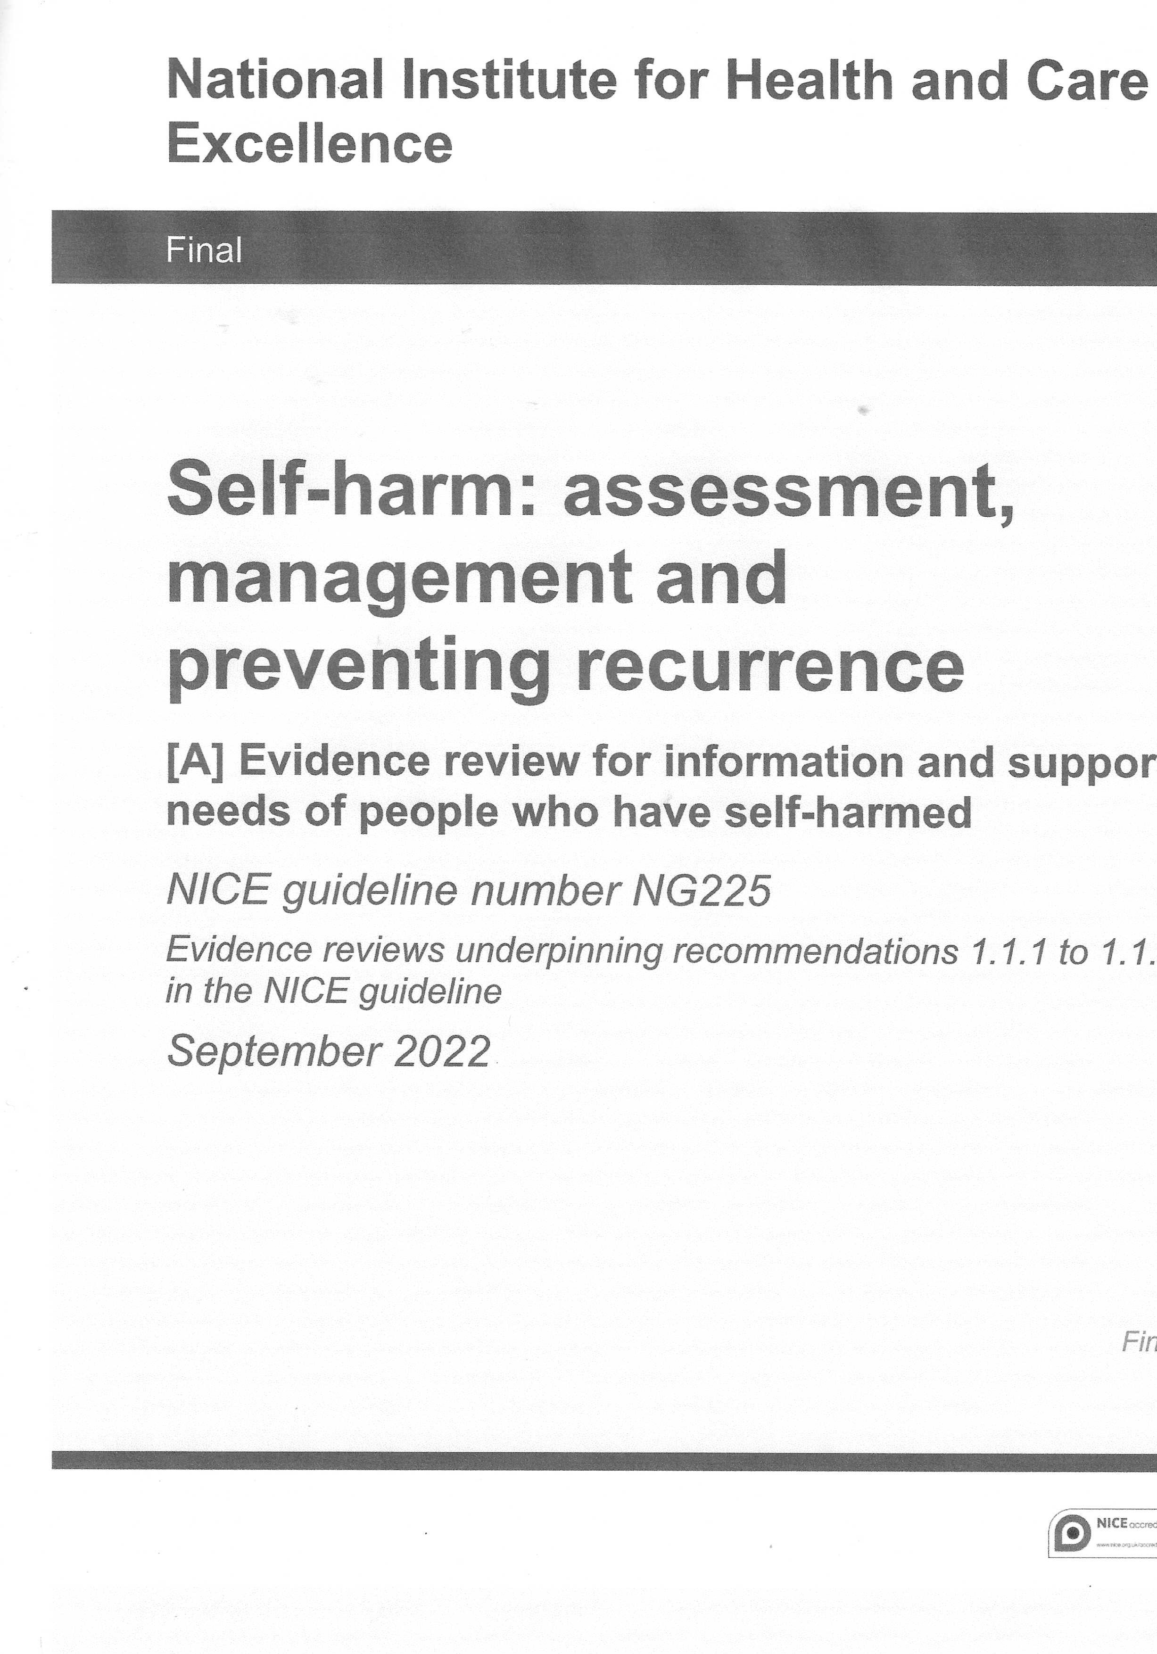
Evidence Review A
Information and Support Needs of People who have self-harmed
245 pages

Slide 7
GUIDELINE DEVELOPMENT PROCESS –EVIDENCE REVIEW
The Evidence Reviews including, economic analyses and committee discussions are all published - each typically over 100 pages long – so over 2000 pages of documentation supporting the GL recommendation.
https://www.nice.org.uk/guidance/ng225/evidence
Other documentation – minutes of meetings, research recommendations, membership on NICE SH webpage
https://www.nice.org.uk/guidance/ng225/history
Committee members considered the evidence, and where good quality evidence was lacking, members contributed their own knowledge and expertise, and also referred to best practice to draw conclusions and made recommendations for the GL

Slide 8
GUIDELINE PUBLICATION
Consultation period on Draft Guideline Jan 2022 to March 2022
Publication 7 September 2022 – Key documents
NICE Guideline “Self-harm: assessment, management and preventing recurrence” (NG225) www.nice.org.uk/guidance/ng225
Responses to comments received also published - 395 pages in total https://www.nice.org.uk/guidance/ng225/documents/consultation-comments-and-responses-2
Updated Quality Standard QS 34 “Self-harm Quality standard” (originally Published: 28 June 2013) www.nice.org.uk/guidance/qs34
This guideline updates and replaces NICE guideline CG16 (published July 2004) and NICE guideline CG133 (published November 2011) – these now removed from NICE webpages

Slide 9
GUIDELINE OVERVIEW
Covers assessment, management and preventing recurrence for children, young people and adults who have self-harmed.
It includes those with a mental health problem, neurodevelopmental disorder or learning disability and applies to all sectors that work with people who have self-harmed.
Self-harm is defined as “intentional self-poisoning or injury, irrespective of the apparent purpose”. The guideline does not cover repetitive, stereotypical self-injurious behaviour (such as head banging).
Who is it for?
• Healthcare professionals and social care practitioners, commissioners and providers
• Staff in educational settings
• Third sector organisations
• The criminal justice system
• People using self-harm services, their families and carers

Slide 10
GUIDELINE RECOMMENDATIONS
15 main topic areas, each with a set of recommendations covering
Compassionate approaches and involving families and carers (4 topics)*
Assessment and care - approaches, tools, assessment by health professionals and by other sectors (4 topics)
Hospital admission, discharge and after care (2 topics )
Interventions, support and safe prescribing (3 topics)
Training and Supervision (2 topics)
Each topic area contains several recommendations – over 60 recommendations in total
Recommendations supported by
Rationale on why the Committee made the recommendations and
Impact for current practice

Slide 11
GUIDELINE RECOMMENDATIONS FOR RESEARCH
To address gaps in the evidence base the Committee also made recommendations for studies into
Models of Care – effectiveness of different models
Assessment in non specialist settings -
Admission to hospital – effectiveness of routine vs automatic admission
Psychological interventions – effectiveness including digital vs F2F
Harm minimisation - effectiveness of strategies

Slide 12
PART 2
SELECTED RECOMMENDATIONS
COMPASSIONATE APPROACHES
Information and Support
Consent and Confidentiality
Safeguarding
INVOLVING FAMILIES AND CARERS

Slide 13
COMPASSIONATE APPROACHES - 1 INFORMATION AND SUPPORT
Committee considered
published evidence from over 20 qualitative studies in relevant healthcare settings, several in the UK (NGA evidence reviews A and B)
Their own knowledge and experience
NHS guidance on patient experience
Patient experience in adult NHS services
Recommendations
Cover what items of information should be raised, shared and provided in discussion with people who self harm, their families and carers. This includes
Specific items of information on self harm, eg what is it, reasons for SH behaviour, coping strategies etc
Support available
Written Care Plan and Safety Plan
Additionally, information need to be TAILORED, sensitive and empathetic, conveyed in a spirit of optimism
Recognise that the support and information needs to be ADAPTED to those who may be subject to discrimination such as physical disability, learning difficulties, LGBTQ+ community

Slide 14
COMPASSIONATE APPROACHES - 1 INFORMATION AND SUPPORT
CARE PLAN
The plan of treatment or healthcare to be provided to the service user.
It typically documents the needs and safety considerations of the service user, the interventions that will support their recovery, as well as the key professionals and practitioners involved in their care.
SAFETY PLAN
A written, prioritised list of coping strategies and/or sources of support that the person who has self-harmed can use to help alleviate a crisis.
Components can include recognising warning signs, listing coping strategies, involving friends and family members, contacting mental health services, and limiting access to self-harm methods.

Slide 15
COMPASSIONATE APPROACHES - 1 INFORMATION AND SUPPORT
IMPACT ON PRACTICE
Make it easier to get support and information after an episode of self harm
Reduce the variation in information provided
Service providers may need to change the information they give – but cost should be minimal.
People who self harm, family and carers will be better informed and supported
As a result, family members/carers may seek further care for themselves – difficulty to estimate the effect will have on practice

Slide 16
COMPASSIONATE APPROACHES - 2 CONSENT AND CONFIDENTIALITY
Committee consideration
A systematic review of the literature was conducted but no studies were identified about most effective approach to obtain consent and ensure confidentiality (Evidence Review C)
Committee used knowledge of best practice and
Existing guidance and practice
As a result Committee were not able to be more specific in their recommendations about how consent and confidentiality should be considered specifically for people who have self harmed
Recommendations (these include the following…)
Professionals and practitioners should be aware of the principles of and how to apply relevant legislation and associated guidance/CoPs (Mental Capacity Act 2005, Mental Health Act 2007, Children Act 1989, Children and Family Act 2014)
Understand how capacity and competence to consent apply to children and young people of different ages
In discussions about capacity and consent, staff to have access to specialist advice and, if needed, legal advice
Staff to be familiar with limits of confidentiality about treatment and care
Be aware of benefits of involving families/carers bur recognise need to obtain consent from person who have self harmed
If need to break confidentiality – need to make person who has self harmed aware

Slide 17
COMPASSIONATE APPROACHES - 2 CONSENT AND CONFIDENTIALITY
IMPACT ON PRACTICE
Recommendations in line with existing good practice
Should result in easier access to legal advice
Better awareness of the benefits of sharing information

Slide 18
COMPASSIONATE APPROACHES - 3 SAFEGUARDING
Committee consideration
A systematic review of the literature was conducted but no studies were identified about most effective approach to safeguarding (Evidence Review C)
Committee used their knowledge of best practice and
Existing guidance and practice
Recommendations
Professionals and practitioners should understand when and how to apply principles of Care Act 2014, Children Act 1989 and Children and Family Act 2014
Staff to ask about safeguarding concerns – eg domestic abuse, exploitation etc
Staff to be aware of local safeguarding procedures - seek advice from local lead on safeguarding
If people referred to local health or social services under safeguarding procedures – use a Mukti-Agency approach (eg involving education) when assessing and planning person’s needs

Slide 19
COMPASSIONATE APPROACHES - 3 SAFEGUARDING
IMPACT ON PRACTICE
Recommendations in line with existing good practice
Should enable better communication and transitions across services through multi-agency approaches

Slide 20
INVOLVING FAMILIES AND CARERS
Committee consideration
There was conflicting evidence about IF and HOW family members should be involved in the support and treatment of people who self harmed.
Evidence considered
A systematic review of evidence of views and preferences of service users and best ways of involving families and carers, and staff working in the management of people who have self-harmed (Evidence Review D) showed positive and negative effects
Recommendations based on this evidence and also committee’s knowledge and experience
There was good evidence that involving family/carers can have a positive effect but need to consider persons preferences and capacity. Sometimes involvement is not appropriate.
Non verbal means of communication can help to bring therapeutic rapport and understanding of needs

Slide 21
INVOLVING FAMILIES AND CARERS
Recommendations (these need to be considered alongside those recommendations on consent and confidentiality)
Ask service user whether they would like family/carers to be involved – encourage involvement
If involving families/carers, take into account issues such as
  Consent
  Safeguarding concerns
  Mental capacity, age and competence
  Persons right to confidentiality and autonomy in decision making
  Balance between benefits and risks of involving family/carers
Use a collaborative approach
  involve person in decision making eg in developing their safety plan
  family members can still provide information even if consent to involvement in persons care has not been given
If person finds it difficult to vocalise their distress – try alternatives – eg non verbal language, letters. Safe words

Slide 22
INVIOLVING FAMILIES AND CARERS
IMPACT ON PRACTICE
Should make it easier for professionals to recognise when it is appropriate to involve families/carers in the care of the person
Should allow person who has self harmed to make decisions about involving families/carers
Should enable family members and carers to be involved in care in a collaborative and helpful way

Slide 23
THANK YOU FOR LISTENING
– ANY QUESTIONS?

