Slide 1
Ambulatory Emergency Pathways
Using their potential for managing gynae emergencies
Dr Theresa Hinde
Consultant Anaesthetist and Clinical Director of Day Surgery
Torbay Hospital, Devon
Council Member British Association of Day Surgery
HCCUK Conference February 2023
Notes:
My name is…
I am …….
During this talk I would like to impart our experience of initiating an emergency ambulatory pathway and how this pathway can be used to serve the gynae emergency population.

Slide 2
Ambulatory Emergency Surgery: general principles
Emergency lists are under pressure
In patient beds are under pressure
Minor but urgent cases frequently ’bumped’
Delays for all
Is there another way…
NHS Long term plan:
    Same Day Emergency Care 12 hours per day 7 days per week.
COVID-19 adds urgency to find solutions
Notes:
Acute surgical patients awaiting minor or intermediate procedures often occupy impatient hospital beds and are frequently delayed due to their lower priority on busy inpatient emergency lists.

Slide 3
Potential advantages
Patient experience
Timely surgery
Improved flow through the organisation
Saved bed days
Saved emergency theatre capacity
Notes:
The provision of emergency ambulatory surgery can improve both patient experience and efficiency in the form of saved emergency theatre operating time and reduced bed occupancy.
Improves patient experience and flow through the hospital.

Slide 4
Definition of ambulatory emergency surgery
International Association of Ambulatory Surgery (IAAS):
‘the management of an emergency patient according to an ambulatory surgical pathway, avoiding an overnight stay following the surgical procedure’
Notes:
Ambulatory emergency surgery is defined as:

Slide 5
Our Motivation: Gold Standard
RUH Bath – Sarah Richards Team
Ambulatory Emergency Clinic each morning
Dedicated emergency day surgery theatre each afternoon
90 bed days/month saved
Additional 30 bed days saved for emergency inpatients who get to theatre sooner
  dramatic reduction in time to theatre and mortality

Slide 6
Our motivation
Inspired by Bath story
Dedicated DSU
Recognised some staffed lists that had no surgeon e.g. half term
Set up ambulatory pathway to utilise these lists
  Pull patients from different locations
Learning ever since!
You don’t have to have a stand alone unit
  Apply a pathway to your usual day surgery processes and staff
Notes:
Bath have an ambulatory emergency unit for their general surgical patients. They have dedicated morning clinics to see urgent patients, dedicated radiology slots daily to secure up to date imaging and dedicated theatre capacity in the afternoons. This is clearly an exceptional service but we wanted to see if we could offer some form of emergency ambulatory surgery in our organization.

Slide 7
Who?
Many usual day surgery principles apply to urgent cases
We should ask ourselves:
What can we do to enable this emergency patient to be a day case?
  Is the procedure suitable for same day discharge?
  Social circumstances acceptable? (short notice)
  Medical fitness?
  Think about day case potential early in patient journey
  Phone a friend!
Do we really need to admit them at all?
Notes:
SO we need to start at the beginning-who is suitable for ambulatory emergency surgery?
The same principles apply medically.
Socially there needs to be someone available to care for the patients at short notice-usually have longer to orgais-so may not suit all.

Slide 8
What Procedures?
6th BADS Directory of Procedures:
Expedited Procedures
Urology
Incision & Drainage of Abscess
- axillary, groin, neck, perianal, pilonidal
Laparoscopic Appendicectomy
Laparoscopic Cholecystectomy
Incarcerated Hernia
- Inguinal, femoral, paraumbilical
Biopsy
- lymph node, temporal artery
General Surgery
Ureteric Stones
Torsion
Gynaecology
ERPC
Lap Ovarian Cystectomy
Bartholin's Cyst
Ectopic Pregnancy
Notes:
The BADS directory of procedure is a very valuable resource when evaluating what is possible. It highlights recommended day case rates achievable for certain procedures

Slide 9
Procedure | Zero-night stay
Incision and drainage of Bartholin cyst / abscess | 95%
Evacuation of retained products of conception | 95%
Laparoscopic management of ectopic pregnancy | 55%

Slide 10
Emergency Gynae Pathways: Where?
How to accommodate patients from the CEPOD lists? Where to operate?
Urgent cases added to a slot on an elective gynae list and discharged via day surgery pathway
e.g. ERCP
Urgent cases brought in from home, surgery via any emergency list, discharged via day surgery pathway
e.g. Bartholin's drainage
Urgent cases from acute ward operated on via any emergency list discharged via day surgery pathway
e.g. Diagnostic lap/stable ectopic
Notes:
I will look at each option in turn

Slide 11
Urgent cases on Elective Lists

Slide 12
Example: Torbay ERPC Pathway
Early pregnancy unit
Decision made for surgery
Patient sent home to return for surgery
  better for vulnerable patients who have just received bad news
Arrange booking onto next day-surgery gynae elective list
Discharge via usual day surgery pathway
    Back up-still send home, operate on emergency list but discharge via day case pathways.
Out patient management possible (if service offered)

Slide 13
Urgent Cases on any Emergency List

Slide 14

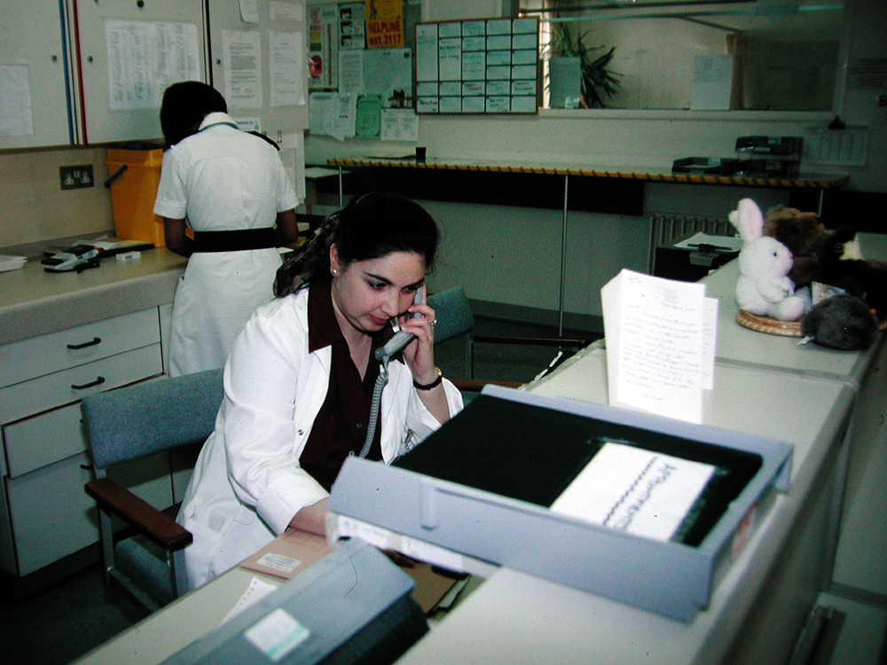
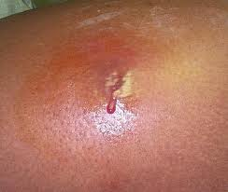
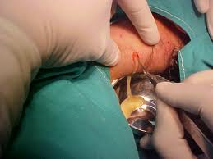
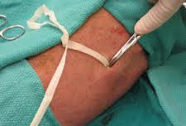
Planned Emergency ‘Abscess’ Pathway
Minor emergency procedure required
Pre-operative assessment by surgical team and nursing team if possible
Home with fasting instructions avoiding admission
Patient advised time and place of admission for surgery
Booked and Added to emergency ‘pool’ of patients
Surgical location dependent on best availability
Emergency procedure performed
Patient discharged on day of surgery

Slide 15
Abscess Pathway
‘Golden patient’
Patient reports to Day Surgery Unit 7:45
Sent for from emergency theatre 8am
Surgeon released from handover at 8:30 to operate
Back in DSU by 9:30 am
Precious emergency list down time utilized
If possible run a dedicated ambulatory emergency list and surgery in the DSU
Notes:
This is our process outside of COVID times

Slide 16
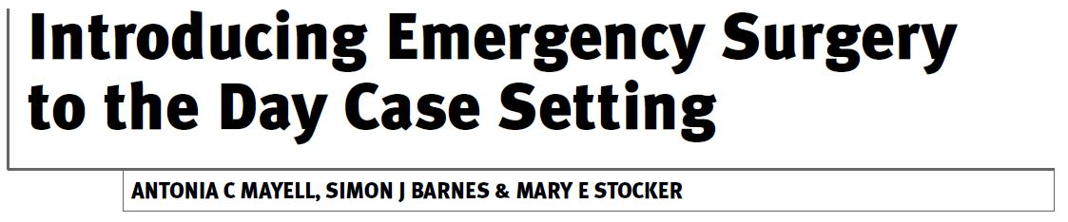
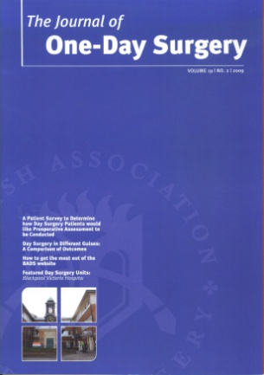
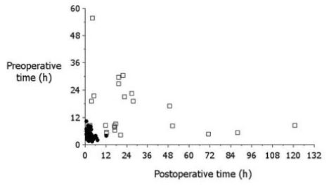
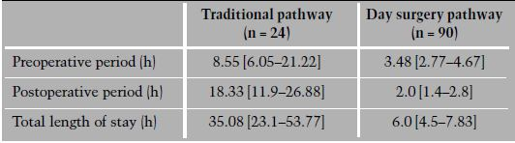
48 patients with abscesses
Unplanned overnight admission rate 5.5%
Traditional pathway 5.7 times longer than day case pathway

Slide 17
Urgent Cases on Dedicated Emergency Day Surgery Lists

Slide 18
Torbay Ambulatory Emergency Pathway
Inspired by Bath
2017: rebranded any unutilised day surgery lists as dedicated ‘DSU Emergency Lists’ (short notice list down, half terms etc…)
Ensured day surgery is considered for all emergencies
What could be easier?

Slide 19
Patient locations and booking
From home (simple cases)
From in-patient beds (‘bigger’ intermediate cases)
Direct from ED or surgical receiving unit/gynae assessment unit
‘Suitable for ambulatory emergency list’ using tick box on booking form
Added to ambulatory emergency patient ‘pool’ and booked onto an appropriate ambulatory list
Confirmatory decision made by emergency teams on day
Details transferred to DSU administrative team
    Pull notes/electronic transfer
Surgery via dedicated ambulatory list in DSU

Slide 20
Day Surgery Ambulatory Pathway
First 22 months..(all specialties)
442 patients (18 children, 424 adults)
386 hours of emergency theatre time liberated, saving around £347,280.
370 patients (83.7%) were successfully discharged same day.
301 patients (68.1%) avoided a pre-operative night stay.
  671 bed days saved with estimated cost of £268,400.
Next day, 90% of 257 patients (58.1%) followed up by telephone reported feeling ‘good’ or ‘very good’.

Slide 21
Outcome (pre-COVID)
Two dedicated DSU Emergency Lists/week-mixed specialty
One “hot” urology list/week
Surgeons depended on DSU to manage emergencies

Slide 22
Opportunistic Emergency Slots

Slide 23
Opportunistic emergency slots
Teams opportunistically identify day case suitable inpatients
Theatre teams opportunistically identify vacant theatre slots
Surgery in any inpatient or DSU theatre with practical available capacity
Discharged using day surgery discharge criteria
Change in medical culture noticed:
  Theatre teams proactively identify lists which might finish early
  Communication with on on-call team
    ‘pulling’ suitable cases from the emergency list to the ambulatory setting.

Slide 24
Challenges
Consider ambulatory emergency surgery as the norm not the exception
Robust way of identifying ambulatory emergencies
  Emergency booking form and handover meetings-potential cases
Gain confidence from existing pathways
  Safety netting
Anaesthetic cover-ideally dedicated to list
Shared lists with other specialties
  Care with scheduling, timings and briefs
Co-ordinator role

Slide 25
Advantages
Increased patient satisfaction
Reduced bed days
Liberated emergency theatre hours
Improved flow
Staff morale
Push back against ‘bedding’ day surgery during crisis.
  A functional unit keeps on top of elective waiting lists
  Relieves pressure for the acute hospital.
Don’t need a dedicated unit - apply principles to existing ambulatory pathways
Consider any list with space ensuring discharge via usual ambulatory pathways

Slide 26
Tips
Enlist a clinical champion
Collect data and audit and share
Involve key stakeholders in designing process specific to your Trust

Slide 27
Challenge..
Think about your emergency admissions
  Who could go home for surgery the following day?
  Who could be transferred to a day case pathway post-operatively?
  Who “really” needs to be admitted at all?

Slide 28
Questions?

