Slide 1
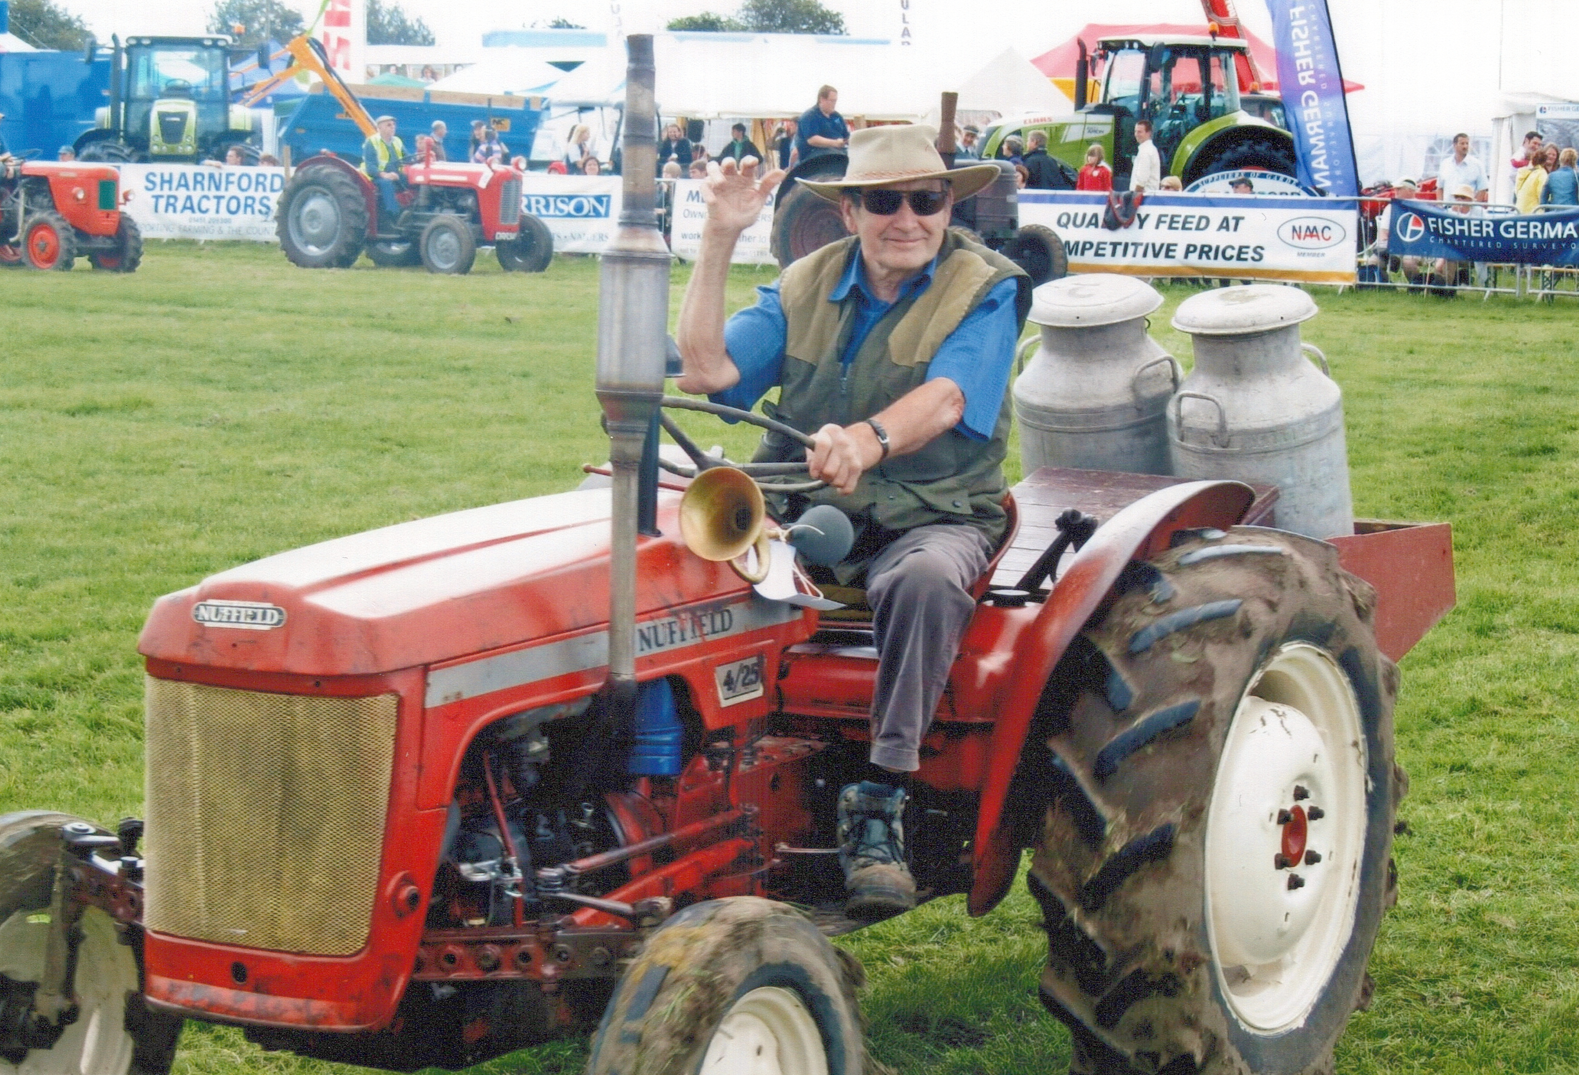
Let Him Eat Cake
Kate Parry​​
03/02/2023

Slide 2
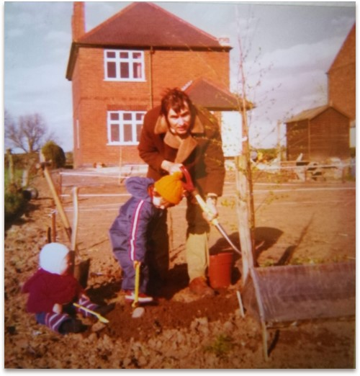
Agenda
Importance of considering the person behind the symptoms
Responsibility as a non-medical prescriber
Importance of asking what is important to the patient / carer.
Notes:
The main aims of this presentation are in consequence of my experiences as a daughter / carer for my Dad. This presentation does have personal content as it is fundamentally about my Dad’s health care, please bare with me if I do get upset as I am ok.

Slide 3

Presentation
I completed the non medical prescribing course
in September 2022, having started the course in February. My background is in mental health nursing. The course increased my knowledge of physical health and physical health medications
Notes:
Whilst studying to become a Non-Medical Prescriber I became aware of different services within the NHS. I had opportunity to shadow different practitioners, observing their interactions with patients under their care. ​
This enabled me to reflect on the care we have received as a family whilst my Dad was poorly and has enabled me to consider my own interventions as an NMP.

Slide 4
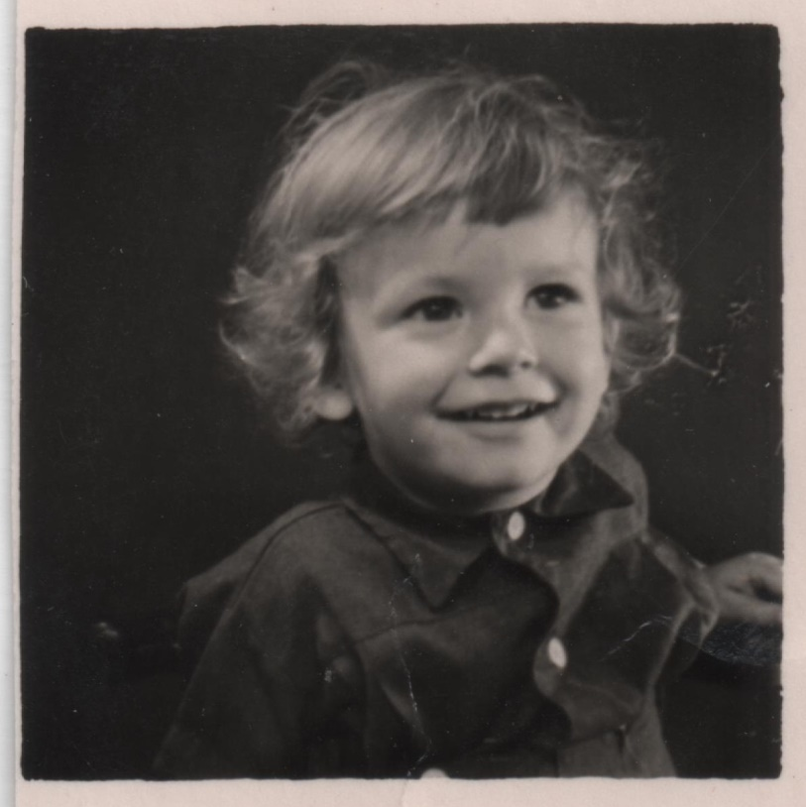
Dad
Notes:
On the 23rd February last year my Dad turned 79, 4 days later he died, after taking his own life. This was not something I would have ever expected. Around the time of his death I remember feeling proud of him thinking that he had took control of his situation. However this led to the realization that for the previous few years he had no voice and he was in the hands of the healthcare system which at times did really let him down.

Slide 5
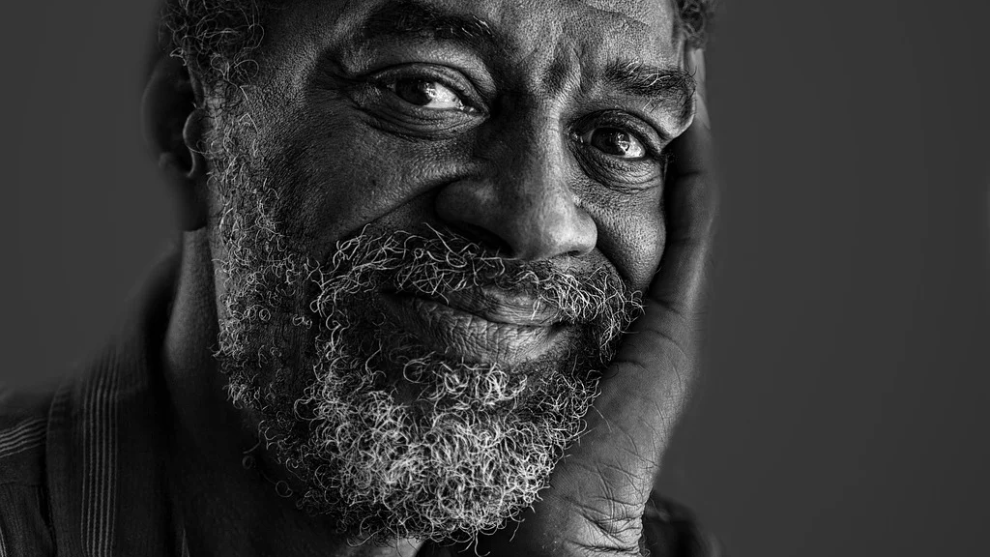
The aging process
Reduced liver volume
Skin becomes thinner
Reduced muscle mass
Weight loss
Renal impairment (reduced nephrons)
Increased gastric acid
Constipation
Increased falls
Reduced water content
Communication
Cognitive impairment
Reduced cardiac out put
Increased heart size (but thickened walls)
Reduced brain size
Slowed metabolism
Reduced mobility
Slowed gut transit time
Reduced saliva
Production of red blood cells decreases
Reduced number and efficacy of neutrophils
Notes:
This is just a reminder of how the ageing process impacts on all of the systems in our body and how as non-medical prescribers we need to take this into consideration.

Slide 6
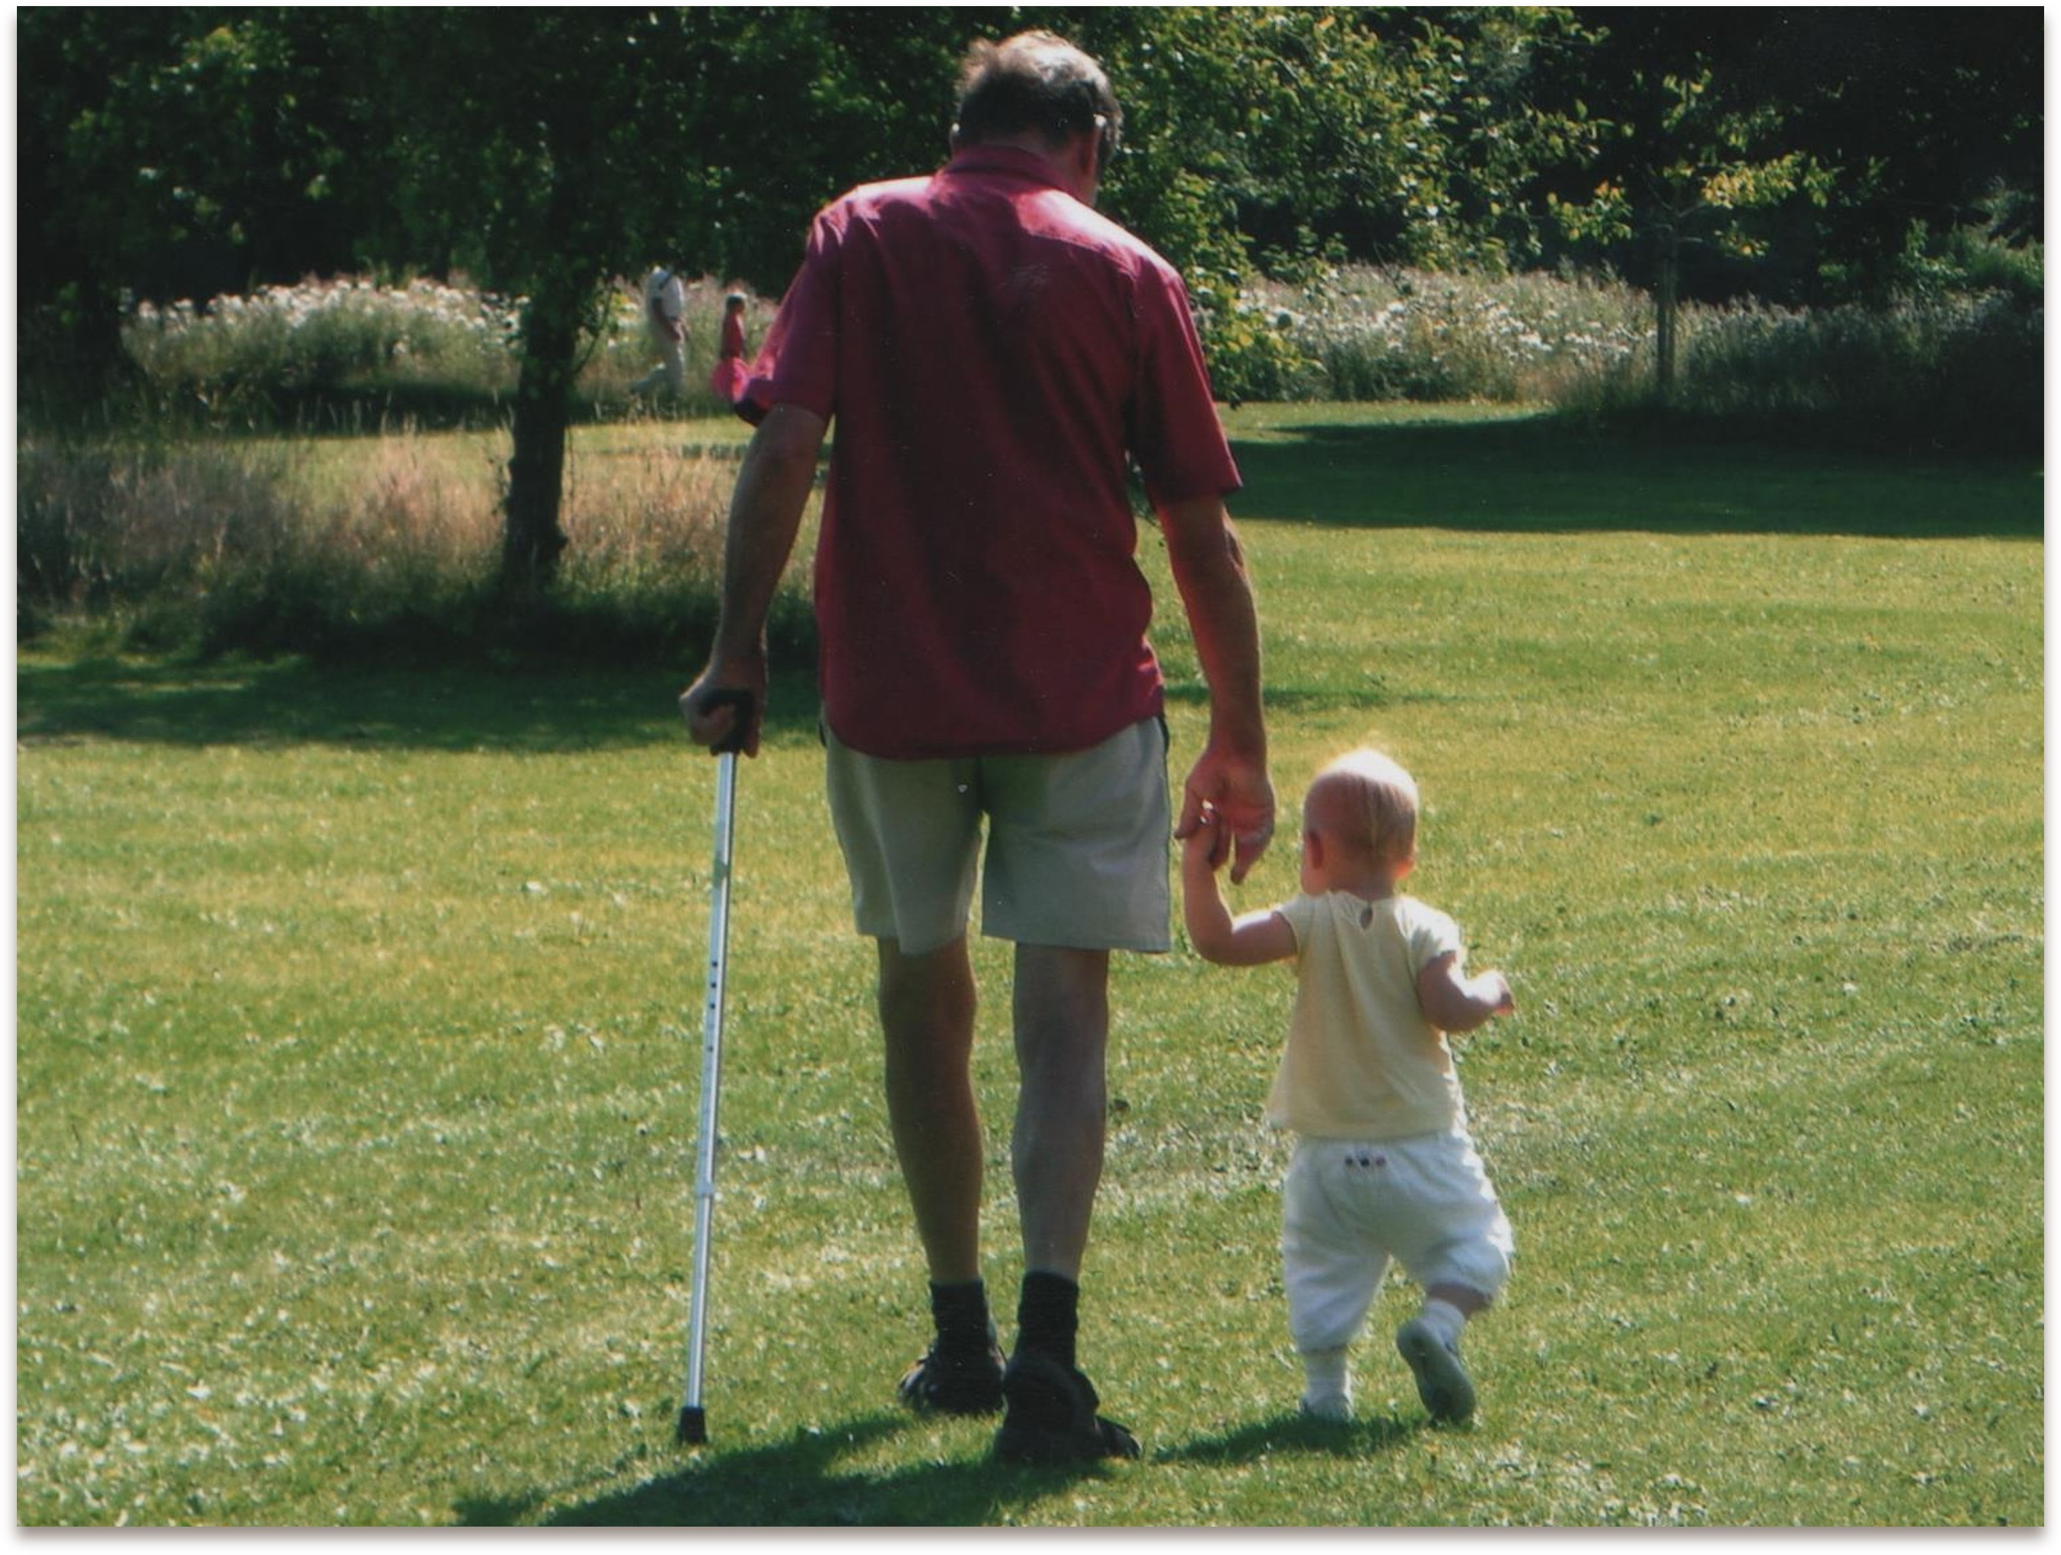
Health Conditions
Rheumatoid arthritis
Urology difficulties – Frequent UTI’s
Diabetes
Osteoporosis
Constipation / Diarrhoea / vomiting
Failing eyesight
Sleep apnoea
Heart Failure
Frequent Sepsis
Foraminal Stenosis
Pain
Notes:
For most of his adult life Dad suffered with ill health, specifically with Rheumatoid Arthritis. He never let his illnesses define him. Until the last few years he was active and would do his best to manage his disabilities. Over the years he had many joint replacements and procedures in relation to the arthritis. In the last few years of his life he developed other debilitating conditions. Including Heart Failure, Diabetes, Osteoporosis, Chronic Back Pain, Issues with his bladder, Frequent episodes of vomiting and diarrhoea, Constipation, failing eyesight. As these conditions progressed his quality of life deteriorated.

Slide 7
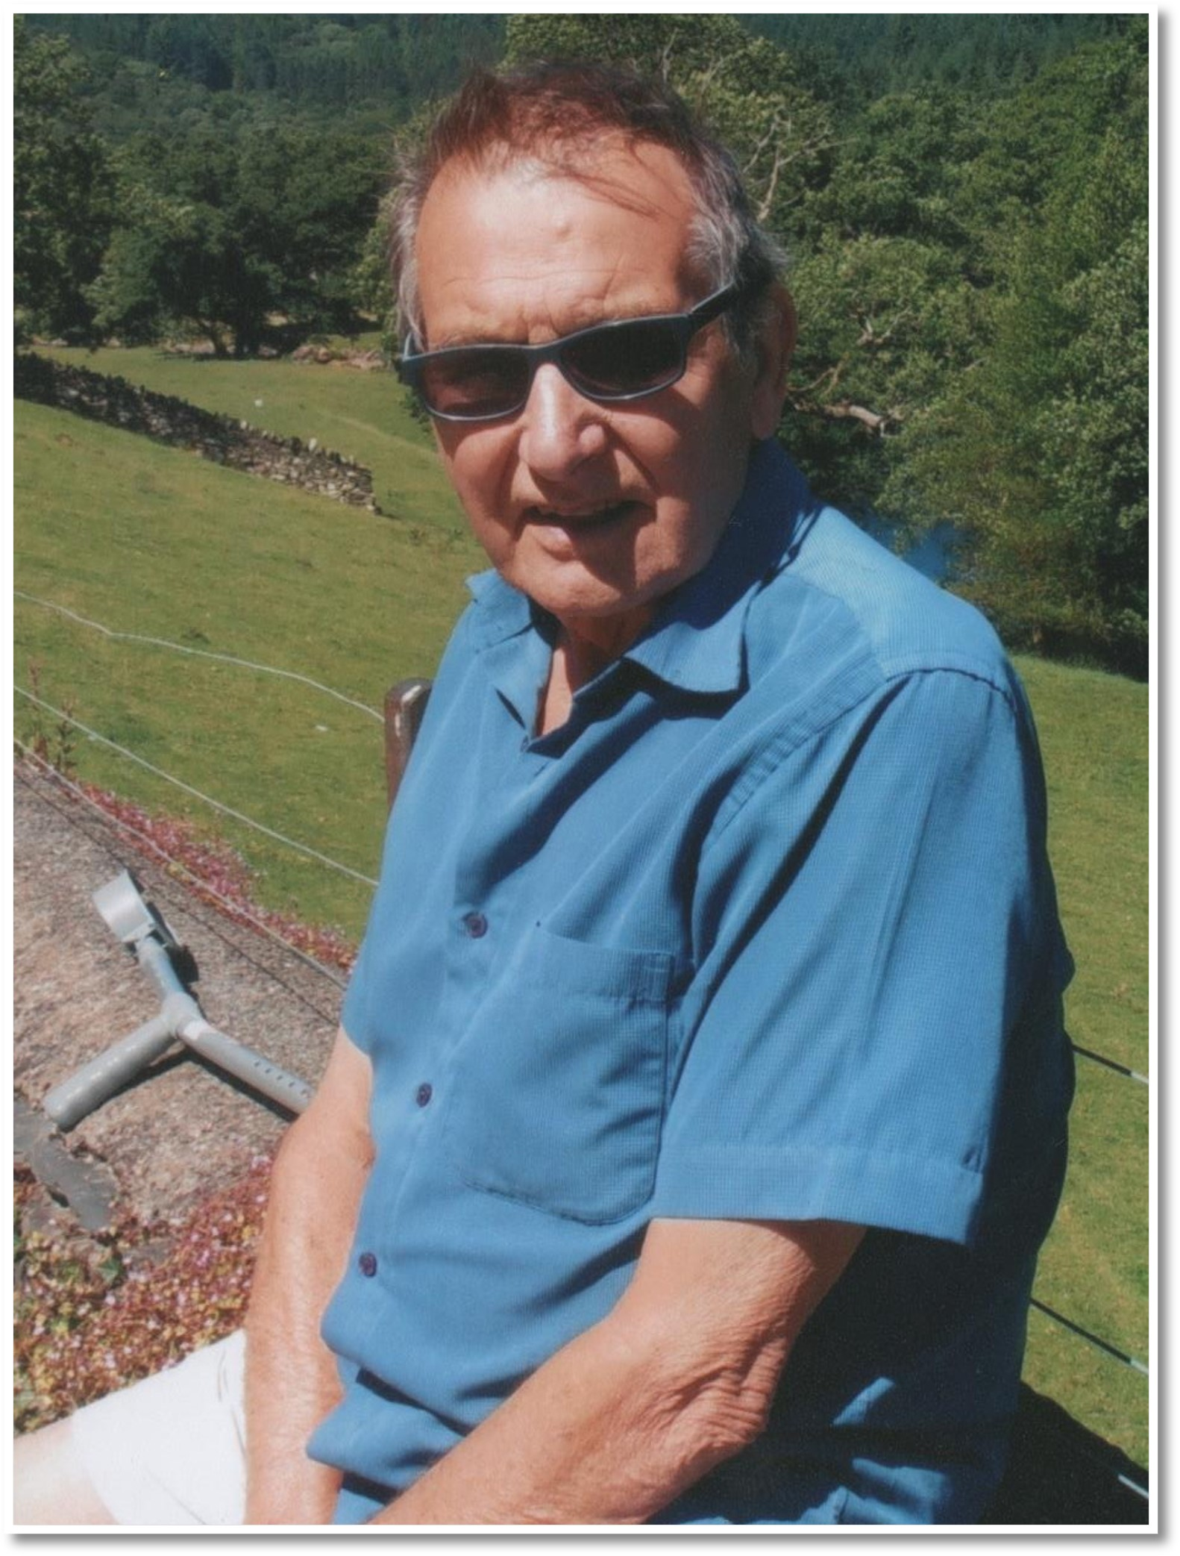
Health Care Providers
GP
Practice Nurse – Diabetes
Cardiology + Heart Failure Nurse
Chiropody + Podiatry
Ophthalmology
Rheumatology
Urology
Sleep clinic
A & E
Hospital Wards
Physio/OT
Notes:
My Dad was a very compliant patient, he trusted those who gave him care. He rarely complained about the care or services that he received. As the slide shows Dad was under numerous different services; An indication of what how they lived is that in the week following his death he should have had 8 clinical appointments with different medical professionals. Dad was always willing to try suggestions made by health care providers, whether this was a medical procedure or a new medication. I believe that he always had faith that the intervention would be the one that would make him feel better. One of the issues we experienced is that each specialist area would only be able to focus on that set of symptoms, however each intervention had the potential to have an impact on something else.

Slide 8

Polypharmacy
Appropriate and inappropriate polypharmacy
Increases risk of ADR
Frailty
Multiple hospital admissions
Notes:
This slide is a reminder about polypharmacy. There are many situations where this can not be avoided. However as NMP’s we need to be aware of those at risk of inappropriate prescribing and how being on multiple medications can increase the risk of hospital admission. Fialova et al (2018) have reported that older patients are under represented in clinical trials. This means that there is a lack of evidence on the efficiency and safety of frequently used medications in this population. Patients who are identified as being frail are less likely to have resilience to drug changes and an increased risk of hospital admission
The more drugs the higher the risk of adverse drug reactions. Polypharmacy increases the risk of unnecessary exposure to medications where there may be doubtful efficacy and an increased risk of admission.

Slide 9
Medications
Methotrexate injections Paracetamol
Atorvastatin Prednisolone
Bumetanide Pregabalin
Buprenorphine Patch Ramipril
Calci-D Risedronate Sodium
Citalopram Senna
Codeine Sotalol CosmoCol Tamsulosin
Edoxaban
Finasteride
Folic acid
Glucogel
Humalog Mix
Lansoprazole
Linagliptin
Mirabegron
Nitrofuratoin
Novorapid
Notes:
26 medications
Risk of adverse drug reactions increase with the number of drugs prescribed
For my Dad the difficulty of having so many professionals involved is that they could and often did make changes to the drug regime, but this always appeared to be in connection to the disease that they were responsible for. A change would be made with the expectation of this being followed up by the GP. There are several issues with this for example how is the change going to interact with the other medications, b) realistically how can a GP have the knowledge of the impact that all these drugs will have with one another.

Slide 10

Aging process or side effect?
How would you know the difference?
Notes:
In the elderly there is a challenge of considering whether a presenting symptom is in consequence of ill health or a side-effect of a medication.
Ageing process impacting on response to medication is considered to start at 40 years
Where there are numerous drugs it is important to consider whether presentation is consequence of drug interactions
Side-effects can develop over time – should not be confused with a new symptom
Need for a full assessment. Not sure if Dad had this?

Slide 11
Cycle of Ill-Health
Diabetes – increased risk of UTI
Prostate = Increase of UTI
UTI = Increased risk of Sepsis
DMARDs – prolonged use of high doses of steroids can increase blood sugars – Diabetes
Dmards prolonged use of high doses of steroids can increase risk of sepsis
Notes:
DMARDS are Disease modifying Anti Rheumatic drugs. Dad was on Methotrexate, he was prescribed patches then went on to have weekly injections.
In consequence of the NMP course I became aware of the risks associated by Dad’s illnesses and medication regime.
I think if we had known we may have had a different approach to Dad’s health and our own expectations. I do feel embarrassed that as a nurse I should have had more knowledge I should have worked this out, as a daughter I just wanted someone to make Dad better, so I wanted him to have more drugs in the belief that maybe that would be the one that would make him feel better. Only after doing the course did I realise that his medication regime could have been contributing to his poor health and frequent hospital admissions.
Dad was frequently admitted with urinary sepsis. As a family we were on a constant battle to try to prevent Sepsis, but the facts are that older people are more vulnerable, People taking long term steroids or immune depressants are more vulnerable and people with impaired immune function. No-one ever sat us down to inform us of this risk cycle.

Slide 12
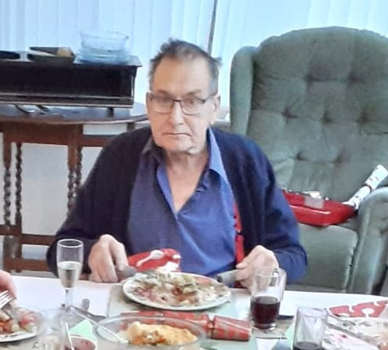
Hospital Admissions
13/11/2019 11/11/2020
04/12/2019 21/01/2021
06/06/2020 30/01/2021
30/06/2020 01/09/2021
21/07/2020 09/11/2021
08/08/2020 27/11/2021
05/02/2022
Notes:
This is a list of Dad’s hospital admissions when things started to get really bad until the end. What this list doesn’t portray is that everytime he got taken away in an ambulance the fear of whether we would see him again or how stressful it was in the build up of making the call to 999 and waiting for the ambulance. It doesn’t portray the hours spent on the phone trying to get through to A & E, it doesn’t portray the frustration of not being able to speak to people giving him medical care. It doesn't portray the impact of being given devastating information over the phone, being powerless to support him during the admissions that happened during COVID. As a family member I have a belief that COVID restrictions provided wards an opportunity to change the way families were liaised with and not for the better. During this time there were occasions where I felt ashamed to call myself a nurse in response to the care my Dad received and in consequence of the way we were communicated with.

Slide 13
Who has overarching responsibility?
GP?
Prescriber?
How will this be reviewed?
Does the patient understand?
What expectations do you have of the patient?
Notes:
BNF “ old people, especially the very old require special care and consideration from prescribers”

Slide 14
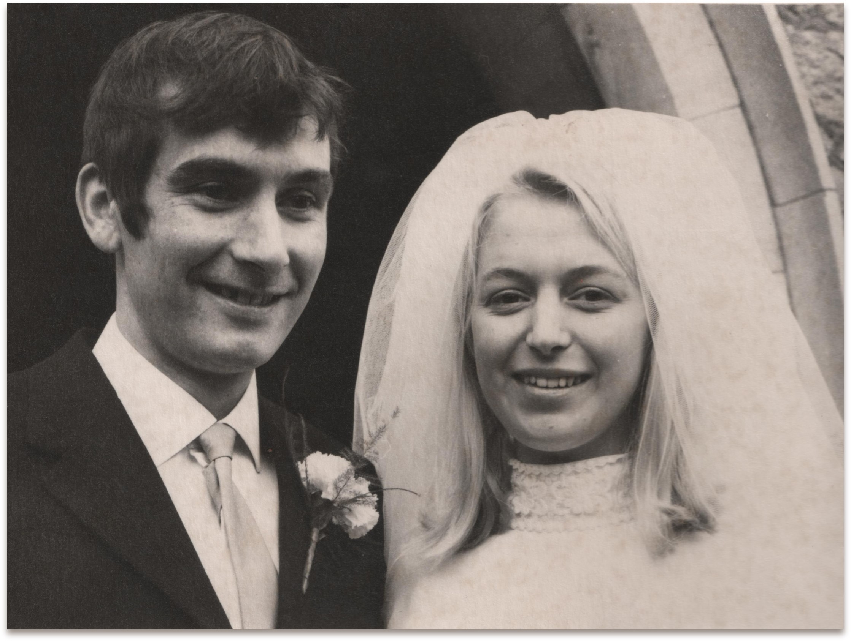
The Impact on Carer’s​
Not being involved in care decisions but expected to provide care.
Not heard
Unrealistic expectations
Notes:
My Mum and Dad’s relationship was detrimentally affected by my Mum having the responsibility of being his carer. As prescribers we have to consider the impact on carer’s if we are going to ask them / rely on them to help us to provide patient care. Whilst recognised as my Dad’s carer it was very difficult to offer support as he was able to function or he wasn’t, there wasn’t much in between. My Mum was often excluded from decisions around his care, or occasionally the brunt of critism. My Mum’s main aim was to keep Dad well. A significant impact was the diagnosis and then progression of diabetes. This always felt to be an add on diagnosis with the subtext of it being “type2”. As type 2 it was also felt that there was some association that it was Dad’s fault he had diabetes. They managed for a long time on metformin, however one hospital admission resulted in Dad being prescribed Insulin. This was really difficult as Dad did have issues with dexterity because of the arthritis but my Mum js not keen on needles. Due to Covid Mum was not allowed onto the ward for the demonstration of how to administer insulin. They were also given a promise by the ward that they would have district nursing support. Mum took the diagnosis of the diabetes very seriously and this created a strain on their relationship. My Dad did not drink or smoke, they had a healthy lifestyle however he did like cake and puddings. As you have seen from the photos he was not a big man, he was not overweight. As the diabetes got more out of control his diet became more restricted and this had a huge impact on their quality of life. There was one occasion where Mum and Dad visited the practice nurse for a review of his blood sugars and when told that they had homemade soup were criticised by the practice nurse for using a stock cube and a carrot.
As a prescriber are you involving the carer? What if every clinician who has contact is asking carer to take on another responsibility? What do you require of them? Do they have the emotional and physical capacity – talk about insulin. Don’t make promises about other services unless you know that this can be delivered.

Slide 15
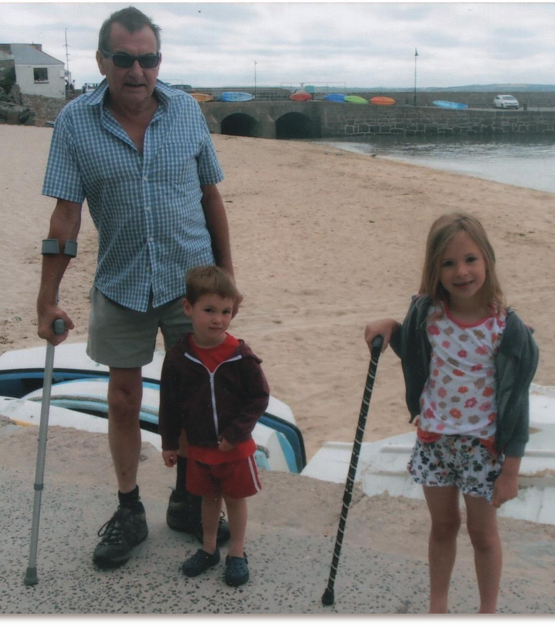
What could have been better?
Diabetes care
Holistic Care
Asking the patient
Honest conversations
Notes:
Reassurance that when a new drug was prescribed were interactions with other medications considered. What were the long term effects of the medication?
Diabetic nurse – what is important to you?
What did Dad want? He wanted to be pain free, he wanted to know what was causing pain in his left side.

Slide 16
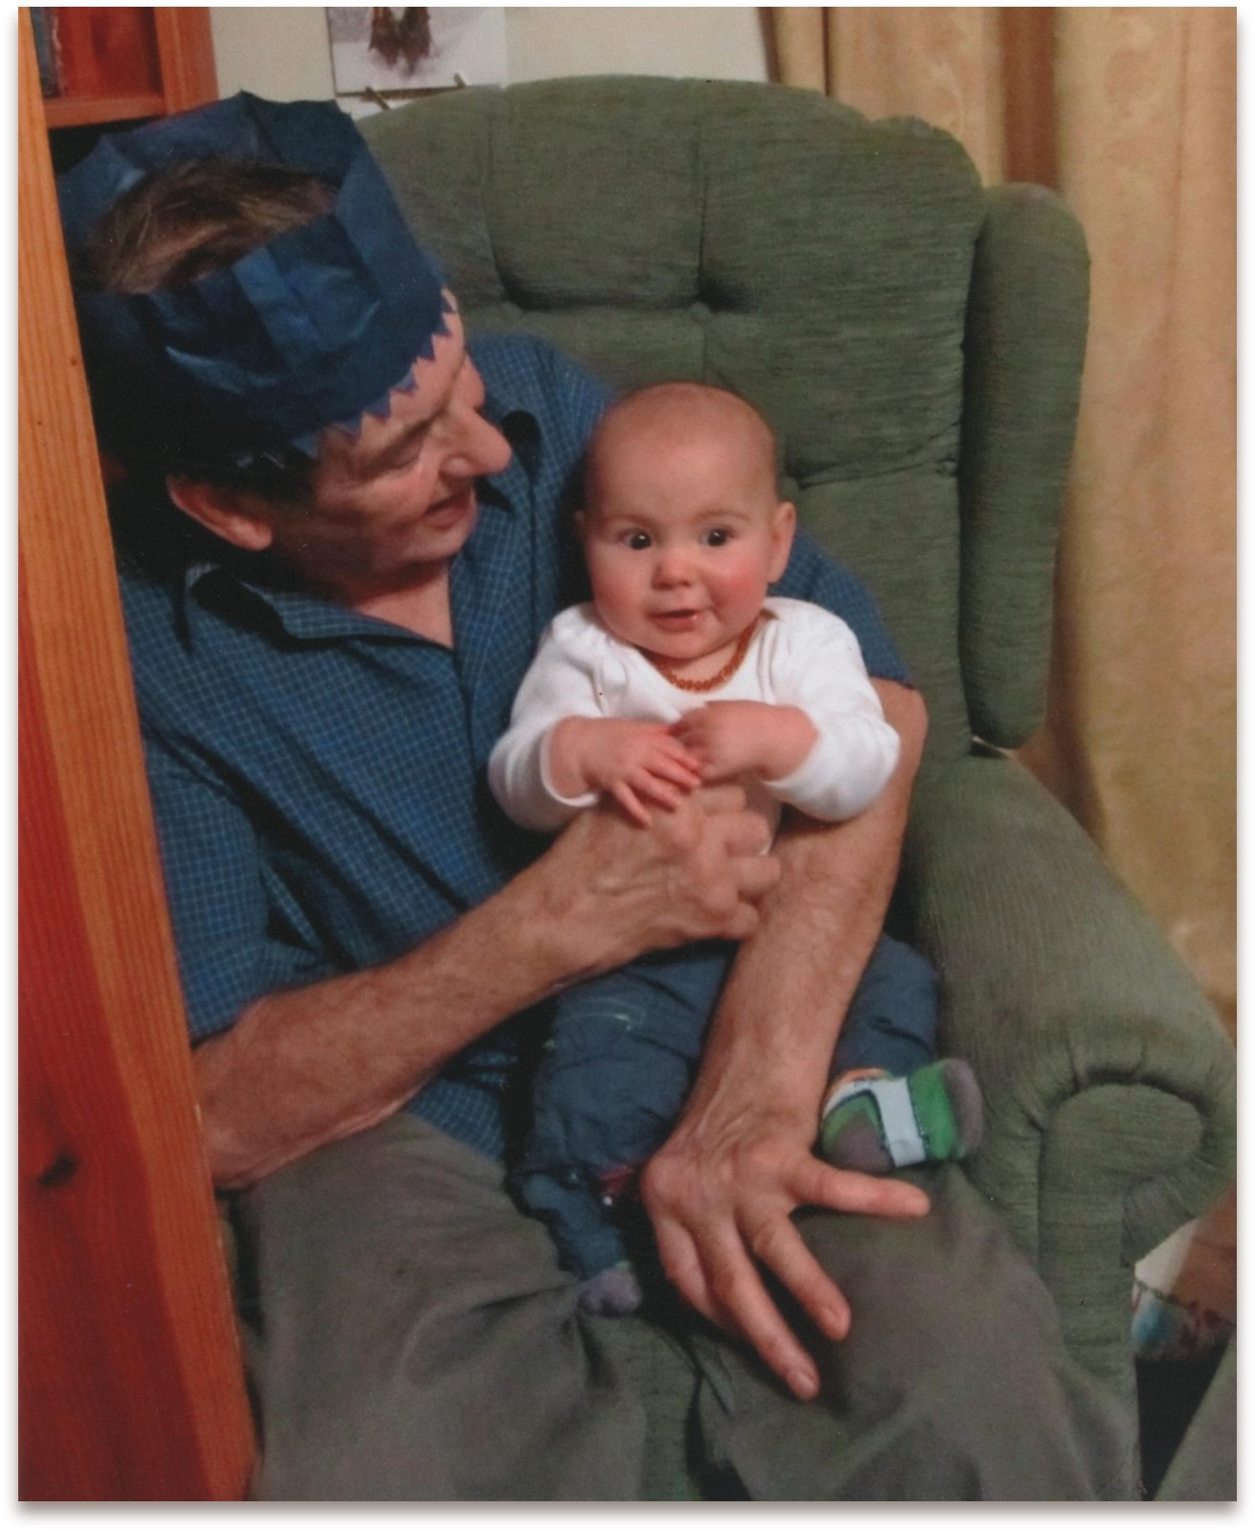
Key Points
As non –medical prescribers and fundamentally as health care professionals we have to commit to;
To see patients as people not a set of symptoms
To enable patients to make their own decisions regarding their own care.
Be clear as prescribers about what we are aiming for by prescribing that medication.
Individual responsibility to consider drug interactions when prescribing.
Improving the patient experience for the patient and carers/family
Notes:
Thank you for your time.

