Slide 1


Paul Davis MBE
Patient Safety Incident Response Framework
…how can it improve our response to patient safety incidents

Slide 2

Video courtesy of Willem Hebbe – www.11foot8.com
Notes:
Objective: to play video of different vehicles hitting the same bridge.
Facilitator notes: ask delegates what they think of this and ask them ‘why is this happening?’. Ask them ‘are all these people just error-prone/idiots or is there something else at play here?’

Slide 3


Who or what caused this accident…
Notes:
Listen to answers and establish that we don’t know enough to understand the things that might have led up to these accidents

Slide 4
Video courtesy of Willem Hebbe – www.11foot8.com
Notes:
Objective: to play video of different vehicles hitting the same bridge.
Facilitator notes: ask delegates what they think of this and ask them ‘why is this happening?’. Ask them ‘are all these people just error-prone/idiots or is there something else at play here?’

Slide 5
Does this change your perspective…
Notes:
Listen to answers and establish that we don’t know enough to understand the things that might have led up to these accidents

Slide 6
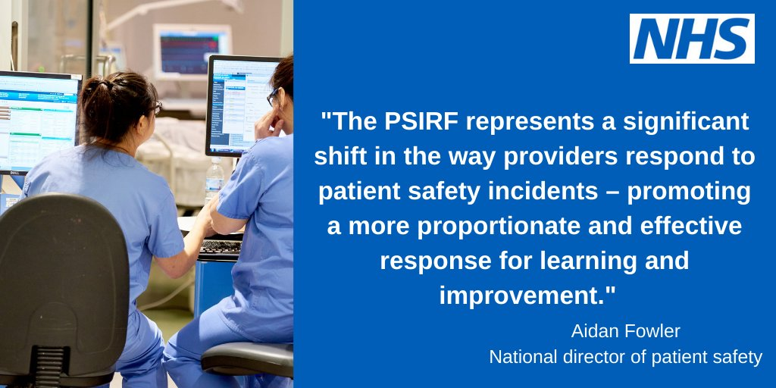

Slide 7
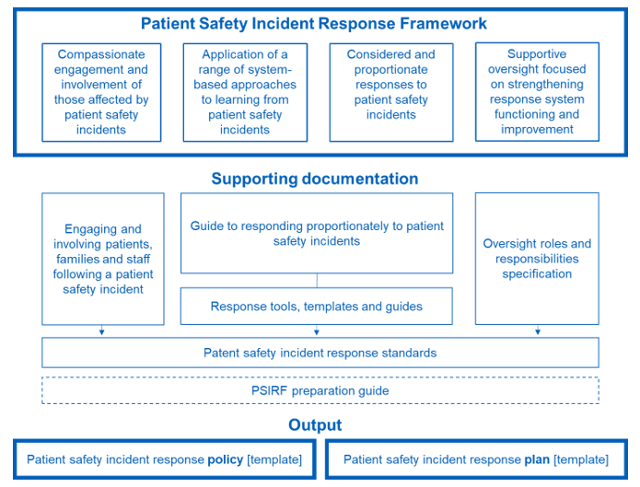

Slide 8

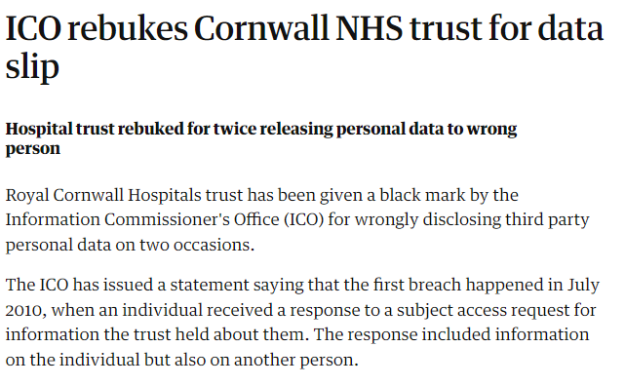

Proportionate response

Slide 9
WHAT happened?
WHY did it happened?
HOW can we stop it happening again?

Slide 10



Slide 11


Slide 12
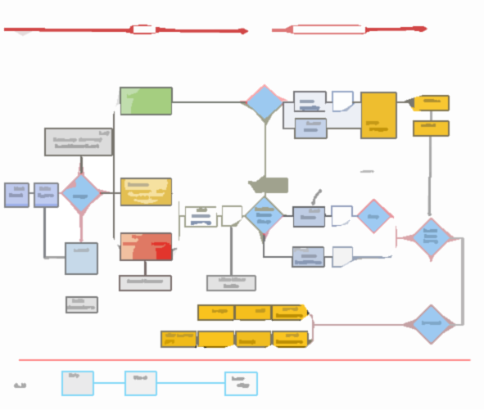
LEARNING RESPONSE PROCESS MAP

Slide 13
WHAT IS A PROPORTIONATE RESPONSE?
A typical local learning response process…
No further action
Determine level of harm
Review group decide level of proportionate investigation
Immediate evidence gathering to establish the facts
Initial
information
Patient Safety Review
Incident reported
PSII

Slide 14
Proportionate response?
Maternity & neonatal for HSIB Mat or SpHA
Child deaths
Does the PSI meet the following criteria
Mental health related homicides
Death of person with a learning disability
Safeguarding incidents
Never events
Incidents in screening programmes
Trust led PSII
or
Y
Y
Deaths in custody
Deaths thought more likely than not due to problems in care
Refer for external review
Domestic homicide
Deaths of patients detained under the Mental Health Act (1983) or where the Mental Capacity Act (2005) applies
LD death where patient safety incident may have contributed
Suicide/self harm of person in state care
Proportionate response
N
N
https://www.england.nhs.uk/wp-content/uploads/2022/08/B1465-3.-Guide-to-responding-proportionately-to-patient-safety-incidents-v1.1.pdf

Slide 15
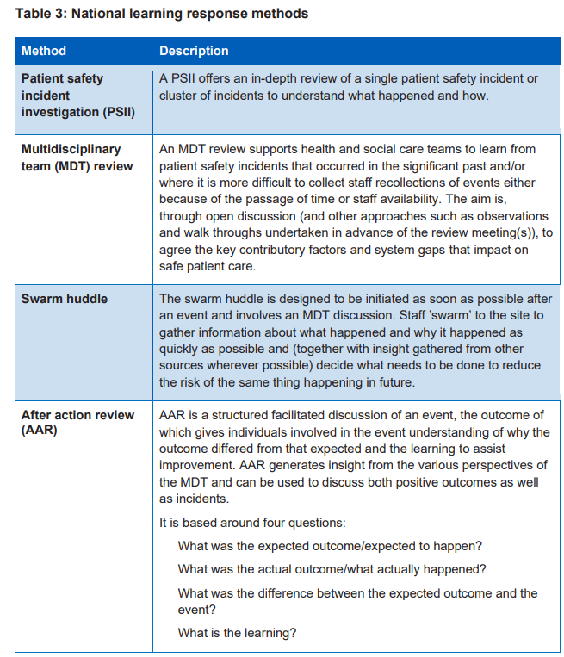
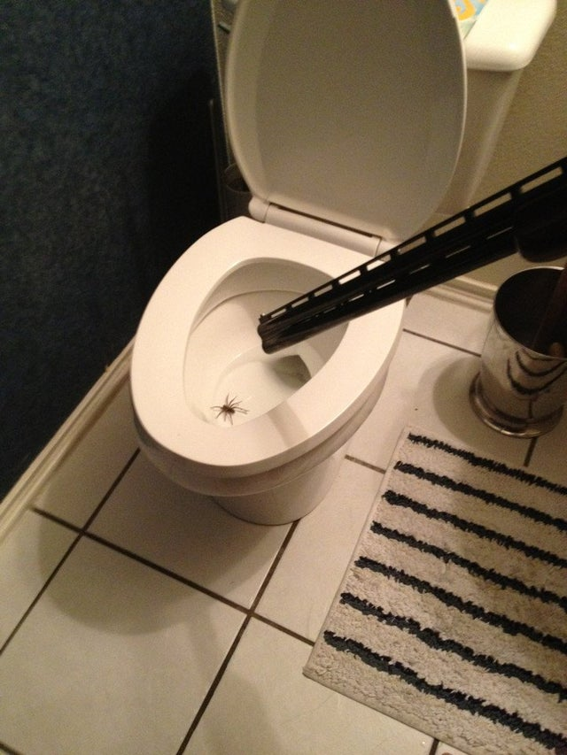
Proportionate response?

Slide 16


“But last month under the SI Framework that would have been investigated as a serious incident!”

Slide 18

SYSTEMS THINKING

Slide 19
Complex systems are basically safe
This Approach to human error…
Humans are unreliable and they undermine safety defences, rules and regulations
Sack, re-train or discipline and blame the individual
To make systems safer restrict the human contribution by tighter procedures, automation, more supervision
Adapted from Dekker The field guide to understanding ‘Human error’
Notes:
Objective: show the slide and ask what the downsides of this approach is.
Notes: ask how far this is still happening across industries.

Slide 20
Or … this approach?
Complex systems are not intrinsically safe
Accept that human error is a symptom of problems within the system
Humans have to create safety by practice at all levels of an organisation
Complex systems are trade-offs between multiple conflicting goals (safety, efficiency, reliability)
Adapted from Dekker The field guide to understanding ‘Human error’
Notes:
Objective: ask what the potential benefits of this approach are.
Notes: ask the group what their thoughts are on this.

Slide 21

Blood Transfusion Policy was not followed.
RN1 should not have given the blood to another
member of staff to transfuse.
RN2 did not complete any safety checks at the patient
bedside before administering the blood.
Failure to follow criteria for Enhanced Care Level 3 patients at the time of the incident.
The Nurse in Charge (NIC) did not take ownership of NIC duties such as delegation of care delivery to maintain patient safety.

Slide 22
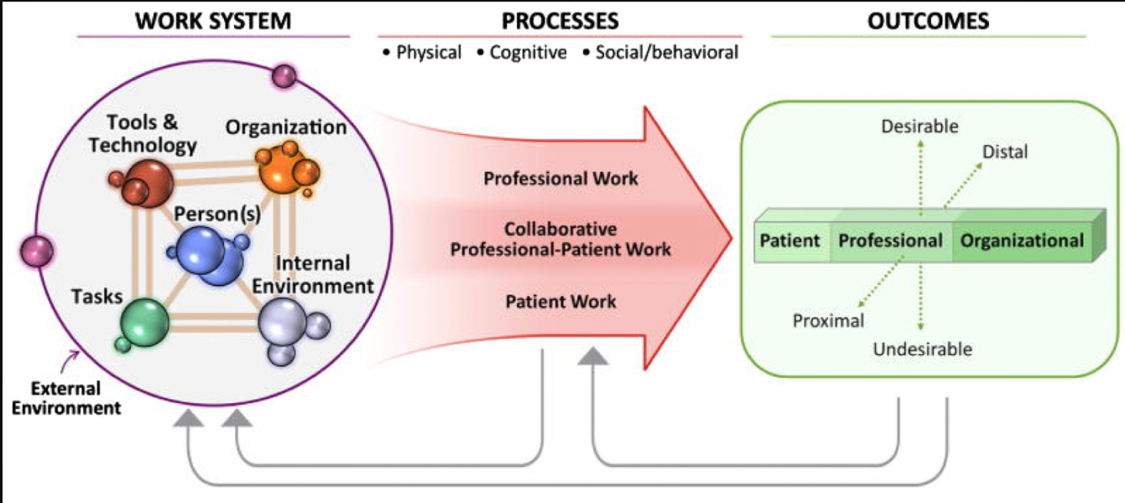
Systems thinking: Systems Engineering initiative for Patient Safety
A key systems question:
Under these conditions,
…can this person,
…with this training,
…do this task,
…using this equipment,
…to these standards?
Taking a more systems-based approach shifts the focus from the individual(s) doing the work to a group ownership of making the organisation safer.

Slide 23



Understand the difference between what we think happens in the system & what actually happens
What you should do…
What you normally do…
What you did on this occasion.
Notes:
Much of investigation to establish causation is about understanding what we should be doing as set out in rules, regulations etc what we do normally on a day-to-day basis to find work arounds to rules that are unworkable, equipment that doesn’t function as intended, environments that are imperfect and then what we actually do in the work place and how the aforementioned work arounds let us down.

Slide 24
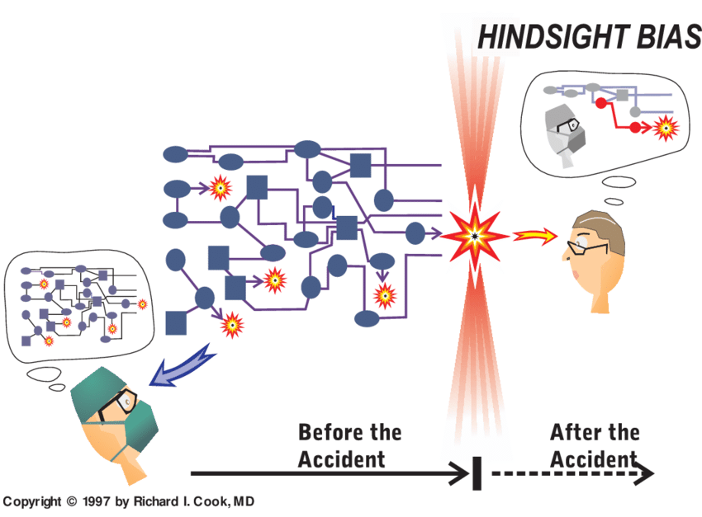
Why did it make sense at the time for individuals to make the decisions they made…

Slide 25

Proportionate responses
How are we triangulating insight from our responses to patient safety incidents?
Are we using recognised system-based methodologies for data collection and analysis?
Is external guidance/information used to inform patient safety responses and findings?
Do we have collaborative arrangements with our ICB to facilitate cross-system learning responses? This includes processes for recognising when support may be required and raising this with ICB colleagues.
Are learning responses completed in a timely manner in line with expectations of those affected?
Is the organisation’s leadership clear in communicating to teams that an individual learning response should not be conducted for every incident that results in moderate or more severe harm? And do leaders support teams where this policy is challenged?
Is there evidence that teams are attempting to conduct a learning response to every incident, and therefore resources are spread too thinly?
Are there opportunities for teams to learn from when things do and do not go well?
Is there evidence of filtering or censorship of findings or suggested improvements?
Is learning and improvement work adequately balanced? (ie balance of horizon scanning, thematic work, and individual learning responses)
https://www.england.nhs.uk/wp-content/uploads/2022/08/B1465-4.-Oversight-roles-and-responsibilities-specification-v1-FINAL.pdf

Slide 26
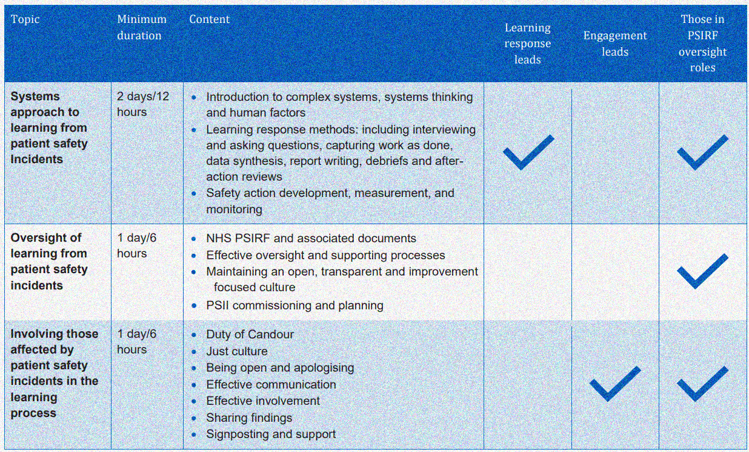
INVESTMENT IN TRAINING AND COMPETENCY

Slide 27

Extracts from the framework …
Learning responses are
Not conducted by people involved in the incident or managing the staff involved
Teams consist of more than 1 person to allow multiple perspectives
Led or chaired by those with at least 2 days formal training and skills development in the ‘systems approach’
appropriate level of seniority and influence within an organisation – this may depend on the nature and complexity of the incident and response required, but it is recommended that learning responses are led by staff at Band 8a and above
https://www.england.nhs.uk/wp-content/uploads/2022/08/B1465-5.-Patient-Safety-Incident-Response-standards-v1-FINAL.pdf
Notes:
Important that you know what the framework says so that you can support your case for more support/resource

Slide 28
PSII Training is delivered by those with:
  30+ days training
  current in investigation best practice
Learning response leads attend update training and networking events annually
Have dedicated time to conduct PSIIs ( their role is back-filled)
Clinical SMEs have relevant knowledge and skills and are involved throughout the PSII
Learning response leads have completed level 1 (essentials of patient safety) and level 2 (access to practice) of the patient safety syllabus.
Notes:
Important that you know what the framework says so that you can support your case for more support/resource

Slide 29

Engagement and involvement training
Engagement and involvement with those affected is led by those with at least six hours of training in involving those affected by patient safety incidents in the learning process.
Engagement leads have completed level 1 (essentials of patient safety) and level 2 (access to practice) of the patient safety syllabus.
Engagement leads undertake continuous professional development in engagement and communication skills and knowledge, and network with other leads at least annually to build and maintain their expertise.

Slide 30

OVERSIGHT
All patient safety incident response oversight is led/conducted by those with at least two days’ formal training and skills development in learning from patient safety incidents and one day training in oversight of learning from patient safety incidents.
Those in an oversight role within an integrated care system (ICS) have completed level 1 (essentials of patient safety) and level 2 (access to practice) of the patient safety syllabus.
Those with an oversight role on a provider board or leadership team (eg an executive lead) have completed level 1 (essentials of patient safety) and level 1 (essentials of patient safety for boards and senior leadership teams) of the patient safety syllabus.
All individuals in oversight roles in relation to PSIRF undertake continuous professional development in incident response skills and knowledge, and network with peers at least annually to build and maintain their expertise.

Slide 31
Competence and capacity
Are we employing and continuously developing expertise in patient safety science for key roles?
Are our learning responses adequately resourced (including funding, time, equipment, and training)?
Are training and competence requirements met for learning response leads?
Do we have the competence within our teams to feel we can confidently have conversations with patients and families about patient safety incidents?
Does our ICB have its own continuous development plans in patient safety science training and competence to enable it to participate effectively?
Are our teams confident in having conversations with patients and families affected by an incident but where an individual learning response will not be completed in response?
Are oversight training and competence requirements met within the ICS?
Can the organisation describe its capacity to effectively deliver its patient safety incident response plan?
Is staff time protected or dedicated full-time roles in place for patient safety incident response?
Do the organisational stakeholders (eg patient safety partners, clinical teams, support staff) have continuous professional development opportunities to enable them to participate effectively?
Can the organisation describe where the capacity is to implement improvement based on patient safety incident response?
Is access to expertise and support provided?

Slide 32
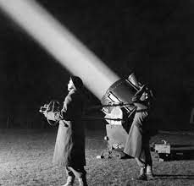

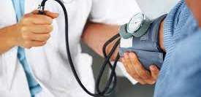
Opportunities for learning under PSIRF?

Slide 33
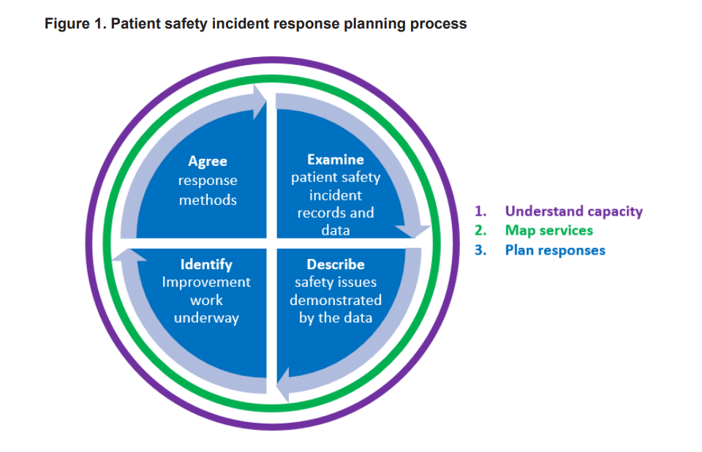
Patient Safety Incident Response Plan
Organisations are required to develop a patient safety incident response plan in line with the national template. The plan sits alongside an organisation’s patient safety incident response policy to guide responses to patient safety incidents.
An organisation’s plan represents a proposal for how the organisation intends to respond to patient safety incidents over a period of 12 to 18 months.
Organisations must remain flexible and consider each patient safety incident in light of the specific circumstances in which it occurred and the needs of those affected, as well as the plan.
https://www.england.nhs.uk/wp-content/uploads/2022/08/B1465-3.-Guide-to-responding-proportionately-to-patient-safety-incidents-v1.1.pdf

Slide 34
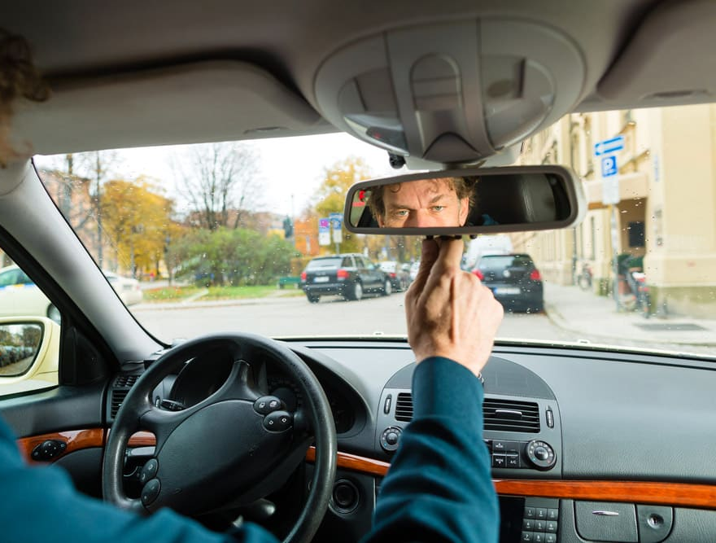
SAFETY IN THE REAR VIEW MIRROR

Slide 35
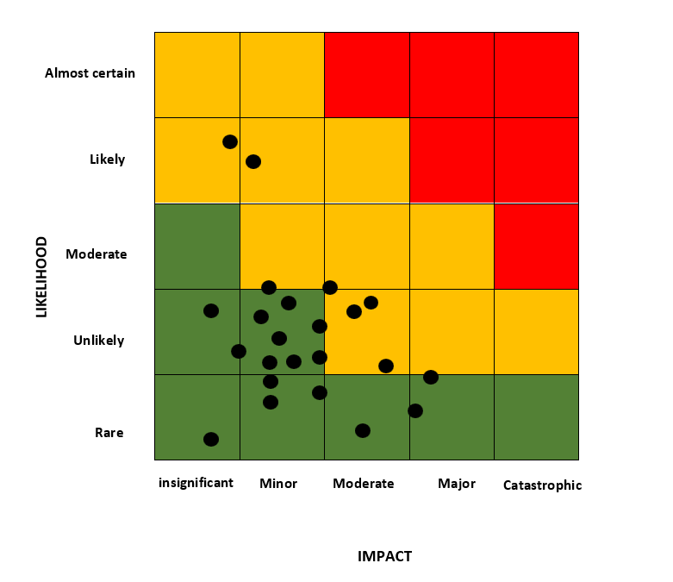


Slide 36
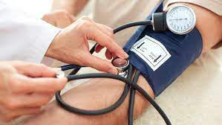
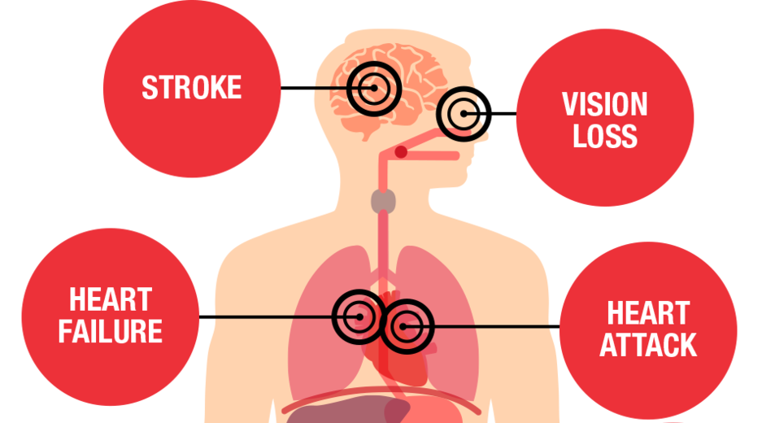
Lead & lag indicators

Slide 37
Proportionate response?
HOW DO WE TRACK & RECORD THE LEARNING FROM THESE EVENTS

Slide 38
LEARNING RESPONSE PROCESS MAP

Slide 40

SAFETY
SAFETY

Slide 41
Oversight: The function by means of which a competent authority ensures that the applicable requirements are met by regulated entities
COMPLIANCE
V
PERFORMANCE

Slide 42
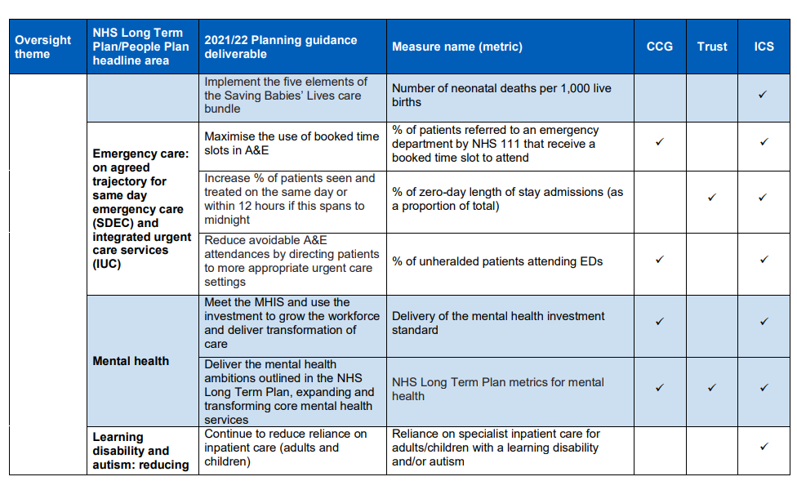
NHS oversight metrics for 2021/22
https://www.england.nhs.uk/wp-content/uploads/2021/06/B0693-nhs-oversight-metrics-for-2021-22.pdf

Slide 43

Oversight Approach
Use a variety of data
Reduce the information collection burden
Oversight is not ‘one size fits all’
Capture meaningful insight from patients, families, and staff
Metrics require clarity and purpose
Be aware of perverse incentives
Oversight roles and responsibilities specification
B1465-4.-Oversight-roles-and-responsibilities-specification-v1-FINAL.pdf (england.nhs.uk)

Slide 44
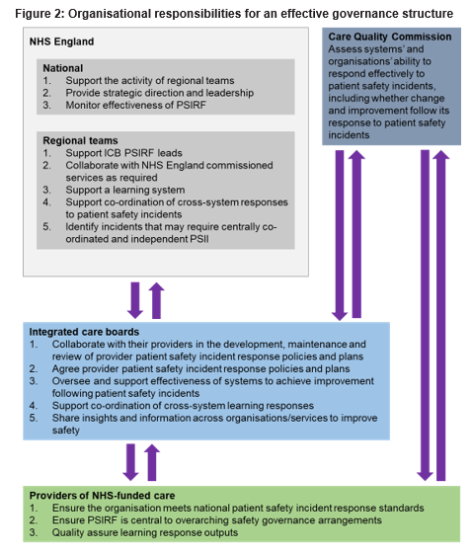
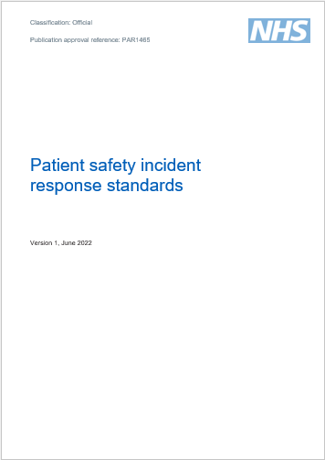
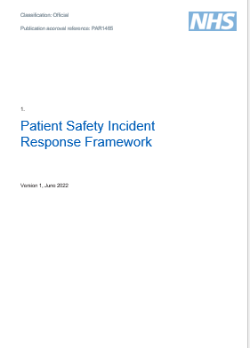

Slide 45





OUTPUT
SAFETY
EFFICIENCY

Slide 46


Slide 47
X
X
X
X
X

Slide 48
Policy, planning and governance
Does our patient safety incident response plan match the risks that feel tangible to us as an organisation?
Does emerging intelligence match our assumptions about the biggest risks in our plan?
Can we demonstrate wide collaboration and stakeholder involvement in the development and maintenance of our plan?
Does our plan demonstrate a thorough analysis of data and provide a clear rationale for the selection of patient safety incidents for further learning?
Is our ICB assisting cross-organisation working and information sharing?
How do we choose our response to a patient safety incident?
How do we support those who bring ‘bad news’ or surprises about organisational safety?
Is the patient safety incident response plan being updated as required and in accordance with emerging intelligence and improvement efforts?
Does the patient safety incident response plan accurately address the known patient safety-related challenges for this organisation?
Is work progressing to fulfil any gaps identified in meeting national patient safety incident response standards?
What learning is emerging through collaborative external (peer) review? How is this contributing to improvement?
What is the quality management process for the outputs of patient safety incident response (eg PSII reports)?
Does quality management involve key stakeholders (eg safety experts, patient safety partners, staff representatives)?

Slide 49
?
?
?
?
?
Engagement and involvement of those affected by patient safety incidents
?
Policy, planning and governance
Proportionate responses
Safety actions and improvement
?
Competence and capacity
?
?
?
?

Slide 50
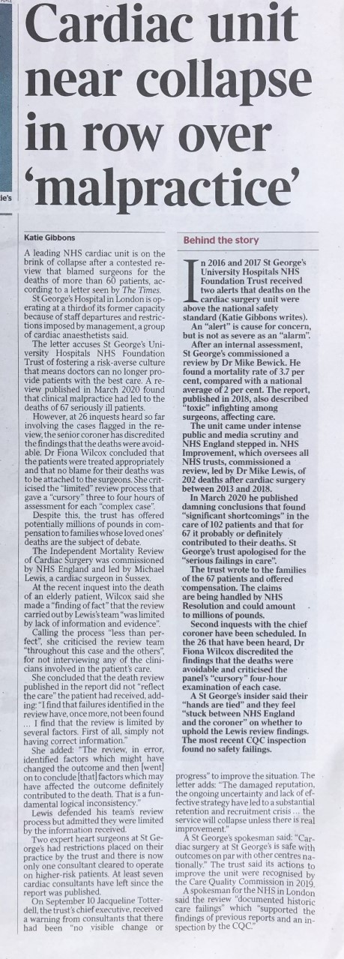
Notes:
St Georges Hosp
Damaging local review which blamed individuals for errors
Coroner disagrees

Slide 52
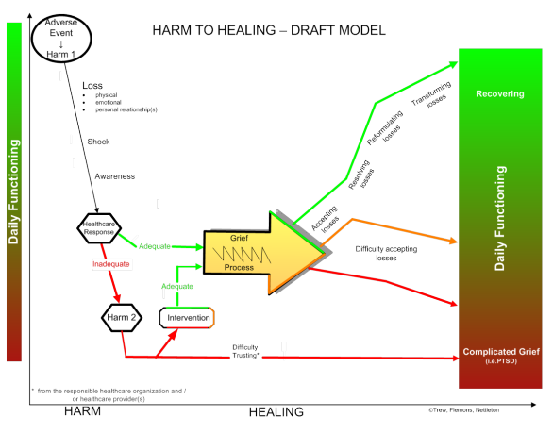
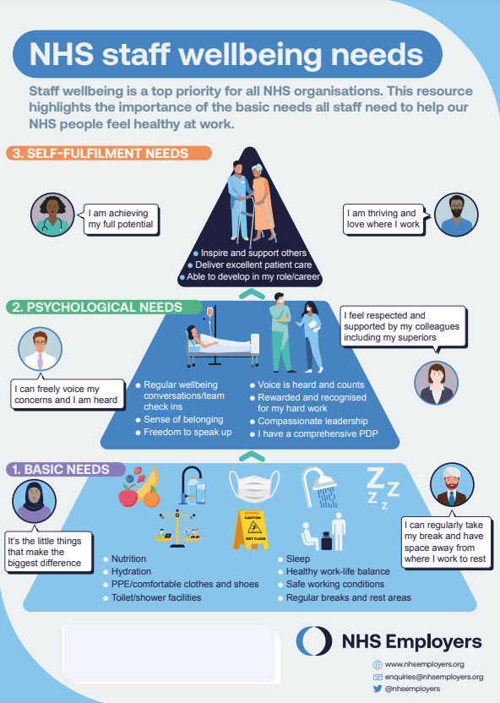
Done with people not to people
https://www.patientsafetyinstitute.ca/en/toolsResources/Research/commissionedResearch/HarmtoHealing/Documents/Harm%20to%20Healing.pdf

Slide 53
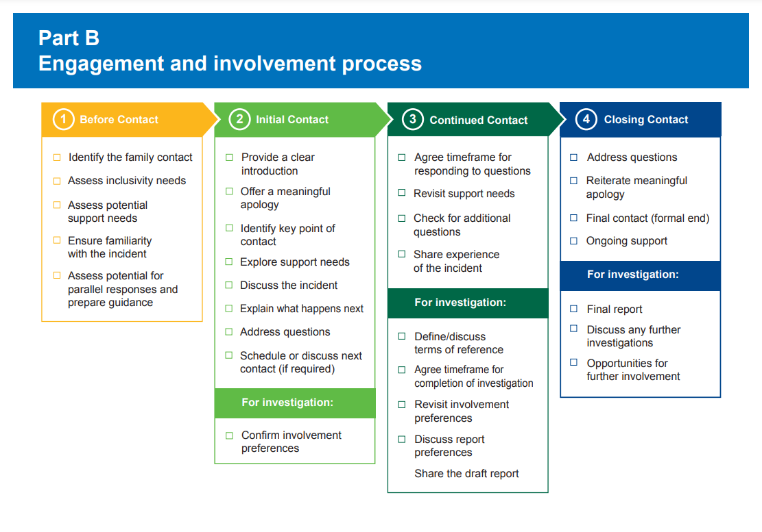

Slide 54
Engagement and involvement of those affected by patient safety incidents
How do we ensure those affected by patient safety incidents are engaged and involved in any learning response?
Does engagement include prompt and effective communication between those affected by a patient safety incident and our organisation?
Does engagement and involvement occur respectfully and according to individual needs?
How do we know how well our processes are working? What are the current barriers?
Are patients or staff with protected characteristics represented more often than others in any of our incidents and responses? What are the organisational or cultural reasons behind this?
What is the provider’s understanding of engagement and involvement?
What improvement work is ongoing to facilitate quality engagement and involvementIs compassionate engagement equitable for all?
How extensive is the evidence of a just culture (eg does ‘blame’, or focusing on individual actions or omissions in investigations still occur)?
What do external data sources (eg NHS staff survey, GMC training survey, say about staff experience?
Is the organisation aware of its successes and challenges regarding staff support in response to incidents?

Slide 55

SAFETY
ACTIONS…

Slide 56
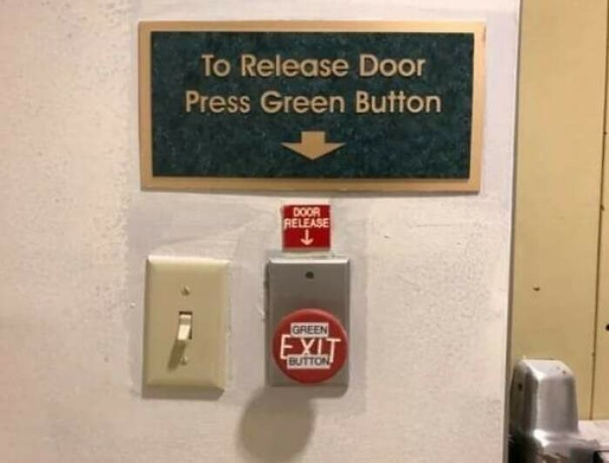

Slide 57
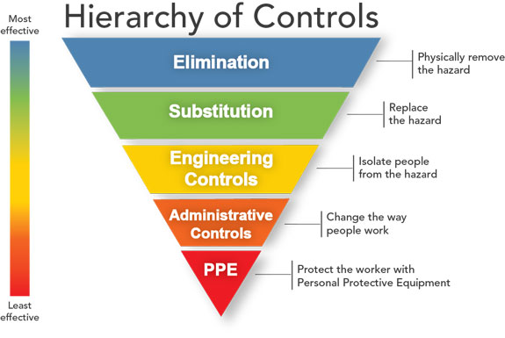
Recommendations
Making recommendations

Slide 58
Safety actions and improvement
How easy is it to make an improvement in our organisation? Is time, priority and expertise given to those who need it?
Do we have and use processes to share emergent intelligence and receive support from external partners (eg ICSs, regional and national NHS teams, royal colleges, professional associations, patient groups, charities etc)
How do we assess the sustainability of our safety actions and improvements?
Is learning triangulated across the range of incident response methods used to inform improvement?
Can the organisation describe safety improvement in progress, what they aim to achieve and their interim successes and challenges?
What is the provider board doing to support local teams on challenges in patient safety improvement?

Slide 59
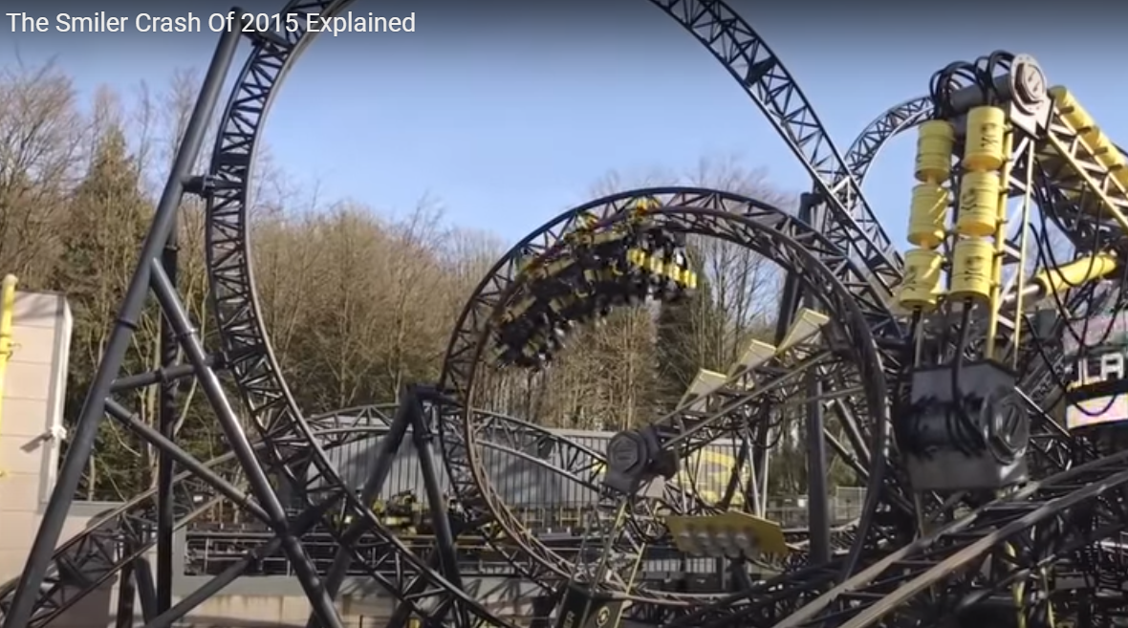

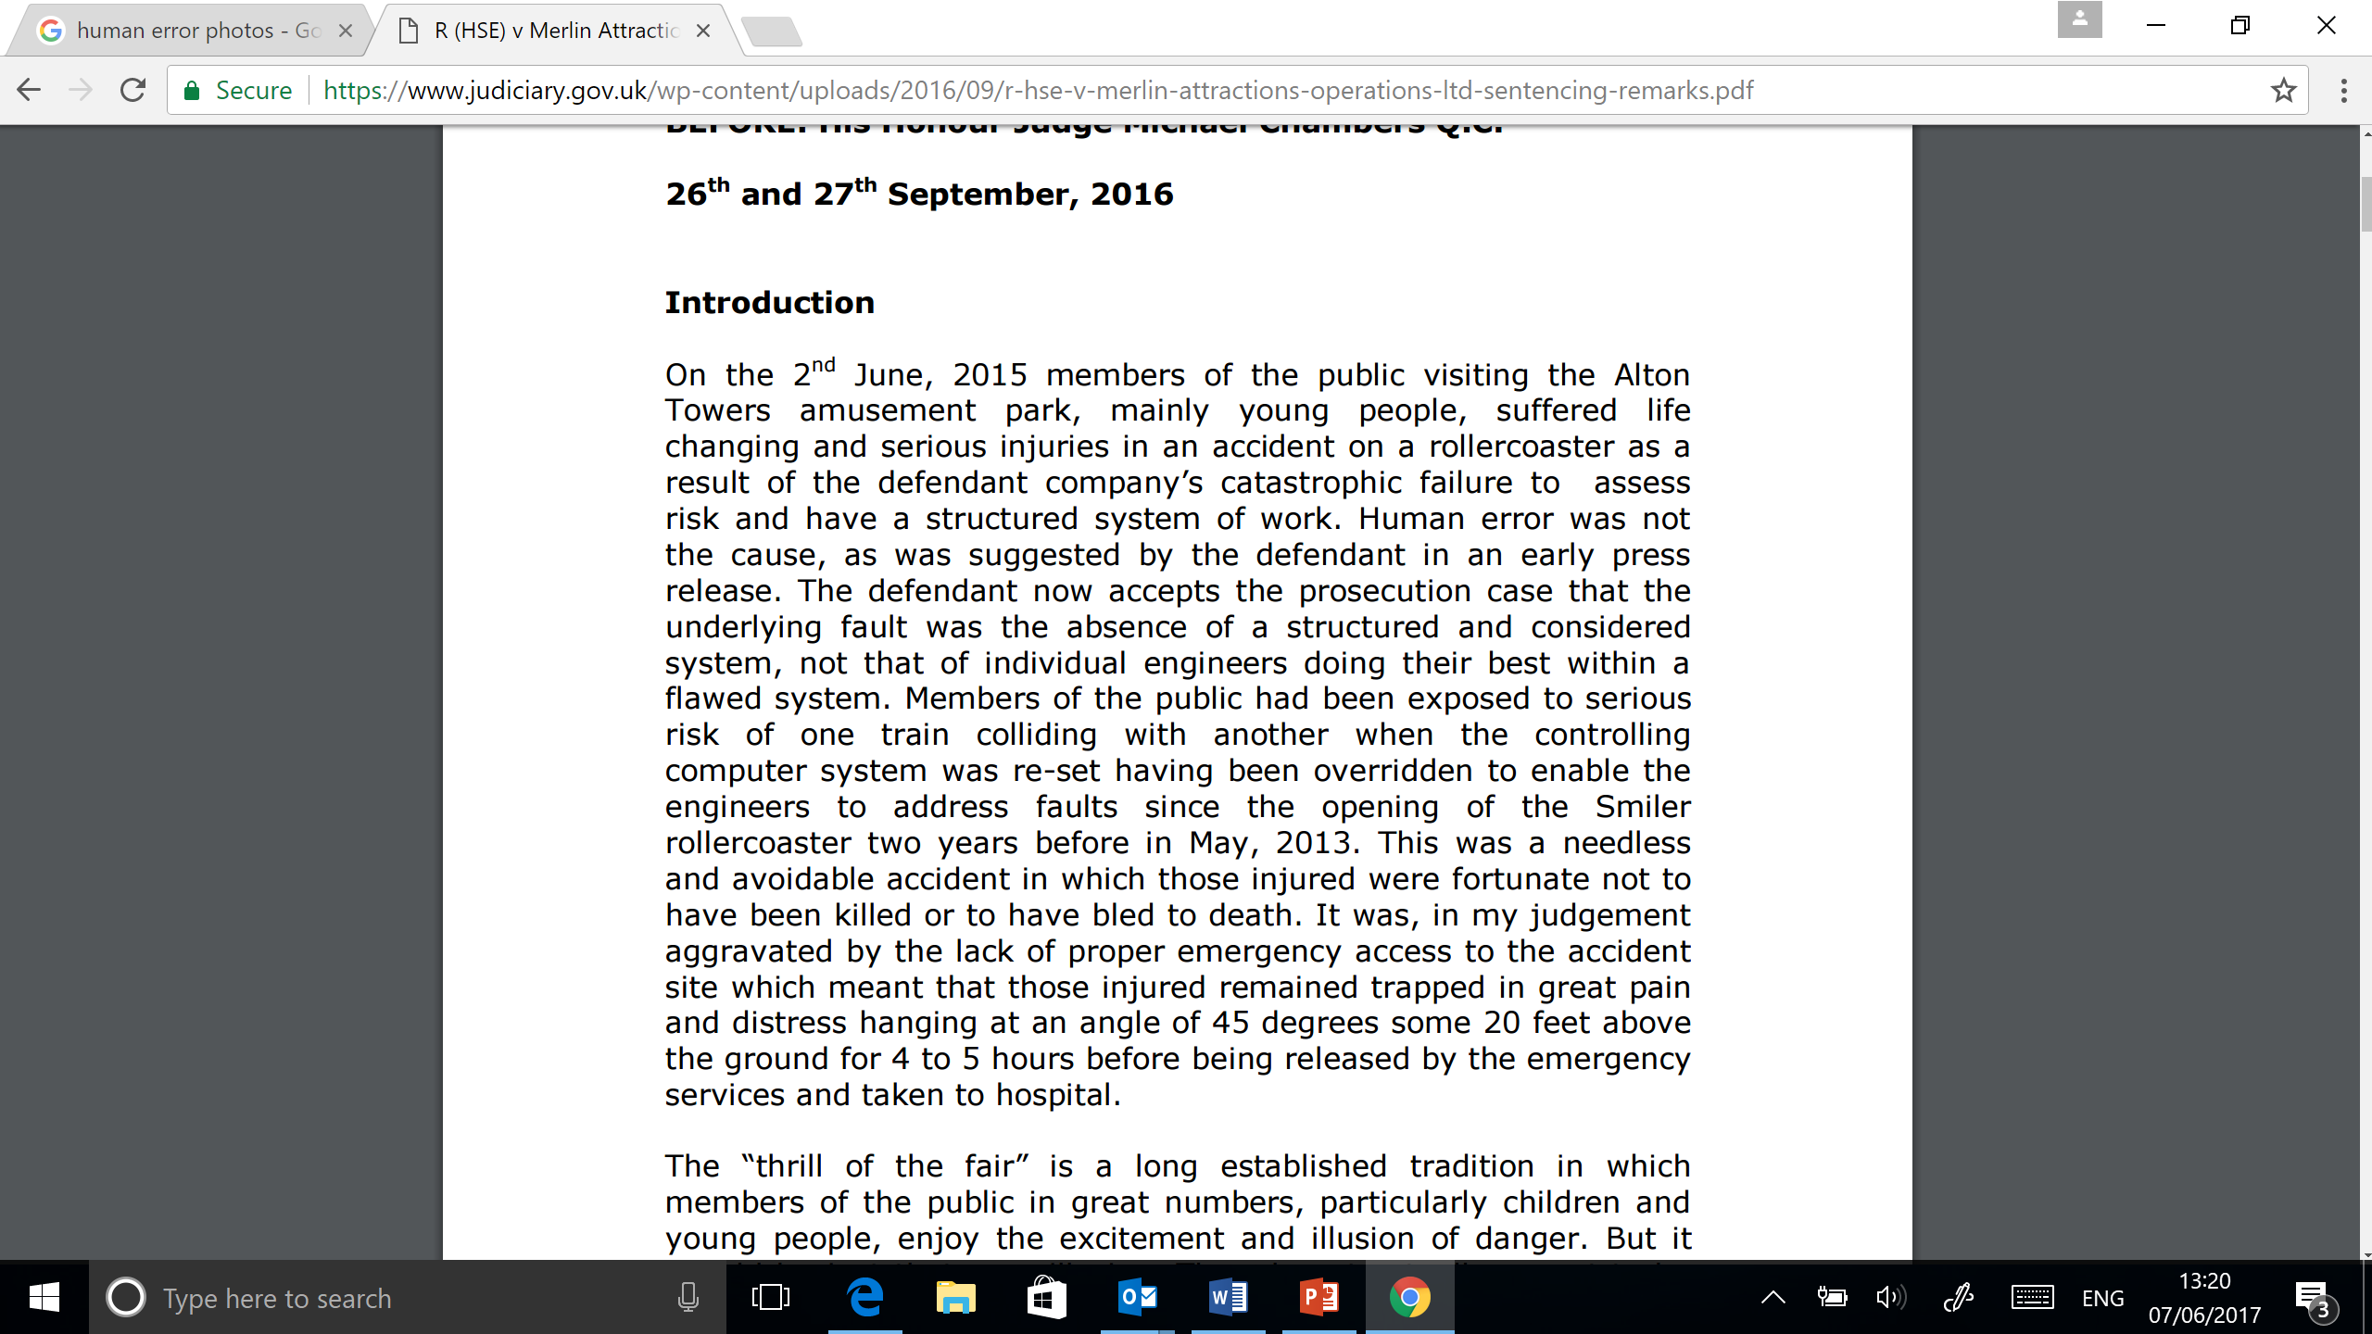

Slide 61
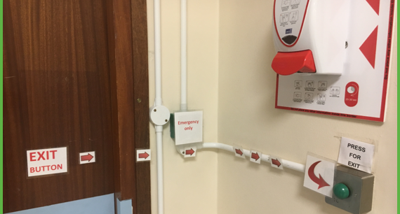
Summary & Questions
Paul.davis23@nhs.net

