Slide 1


Managing challenging, aggressive and violent behaviour
Challenges, Opportunities and Trends
Reducing, and making safer, the use of coercive & restrictive interventions
Eric Baskind
Healthcare Conferences UK
2 February 2023

Slide 2
Overview
lack of clarity and consistency re violence/aggression and challenging behaviours/clinical procedures
confusion about which staff should be trained and in what skills
overuse of coercive and restrictive interventions remains a significant issue
with restraint, injuries (physical/psychological) / fatalities are specific concerns
main focus continues to be on reducing all kinds of coercive and restrictive interventions to a minimum whilst maintaining safety
need for cross-sector oversight / standardised approach
lots to learn from coronial Reg. 28 reporting
several controversies remain unanswered

Slide 3
3 fundamentals for managing Violence, Aggression, and other Challenging Behaviours (VAoCB)
1. Safety. What is the best way to keep patients and staff safe from VAoCB?
If considering any coercive or restrictive intervention, ask:
2. Just because we can doesn’t mean we should
3. Is it necessary, proportionate, lawful, safe?

Slide 4
Once the fundamentals have been understood, other issues fall into place
Prone restraint
Pain compliance
All patient-centred
Mechanical restraint
Seclusion/segregation
Chemical restraint
Advanced PPE

Slide 5
Who should be trained, and in what skills?
Common examples
Patient-facing clinical: no common theme: some Trusts provide training – others don’t. Content of any training varies widely.
Patient-facing non-clinical: generally none.
Security: depending on whether they are contracted or employed by Trust: either SIA training (often minimal) or specialist healthcare training.
In most cases conflict-resolution and de-escalation training (CRT) is very poor. This is often more important than physical intervention training because it has the potential to manage a potentially aggressive incident at an early stage without the need for any kind of restrictive intervention.

Slide 6
What skills should staff be trained in?
This question can only be answered following suitable & sufficient risk assessment and training needs analysis. The following table is an example only
 | CRT, security awareness | clinical holding | personal safety (breakaway) | restraint
patient-facing staff | ✓
clinical staff | ✓ | ✓ | by R.A.
security staff | ✓ | ✓ | ✓ | ✓
Specialist clinical response team (SCRT) | ✓ | ✓ | ✓ | ✓

Slide 7
Some issues for debate
a need for increased staff and organisational accountability
many organisations believe that restraint is over-used …
… it is, but many train staff only to restrain and then complain when they do restrain
what’s in a name? For example, do the terms “physical intervention” and “restraint training” give the wrong impression? How about “safety intervention”?
should there be a rebuttable presumption that use of force is a failure in care/treatment/incident management?
does conflict often/ever depend on staff rotas/shifts?

Slide 8
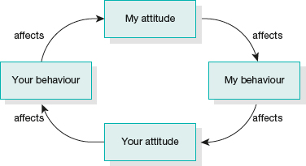
Betari box – the cycle of conflict

Slide 9
Some concerns
Key definitions
Inaccurate data
Reporting issues – what do you want to record?
(1) prone restraint holding a person chest down, whether the patient placed themselves in this position or not, is resistive or not and whether the person is face down or has their face to the side. It includes being placed on a mattress face down while in holds administration of depot medication while in holds prone, and being placed prone onto any surface (CQC)
(2) staff grabbed by P. Breakaway and restraint. Often only final intervention/position recorded but this provides inaccurate record
Responsibility
Training time / costs
Absence of standardised approach

Slide 10

ROYAL COLLEGE OF NURSING ANNUAL CONGRESS
Liverpool, 2013
Resolution: “That this meeting of RCN Congress asks Council to lobby UK governments to review, accredit and then regulate national guidelines of approved models of physical restraint”
Resolution passed:-
For: 99.8% (470). Against: 0.2% (1). Abstain: 1
What has happened since?
New BILD/RRN certification
Mental Health Units (Use of Force) Act 2018
and Statutory Guidance
SWC Expert Group endorsement programme

Slide 11
Wide choice of interventions (physical/mechanical)
many different techniques/equipment to choose from
absence of standardisation (outside of police/prison/high secure hospitals)
concerns about using mechanical restraints. Justified?
current practice is to reduce the number of skills taught; eg.
HOMES (Home Office Manual for Escorting Safely)
12 core techniques
High Secure Hospitals
Breakaway – 4 fundamental skills

Slide 12
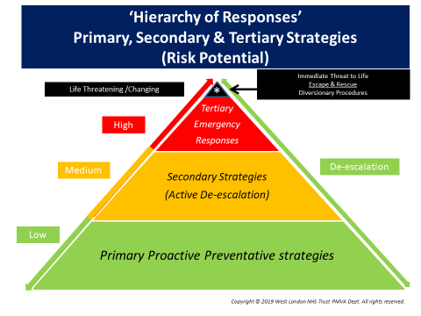

Slide 13
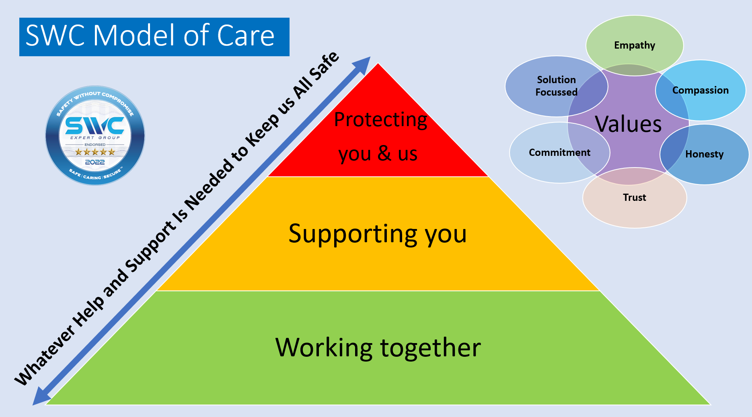

Slide 14
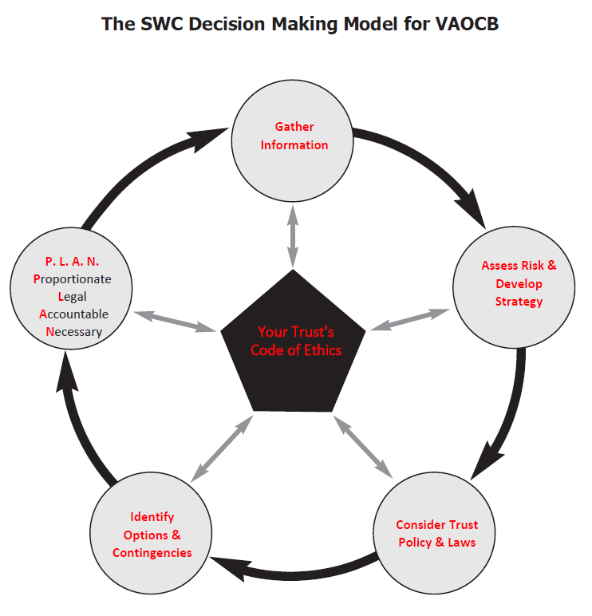

Slide 15
Four key controversies
‘No-restraint’ policies
Prone restraint positions
Pain-compliance techniques
Mechanical restraints

Slide 16
No-restraint policies (NRP)
Why do they exist?
“Behaviour is a matter for the police”.
Unsafe and potentially dangerous.
Unenforceable/unlawful.
Places organisation at risk (civil claims, HSE investigations/ prosecutions, etc).
NRP and Lone Workers:
HSE: “those who work by themselves without close or direct supervision”.

Slide 17
Mental health trust prosecuted after nurses stabbed
HSE brought case against Oxleas NHS Foundation Trust after an inpatient stabbed two members of staff at the Bracton Centre in Dartford in July 2016.
Improvement Notice issued alleging the Trust “failed to make a suitable and sufficient assessment of the risks to the safety of employees and third parties for the purposes of identifying the preventative and protective measures required to control violence and aggression demonstrated by the service users of the Burgess Ward.”
Failed to conform to ss 2(1) and 3(1) HSWA 1974 (duty to ensure H&S) and Reg 3.1 of the Management of Health & Safety at Work Regulations 1999 (risk assessments).

Slide 18
(2) Prone restraint positions
what is (should) the debate about?
Safety (patient/staff)
Control/secure
Confusion
“… more people die when restrained in prone than in any other position; therefore, prone restraint must cause more deaths than other positions …”.
Evidence?
Attempts to ban its use. Is it banned?
Alternatives/consequences?

Slide 19
Many key dates, but consider:
2004: Dr Cary, Consultant HO Forensic Pathologist, evidence to Bennett inquiry: “Prone restraint is an area that we know from cases around the world is a position in which people appear to die suddenly when restrained for long periods.” Sir John Blofeld recommended use of prone should be limited.
2005-7: NICE did not accept this recommendation. “No clear evidence that prone presented significantly greater risk than other positions”.
2011: Winterbourne View.
2013: MIND pressures government to stop all “face-down” restraint of people with mental-health problems in healthcare settings. Data secured by MIND (FOI) reveals that at least 3,439 patients in England were restrained in a “face-down” position in 2011-12 despite the increased risk of death from this kind of restraint.
2014: DH ‘Positive & Proactive Care, para 70.

Slide 20
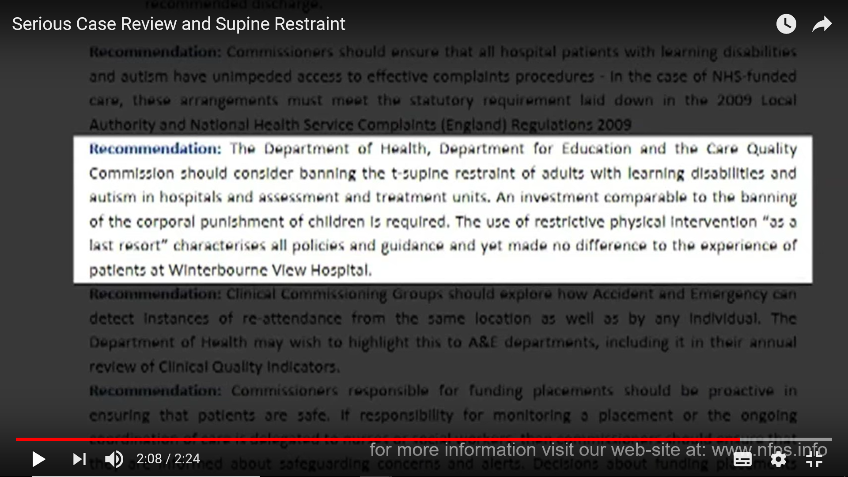
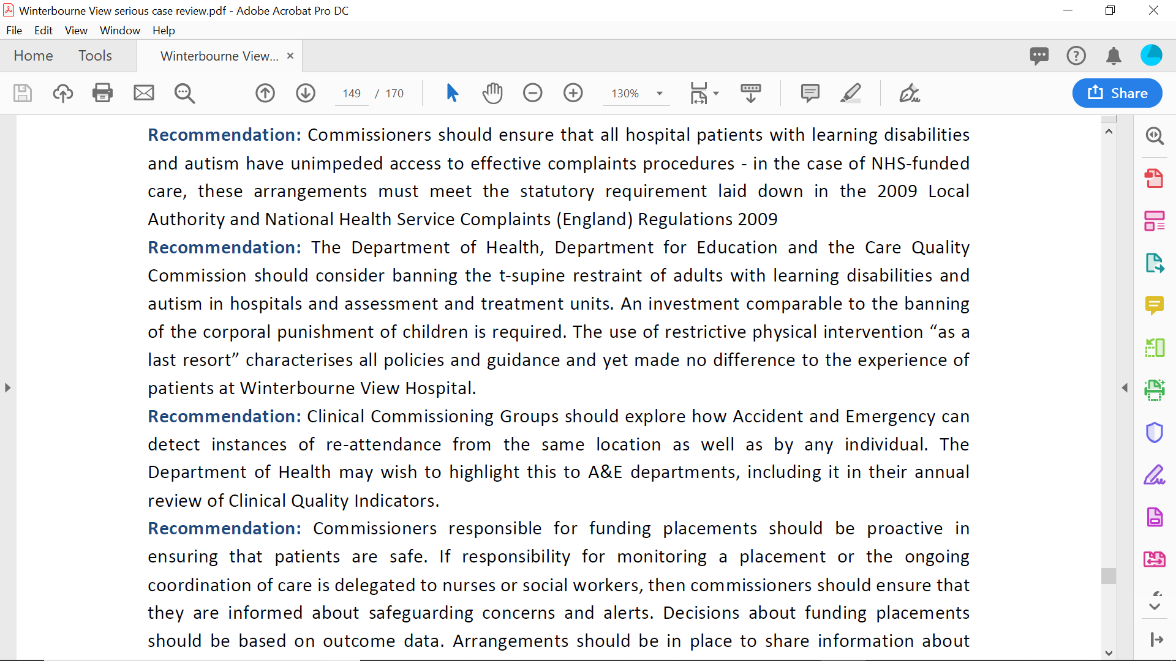
Winterbourne View – Serious Case Review (p135)

Slide 21
Lung function: prone v supine as a comparison to standing

Slide 22
Prone v supine as a comparison to standing
 | Forced Vital Capacity (FVC) (mean lung function) | Forced Expiratory Volume in 1st second (FEV1)
1. Standing control position | 100% | 100%
2. Supine (held by arms in ‘chicken wing’) | -3.56% | -3%
3. Prone (held by arms in ‘chicken wing’) | -7.8% | -7.87%
4. Forced prone (leaning in towards subject) | -23.83% | -27.39%
5. Forced prone (with fig 4 leg lock and arms restrained) | -30.46% | -29.87% (one participant showing -57%)
Reduction in lung function compared with position 1 : Bold = statistically significant
Experiment conducted by Parkes et al. See Med Sci Law 2008 Apr;48(2):137-41

Slide 23
Comparison of various seated positions
 | All | BMI less than 25 (FVC) | BMI greater than 25 (FVC)
1. Standing control position | 100% | 100% | 100%
2. Seated control position (upright; no restraints) | -4.3% | -6.5% | -2.5%
3. Seated – leaning forward to furthest point possible; not held/restrained | -28% | -18.2% | -36.3%
4. Seated – as 3; but restrained with double fig-4 arm holds | -32.5% (1 participant showing -80.6%; 5 showing greater than -50%) | -17.6% | -44.7%
Reduction in lung function compared with position 1
Bold = statistically significant
Experiment conducted by Parkes et al. Med Sci Law 2011; 51: 177–181

Slide 24
Position 4

Slide 25
INDEPENDENT REVIEW OF RESTRAINT IN JUVENILE SECURE SETTINGS
Peter Smallridge and Andrew Williamson, 2008
“In the light of the competing evidence we feel that we cannot make any recommendation to ban prone restraint, but we consider it prudent that when prone restraint is used there should be a re-assessment of the risks after control has been obtained in the initial restraint.”
(para 6.35)

Slide 26
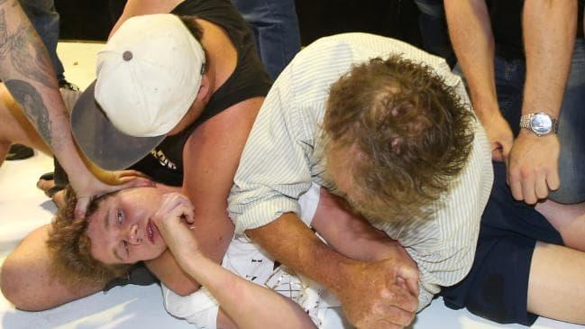
Supine as an alternative to prone?

Slide 27
Summary
Restraint position can be a factor in death during restraint, typically when other factors contribute to the overall situation.
Focus needs to be on restraint reduction and safety rather than “banning” prone restraint.
Use of prone restraint is a commonly-used (overused) technique across many sectors (eg police and prison service). Why? Consider foetal safety position.
No restraint position can ever be 100% safe but restraining subject on ground can be more dangerous than standing restraint positions. But, applied correctly and in appropriate circumstances it can be an important part of the restraint mix.

Slide 28
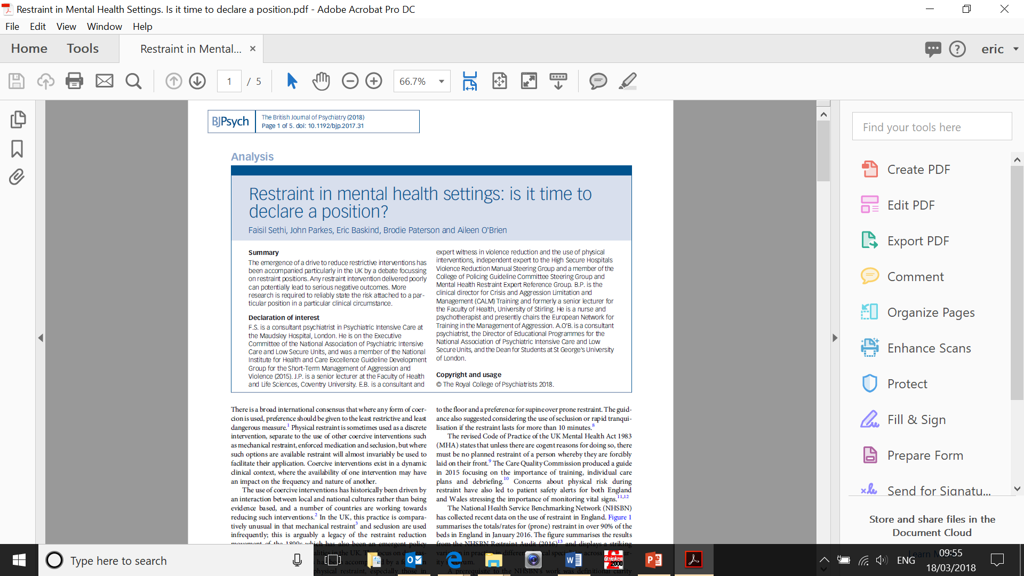
The British Journal of Psychiatry (2018)

Slide 29
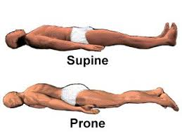
Potentially unsafe
Still potentially unsafe
Risks not eliminated – just different and need managing.
Time in restraint can be critical. Avoid all takedowns/ floor (surface) restraint if possible.

Slide 30
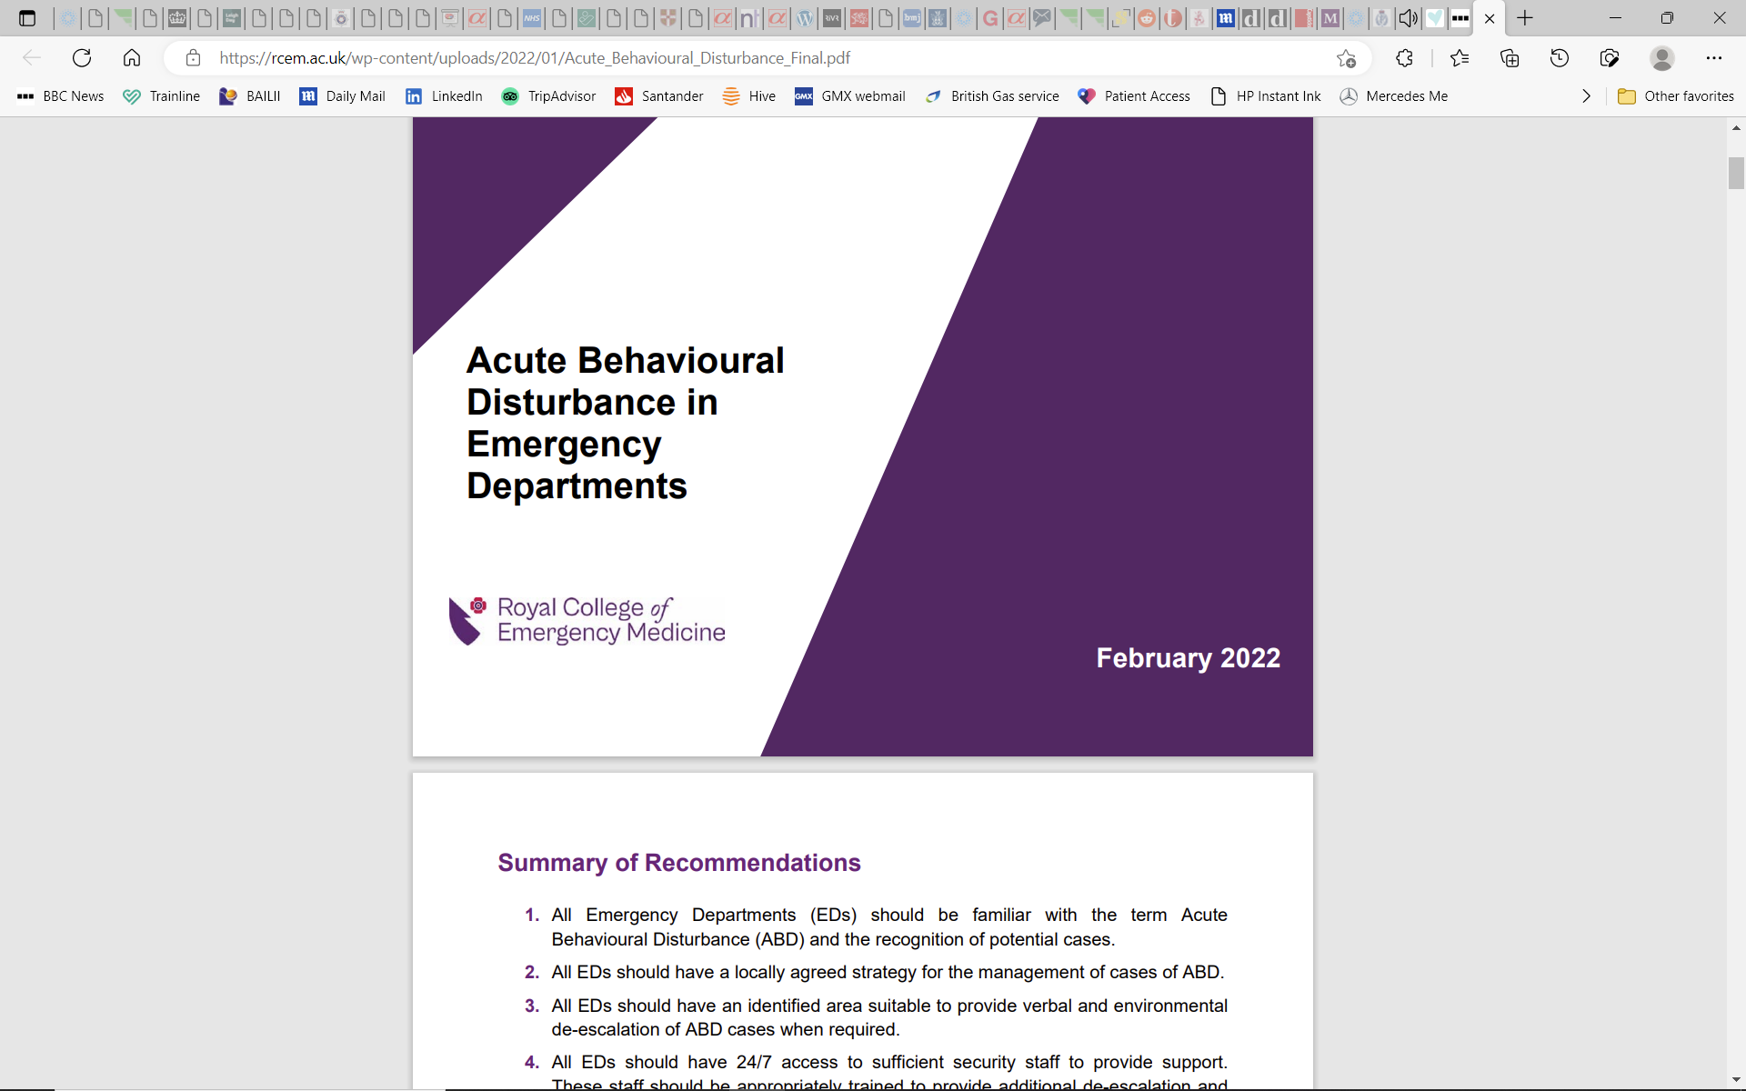
“It has previously been suggested that restraint in the prone position contributed to deaths. Although this theory has not been supported by recent research, it would be prudent to ensure that there is no obstruction to ventilation and to minimise the risk of asphyxiation.”
Royal College of Emergency Medicine, Best Practice Guideline, “Acute Behavioural Disturbance in Emergency Departments”, February 2022
See further:
Vilke GM. Restraint physiology: A review of the literature. J Forensic Leg Med. 2020;75:102056. doi:10.1016/j.jflm.2020.102056

Slide 31
Time in restraint
Q: For how long is it safe to restrain someone, especially on the ground?
3 minutes (Bennett Inquiry)
5 minutes (prison service manual 1999)
10 minutes (NICE NG10)
none of the above

Slide 32
Time in restraint – key issue in safety
‘The amount of time that restraint is applied is as important as the form of restraint and the position of the detainee.
Prolonged restraint and prolonged struggling will result in exhaustion, possibly without subjective awareness of this which can result in sudden death.’
Police Complaints Authority. ‘Policing Acute Behavioural Disturbance’, Revised Edition, March 2002

Slide 33

NICE Guideline NG10
Do not routinely use manual restraint for more than 10 minutes (6.6.3.13) – how practical is this? when does timing start?
Consider rapid tranquillisation or seclusion as alternatives to prolonged manual restraint (longer than 10 minutes) (6.6.3.14)

Slide 34
(3) Pain-compliance techniques
The argument: ‘The deliberate infliction of pain on anyone cannot be justified’.
Pain compliance is generally unnecessary but may be safer alternative in certain high-risk situations, eg:
to prevent lengthy restraint/more risky positions
to force subject to release grip (bite, weapon, person)
wherever it is safer option in all of the circumstances
Disingenuous to give intervention a different name to disguise it: “distraction techniques”, “escape and rescue”, etc.
See: Positive & Proactive Care, DH, April 2014 [69],
Mental Health Act Code of Practice (2015) [26.41],
NICE Guideline NG10 [6.6.3.5/8.4.3.2]

Slide 35
(4) Mechanical restraint
‘the use of a device to prevent, restrict or subdue movement of a person’s body, or part of the body, for the primary purpose of behavioural control’ (Department of Health 2014, paragraph 78).
not a complete alternative to physical restraint as they cannot be applied unless the subject is under some degree of control. In most cases staff will need physically to restrain the subject before applying mechanical restraints.
any kind of physical intervention should be used only where necessary and mechanical restraint, being part of the intervention mix, is no exception.
can be very helpful for de-escalation.

Slide 36
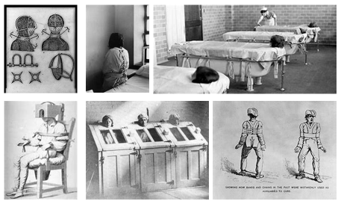

Slide 37
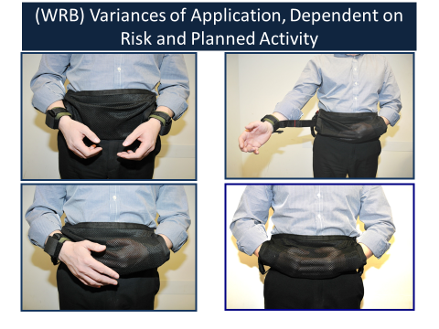

Slide 38
Manual Handling Operations Regulations 1992
Physical restraint is a manual handling activity.
The Manual Handling Operations Regulations 1992, as amended by the Health and Safety (Miscellaneous Amendments) Regulations 2002, applies.
Employers are required to fulfil a number of criteria to reduce the risk of manual handling accidents at work.
This includes a requirement that employers “shall so far as is reasonably practicable avoid the need for his employees to undertake any manual handling operations at work which involve a risk of their being injured” (reg. 4(1)(a)).

Slide 39
Case study
Male adult - severe personality disorder - intelligence within normal range - has capacity - whilst detained in psych. hospital assaulted staff - 5 years’ prison.
Serious self-harming (self-strangulation with ligatures and plastic bags, burning himself, head-butting and self-laceration, frequently re-opens wounds).
Transferred from prison back to psych. hospital - detained MHA. Mechanical restraint used to prevent him from using his hands to self-harm.
(Notts Healthcare NHS Trust v RC [2014] EWCOP 1136)

Slide 40
NICE NG10
6.6.3.18-19
mechanical restraint in adults only in high-secure settings (except when transferring service users between medium- and high-secure settings)
why restricted to setting?
contrary to the Manual Handling Regs
generally unnecessary but may be safer in certain high-risk situations, eg:
preventing otherwise prolonged restraint/more risky positions
avoiding the use (or repeated use) of pain-compliance
wherever it is safer option in all of the circumstances
not to be confused with bed cages, ties, used outside UK

Slide 41
Engages 2nd limb of NICE NG10 para 6.6.3.19 - “mechanical restraint to be used as a last resort and for the purpose of limiting self-injurious behaviour of extremely high frequency or intensity”.
But query 6.6.3.18 which restricts M.R. to high-secure settings. Why??? What alternatives did staff have?
manual restraint to prevent his self-harming behaviour. Consider risks/prolonged restraint issues and para 6.6.3.13 (10 mins guideline)
seclusion/forced rapid tranq not appropriate (6.6.3.14)
why should it matter whether P’s behaviour occurred whilst detained in low, medium or high secure hospital or continued while he was detained in prison hospital wing?

Slide 42
We recognise that the use of mechanical restraint may be considered to be the least restrictive intervention in some specific cases, and may present less risk to the individual than the alternative of prolonged manual restraint or transfer to a more restrictive setting.
This could provide a valid reason for using mechanical restraint in an emergency or ‘unplanned’ interventions, as well as planned interventions.
CQC 2018
Restraint: physical and mechanical guidelines

Slide 43
Protecting your organisation from problems and harm
ensure records are maintained and are accurate
contentious documents (ie use of force forms) must be completed independently of other persons
ensure everything is appropriately recorded (“If it is not written down it didn’t happen”)
always have your policies and physical skills independently reviewed
where appropriate, engage independent investigators to review significant events
where you intend to depart from guidance, set this out clearly, with reasons
independent support/assurance important

Slide 44
Designing and implementing a successful restrictive interventions reduction policy
all kinds of restrictive interventions must be minimised
work I am carrying out suggests 43% of physical interventions were unnecessary (247 reviews between 2018 – 2022)
reducing restrictive practices must be embedded into policies and have support from Board and senior managers
must also be embedded in training
many organisations are starting to review number of interventions by individual staff. This could help identify excessive UoF by some staff, but there could be good reasons for this
where relevant, compliance with BILD/RRN standards
RRN standards contain some extremely helpful guidance for reducing restrictive practices

Slide 45

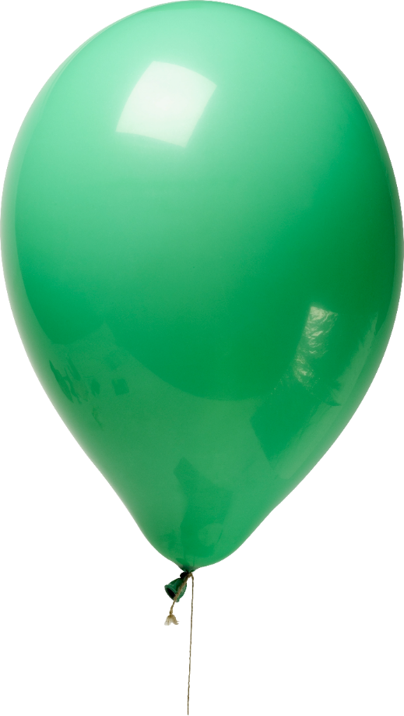
All kinds of restrictive interventions must be minimised
restraint, seclusion, LTS, coercion, etc.
Eliminating any kind of intervention is like squeezing a balloon.
The problem will move elsewhere.

Slide 46
Key learning from previous cases where death or significant harm has been caused or ‘near misses’
thorough investigation and learning points acted on without delay
engage independent experts where required
death results in Inquest or FAI where its cause will be thoroughly investigated. Prevention of Future Deaths Report (Inquest) or Recommendations from Sheriff (FAI) may follow
no corresponding investigation in non-death cases
the difference between P being injured and dying is often a matter of chance
consider Prevention of Future Harm from PMVA report

Slide 47
Key learning from outstanding/poor practice in PMVA
many good practices/outcomes – good opportunity for future learning/training
poor practices often brushed under carpet
consider amending UoF form for staff to explain:
what went well?
what went wrong/not so well?
what would you do differently?
what would you change?
safety person – one of the most important safety considerations in managing violence and aggression

Slide 48

The SWC checklist for safer interventions
Pre | During | Post
Have all interventions been risk assessed? (medical, legal, biomechanical, ethical, etc)? | Is it necessary? | Post-incident debrief
Have your processes been externally reviewed and signed off as appropriate? | Does it remain necessary throughout? | Lessons learnt
Are all staff sufficiently trained? | Can it be planned? (If so, reflect on necessity throughout planning and at point of implementation) | Restraint safety manager ( national safety commissioner)
 | The safety person | External review
 | Continuously think about the aim of the intervention? | Adverse incidents and coronial PFD reports
 | Are there less risky / restrictive alternatives?

Slide 49

Thank you
e.i.baskind@bsdgb.co.uk
e.i.baskind@swcexperts.com

