Slide 1
Learning from Lived Experience
Sarah Rae
11th October 2022

Slide 2
Safety in Mental Health Settings project

Slide 3
Safety in Mental Health Settings (SiMHS) project
Project aims:
To explore the issue of violence and aggression on adult acute care wards and PICU across London
To standardise and improve best practice, and make services safer for all who access and work in these services.

Slide 4
Qualitative work
Focus groups: five, two-hour, online sessions (23 service users with inpatient experience and one carer)
E-survey: completed by a diverse range of respondents (84) most with recent inpatient experience (only 38% ‘White British’)

Slide 5
Service user experience survey
70% of respondents reported witnessing an incident of violence and aggression
over 70% found this ‘somewhat worrying’ or ‘extremely worrying’.

Slide 6
Service user focus groups - improvement ideas
Increased visibility and accessibility of staff on the ward
More responsive staff who proactively address service users’ concerns
Improved communication with staff (also better communication between staff)
A shift towards more equal power dynamics with staff working alongside patients
Greater range of activities
Implementing trauma informed ways of working
Improved supervision and management action to avoid poor leadership
Managers who are more assertive over standards of practice
Robust whistleblowing polices to ensure patients can register complaints more easily
Notes:
Report was published summarising key themes that emerged from the focus groups which also included implications for practice
The LEAG were invited to review the exec summary and reflect on the implications practice
was crucial to be able to respond and build relationships

Slide 7
Rachel’s experience
“To be honest, when I go into acute setting I almost feel I have to go into survival mode. It is a really strange feeling. You don’t feel safe. You are already quite traumatised going in in terms of the journey you have had there, or in terms of the journey that I had had getting to hospital, so feeling incredibly paranoid, vulnerable, scared, so you already have a lot of feelings running through and surging through your brain and your body, and then you get onto this ward and I have always found that I felt like now I have to put on the armadillo, if you like, and I have to become this tough – put on a tough persona because I am aware that not only do I have to do that in terms of staffing, because I know I am going to encounter difficulties in terms of confrontation with staff and in terms of restraint as regards to me, but also in terms of patient as well – patient-to-patient safety, and I think, again, that’s quite huge.”
Notes:
Report was published summarising key themes that emerged from the focus groups which also included implications for practice
The LEAG were invited to review the exec summary and reflect on the implications practice
was crucial to be able to respond and build relationships

Slide 8
PROMISE Programme PROactive Management of Integrated Services & Environments

Slide 9
In the Journal of Mental Science for 1862 is reprinted a lecture given in Cambridge by Dr J. Lockhart Robertson on 'The Progress of Psychological Medicine since the Sixteenth Century’.
“In order vividly to see the progress which medical science has made since Dr Caius' time let us look at one of our English county asylums of today. A very good specimen is the Cambridge Asylum at Fulbourn under the able administration of my friend Dr Lawrence.
The first great fact observed is the entire absence of all means of mechanical restraint. Neither belt, strait-jacket, manacle, strong chair, or any other means whatever for restraining the patient, are to be found there”.
‘The Story of a Mental Hospital: Fulbourn 1858-1983’ by David H. Clark
Pause for thought…
https://www.clahrc-eoe.nihr.ac.uk/2016/07/8095/

Slide 10
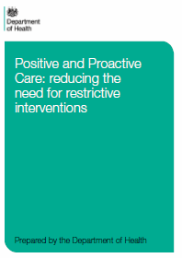
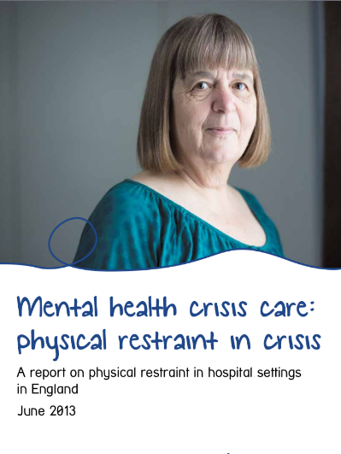
Inception of PROMISE
Meeting of Minds
Initiation of PROMISE
DOH Guidance
Sept 2013
DOH provides a tremendous boost to examine restrictive practice
Mind Report
Highlights inconsistencies from 38 to 3000+ PI incidents
Apr 2014
June 2013
https://www.clahrc-eoe.nihr.ac.uk/2016/07/8095/
Notes:
Cape Town: PROMISE

Slide 11
2014 data
 | Jan 2014 | Feb 2014 | Mar 2014 | Apr 2014 | May 2014 | Jun 2014 | Jul 2014 | Aug 2014 | Sep 2014 | Oct 2014 | Nov 2014 | Dec 2014 | Total
CAMH North | 0 | 1 | 0 | 0 | 0 | 0 | 0 | 0 | 0 | 0 | 0 | 0 | 1
Cavell Centre - Maple 2 | 0 | 0 | 0 | 0 | 1 | 0 | 0 | 0 | 0 | 0 | 0 | 1 | 2
Cavell Centre - Oak Ward 1 | 6 | 4 | 0 | 1 | 1 | 4 | 4 | 3 | 1 | 0 | 0 | 1 | 25
Cavell Centre - Oak Ward 2 | 1 | 4 | 4 | 1 | 2 | 1 | 0 | 1 | 2 | 5 | 0 | 1 | 22
Cavell Centre - Oak Ward 3 | 1 | 0 | 0 | 1 | 0 | 1 | 0 | 0 | 0 | 0 | 0 | 0 | 3
Cavell Centre - Poplar Ward (PICU) | 0 | 8 | 4 | 2 | 5 | 5 | 2 | 2 | 1 | 0 | 0 | 4 | 33
Community Mental Health - Hunts OP | 0 | 0 | 0 | 0 | 0 | 0 | 0 | 0 | 0 | 0 | 0 | 1 | 1
Darwin Centre for Young People | 47 | 14 | 1 | 14 | 21 | 1 | 0 | 0 | 0 | 1 | 0 | 0 | 99
Darwin Nurseries | 1 | 0 | 0 | 0 | 0 | 0 | 0 | 0 | 0 | 0 | 0 | 0 | 1
Eating Disorder Service | 1 | 0 | 0 | 0 | 0 | 0 | 0 | 0 | 0 | 0 | 0 | 0 | 1
George Mackenzie House | 1 | 2 | 1 | 0 | 2 | 0 | 0 | 0 | 0 | 0 | 0 | 0 | 6
IASS | 2 | 0 | 0 | 0 | 0 | 0 | 0 | 0 | 0 | 0 | 0 | 0 | 2
Learning Disabilities - The Hollies | 0 | 0 | 4 | 1 | 1 | 1 | 0 | 0 | 2 | 4 | 1 | 0 | 14
Mulberry 1 (Formerly Friends Ward) | 0 | 2 | 0 | 0 | 0 | 0 | 0 | 1 | 0 | 0 | 0 | 0 | 3
Mulberry 2 (Formerly Adrian House) | 2 | 2 | 2 | 0 | 0 | 6 | 1 | 0 | 6 | 0 | 2 | 14 | 35
Mulberry 3 formally (Cedars Recovery) | 0 | 0 | 0 | 0 | 0 | 1 | 0 | 0 | 0 | 0 | 0 | 0 | 1
Not applicable | 0 | 0 | 0 | 0 | 0 | 1 | 0 | 0 | 0 | 0 | 0 | 0 | 1
Oak 4 (LVG) | 0 | 2 | 3 | 2 | 0 | 1 | 6 | 0 | 0 | 0 | 2 | 2 | 18
Springbank | 3 | 5 | 2 | 0 | 1 | 0 | 2 | 4 | 8 | 15 | 16 | 1 | 57
The Fens Unit (DSDP Whitemoor Prison) | 1 | 0 | 0 | 0 | 0 | 0 | 0 | 0 | 0 | 0 | 0 | 0 | 1
Willow (Formerly - David Clarke House) | 0 | 0 | 0 | 0 | 0 | 2 | 0 | 0 | 0 | 0 | 0 | 0 | 2
Total | 66 | 44 | 21 | 22 | 34 | 24 | 15 | 11 | 20 | 25 | 21 | 25 | 328
https://www.clahrc-eoe.nihr.ac.uk/2016/07/8095/

Slide 12
Aims of the qualitative study
Improve understanding of the subjective experience of physical restraint for patients and staff on mental health wards within CPFT.
Elicit suggestions from patients and staff on how to reduce restraint.
Explore patient and staff understanding of and views about proactive care.
https://www.clahrc-eoe.nihr.ac.uk/2016/07/8095/

Slide 13
Suggestions: a brief overview
Communication and relationship
Get to know the patient
Inform and explain
Compassion and empathy
Talking to de-escalate
Spend more time with patients
Build therapeutic relationships
Listen, listen, listen!
Humanise care
Staffing
More staff members and more staff time
Learning from more experienced staff members
Using and developing staff skills
Peer support workers
Staff support from above
Activities and distraction
Individual or one-to-one activities
Group activities
Meaningful and stimulating activities
Environment and space
Specific ward rooms
Physical/aesthetic environment
Take patients off the ward
Personal space
Different spaces for different types of patients
Outside space
Mixed gender wards
More space in general
Money and resources
Money and resources for inpatient care
Money and resources for community care
Personalised and patient-led care planning
Patient involvement in care planning
Personalised care planning
No ‘one size fits all’
https://www.clahrc-eoe.nihr.ac.uk/2016/07/8095/

Slide 14
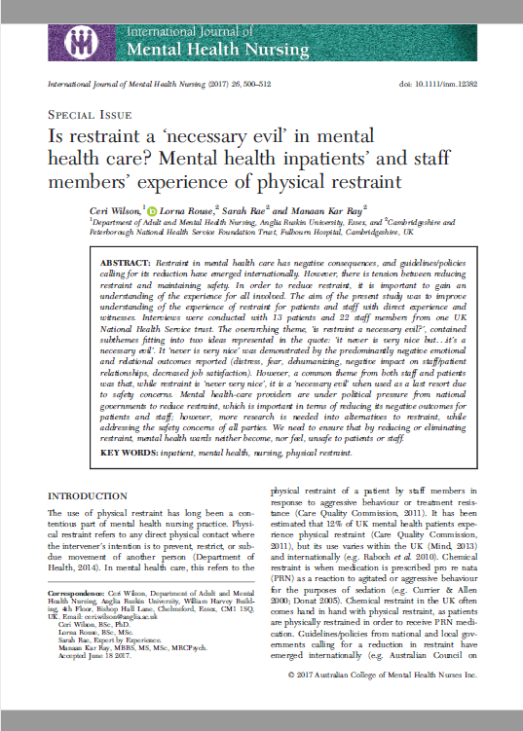
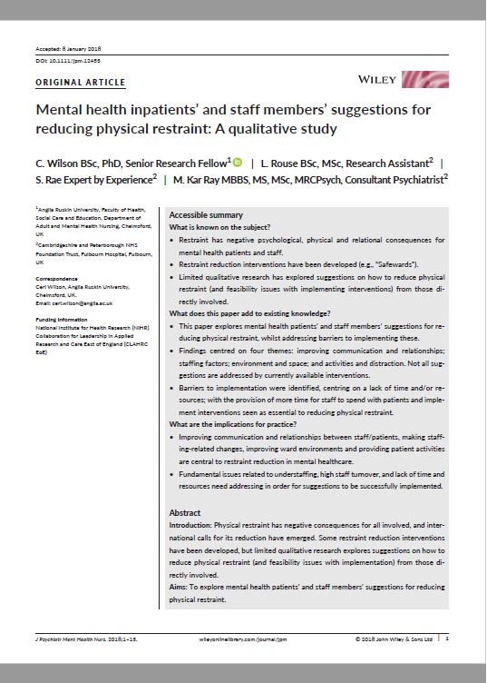
Qualitative study findings
https://www.clahrc-eoe.nihr.ac.uk/2016/07/8095/

Slide 15
A necessary evil?
Staff member 2, witness:
“…it never is very nice but I suppose it’s got to be done… it’s a necessary evil I suppose…”
Patient 2, witness:
“…I don’t think you’re ever going to negate it completely simply by the nature of people’s illness.”
https://www.clahrc-eoe.nihr.ac.uk/2016/07/8095/

Slide 16
Collating frontline initiatives
Over 200 bottom-up initiatives listed
Mapping exercise undertaken across all wards
Staff encouraged to innovate to develop new ideas
Key individuals (ward managers, consultants) sent to conferences and learning sets
Shared the stories and the numbers in Acute Quarterly Meetings, seeking their ideas
Key indivKey individuals (Ward Managers, Consultants) sent to conferences and learning sets.
iduals (Ward Managers, Consultants) sent to conferences and learning sets.
https://www.clahrc-eoe.nihr.ac.uk/2016/07/8095/
Your Logo

Slide 17
‘No’ Audit - adopting a yes culture
R – Reframe: What would it have taken to say yes?
E – Easy: Was ‘no’ the easy option?
F – Feeling: What would it have felt like?
L – Listen: Did we listen?
E – Explain: Did we explain?
C – Creative: Where we creative enough?
T – Time: Did we take the time?
Yes
No
Yes
No
No
Yes
https://www.clahrc-eoe.nihr.ac.uk/2016/07/8095/
Acknowledgement: Mulberry 2, Fulbourn Hospital, Cambridge

Slide 18
PROMISE Patient Advisory Group
https://www.clahrc-eoe.nihr.ac.uk/2016/07/8095/

Slide 19
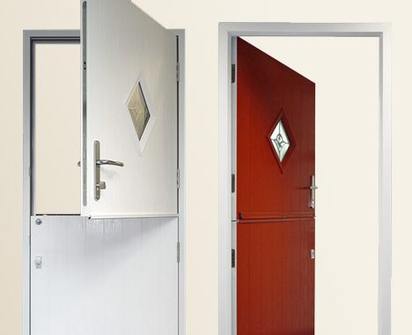
Improving environments
Challenging ‘them and us’
Replacing a stable door
Promoting dignity
Facilitating conversation
Dispensing of symbols of institutionalisation and power imbalance
https://www.clahrc-eoe.nihr.ac.uk/2016/07/8095/

Slide 20
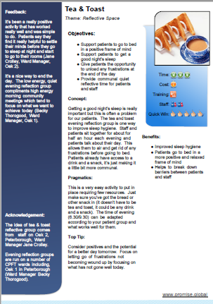
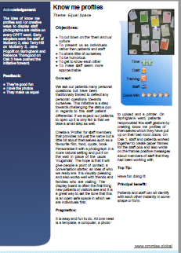
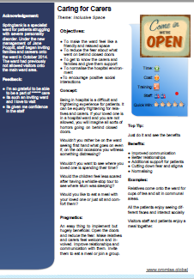
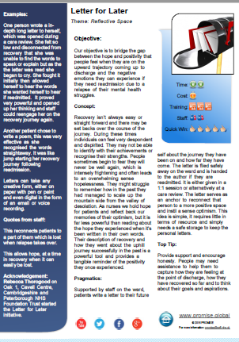
Frontline initiatives continued
Caring for carers
Transforming spaces
Mood and food
Ready steady care
Comfort in a box
https://www.clahrc-eoe.nihr.ac.uk/2016/07/8095/

Slide 21
Report (daily)
01
We manage what we measure, daily reporting on outcomes for safety, clinical effectiveness and patient experience
Reflect (weekly)
02
Doing what counts not just what we count, staying on task by creating a mindful reflective space for staff at least weekly
Review (monthly)
03
Finger on the pulse from board to ward, use the data to track against planned trajectory and proactively identify emerging hot spots
Report
PROGRESS
Reflect
Refresh (annually)
Review
04
Refresh
Annual business plan which lays out trajectory against key measures and how to achieve them with resource layout
PROactive Governance of Recovery Settings and Services
https://www.clahrc-eoe.nihr.ac.uk/2016/07/8095/

Slide 22
PROMISE results
https://www.clahrc-eoe.nihr.ac.uk/2016/07/8095/

Slide 23
Patient experience scores
https://www.clahrc-eoe.nihr.ac.uk/2016/07/8095/
Notes:
Likely affected by many other factors, however important to map pout the therapeutic day of the patient

Slide 24
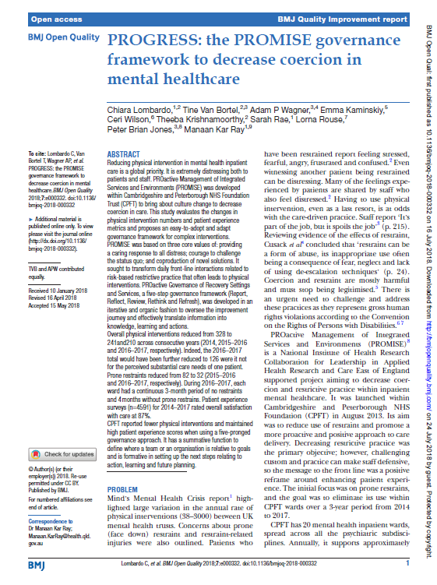
PROGRESS: the PROMISE governance
framework
https://www.clahrc-eoe.nihr.ac.uk/2016/07/8095/

Slide 25
Sarah Rae
sarah.rae@rockyroad.org.uk
https://www.clahrc-eoe.nihr.ac.uk/2016/07/8095/

