Slide 1
The Parliamentary and Health Service Ombudsman
The Ombudsman, the Complaint Standards and You
Cameron Kennedy – Liaison and Training Manager
Jo Power - Liaison and Training Officer

Slide 2

Overview
              The Ombudsman – who we are, what we do
              How we investigate complaints
              Rolling out the NHS Complaint Standards.

Slide 3



Who we are
Parliamentary Commissioner Act 1967
Health Service Commissioners Act 1993
18%
82%
Complaints about UK government departments and public organisations
Complaints about the NHS in England

Slide 4

What we do - NHS complaints second and final stage
Under Regulation 14(2)(c) and Regulation 14(2)(d), the local response must tell the complainant of their right to take the complaint to the Ombudsman
The Local Authority Social Services and National Health Service Complaints (England) Regulations 2009

Slide 5


Our numbers – 2021-22
122,367 enquiries received
26,043 complaints were not ready for us
36,614 decisions were made, including:
  29,213 decided after initial checks
  29 cases resolved through mediation
  6,760 decided at primary investigation
  612 decided after detailed investigation

Slide 6
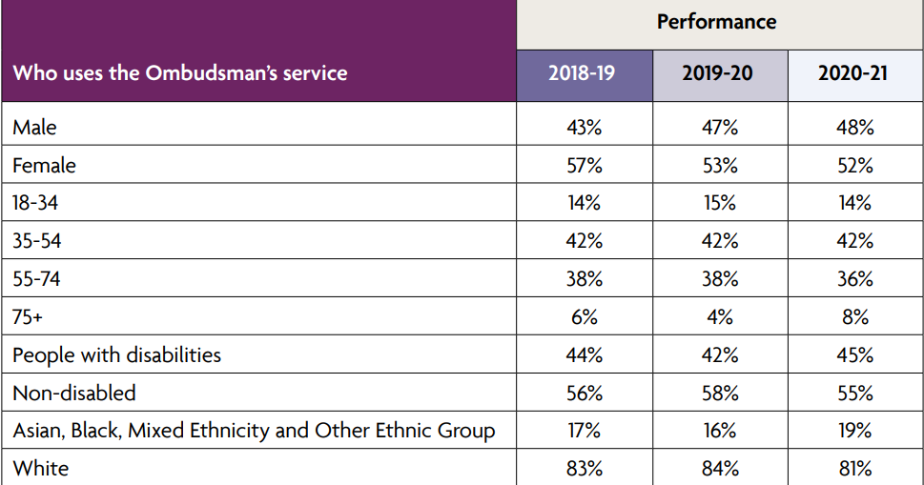
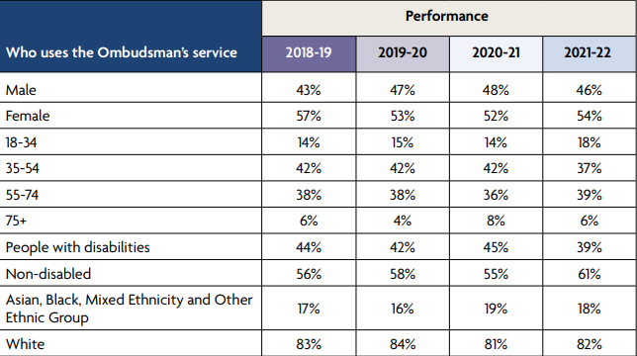
Our customers

Slide 7
Recommendations in 2021-22
We recommended 361 apologies | We made 294 service improvement recommendations
We recommended 85 other actions to put things right | Financial remedy recommendations totalled £265,656

Slide 8
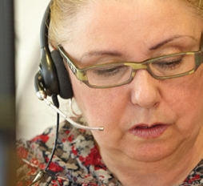
Our casework process – first steps
First contact
Our staff consider:
  Has local resolution finished?
  Is it in remit?
  Is it properly made?
  Is dispute resolution appropriate?

Slide 9

Our casework process – should we investigate?
Is there a case to answer?
indication of an injustice or hardship arising from a possible failure in service that has not yet been remedied
Can it can be resolved quickly?
Proposal to investigate

Slide 10

Our casework process - investigation
How we gather evidence
from both sides
opportunity to tell us what lay behind clinical decision making
clinical records
CCTV, phone records
Witness statements, visits, interviews

Slide 11

Our casework process
Investigation
Our approach
We look to see if what happened was in keeping with relevant regulations, standards, policies and published guidance.
Our decision
If it wasn’t, we look to see how significant the shortfall is and what impact it has had and, if it has caused hardship or injustice, has that already been remedied by the organisation.

Slide 12

The NHS
Complaint Standards

Slide 13

Research found three core issues:
No consistency
No core training/support
Complaints not valued

Slide 14
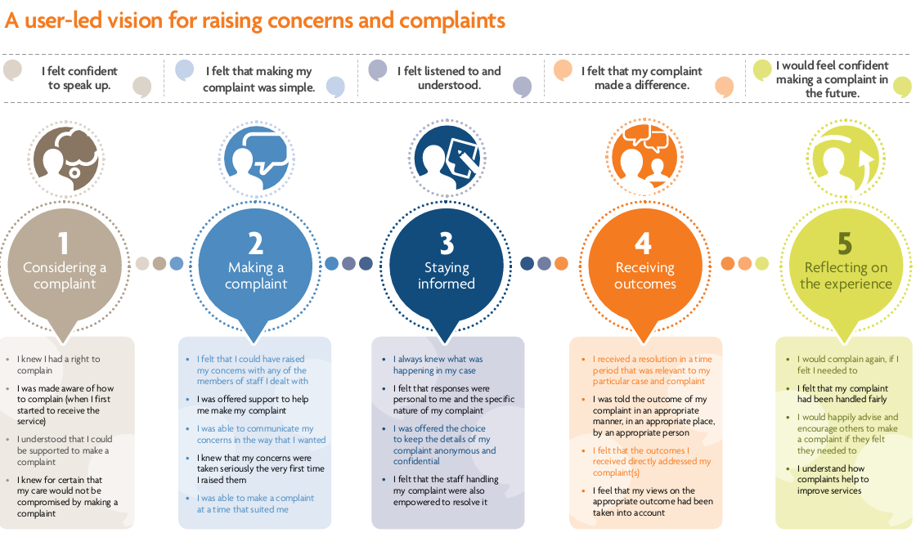
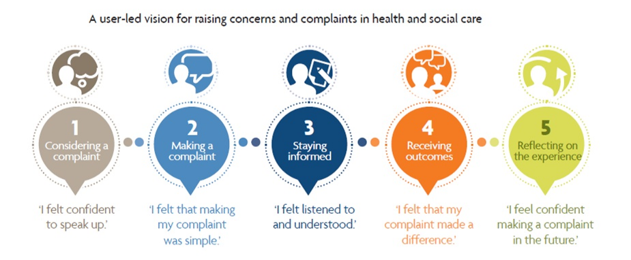

My Expectations

Slide 15



Slide 16

Three Steps
How to work with your team and resolve complaints early where you can
If needed, how to carry out a full and fair investigation
If something has gone wrong, how to put things right and ensure learning is captured, embedded and services improve

Slide 17

How will this help?
One set of Standards and one procedure for all of the NHS to follow so everyone is clear
Focus on working together and supporting colleagues to resolve complaints as they arise, saving time and resources
Focus on learning and improving services for everyone

Slide 18
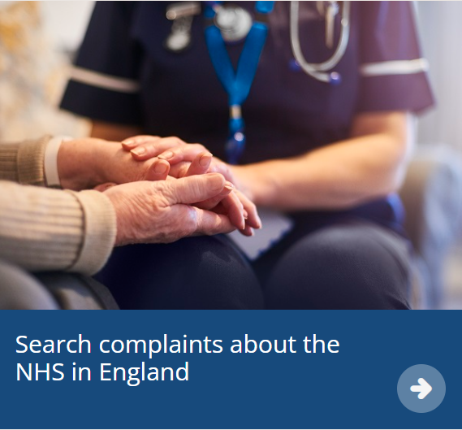
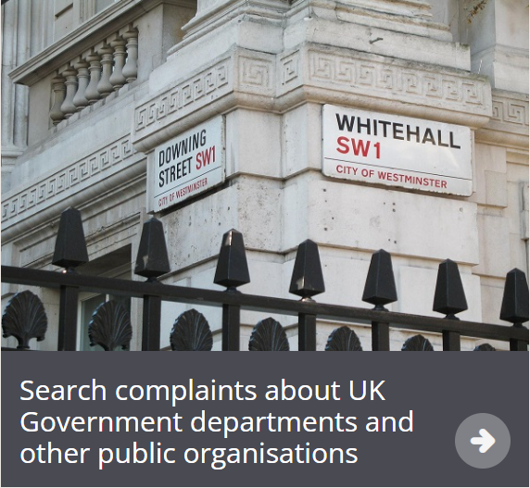
Embedding the Standards in our casework

Slide 19

Casework trial update
When the trial is complete we will embed the Complaint Standards into all of our casework from April 2023
This will be a staggered roll out
Once finalised, we will share our approach so that organisations will know how we are applying the Standards to the complaints we receive

Slide 20
Casework trial update
We will use the Standards as a reflective guide for good practice in complaints handling, rather than a stringent ‘rulebook’
We will refer to the Standards in an advisory way, particularly referring to them in any recommendations we may make on improving complaint handling

Slide 21
Casework trial update
We will continue to work with stakeholders to determine how PHSO will report on progress in embedding the Complaint Standards ensuring we highlight best practice alongside reporting on broad themes we have seen on complaints handling through our casework.

Slide 22
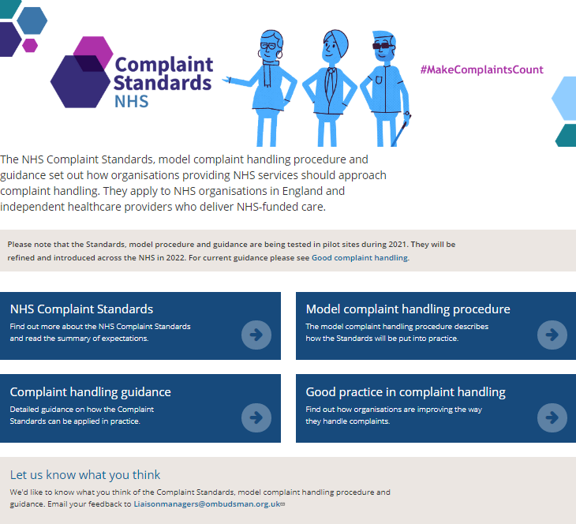
The procedures and the guidance are available on our website.
www.ombudsman.org.uk/complaint-standards

Slide 23
Community of practice
Share experiences with other NHS organisations
To join, email Liaisonmanagers@ombudsman.org.uk

Slide 24




Thank you
Website
www.ombudsman.org.uk
@PHSOmbudsman
Helpline
0345 015 4033
8.30 - 5.00 Monday to Thursday
8:30 –12:00 Friday
Parliamentary and Health Service Ombudsman
Email
liaisonmanagers@ombudsman.org.uk
Radio Ombudsman Podcast

