Slide 1
Best Practice Management of End Stage Heart Failure Dr Sharon Chadwick FRCP Consultant in Palliative Medicine

Slide 2
Objectives
By the end of this session you will:
Feel more confident to manage end stage heart failure
Understand the complexities of managing advanced heart failure
Feel able to address symptom control needs
Be more pro-active in discussing advance care planning
Be aware of the ethical dilemmas that might arise
Consider what is right for the individual patient and family
Consider how best to foster relationships locally to provide the best care for patients and families
Know who to ask for help

Slide 3
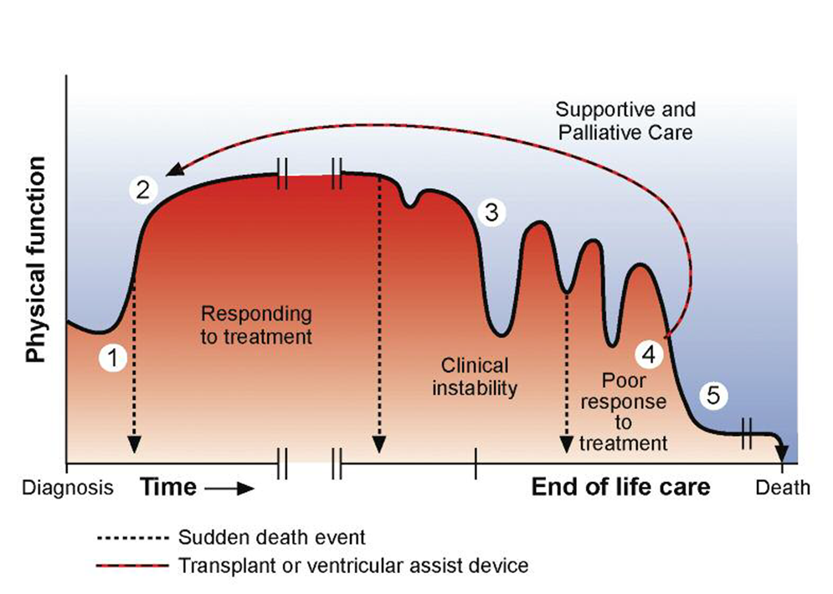
Typical course of heart failure

Slide 4
poor prognosis
Increasing age
Dependent for more than 3 activities of daily living
Cardiac cachexia
Resistant hyponatraemia
Serum albumin less than 25g/l
BNP ≥ 400 pg/ml
Multiple shocks from ICD
Comorbidities especially cancer
End of Life Care in Heart Failure: A Framework for Implementation. NHS End of Life Care Programme 2014

Slide 5
considerations
Patients with advanced heart failure are likely to have multiple hospital admissions in the last year of their life
Patients are walking a tightrope between renal impairment and fluid overload
Prognosis is more difficult to predict in heart failure than in any other life limiting illness
Comorbidities and poly pharmacy add increasing complexity

Slide 6
Potential problems for the individual patient
Multiple comorbidities
LVF
Angina
Atrial fibrillation
COPD
Peripheral vascular disease
Impaired renal function
Diabetes mellitus
Cerebrovasular disease
Osteoarthritis
Depression
Falls
Cancer
Polypharmacy

Slide 7
Potential problems for the individual patient
Multiple symptoms
Fatigue
Dizziness
Breathlessness
Peripheral oedema
Nausea
Constipation
Immobility
Constipation
Pain
Low mood
Social isolation

Slide 8
Palliative Care in Heart Failure
Whatever the aetiology there is a high symptom burden (O’Leary N et al 2009)
Quality of life can be poor for both patients and carers (Squire I et al 2017)
Often multiple comorbidities
Inevitable deterioration
Life limiting illness with increasing hospital admissions due to either fluid overload or acute on chronic renal failure in the final stages of the disease (Brännström M, et al 2014)

Slide 9
SYMPTOM CONTROL
Breathlessness
- non pharmacological measures (fan, pacing, rehabilitation)
- opioids, start low go slow. Morphine liquid 1 -2ml
(2 to 4mg) twice or three times daily or
oxycodone 1 to 2 ml twice daily if eGFR<30
Leg swelling
- elevation, light compression stockings. Whose problem?
Increase diuretics?
Difficulty sleeping
- Why? Sleep hygiene, reduce fluid intake during evening, screen
for depression
Swollen abdomen
- is this constipation, is it ascites, is it obesity?
Confusion
- check electrolytes, check drugs, possibly vascular dementia,
always screen for infection

Slide 10
Fatigue
Sleep hygiene and siestas
Cardiac/palliative rehabilitation
Check for reversible causes; electrolyte disturbance, anaemia, hypotension, depression, nocturia, drugs
Check iron studies (ferritin and Tsats). IV iron
Reduces the risk of hospitalisation for HF
Improves New York Heart Association (NYHA) functional class
Improves quality-of-life and exercise capacity (as measured by 6-min walk test (6MWT)) distance and peak oxygen consumption

Slide 11
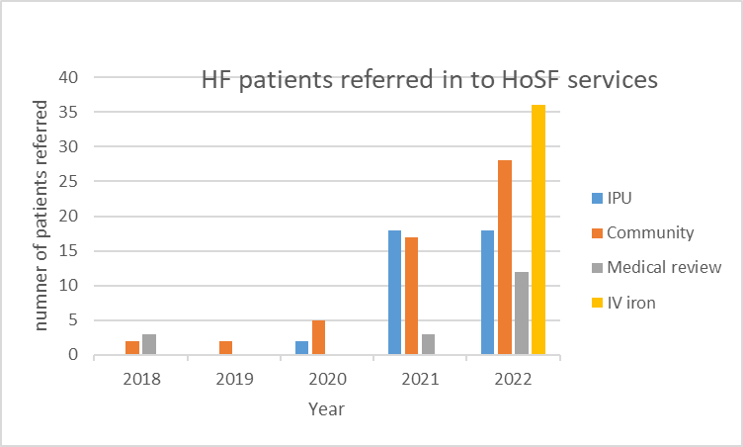
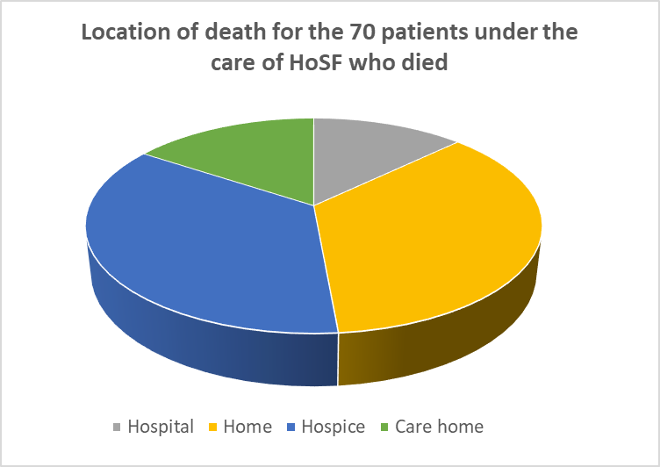
Heart failure at HoSF

Slide 12
Palliative Care in Heart Failure The Calman Gap
Calman K 1984

Slide 13
Potential problems for the individual clinician
Too many symptoms
Too many drugs
Devices that we are unfamiliar with
Don’t know where to start
Not enough knowledge
Fear of making things worse
Reluctant to stop drugs colleagues have started
New drugs, new interventions, difficult to keep up

Slide 14
Don’t panic!!
Help is at hand
Community heart failure team –previously only for those with LVSD. Now able to help with valvular HF, HF-PEF, RV failure.
Palliative care – variable experience and knowledge.
But…. will work together with the HF team to help with symptom control
The HF MDT is an ideal way to learn from each other

Slide 15
Top tips
Let the patient set the agenda for the consultation
Beware oxygen for breathlessness in heart failure
Remember non-pharmacological management of breathlessness
Always check pulse, blood pressure, heart rate and renal function before making any changes
Review medication but don’t rush this and whenever possible consult with the heart failure nurse specialist. Deprescribing is as important as prescribing.

Slide 16
Medication review-key points
Remember that in heart failure, beta blockers, ACE inhibitors and diuretics and spironolactone improve prognosis and symptom control
Be wary about stopping anti-anginals too quickly ESPECIALLY if there is any suggestion that the patient has had recent chest pain
Be very cautious about stopping beta blockers and if you do plan to stop them, do this gradually and in consultation with the cardiologists
Stop the statin, the calcium and vitamin D supplements, the bisphosphonates, the iron, folate and vitamin supplements

Slide 17
Devices (ICDs & PPMs)
Its complicated!
PPMs-for heart block
CRTDs- for heart failure with LBBB at risk of VF or VT
CRT-P for those with HF and LBBB for whom defibrillation would not be appropriate
ICDs for those at high risk of persistent VT or previous VF.
20% patients dying with an active ICD in situ receive shock(s) as they are dying

Slide 18
AN ILLUSTRATION

Slide 19
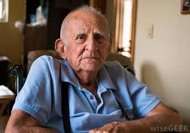
Mr PW
84 years old. Severe heart failure, EF 23%. CRT-D, atrial fibrillation, COPD, NIDDM, renal impairment, gout, peripheral vascular disease, previous CVA, falls
3 admissions in last 6 months. 2 for decompensated heart failure, 1 with infective exacerbation of COPD.
General significant decline in last 6 months
Some cognitive impairment
CRT-D has never fired

Slide 20
MR PW
Current medication
Bisoprolol 7.5 mg twice daily Allopurinol 100 mg daily Lansoprazole 30 mg at night Ultibro Breezhaler one puff daily Ezetimibe 10 mg daily Bumetanide 1 mg daily Sodium chloride nebulisers Metformin 500mg twice daily
Entresto 97/103 1 tablet twice daily
Salbutamol inhaler used if needed
Prednisolone 15 mg daily (reduced from 40 mg daily, to be further reduced by 5 mg every three days for gout)
Ferrous sulphate 200mg three times daily
Movicol 2 sachets twice daily

Slide 21
Current issues:
Nausea
Fatigue
Aching in legs
Postural hypotension
Constipation/diarrhoea
Breathlessness on exertion
Too many drugs
Too many hospital appointments
Frustrated in not being able to do the things that he wants to do

Slide 22
On examination
Pulse 48 regular, BP 95/55. Chest clear. No ankle swelling.
Blood results
Na 136, K 4.5, Ur 14 Cr 142 eGFR 50
LFTs –mildly deranged in keeping with hepatic congestion
BNP 1435
BMs 4 to 6
HbA1C 6%

Slide 23
Hospital Appointments
Cardiology- 3 hospital consultants and a heart failure nurse
Respiratory- 2 hospital consultants with associated CT chest booked and PFTs and an arms length respiratory nurse specialist
Rheumatology-investigations and F/U clinics (for gout)
Vascular-Investigations and followup clinics
Diabetes specialist clinic
Nephrology- initial appointment and associated investigations

Slide 24
Plan
Rationalise medication
Reduce Bisoprolol
Stop ezetimibe
Consider need to restart edoxaban
Titrate up allopurinol according to renal function
Try reducing/stopping lansoprazole once prednisolone has stopped
Stop Movicol and start sodium picosulphate
Reduce Entresto dose
Rationalise hospital appointments
Check bloods
ACP discussion
Interrogate device and consider deactivating ICD
Following chest CT and PFTs if unremarkable consider discharge from respiratory

Slide 25
Key moral/ethical considerations
Stopping drugs that improve prognosis to achieve better quality of life
To anti-coagulate of not to anti-coagulate in AF in falling patients
Deactivation of ICDs
Has the device recently fired or fired at all
Need to explain that deactivation does not mean certain or imminent death
Risk of VF less as disease progresses
DNACPR in those with an active ICD
Would prevent CPR in the event of an irreversible asystolic arrest or PEA

Slide 26
A Plea from me
Please, in your daily work
Consider referral to palliative care or at least a palliative approach for deteriorating symptomatic patients both those with cancer and non-cancer (including frailty/multimorbidity)
Consider if you would be surprised if your patient dies in the next year
If you would not be surprised, address advance care planning including
preferred place of care
preferred place of death,
preference around future hospital admissions
DNACPR and deactivation of ICDs
prescription of JIC medicines.
Make sure that you discuss all this with family members too.
If you can do this, it will make life so much easier for you and your colleagues and will improve the way that people die

Slide 27
Advance Care Planning What is it?
An opportunity!
To help patients understand that they may have a poor prognosis
To explain choices that individuals may or may not have
To start conversations in families about what might lie ahead
To help people to understand that they are not going to live forever!

Slide 28
Just in case drugs
Morphine 2.5 to 5mg s/c prn or if eGFR <30ml/min, oxycodone 1.25 to 2.5mg s/c prn.
For pain or breathlessness
Midazolam 2.5 to 5mg s/c prn
For breathlessness or agitation
Haloperidol 1.5mg to 3mg
For nausea or hallucinations
Glycopyrronium 200 to 400mcg s/c
For excess secretions
Furosemide 40mg s/c prn (2 x 20mg/2ml)
For peripheral or pulmonary oedema

Slide 29
When should we do it?
Following a change in circumstance
New diagnosis
Deterioration in condition
Hospital admission
Admission to a care home
If given a relevant cue by a patient
Use of SPICT (Supportive and Palliative Care Indicators Tool)

Slide 30
SPICTTM -Supportive and Palliative Care Indicators Tool
Developed by University of Edinburgh and NHS Scotland
Defines criteria for considering a palliative approach
Look for any general indicators of poor or deteriorating health.
Unplanned hospital admission(s).
Performance status is poor or deteriorating, with limited reversibility. (eg the person stays in bed or in a chair for more than half the day.)
Depends on others for care
The person’s carer needs more help and support.
Progressive weight loss; remains underweight; low muscle mass.
Persistent symptoms despite optimal treatment of underlying condition(s).
The person (or family) asks for palliative care; chooses to reduce, stop or not have treatment; or wishes to focus on quality of life.

Slide 31
SPICTTM -Supportive and Palliative Care Indicators Tool
Heart failure or extensive, untreatable coronary artery disease; with breathlessness or chest pain at rest or on minimal effort.
Kidney disease
Stage 4 or 5 chronic kidney disease (eGFR < 30ml/min) with
deteriorating health.
Kidney failure complicating other life limiting conditions or
treatments.
Stopping or not starting dialysis.

Slide 32
Remember…….
Always know the indication for each individual drug
Beta blockers for heart failure, angina, rate control
Warfarin for AF or metallic valve
Always consult with the heart failure nurse or if not known to them consult with GP
Make sure you know about other PMH including TIAs, CVAs, bleeds etc
Gradually wean off medicines and check pulse, BP and bloods regularly during periods of change
Consider compression stockings & midodrine for postural hypotension

Slide 33
And finally…….
For patients with a pacemaker/ICD be even more cautious about discontinuing drugs with a potential rate controlling or anti-arrhythmic effect
Always discuss with a cardiologist
Be very clear about what you are trying to achieve when adjusting medication and explain clearly to patients and when appropriate, their families
Think carefully about DNACPR discussions with those who have an active ICD especially if it has fired

