Slide 1
Medical Leadership at Board level
Stephen Parker
Medical Director
Isle of Wight NHS Trust

Slide 2
Introduction
Strategic, tactical and operational leadership
What makes a good board
Importance of board level clinical leadership
Role of the Medical Director
Personal attributes
Key professional relationships and stakeholder
Why would you ever want to do the role?

Slide 3
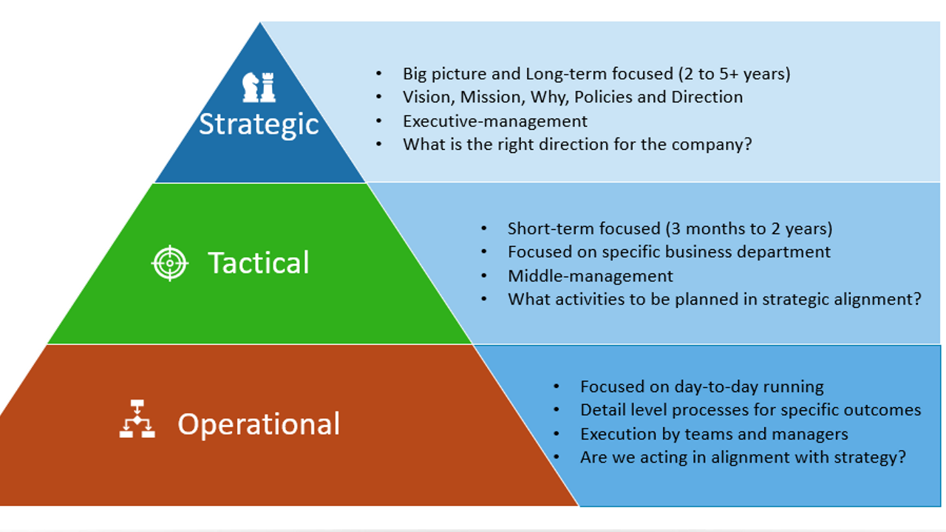

Slide 4
What makes a good board
Great boards lead rather than manage the organisation
Function in the strategic arena
Delegate effectively and have honest conversations
Inspire and encourage others rather than micromanage
Creative and innovative, particularly when it comes to problem solving
Have good succession planning and regular board turnover is not bad
Work as team and challenge appropriately
Review their own performance and set a board development programme

Slide 5
Role of the Board
Role of the Board
Formulates strategy for the organisation
Ensures accountability and manage risk
Shapes the culture of the organisation
Executive and non-executive members
Role of the Medical Director has evolved over the last 20 year
Previously the ‘medical voice’ on the board
Now fully integrated executive role with defined portfolios and responsibilities
Clinically-led organisations
Deliver better care and outcomes
Embrace change and innovation

Slide 6
Role of Medical Director
Difficult to define with diverse challenges role
No two organisations are the same and therefore there is variability
You can produce a job description but what does it really mean in reality
You are not the ‘shop steward’ for doctors on the board
But you have to have the ‘dressing room’ on you side
You are the clinical voice on the board – safety and clinical outcomes
Set culture within the organisation and are often seen as the voice of reason
No clear development pathway

Slide 7
NHS Confederation view of MD
Leading the formation and implementation of clinical strategy
Taking a lead on clinical standards
Providing clinical advice to the board
Providing professional leadership and being a bridge between medical staff and the board
Providing translation, assessing the mood and creating alignment between the organisation and doctors
Increasing outward facing work with external organisations
Plus all the other things they never told you about – RO, Education, Research, Caldicott Guardian

Slide 8
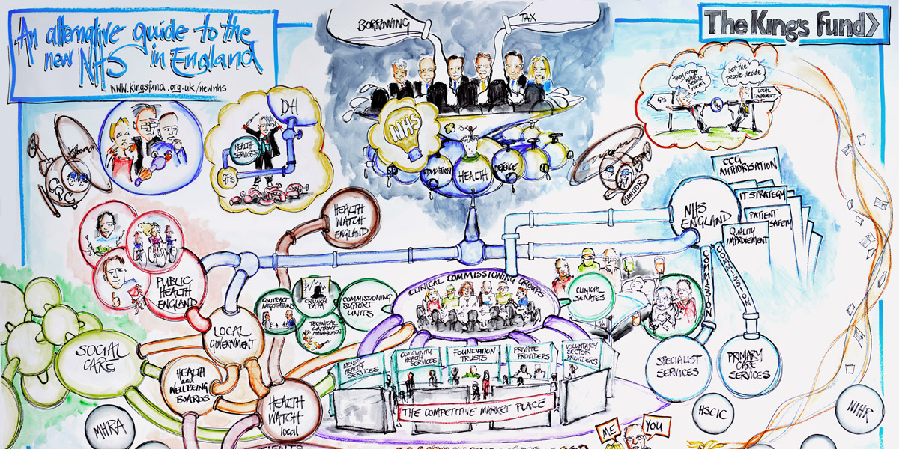
We live in a complex world

Slide 9
Personal attributes
Resilience
Integrity
Honesty
Visibility
Availability
Communication skills
Compassion
Courage
Negotiation skills
Hold people to account
Prioritise
Humility and empathy

Slide 10
Key Professional relations
A cohesive and collegiate executive team is important
You need to get out and about and everyone who you interact with will judge you
The CEO is your boss but you Director of Nursing and Chief Operating Officer are you closest allies
Deputies and Associate Directors are needed to help you
Non-executive directors hold you to account but can should be sympathetic
You will need to be available to all clinical staff
Patients or relatives will need your support

Slide 11
Key stakeholders
Internal
Board members
Senior clinical leaders
Consultants
Junior doctors
LNC
Patients and relatives
Patient council
Legal team
Research director
Medical Education
External
ICB / Region
Postgraduate Dean
Medical School
GMC
Press
Other provider MDs
Primary Care Networks
Patient Groups

Slide 12
Why would anyone ever want to be a clinical leader?
All doctors are leaders in some form of fashion
You are leader whether you like it or not
Leadership training and development has been incorporated in medical education
Only 10% doctors ever progress a formal leadership role
To be a senior medical leader you have to have desire
Lead not simply manage
Front up difficult transformational change
To be resilient and be able to have honest conversations
The role is not without risks in terms of challenges and tenure
Rewards are multiple if you are willing to take up the challenge

Slide 13
Themes to be discussed
Do you need a formal leadership qualification
Balance between executive and clinical responsibilities
Importance of deputies and the ability to delegate
Groups, mergers – site teams
Training, induction, mentorship and peer support
What do you do for professional development
Succession planning
What do you do after being the medical director
Importance of work life balance

