Slide 1
Diversion of Controlled Drugs from the Legitimate Supply Chain
Grant Powell
2023

Slide 2
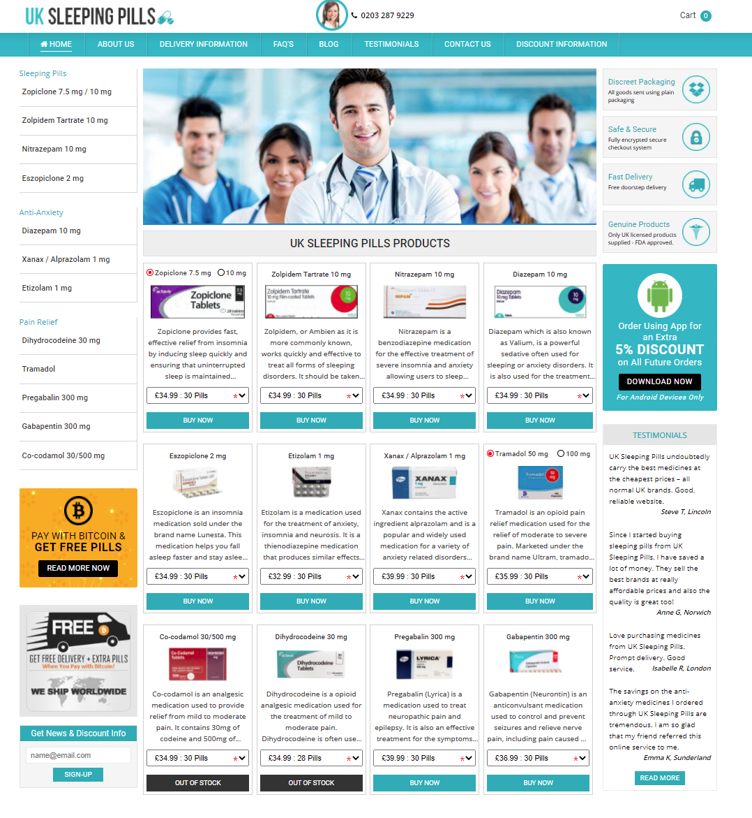
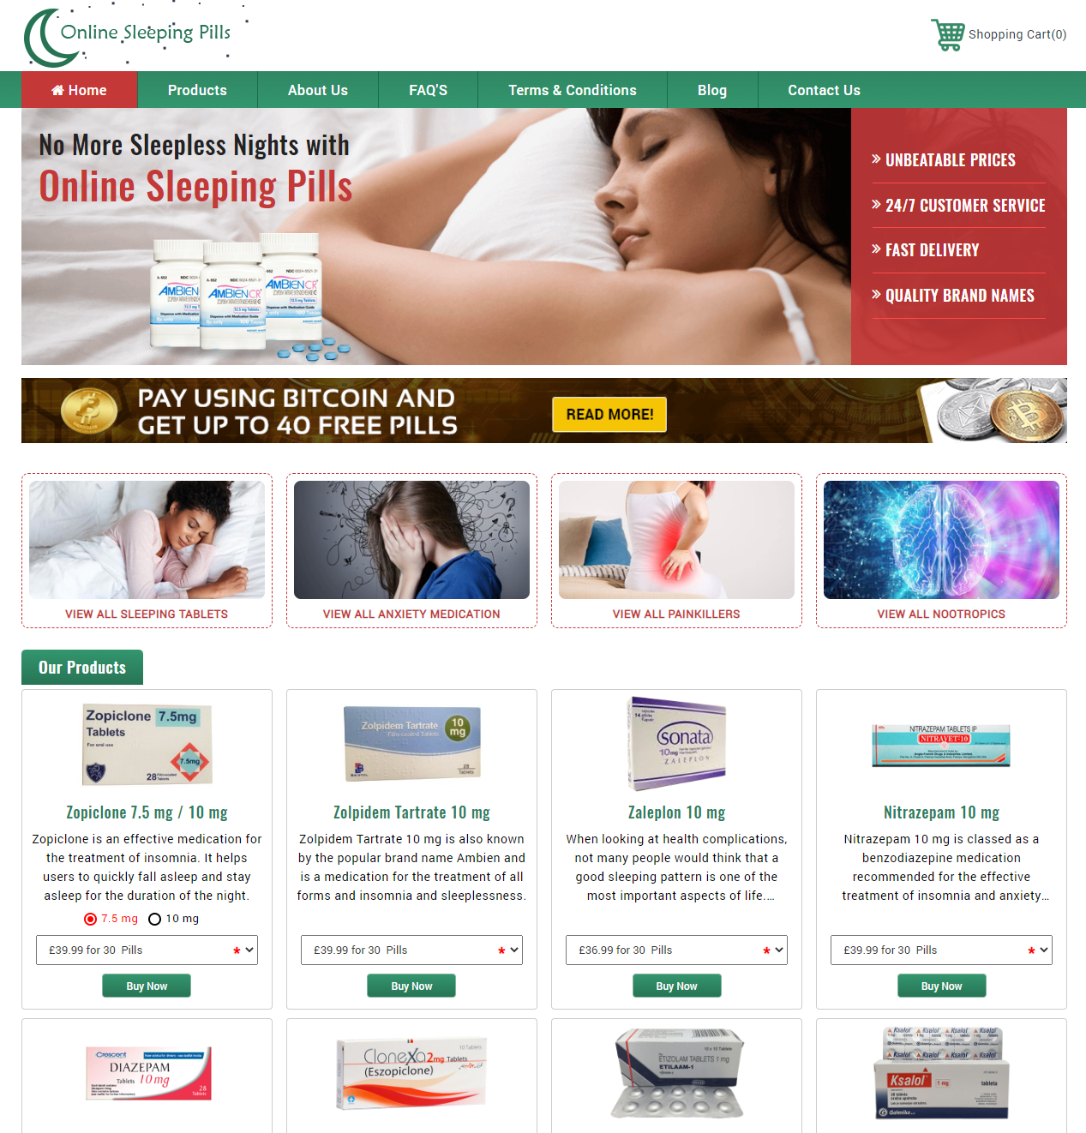
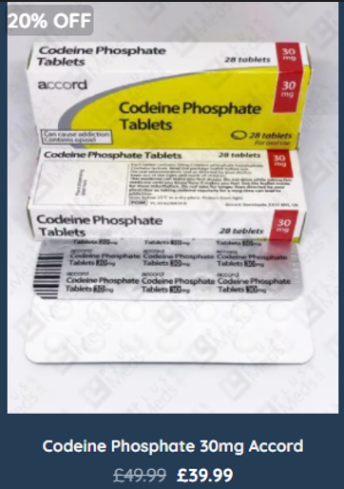
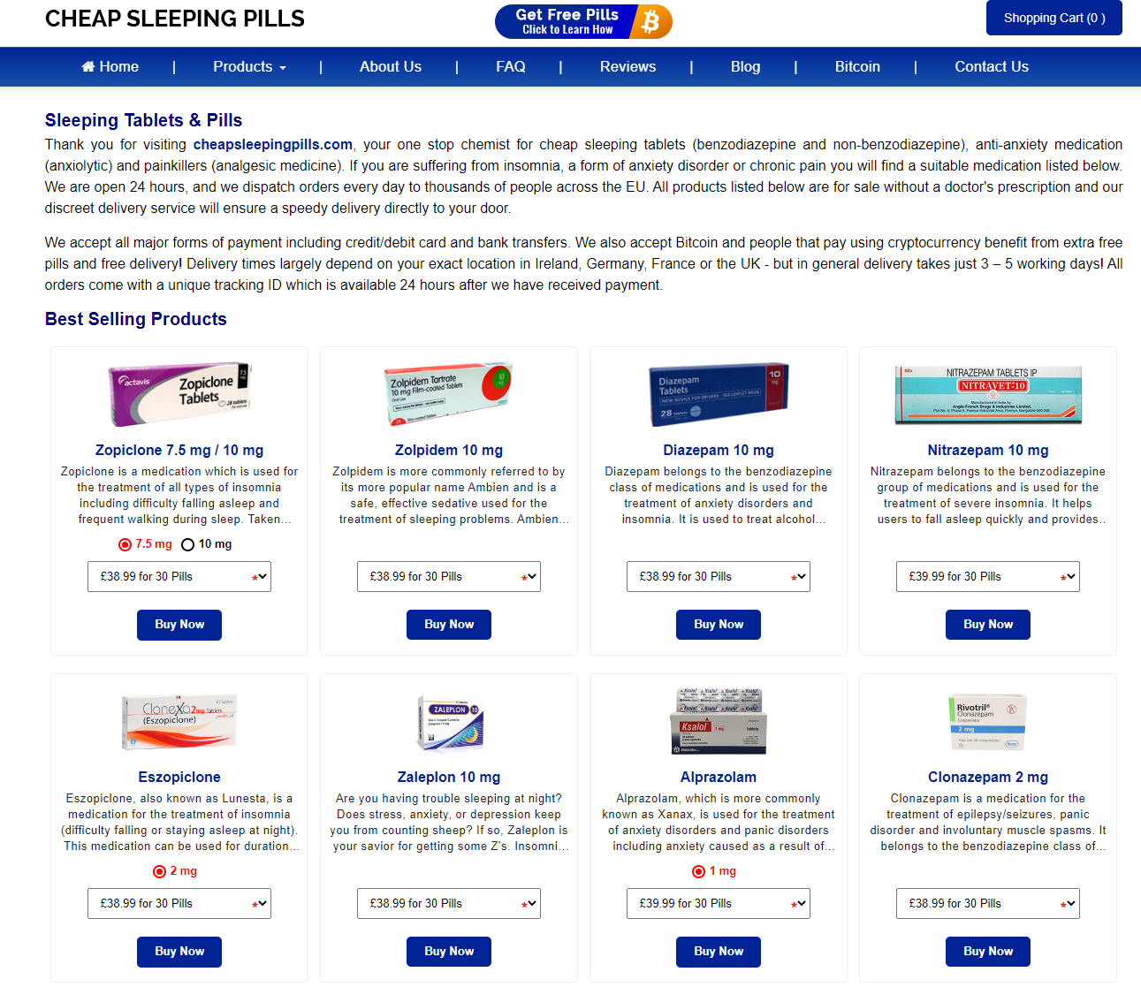
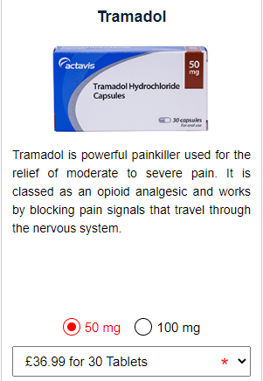
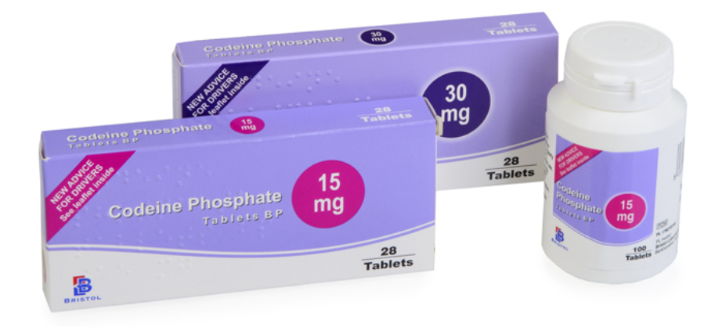

Slide 3


Slide 4
Benzodiazepines, Non Benzodiazepines Opioids and Z Drugs
Controlled Drugs - as defined by the Misuse of Drugs Regulations 2001 and the Misuse of Drugs Act 1971
Designed for short term prescription.
All carry potential for misuse and dependence.
Dependent users gradually increase dose.
The prescribed dose is normally 1 tablet per day for a restricted time (often 14 – 28 days maximum.) Usually at the lowest dose manufactured.

Slide 5
So ….where are the criminals operating the websites sourcing their products from?
The websites advertise ‘UK Supply Chain’ drugs.
They often use ‘library photographs’ taken from the internet.
Customers recognise the brands as those that they have previously been prescribed.
They have confidence in both the product and the website.

Slide 6
Purchasing and Dealing in Controlled Drugs
In the United Kingdom only two categories of persons can legally purchase controlled drugs:
Licenced medical practitioners – this includes doctors and pharmacists / hospital trusts etc.
Licenced wholesalers.
Licenced medical practitioners cannot sell controlled drugs otherwise than by way of dispensing against prescription – NHS or private. Unless they also have a Wholesale Dealers Authorisation (WDA(H)) and a Home Office Controlled Drugs Licence (HOCDL).
A licenced wholesaler can sell controlled drugs but they must have a Wholesale Dealers Authorisation (WDA(H)) and this authorisation must be endorsed for ‘Narcotics & Psychotropics’

Slide 7
Wholesale Dealers Authorisations - (WDA(H))
These authorisations are issued by MHRA. If the applicant wishes to trade in controlled drugs then they must apply for an endorsement authorising trade in Narcotics and Psychotropics.
In the UK there are around 2000 WDA(H) authorities of which around 500 include Narcotics and Psychotropics.
The applicant is subject of a stringent inspection by MHRA GDP inspectors prior to approval.
There are regular re-inspections of those who are authorised.
If the authority is endorsed for Narcotics and Psychotropics then the wholesaler must also have a separately applied for Home Office Controlled Drugs Licence (HOCDL).

Slide 8
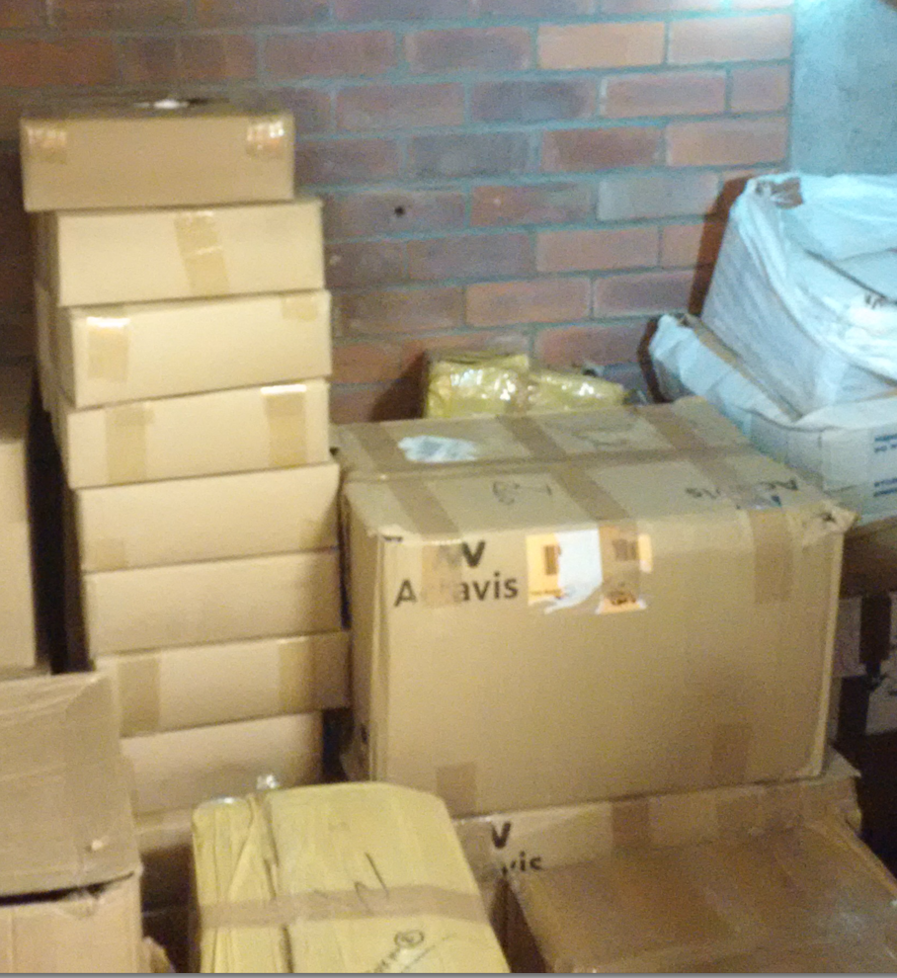
Evidence of Diversion
Unfortunately controlled drugs are sometimes subject of diversion from the regulated supply chain.
This image, taken during a scene search identifies Packaging that indicates the boxes originated from a major UK manufacturer.

Slide 9
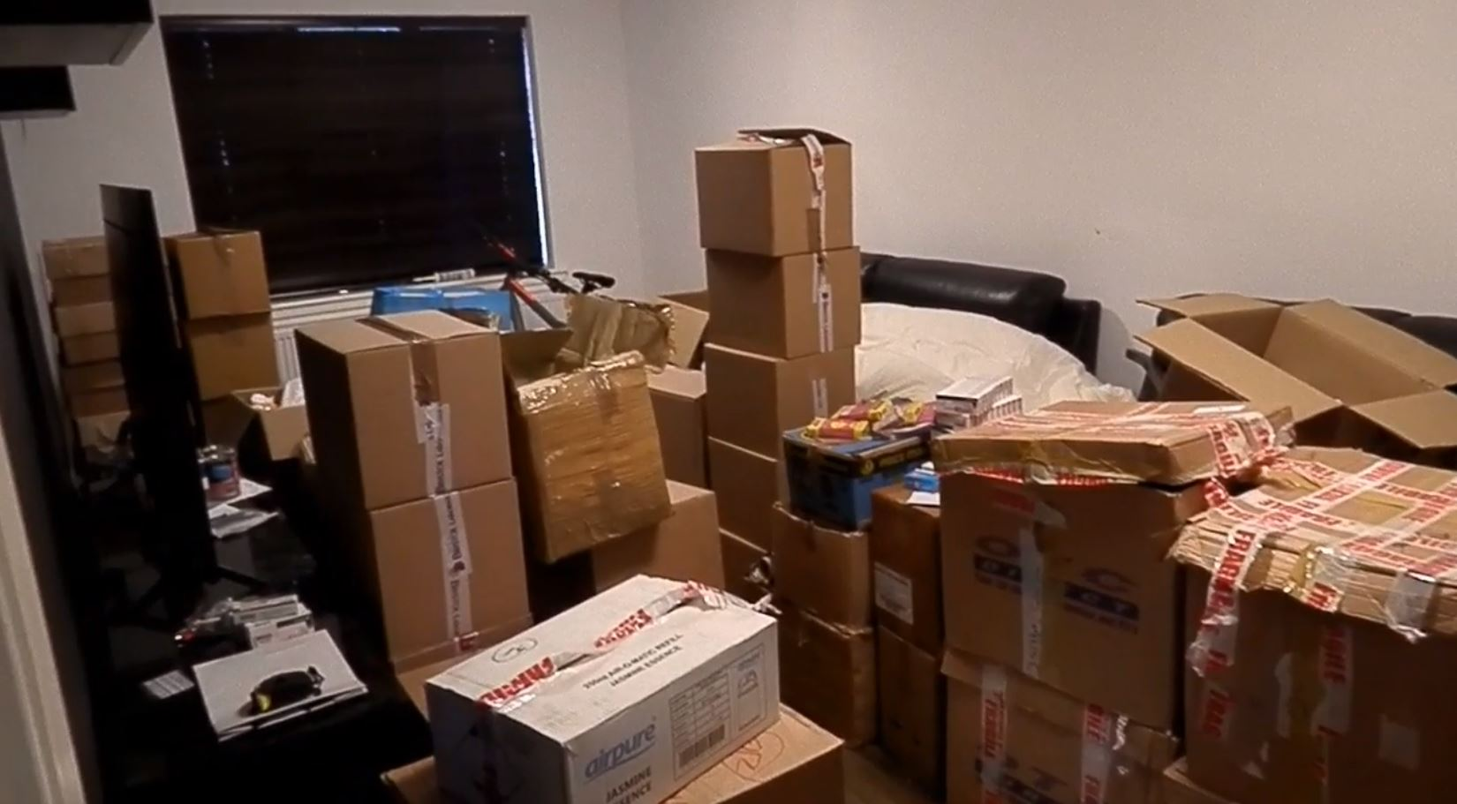
Boxes of UK supply chain drugs found in a residential ‘picking and packing’ room used to service the websites.
Bristol Labs Boxes

Slide 10
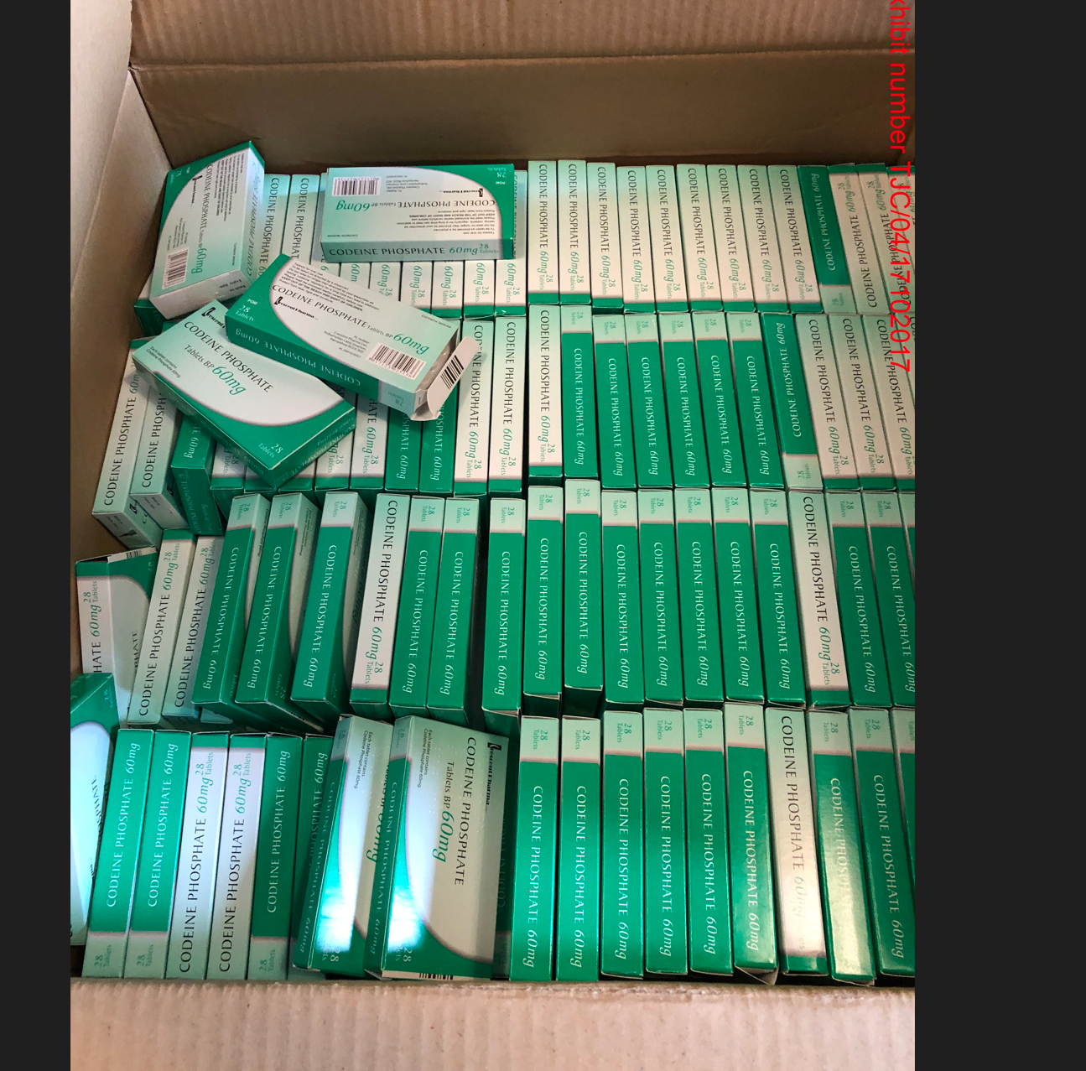
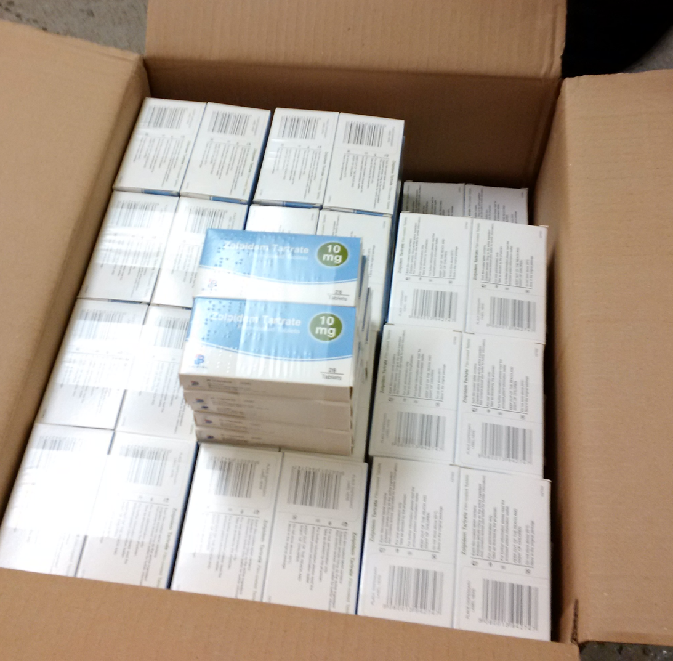
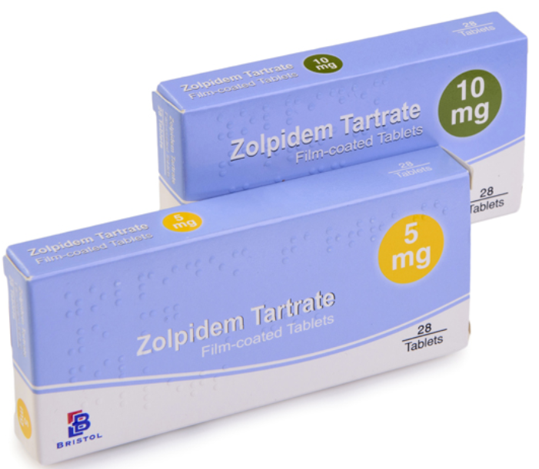
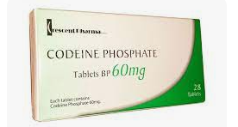
Crescent Pharma Codeine Phosphate – Class B Controlled Drug
Bristol Labs Zolpidem Tartrate – Class C Controlled Drug

Slide 11
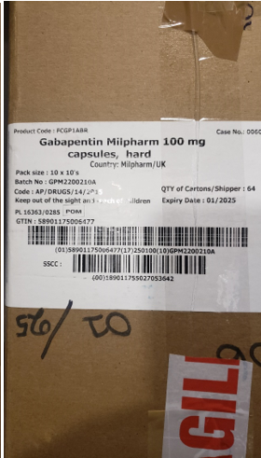
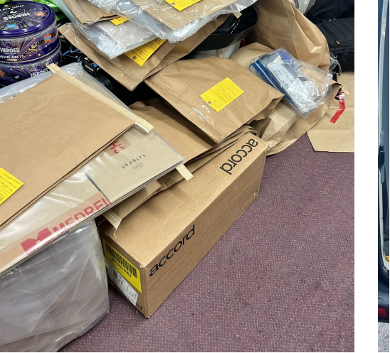
Gabapentin – Class C controlled drug

Slide 12
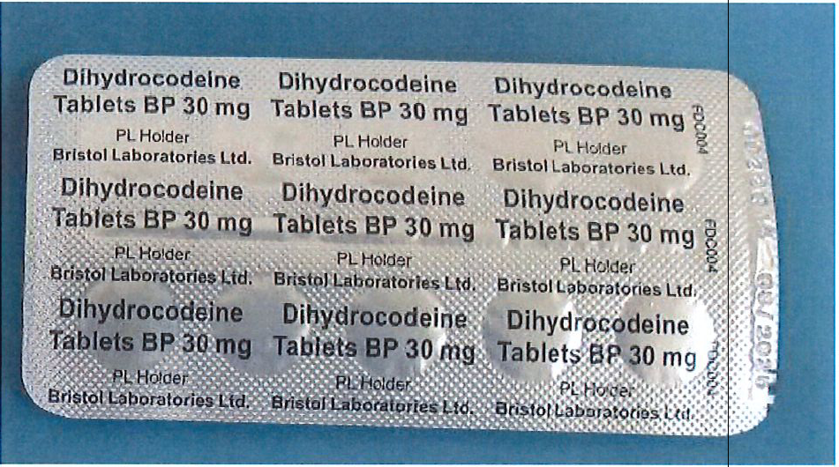
Bristol Labs Dihydrocodeine purchased from an unlawfully operating website during March 2023.
Pack expiry date 08/2025
Transaction completed by bitcoin payment.

Slide 13
How much is dispensed?
An average High Street pharmacy will dispense around 10-15 packets a week against prescription (all strengths of product combined).
Usually prescribed at its lowest strength (Diazepam available in 2mg / 5mg / 10mg presentations)
Higher strengths are normally used in hospitals and nursing homes.
Re-ordered following dispensing – not stockpiled.
Relatively low purchase price. Easily re-ordered.

Slide 14
How much is being purchased?
In 2016 instances of 20,000 packets of Diazepam at 10mg strength being delivered to community pharmacies (10mg is rarely prescribed for dispensing at pharmacies)
No WDA(H) held. No Home Office Controlled Drugs Licence held.
Wholesalers not conducting effective due diligence.
Now….
Advisory cap of 100 packets maximum order. If a larger order is made then managerial scrutiny of the order should take place.
Greater due diligence surrounding the correct licences being in place.

Slide 15
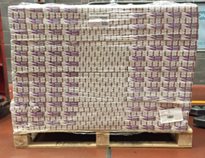
Pallet containing 13,440 packets of Diazepam

Slide 16
Pharmacy Purchases
Why would a pharmacy (which is not licenced to wholesale) want to buy 20,000 packets of a drug which:
Has a shelf life of three years.
That is at maximum strength (10 mg) which is not generally prescribed.
That takes up an enprmous amount of space in the pharmacy.
Over 1 year there may be a requirement for 600 packs (50 x 12) at normal dispensing rates.
Over three years 1800 packs would be dispensed.
After that the remaining 18,200 packs are out of date.

Slide 17
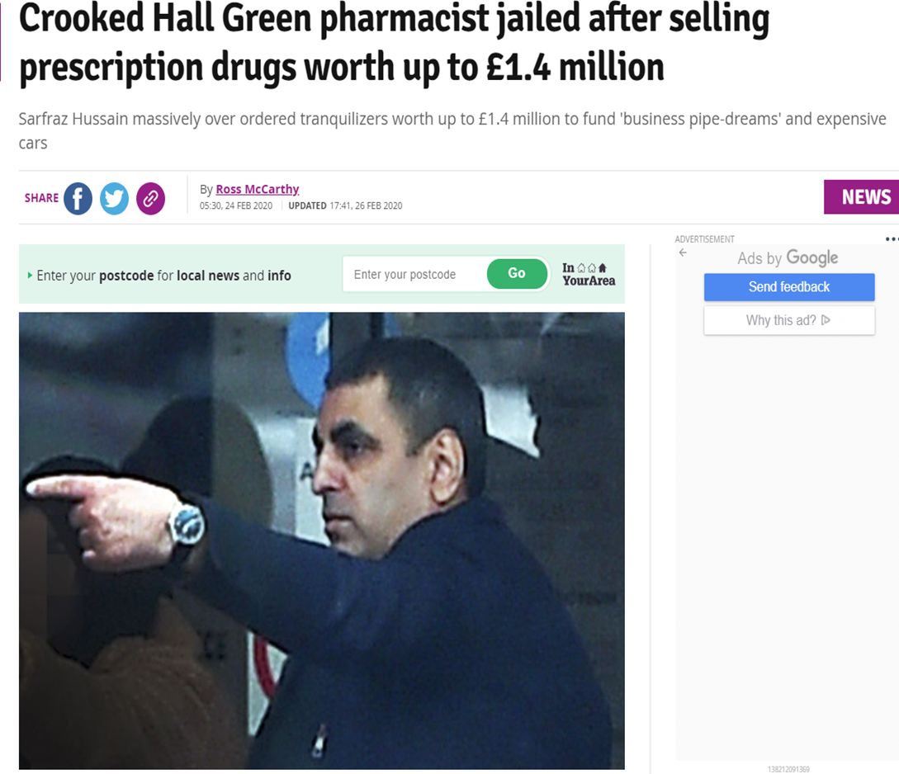

Slide 18
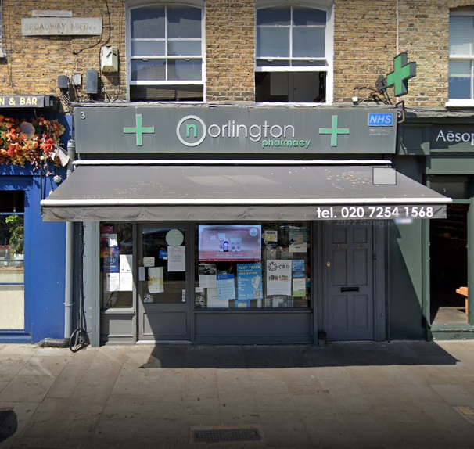
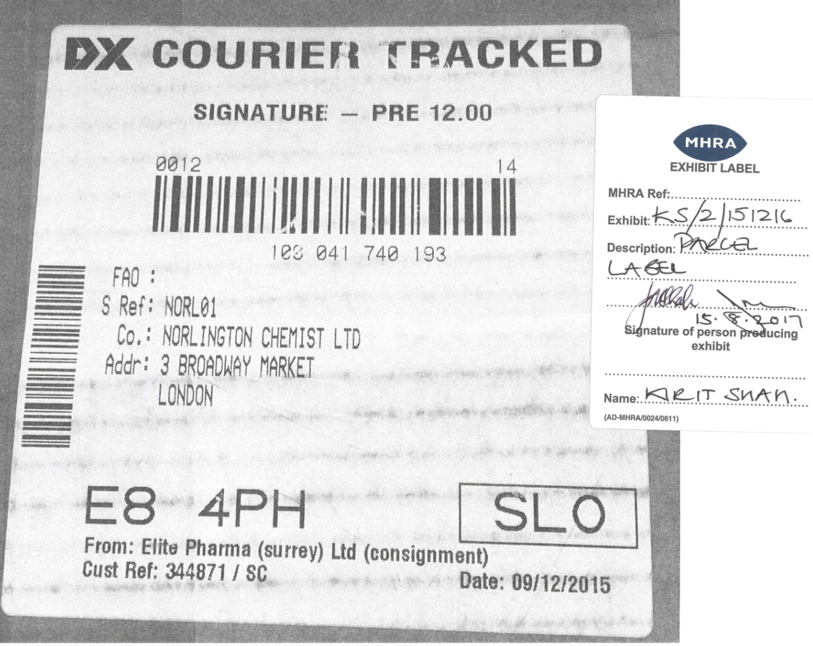

Slide 19

Op MALA
Generated from the box of Codeine Phosphate seized during a search.
Pharmacy manager at Norlington Chemist identified as diverting the medication.
Family owned and run pharmacy. His mother was the pharmacist.
Admitted to selling boxes and boxes of controlled drugs to ‘men in white vans’ who called at the rear of the pharmacy.
Paid around £15k cash per van load.
Admits at least 23 van loads.

Slide 20
Some Good News…….
Greatly Reduced over-purchasing without the requisite licences.
Greater vigilance by wholesalers.
-73% reduction in wholesale of 10mg Diazepam between 2016 – 2017.
Recent successes in removing unlawful websites
Some Bad News…….
There are still individuals determined to divert product using multiple wholesalers and purchasing at just below the 100 pack threshold.
Increased reporting of Burglaries / Theft from motor vehicles (lorries).
Robberies at Wholesalers.
Unlicensed and falsified drugs in counterfeit packaging being supplied by unlawful websites.

Slide 21
The Rise of Falsified Medicines / Counterfeit Presentation
Increasing quantities of Falsified Medicines in Counterfeit Packaging being seized by Police / provided by illegal websites.
Frequently products being sold as Diazepam / Zopiclone / Zolpidem / Tramadol in recognised supply chain livery is found to contain other controlled drugs.
In particular Flubromazolam and Bromazolam
Both drugs are unlicensed for use in the UK and Europe
Extremely potent with severe side effects.
Particularly dangerous when the user is expecting a different drug.

Slide 22
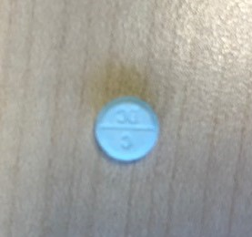
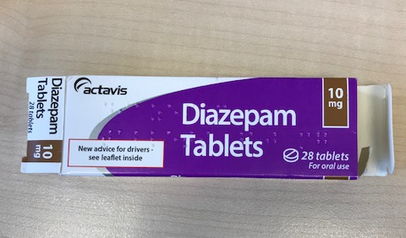
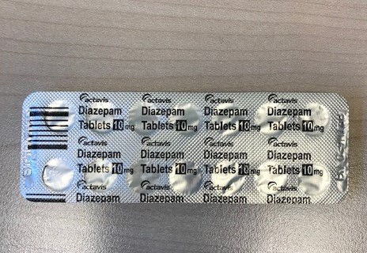
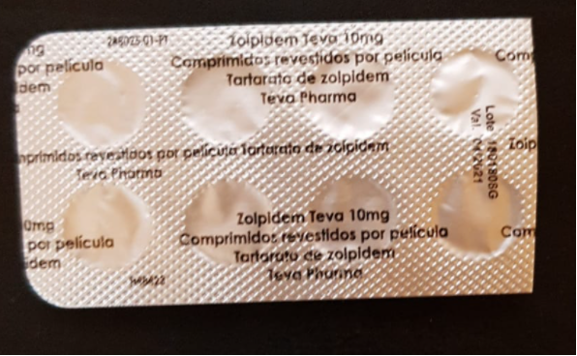
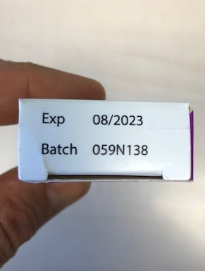
FLUBROMAZOLAM / BROMAZOLAM
TEVA Zolpidem Lote (sic) 1801808G . Confirmed as containing 0.20mg of Flubromazolam per tablet.
ACTAVIS Diazepam batch number 059N138.
ACTAVIS Zopiclone batch number 059N13B.
FLUBROMAZOLAM is 40 times stronger than diazepam.

Slide 23
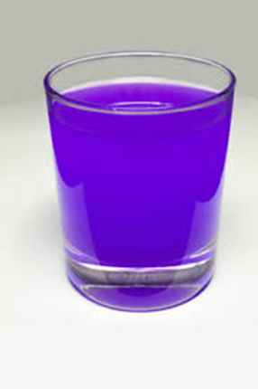
PURPLE DRANK
‘Purple Drank / LEAN / SIZZURP’ is a recreational drug, created by combining prescription-grade cough syrup with a soft drink and hard candy. The concoction originated in Houston, Texas and is popular among those who belong to the hip hop subculture – Wikipedia
Regular overordering of Codeine Linctus (Cough Medication) and Promethazine Hydrochloride (Phenergan Elixir) used to treat allergies / travel sickness / sleeping difficulties. 500 bottles at a time.
More frequent fraudulent purchasing attempts by ‘ghost purchasers’ claiming to be pharmacists.
Causes euphoria, motor-skill impairment, lethargy, drowsiness.

Slide 24
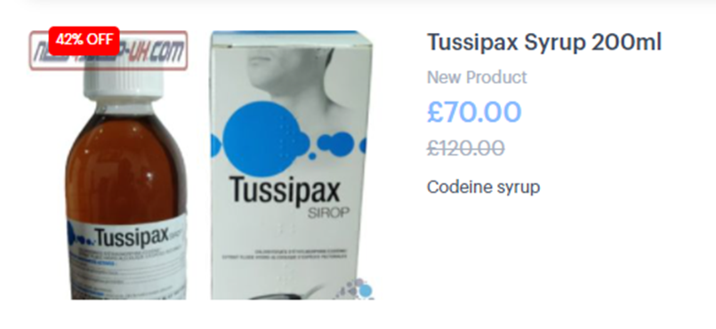
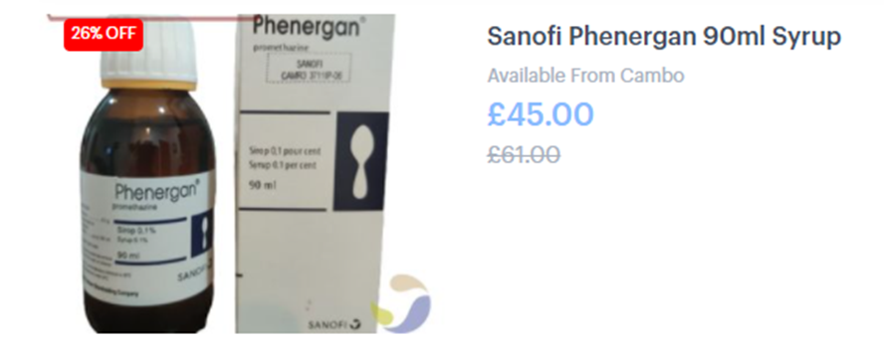
Pharmacy Over-ordering
Evidence of excessive ordering of product by some independent pharmacies. Normal purchasing for a pharmacy is an average of 10 bottles per month. Reports of pharmacies ordering 500+ bottles. Retail sale at a pharmacy is around £3.50 per bottle.
Enormous demand for products selling on illicit websites at inflated prices:

Slide 25
Drug Status in UK
Promethazine hydrochloride (Phenergan Elixir) – ‘P’ - Pharmacy Medicine.
Codeine linctus – ‘P’ - Pharmacy Medicine.
Codeine linctus is classed as a Schedule 5 Drug under the Misuse of Drugs Regulations 2001.
Codeine is a controlled drug – Class B as defined by the Misuse of Drugs Act 1971, however as the concentration of codeine is very low it is permitted to be sold as a pharmacy only medicine.

Slide 26
MHRA Borderline Advice / Home Office Advice
Borderline assess that when codeine linctus and promethazine hydrochloride are mixed together the resultant mixture has no medicinal purpose.
The combination is therefore not a medicine and is a recreational drug.
The Home Office have the remit of adding substances that may fall under the New Psychoactive Substances Act 2016.

Slide 27
Thank you for your attention
Grant Powell
Criminal Enforcement Unit Senior Manager – Investigation & Disruption
Email: grant.powell@mhra.gov.uk
Mobile: 07770227098

