Slide 1




Supporting Adults with Eating Disorders: Improving Access and Spreading Hope
Dr Giulia Di Clemente
#FREEDfromED

Slide 2

Overview
The case for early intervention
  The FREED model
Implementing early intervention
  Practicalities and progress with scaling FREED
Tailoring early intervention
  Creative ways to reach out
  Improving access and addressing inequalities in access

Slide 3
Overview
The case for early intervention
  The FREED model
Implementing early intervention
  Practicalities and progress with scaling FREED
Tailoring early intervention
  Creative ways to reach out
  Improving access and addressing inequalities in access

Slide 4

Why early intervention?
Eating disorders typically develop in adolescence and young adulthood, when the brain is still developing
Poor nutrition, hormonal changes and high stress disrupt brain maturation and cause neurocognitive changes
ED behaviours are initially rewarding, then habitual, then neurocognitively maintained
Prognosis may be best with <3 years illness duration
Social, emotional and educational development interrupted by long illness duration

Slide 5
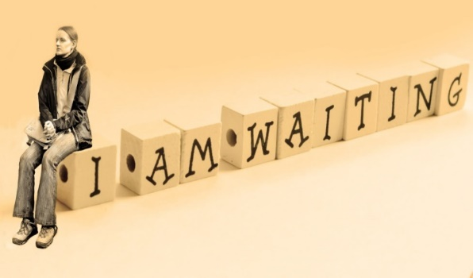


Why FREED?
A systematic review of the average duration of untreated eating disorder (DUED) (i.e. time from onset to first evidence-based treatment) showed:
30 months (2.5yrs) for anorexia nervosa
53 months (4.4yrs) for bulimia nervosa
67 months (5.6yrs) for binge eating disorder
Service for young people (age 16-25) with recent onset ED (< 3 yrs illness)
Aims:
Provide a service tailored to developmental & illness stage
Reduce Duration of Untreated ED (DUED) & improve outcomes
Austin et al., European Eating Disorders Review 2021

Slide 6
Core Components of FREED
Components | Aims: To shorten duration of untreated illness and increase likelihood of recovery in young people with recent onset EDs
Structure | Service-within-a-service FREED champion with protected time Mini-team
Processes & Procedures | Waiting time targets Engagement call within 48 hours of referral FREED-patient tracker, weekly huddles, supervision
Content | Evidence-based treatments with developmentally informed adaptations, e.g.: Focus on malleability of brain changes → highlighting need for early nutritional action Involvement of parents where possible Explore social media use Focus on managing ‘adulting’, incl. identity development & transitions
Style | Person-centred & youth friendly Motivational

Slide 7
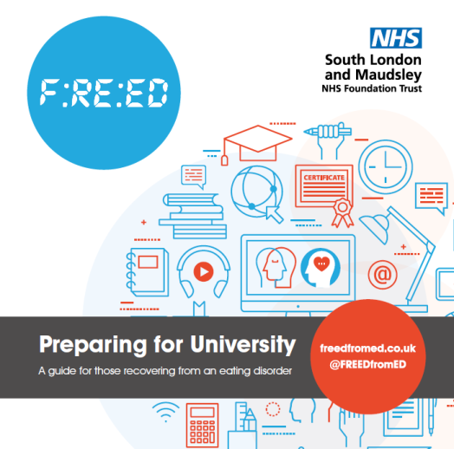
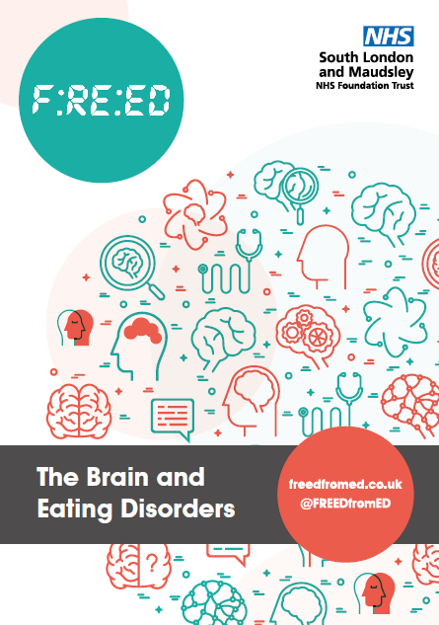
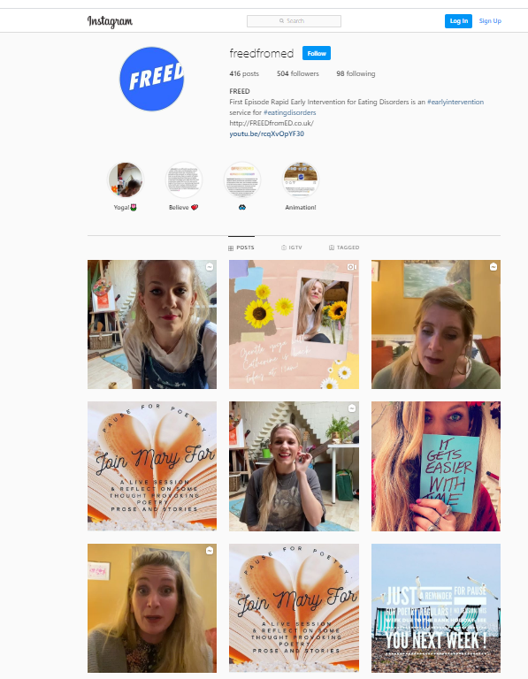

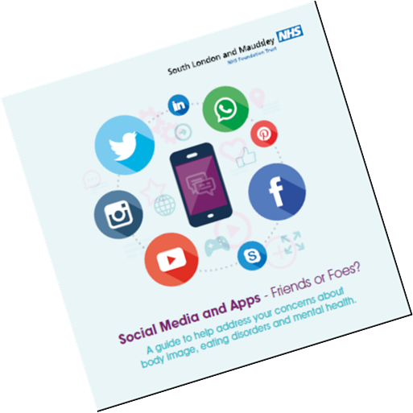

Slide 8
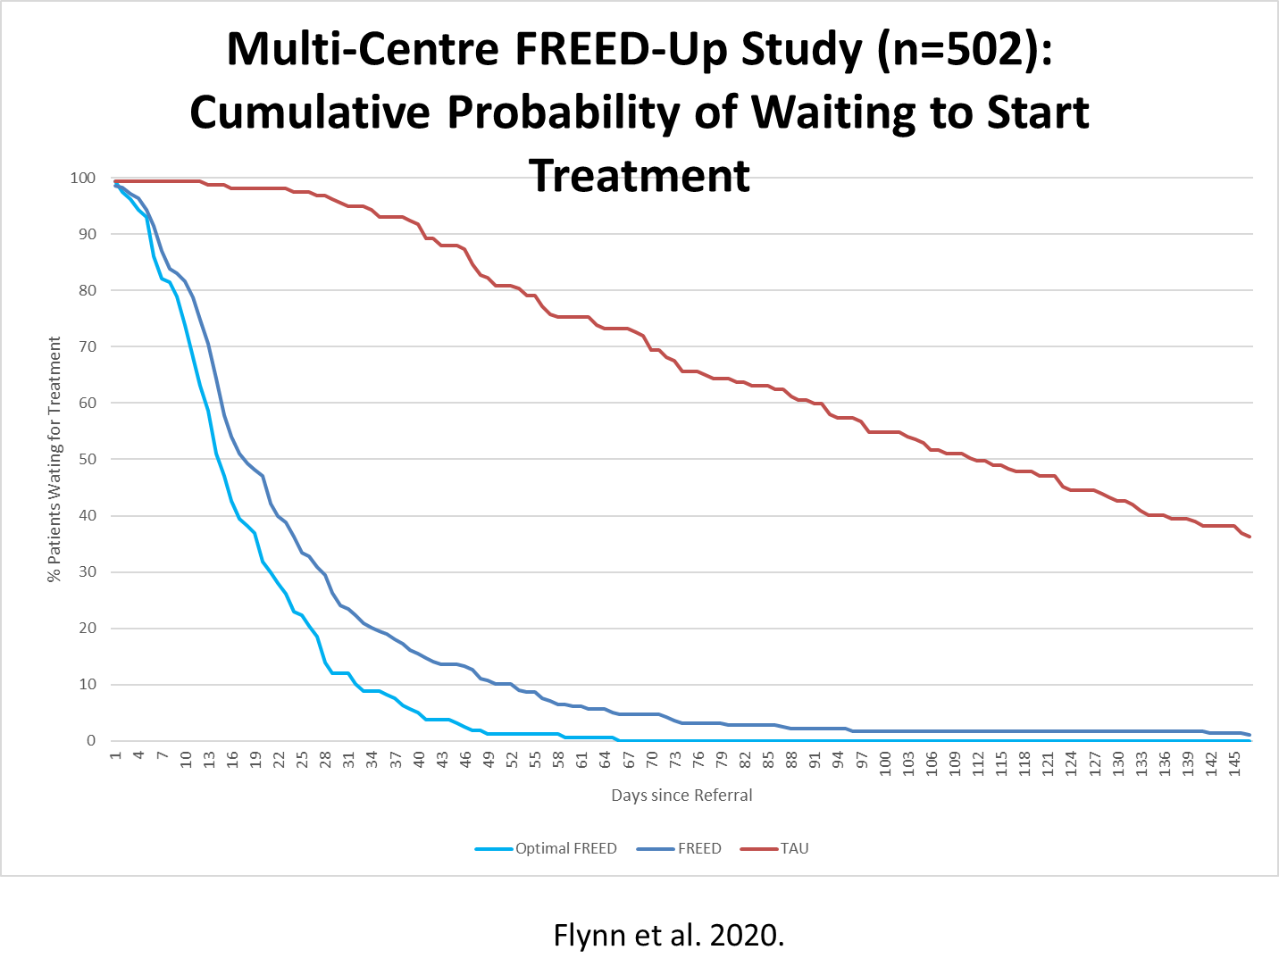
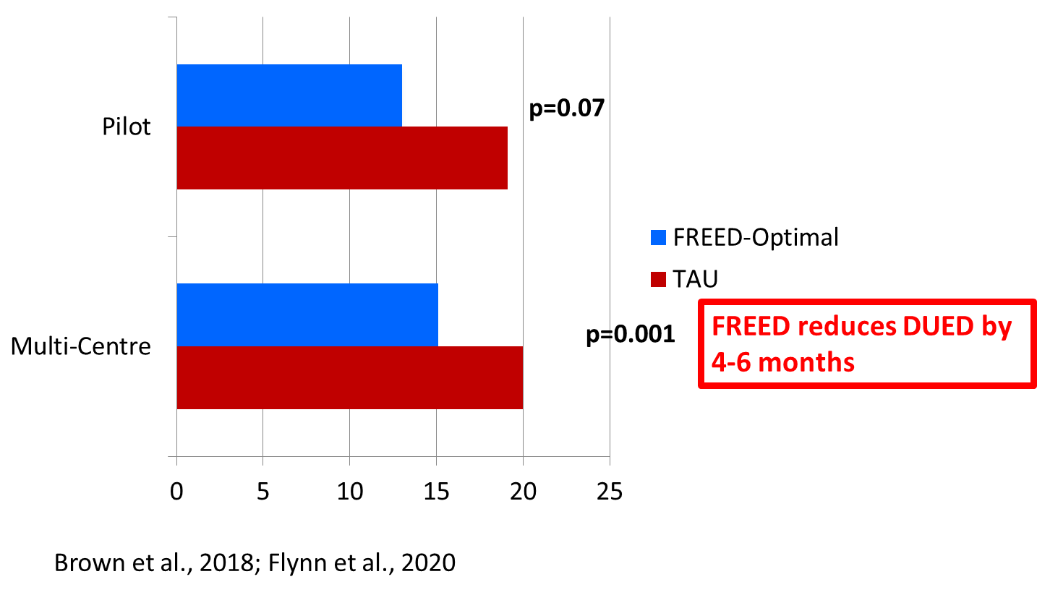
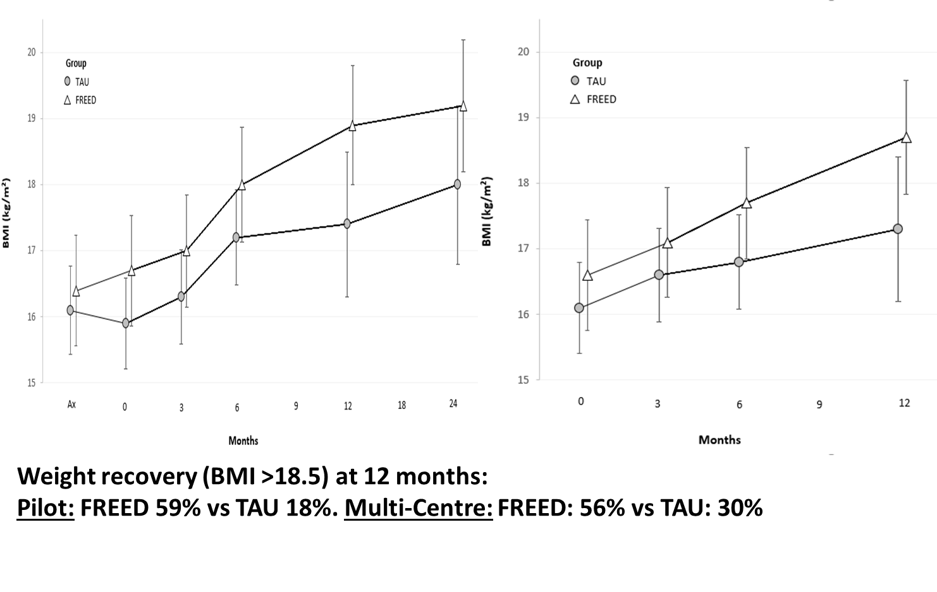
Cost savings of £4,400 per patient
95% of FREED-Up patients very positive about their treatment
Potterton et al., 2021
McClelland et al. (2016); Fukutomi et al. (2020); Austin et al. (2021)

Slide 9
Patient Experience of FREED
“Understanding that you need help is a massive step. Asking for it is also so monumental. Having a service like this that makes asking so easy and natural is so, so vital. It feels amazing to have been part of a service that acts so quickly and makes you feel safe.”
“I nearly dropped out of university last year, when my anorexia was at its most aggressive. FREED's rapid intervention prevented this. I am slowly regaining the energy levels that anorexia drained from me. I can only thank FREED for quite literally saving my life.”
Potterton et al., 2021.

Slide 10
Overview
The case for early intervention
  The FREED model
Implementing early intervention
  Practicalities and progress with scaling FREED
Tailoring early intervention
  Creative ways to reach out
  Improving access and addressing inequalities in access

Slide 11

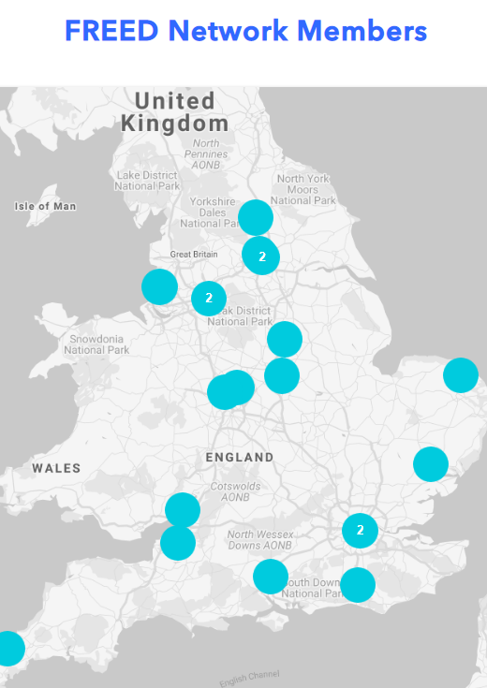
Scaling FREED across England
FREED Network: Over 50 ED services
Training & implementation support
Data sharing & outcome summaries
“It's inspiring…to hook-up with people who are doing the same job as you in a different part of the country”
“There's always a lot to learn from other services and how they are running FREED …. it's really helpful and supportive”
For FREED coming together…it just generated...a lot of hope and optimism, so that was…nice to be a part of”
www.FREEDfromED.co.uk

Slide 12
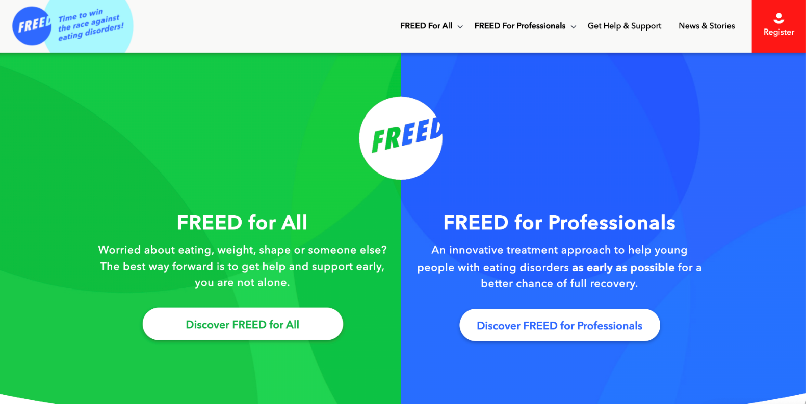
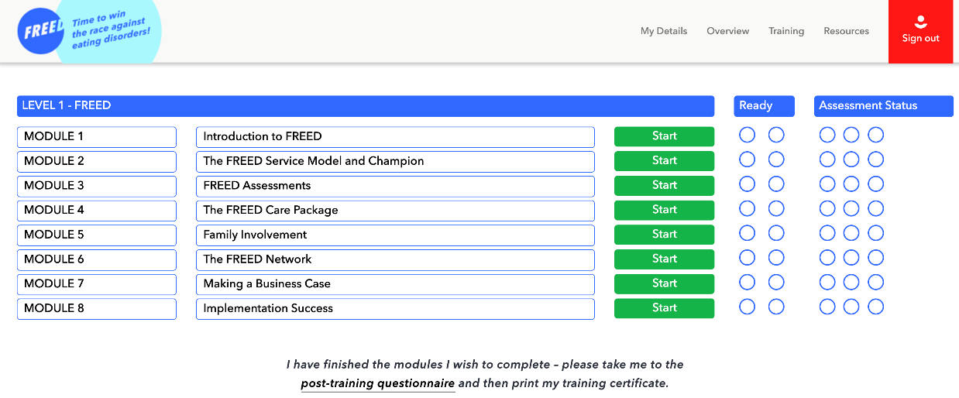
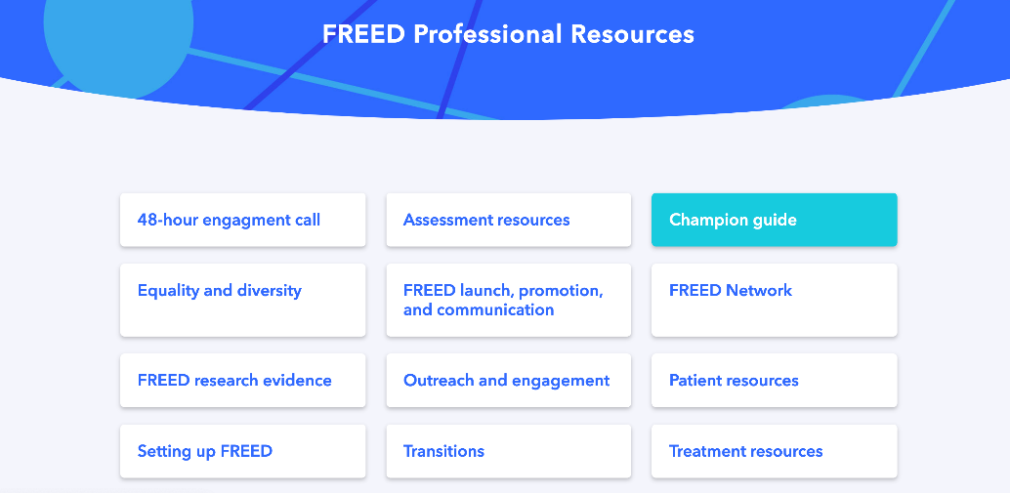
www.FREEDfromED.co.uk

Slide 13
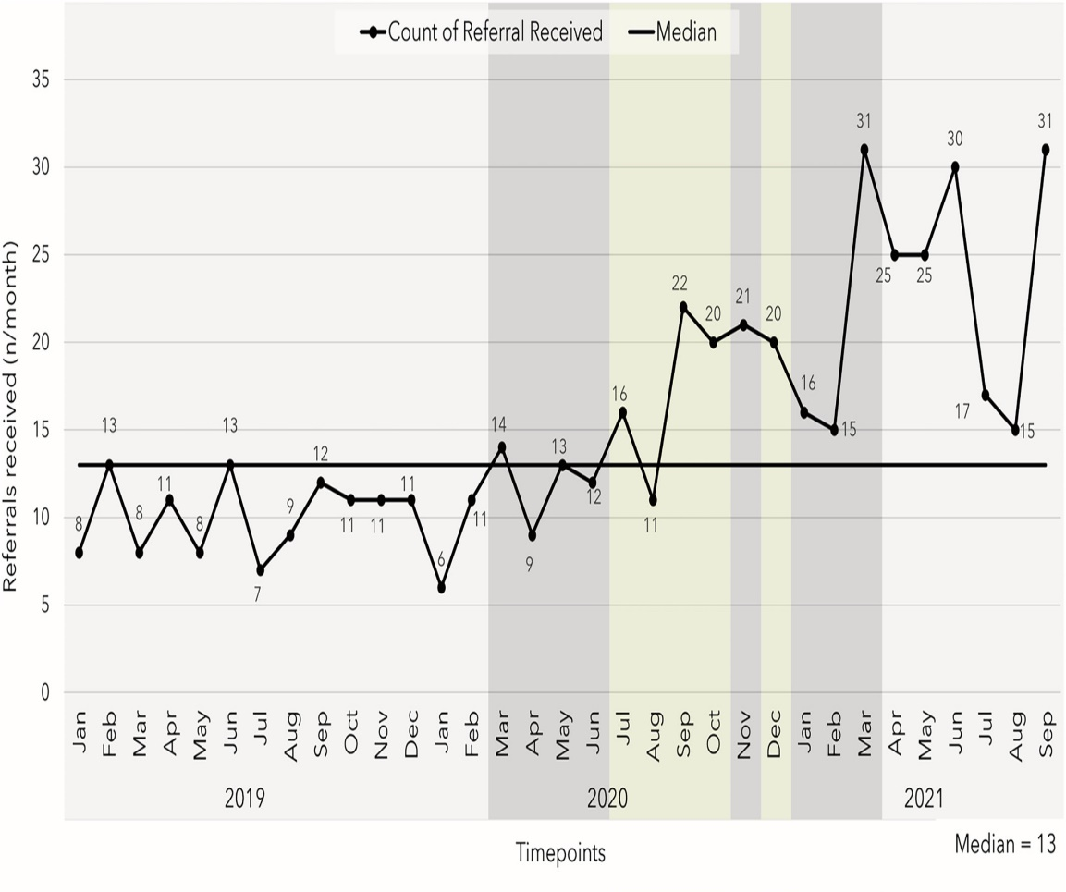
Learning from the national roll-out
Despite the pandemic, FREED appears
to be largely replicating:
  Some increases in waiting times relative to the initial studies
  Diagnostic mix: ~40% AN and 30% BN
  Mean age ~20 years, mean DUED ~15 months
  Positive clinical outcomes
Study period: Jan 2019-Sept 21
3 FREED services with data from pre- to post-pandemic:
  Increase in referrals of 40%
  Increases mainly in anorexia nervosa
  Severity similar to pre-pandemic
  Referral stay high until April 2022, then gradually reduce
Hyam et al., 2022, IJED

Slide 14
Members views on FREED and the FREED Network
“…supervision meetings with other services … there's always a lot to learn from other services and how they are running FREED …. it's really helpful and supportive”
“it helps you hear about challenges that other teams have faced and what they've tried”
Overall clinicians are positive
Biggest barriers: capacity and competing demands
Biggest facilitator: hope and enthusiasm
FREED Network training and support are experienced as helpful
“I don't think we have a choice for it to be sustainable or not. …Early intervention isn't an option, it's a necessity”
“It's inspiring …., it's nice to hook-hook up with people who are doing the same job as you in a different part of the country”
“The FREED Network allowed us to do to be part of something that was a wider initiative”

Slide 15
Overview
The case for early intervention
  The FREED model
Implementing early intervention
  Practicalities and progress with scaling FREED
Tailoring early intervention
  Creative ways to reach out
  Improving access and addressing inequalities in access

Slide 16

Components of DUED
as
Service related delays
Patient (and primary care) related delays
Problem awareness
Help seeking
Referral routes into specialist care

Slide 17


Reaching out
Smartphone-friendly online decision-making tool (FREED-M) for young people with early stage eating disorders (EDs). Aims: to improve knowledge about EDs and motivation to seek treatment, and facilitate early steps towards change.
- Mobile
Community
Primary care
Specialist services

Slide 18
Creative care
Different technologies for contact
Session timing and format
Technology in treatment (e.g, apps)
Personalised treatment
Who is involved
Art, language, movement, images

Slide 19
Under-served and marginalised groups
Black and ethnic minority groups
Cultural differences, including language and body-related attitudes
LGBTQ+ groups
Men
People with co-morbid physical health issues
People in larger bodies
Especially hard if you are all of the above!

Slide 20
Addressing inequalities in access
Focus groups to understand barriers and what we need to do differently
Active outreach via community links, e.g., religious leaders, community groups
Use of interpreters
Guidelines and training for staff
Awareness of language – cultural differences but also bias and attention to preferred pronouns and terminology
Awareness of barriers and increased flexibility and pro-active engagement
Therapist characteristics and patient choice in therapist (within reason)

Slide 21
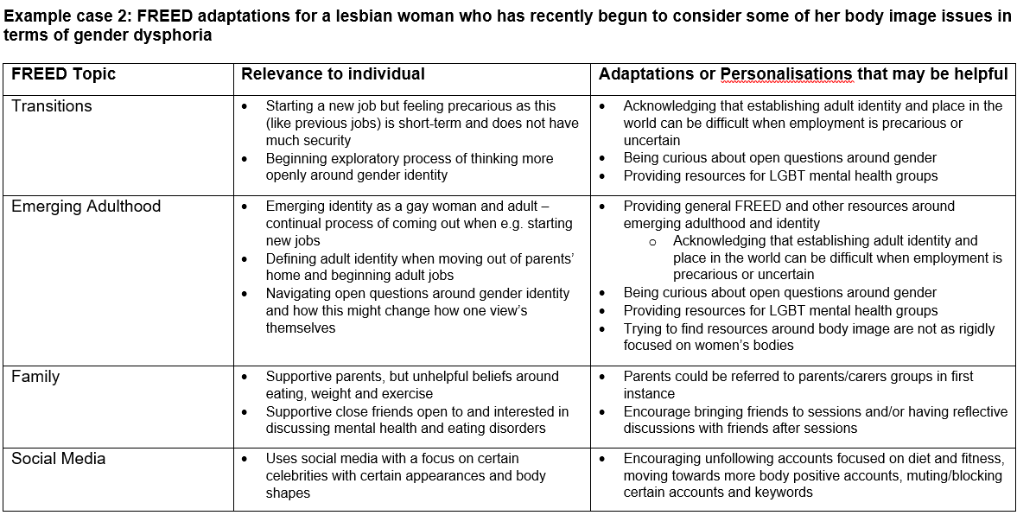

Slide 22


Improving access for all
Appropriate care
Access
Identification

Slide 23








Questions?
Thanks to our partner organisations and all the services, clinicians, service users and carers involved with the FREED Network

