Slide 1
FALLS PREVENTION SERVICES – core elements, national and international developments
Preventing Falls in Older People
Friday 28th April, 2023
Cameron Swift, King’s College School of Medicine, London

Slide 2
KEYS TO AN EFFECTIVE FALLS SERVICE
1. Concept – an age associated syndrome
2. Evidence – positive and negative
3. Structure and delivery - crossing all boundaries
4. Audit - measuring process and outcome

Slide 3
(1) CONCEPT: FALLS IN LATER LIFE: A SIGNAL as well as a threat
Commonly detectable (Intrinsic / Extrinsic):
Ageing processes (diminished physiological reserve)
Suboptimal physical fitness
Stable specific impairment (e.g. sensory, motor, visual, CNS)
Unstable systemic illness (diagnosed or undiagnosed)
Environmental risk factors

Slide 4
(2) EVIDENCE - POSITIVE: FALLS IN LATER LIFE – PREVENTABLE (Close et al, Lancet 1999)

Slide 5
(2) EVIDENCE - POSITIVE :- EXAMPLES OF ATTRIBUTABLE MEDICAL PROBLEMS IDENTIFIED - (80% +) (Close et al, Lancet 1999)
Cardiovascular/circulatory – (e.g. postural hypotension , arrhythmias, carotid sinus syndrome, pacemaker failure) (17%)
Visual impairment (59%), poor stereoscopic vision (62%), cataract (35%)
Decreased lower limb power (28%)
Peripheral neuropathy (20%)
Measured strength/balance impairment (72%)
Measured cognitive impairment (34%), depression (18%)
Undiagnosed malignancy (2%)

Slide 6
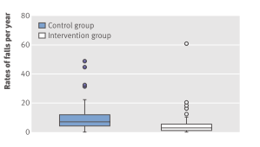
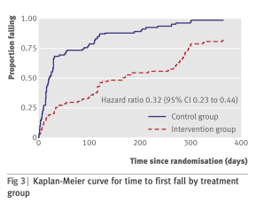
(2) EVIDENCE - POSITIVE:
FALLS IN LATER LIFE – PREVENTABLE (LOGAN et al, BMJ 2010)
(7.68 vs 3.46 control vs intervention)

Slide 7
(2) EVIDENCE - POSITIVE: FALLS IN LATER LIFE – PREVENTABLE (DAVISON et al, 2005)

Slide 8
(2) EVIDENCE: BROADER OUTCOMES - EFFECT OF AN A&E-BASED MULTIFACTORIAL INTERVENTION ON BARTHEL ADL INDEX
(from data of Close et al, 1999)
Notes:
This slide illustrates the change in Barthel scores over the one year follow up period. Repeated analysis of covariance using baseline Barthel as the covariate shows a statistically significant difference between the groups and a significant change in scores over time

Slide 9
(2) EVIDENCE - Exercise in older people living in the community (Cochrane Review 2019) (Sherrington et al)
108 RCTs with 23,407 participants living in the community in 25 countries.
Most trials had unclear or high risk of bias
81 trials (19,684 participants) compared exercise (all types) with control
Exercise reduces the rate of falls by 23% and number of people experiencing one or more falls by 15%
Findings for other outcomes are less certain

Slide 10
GtACH MULTICENTRE CLUSTER RCT from Logan et al BMJ Dec 2021
Fall Rate per participant [mean(sd)] | GtACH | Usual Care | Adjusted Ratio ** | p
0 – 3 months | 0.55 (1.36) (n=708) | 0.88 (2.37) (n=826) | 0.74 | <0.01
3 – 6 months* | 0.49 (1.13) (n=630) | 0.89 (2.60) (n=712) | 0.63 | <0.001
6 – 9 months | 0.60 (1.29) (n=547) | 0.73 (1.85) (n=633) | 0.91 | n.s.
9 – 12 months | 0.55 (1.14) (n=502) | 0.79 (2.37) (n=573) | 0.93 | n.s.
Fall Rate per 1000 resid. Days (m+sd) | GtACH | Usual Care
0 – 3 months | 6.93 (20.56) | 10.24 (27.26)
3 – 6 months* | 6.04 (14.02) | 10.38 (29.52)
6 – 9 months | 7.28 (16.67) | 9.21 (28.77)
9 – 12 months | 6.22 (12.88) | 9.22 (27.36)
* Primary outcome ** Includes both outcome variables

Slide 11
(2) EVIDENCE: FALLS IN INPATIENTS
Highest risk category
Heterogeneous studies and settings (e.g. acute. non-acute, mixed)
Inconsistent or negative findings with single factor or non-tailored interventions
Risk factor prediction tools insufficiently sensitive or specific
More research needed
Some moderate/low evidence for multifactorial assessment and intervention strategies

Slide 12
(2) EVIDENCE - POSITIVE: Effect of targeted risk factor reduction programme on inpatient falls (per thousand occupied bed days) (Healey et al, 2004)

Slide 13
“Fallsafe” care bundle key elements [RCP 2015]
Cognitive assessment*
Delirium screen*
Bed-rail/Ultra-low bed strategy*
Basic visual check*
Lying & standing blood pressure & pulse*
Medical & medication review*
Tailored on-ward (v 2-hr) observation regimen

Slide 14
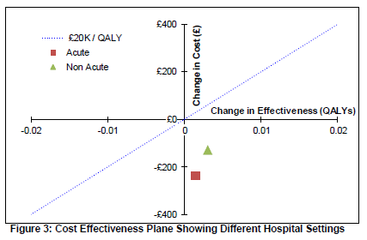
NICE CG 161: COST-EFFECTIVENESS OF INPATIENT FALLS PREVENTION

Slide 15
(2) EVIDENCE:“NEGATIVE” , UNCERTAIN OR ATTENUATED INTERVENTION FINDINGS
Single interventions – untargeted group exercise, cognitive/behavioural, vision correction alone, Vit D (?)
Focus on cognitive impairment (A&E /Care home) (e.g. Shaw et al, 2003, Whitney et al, 2017)
Unidisciplinary assessment with non-linked referral (Lightbody et al, 2002; Spice et al 2009)
Risk factor prediction tools in inpatients [e.g. Barker et all (6-Pack), 2015]
Risk factor prospective postal screening intervention in primary care (Bruce et al, 2021)(PreFIT)
Assistive technology

Slide 16
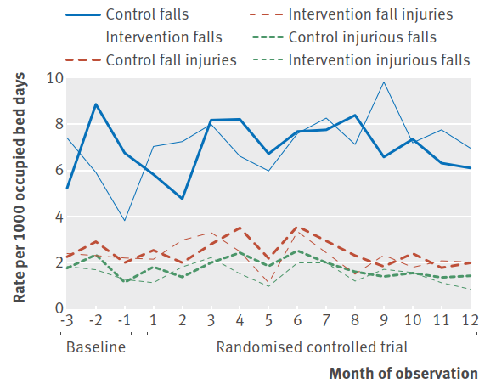
The “6-pack” (risk prediction tool based) study [Barker et al; bmj (2016) 352;h6781]

Slide 17
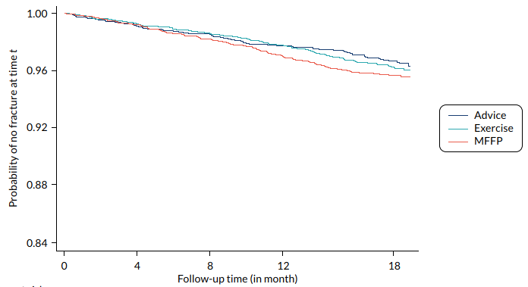
Prefit Cluster RCT (Bruce et al, 2021)

Slide 18
(2): NATIONAL EVIDENCE-BASED GUIDANCE - NICE guideline on falls (CG161) (2013-date: review 2024)
Case/risk identification (opportunistic case-finding)
Multifactorial falls risk assessment/diagnosis
  Falls history
  Assessment of:
    gait, balance and mobility, and muscle weakness
    osteoporosis risk
    perceived functional ability and fear relating to falling
    visual impairment
    cognitive impairment and neurological examination
    urinary continence
    environmental hazards
  Cardiovascular examination and medication review
Individualised multifactorial interventions

Slide 19
CG 161 GENERIC FALLS ASSESSMENT AND INTERVENTION ACTIVITY (UK evidence & focus)
CASE/RISK
IDENTIFICATION
NETWORKED
FALLS SERVICE
Case / risk identified at routine health screen
MULTI-FACTORIAL
ASSESS-MENT
INDIVIDUAL-ISED SINGLE OR MULTI-FACTORIAL INTERVEN-TION & FOLLOW-UP
PRIMARY & COMMUNITY
CARE
Case / risk identified at presentation with fall / other problem
Case / risk identified at presentation with fall / other problem
SECONDARY
CARE
Presentation at A&E with fall injury/ Inpatient >65 / or Inpatient >50 with known clinical risk
BONE HEALTH
SERVICE

Slide 20
(2) INTERNATIONAL CONSENSUS: World Guidelines for Falls Prevention and Management for Older Adults (Montero-Odasso M et al, 2022)
Major evidence-linked consensus statement – 57 co-authors from 72 institutions; 96 Expert participants; 39 countries; 5 continents (low on Africa); 36 Societies; 249 references.
Modified GRADE evidence assessment (1-2; A-C; E) and Modified Delphi consensus process
Comprehensive, detailed recommendation statements (including available validated measurement options) on:
  Fall risk stratification
  Assessment *
  Personalised management and intervention *

Slide 21
(2) INTERNATIONAL CONSENSUS: World Guidelines for Falls Prevention and Management for Older Adults (Montero-Odasso M et al, 2022)
Risk stratification (Low; Intermediate; High)(see Algorithm)
  Opportunistic case-finding *
  Presentation with falls/related injuries *
Multidomain Assessment & Interventions *(High Risk);(Perception of older adult throughout)
Low Risk (Fitness advice) and Intermediate Risk (Exercise Regimens) Management
Inpatient *, Care Home & LMI National settings

Slide 22
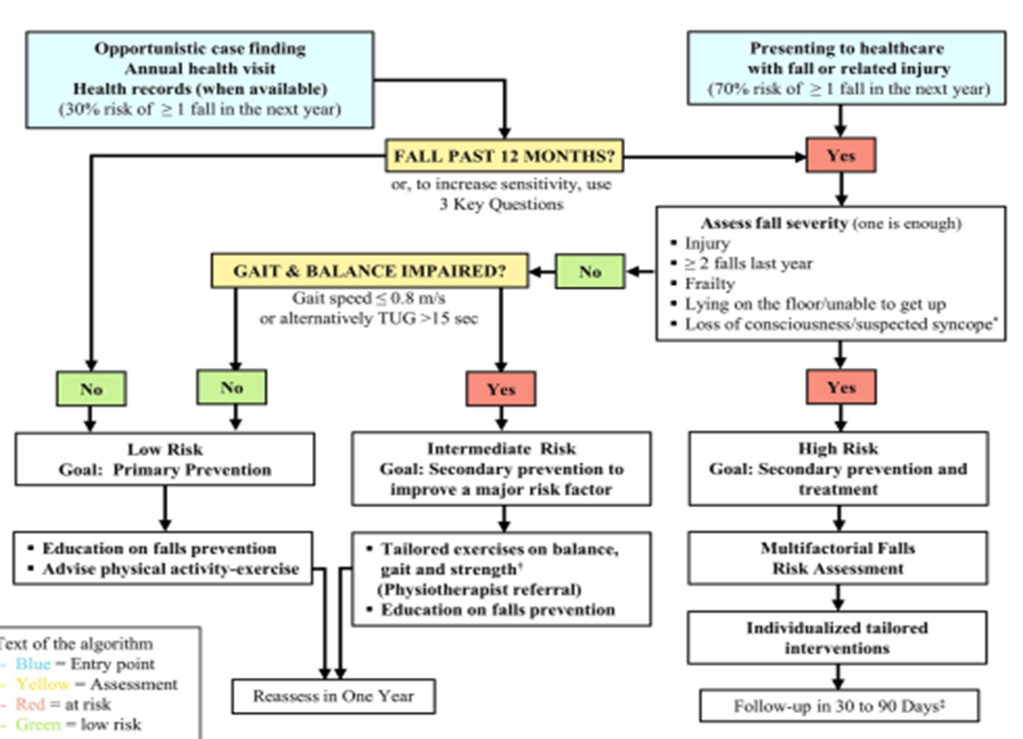
(2) INTERNATIONAL CONSENSUS: World Guidelines for Falls Prevention and Management for Older Adults (Montero-Odasso M et al, 2022)

Slide 23
(2) INTERNATIONAL CONSENSUS: World Guidelines for Falls Prevention and Management for Older Adults (Montero-Odasso M et al, 2022)
MULTIFACTORIAL ASSESSMENT:
  Mobility *: Balance; Gait; Muscle strength; Aids; Feet & footwear; Concerns re falling
  Sensory function *; Dizziness/vestibular; Vision; Hearing
  Activities of daily living *; Functional ability
  Cognition *; Cognitive ability; Delirium
  Autonomic *: Orthostatic hypotension; Urinary incontinence
  Disease occurrence *; (CGA); Cardiovascular; Other contributory conditions; #Risk; PD; Depression;
  Medication *
  Nutritional status; Vit D *
  Environmental *

Slide 24
(3) STRUCTURE & delivery - COORDINATING ACROSS BOUNDARIES: GENERIC FALLS SERVICE NETWORK – AN OPPORTUNITY TO LEAD
PRIMARY & COMMUNITY
CARE
MAINSTREAM SECONDARY CARE
NETWORKED FALLS SERVICE (LINKED TO MEDICAL GERONTOLOGY)
ACCIDENT & EMERGENCY MEDICINE
POPULA
TION-BASED/
OPPORTUN-ISTIC CASE- FINDING INCL. 1ST RESPONSE
ACUTE INPATIENT MEDICINE & GERONTOLOGY
TRAUMA, & ORTHO-PAEDICS
OTHER MEDICAL & SURGICAL SPECIALITIES
HOME-BASED EXERCISE
PROGRAMMES INCL 3RD SECTOR
DAY HOSPITAL, OUTPATIENT CLINICS & REHABILITATION
BONE HEALTH SERVICE

Slide 25
(3) STRUCTURE - IMPROVING IMPLEMENTATION
(RCP 2017)
MANAGEMENT LEVEL
Organisation-wide Patient Safety Group
Structured rapid assessment procedures (including standardised delirium tools)
Robust data and reporting on falls & fractures
CLINICAL
Multi-D Falls Working Group auditing v QS 86
Audit of Postural BP, Visual, Medication and Walking-aid use review and provision

Slide 26
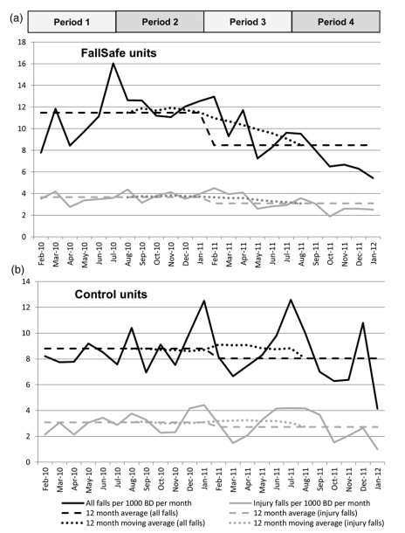
(4) AUDIT - INPATIENT IMPLEMENTATION & OUTCOME MEASUREMENT “Fallsafe” QI evaluation [Healey et al 2014]

Slide 27
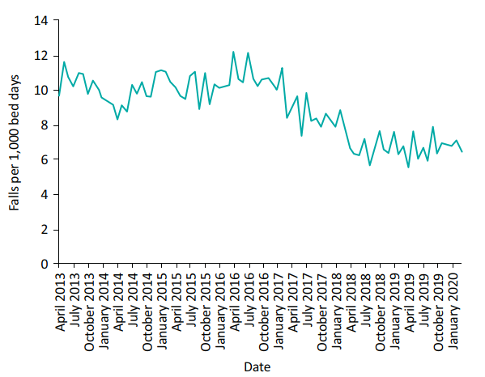
4: LOCAL AUDIT/QI: Inpatient falls per 1,000 bed days AT Northumbria Healthcare NHS Foundation Trust 2013–2020. (Richardson et al., 2020)

Slide 28
(4) NATIONAL AUDIT - QS 86 2017 UPDATE STATEMENTS
1 Older people are asked about falls when they have routine assessments and reviews with health and social care practitioners, and if they present at hospital.
2. Older people at risk of falling are offered a multifactorial falls risk assessment.
3. Older people assessed as being at increased risk of falling have an individualised multifactorial intervention.
4.Older people who fall during a hospital stay are checked for signs or symptoms of fracture and potential for spinal injury before they are moved.
5. Older people who fall during a hospital stay and have signs or symptoms of fracture or potential for spinal injury are moved using safe manual handling methods.
6. Older people who fall during a hospital stay have a medical examination.
7. Older people who present for medical attention because of a fall have a multifactorial falls risk assessment.
8. Older people living in the community who have a known history of recurrent falls are referred for strength and balance training.
9. Older people who are admitted to hospital after having a fall are offered a home hazard assessment and safety interventions.

Slide 29
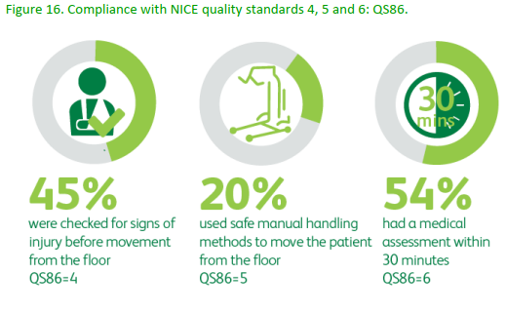
(4) NICE QS 86 ADHERENCE (naif audit) (RCP 2020)

Slide 30
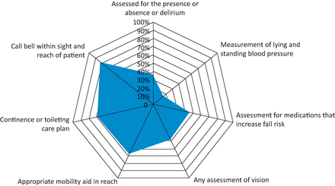
(4) NATIONAL AUDIT – SNAPSHOT DATA -INPATIENT FALLS 2017 (v 2015) (RCP 2019)

Slide 31
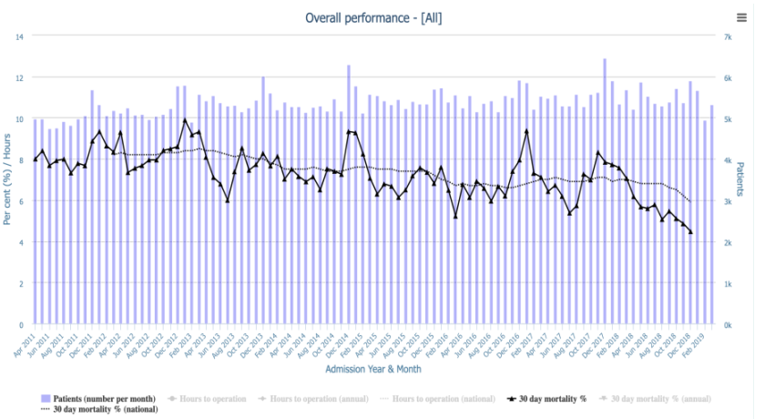
(4) 30-DAY HIP FRACTURE mortality, 2011-2018 (NHFD 2019)

Slide 32
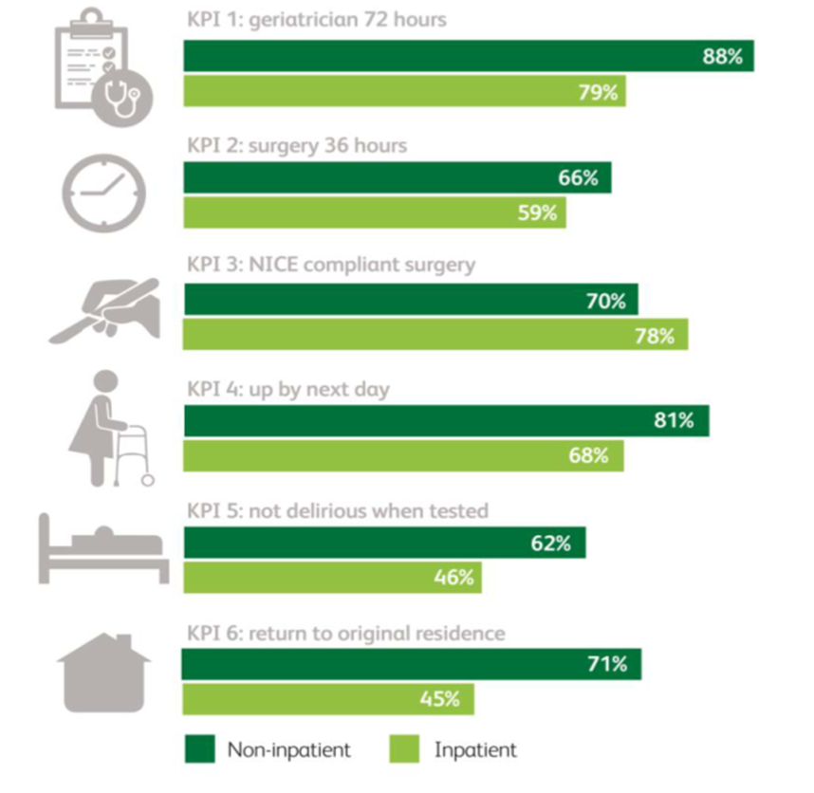
NHFD 6 KPI’s FOR INPATIENT &
NON-INPATIENT HIP FRACTURE [NHFD 2022]

Slide 33
(4) NATIONAL AUDIT OF INPATIENT FALLS (naif) 2018-21 (RCP 2021)
DATA – regularly updated, openly accessible
GUIDANCE – e.g.
  Vision assessment
  Postural blood pressure measurement
  Post-fall management*
  Gaining insight (v. incident review only)*
    Hot debrief (immediate info collection)
    After action review (MDT learning)
            *In development

Slide 34
KEYS TO AN EFFECTIVE FALLS SERVICE
1. Concept – an age associated syndrome
2. Evidence – positive and negative
3. Structure & Delivery - crossing all boundaries
4. Audit - measuring process and outcome

