Slide 1




Driving Improvement through National Guidance, National and Local Audit
Julie Whitney
28/04/2023

Slide 2
Content
The problem of inpatient falls
The evidence
NICE guidelines and quality standards
Using audit to drive improvement

Slide 3
Inpatient falls
NHS Improvement 2017

Slide 4
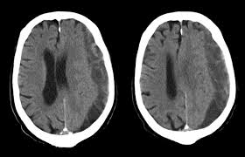
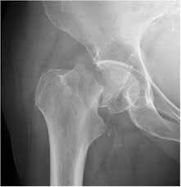
Inpatient falls
NHS Improvement 2017

Slide 5
Inpatient falls
Falls in hospital can result in:
Loss of confidence and slower recovery, even when physical harm is minimal
Distress to families and staff
Legal action against hospital trusts
Overall costs to hospitals of £630 million per year

Slide 6
“Like most people, I’d always considered a hospital to be a place of safety. So, when my mother was admitted to A&E after breaking her hip, I took it for granted that she’d be in safe hands, and that staff would do everything possible to make her better.”
Julia Ellis (chair of the FFFAP Patient and Carer Panel)

Slide 7
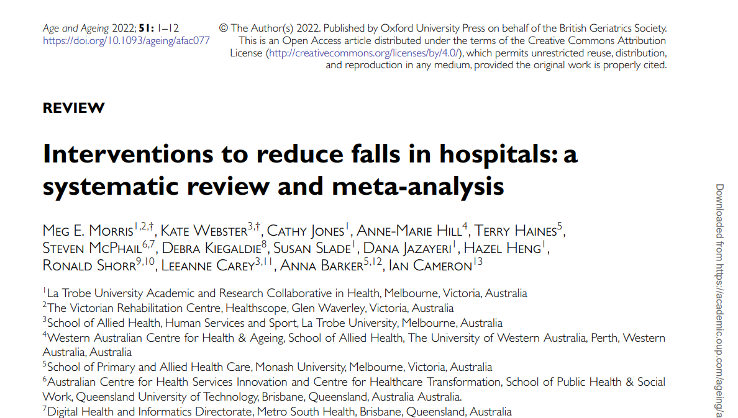
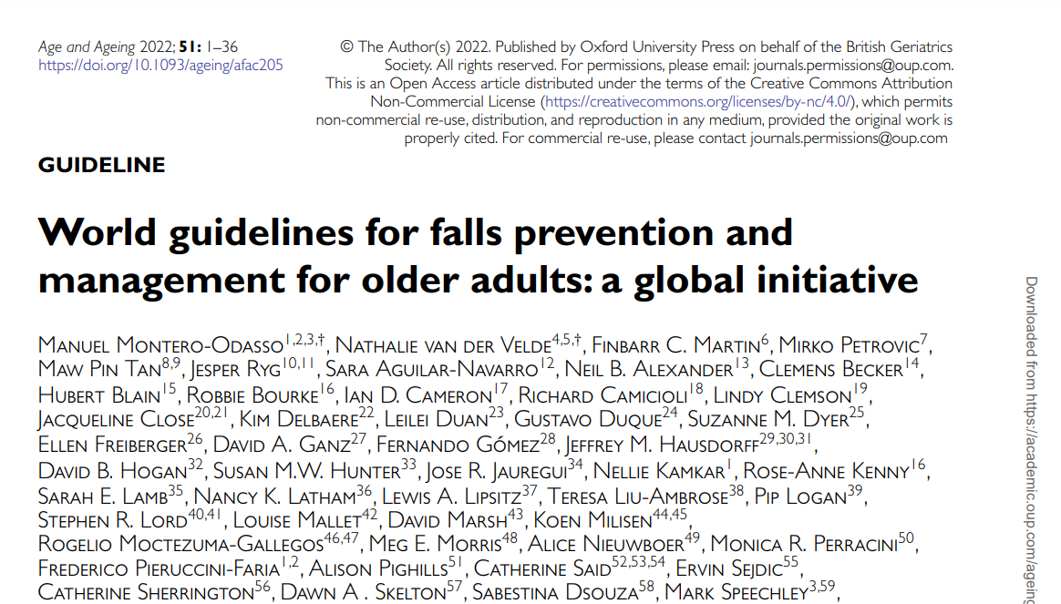
The Evidence

Slide 8
Cochrane Findings
Additional physiotherapy (supervised exercises) in rehabilitation wards (subacute setting):
Uncertain due to low quality evidence
Rate ratio: 0.59, 95% CI 0.26 to 1.34 / Risk ratio: 0.36, 95% CI 0.14 to 0.93
Bed and chair sensor alarms in hospitals:
Uncertain due to low quality evidence
Rate ratio: 0.60, 95% CI 0.27 to 1.34 / Risk ratio: 0.93, 95% CI 0.38 to 2.24
Multifactorial assessment and intervention:
Uncertain due to low quality evidence
May reduce rate of falls
Rate ratio: 0.80, 95% CI 0.64 to 1.01 / Risk ratio: 0.82, 95% CI 0.62 to 1.09
More likely in a subacute setting. Rate ratio: 0.67, 95% CI 0.54 to 0.83

Slide 9
Morris et al (2022)
Education:
High certainty evidence
Rate ratio: 0.70, 95% CI 0.51 to 0.96
Risk ratio: 0.62, 95% CI 0.47 to 0.83
Assistive devices
Low-moderate certainty evidence
Rate ratio: 1.22, 95%CI 0.84-1.78
Risk ratio: 1.11, 95% CI 0.94 to 1.31
Additional rehabilitation
Very low certainty evidence
Risk ratio: 0.72, 95% CI 0.12 to 4.32
Environmental modifications:
Very low certainty evidence
Risk ratio: 2.87, 95% CI 0.58 to 14.27
Multifactorial Ax and Ix:
Very low certainty evidence
Rate ratio: 0.80, 95% CI 0.63 to 1.01
Risk ratio: 0.72, 95% CI 0.46 to 1.12

Slide 10
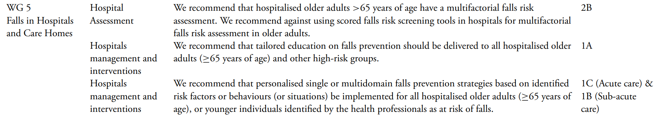
World Falls Guidelines

Slide 11

The Guidelines

Slide 12
The paradigm for falls prevention
Identify those at high risk
Multi-factorial assessment
Intervention to address assessment findings

Slide 13

NICE CG161 - HOSPITAL
1.2 Preventing falls in older people during a hospital stay
1.2.1 Predicting patients' risk of falling in hospital
1.2.1.1 Do not use fall risk prediction tools to predict inpatients' risk of falling in hospital. [new 2013]
1.2.1.2 Regard the following groups of inpatients as being at risk of falling in hospital and manage their care according to recommendations 1.2.2.1 to 1.2.3.2:
all patients aged 65 years or older
patients aged 50 to 64 years who are judged by a clinician to be at higher risk of falling because of an underlying condition. [new 2013]

Slide 14
How to prevent falls in hospital settings?
Identify those at high risk
Multi-factorial assessment
Intervention to address assessment findings
Aged >65
50-64 judged by clinician

Slide 15

Multi-factorial Assessment
NICE CG161:
cognitive impairment
continence problems
falls history, including causes and consequences (such as injury and fear of falling)
footwear that is unsuitable or missing
health problems that may increase their risk of falling
medication
postural instability, mobility problems and/or balance problems
syncope syndrome
visual impairment

Slide 16

Multi-factorial Intervention
NICE CG161:
1.2.2.4 Ensure that any multifactorial intervention:
promptly addresses the patient's identified individual risk factors for falling in hospital and
takes into account whether the risk factors can be treated, improved or managed during the patient's expected stay. [new 2013]
1.2.2.5 Do not offer falls prevention interventions that are not tailored to address the patient's individual risk factors for falling. [new 2013]

Slide 17
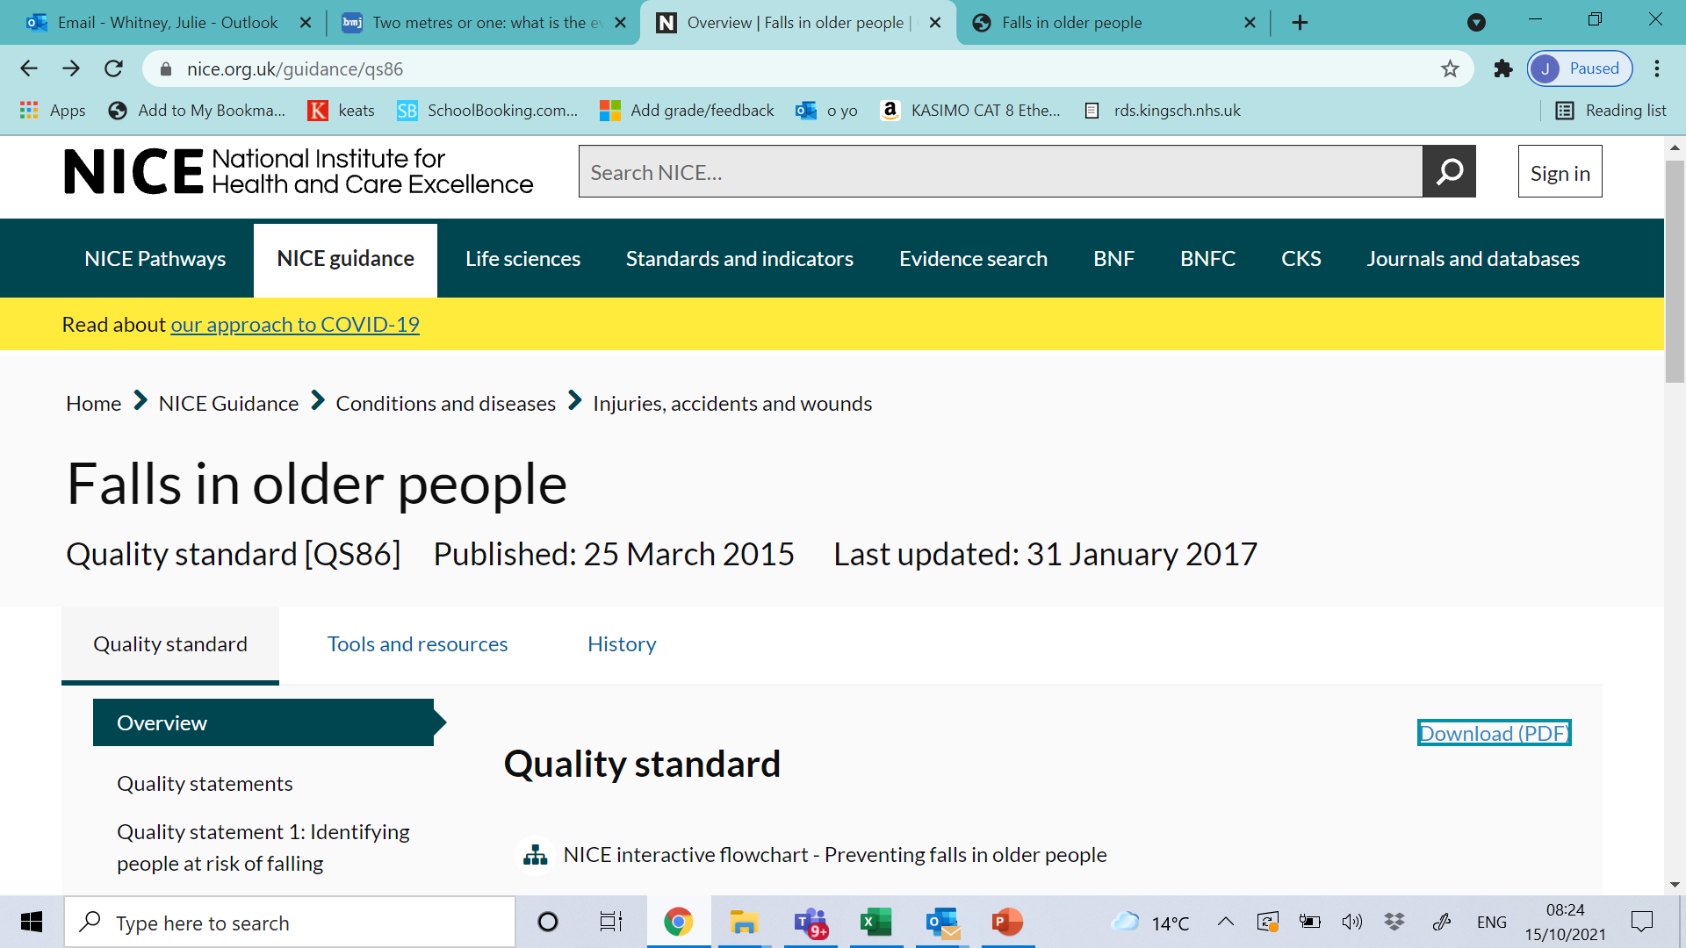
Quality standards

Slide 18
NICE Quality standard 86: 4, 5 and 6
Quality statement 4: Checks for injury after an inpatient fall
Quality statement 5: Safe manual handling after an inpatient fall
Quality statement 6: Medical examination after an inpatient fall

Slide 19
Driving change through National Audit
Commissioned by Health Quality Improvement Partnership (HQIP) contracted to the Royal College of Physicians (RCP)
Since January 2019 has continuously audited all people aged>60 who sustained a hip fracture while an inpatient in English or Welsh NHS setting.

Slide 20
NHFD identifies inpatient fall with femoral fracture
Notifies relevant falls audit team
Falls audit team to review patient notes and extract data on:
Post fall management (QS86 s4,5 and 6)
Fall prevention activity prior to the femoral fracture (CG161)

Slide 22
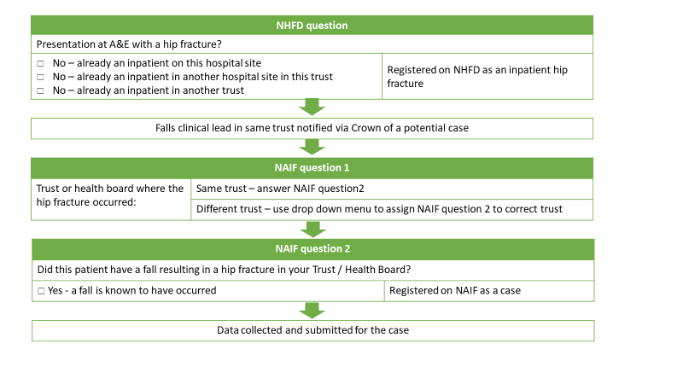
2006
1394
21% - not a fall

Slide 23
Most hip fractures occur on medical wards
80% hip fractures occur on the first fall
There is only one chance to get things right!

Slide 24
Fall prevention activity prior to the fracture
76% had a MFRA
3 days prior to the fall that caused the fracture
New KPI – high quality MFRA
Documented evidence of assessment of 5 or more of these risk factors
31% patients had a high quality MFRA
Components of MFRA

Slide 25
Prevalence of risk factors

Slide 26
Care plans followed

Slide 27
Post fall management
Analgesia prescription
78% = prescription recorded
Time to analgesia
Median of 2 hours (IQR 1-4)

Slide 28
Recommendations
All inpatients aged over 65 to have a high quality MFRA regardless of their ward
Ensure action is taken to address risk factors identified in MFRA
Use quality improvement methods to increase the proportion of inpatients who undergo high-quality MFRA
Trusts should ensure there are staff with appropriate competencies to undertake effective post-fall management 24/7
Trust should have access to flat lifting equipment on all sites
Prompt medical assessment and diagnosis of injury after fall should be undertaken to ensure patients have immediate access to analgesia
Don’t use falls or fracture rates to compare between Trusts, focus on performance-based KPIs or performance over time

Slide 29
How to drive improvement
1
Identify the problem to be addressed
2
Identify the stakeholders and work out how they need to be involved
3
Get to the bottom of the reasons underlying the problem
What outcomes are you looking to change?
4
Decide a small, simple change that can be made
Talk to the patients
Set SMART goals
Decide how the project will be measured
5
Develop analysis tools and dashboards to continuously follow progress
6
Determine sustainability and think about spread
Celebrate success

Slide 30
What is the aim of the project? - Driver Diagram
AIM
PRIMARY DRIVERS
SECONDARY DRIVERS
CHANGE IDEAS
Check for injury before moving
Protocols
Update protocol
Safe lifting procedures
Training / competencies
New training
Safe Post-fall Care
Timely medical examination
MDT communication
Falls response team
Access to diagnostics
Staffing
Falls champions
Analgesia
Equipment
Flat lifting equipment on site

Slide 31
Who are the stakeholders?
What do the patients think?
High power | Chief executive Chief nurse Director of therapies Medical / clinical director Board members | Consultants Matrons Senior therapists Ward managers
Lower power | EPR team Ward clerk Domestic staff | Patients Nurses Junior therapists Therapy assistants HCAs
 | Low impact | High impact

Slide 32
Identify what happens now
Patient is distressed, as are the staff. Strong temptation to get the patient off the floor ASAP.
Cannot find the scoop hoist (which might be indicated as patient is in pain) but no one knows where it is.
No documentation of the assessment for injury or method used to lift from the floor.
Patient has a fall
Patient is on the floor and distressed
Patient remains on the floor for 30 minutes
Patient is hoisted into bed
Patient found to have a hip fracture 3 hours later
Staff not sure how to assess for injuries – how to perform the examination and what to look for.
Examination did not flag an injury – referred for medical review but no urgency.

Slide 33

Starting the improvement journey
SMART Goal setting
100% of patients who fall on one ward have documented assessment for injury and method of lifting in the 1 month follow up.

Slide 34
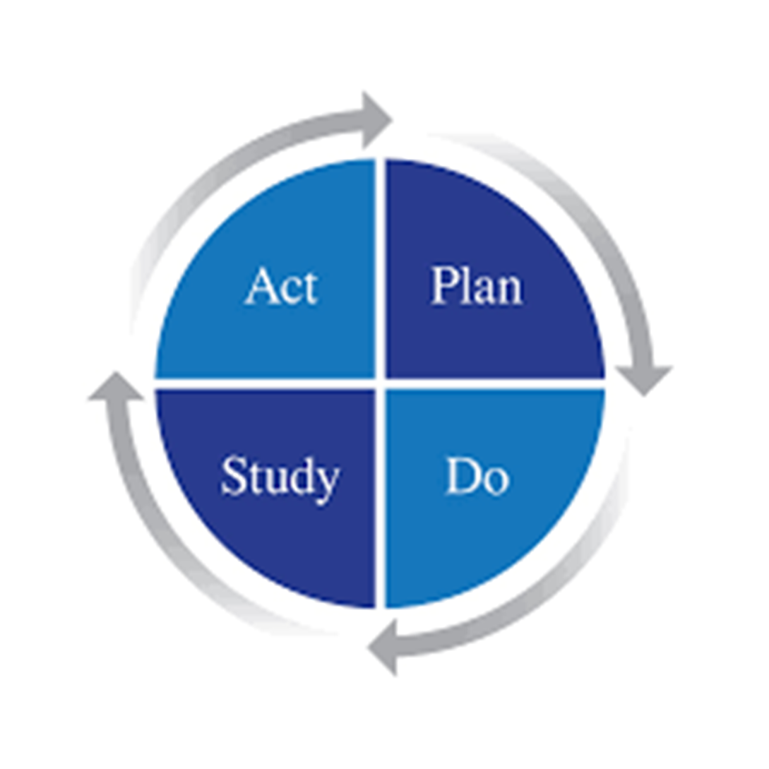
Select a method

Slide 35
Explore the challenges and find a focus
Equipment
People
No training/competencies on PFM
Not aware of need to record
COW not working and no time later in shift to add
No debrief process
No documentation of the assessment for injury or method used to lift from the floor.
Lack of agreement as to who records this
In red for staffing and several falls, so not time to record
Not part of post-fall protocol
Methods
Environment

Slide 36
Improvement intervention
To update the post-fall protocol including documentation
To develop a post-fall documentation checklist on EPR
To develop a communications strategy to inform clinical staff of these changes

Slide 37
Measurement of change

Slide 38
Sustainability and spread

Slide 39



How can the (NAIF) audit help with this?
Data
Resources

Slide 40
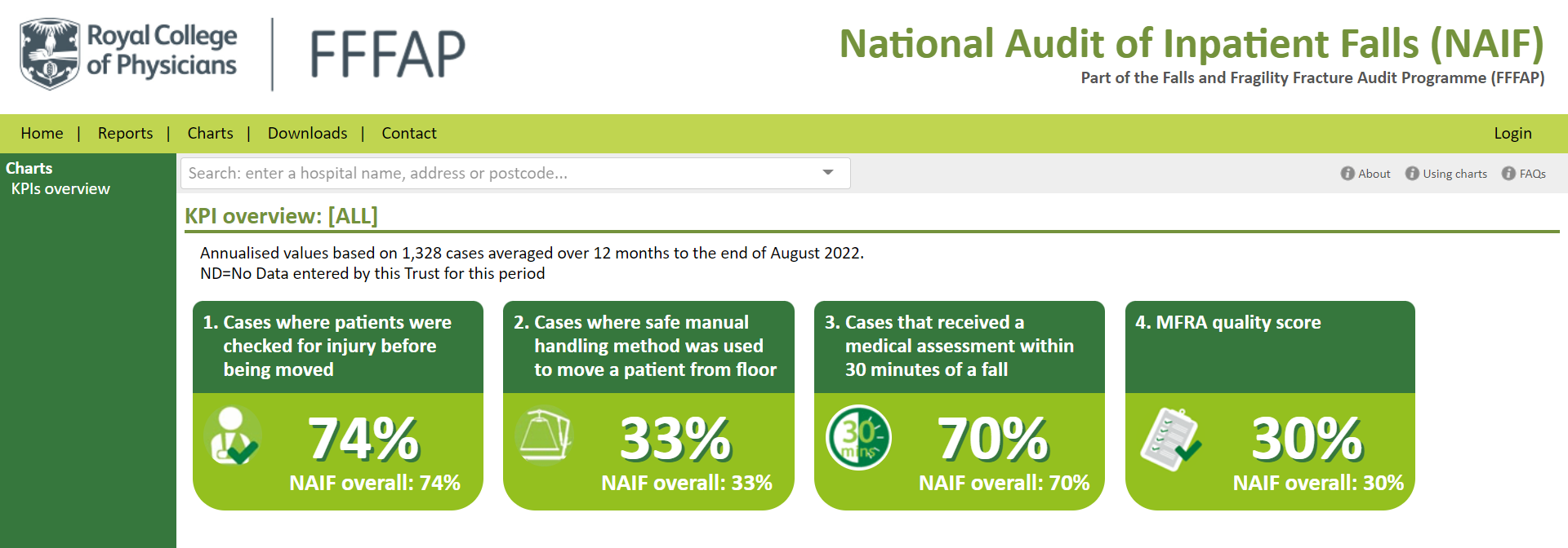
Data

Slide 41
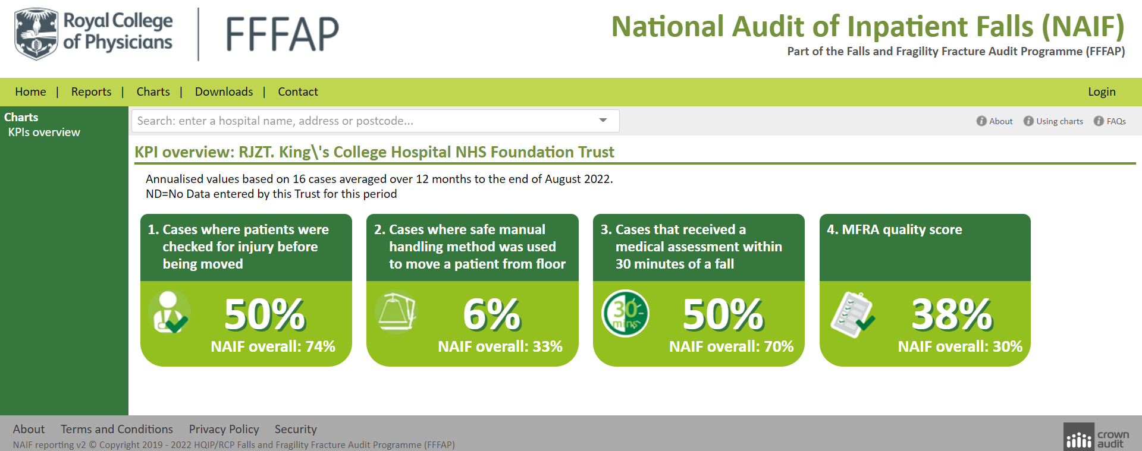

Slide 42
Resources:

Slide 44
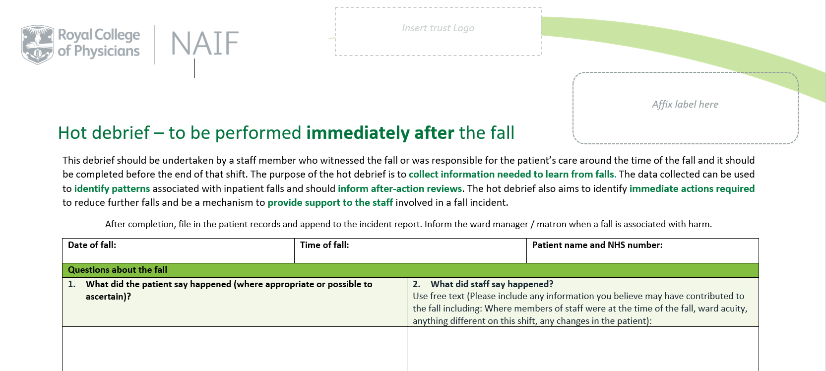
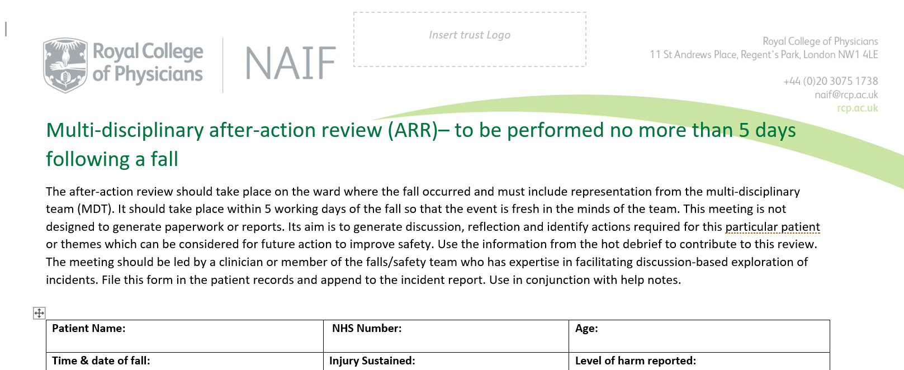
Gaining insight from inpatient falls (PSIRF)

Slide 45
Thank you & Questions

