Slide 1
Deprivation of liberty: DoL without LPS Lessons from getting it wrong …
Healthcare conferences
Ben Troke
Partner, Hill Dickinson
Notes:
intro

Slide 2
Outline
Unlawful DoL and compensation
Legal costs
Publicity
Ombudsman
(CQC)

Slide 3
Art 5 – Right to liberty and security
“Everyone has the right to liberty and security of person. No one shall be deprived of his liberty save in the following cases and in accordance with a procedure prescribed by law”:
…;
lawful detention for the prevention of the spreading of infectious diseases, of persons of unsound mind, alcoholics or drug addicts or vagrants;
4. Everyone who is deprived of his liberty by arrest or detention shall be entitled to take proceedings by which the lawfulness of his detention shall be decided speedily by a court and his release ordered if the detention is not lawful.
Notes:
Care Act s73
Makes clear that HRA covers people receiving domiciliary care / supported living commissioned by the state
Previously only for care homes where commissioned / delivered by the state

Slide 4
ECHR Article 5
(5) Everyone who has been the victim of arrest or detention in contravention of the provisions of this Article shall have an enforceable right to compensation.

Slide 5
Human Rights Act 1998 s8(3)
No award of damages is to be made unless, taking account of all the circumstances of the case, including—
(a) any other relief or remedy granted, or order made, in relation to the act in question (by that or any other court), and
(b) the consequences of any decision (of that or any other court) in respect of that act, the court is satisfied that the award is necessary to afford just satisfaction to the person in whose favour it is made.

Slide 6
A technical breach?
Bournewood (Court of Appeal) – December 1997
HL v UK (October 2004)
Bostridge v Oxleas NHS FT (2015, court of appeal)

Slide 7
Getting it wrong…
Neary (2012)
Mr and Mrs D (2013)
RF v Essex CC (2015)
Esegbona v King’s College Hospital (2019)
Emile v Haringey (2020)
Insurance?
Publicity?
Legal costs and other resources?
Notes:
The measure of something going badly wrong with DoL is primarily that someone’s rights are breached – they are not where, or cared for in the way that they should be.
Not every such case will lead to compensation claims, damages awards and awful publicity, but the cases that do are a fair indication that something has gone wrong…
I’d always say something like the harm of these cases – and others like them which don’t generate an award of compensation – is of course measured in the adverse impact on the lives of vulnerable individuals not just in damages award but these are sobering from a public body perspective…
In Neary, LB Hillingdon ended up paying £35k in compensation to Steven Neary and to his father Mark for breaches of their rights when Steven went into respite care for a few days and was kept there for a year.
In Esegbona, a decision about discharge from hospital was so badly managed that her estate was awarded around £15,000 in compensation for “false imprisonment” for the 119 days after she said she wanted to go home, because her capacity to make that decision for herself was not properly assessed and then the family were deliberately excluded from the best interests decision making, such that a further award of aggravated damages of £5,000 was made for failure to follow the MCA.
In Emile the local authority sought to recover £80,000 of unpaid care home fees from a lady’s estate after she died, and instead ended up paying her estate £130,000 in damages for unlawful DoL as there was no DoLS authorisation in place for 8 ½ years of her time there, and – worse – the LA had not properly considered whether it was in her best interests to remain there or to move there in the first place.
And the lesson of each of them is that the problems come from getting the MCA badly wrong to start with, not the niceties of DoL due process….

Slide 8
Neary
Stephen Neary was unlawfully kept from his father for the year in 2010, DoLS authorisations were flawed, breaching Stephen’s Article 5 and Article 8 rights
A hearing in July 2012 approved a settlement of £35,000 in compensation

Slide 9
Mr & Mrs D (2013)
Couple, married 37 years – sought 2 weeks respite for Mrs D (Huntingdon’s and high level of care needs) in August 2011.
LA refused to allow her to return home, but did not put DoLS authorisation in place initially, and then delayed compliance with DoLS condition of urgent CoP application.
Eventually heard by CoP in September 2012 – return home in best interests, but resisted by LA until January 2013.
LA settled compensation at £27,500 + costs in total – approved by court, (based on admitted unlawful DoL for 21 weeks)

Slide 10
RF v Essex CC (2015)
91yo, former RAF gunner, living alone (with “Fluffy”)
Dementia, and LA concern about financial exploitation
Removed to locked dementia unit and kept there for 17 months, against his wishes – DoLS authorisations only partly in place.
Court ordered in best interests to go home, and approved agreed settlement:
£60,000 in compensation + legal costs
Waived c£25,000 in care home fees;
Front page news.

Slide 11
“It is hard to imagine a more depressing and inexcusable state of affairs…
The conduct of ECC has been reprehensible …
The sad and disturbing consequences for P cannot be ignored…”

Slide 12
Esegbona v King’s (2019)
68yo – SOB – ICU, intolerant of her tracheostomy
Ready for discharge – she wants to go home
Placed in a nursing home some 4 months later (“not to be discussed with p’s family”)
Died => clinical negligence claim (£3,500 PSLA)
AND – claim for “false imprisonment” (!)
Upheld – awarded £130pd for 119 days = £15,470
AND - £5,000 aggravated damages for breach of MCA

Slide 13
Emile v Haringey (2020)
Mrs E, with dementia, was removed by LA into a care home for her own safety due to ?abuse by husband
Stayed there (even after husband’s death) for 11 years til hear death, only a DoLS authorisation for the last 3 years
LA sued the family for unpaid care home fees of £80,000
Family counterclaimed for unlawful DoL, and won £130,000 – based on c£1,400 pcm (a district judge).

Slide 14
Award upheld by Circuit judge on appeal
“… that the LA perceives itself to be beleaguered by what it may see as the shifting sands of guidance and continuing changes in emphasis regarding their legal obligations under DoLS standards with significant impact on its resources, these factors are not grounds for reducing any damages awarded…”
Mrs E’s “freedom was unlawfully compromised for the greater part of the last decade of her life, where less intrusive options of accommodation and care should have been considered. The good intentions and benign motives of the local authority are scant consolation to the person deprived of their liberty”

Slide 15
Legal costs of COP proceedings
Ordinary rule is no order for costs in the Court of Protection in health and welfare cases, but discretion for the court to order costs against a party
G v E (Costs) [2010] – Baker J:
“In this case the local authority’s blatant disregard for the processes of the MCA and their obligation to respect E’s rights under the ECHR amount to misconduct which justifies departure from the general rule”.
Upheld in the Court of Appeal

Slide 16
Naming and shaming …
“I therefore name Manchester City Council as the local authority because the arguments in favour of publicity — openness and public accountability — are truly compelling. These arguments manifestly amount to a "good reason" for taking this step and, considering the various factors for and against, the balance manifestly comes down in favour of publication in this case. … It is important that the residents and council tax payers of the city of Manchester know what has happened so that the local authority can be held accountable. And it is to be hoped that the publicity given to this case will highlight the very significant reforms of the law implemented by the Mental Capacity Act and in particular the DOLS in schedule A1, and the consequent very considerable obligations imposed on local authorities and others by the complex procedures set out in those reforms”.
Manchester City Council v E (2010)
Notes:
Led to coverage on Channel 4 TV news, and the Guardian.

Slide 17
The Ombudsman
Local Government and social care ombudsman v Staffordshire CC (March 2019)
Since 2016, Staffs had decided as policy not to process DoLS applications of low / medium priority “…because of lack of financial resources”.
Ombudsman found this was “fault leading to injustice”.

Slide 18
“Applying the process properly would not change the outcome for most of the people affected, other than confirming that it is in their best interests to be deprived of their liberty. However, it is possible that some of the people stuck in the backlog for years should never have been deprived of their liberty”.
Notes:
NB current average for a DoLS SA is 153 days – cf UA can only last 14 days.
A large proportion of people wait over a year.
Huge numbers of people are unlawfully deprived of their liberty
Will the courts start to use their discretion to start awarding serious compensation to those where there is a “technical breach” only? To drive a change in behaviour by commissioners
NB not only the (mis)use of DoLS but also those in the community where cases are not brought to COP to authorise (and the huge delays there) - who also have the iniquity of the lack of non means tested legal aid, which is available only for s21A challenges which need there to be a DOLS authorisation in place.
No to mention CQC / regulatory liabilities -
And of course the harm to P, even if there is no other substantial liability

Slide 19
The most important thing about DoL …
…Is to get the MCA right
Be clear about the decision that needs to be made
Don’t confuse capacity and best interests – the “protection imperative”; and risk aversion in both
Understand the role of consultation and collaboration (with P and others)
Remember Article 8 rights
Remember the LA is a servant not a master …
And avoid delay in getting to court

Slide 20
http://www.lawbriefpublishing.com/product/medicaltreatmentdecisions/ All proceeds to the Alzheimer’s Society

Slide 21
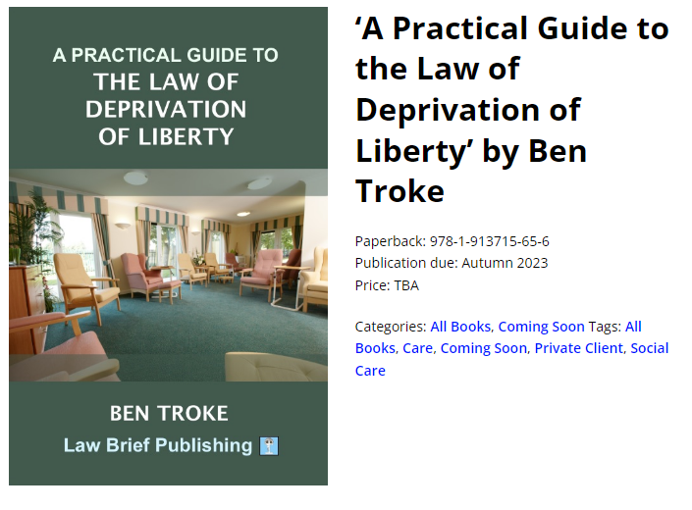

Slide 22
Any questions?
Ben.troke@hilldickinson.com
https://www.linkedin.com/in/bentroke/

