Slide 1
TONY COLLIER BEM
Prostate Cancer UK Ambassador, awareness speaker and fundraiser
Prehab4Cancer & EMBRaCE-GM Patient Representative
Greater Manchester

Slide 2
My Story
Life changing event aged 45
  Diet
  Alcohol
  Exercise
Running
  Marathons
  Ultra marathon
Running Into Cancer
  Diagnosis
  Prognosis

Slide 3
My Story
Choices post diagnosis
  2 ways forward
Side effects of treatment
  Loss of muscle mass
  Weight gain
  Hot flushes
  Hot sweats
  Fatigue
  Loss of libido/sexual function
  Mental health Impact
    Anxiety
    Depression
    Counselling and psychosexual therapy
Impact on exercise
Exercise a vital part of maintaining my physical and mental well being
Taking control rather than being controlled (Exactly what Prehab does for cancer patients)

Slide 4






Prehab4Cancer & Recovery
Programme: Greater Manchester
@Prehab4Cancer
Notes:
Introduce myself + the service

Slide 5
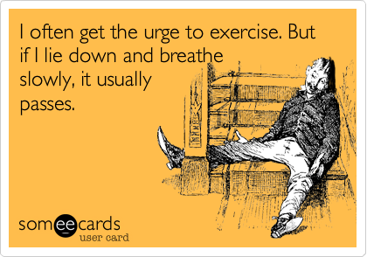

Notes:
ZM

Slide 6
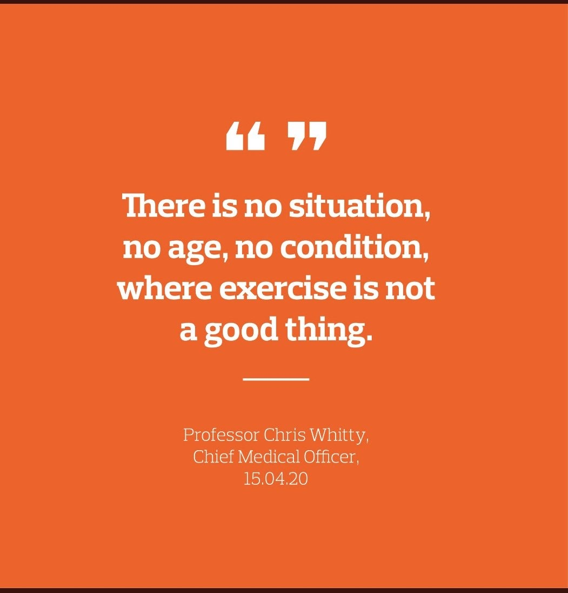

Slide 7

We no longer need to prove that Prehab/Rehab benefits cancer patients. It’s now a given! *
*Dr John Moore – Clinical Lead Prehab4Cancer

Slide 8

More evidence
HIIT aerobic exercise can elicit a tumour suppressive response in men with advanced prostate cancer*
*GAP4 trial paper published 29.11.22

Slide 9
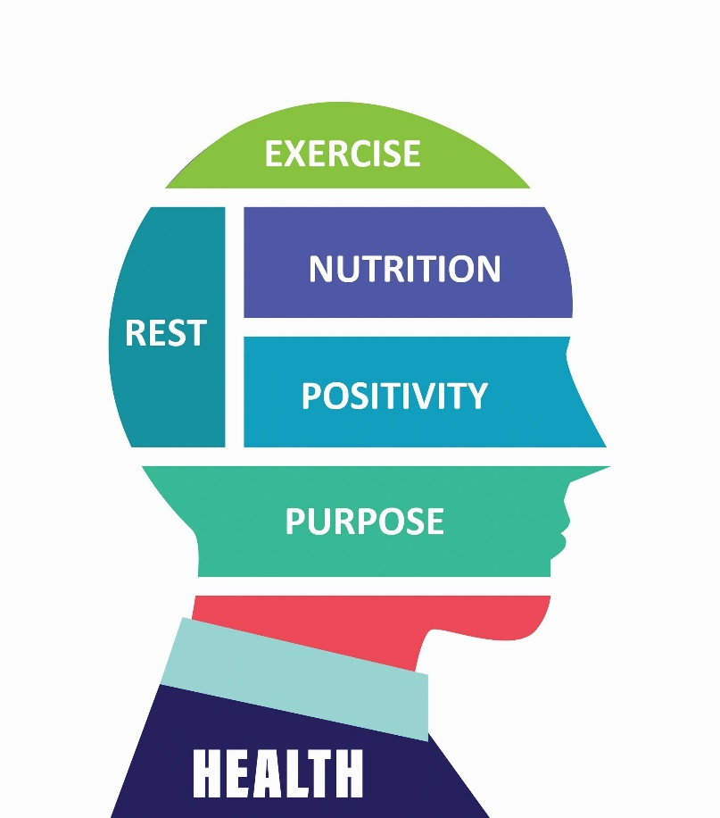


Prehabilitation can be defined as:
“Prehabilitation enables people with cancer to prepare for treatment through promoting healthy behaviours and through needs-based prescribing of exercise, nutrition and psychological interventions. Prehabilitation is part of a continuum to rehabilitation.”
This Photo by Unknown Author is licensed under CC BY-SA

Slide 10


What is Prehabilitation?
The preparation for the physiological and psychological challenges of cancer treatment
Benefits:
  Shortened recovery
  Reduce treatment-related complications
  Improve adherence & completion of treatment
  Improve quality of life
  Transition to lifelong habit of physical activity
Prehabilitation and rehabilitation are essential for reducing the future needs of people with cancer.
Independent Cancer Taskforce 2015 5-yr Strategy for cancer
Normal recovery
Complicated recovery
Reduces organ function
Accelerated atherosclerosis
Immune function altered
Treanor et al. Journal of Cancer Survivorship. Meta-analysis
Notes:
ZM

Slide 11
Benefits of Prehabilitation
For Surgery & Treatment
Shortened and less complex recovery
Potential reduction in length of stay
Reduce treatment-related complications
Improve adherence & completion of treatment
Potential reduction in toxicity
Improved cardiorespiratory function
Reduced impact of Sarcopenia
For Longer Term Rehabilitation
Improved functional capacity
Improved strength & bone health
Improved Mental wellbeing
Improved confidence & Self esteem
Improve aspects of Neuro-cognitive function
Transition to lifelong habit of physical activity
Reduced risk of cancer specific mortality
Reduced risk of all-cause mortality
Reduced risk of recurrence

Slide 12
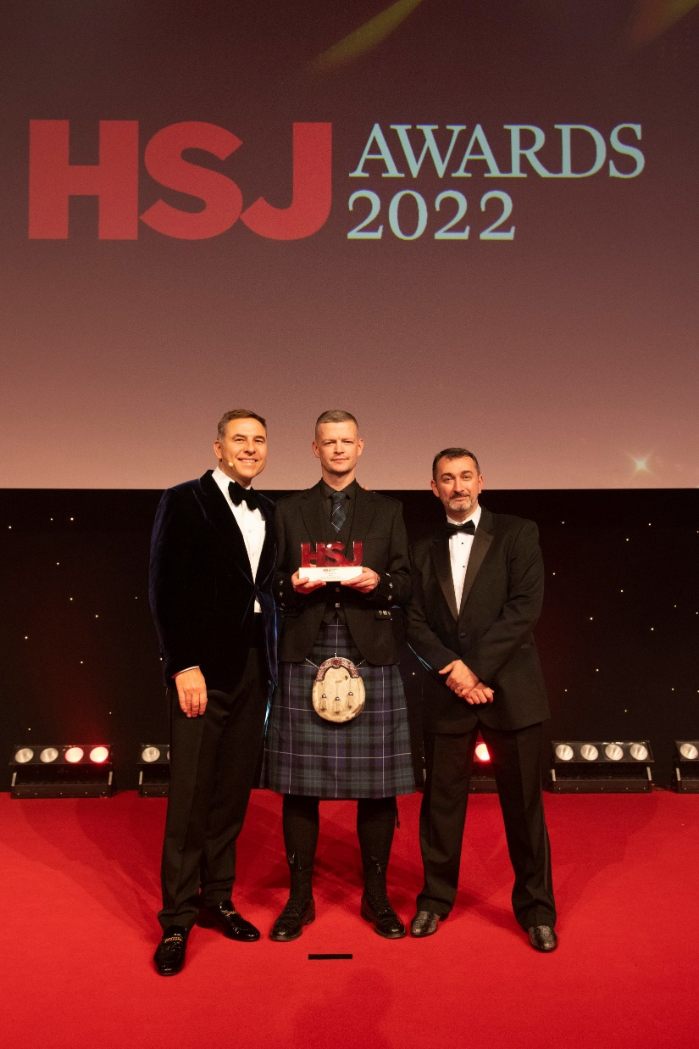


The GM Model – (HSJ Award winning)
Codesign & Collaboration
First system to Launch in the UK – April 2019
Whole system, Multimodal approach to Prehabilitation and Rehabilitation for Greater Manchester
Clinically led – Evidence-Based practice
Designed in collaboration with GM Cancer & GM Active
3 Point programme – Exercise, Nutrition, Wellbeing
Referral point built into clinical pathways
Prehab team members of clinical MDTs
Patients assessed at set time points using validated measures
Tailored and progressive exercise prescription
Specialised exercise guidelines, wellbeing intervention and dietic support
Equity of access which is Local & accessible
Steering groups to support and shape the service including Patient reps

Slide 13





Governance Structure (Stakeholder Engagement)
GM Active Board
GM Health and Social Care Partnership
USER REPRESENTATION IN EVERY GROUP
GM Cancer Board
GM Cancer Pathway Boards
GM Active Health Leads Group
Programme assurance board
Project Steering Group
Colorectal Pathway
Salford community leisure (hosts)
Performance Review & Implementation Group
GM Cancer
Prehab4Cancer
project team
Lung Pathway
GM Active Prehab4Cancer Core Delivery team
Exercise
Expert group
OG Pathway
Expert Research Groups
Wellbeing Expert group
BI and Data insights
Nutrition
Expert group
Notes:
13

Slide 14

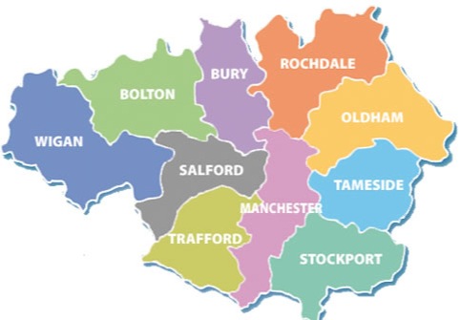
Whole Systems Approach
1 Cancer Alliance
10 Boroughs
10 Councils /Local authorities
10 Clinical Commissioning Groups
12 Referring Hospitals
5 Cancer Hubs
2 Rapid Diagnostic Centres
12 Leisure Providers
14 Pathway Board Managers
5 Clinical Leads
20-30 clinical referring teams

Slide 15
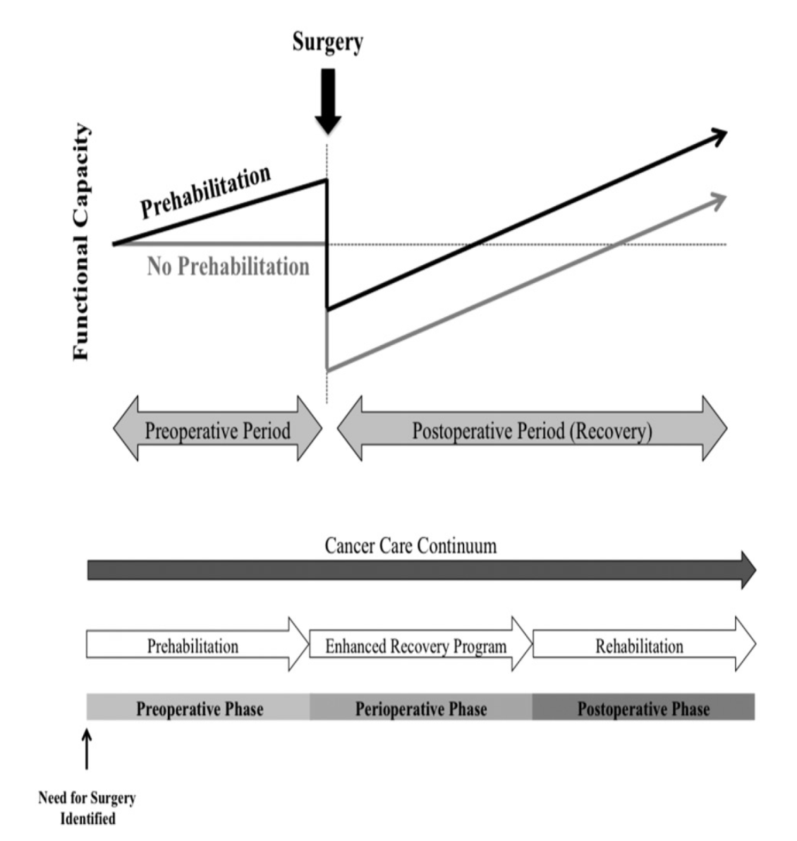

Prehab
Preparation for planned body stressor
MINNELLA ACTA ONCOLOGICA 2017
Notes:
Principles of Prehab….emerging evidence….

Slide 16
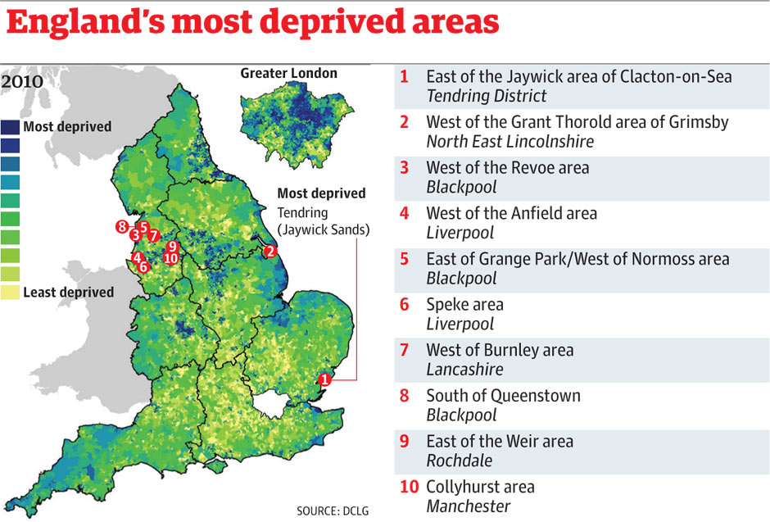
GM health is poorer than the UK average, with more people here suffering heart disease and cancer.
One in five people in Greater Manchester live in the one of country’s most disadvantaged areas.
More than two thirds of early deaths in our region are caused by smoking, alcohol dependency, poor diet and air pollution.
‘Invisible patients’ are more common in deprived areas and present as emergencies with advanced cancers
Notes:
ZM

Slide 17
The Prehab4Cancer Pathway
OUTCOMES
PREHAB
3-6 weeks
UNIVERSAL
REHAB
12 weeks
Positive Exit into community
A
Refer to Prehab4
Cancer
SURGERY
MDT decision to operate
A
A
A
TARGETED
CHEMO
REHAB
12 weeks
A
Implementing a system-wide cancer prehabilitation programme
Moore et al
EJSO 2021 47, 3: 524-532

Slide 18

Programme Model - Surgical
Prehab up to 12 weeks
Rehab 12 weeks
S
U
R
G
E
R
Y
B
R
E
A
K
Supervised
3 monitored sessions per week
Intensity/Duration/Mode prescribed by specialist
Continuous
Steady State CV (40-70% Max Hr)
Progressing intensity based on HR & RPE
MSE combat sarcopenia
3x weekly sessions
Post Surgery update
Contact 4 – 6 weeks post
Establish plan of action for commencing rehab with Post Op Assessment
Patient centred Rehab
12 week pass to local gym
Prescribed exercise programme and supported sessions with specialist
Signposted to local community activities to promote long term exercise adherence and improvement of health
Positive exit strategy
ASSESSMENT
Universal
1-1 session with specialist to prescribe exercise programme
Weekly progress updates
Independent exercise at local leisure centre
Re-HIIT
Interval type exercise
Work : Active Recovery (60-80+ Max Hr)
RPE & HR monitoring
MSE combat sarcopenia
3x weekly sessions
Notes:
Walk Test results determine supervised or universal pathway 400+ metres universal along with medical status and overall picture of clients

Slide 19

Programme Model - Treatment
Pre-Treatment
During treatment
Rehab 12 weeks
Progressive/Continuous
Steady State CV (40-70% Max Hr)
Progressing intensity based on HR & RPE
MSE combat sarcopenia
3x weekly sessions
TREATMENT BEGINS
No expectation or target number of sessions
Patients receive support contact calls from specialists with advice and education around fatigue management
Offer of supporting patient to maintain some level of activity
Any pre prescribed programme is adjust for frequency, intensity & duration to accommodate treatment
Constantly adaptived programming throughout treatment
Post Treatment update
Establish plan of action for commencing rehab with Post treatment Assessment
Patient centred Rehab
12 week programme
Prescribed exercise programme and supported sessions with specialist
Progressive programme to help build patients functional capacity.
Focus on patients aims and goals
Motivational and behaviour change strategies used to build long-term adherence
Assessment
Re-HIIT
Interval type exercise
Work : Active Recovery (60-80+ Max Hr)
RPE & HR monitoring
MSE combat sarcopenia
3x weekly sessions

Slide 20

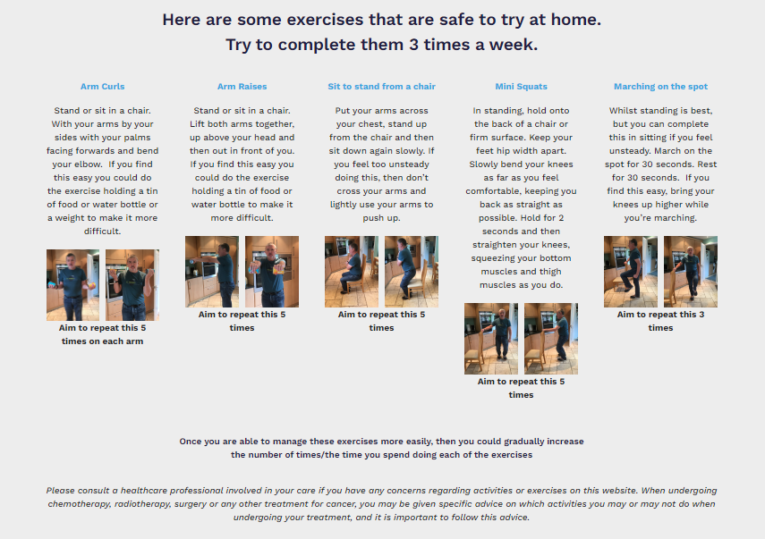
Prehab advice for non-eligible patients
Notes:
Website includes:
Advice on exercising
Exercises to try at home
Links to youtube channel with video demonstrations by exercise specialists
Nutritional advice and links to other resources
Wellbeing advice and links to other resources, including signposting for self referring to mental health services in Greater Manchester, and how to find local mental health services elsewhere.

Slide 21

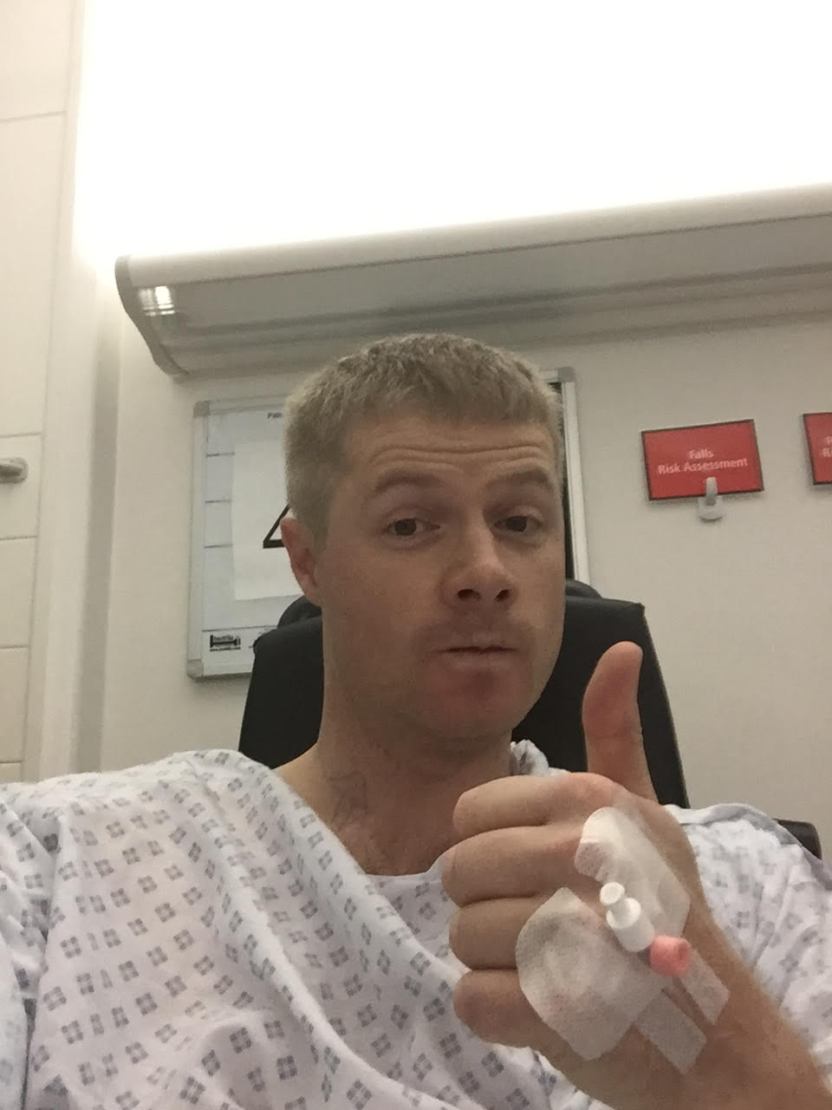
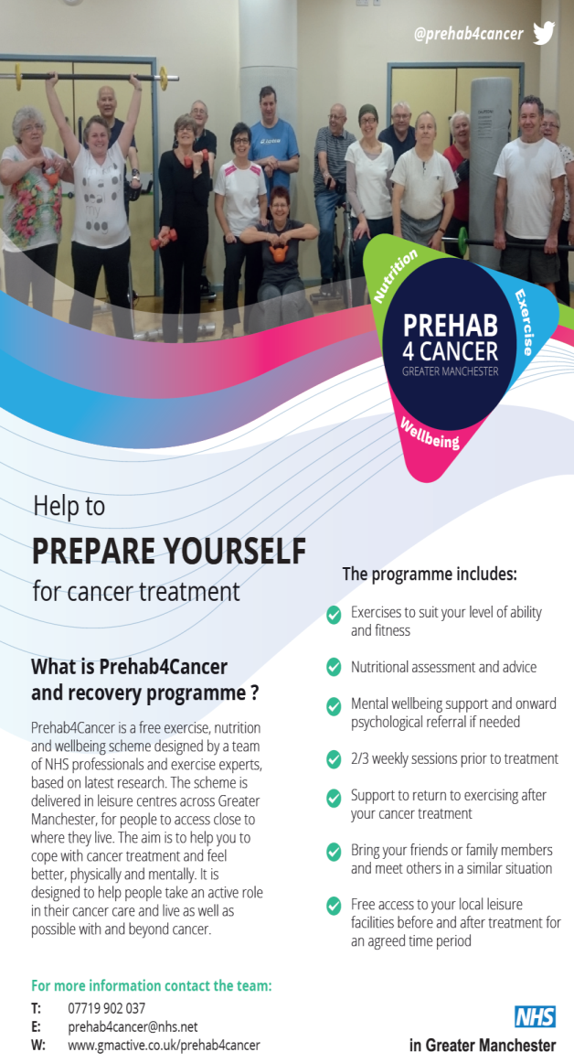
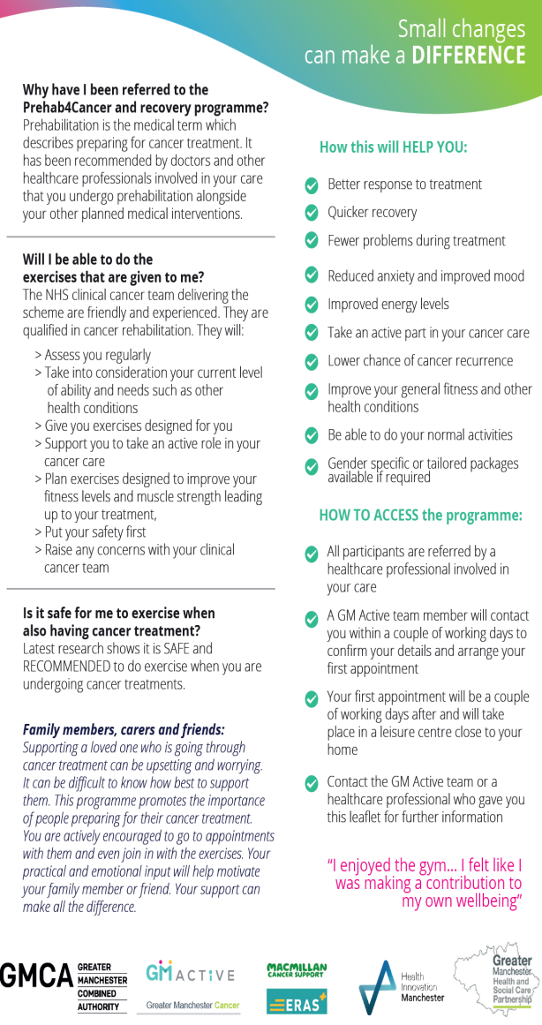
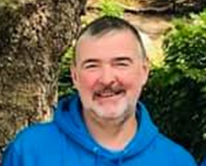
User Involvement: co-design & co-production
Notes:
Co-designed with people affected by cancer

Slide 22

Remote Service Delivery (COVID)
Referrals continued throughout lockdown. Referral form updated to include Blood Pressure, Resting Heart Rate and O2 Sats
Patients contacted >48 hours from referral, telephone/video call initial assessment
Personalised Home Exercise Pack sent via e-mail or post incl. resistance bands
2x a week tel/video call exercise sessions (Targeted 40%), 1x a week tel/video call exercise sessions (Universal 60%)
Intervention videos available via YouTube, Live exercise session timetable, Digital Heart Rate Monitors (MyZone) supporting assessment + adherence
1000 Patients have accessed the programme since the Pandemic began
Over 1500 attendances at online classes
85% Engagement Rate
***Co-designed to plan for safe return to face to face assessment clinics & exercise sessions from May 2021

Slide 23
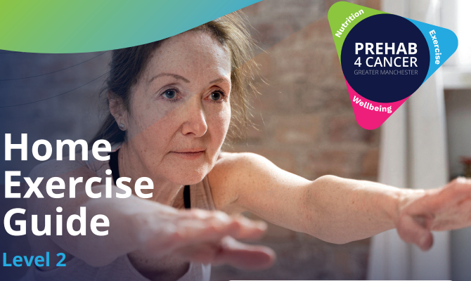
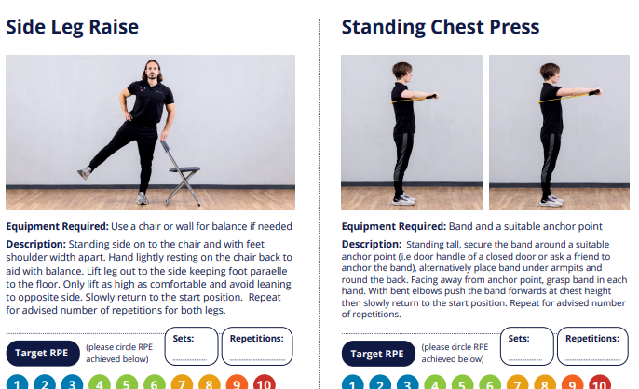
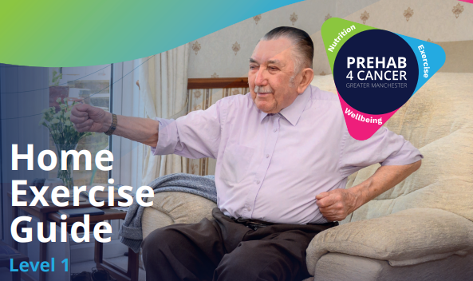
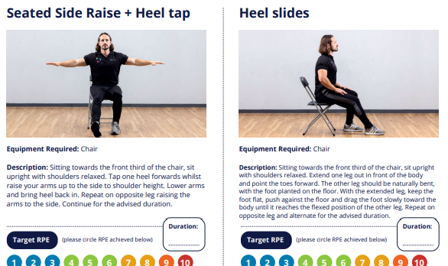
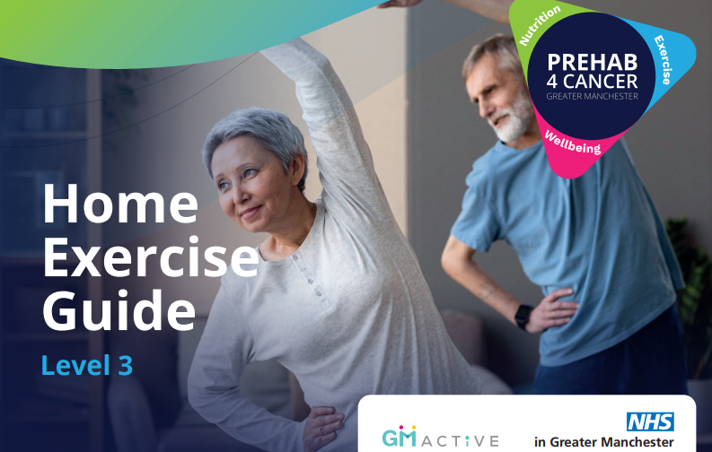
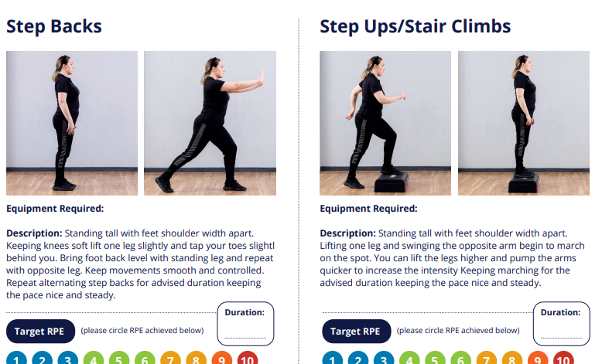
HOME EXERCISE PACKS
39783_Prehab4Cancer-Booklet 3-PRESS gpl.pdf

Slide 24
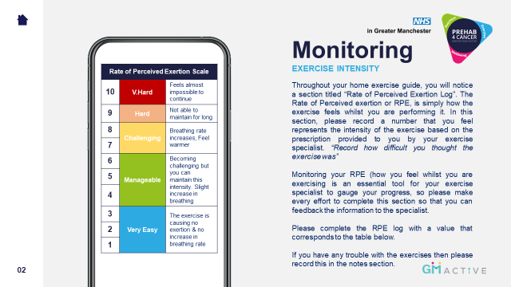
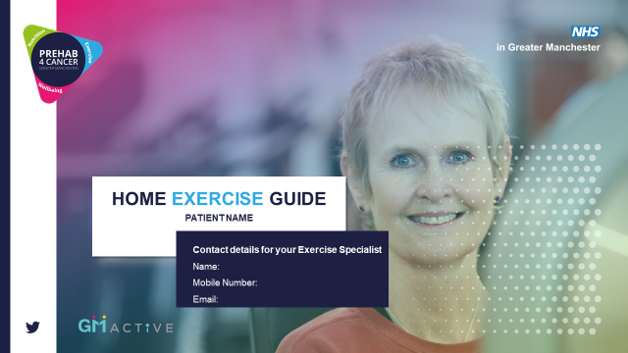
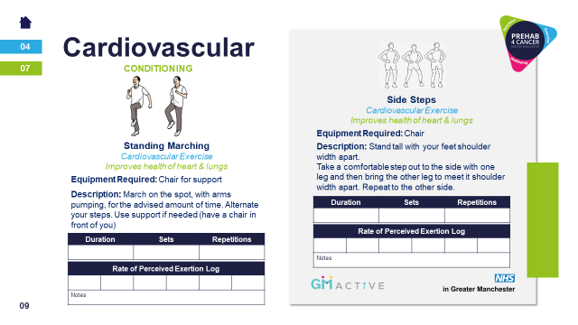
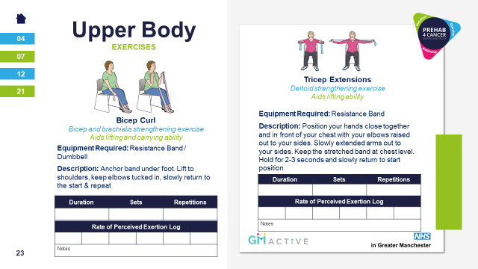

Slide 25


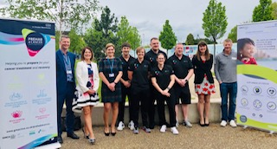
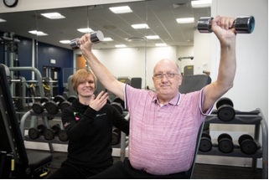
  Launched April 2019….
  Over 1000 patients referred in first year
  80% participation rate
  94% uptake rate from initial assessment
  100% patients accessing service locally
  Participants are showing clinical significant improvement in fitness during prehab phase & improved recovery post-surgery. Nutritional status is maintained.
Participants demonstrate improved confidence, motivation, sense of control & overall patient experience *anecdotal from HCPs across GM & through participant focus groups

Slide 26

Overview Figures
Outcome Measures:
Clinically significant CV Function improvement - >50m on 6MWT and >65m on Incremental walk test
Stabilised weight & BMI across all 3 tumour groups
Significant improvement for lower body strength (+5 on Sit to Stand test)
Increased sense of Wellbeing and Quality of life measured on validated tools
Patients returning for Post Op assessment and showing fitness was better than their baseline
Full programme evaluation and our data has now been matched with hospital data to produce:
Length of Stay and Length of stay on critical or high care
Number of readmissions in 30 + 90 days post discharge
Mortality: patient survival at 30 days, 90 days, 1 year and 2 years post-surgery.
Independent assessment of programme now completed (https://www.scwcsu.nhs.uk/case-studies/evaluating-the-success-of-the-prehab4cancer-programme )
Notes:
IMPACT

Slide 27
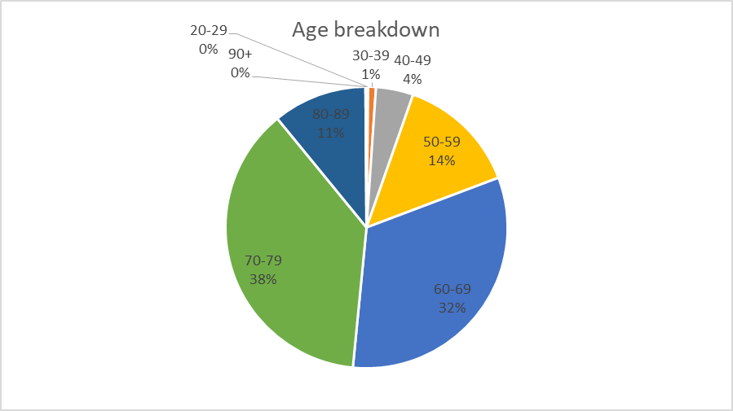
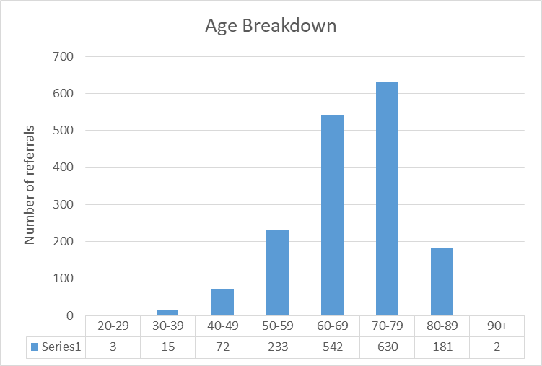
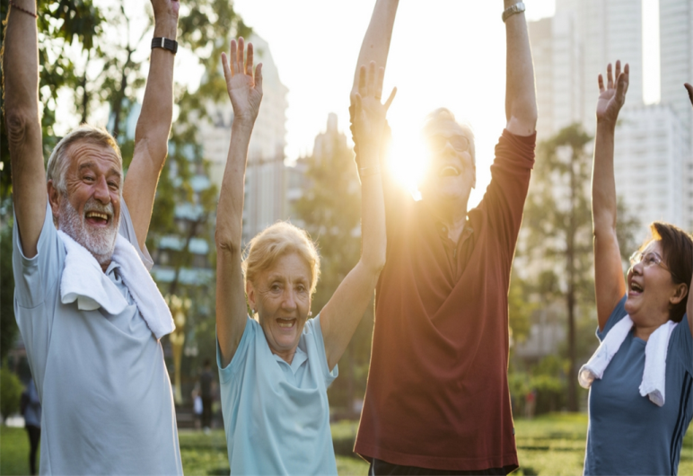
Prehab4Cancer participants (by age)
Age SHOULD NOT be a BARRIER to exercise…

Slide 28
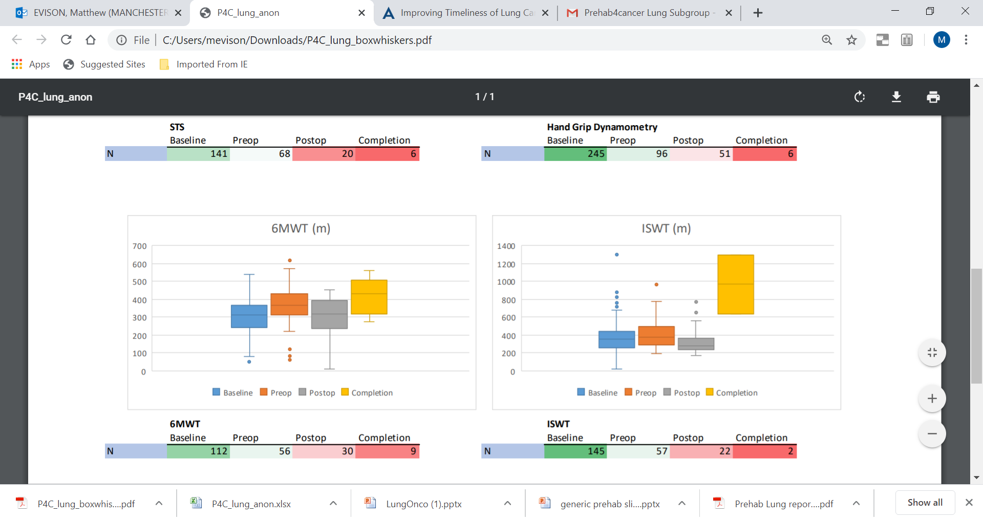
Physiological assessments (walk tests)
Six Minute Walk Test (6MWT) – frail, older patients or those contraindicated for the ISWT.
Incremental Shuttle Walk Test (ISWT) – standard ax. within lung pathway, bleep test
Notes:
KRG

Slide 29
P4C Patient Quote 1
Patient improved Sit to stand from 28 to 40 in 3 weeks. Patient quote 'I knew I had people checking on me so had to do my exercises, also I wanted to go into surgery knowing I'd done everything I could - no regrets'

Slide 30
P4C Patient Quote 2
Patient has just improved Sit to Stand from 0-12 in 3 weeks of home exercise. Patient quote 'I was scared of the operation & felt like I HAD to do the exercises. Now I feel ready for the operation & WANT to do my exercises'

Slide 31
SUMMARY
  Patient Level Data and qualitative interviews/focus groups shows:
  Participants are showing clinical significant improvement in fitness during prehab phase & improved recovery post-surgery. Nutritional status is maintained.
  Participants demonstrate improved confidence, motivation, sense of control & overall patient experience.
  Participants maintaining healthy lifestyle behaviours beyond engagement in service provision, at 1 year follow up.
Notes:
ZM Conclusion

Slide 32
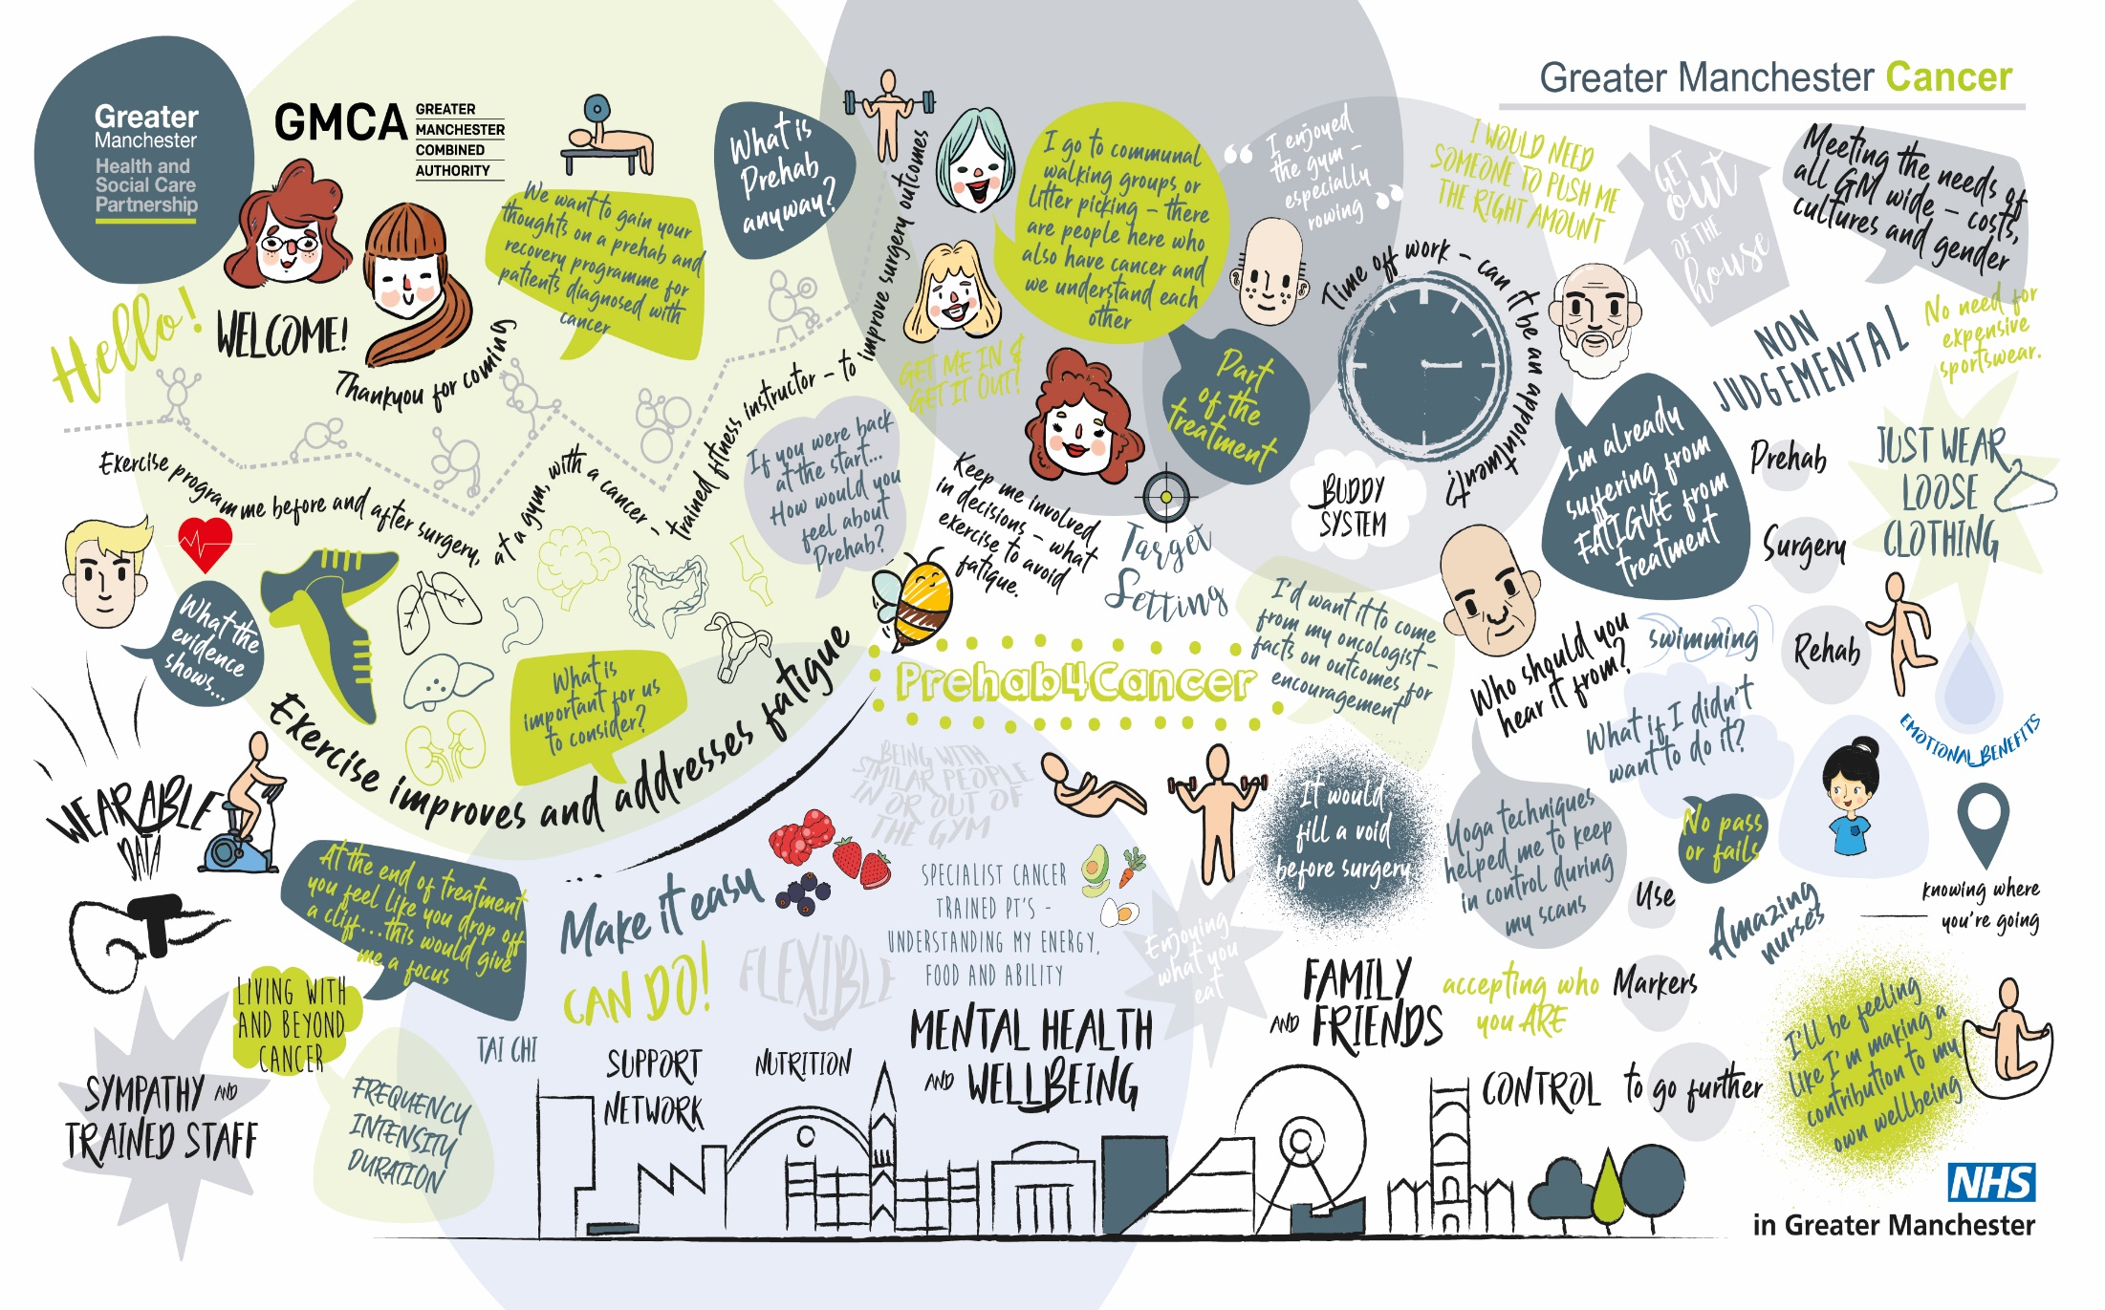
Notes:
ZM SALIENT POINTS FROM THIS GROUP – Patients perspective:
Consistent info – from oncologist/surgeon – part of treatment – need an appt letter,
Falling off a cliff
CONTROL
Fatigue
Therapeutic rapport – people involved
Personalised care!!

Slide 33
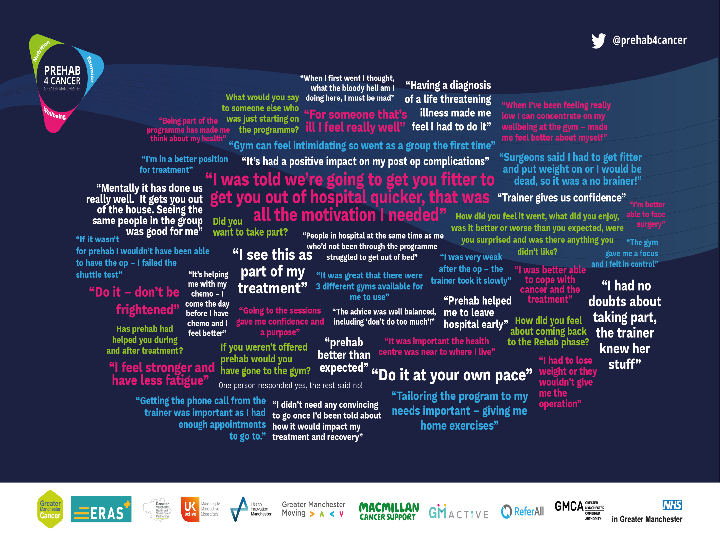
Notes:
Patient focus groups October

Slide 34
Data Summary to 31 December 2022
3353 referrals made since April 2019
Recurrent funding agreed
Engagement rate of 77% across whole programme
Referral pathways in all GM hospitals
Expansion in to Mid and East Cheshire (currently undergoing evaluation to gain sustained funding)
Expansion into more treatment pathways in Lung cancer
Blended approach to delivery – Online, Face to Face and home exercise offered to all
Consistent improvements in outcome measures
Flexible and adaptable delivery incorporating core delivery team and wider GM Active network of staff
Constraints - £ and people

Slide 35
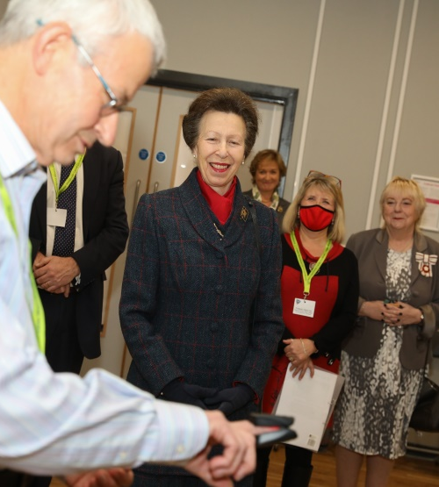
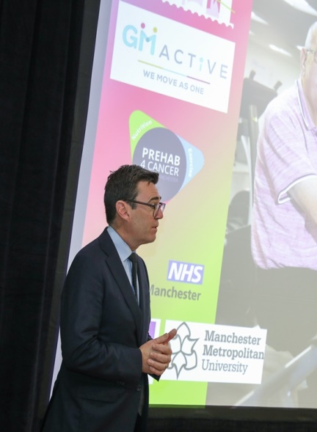
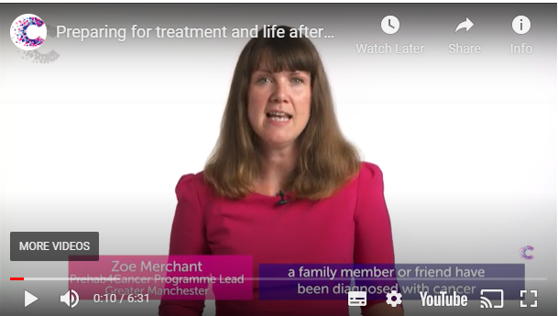

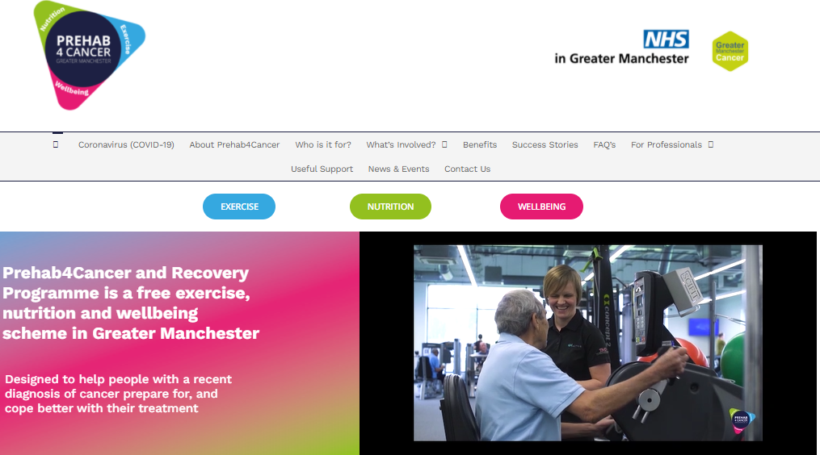

Greater Manchester Mayor Andy Burnham
Royal visit from HRH Princess Anne
Cancer Research UK, 2021 Prehabilitation resources
GM Active Training Academy
70,000 hits on P4C website
HSJ Partnership Award Winners 2022
Notes:
KRG
HRH: RCOT Patron
CRUK Resources easily accessible to Persons affected by cancer and professionals
GM Mayor – huge support and advocator of the programme. Winner of the GM commitment to moving

Slide 36
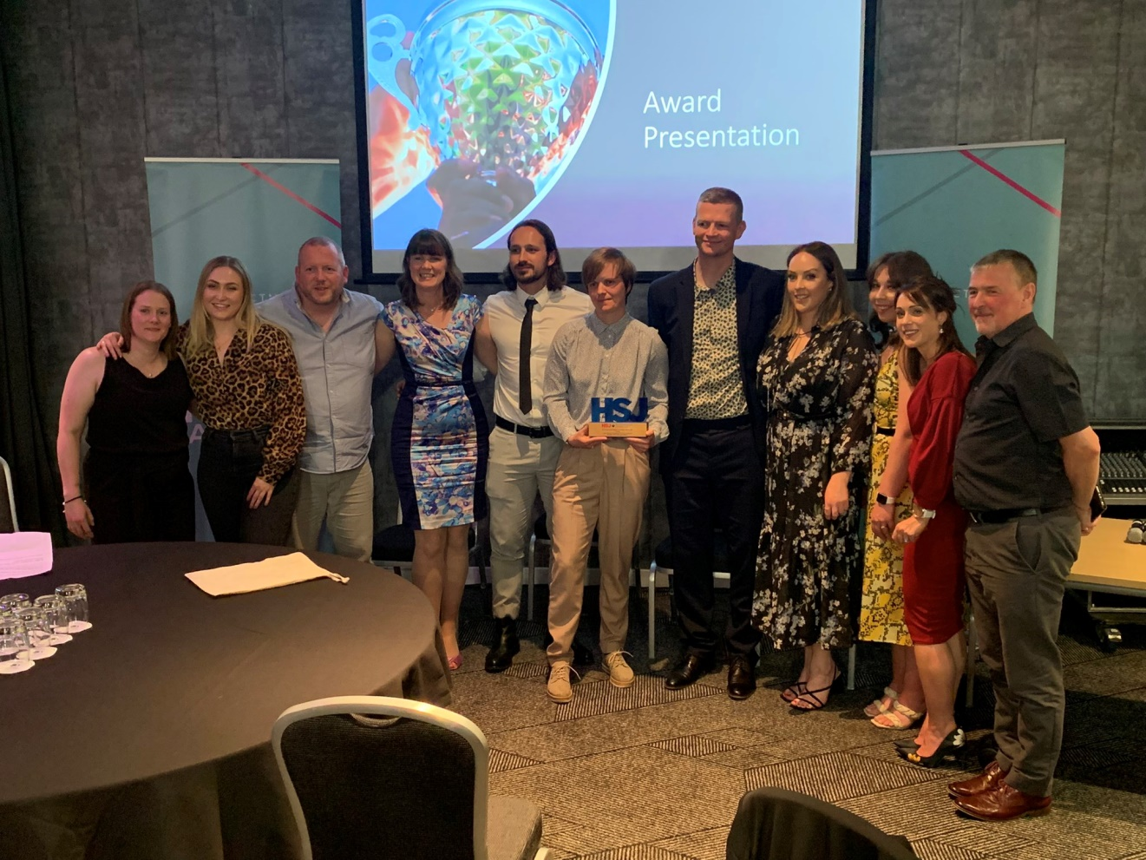
Part of the team

Slide 37
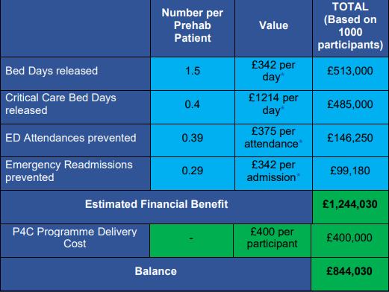
Health Care Resource Use & Associated Savings (ROI)
Reduced Length of Stay by 2 days = 381 bed days saved
Reduced 30 & 90 emergency readmissions = 35 bed days saved
Reduced Emergency Department attendances = 6 bed days saved
£400 cost per participant to deliver
£1,244 provider efficiencies per patient

Slide 38
Benefits to Patients, Pathways & Systems
Patients are optimised prior to surgery & treatments
Long-lasting health benefits following rehabilitation
Quality of life, physical activity improvements, long-term behaviour change
Improvements to wider health by reducing burden on primary care and local health and social care services
Improvements are seen in both ward and critical care bed day usage
Efficiency improvements to pathways
Evidence supports improved survival in patients who complete prehab
Cost-effective with targeted resources

Slide 39
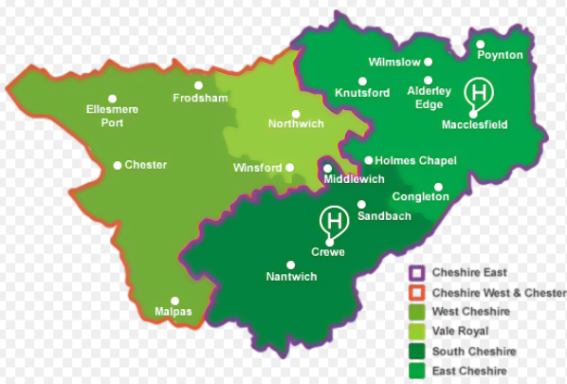


Next Steps:
Present Evaluation report to NHS England
Influence national strategy – Get Prehabilitation named within the Long-term Plan
PREHAB4ALL Expanding to other cancer pathways
Securing Cheshire Expansion – Currently in an 18-month pilot phase
Increasing digital provision
Using the model to build into prevention pathways and population health
Build on the success story
Continue to add to research base

Slide 40

Enhanced Monitoring for Better Recovery and Cancer Experience in Greater Manchester
© Copyright. All rights reserved 2021

Slide 41



The Enhanced Monitoring for Better Recovery and Cancer Experience in Greater Manchester
The challenge:
“There was a massive gap between GP and hospital care.”
EMBRaCE-GM PPI, Oct 2020
We need real-world data:
Sleep
Vital signs
HRV
Symptoms
Activity levels
Digital phenotypes of recovery
Data to stratify interventions
Support development of digital cancer care tools
Inform drugs and therapeutics trials
© Copyright. All rights reserved 2021

Slide 42

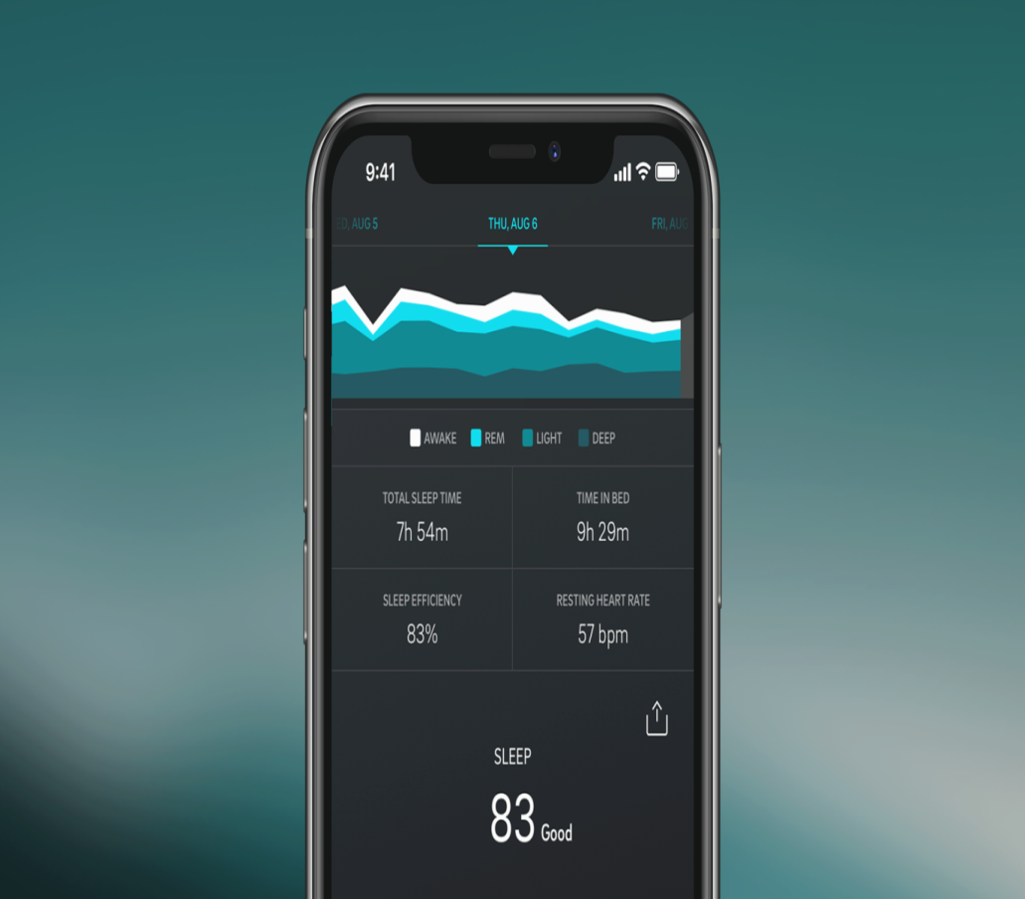
The solution
Commercial wearable vital signs monitoring…
OURA RING
Sleep
Fatigue
Physical Activity
Mindfulness
Relaxation
Heart Rate
Temperature
Mental Health
Objective, patient generated. With PROMs from mobile devices.

Slide 43


Aims
Can wearable vital signs monitors provide useful data during cancer treatment?
Are such devices acceptable to patients?
What could we achieve with the data obtained?
What do health care professionals think of this data?
Different patients, different treatments and different devices…
…are the answers the same?
© Copyright. All rights reserved 2021

Slide 44
There are lots of questions to answer…
How do activity levels reflect recovery?
How does cancer treatment affect patients’ sleep and fatigue levels?
Can heart rate variation predict a good recovery? Or identify problems?
Can we get computers to analyse the data to predict problems in advance?

Slide 45
Conclusion
Patient involvement in co-design vital
Patient driven and led
Patients front and centre
Evidence that exercise is important for cancer patients now overwhelming
VFM now proved
Walking the walk as well as talking the talk

Slide 46
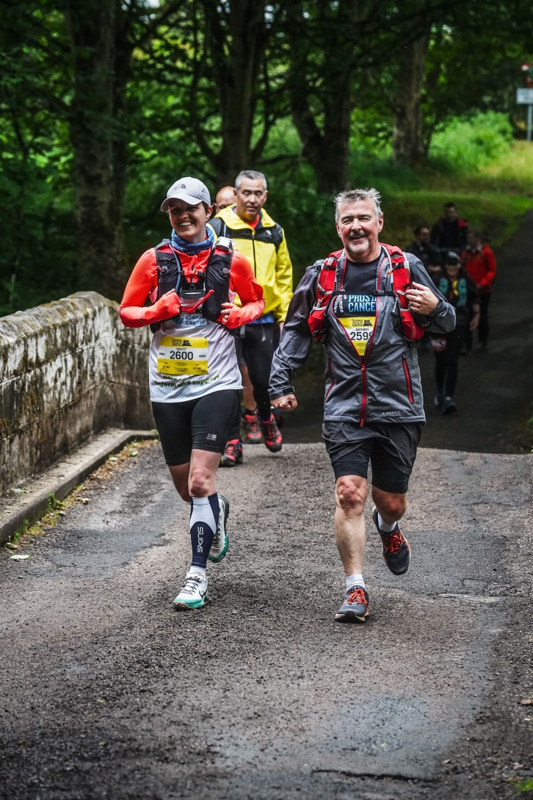
Walking the Walk

Slide 47
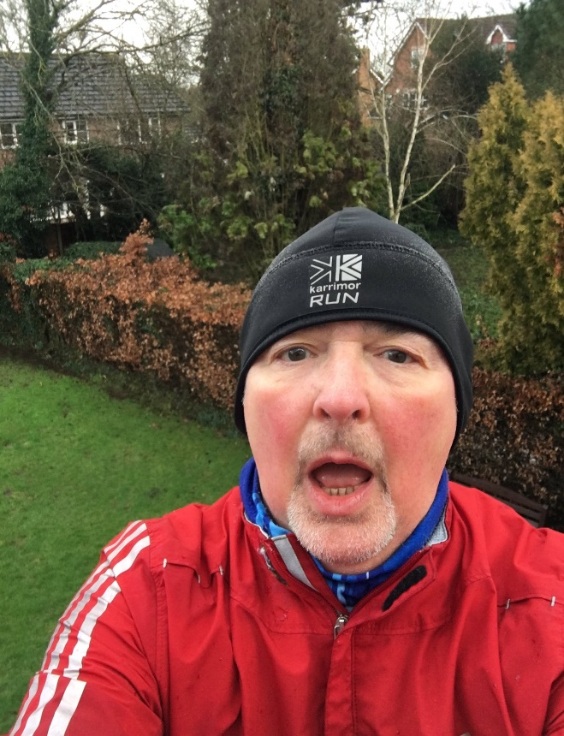
Walking the Walk
2022 Challenge
Move Charity
5K Your Way
https://www.justgiving.com/fundraising/5k365days

Slide 48
Questions

