Slide 1
Setting up and running virtual wards
Dr Esther Clift @estherclift
Consultant Practitioner, Frailty & Leading a Virtual Ward- Southern Health NHS Foundation Trust
Co-Chair, Expert Reference Group, The Virtual Wards and Urgent Community Response Capabilities Framework

Slide 2
Welcome!
Rules of engagement

Slide 3
Virtual wards provide hospital level care at home
virtual ward
The acuity and complexity of the patient's condition differentiates virtual wards from other community and home-based services
It provides urgent access to hospital-level diagnostics (such as endoscopy, radiology, or cardiology) and may include bedside tests such as point of care (POC) blood tests
It provides hospital-level interventions (such as access to intravenous fluids, therapy, and oxygen)
It requires daily input from a multidisciplinary team and sometimes multiple visits and provisions for 24 h cover with the ability to respond to urgent visits, often enabled by technology
It requires consultant practitioner specialist leadership and clear lines of clinical responsibility
Defined inclusion and exclusion criteria, with defined target population and deliver a time-limited short-term intervention of 1–14 days.
VW patients have equity of access to other specialty advice as though an in-patient.
ˈvəːtʃʊ(ə)l wɔːd
A virtual ward is a safe and efficient alternative to NHS bedded care.
Virtual wards support patients who would otherwise be in hospital to receive the acute care and treatment they need in their own home.
This includes either preventing avoidable admissions into hospital, or supporting early discharge out of hospital.
NB: A virtual ward is not a mechanism intended for enhanced primary care programmes; chronic disease management; intermediate or day care;or proactive deterioration prevention. Wider virtual care supported services (including NHS@home) are scaling to enabling these cohorts to be increasingly supported at home / in the community.

Slide 4
Critical success factors when designing and scaling virtual wards across ICS footprints
Appropriate clinical leadership and governance in place at a system and provider level
A competency-based approach, avoiding assumptions about professional boundaries and early investment in workforce development and training
Integrated ICS and place based working across health and social care considering use of provider collaboratives
Remote monitoring technology and wider digital platforms to deliver effective and efficient care..
An incremental approach to improvement and growth

Slide 5
Looking forward: national ambition in England for 2023/24
The 2023/24 Priorities and Operational Planning Guidance and the Delivery Plan for Recovering Urgent and Emergency Care lay out the ambition for virtual wards:
The longer-term ambition for the programme is to:
achieve 40-50 virtual ward ‘beds’ per 100k population
Systems are asked to:
scale-up virtual ward capacity from current levels of ~7,000 VW beds (Jan 2023) to over 10,000 beds ahead of winter
To meet these ambitions, systems are asked to:
continue scaling up frailty and ARI virtual wards
develop virtual wards for a wider range of conditions
In addition to scaling-up capacity, we will:
increase utilisation of virtual wards towards 80% by September 2023
support systems to standardise their virtual wards offer

Slide 6
Virtual Ward and Urgent Community Response Capabilities Framework

Slide 7
Introduction
Stephanie Somerville, Director of Community Transformation at NHS England, and Shabana Janjua, Director of Community Care at NHS England add:
“This framework is key to informing workforce education, training and career progression as well as informing local workforce models. The framework provides a standard and greater clarity on the scope of practice for nurses, allied health professionals and support workers in multi-disciplinary teams working within virtual wards and urgent community response teams in the community.”

Slide 8
https://www.skillsforhealth.org.uk/wp-content/uploads/2022/09/VW-and-UCR-Capabilities-Framework-FINAL-290922-proofed-version-with-sigs.pdf
All 2-hour UCR services, however configured, are expected to provide crisis care for the following nine conditions/needs as a minimum:
• Falls
• Decompensation of frailty
• Reduced function/deconditioning/reduced mobility
• Palliative/end-of-life crisis support
• Urgent equipment provision to support a person experiencing a crisis/at risk of hospital admission
• Confusion/delirium
• Urgent catheter care
• Urgent support for diabetes
• Unpaid carer breakdown which, if not resolved, will result in a healthcare crisis for the person they care for

Slide 9
Capabilities
Capabilities are the attributes (skills, knowledge, and behaviours) which individuals bring to the workplace. This includes the ability to be competent and beyond this, to:
Manage change
Be flexible
Deal with situations which may be complex or unpredictable and escalate/refer appropriately to ensure patient safety
Continue to improve performance (Skills for Health 2020).

Slide 10
Tier descriptors
Tier 1 All staff who work in the virtual ward and urgent community response teams. This tier will be relevant to health and social care staff in a variety of roles.
• Administrator (health and social care) • Healthcare support worker • Social care worker • Nurse • Allied health professional • Doctor • Clinical lead
Tier 2 This tier is particularly relevant to independent and autonomous practitioners. Staff in this tier will provide direct care and services to patients, make decisions relating to patient care, work within their scope of practice and take accountability for the care and services they provide. They may need to seek support from others where more complex decisions on care and management need to be made, beyond their scope of practice.
• Nurse • Allied health professional • Pharmacist • Social worker
Tier 3 This tier is most relevant to those staff with clinical and professional accountability and responsibility for the whole care of the patient, including escalations within the system. Staff working within this tier will be responsible for managing service, system risk and flow, as well as leading teams, and managing care and specialist services at the highest level.
• Advanced clinical practitioners (leading the system) • Senior clinician • Consultant

Slide 11
Capability titles
11 core capabilities
4 capabilities specific to the delivery of care within urgent community response services
4 capabilities which relate specifically to the virtual ward.

Slide 12
Capabilities
Capability 1. Communication and consultation skills
Capability 2. Practising holistically to personalise care and promote wellbeing
Capability 3. Families and carers as partners in care
Capability 4. Working with colleagues and in teams
Capability 5. Information gathering and interpretation
Capability 6. Clinical examination and procedural skills
Capability 7. Making a clinical diagnosis and ongoing clinical risk management
Capability 8. Prescribing treatment and administering medication
Capability 9. Leadership, management, and organisation
Capability 10. Education and development
Capability 11. Research and evidence-based practice
Urgent community response ‘specific’ capabilities
Capability 1. Dealing with referrals and ensuring assessment
Capability 2. Prioritising care and outcomes
Capability 3. Enabling care and/or therapy interventions
Capability 4. Transfer of care
Virtual ward ‘specific’ capabilities
Capability 1. Referral
Capability 2. Assessment and personalised care/management planning
Capability 3. Technology enabled monitoring
Capability 4. Leadership

Slide 13
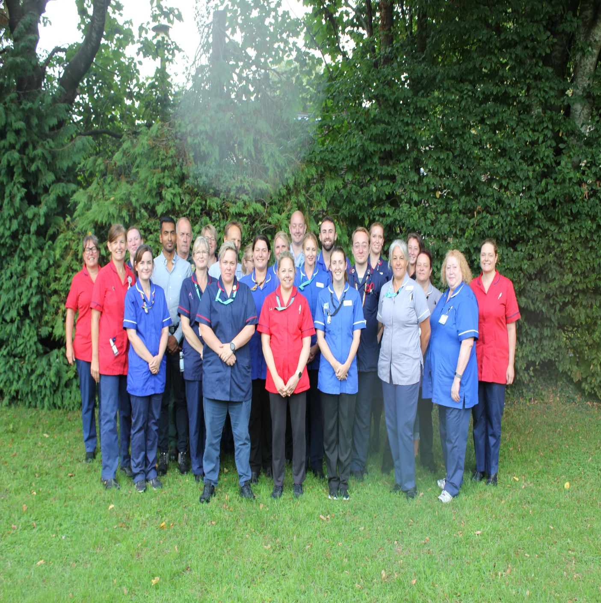
“I attribute the success of the team to the generalist approach that the frailty practitioners take with the patients. The consultant frailty practitioners truly view the situation not as ‘what’s the matter’ but rather ‘what matters to you’ and allows a truly holistic and patient focussed approach. As doctors we can sometimes become more focussed on the medical issues, drug manipulation and investigations when sometimes practical approaches are more fitting” Professor Johnny Lyon-Maris (General Practitioner)

Slide 14
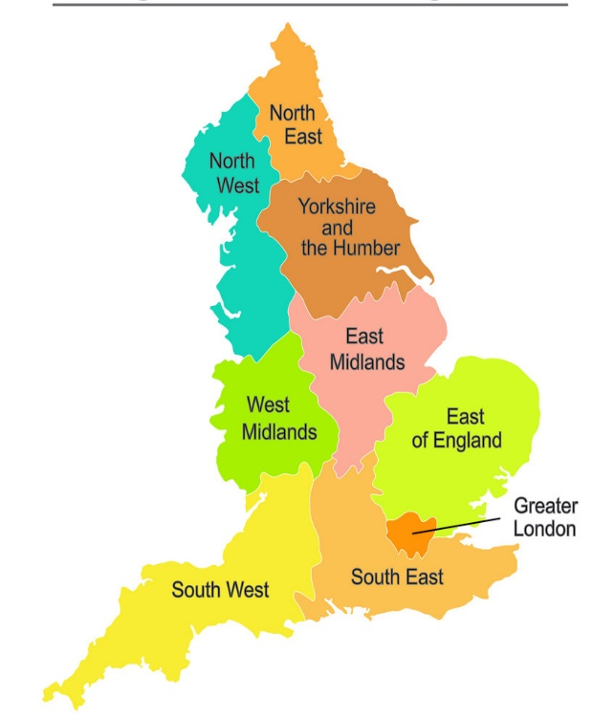
Highest concentration of older people in the country
Longer life expectancy, but healthy life expectancy is decreasing
Population of 570,954

Slide 16
“The Frailty support team has made a real difference to the care available to patients with decompensating frailty within the community. We are able to offer excellent community based care in a way which values the patient’s autonomy and wishes. The breadth of knowledge within the team helps us to treat patients holistically and ensure that care is individualised and appropriate”.
Dr Rachel Anderson Consultant Respiratory Physician & Clinical Director

Slide 17
“They knew exactly what they were doing and were very efficient and professional”.
Patient

Slide 18
Virtual wards – join the national community
Visit the website: England.nhs.uk/Virtual-Wards
Tweet: @NHSEnglandCHS or #VirtualWards
Join the NHSFutures site: Future.nhs.uk/NationalVirtualWards
Sign up for the community of practice: search “Virtual wards community of practice”
Sign up to the bulletin: Search ‘virtual wards bulletin’
Keep in touch

Slide 19
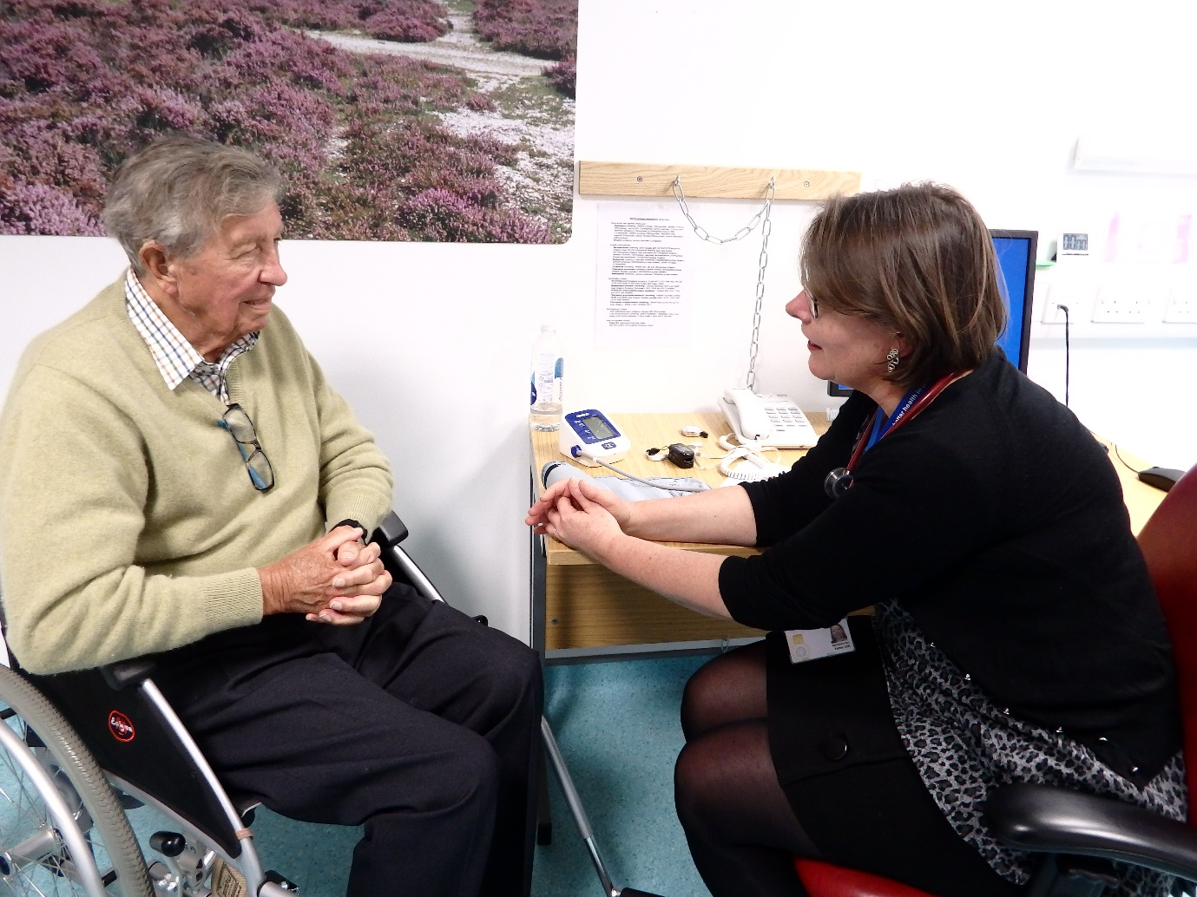
Thank you!

