Slide 1
Notes:
Hello. My name is Cassi Harrison, I'm the CEO at Youth Access. We are the national membership organization representing over 100 youth services around the country, many of which provide the Youth Information Advice and Counselling (YIACS) model, so young people can access a range of support for their mental health and the issues that underpin it, under one roof in their local area.
I know that you were expecting me to be joined by a young person today and I apologise that you're stuck with just me – much less interesting, I know! But I will do my best to bring young people's experiences to my presentation. That includes telling you about Our Minds Our Future - a youth-led campaign calling for a mental health system that meets young people’s human rights.

Slide 2
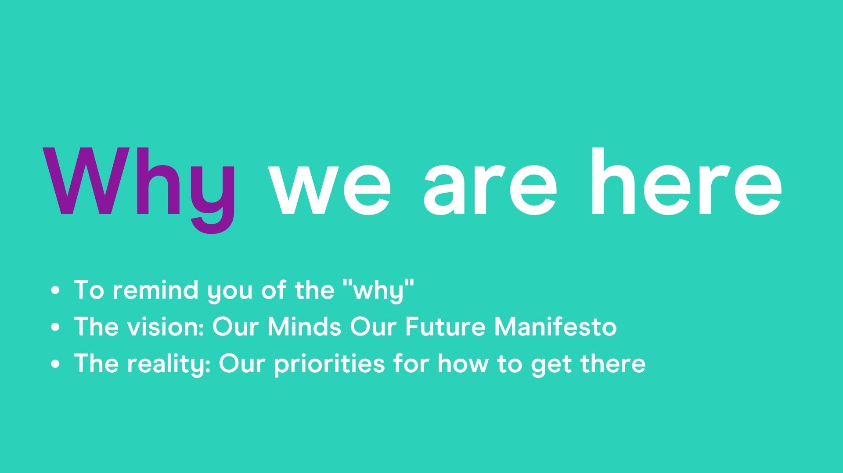
Notes:
You’ll here a lot today about the ‘what’ and the ‘how’ – lots of the presentations are about initiatives and ideas that will certainly help to achieve what young people have been telling us they want. So I'm here to remind you of the ‘why’
I'll share young people’s vision – the Our Minds Our Future Manifesto
And how we are trying to turn that vision into a reality – as I know you’re all trying to do the same thing too

Slide 3
Notes:
So before we dive in, I wanted to ask you all a question:
Given the current economic climate – what do you think are the biggest challenges for young people and how can we help overcome them?
Can you take a moment to have a think, and then wrote your number in the chat box.
………
[Read out some answers]
Great answers! All very insightful!
Now, can I ask….Where did your answer come from?....
It’s really important when we’re working out how to overcome the massive challenges facing young people today that we are actually listening to what they’ve been through and what they want.

Slide 4
Notes:
Young people's lives have been turned upside down in the last few years. They have been faced with a massive amount of change and limited support to adapt to it.
Last year we published a series of briefings to summarise the impact of Covid on the social determinants of young people’s mental health, an it showed that…it’s bad. Young people are facing the really sharp edge of the economic and social fallout of Covid, and the repercussions of that will be with us for some time. Just last week two studies were published involving a combined 15,000 young people which showed that they have been disastrously affected and that it is continuing to deeply affect their lives. Almost half of young people asked by the Prince's Trust felt hopeless about the future.
Add to that the increases in cost-of-living crisis and poor economic outlook. The impacts for young people, who we know are usually disproportionately affected in times of recession, are potentially huge. One of our members was telling me that they've had a 3 fold increase in young people at risk of homelessness and services across their county have seen a 10 fold in demand for debt advice.
Our members are telling us that young people they support have increasingly complex needs as a result of all of these things going on in their lives.
Of course all of this comes at a time when the mental health system was already struggling to meet young people's needs and rights. One service told me recently that they had increased their provision by 75% since 2019 and were still not able to meet demand.
And we can't ignore the systemic and structural inequalities that some young people face – those from racialised communities, LGBTQ young people for example – who are disproportionately affected by the social determinants of mental health, the negative impact on mental health of experiencing oppression and discrimination and services not designed for or reflective of them.
You will all see how public spending affects your services, but also the others that provide that wider support – youth work, social care, housing.
And we are operating in a complex, chhanging environment with the creation of Integrated Care Systems.
Bit bleak, sorry! But important to think about the challenges facing young people and all of us in this room. This presentation will get a bit more more positive, I promise!

Slide 5
Notes:
​
Young people have rights. That includes the right to the highest attainable standard of mental health AND to be involved in decisions that affect them, at individual and system level. As you can see here, these rights are enshrined in UN Conventions. Human rights are also built into the NHS Constitution.
At Youth Access we take a rights-based approach. This means that these things are not nice to have. They are what young people should expect and people with power should be held accountable for providing them.
Young people tell us that they do want to be involved, but often when they are, it’s not very satisfying, it’s tokenistic, it’s ad hoc and seems to lead nowhere.
Fed up doing bitty consultations or tokenistic one-off engagement. Wanted to have a basis for our whole strategy to influencing. So idea for the manifesto. Started with previously created documents, in new context of pandemic….

Slide 6
Notes:
The manifesto was created with young people based on their experiences and what other young people had written before – they didn’t start from scratch.
They outlined 7 priorities……
Experts who understand the unique issues facing young people in today’s world.
Services made for us - online and in-person, in schools, colleges and unis, and informal settings like youth clubs, drop-ins and text-based support.
Services made with us so we’re part of decisions being made about our own mental health care and the wider system.
Equity, diversity & accessibility, making sure services cater to everyone, accounting for differences and preferences.
Help when we need It, avoiding long waiting lists, arbitrary thresholds and cut-offs.
Education & training for all – so young people and all professionals working with us understand mental health and where to get help.
A ‘whole life approach’ to mental health that extends beyond the counsellors office or clinic, to offer individualised support with the economic, social and cultural issues that affect our wellbeing.
This should act as a basis to build on with more conversations with young people about the specifics of system & service design

Slide 7
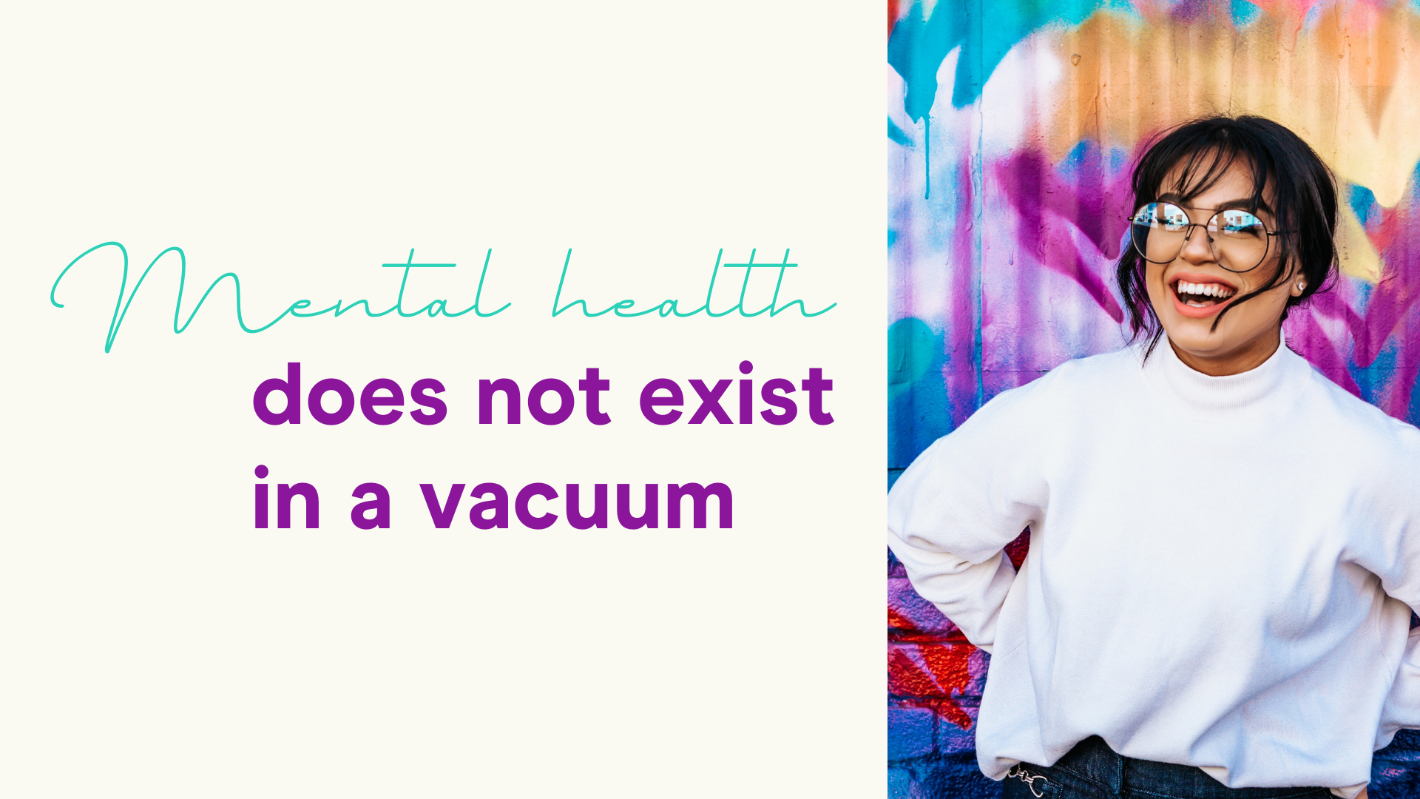
Notes:
The last point in the manifesto – a whole life approach – is one that is central to the approach taken by our members
Because we know that mental health does not exist in a vacuum – clear to most of us during the pandemic
If a young person is in poor housing or at risk of homelessness, if they are struggling with debt, can't access benefits, can't get a decent paid job... all of these things can affect and be affected by our mental health

Slide 8
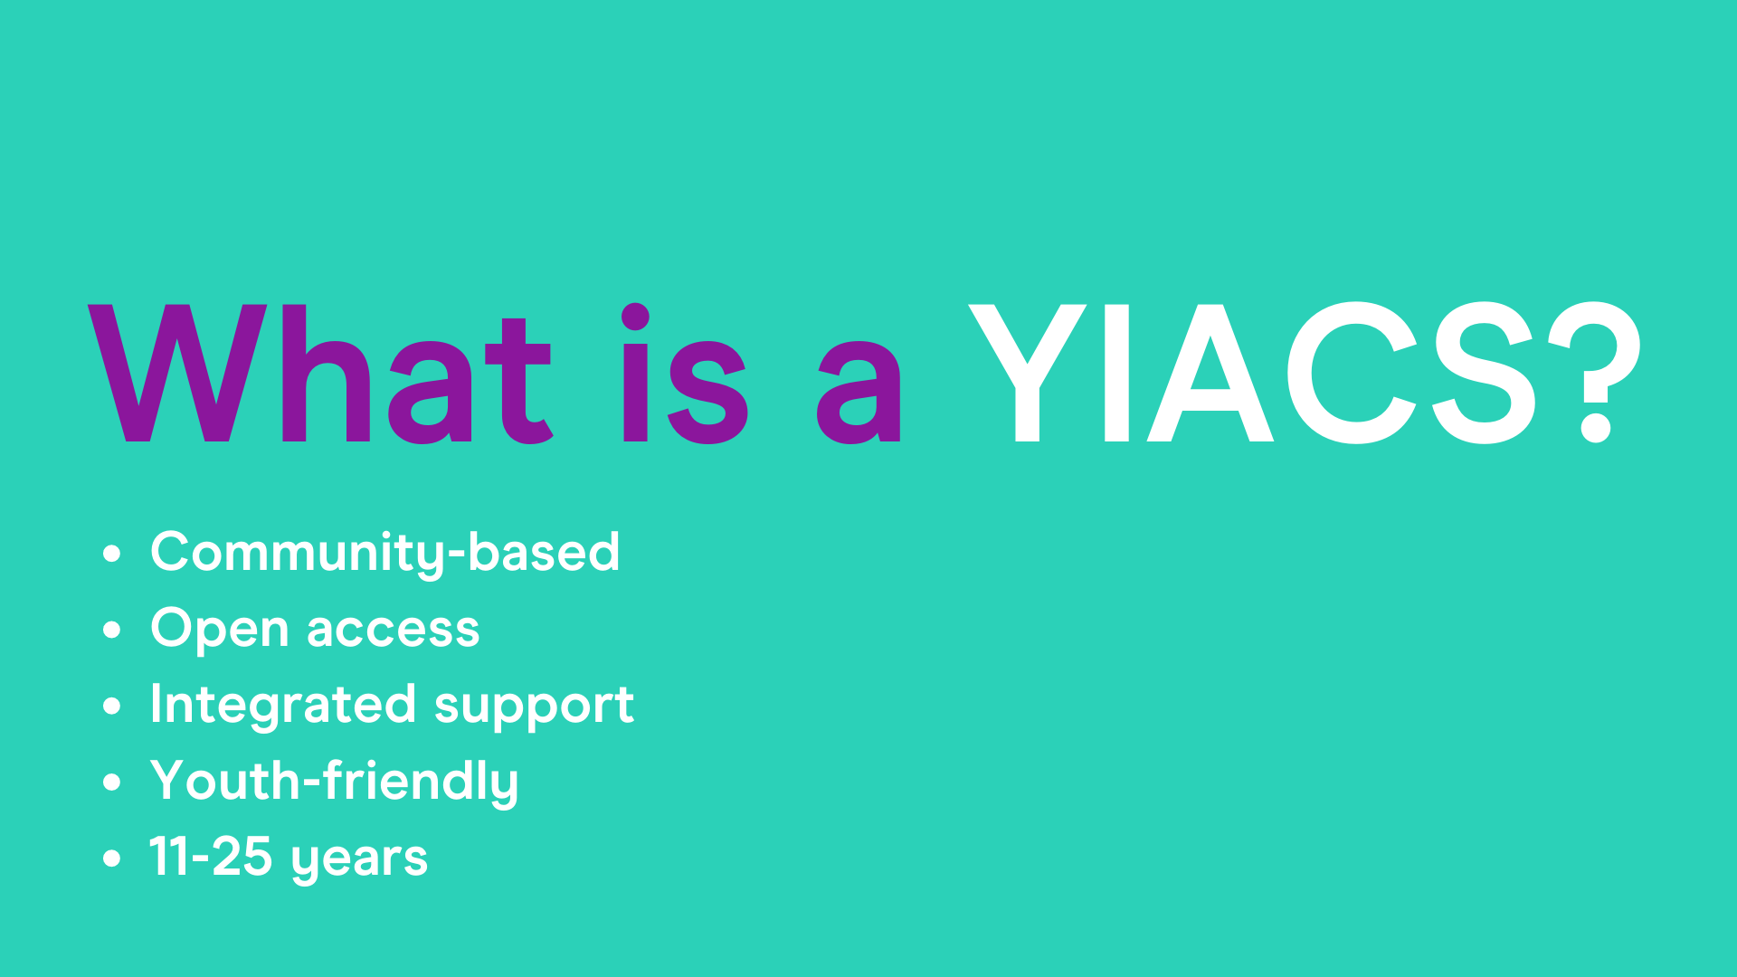
Notes:
Youth Information Advice and Counselling Services
Also known as open access hubs or one stop shops
Based in their local communities
Don't need a referral, no arbitrary threshods, never turned away because not sick enough
Help with everything a young person needs all in one place -
Youth friendly spaces, often named by young people, designed by them and developed according to their feedback

Slide 10
Notes:
So, how do we make what people want, as outlined in the manifesto, a reality? At the moment, these are some of the areas where YA is focusing...
Last summer the Govt issued a call for evidence, consulting widely to inform the development of a ten year MH plan.
Many organisations and young people were involved. You might have contributed too.
You may have seen the announcement last week that there will now instead be a major conditions strategy. As well as mental health, this will include cancers, cardiovascular disease, dementia and others. We also understand the timeframe will be shorter. While we can all understand the need to avoid silos, we have significant concerns that mental health will not have the same degree of focus once included with all these other areas. There is seems to be a focus on years of healthy life expectancy. Given some of the other consitions included, such as dementia, we are worried that young people will not get the specific focus they need in terms of their mental health. We don't yet know how this strategy will develop or what the process will be, but ensuring young people's voices are heard and needs addressed will be crucial.
One of the ways we will do that is through our Fund the Hubs campaign, which hopefully you will have heard of. It is a joint call from across the sector – including partners like Young Minds and Mind – for a national roll out of early support hubs to provide the kind of support young people tell us they need. Lots of young people and organisations got involved last year and there is a huge amount of consensus. Now that we have had the announcement about the strategy, we are deciding how we can best use that power to influence it. Look out for next stage and get involved!
Two other core parts of the OMOF manifesto we are working towards – supporting services to involve young people in – understanding what works for young people and organisations, and what support they need/we can provide
Driving equity is a core strategic goal for us organisationally - often those young people with

Slide 11
