Slide 1
The Coroner’s Investigation and the Inquest
HM Area Coroner, Nadia Persaud
East London
25 May 2023

Slide 2
OVERVIEW
Inquests
What the Coroner must and must not do
Interested persons and their role
Disclosure and information sharing
What happens at the inquest
Coronial conclusions
What happens after the Inquest
Preventing Future Deaths

Slide 3
WHAT IS AN INQUEST?
An inquest is an inquisitorial process for which the coroner is entirely responsible. There are no parties to an inquest. The rules allow various people to participate as interested persons. There are no pleadings in cases whose facts might engage civil liability and no indictment where criminal responsibility is suspected or clear. The inquest is not an adversarial proceeding. A coroner is a judicial officer working within a statutory framework.
R (Hambleton) v Coroner for the Birmingham Inquests [2018] EWCA Civ 2081

Slide 4
INQUESTS
Explores the questions of who the deceased was; how, where and when they came by their death
Does not determine liability
Witnesses are summoned to attend the inquest hearing
The Coroner can compel evidence to be provided - Schedule 5 of the 2009 Act
Offences are set out under Schedule 6 of the 2009 Act
Open hearings

Slide 5
WHAT A CORONER MUST DO
Conduct a full, fair and fearless inquiry
Comply with the Coroners and Justice Act 2009 and associated Rules and Regulations
Comply with the guidance from the Chief Coroner, unless there are clear and justified reasons for deviating
Abide by the Judicial Oath and Code of Conduct
Keep a recording of proceedings (for at least 15 years)

Slide 6
WHAT A CORONER MUST NOT DO
Appear to determine criminal liability on the part of a named person
Appear to determine civil liability
The coroner must not allow interested persons to become adversarial – the coroner must set the inquisitorial tone for the inquest

Slide 7
RIGHTS OF INTERESTED PERSONS
Right to disclosure of relevant inquest documentation
Right to make submissions to the coroner in relation to the evidence and procedure at the inquest
Right to examine witnesses
Right to be legally represented at the hearing

Slide 8
ROLE OF INTERESTED PERSONS
To assist the coroner in determining the answers to the four statutory questions
To assist the coroner in identifying learning from inquest evidence
To disclose relevant information to the court in a timely manner
To provide evidence with openness and honesty
Assist in ensuring equality of interested persons (in light of limited availability of legal aid)
See Annex A to the MoJ Guidance on Coroner Services for Bereaved People

Slide 9
DISCLOSURE AND INFORMATION SHARING
Coroners Inquests Rules – Rule 13 – disclosure to interested persons
Rule 15 – restrictions on disclosure
Sensitive material may be scrutinized by the coroner before wider disclosure to interested persons
Coroner can compel evidence under Schedule 5 of the CJA 2009
Chief Coroner Guidance No.44 - Disclosure

Slide 10
EVIDENCE FOR AN INQUEST
Gather evidence such as electronic and paper records; section papers; professional emails between teams/services; referral letters; nursing charts; photographs; text messages; notes of intention; CCTV evidence; audio recordings of emergency calls; policies and procedures - anything relevant to the circumstances surrounding the death
Statements from key witnesses
Internal organization governance reports
Request police overview reports
Liaise with other investigators e.g., HSE; CCG; HSIB, Domestic Homicide Reviewers

Slide 11
DOES THE SI ASSIST THE INQUEST?
Provides a chronology of events
Provides an explanation of the services involved with the care of the deceased
Assists in the identification of key issues
Assists in the identification of relevant governance material
Provides the coroner with the understanding of the organisation’s view of the care provided to the deceased
Assists the coroner with the question of preventing future deaths

Slide 12
GOOD WITNESS EVIDENCE
Impression of a witness starts before the witness box
Full and legible contemporaneous records
Timely, accurate, presentable witness statement
In the witness box:
Dress and demeanour
Direct answers to the Coroner, not the family or other IPs
Address the Coroner as Sir or Ma’am
Be prepared! Have statement and records with you
Read statement and records before entering the witness box

Slide 13
GOOD WITNESS EVIDENCE
Use lay language
Take care with language (e.g., ”commit” suicide)
Use post it notes/tabs to find the right records
Know the relevant local policies in place
Know the relevant national policies in place
Ensure you are up to date with all changes in practice/procedure
Remain calm – do not get defensive or angry

Slide 14
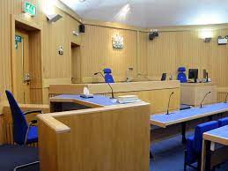
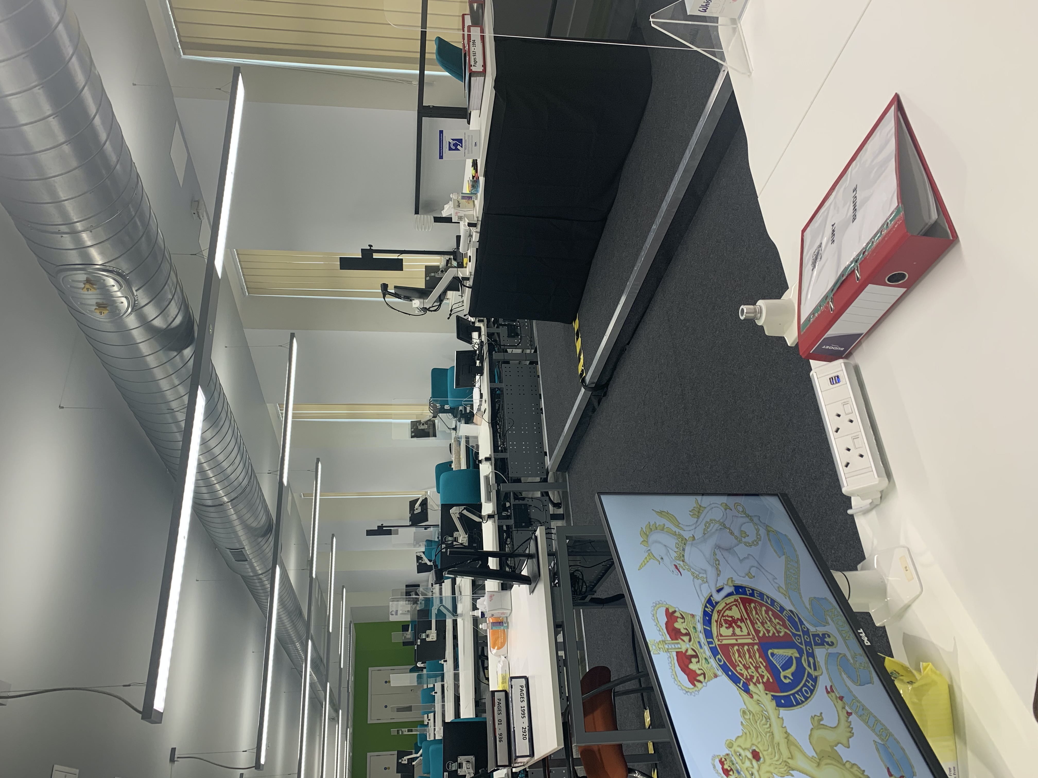

Slide 16
JURY
Most cases are heard by a Coroner alone. Certain cases require a jury. These are:
Deceased died in custody or state detention and the cause of death is violent; unnatural or unknown
Death is due to the act or omission of a police officer in the execution of their duties
Death is caused by a notifiable accident, poisoning or disease
The Coroner also has a discretion to call a jury (if sufficient reason)

Slide 17
INQUEST CONCLUSIONS
The usual inquest outcomes are:
Natural causes
Accidental death
Suicide
Drug related – alcohol related, or a combination of both of these
Lawful or unlawful killing
Road traffic collision
Narrative conclusion
A rider of neglect may be added

Slide 18
ARTICLE 2
Right to Life (ECHR)
3 limbs –negative; positive; investigative
General obligation
Operational obligation

Slide 19
ARTICLE 2 PROCEDURAL OBLIGATIONS
Full facts are brought to light
Culpable and discreditable conduct is exposed and brought to public notice and those responsible are held accountable
Suspicion of deliberate wrongdoing is allayed
Identify and rectify dangerous procedures
Ensure that lessons are learnt, which may save future lives
R (on the application of Amin) v SoS for Home Department 2004

Slide 20
PREVENTING FUTURE DEATHS
The Coroner has a duty to write a report following an inquest if it appears there is a risk of other deaths occurring in similar circumstances. This is known as a 'report under regulation 28' or a Preventing Future Deaths report.
The report is sent to the people or organisations who are in a position to take action to reduce the risk. They must reply within 56 days.
A copy of the report and the replies will be sent to the family, Chief Coroner and other interested persons/organisations

Slide 21
Schedule 5 CJA 2009
Action to prevent other deaths
Where a senior coroner has been conducting an investigation under this Part, into a person’s death and anything revealed by the investigation gives rise to a concern that circumstances creating a risk of other deaths will occur, or will continue to exist in the future, and in the coroner’s opinion action should be taken to prevent the occurrence of such circumstances, or to eliminate or reduce the risk of death created by such circumstances, the coroner must report the matter to a person the coroner believes may have power to take such action.

Slide 22
Anything revealed by the investigation
Concern of circumstances creating the risk that other deaths will occur or will continue to exist in the future
In the Coroner’s opinion, action should be taken to prevent the occurrence of such circumstances or eliminate the risk or reduce the risk of deaths created by such circumstances
Report the matter to a person the coroner considers has the power to take such action

Slide 23
PREVENTING FUTURE DEATHS
A PFD is not a punitive measure – it is a public interest tool for learning
The fact of a PFD report is not an indication that the organisation’s internal investigation has failed
Inquest provides the perfect opportunity for learning. Bishop Jones stated that there needs to be a cultural shift and public bodies need to approach inquests as an opportunity to learn
Proactive involvement by the specialists in determining the content of the PFD report is likely to improve the quality

Slide 24
PREVENTING FUTURE DEATHS
Dame Elish Angiolini (Death in Custody Review), recommended an Office for Article 2 Compliance
Chief Coroner’s office publish reports. Is there scope for greater analysis and wider sharing of good practice?
SAGE journal, analysis of PFDs from 2016-2019; Beachcrofts Solicitors healthcare related PFDs in 2021 and ONS review of suicide inquest PFDs, published in 2023
Chief Coroner’s guidance on PFDs

Slide 25
CAN A PFD REPORT BE CHALLENGED?
R (Siddique & Dr Paeprer-Rohricht v HM Assistant Coroner for East London) [2017]
If the recipient of a PFD report disagrees with factual content of the Report, they should highlight this in their response. A Coroner cannot withdraw a PFD report.

Slide 26
CAN AN INTERESTED PERSON INSIST THAT A PFD REPORT IS WRITTEN?
R v Diarra Dillon and HM Assistant Coroner for Rutland and North Leicestershire and others [2022]
No interested person has the right to be heard or to call evidence simply around the question of preventing future deaths. PFD reports are ancillary to the coronial investigation.
There is a significant subjective element to the Coroner’s decision as to whether action should be be taken to prevent the occurrence or continuation of circumstances creating a risk of death.
There may be circumstances where local action has been taken, but a PFD may still be written to a national organization to highlight issues more widely.

Slide 27
THANK YOU FOR LISTENING AND
ANY QUESTIONS?

