Slide 1
Quality Accreditation, Monitoring & Assurance
Ehsan Haqqani – Associate Director of Governance & Patient Safety
Wrightington, Wigan & Leigh NHS Teaching Hospitals NHS FoundationTrust

Slide 2
WWL priorities

Slide 3
The challenge
What are our standards
Corporate objectives
Regional and national priorities
CQUINs’
External regulators
How do we monitor – ongoing / spot – without compromising frontline care
What intelligent monitoring processes can we use
How do we answer the ‘so what’ question

Slide 4
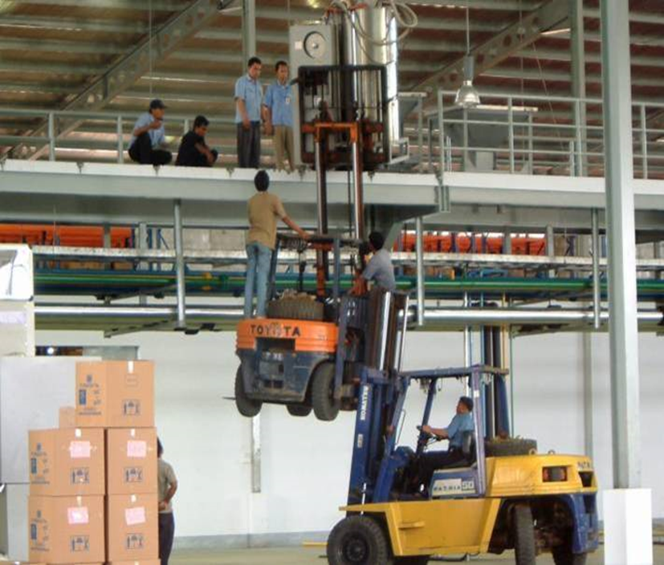
How do you prove quality and safety is your top priority?

Slide 5
Internal monitoring data
ASPIRE accreditation programme
Clinical Quality walkrounds
CEO walkrounds
Estates walkrounds
Dashboards
Audits
Adverse events
Complaints
Quality improvements

Slide 6
ASPIRE
Ward accreditation programme
Assesses at bronze, silver, gold and platinum
Taken standards from CQC, H&S, IPC, and internally defined standards

Slide 7
ASPIRE pre assessment
Review matrons and ward leaders audits
Incidents and complaints
Staff mandatory training compliance
Any other intelligence identified from sources

Slide 8
ASPIRE on the day monitoring
General observations, inc cleanliness, security
Medicine safety, inc trolleys, rounds
IPC, inc sharps, PPE
H&S checks, inc resus trolleys, LOLER
Documentation, inc MUST, fluid balance
Patient experience
Staff experience
Ward leaders experience

Slide 9
ASPIRE post review actions
Areas of immediate concern written up that day
Feedback to Matron, Ward Leader and Divisional Director of Nursing
If ‘white’ ward improvement plan established and revisit in 6 weeks
Annual celebration event for wards participating

Slide 10

How do we report quality?

Slide 11
Managing assurance
Redesign of governance assurance meeting structure
Who went where and what was presented
What could we remove
Was it an assurance group or an action group
Was there a workplan
AAA reports – (Advise, Alert, Assure) to next level and other interested groups

Slide 12
Training and development
Bespoke sessions on writing an assurance report
Healthy challenge from Chairs
Review on terms of reference and how could the groups link together
Further development programmes for different groups of staff to identify what is monitoring

Slide 13
CQC stakeholder group
Reviewing the last CQC assessment
Provision of assurance and sign off for ‘must do’ and ‘should do’ actions
Horizon scanning on inspections in other Trusts to learn
Work on what is outstanding and how to get there

Slide 14
Quality Standards and Accreditations Group
Review the outcomes of ASPIRE visits
Triangulate with other aspects of monitoring
Identifying what is important
Pick up early on with issues
Refer to specialist groups and committees

Slide 15
Quality & Safety Committee
Board level sub-committee
Non Executive led with key executives and AD Governance
Reviews assurances from reporting groups
Assesses key concerns and what is being done to address
Determines what should be advised to the Board
Uses the Alert, Assure, Advise (AAA) reporting mechanisms
Monitors corporate objectives, issues related to CQC registration and compliance, other external accreditations, internal accreditations, risks.

Slide 16
Future
Better definition what is quality as a Trust and at each level
Use the Patient Safety Incident Response Framework to support quality monitoring
Develop Triangulation group to identify early warning areas
Better aligning the governance structure by continuous review
Developing Business Intelligence scorecards for Board and wards
Better involvement with quality champions and innovations – log to track and align quality initiatives to objectives/risks/accreditations/each other

Slide 17

Finally, any questions
Quality is never an accident, it is always the result of intelligent effort
  John Ruskin

