Slide 1
Non Medical Prescribing in Acute Oncology
Alison Taylor
Acute Oncology Nurse Consultant
The Clatterbridge Cancer Centre
alisontaylro12@nhs.net
@AlisonAOnurse

Slide 2
Session Overview
Steroid prescribing
Evidenced based practice
Acute Oncology guidelines
Acute oncology case studies

Slide 3
Acute Oncology and steroid usage
Clinical complication | Dosage
Raised intracranial pressure ( primary and mets) Metastatic spinal cord compression Liver capsule pain Immunotherapy toxicities Superior Vena cava obstruction Appetite Lymphagitis Pneumonitis Anti-emetic Anticancer inflammation Reduce immune response Hypersensitivity | Dexamethasone doses vary 8mg BD Dex 16mg – 8mg BD Dex 4mg BD Prednisolone oral 60mg/day or IV methyl pred 2mg/kg Dex 16mg Dex 4mg Dex 8mg Dex 8mg Dex 2mg TDS Prednisolone 10mg per day prostate Pred 1mg/kg post BMT GVHD Hydrocortisone 200mg IV

Slide 4
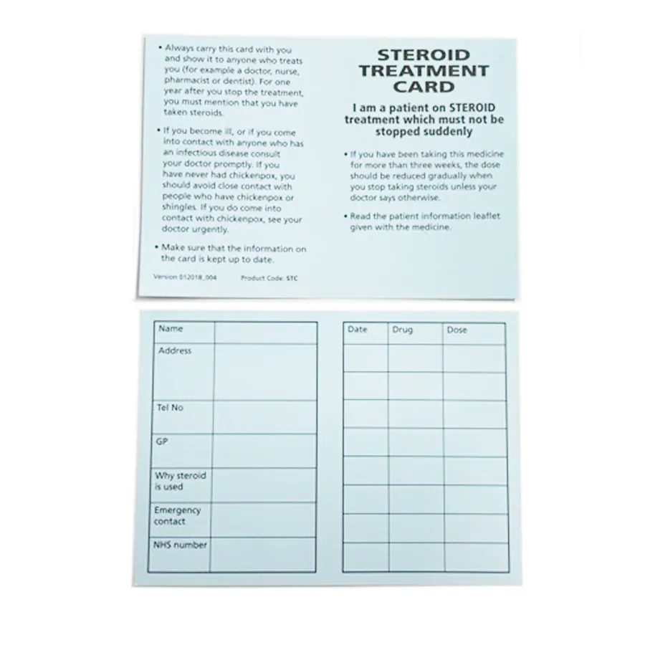
Key factors
PPI protection
Weaning dosage
Times
Dosage and previous history
Blood sugar monitoring
Mouth care
Work quickly – within 30 minutes oral route
Steroids alert card
Follow up – who is monitoring symptoms and dose
Mask infective symptoms
If one given a large dose and then no MSCC etc stop

Slide 5
Common prescribing errors
Wrong dose
Wrong time
Wrong route
Wrong type of steroid
No PPI
No weaning dosage
No follow up
Too slow taper/too fast taper
Abrupt stop

Slide 6
What does the evidence tell us?
Use of the lowest dose of glucocorticoids for the shortest period of time needed to achieve the treatment goals
Management of preexisting comorbid conditions that may increase risk when glucocorticoids are required
Monitoring of patients under treatment for adverse effects who may benefit from additional intervention
Short-term glucocorticoid therapy (two weeks or less) can simply be stopped and need not be tapered.
Hypothalamic-pituitary-adrenal axis (HPA) suppression due to glucocorticoid use of this duration is unlikely, but can occur
In patients who have taken a glucocorticoid for a longer time, suggest a regimen which is largely based upon experience and rests upon the following assumptions:
Factors of age, frailty, concomitant illnesses, dangerousness and likelihood of flare of underlying illness, psychological factors, and duration of previous use of glucocorticoids are taken into account.
The disease is sufficiently stable so that tapering of the dose is appropriate.
The patient has received long-term steroid therapy, not recurrent "pulses" as might be used in asthma.
The observation that HPA suppression is uncommon at prednisolone doses below 5 mg/day

Slide 7
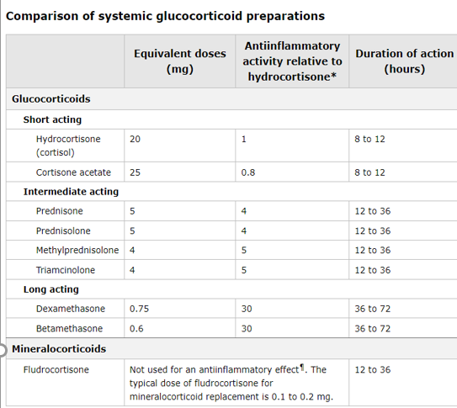

Slide 8
Side effects
Common or very common
Anxiety; behaviour abnormal; cataract subcapsular; cognitive impairment; Cushing's syndrome; electrolyte imbalance; fatigue; fluid retention; gastrointestinal discomfort; headache; healing impaired; hirsutism; hypertension; increased risk of infection; menstrual cycle irregularities; mood altered; nausea; osteoporosis; peptic ulcer; psychotic disorder; skin reactions; sleep disorders; weight increased
Uncommon
Adrenal suppression; alkalosis hypokalaemic; appetite increased; bone fractures; diabetic control impaired; eye disorders; glaucoma; haemorrhage; heart failure; hyperhidrosis; leucocytosis; myopathy; osteonecrosis; pancreatitis; papilloedema; seizure; thromboembolism; tuberculosis reactivation; vertigo; vision blurred
Rare or very rare
Malaise; tendon rupture

Slide 10
Case study one – Recurrent symptoms after treatment
67 year old male – single brain metastasis, resected and the had stereotactic radiotherapy 2 months ago
Presented to routine clinic check up aphasic
No physical symptoms, no facial drop or weaknesses
Steroids 8mg (4mg BD)
MRI brain
Next day after first dose steroid speech had improved
Speech back to normal after 2-3 days
To taper or not to taper?

Slide 11
Guidelines for reduction in brain metastasis

Slide 12
Steroids in brain metastasis weaning

Slide 13
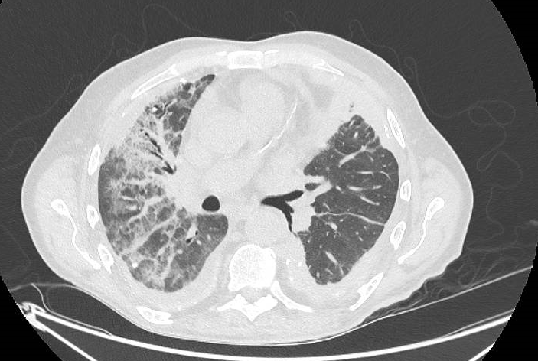
Case two – Nothing to lose
74 year old man
Pleural mesothelioma
C1 ipi/ nivo 8/7/22
Unwell with infective symptoms prior to immunotherapy
Admitted to hospital very unwell same day as IO, pyrexial and confused
?reaction to immunotherapy
2mg/kg IV methyl pred
Also tested positive for covid
Treated as IO pneumonitis, Cytokine release syndrome and COVID

Slide 14
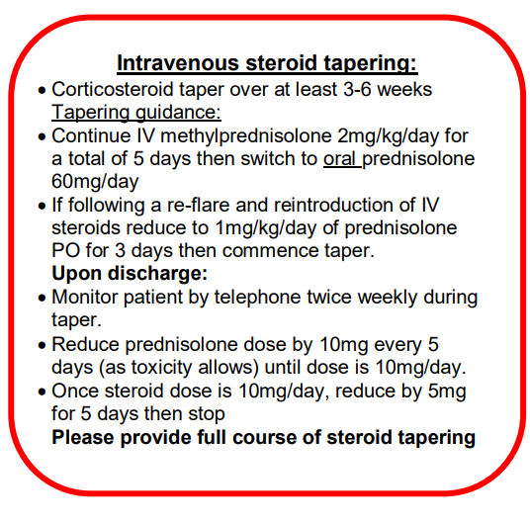
Guidelines for reduction IO

Slide 15
Steroid tapering additional considerations

Slide 16
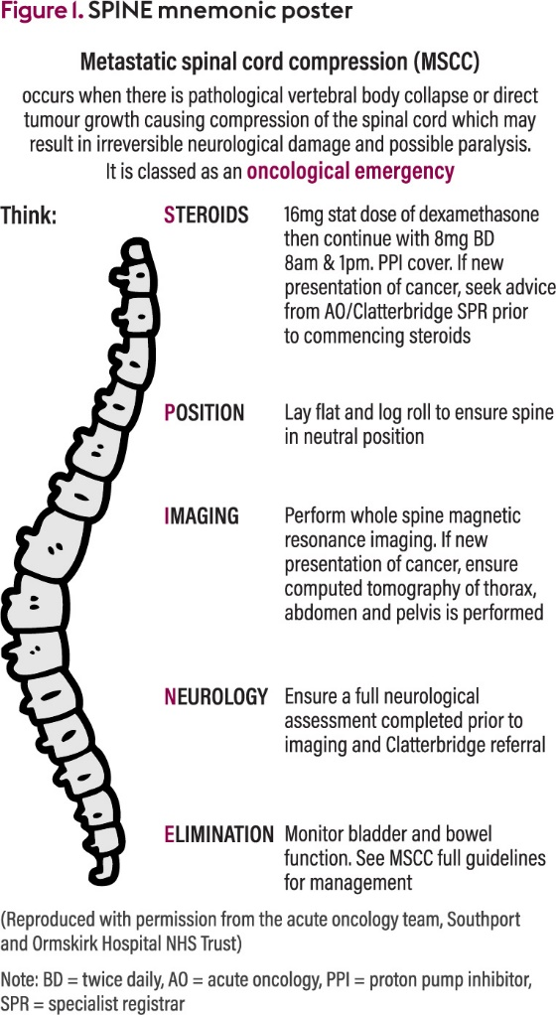
Case three – high dose steroids weaning
56 year old patient with metastatic lung cancer bone liver and brain mets
Presents with new neurology, soles of feet numbness
? MSCC
SPINE
MRI rules out MSCC

Slide 17
MSCC weaning regimen
The dose of dexamethasone may have to be higher in patients receiving phenytoin or carbamazepine
(see Guidelines on Antiepileptics and Corticosteroids) https://pallaborative.org.uk/clinical-standards-and-guidelines/

Slide 18
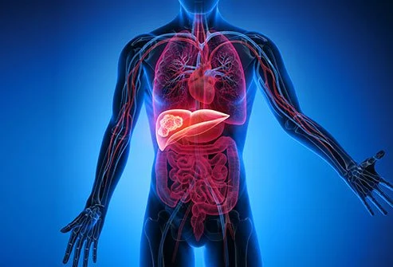
Case 4 – Abrupt stop
64 year old man with cancer of unknown primary, multiple metastatic large volume of liver metastasis.
Due to start SACT
Liver capsule pain
Did not feel steroids were helping pain
Had been on them for over 2 weeks
Stopped dexamethasone and started morphine
Severe pain
Admitted to hospital
Dexamethasone restarted
CTCAP – disease progression

Slide 19
Summary
Multiple benefits for using steroids in acute oncology
Limited evidence for guidelines for doses, timescales or weaning specific for oncology
Key principles can be applied
Use of the lowest dose, for the shortest period of time
Monitoring of patients is required
National UKONS AO and IO guidelines
Avoid common prescription errors
Educate others and the patient

Slide 20
Thank you for listening!

Slide 21
References
Lossignol D. A little help from steroids in oncology. J Transl Int Med. 2016 Apr 1;4(1):52-54. doi: 10.1515/jtim-2016-0011. Epub 2016 Apr 14. PMID: 28191519; PMCID: PMC5290916.
https://www.ukons.org/site/assets/files/1134/acute_oncology_initial_management_guidelines.pdf last accessed 19/09/2022
Sonia Tanwar , Sandeep Singh Int. J. Pharm. Sci. Rev. Res., 72(2), January - February 2022; Article No. 03, Pages: 17-22
https://www.clatterbridgecc.nhs.uk/professionals/guidance/immunotherapy lasted accessed 19/9/2022
Needham, S. and Marshall, J., 2022. Metastatic spinal cord compression: a poster and mnemonic supporting acute hospital staff to deliver optimal patient care. Cancer Nursing Practice, 21(4).
Henzen C, Suter A, Lerch E, et al. Suppression and recovery of adrenal response after short-term, high-dose glucocorticoid treatment. Lancet 2000; 355:542.
https://bnf.nice.org.uk/drugs/dexamethasone/ last accessed 19/9/2022
https://www.clatterbridgecc.nhs.uk/application/files/7715/1506/6536/Metastatic_Spinal_Cord_Compression_Pathway_Guidelines_for_Cheshire__Merseyside_V1.0.pdf last accessed 19/9/2022
https://pallaborative.org.uk/clinical-standards-and-guidelines/ last accessed 19/9/2022
https://www.ukacuteoncology.co.uk/ukaos last accessed 19/9/2022

