Slide 1
Ensuring safety in prescribing practice
Immunotherapy treatment and how to manage side effects
Laura Collantes-Espinosa
Advanced Nurse practitioner
The Royal Marsden NHS Foundation Trust

Slide 2
Learning outcomes
Considerations when prescribing immune checkpoint inhibitors
Managing adverse effects from immunotherapy
Notes:
We will discuss case studies

Slide 3
Laura Collantes-Espinosa
16 years of experience as a nurse in oncology
7 years of experience as an Advanced Nurse Practitioner
2 years in Acute Oncology Service at Imperial College Healthcare
5 years in SACT services at The Royal Marsden

Slide 4
Immune checkpoint inhibitors (ICI)
Immune checkpoint-directed therapies bind lymphocyte ligands or receptors to enhance the lymphocyte activation and allow a cytotoxic antitumor immune response.
Tumour response is more durable than with chemotherapies.
This translates into significant overall survival (OS).
They can trigger autoimmune and inflammatory toxicities in patients, so-called immune-related adverse events (irAEs).
Notes:
Immune checkpoint molecules: modulators of the anti-tumour T cell immune response.
Present on T cells, antigen-presenting cells (APCs) and tumour cells; their interaction activates either inhibitory or activating immune signalling pathways. Examples of inhibitory immune checkpoints shown to induce a negative signal to T cells are:
n Cytotoxic T-lymphocyte antigen 4 (CTLA-4, also known as CD152)
n Programmed cell death protein 1 (PD-1, also known as CD279)
n Lymphocyte-activation gene 3 (LAG-3)
n T cell immunoglobulin and mucin domain 3 (TIM-3)
n V-domain immunoglobulin suppressor of T cell activation (VISTA)

Slide 5
ICI: Classification
Anti CTLA-4: Ipilimumab, Tremelimumab
Anti PD-1 : Nivolumab, pembrolizumab,pidilizumab, cemiplimab
Anti PDL-1: Atezolizumab, durvalumab, avelumab
Combinations: Ipilimumab+Nivolumab
Notes:
n Cytotoxic T-lymphocyte antigen 4 (CTLA-4, also known as CD152)
n Programmed cell death protein 1 (PD-1
microsatellite instability-high (MSI-H) or mismatch repair deficient (dMMR)
Melanoma, renal, H&N,, NSCLC, Lymphomas, HCC, MSI- high MMR deficient mCRC
Bladder cancer, Upper GI cancers

Slide 6
ICI: pharmacology (PD &PK)
ICIs are mostly humanized or human immunoglobulin antibodies (IgG1 or IgG4)
Little or no impact of renal and liver function impairment
Limited diffusion out of the vascular space
Receptor-mediated clearance >Long half-life
Intravenous infusion with varying intervals of administration.
Most compounds are now developed with a flat dose, sufficient to saturate the target.
Notes:
Anti-PD-1 and anti-PD-L1 antibodies were initially developed on weight-based dosing. However, results from several clinical trials have shown no correlation between dose, efficacy and toxicity for anti-PD-(L)1, and for the anti-CTLA-4 antibody ipilimumab, there was no dose-limiting toxicity (DLT) identified in early phase trials.

Slide 7
Immune related Adverse Events (IrAE)
General symptoms of minor intensity: 80 % of patients on monotherapy or 95% in combination therapy.
Serious G3/4 adverse events:55 % in combination therapy. The most common IrAE were diarrhoea (44.1%), fatigue (35.1%), and itching (33.2%).
The first IrAEs to occur are skin symptoms, gastrointestinal and liver symptoms and endocrine system symptoms.

Slide 8
Immune related Adverse Events (IrAE)
Dermatological
Gastrointestinal
Hepatic
Pulmonary
Endocrine
Neurological
Cardiovascular
Musculoskeletal
Renal
Ocular
Haematological

Slide 9
CASE STUDY 1: Nivolumab induced colitis
48 year old male.
Cancer diagnosis: pT4 NI (3/12) moderately differentiated adenocarcinoma of the colon. RAS/RAF wild type, pMMR
Treatment:
September 2018: Left hemi-colectomy.
October 2018: Adjuvant chemotherapy (Capecitabine and Oxaliplatin) x 4 cycles.
July 2019: CT scan demonstrates disease progression in liver and peritoneum.
July 2019: Commenced FOLFIRI and Cetuximab.
September 2019: Disease progression in liver.
October 2019: To start nivolumab/regorafenib
Notes:
microsatellite instability-high (MSI-H) or mismatch repair deficient (dMMR)

Slide 10
CASE STUDY 1: Nivolumab induced colitis
PMH: Hay Fever
PSH: Appendicectomy aged 18
SH: Married, 2 sons, non smoker, alcohol intake within recommended limits
FH: Father and mother colon cancer, 3 siblings cancer free
DH: No regular medication
NKDA

Slide 11
Immune Checkpoint Inhibitors: Baseline tests
Full blood count
Liver function tests
U&Es
Thyroid function tests
Glucose (Hb A1c)
Random cortisol level
ECG
Troponin*
Pulmonary function test*
Morning serum cortisol &ACTH*
Serum BNP *
*if previous pathology
Notes:
Check Marsden guidelines
Expression of PDL1>1% in tumour tissue
The Society also recommends a baseline electrocardiogram and measurement of troponin, with consideration of a baseline pulmonary function test (patients with pre-existing pulmonary disease), morning serum cortisol and adrenocorticotropic hormone (patients with pre-existing endocrine disease), and serum brain natriuretic peptide (patients with pre-existing cardiac disease).

Slide 12
CASE STUDY 1: Nivolumab induced colitis
Jan 20
Feb20
June20
Jan21
May21
Oct22
Arthralgia G1
Diarrhoea G1
Diarrhoea G2
Diarrhoea G3
Diarrhoea, Nausea Arthralgia G2 Vomiting G1
Disease progression
4 c rego/nivo given.Treatment held, predni 40 mg, dietary advice,battery of bloods, faeces &viral screen.
Tests NAD
5c rego/nivo given. Treatment held, admit,IV methylprednisolone 1 mg/Kg started, 1 dose of infliximab (viral screen negative), CTCAP, flexisigmoidoscopy.*
9c rego/nivo given. Analgesics, CRP ok. Worsened over 1 cycle. Treatment held, restarted prednisolone 40 mg, limiting instrumental ADL.
11 c rego/nivo given. Presents with worsening symptoms, abdominal pain. Admission and methylprednisolone restarted.
12c rego/nivo given. Presents with diarrhoea G1 despite an increase on prednisolone to 15 mg. Arthritis well controlled.
5 cycles (+12)given.
Notes:
We will discuss this episode in more detail

Slide 13
Management of Immune related Adverse Events (IrAE)
Diagnosis and grading of irAEs (using CTCAE version 5)
Ruling out differential diagnoses and pre-immunosuppression work-up
Selecting the appropriate immunosuppression strategy for grade 2 events
Active evaluation at 72 h to adapt treatment
Notes:
app with CTCAE
Oncoassist

Slide 14
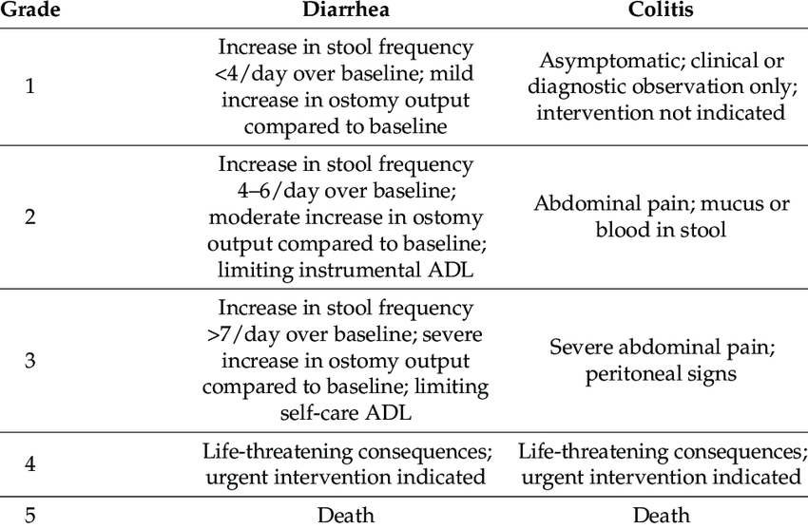
CTCAE grading

Slide 15
CASE STUDY 1: Nivolumab induced colitis
January 2020: First presentation with diarrhoea following 4 cycles
Diarrhoea G1 1 (5 episodes a day, baseline 2), type 7. No blood or mucous. Abdominal discomfort, no cramps.
Abdominal examination NAD
Treatment held.
Start prednisolone 40 mg + PPI cover
Stool sample ,FBC, U&E, Mg, LFT, CRP, TFTs (within normal range)
Stool microscopy for leucocytes/ova/parasites, culture, C. diff toxin & cryptosporidia (NAD)
Notes:
ECG done and it was normal

Slide 16
CASE STUDY 1: Nivolumab induced colitis
February 2020: Second presentation with diarrhoea following cycle 5
G3 diarrhoea
Treatment held > admission.
IV methylprednisolone 1 mg/Kg started
1 dose of infliximab (viral screen negative)
CTCAP: no signs of colitis or bowel obstruction. regression of liver & peritoneal mets.
Flexisigmoidoscopy: Healthy mucosa, inflammatory infiltrate showed in biopsies.
Managed to reduced steroids to 10 mg oral prednisolone but diarrhoea G2.
Stool sample & Blood for CMV/EBV PCR Negative
Notes:
Check prior to administration:
TB infective/exposure history and perform T spot test (if positive, referral to TB specialist indicated); CXR (or CT) to exclude granulomas
Baseline LFTs (if moderate derangement – seek advice prior to administration)
Baseline Hepatitis B & C, HIV, VZV serology
Check vaccination history: seek advice if live vaccine received in last 4 weeks
Start PJP prophylaxis

Slide 17
CASE STUDY 1: Nivolumab induced colitis
April 2020:
GI team suggested budesonide but exacerbated diarrhoea.
Agreed to hold off further treatment until further review.
In the event off significant relapse he should start clipper (beclomethasone) 5mg OD for 8 weeks.
May 2020:
Prednisolone 1 mg
Synacthen test incremented well. Stop steroids.
No diarrhoea, lower energy levels.
Cycle 7 started
Notes:
Beclomethasone is an oral steroid used in ulcerative colitis, chron’s,,etc/ The steroid is release only in the bowel, acting on the gut with fewer side effects
Prednisolone used for more severe flare ups.
Synacthen tests to check adrenal insufficeincy> Acute adrenal crisis “adrenal storm” if stopped suddenly. Life threatening condition.

Slide 18
CASE STUDY 1: Nivolumab induced colitis
June 2020: First presentation with arthralgia following cycle 9.
G1 arthralgia: initially treated with analgesia.
Worsened on day 15, limiting instrumental ADL: G2.
Treatment held.
Restarted prednisolone 40 mg.
October 2020:
Prednisolone down to 5 mg.
Arthralgia well controlled.
CTCAP in July shows stable disease.
Restarts cycle 10.
Notes:
Manages pain by increasing prednisolone to 12 mg after nivo and reducing back to 7 mg 2 days after nivo.

Slide 19
CASE STUDY 1: Nivolumab induced colitis
January 2021: Third presentation with diarrhoea .Worsening symptoms after 11 cycles.
Diarrhoea G2, Nausea G2, Vomiting G1, Arthralgia G2
Abdominal pain 7/10, dull.
Admission: methylprednisolone 1 mg/kg, AXR no perforation, CTCAP no signs of colitis or perforation, stable disease.
Discharged on 40 mg prednisolone
March 2021: Prednisolone 5 mg. No diarrhoea. Arthralgia well controlled.
April 2021: restarts cycle 12

Slide 20
CASE STUDY 1: Nivolumab induced colitis
May 2021: Fourth presentation with diarrhoea after 12 cycles
Diarrhoea G1 despite an increase on prednisolone to 15 mg.
Arthritis well controlled.
June 2021:
CTCAP shows stable disease
GI team suggest starting beclomethasone (clipper) 5 mg OD 4/52, start reducing prednisolone 3 days after starting clipper, faecal calprotectin and MC&S.
After 3 days of clipper no response>colonoscopy and faecal elastase.
After 10 days of clipper improved symptoms. Decrease prednisolone by 5 mg every 5 days, if symptoms worsen to increase until effective dose.
Notes:
(just 1 cycle from last episode)
Beclometasone 5 mg oral (clipper): used for ulcerative colitis, topical. It acts on the gut without the usual side effects of CS

Slide 21
CASE STUDY 1: Nivolumab induced colitis
August 2021:
Continues on 5 mg prednisolone and clipper 5 mg.
CTCAP stable disease.
Colonoscopy shows macroscopically no clear evidence of colitis. Biopsies from terminal ileum and colon show a chronic inflammatory picture with appearances in keeping with mild colitis associated with immunotherapy.
Treatment held until further recovery.
November 2021
Prednisolone 5 mg. Clipper stopped.
Synacthen test inadequate: continue 5 mg prednisolone.
Notes:
He was on prophylactic septrim and vitd-ca
Referred to endocrinologist

Slide 22
CASE STUDY 1: Nivolumab induced colitis
December 2021-February 2022
CTCAP stable disease
Had 3 courses of clipper in total(8 weeks each).
Patient relapses between courses but quickly “captures”.
Viral screening for possible infliximab/vedolizumab for future relapses not controlled by clipper.
March 2022
Tumour markers increasing, CTCAP shows progression
Colitis and arthritis controlled with 5 mg prednisolone
After MDT discussion>to restart rego/nivo
Notes:
All decisions made in conjunction with GI team

Slide 23
CASE STUDY 1: Nivolumab induced colitis
April 2022:
Restarts rego/nivo
Arthritis G1 no colitis
October 2022:
Progression after 5 cycles of nivolumab/regorafenib
Active treatment discontinued
June 2023:
Patient alive on best supportive care.
Notes:
Restarts rego/nivo. Last cycle was April 2021.

Slide 24
Case study 1 : Nivolumab
One of the commonest IrAEs: Colitis
One of the rarest IrAEs: Arthritis
From a prognosis of 6 months to living more than 4 years since starting ICI
Case study 2: Pembrolizumab
The earliest IrAE to appear: Rash
Minor impact on treatment continuation

Slide 25
CASE STUDY 2: Pembrolizumab induced skin toxicity
46 year old female.
Cancer diagnosis: Inflammatory invasive ductal carcinomaER0 (PR0) HER2 0
Treatment plan: Neoadjuvant Carboplatin/paclitaxel/ pembrolizumab 6 cycles followed by EC/pembrolizumab
Notes:
Carbo pacli given every week, pembro 3 weekly

Slide 26
CASE STUDY 2: Pembrolizumab induced skin toxicity
PMH: Nil, premenopausal
SH: Married, 1 daughter
FH: No breast/ovarian cancers
Paternal uncle - lung cancer
Maternal grandmother - stomach cancer
DH: No regular medication
NKDA

Slide 27
CASE STUDY 2: Pembrolizumab induced skin toxicity
Cycle 2 day 1
Develops a skin rash on her face 2 weeks after first dose of pembrolizumab. Acneiform (pustules resolve but erythema maintained). G1
Physical examination: Erythema mainly on cheeks and forehead.
No recent exposure to other drugs or allergens
(paclitaxel?)
No temperatures or signs of viral infection.
Blood parameters within range.
Notes:
Develops a grade 1 acneiform face rash after 1 cycle pembrolizumab.

Slide 28
CASE STUDY 2: Pembrolizumab induced skin toxicity
Disclaimer: Consent obtained for the use of photographs
Notes:
The diagnosis of ircAEs is usually based on clinical evaluation when a simple, non-complicated rash is observed; skin biopsy and more specific tests, depending on the clinical presentation may be needed.Evaluation of the disease severity should be carried out to eliminate rare severe irAEs such as Stevens Johnson syndrome, toxic epidermal necrolysis, bullous lesions and DRESS syndrome that necessitate immediate interruption of ICI therapy, specialist treatment and monitoring.
Dress: Drug rush with eosinophilia and systemic symptoms

Slide 29
CASE STUDY 2: Pembrolizumab induced skin toxicity
CTCAE grading system:
Grade 1: skin rash (macules/papules/pustules), with or without symptoms (pruritus/tenderness/tightness), <10% body surface area
Grade 2: rash covers 10-30% of BSA , associated with psychosocial impact; limiting instrumental ADL
Grade 3: rash covers >30% of BSA , ; limiting self-care ADL
Grade 4: skin sloughing >30% BSA with associated symptoms (eg erythema, purpura, epidermal detachment).
Notes:
Our guidelines: Grade 2: rash covers 10-30% of BSA or grade 3 with minimal symptoms
Grade 3 SYMPTOMATIC
Grade 3: rash covers >30% of BSA OR grade 2 with substantial symptoms (intense or widespread constant itch/ limiting sleep)
CTCAE grade 4: If acneiform: Life-threatening consequences; papules and/or pustules covering any % BSA, which may or may not be associated with symptoms of pruritus or tenderness and are associated with extensive superinfection with IV antibiotics indicated

Slide 30
Skin toxicity

Slide 31
CASE STUDY 2: Pembrolizumab induced skin toxicity
Cycle 2 day 1
Management of Grade 1 skin toxicity:
Avoid skin irritants (use soap-free cleansers such as Dermol® or QV wash)
Moisturise, avoid sun exposure, topical steroids Eumovate® (Clobetasone butyrate, mild strength) +/- antihistamines for itch
Proceed with treatment
Notes:
Develops a grade 1 acneiform face rash after 1 cycle pembrolizumab.

Slide 32
CASE STUDY 2: Pembrolizumab induced skin toxicity
Cycle 3 day 8
Continues to have facial acneiform rash.
“Taking longer to heal” , pustules resolve after a few days.
Noticed changes in colour on her right hand.
Physical examination: Right hand erythematous (purple/red that changes overtime). It feels very hot to her. Worse at night. There is an area that feels swollen/oedematous distal to the ulnar bone. No pain. No injury.
Blood parameters within range.
Notes:
Develops a grade 1 acneiform face rash after 1 cycle pembrolizumab.

Slide 33
CASE STUDY 2: Pembrolizumab induced skin toxicity
Disclaimer: Consent obtained for the use of photographs
Notes:
The diagnosis of ircAEs is usually based on clinical evaluation when a simple, non-complicated rash is observed; skin biopsy and more specific tests, depending on the clinical presentation may be needed.Evaluation of the disease severity should be carried out to eliminate rare severe irAEs such as Stevens Johnson syndrome, toxic epidermal necrolysis, bullous lesions and DRESS syndrome that necessitate immediate interruption of ICI therapy, specialist treatment and monitoring.
Dress: Drug rush with eosinophilia and systemic symptoms

Slide 34
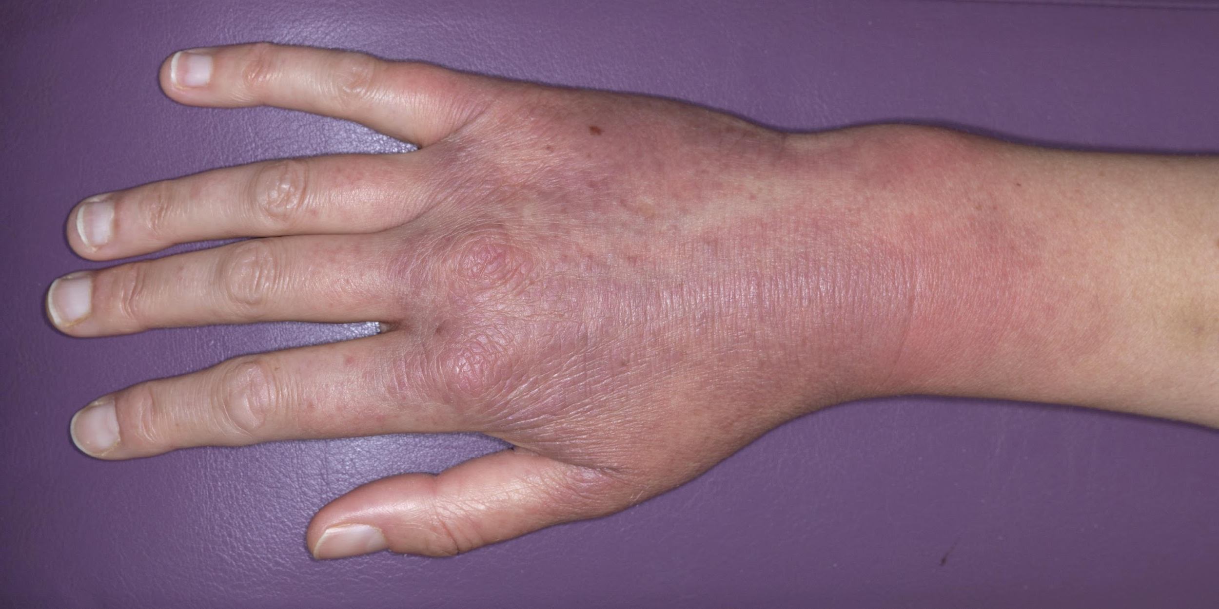
CASE STUDY 2: Pembrolizumab induced skin toxicity
Disclaimer: Consent obtained for the use of photographs
Notes:
The diagnosis of ircAEs is usually based on clinical evaluation when a simple, non-complicated rash is observed; skin biopsy and more specific tests, depending on the clinical presentation may be needed.Evaluation of the disease severity should be carried out to eliminate rare severe irAEs such as Stevens Johnson syndrome, toxic epidermal necrolysis, bullous lesions and DRESS syndrome that necessitate immediate interruption of ICI therapy, specialist treatment and monitoring.
Dress: Drug rush with eosinophilia and systemic symptoms

Slide 35
CASE STUDY 2: Pembrolizumab induced skin toxicity
Cycle 3 day 8
Management of Grade 1 skin toxicity:
We continued with previous measures
Escalated to Elocon® (mometasone furoate, moderate strength) cream od for hand and forehead
Proceed with treatment
Notes:
Develops a grade 1 acneiform face rash after 1 cycle pembrolizumab.

Slide 36
Summary and tips
Remember: every body system can be involved!
IrAEs present in different ways to chemo side effects
Assess every new symptom , never assume!
Refer to specialists team for input
No dose modification with ICI
Steroids must be <10 mg OD for ICI to be effective
Continue to monitor for symptoms after finishing treatment (this can appear months later)
Exercise caution with antibiotic use, interesting references to read on this
Notes:
headaches, back pain, changes in vision, mucositis!

Slide 37
Other considerations: Corticosteroids (CS)
To minimize the occurrence of CS-induced AEs, ESMO proposes:
To use the lowest effective CS dose, for the shortest possible duration (it can be several weeks for grade 3 irAEs, including tapering).
CS therapy tapering or discontinuation only on medical advice .
Lifestyle adaptations to minimize the risk of CS-induced Aes.
Notes:
If steroids >4-6 w>Prophylactic antibiotics (septrim-PCP)+ vitd and calcium
DM
GI problems
Fragile skin
Psychosis
Weight changes
Adrenal crisis/storm

Slide 38
Any queries contact me on:
Laura.collantes1@nhs.net
Thank you for your time!

Slide 39
Reference list
Centanni M., Dirk Jan A. R. Moes , Iñaki F. Trocóniz,Joseph Ciccolini and J. G. Coen van Hasselt (2019 ) Clinical Pharmacokinetics and Pharmacodynamics of Immune Checkpoint Inhibitors available at https://www.ncbi.nlm.nih.gov/pmc/articles/PMC6584248/
Electronic medicines compendium available at https://www.medicines.org.uk/emc#gref
Fearfield L., Heelan K., Harland C., Larkin J., Turajlic S., Chauhan D. And Yousaf N. (2019) Immune Checkpoint Inhibitor (Icpi)-related Toxicity: Management Of Skin Rash/Toxicity Available at RMH intranet
Shuai J. , Shuai G. , Qian C. , Chen Z., Mengfei C. , Yang Y. , Shuo Z., Ning S. and Mei D. (2021) Effects of Concomitant Antibiotics Use on Immune Checkpoint Inhibitor Efficacy in Cancer Patients. Frontiers in Oncology available at https://www.frontiersin.org/articles/10.3389/fonc.2022.823705/full
Haanen J., Obeid M., Spain L. , Carbonnel F. , Wang Y. , Robert C., Lyon A. R. , Wick W. , Kostine M., Peters S. , Jordan K. & Larkin J. , on behalf of the ESMO Guidelines Committee (2022) Management of toxicities from immunotherapy: ESMO Clinical Practice Guideline for diagnosis, treatment and follow-up Available online at https://www.esmo.org/guidelines
Haanen J., Lugowska I., Garassino M.C., Califano R. (2018) ESMO Handbook of Immuno-Oncology available at https://oncologypro.esmo.org/education-library/esmo-handbooks/

Slide 40
Reference list
Pinato DJ, Gramenitskaya D, Altmann DM, et al (2019) Antibiotic therapy and outcome from immune-checkpoint inhibitors. Journal for ImmunoTherapy of Cancer. 7:287. doi: 10.1186/s40425-019-0775-x available at https://jitc.bmj.com/content/jitc/7/1/287.full.pdf
Spain L., Yousaf N. And Hunter N. (2017) Immune Checkpoint Inhibitor (Icpi)-related Toxicity: Supportive Management Of Patients On High Dose Steroids Available At Rmh Intranet
Spain L., Yousaf N., Turajilic S., Yousaf N., Larkin J., Powell N., Riley U. And Chauhan D. (2019) Immune Checkpoint Inhibitor (Icpi)-related Toxicity: Management Of Diarrhoea & Colitis Available At Rmh Intranet
U.S. Department of Health and Human services (2017) Common Terminology Criteria for Adverse Events (CTCAE) Version 5.0 available at Common Terminology Criteria for Adverse Events (CTCAE) (cancer.gov)
Wojtukiewicz M.Z., Rek M.M.,Karpowicz K., Górska M.,Polityńska B.,Wojtukiewicz A.M.,Moniuszko M. Radziwon P.,Tucker S.T.,and Honn K.V. (2021) Inhibitors of immune checkpoints—PD-1, PD-L1, CTLA-4—new opportunities for cancer patients and a new challenge for internists and general practitioners. Cancer metastasis Rev. 40(3): 949–982. available at https://www.ncbi.nlm.nih.gov/pmc/articles/PMC8556173/

