Slide 1
The Nursing Associate Role
Regulation and Standards

Slide 2
#Hello My Name Is……

Slide 3
The Role: The Story So Far

Slide 4
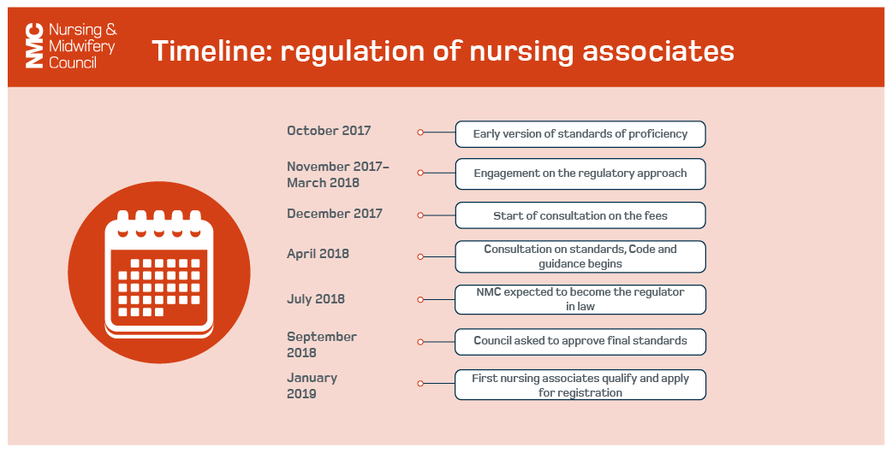
The Story So Far
Notes:
SHAPE OF CARING review by Health Education (HEE) identified a skills gap between the roles of health care assistants and registered nurses.
Nurse Associates were proposed to support the delivery of nursing care across a wide range of health and care settings.
Nurse Associates are a profession in their own right with registration on the NMC register – but also provide a progression route into graduate nursing degree programmes.
Nurse Associates can work across a variety of care settings – though their registration is generic.
The role and regulation applies to England only.
The NMC became the legal regulator for Nurse Associates in England in July 2018.
The Nurse Associate part of the NMC register opened on 28th January 2019.
Nurse Associates are required to revalidate every 3 years – and the first group revalidated in January 2022.

Slide 5
Regulation

Slide 6
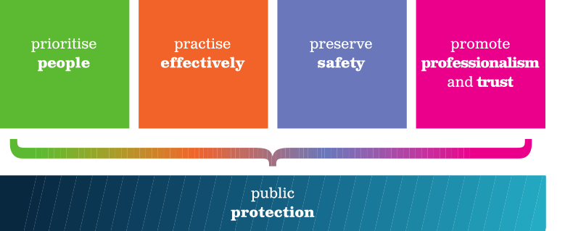
THE CODE
Together they signify good nursing, midwifery and nursing associate practice

Slide 7
Standards Development

Slide 8
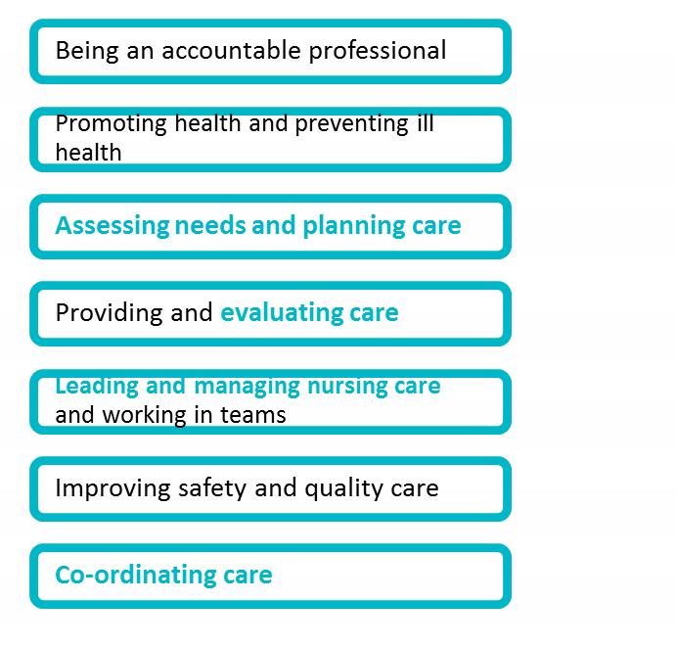
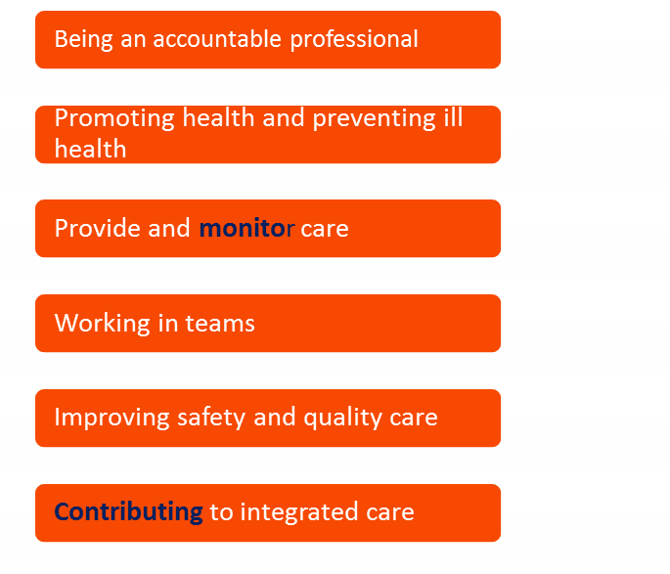
Comparison of proficiencies
Future nurse
Nursing associate
6
PLATFORMS
7
PLATFORMS
Notes:
The standards of proficiency set out what ALL nursing associates need to know and be able to do in order to join the register
Like nurses and midwives, nursing associates can develop further knowledge and skills and enhance their scope
The standards are derived from the new nursing standards, to show synergies and differences
Skills annexes are included and refer to communication and relationship skills and procedures to be achieved at the point of registration.

Slide 9
Delegation and Accountability
Delegation = transfer to a competent individual, the authority to perform a specific task in a specified situation.
Accountability = the principle that individuals and organisations are responsible for their actions and may be required to explain them to others.
Nurse Associates uphold the SAME CODE as nurses and midwives.

Slide 10
Challenges v’s Opportunities
Knowledge expansion.
Support, not replace, registered nurses
Scope of practice will develop over time
Employer led.

Slide 11
The Future……

