Slide 1


Implementing the Nursing
Associate role in practice
Lyndsay Murden
Senior Workforce Lead
Nursing, Midwifery & AHP Team, NEY
NHS England

Slide 2
Session Overview
To review the Nursing Associate role
To review funding offers available
Scope of Practice
Considerations for workforce planning
The future of Nursing Associate role

Slide 3

The Nursing Associate Role
Shape of Caring Review (2015) recommended a
bridging role between Health Care Support Workers
& Registered Nurses.
Health Education England funded a national pilot
of 2,000 Nursing Associates across 35 test sites in
England started in January 2017.
First Nursing Associates qualified and joined the NMC register in January 2019.
‘Nursing Associate’ is a protected title in law, ensuring only those with the appropriate qualifications can use them.
Notes:
Work of Lord Willis which is on the back of the Francis report

Slide 4
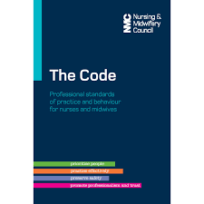

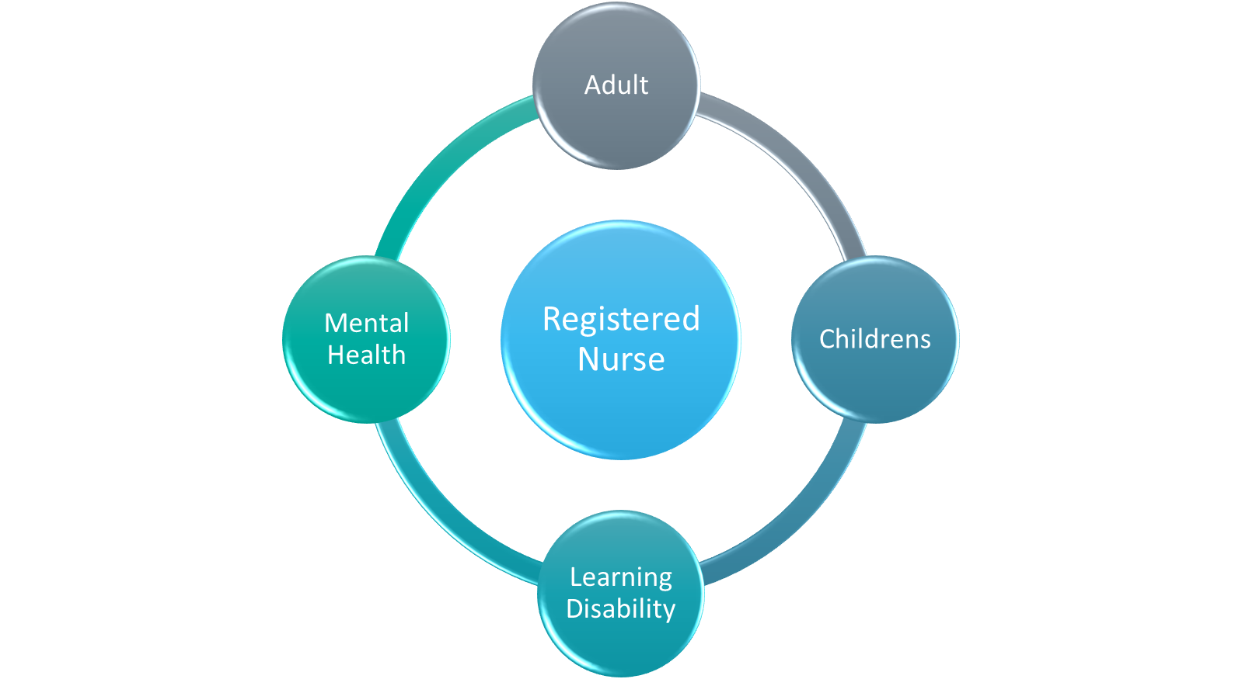
The Nursing Associate Role
Notes:
Nursing Associates work independently under the direct & indirect supervision of the Registered Nurse and other health care professionals.
Bridging role
Work across all 4 fields of nursing and are equipped with the knowledge, skills & behaviors to enable them to support the delivery of nursing care across a wide range of health & care settings.
They provide care for people of all ages and from different backgrounds, cultures and beliefs.
Regulated role by the NMC

Slide 5
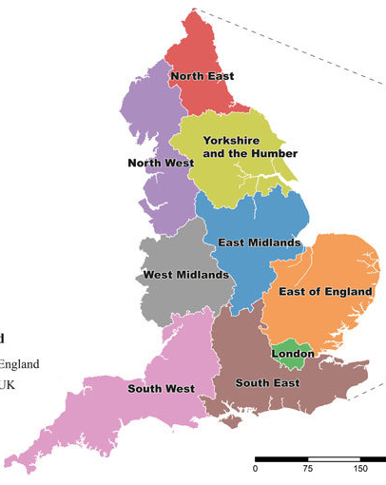



Distribution of
Nursing
Associates
Adult 128
CYP 4
Community 15
MH 21
LD 15
Adult 400
CYP 58
Community 94
MH 44
LD 16
Adult 432
CYP 53
Community 95
MH 98
LD 34
Adult 218
CYP 16
Community 42
MH 20
LD 15
Adult 689
CYP 68
Community 160
MH 52
LD 31
Adult 314
CYP 50
Community 152
MH 49
LD 28
Adult 250
CYP 3
Community 94
MH 6
LD 14
Adult 293
CYP 6
Community 100
MH 67
LD 15

Slide 6
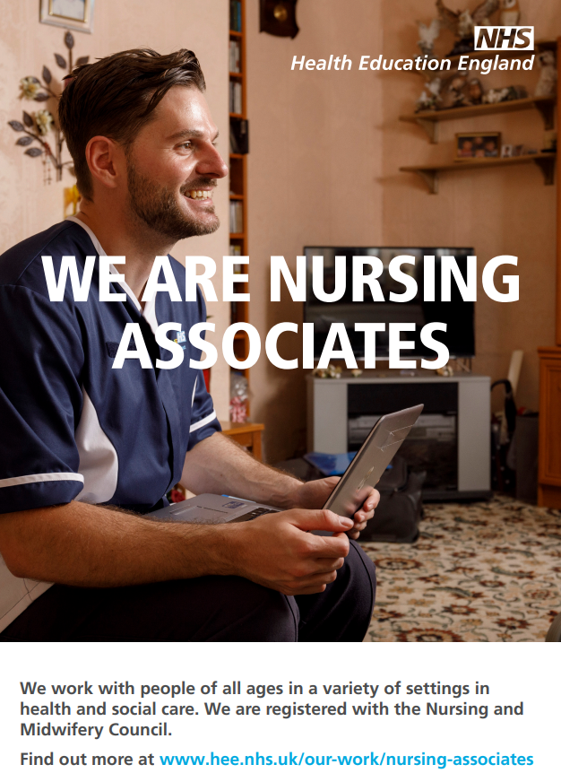
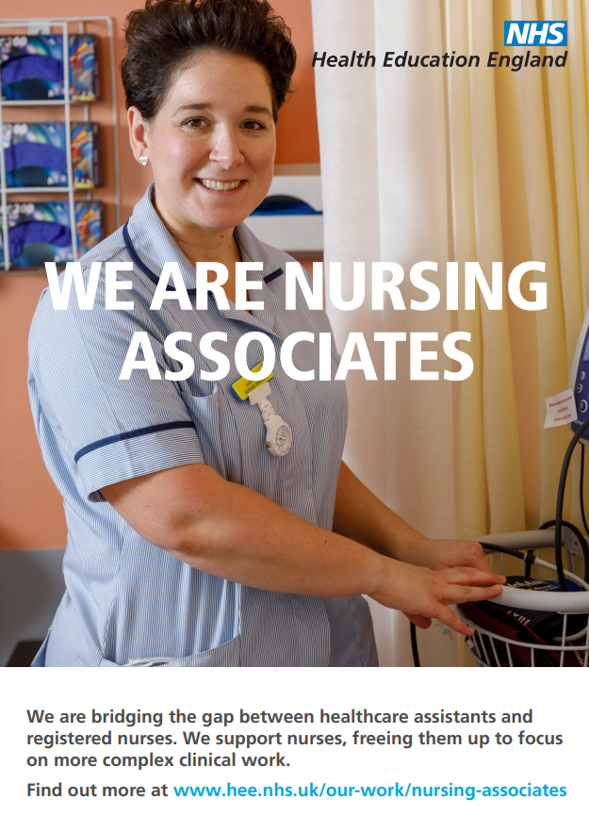
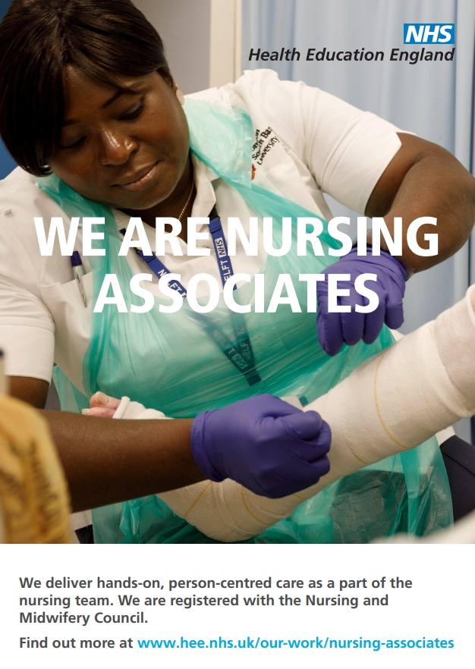
Why employ a Nursing Associate?
Notes:
Improve staff retention through career progression.
‘Grow your own’ nursing workforce.
Examples – PC and LD lead, Working at HEIs, Quality lead, PC- undertake LTC reviews for simple pts allow RN for pts with co-morbidities

Slide 7
Programme requirements
‘Off the job’ learning – study day at HEI
‘On the job’ Learning – Protected Learning Time in Hub area
Placements – 4-8 weeks per year
Two programmes on offer - Apprenticeship or Direct entry
Notes:
Should cover 4 fields – Adult, Child, MH and LD, can mould TNA into what you require them to be.
Apply via UCAS as delivered by universities.
You would have to self-fund course fees for this option and would normally be a full time student.
2 years in length.
Gain a Foundation Degree Level 5 and be eligible to register with the NMC upon successful completion of programme.

Slide 8
Funding available
Apprenticeship levy
  Non levy paying organisations
    1 Reservation of funds (95% of costs paid with 5% contribution from the employer)
    2 Levy transfer (100% of costs paid).
Incentive funding
  Standard funding offer – total of £8,000 (£4,000 per year).
  Enhanced Learning Disabilities offer - £15,800 (£7,900 per year)
Notes:
Cost of programme delivered by the university is £15,000.
paid in installments to the employer and used to support the trainee, e.g., travel expenses, uniforms, IT equipment
It can be used to support the wider nursing workforce development & the deployment of Nursing Associates.
Paid to employers, for those trainees who can evidence 50% of their time, while on programme, in a Learning Disabilities setting, the total package of funding is £7,900 per year and can be used to support the release of staff.
Trainee Nursing Associates and Nursing Associates became part of the Primary Care Networks (PCN) Additional Roles Reimbursement Scheme (ARRS) in October 2021. (You will need to speak to your PCN leads about this.)

Slide 9
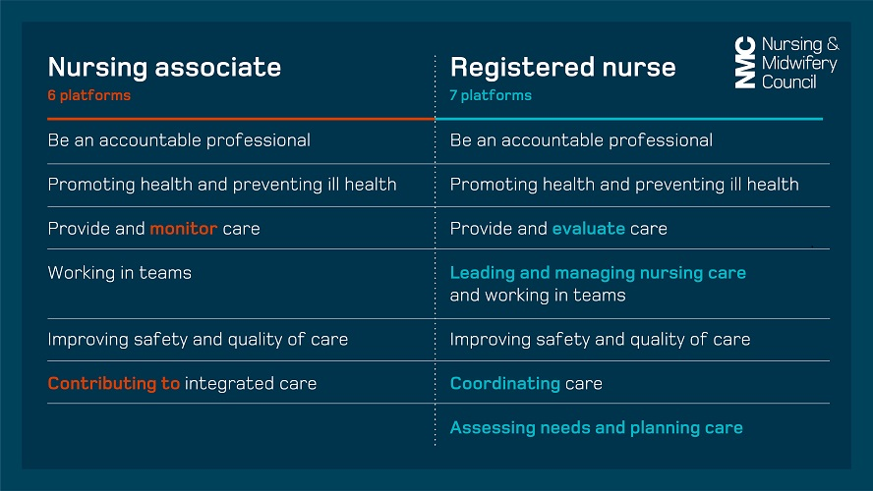
Comparison with Nurse Proficiencies
Notes:
Assist in the assessment, planning & evaluation of care. The Registered Nurse will retain responsibility as the primary care assessor, planner and evaluator.
NAs – Care givers

Slide 10
Considerations for the NA Role
How can the Nursing Associate role fit into your team?
What do you see as being the Challenges, Barriers & Solutions?
What do you see as being the Opportunities & Benefits?
What support may be needed?

Slide 11

Scope of Practice
Notes:
Employer led
No restrictions if appropriate training and competency
Varies between areas

Slide 12
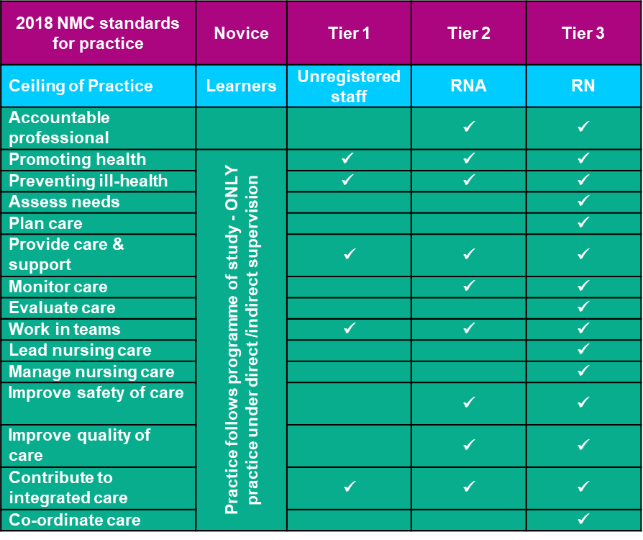
Nursing Professional duties

Slide 13
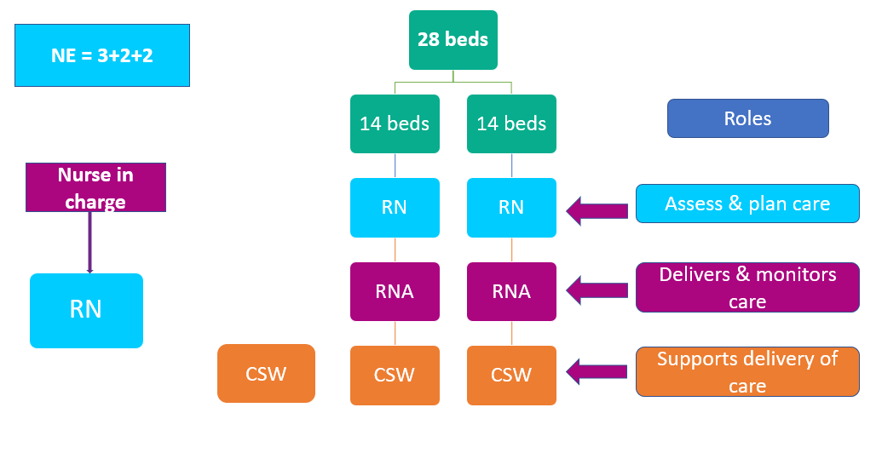
Considerations for workforce planning – Option 1

Slide 14
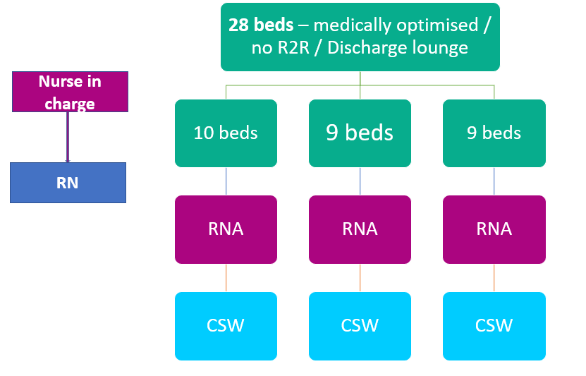
Considerations for workforce planning – Option 2

Slide 15
Next Steps
Top up to Registered Nurse
CPD
Embedding the role
Notes:
Nursing Associates can develop their scope of practice, as registered nurses do in line with the NMC code

Slide 16
Future work
Learning Disabilities Social Care / Primary Care pilot
Primary Care / Community Trust partnership
Maternity services
Sexual health
Notes:
Nursing Associates can develop their scope of practice, as registered nurses do in line with the NMC code

Slide 17

Any Questions

Slide 18
Break out rooms – 15 mins
Where so you see the Nursing Associate
role in 5 Years time?

