Slide 1
Developing the role of the physician associate Friday 16th June 2023 Chandran Louis PA-R, FHEA Faculty of Physician Associates, Vice president KSS director for the South East School of PAs. Written chief examiner, Master's in Physician Associate Studies SGUL Senior Lecturer at SGUL
FPA National Update

Slide 2
Contents
What is the FPA?
FPA board
PAMVR
FPA aims (e-portfolio)
FPA census
PA regulation
E-portfolio
Preparing for regulation
Prescribing
PA career development framework
FPA annual conference

Slide 3
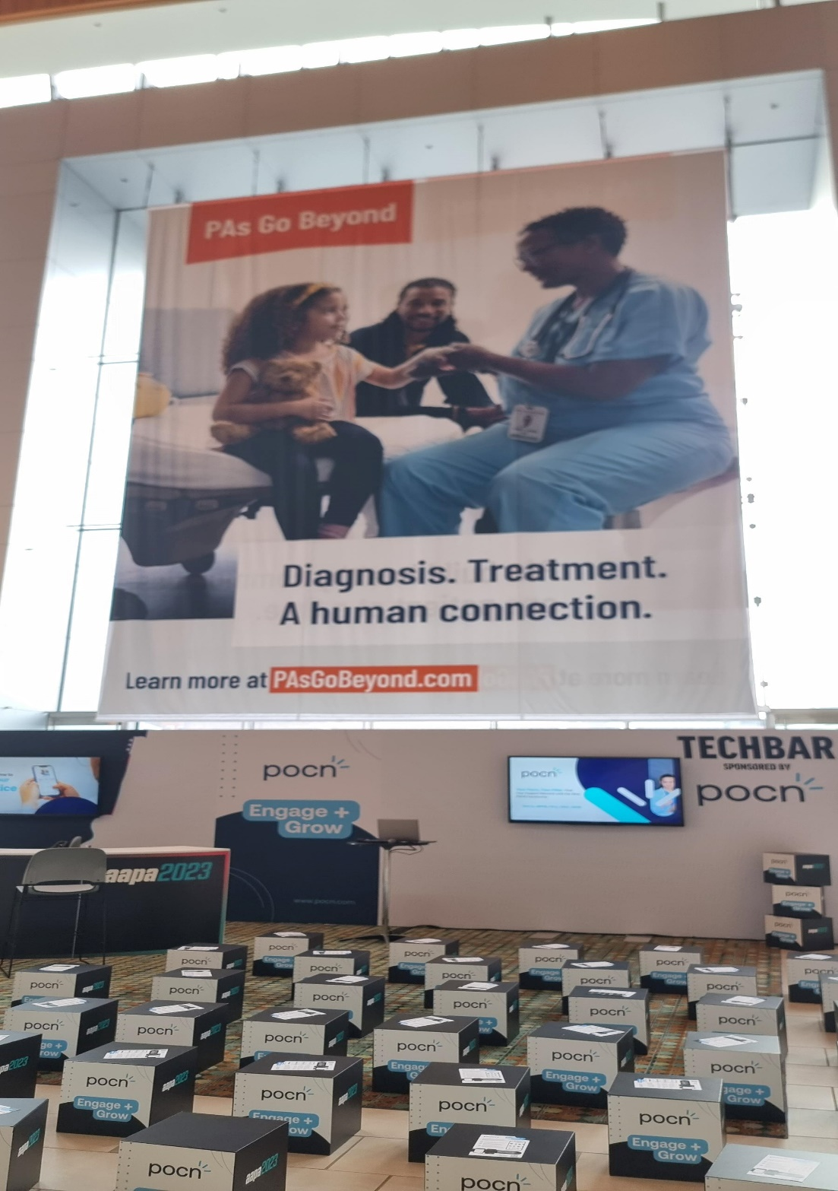

Slide 4
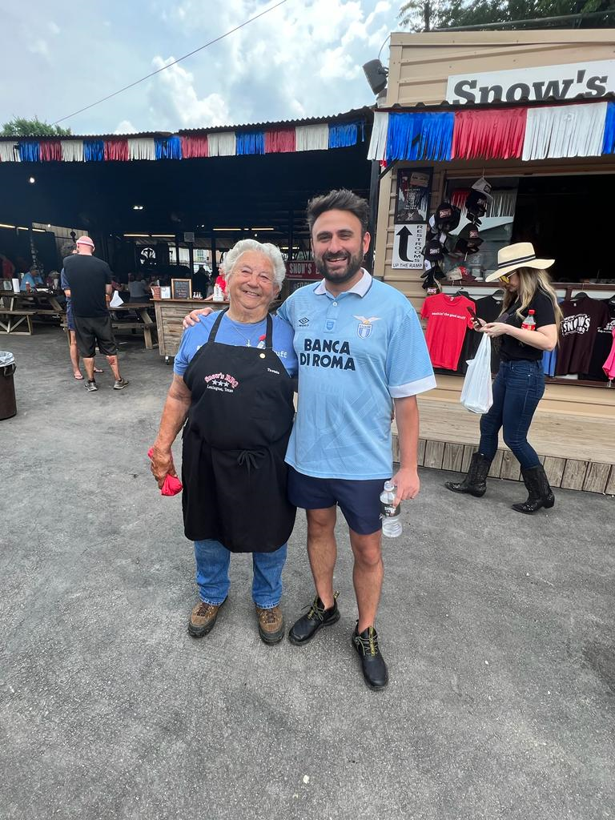

Slide 5
What is the Faculty of Physician Associates (FPA)?
Professional membership body campaigning for progress and change in the profession
Set standards for education and training of PAs
Support members (now over 3,800 practising PAs) in their professional and clinical careers
Offer advice to government
Take part in national debates

Slide 6
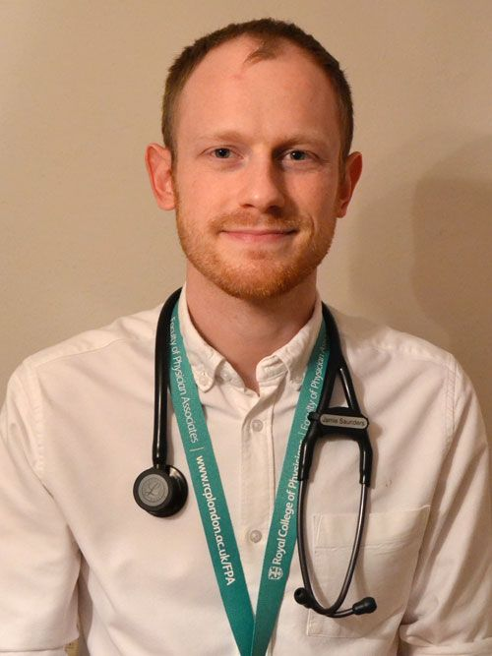
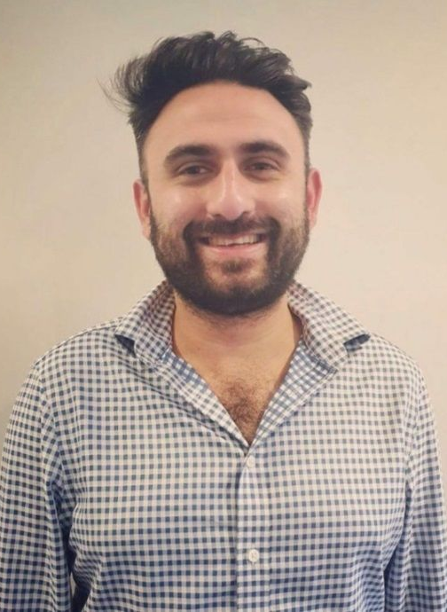
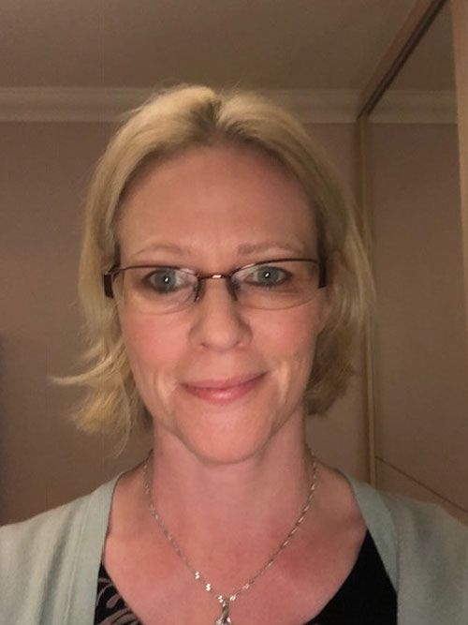
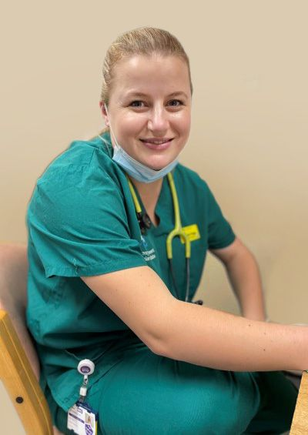
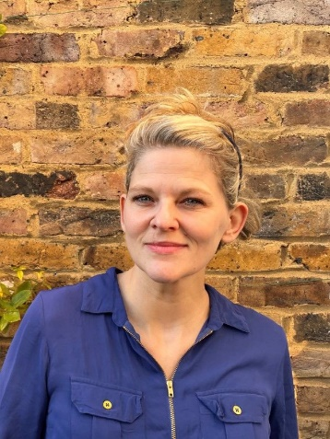
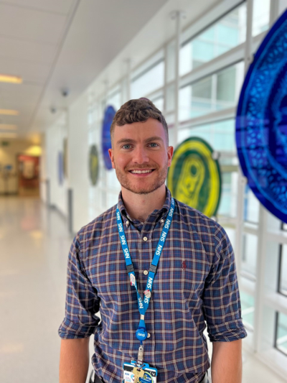
FPA Board
President
Jamie Saunders PA-R
Vice President
Chandran Louis PA-R
Dean
Pauline Weir PA-R
Secretary
Helen Fogg PA-R
Qualified PA Member
Amy Donaldson-Perrott PA-R
Board Member
Jack Hill PA-R
Board Member
Mobashar Rashid

Slide 7
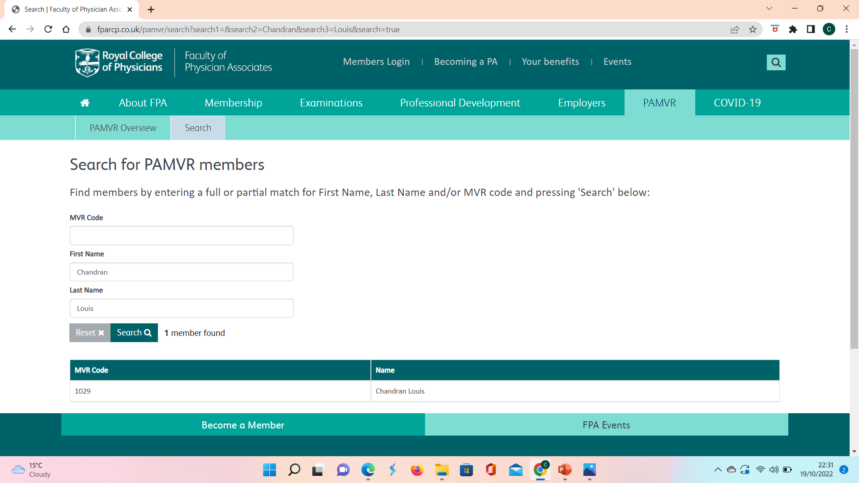
Physician Associate Managed Voluntary Register (PAMVR)
Register of fully qualified physician associates who have been declared fit to practice in the UK
Be a graduate of a nationally recognised PA
programme
Passed the PA National Exam
Agree to FPA Code of Conduct
50 hours CPD per year
Provide seamless transition onto the GMC register in 2024

Slide 8
FPA Aims

Slide 9
FPA Aims
Physician associate scope of practice
PAs assess, diagnose and treat patients every day across the UK, providing high-quality, evidence-based medical care
Physician associate career progression
We have established a task and finish group, which is aiming to finalise a career development pathway offering advice and guidance to qualified FPA members
Physician associate regulation
GMC, FPA and DHSC are working closely to introduce GMC regulation of PAs (2024)
National Guidance Documents
Streamlined national guidance for PAs, consultant/GP supervisors and employers
IR(ME)R
Supervision
President
Jamie Saunders PA-R

Slide 10
PA stakeholder event: Keele
FPA Aims
Working with colleges and societies
Important to engage with colleges such as SAM, RCPsych, RCS, BAUS and RCOphth help develop and ratify curriculums.
Keep engaging stakeholders
Work with stakeholders such as Patient Carer Network to help promote the PA profession. Establish new opportunities for PAs such as associate principal investigator scheme (NIHR)
ePortfolio
Developing an ePortfolio to allow PAs to record their clinical skills, knowledge, reflection and competencies against the curriculum. To aid and support in revalidation and CPD. The ePortfolio will be interactive between PAs and their supervisors.
Modernise
To encourage PAs to maintain their FPA membership we continue to develop highly diverse and engaging content at the annual conference including networking opportunities and skills sessions.

Slide 11
Recertification
Normally a 200 SBA every 6 years across the breadth of medicine (Removed mar 2023)
GMC revalidation approach will be based on annual employer appraisal, reflection and local governance
The FPA will launch an ePortfolio for qualified FPA members in October 2023. This new electronic platform will include the FPA Core Clinical Practice Curriculum (CCPC).
The CCPC will include all the core areas of practice in which a PA is expected to maintain knowledge, and cover the areas that have traditionally been assessed in the recertification assessment.

Slide 12
Recertification
log evidence of clinical competencies., completing direct observation of procedural skills (DOPS), mini clinical evaluation exercise (mini-CEX), case-based discussion (CBD) forms, audit, QI etc.
gather multi-source feedback (MSF) and patient feedback forms
complete the FPA appraisal toolkit
record CPD.

Slide 14
PA Regulation
3-month consultation
Now
Spring 2023
2024
Updates/Amendments
Parliament Passes Law
GMC Allowed to regulate PAs and AAs in law
Draft Bill Consultation
Target Dates
GMC Consultation on draft “rules”/Regulations
PA Register
Start of 2024 (6-12 months)
Planned Q4 2024

Slide 15
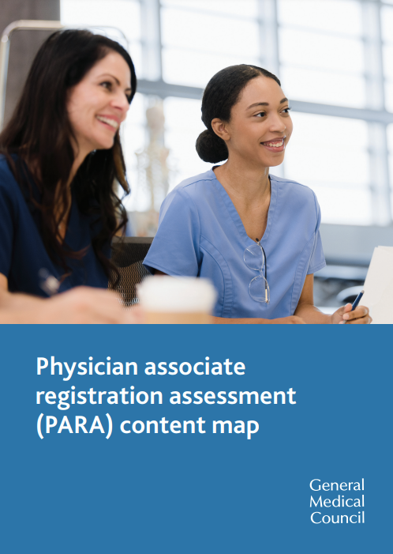
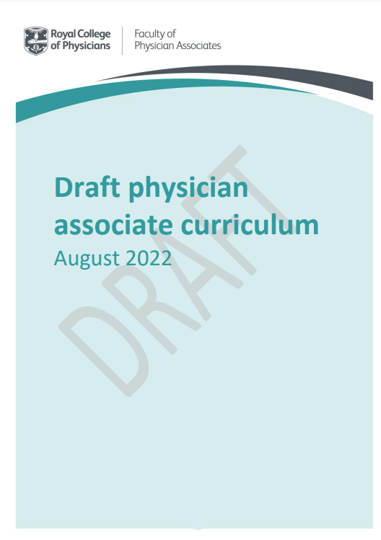
Preparing for PA Regulation – Pre-registration standards
The knowledge, skills and behaviours that’s PAs and AAs will have to adhere to when they start work.
The content for the knowledge test and OSCE that the GMC will use to test the PAs fitness to join the register
How PAs should learn and how HEIs should approach their programme (competency based)

Slide 16
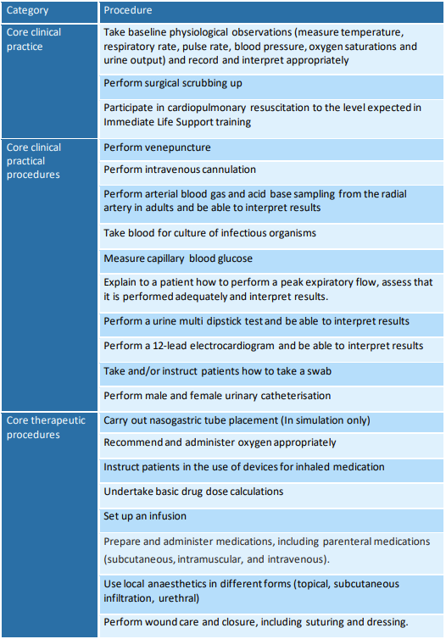
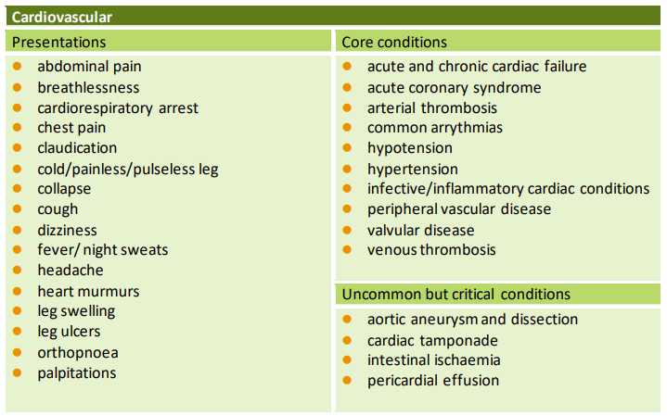
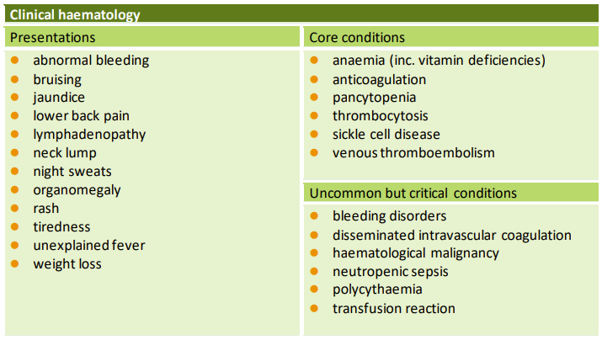
Preparing for PA Regulation – PARA content map

Slide 17
Physician Associate Prescribing

Slide 18
PA Prescribing
2023
2024
PA/AA Regulation Bill
PA Register
Case of Need
Commission for Human Medicines (CHM)
Public Consultation
Parliament Passes Law

Slide 19
PA Career Development Framework

Slide 20
PA Career Development Framework
HEE Core Capabilities Framework for MAPs
Core skills, knowledge and behaviours and specifies that which is common between different MAP professional roles

Slide 21
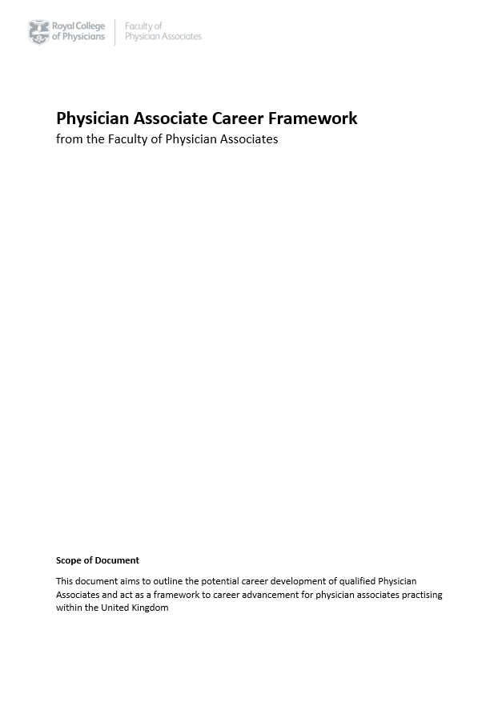
PA Career Development Pathway
FPA Career Development Pathway
Ongoing work
-Mapping out the PA career
-Looking at newly qualified PAs to lead PAs
Task & Finish Groups underway
Feed into NHSE MAPS career development framework
DRAFT

Slide 22
FPA Annual Conference
Friday 8 December 2023
London RCP and RCP Spine Liverpool
23 hours of CPD credit
Networking on-site or full remote tickets
Blueprinting to support recertification (when using the CCPC)

Slide 23
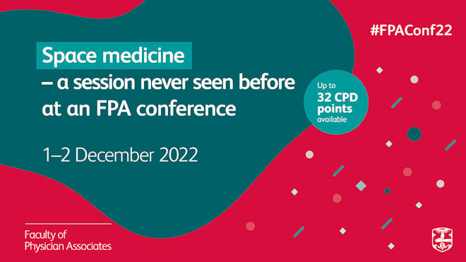
PA national conference 2022 (01/02 December)

Slide 24
Questions?
Chandran.louis@rcp.ac.uk

