Slide 1


The importance of high-quality Bereavement Care
Implementing the
National Bereavement Care Pathway
June 2023
bereavementcare@sands.org.uk
www.sands.org.uk www.nbcpathway.org.uk www.nbcpscotland.org.uk

Slide 2
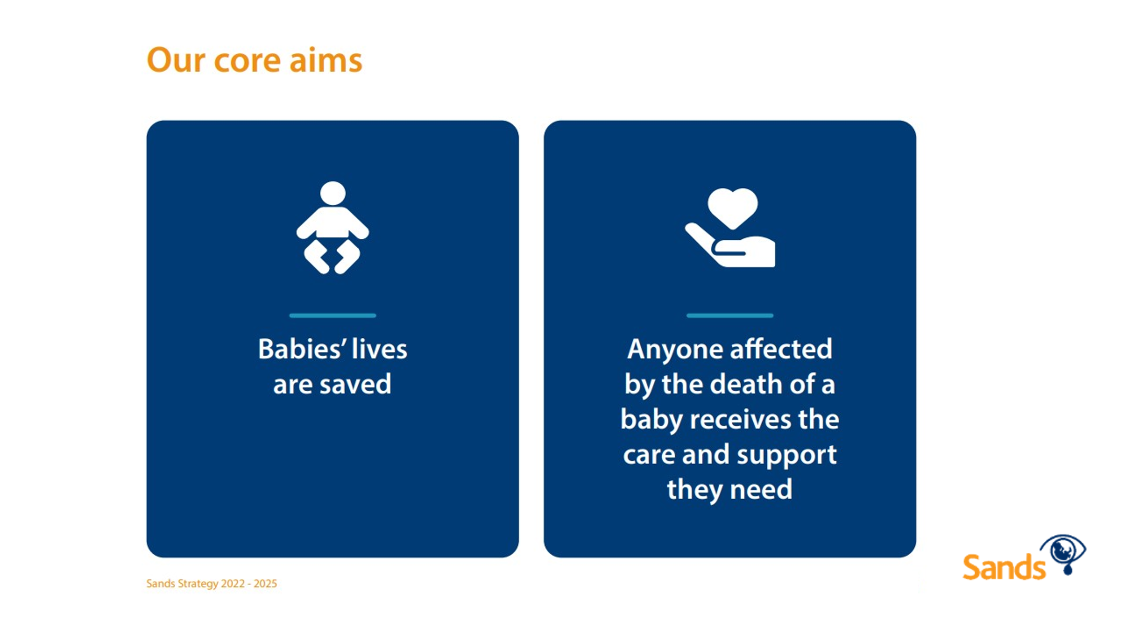



Sands’ mission:
Help save babies’ lives
Ensure excellent bereavement
care for all those who need it
Provide the right bereavement
support for as long as it is needed

Slide 3
Pregnancy loss and the death of a baby
Although the trend is positive, there is much to do to achieve the national target of a 50% reduction from 2015-2025:
Around 13 babies are stillborn or die neonatally every day in the UK
This equates to around 4,000 per year
Many more pregnancies end in miscarriage
Compared to other developed nations, our figures are poor
Good quality care cannot replace a much longed-for baby, but can help make the bereavement journey more manageable

Slide 4

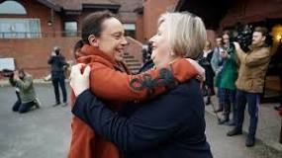
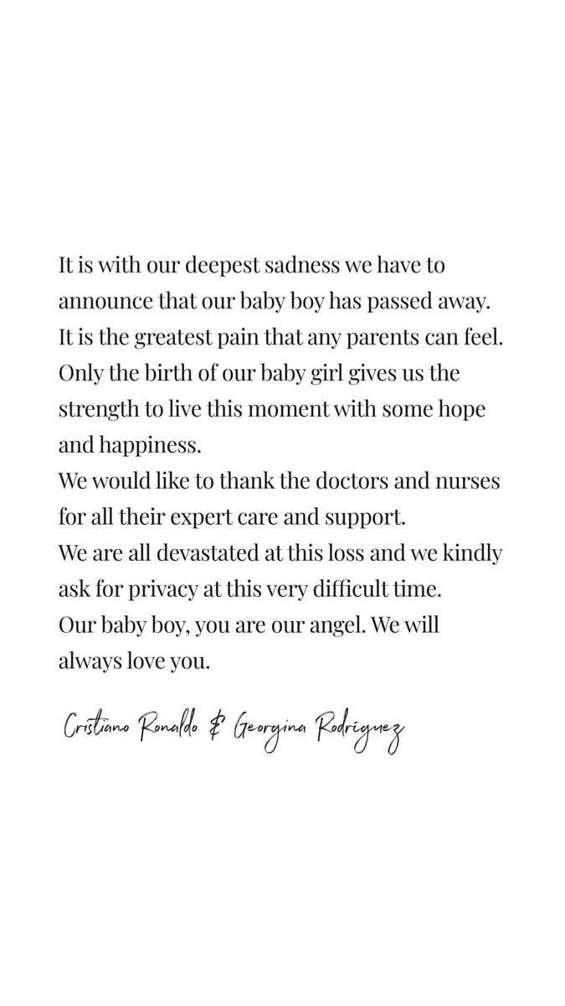

Bereavement care in the news

Slide 5

NBCP Around the UK
England
  113 trusts voluntary signed up – 15 to go
  Moving from project phase to embedding
  New resources released next week & workshops start
Wales
  Lots of Boards already using NBCP resources
  Working with bereavement sub-group to develop bereavement standards
  Pushing for a national bereavement care pathway – proposal with Welsh Government

Slide 6
NBCP Scotland
4-year project funded by Scottish Government
Embedded into Scot Gov Best Start Programme
Currently 9 out of 14 NHS Scotland Boards are signed up
Project Manager supports NBCP Leads with fortnightly individual meetings, monthly network support meetings and project planning
NBCP Scotland National Event – April 26th in Edinburgh
Learning Events will take place across the country throughout 2023
Final 5 boards must sign up by March 2024
Notes:
NHS Scotland is devolved
Big difference in Scotland is this is mandatory
Expectations that the remaining boards will be signed up by end of year
Meetings provide opportunity to share practice, seek guidance and vent in a safe and confidential space
203 people in person and 135 online – unlimited space online, so please do register if you would like to attend (link in chat box)
Learning events will be focussed on Good Practice, but always looking to share information about sands and any latest news and research

Slide 7
NBCP Around the UK
Northern Ireland
  Lots of Boards already using NBCP resources
  Some progress in 2021 but still much more to do
  Delay due to political situation

Slide 8

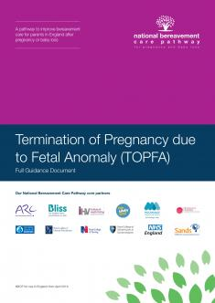



The National Bereavement Care Pathway
“To ensure that all bereaved parents are offered equal, high quality, individualised, safe and sensitive care”
www.nbcpathway.org.uk
www.nbcpscotland.org.uk
Notes:
The NBCP has been going since 2017. between 2017 – 2019, 32 trusts piloted the programme, including a number in the North West such as Morecambe Bay, Liverpool Women’s, Oldham General, Alder Hey…
An independent evaluation in 2019 highlighted the success of the programme and its importance in improving bereavement care across all five pathways – miscarriage, TOPFA, stillbirth, neonatal death, SUDI.

Slide 9
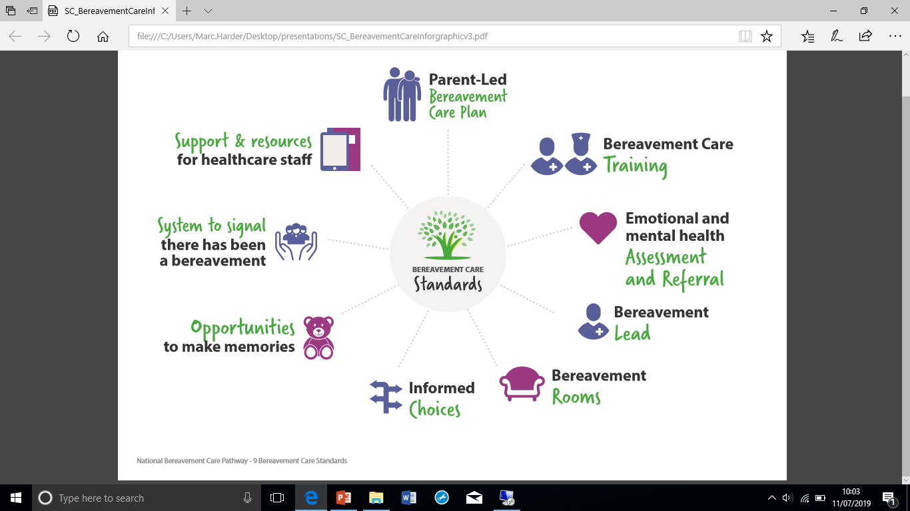
High Quality Bereavement Care consists of 9 standards
Notes:
These are the 9 standards which form the NBCP. Trusts aim to achieve these each time every time.

Slide 10












Making Memories
Photographs & videos
Teddy bears/keepsakes
Memory Box
Hand prints/ Foot print/ lock of hair
Memory Book
Birth certificates/records
Taking baby home
Music
Bathing
Family visiting
Time
Please take photos for families. I really didn’t want to
at the time as I didn’t understand why I would want to
remember any of that nightmare... but honestly I do. I
wish I had more pics... the details in his hands, his feet, his little ears... I wish I had more”
(bereaved mum)
Notes:
Clare

Slide 11
High Quality Bereavement Care consists of 9 standards
Notes:
These are the 9 standards which form the NBCP. Trusts aim to achieve these each time every time.

Slide 12
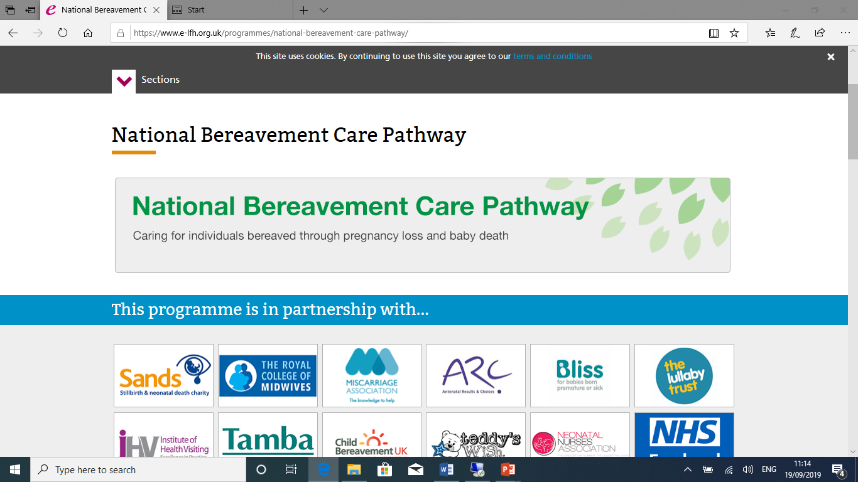
NBCP e-learning modules
www.e-lfh.org.uk /programmes/national-bereavement-care-pathway
10 minute introduction module for all
(café baristas, porters, MPs!)
30 minute focused for HCPs
Thousands of modules completed
Satisfaction high at 97%
Wide coverage across the country
Increasingly popular during COVID
Lots of on-line and face to face training available via the Sands website
Notes:
E-learning modules are available on the e-lfh platform

Slide 13
High Quality Bereavement Care consists of 9 standards
Notes:
These are the 9 standards which form the NBCP. Trusts aim to achieve these each time every time.

Slide 14
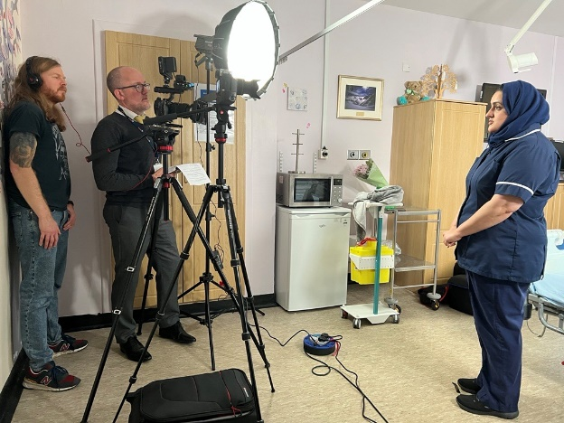
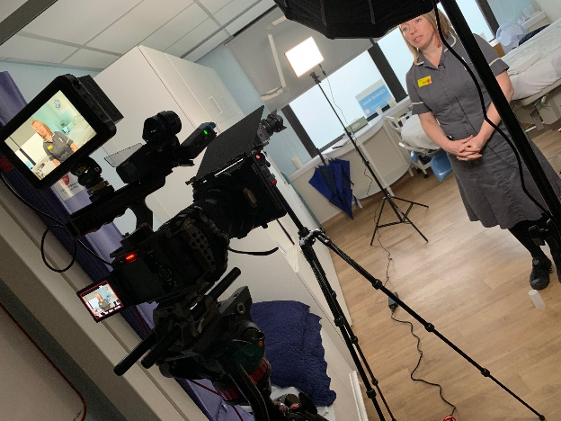
NBCP Resources Toolkit
Parent feedback
Being Strategic
Working together
Staff wellbeing
find the toolkit online at www.nbcpathway.org.uk
Notes:
Eyes and ears on the ground. Bi-monthly visits, email and calls
AIM - HLV in every hospital
HPs are aware of and know how to access Sands training, SS’s, NBCP guidelines and resources to encourage better BC
With a view to moving into NI and Wales
90 volunteers of which around 80 are active
Support – FB, Online group catch ups, 121 support,
The impact - have coverage in 80 hospitals.
hospitals participating in BLAW
bereavement hospital staff away days - Sands HLV asked to set up a Sands stall
Reps on the MVP can speak as parent voice but also share any intel
two volunteers have actively encouraged NBCP sign ups (East Kent/JPH)

Slide 15
Next steps & additional resources
Sands Awareness Month June 2023
Sands bereavement support – web, phone, Facebook, Sands United
NBCP monthly drop-in sessions
Sands Bereavement Care Audit
Sands Consultancy Service
Sands training online and in person https://training.sands.org.uk/
Further toolkit modules & workshops early 2024

Slide 16
Remember to take
care of yourself.
You can’t pour from an empty cup

Slide 17
Note: NBCP guidance updates released in summer 2022
For information about signing up or anything else regarding the NBCP
please contact marc.harder@sands.org.uk
www.nbcpathway.org.uk
Notes:
The pathways are currently being updated and will be available later in the spring – look out for them on the website

Slide 18

Thank you. Please stay in touch
bereavementcare@sands.org.uk
www.sands.org.uk
www.nbcpathway.org.uk
www.nbcpscotland.org.uk

