Slide 1
IMPROVING HIP FRACTURE CARE AND OUTCOMES
Cameron Swift. King’s College School of Medicine, London
July 2023

Slide 2
Background – need & opportunity
Epidemiological and public health importance
Recognised need to raise standards
Professional & political momentum
Demographic paradigm for health care
Contemporary national Clinical Guidance (e,g. CG124 & QS16)
National audit (NHFD) and Best Practice Tariff

Slide 3
CG124 (2011 -14 -17-19) Categories
Imaging options in occult hip fracture
Timing of surgery
Analgesia
Anaesthesia
Planning the theatre team
Surgical procedures (2017 / 2019/ 2023 updates)
Mobilisation strategies
Multidisciplinary management (HFP)
Patient and carer information

Slide 4
Hip Fracture Programme Model [CG124]
Acute orthopaedic or orthogeriatric ward base
Orthogeriatric assessment
Rapid optimisation of fitness for surgery
Early identification of individual goals for multidisciplinary rehabilitation to recover mobility and independence, and to facilitate return to pre-fracture residence and long-term wellbeing
Continued, coordinated, orthogeriatric and multidisciplinary review
Liaison or integration with related services, particularly mental health, falls prevention, bone health, primary care and social services
Clinical and service governance responsibility for all stages of the pathway of care and rehabilitation, including those delivered in the community.

Slide 5
Management of hip fracture
Accident & Emergency: Preliminary Assessment -
Surgical, Anaesthetic, Medical, Nursing, Rehab goals
Theatre
Orthopaedic / Specialist Ward:
Perioperative surgical, nursing and related management with
referral as required
“Usual Care”
MDM: HFP
MDR: SD
MDR: GORU
MDR: IC
MDR: MARU
MDR: SC
FINAL DISCHARGE

Slide 6
Key model inputs and CEA findings
COSTS FOR EACH
STRATEGY:
Rehab programme
Complications
Readmissions
Health care costs after
hospital discharge
Social care costs (when
living in own home or in
residential or nursing home)
HEALTH OUTCOMES
FOR EACH STRATEGY
EQ-5Ds scores for
all health states*
Life expectancy
= QALYs
HEALTH
STATES
HFP is the DOMINANT STRATEGY
(more effective, less costly)
than both GORU/MARU and usual care

Slide 7
NICE Quality Standards
Not fixed targets
Measurable high level audit measures of local quality in structure, process or outcome
Expressed as proportions – not necessarily 100% norm
Maximally evidence-based
Where possible, set in the context of national data collection – for Hip # the NHFD
Selection periodically adjusted for perceived priority improvement need.

Slide 8
QS16 Statements (1-3)
1. Adults with hip fracture are cared for within a Hip Fracture Programme at every stage of the care pathway. [2012, updated 2016]
2. Adults with hip fracture receive surgery on a planned trauma list on the day of, or the day after, admission. [2012, updated 2016]
3. Adults with displaced intracapsular hip fracture have a total hip replacement if clinically eligible, rather than hemiarthroplasty. [2012, updated 2017]

Slide 9
QS16 Statements (3-6)
4. Adults with trochanteric fractures above and including the lesser trochanter receive extramedullary implants. [2012, updated 2016]
5. Adults with subtrochanteric fracture are treated with an intramedullary nail. [new 2016]
6. Adults with hip fracture start rehabilitation at least once a day, no later than the day after surgery. [2012, updated 2016]

Slide 10
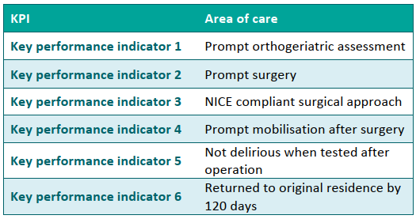
NHFD Evidence-based KPI’s 2019 & 2021 (COVID19) RCP NHFD 2022
2019 2021

Slide 11
NHFD Evidence-based KPI’s to end January 2023. RCP NHFD 2022

Slide 12
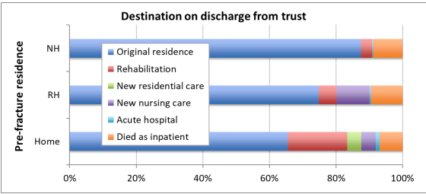
KPI 6: Discharge destination (120-day follow-up in only 40% esp ↓units) (NHFD 2020)

Slide 13
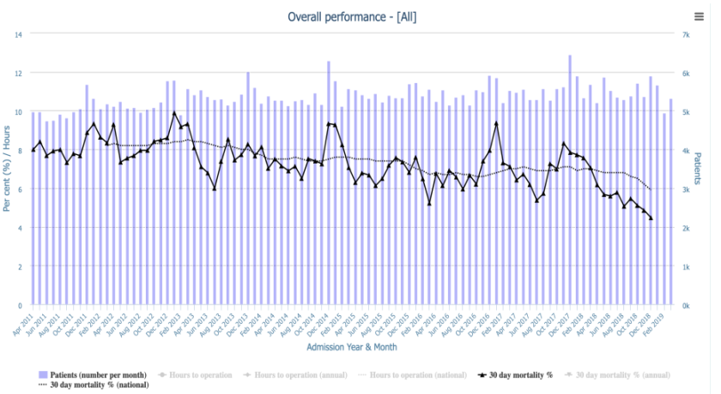
Seasonal variation in 30-day hip# mortality, 2011-2018 (NHFD 2019) (See also Griffin et al 2021: EQ-5D-5L)

Slide 14
KPI 3: CG124-Consistent Surgical Procedure (to 2017)
IM nail for subtrochanteric fracture
SHS (v IM nail) for A1 / A2 trochanteric fracture
Cemented arthroplasty (hemi/THA) for displaced intracapsular fracture
THA if (i) outdoor mobile (+/- stick),
(ii) cognitively intact & (iii) medically GA fit.

Slide 15
THR Dec 2018 – Feb 2021 (NHFD 2021) (see “HEALTH” nejm 2019: Judge et al bjj 2020)

Slide 16
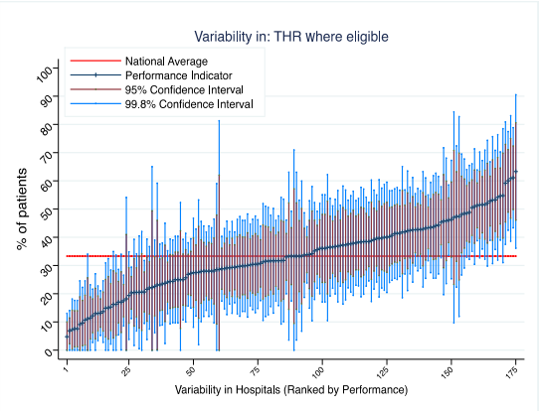
Variability in THR (NHFD 2019) (see “HEALTH” nejm 2019: Judge et al bjj 2020)

Slide 17
Rates of THA and hemiarthroplasty set against criteria that define greatest fitness (NHFD 2021)

Slide 18
Surgical procedure NICE CG124 Jan 2023
Consider total hip replacement rather than hemiarthroplasty for people with a displaced intracapsular hip fracture who:
were able to walk independently out of doors with no more than the use of a stick and
do not have a condition or comorbidity that makes the procedure unsuitable for them and
are expected to be able to carry out activities of daily living independently beyond 2 years. [2023]

Slide 19
SHS for A1/A2 # 2021 (NHFD 2022)

Slide 20
Surgical Procedure NICE CG124 (Revised) Jan 2023
Hospitals should aim to use a single type of cemented femoral component for hemiarthroplasties as standard treatment for displaced intracapsular hip fracture management. [2023]
If equivalent cemented femoral component designs are available, organisations should take into account overall costs, including training needs, and how familiar the team is with the component. [2023]
Record long-term data on hemiarthroplasties, including patient-reported outcomes and adverse events, for submission to a national registry. [2023]
Use extramedullary implants such as a sliding hip screw in preference to an intramedullary nail in people with trochanteric fractures above and including the lesser trochanter (except reverse oblique). [2011 Rev 2023]

Slide 21
NHFD Additional developments (NHFD 2021-22)
Transition from annual audit report to quarterly online QI platform
New additional KPI’s
KPI 0: (i) prompt nerve block consideration & (ii) prompt admission to appropriate ward.
KPI 7: Medication for secondary prevention with 120-day follow-up
Data on periprosthetic and non-hip femoral fractures
Integration of NAIF & inpatient hip#

Slide 22
Nhfd Data 2018 (naif audit) (RCP 2020)

Slide 23
Nhfd Data 2018 (naif audit) (RCP 2020)

Slide 24
IHF LOCATION (NAIF 2019) (RCP 2020)

Slide 25
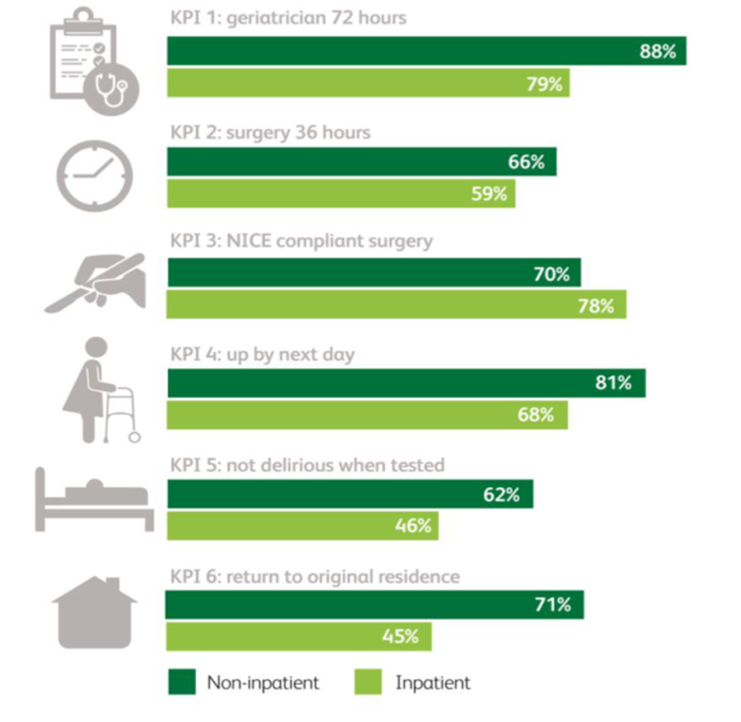
NHFD 6 KPI’s FOR INPATIENT & NON-INPATIENT HIP FRACTURE [NHFD 2022]

Slide 26
EVIDENCE - POSITIVE: Effect of targeted risk factor reduction programme on inpatient falls (per thousand occupied bed days) (Healey et al, 2004)

Slide 27
“Fallsafe” care bundle key elements [RCP 2015]
Cognitive assessment*
Delirium screen*
Bed-rail/Ultra-low bed strategy*
Basic visual check*
Lying & standing blood pressure & pulse*
Medical & medication review*
Tailored on-ward (v 2-hr) observation regimen

Slide 28
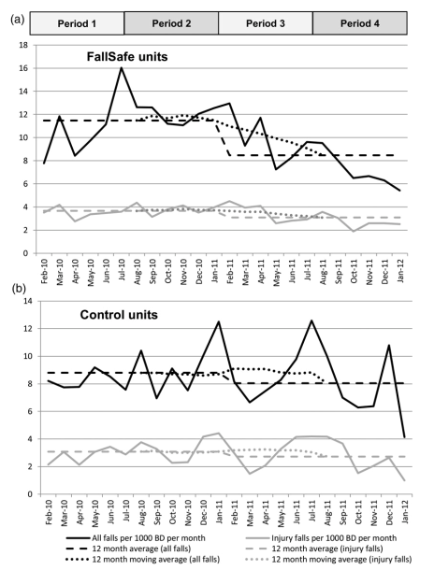
INPATIENT IMPLEMENTATION & OUTCOME MEASUREMENT “Fallsafe” QI evaluation [Healey et al 2014]

Slide 29
EVIDENCE: NICE CG 161: COST-EFFECTIVENESS OF INPATIENT FALLS PREVENTION

Slide 30
NATIONAL AUDIT – SNAPSHOT KPI DATA -INPATIENT FALLS PREVENTION 2017 (v 2015) (RCP NAIF 2019)

Slide 31
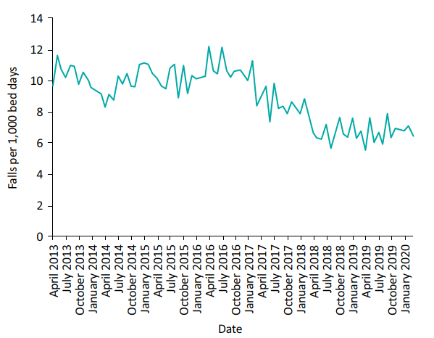
NATIONAL AUDIT & QI: Inpatient falls per 1,000 bed days AT Northumbria Healthcare NHS Foundation Trust 2013–2020. (Richardson et al., 2020)

Slide 32
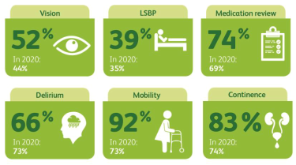
2021 NAIF KPI’S (85% Trusts) (NAIF 2022)

Slide 33
2021 (85% Trusts) post-fall management (v 2018 - 45%/ 20%/ 54%) (NAIF 2022)

Slide 34
Outcome effects of some organisational factors (REDUCE Study: Patel et al 2022)
Superspell LOS; +/- 2 day reduction with (e.g.)
Prompt O-G assessment
Prompt mobilisation
30-day casemix adjusted mortality; 10% reduction with (e.g.)
Patient experience feedback discussion at clinical governance meeting
Prompt surgery to >80% of patients

Slide 35
Some NHFD-based recommendations for local progress & QI: [NHFD 2022]
Quarterly and monthly multi-d governance meetings to review performance and plan QI
Use NHFD runcharts and KPI caterpillar plots to (i) monitor QI progress and (ii) best practice alongside better performing units
Use new KPI’s 0 & 7 to improve respectively
(i) nerve block use and fast track admission to appropriate ward;
(ii) bone health follow-up and secondary # prevention

