Slide 1

Increasing access to treatment for women with common mental health problems during the perinatal period: Developing a model of service delivery in which mental and physical health care are integrated into the work of maternity and health visiting services
Laura Seebohm
CEO, Maternal Mental Health Alliance (MMHA)

Slide 2


Overview
1. Perinatal mental health in the UK
2. Progress so far
3. Parity and prevention
4. Listening to women and their families
5. Increasing access to treatment
6. Context is key

Slide 3

Perinatal mental health in the UK
~20%
women develop a
mental illness during pregnancy or the first year after having a baby
7 in 10
women hide or underplay the severity of their illness
Suicide
remains a leading cause of death during and after pregnancy
Notes:
It is estimated that 1 in 5 women develop a mental illness during pregnancy or within the first year after having a baby. If untreated, this can have a devastating impact on women, babies and families. We also know that maternal mental health issues often go unrecognised, undiagnosed and untreated.

Slide 4


Slide 5
Our ambition
Ensure that all women can access and receive high quality compassionate care and support for their mental health during the perinatal period

Slide 6

Progress so far
Notes:
The first 10 years of the members of the MMHA achieved so much to bring perinatal mental health to the fore.

Slide 7


Counting the costs
£8.1bn
if we don't act
£377m
if we take an evidence-based approach
Notes:
There was a compelling case – cost of this to society was calculated conservatively to be more than £8.1 billion for each annual group of births in the UK

Slide 8
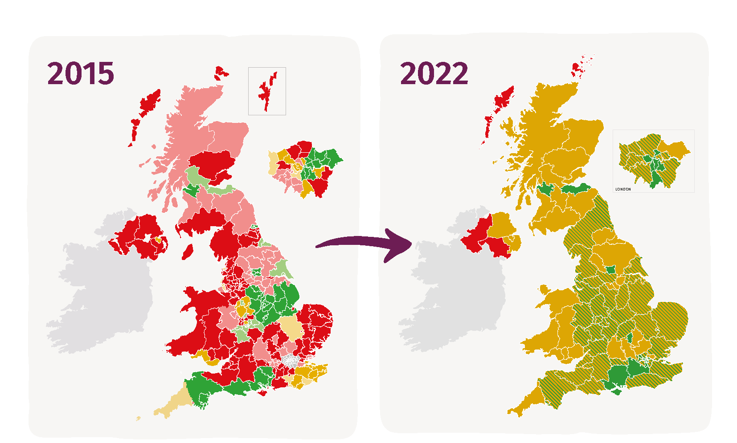

Slide 9
Minding the gap
What about the women who doesn’t meet the threshold for specialist intervention?
Notes:
But we always knew that this left a major gap for women with common MH needs who do not meet the threshold for specialist services, and for whom the outcomes of not having their suffering recognised can be just as devastating.
The most common major health complication of maternity is depression
Mental ill health remains one of the leading causes of maternal death in the perinatal period

Slide 10

Parity and prevention

Slide 11

Why parity is so important
50%
of women with depression go undetected
50%
of those detected do not receive treatment
50%
of those who are offered support do not receive NICE guideline quality treatment
If this was for physical conditions, it would be a scandal
Notes:
But this is not inevitable and not irreversible

Slide 12
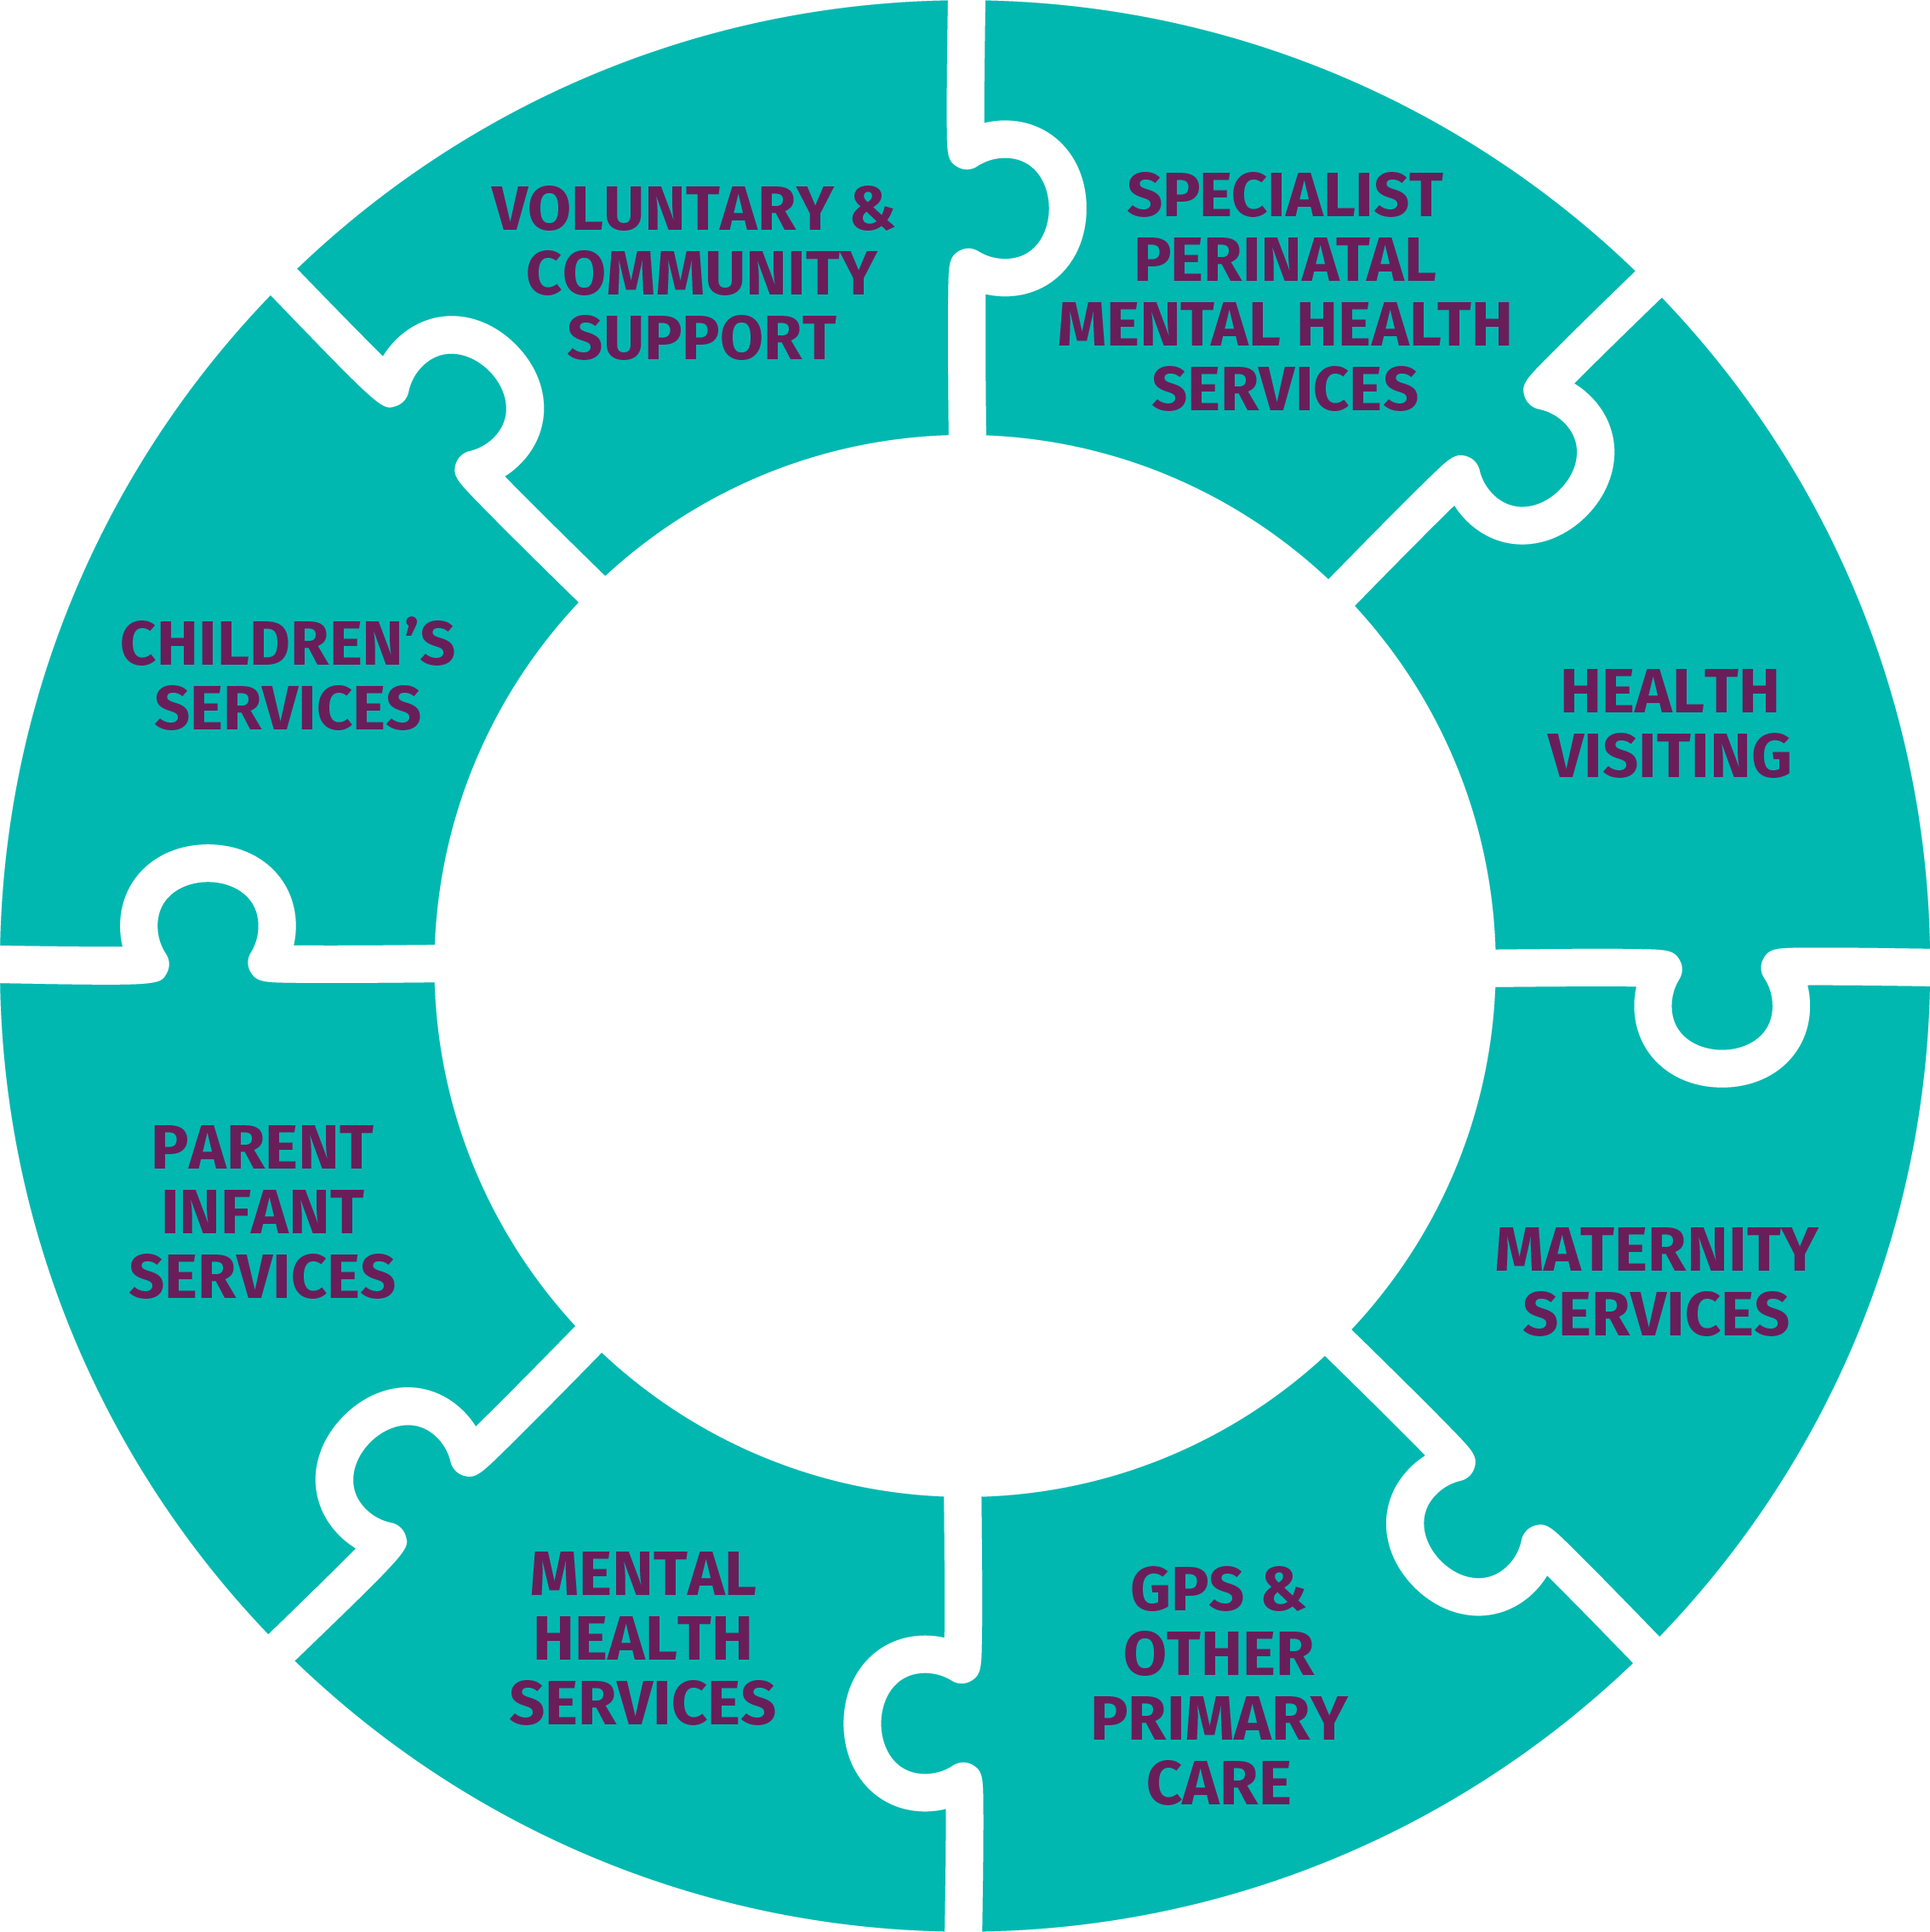
Make all care count
Notes:
Our next step is the Make All Care Count campaign, to support the investment and practice of professionals across universal services and wider pathway to provide support and care that works for ALL women.

Slide 13

Listening to women and families

Slide 14
Our survey said…
All respondents experienced at least one common physical/mental health condition
4 out of 5 most commonly experienced challenges related to mental health
Family and friends are a significant source of support
Social issues are a real factor, with the cost of living cited as the second highest factor exacerbating mental health issues
Childhood trauma also prevalent > as important as biological/hormonal factors
Fear of stigma and judgement is significant
Notes:
Deltapoll survery commissioned September 2022 of 500 new mothers.
Need to raise public awareness but after this, it is MWs, health visitors and GPs who women speak to – and most young mums go to professionals rather than family/friends

Slide 15
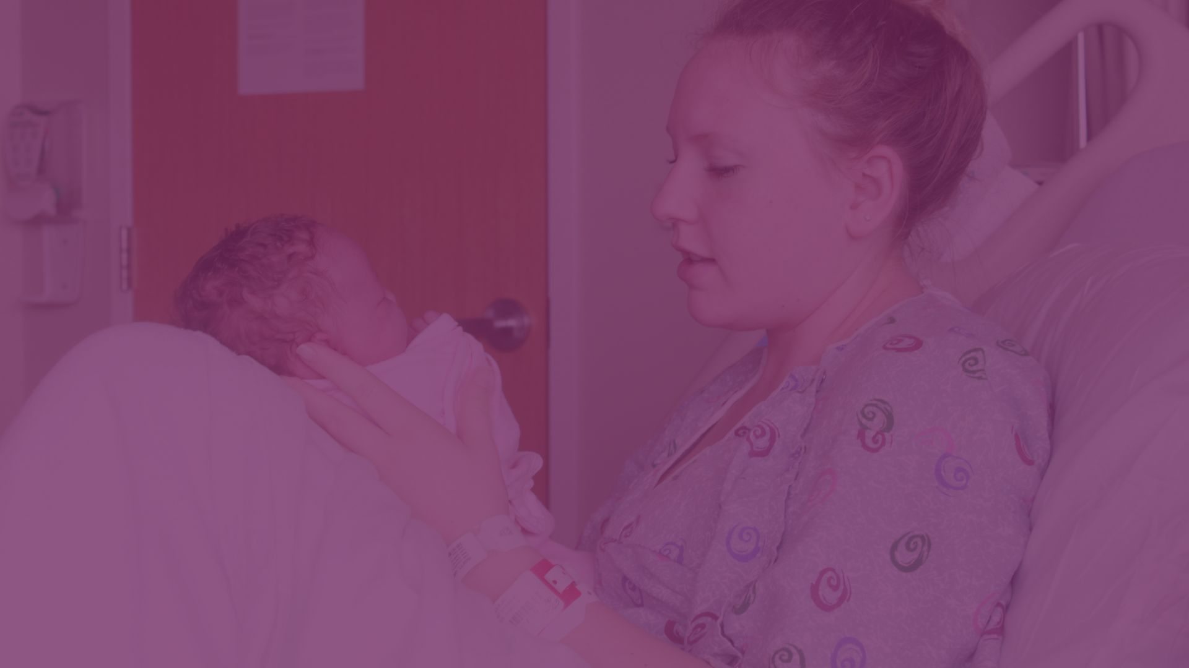
Increasing access to treatment
Notes:
For Common MH Issues and the Role of Universal Services in perinatal MH care

Slide 16

New economic research
Notes:
February 2022 - report commissioned from LSE - an Economic Case for increasing access to treatment for women with common mental health problems in the perinatal period.
advocates specifically for the Integration of MH support into maternity settings – they are especially well placed to identify problems early on, understand individual needs and take action

Slide 17
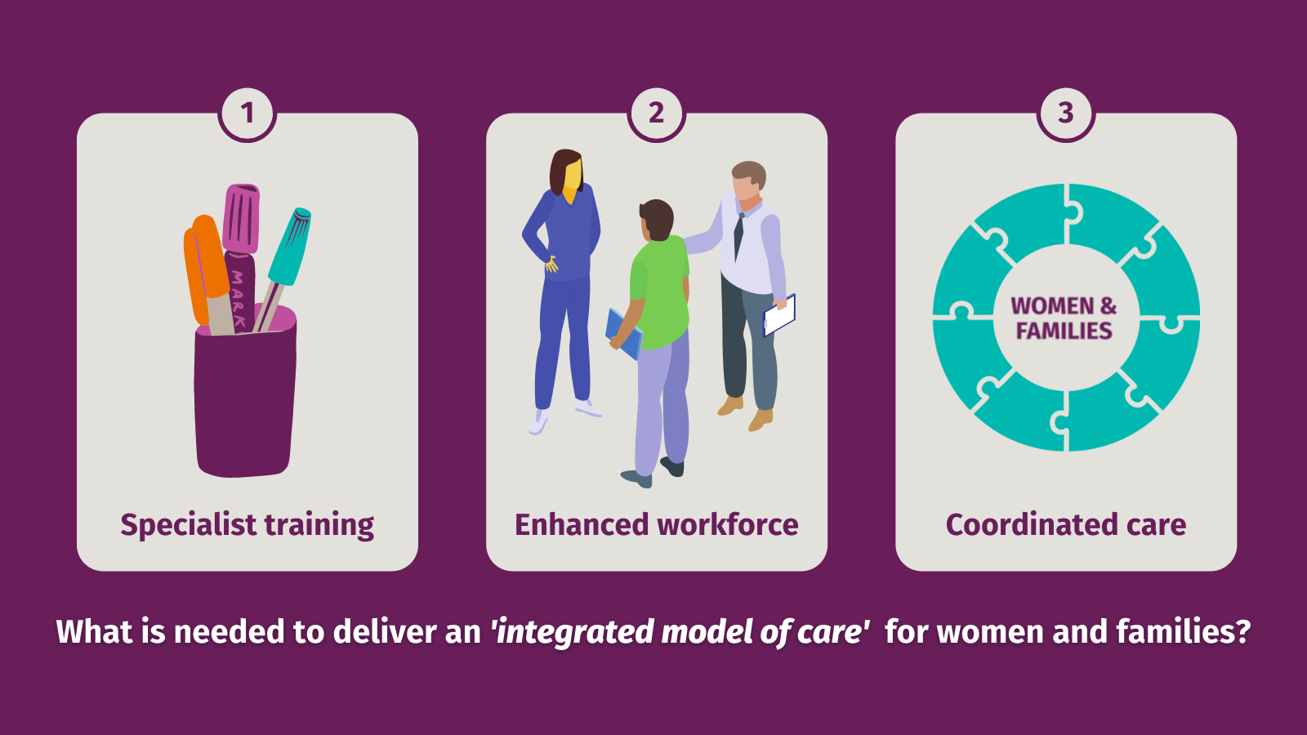
Notes:
The Model
Specialist PMH midwives and Specialist Health Visitors in this model would provide supervision, training and strategic oversight to a well-resourced workforce of midwives
Specialist MWs work closely in a multidisciplinary way with MH practitioners, who would provide treatment, alongside a new role for health visitors providing low-intensity interventions
Specialist HVs also providing MH support themselves for low need MH issues
Specialist HVs and MWs also support in setting up relevant collaborative arrangements - co-ordinate care across the pathway including importantly the VCSE.

Slide 18
The economic case
The LSE research finds that developing a model of service delivery in which mental and physical health care are integrated into the work of maternity and health visiting services generates nearly half a billion pounds of net benefit over a ten-year period.
This would involve 891 more health visitors, 347 more midwives, and 302 more MH practitioners are needed to support mothers’ mental health (in addition to identified shortages of 2k midwives and 5k health visitors).
On one hand we can’t be naïve about the real workforce pressures. On the other, we need to campaign for PMH support even more – the case is so compelling!

Slide 19


Context is key
Stigma and
other barriers
Health and social
care landscape
Inequalities

Slide 20






Stigma and barriers
Raising
awareness
Building
trust
Fear of
judgement
Social, cultural
and economic lives
Notes:
MMH embedded in universal services means it’s something we talk about all the time – reduces stigma
Raising awareness – Ensuring pregnant women and partners know the signs of emerging MH problems (and what to do if these occur)
Building trust – help women to feel confident speaking out –
Fear of child removal and judgement cannot be underestimated. Women don’t know what will happen if they do disclose
Exacerbated within the Context of social, cultural and economic lives and an understanding of the interplay with addiction, domestic abuse, poverty experiences of discrimination etc – additional layers of perceived (and sometimes very real) judgement, and interventions which can feel very punitive

Slide 21
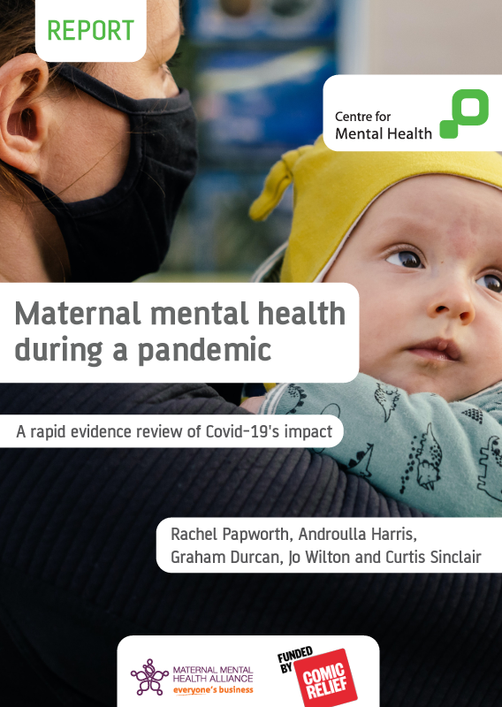
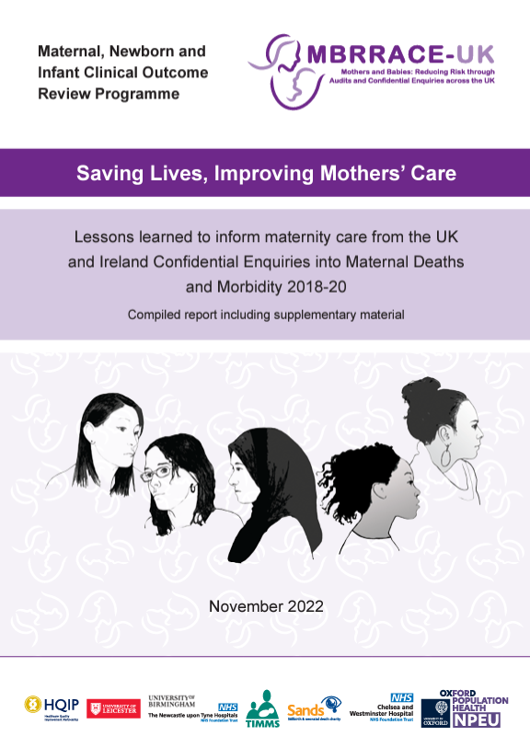
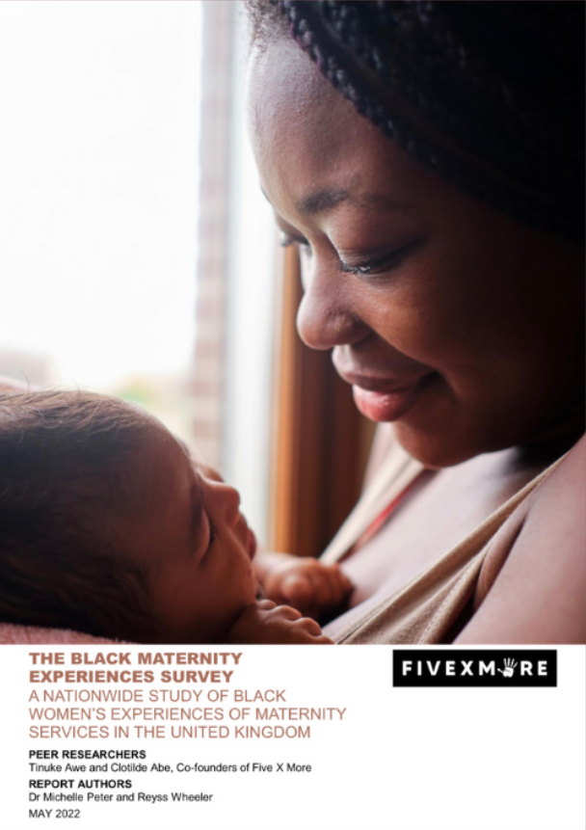
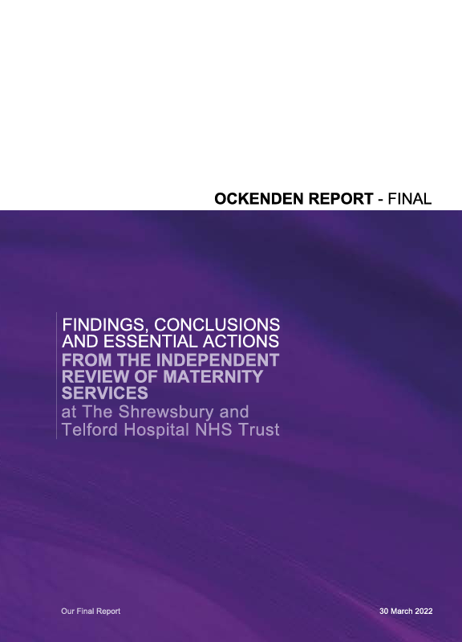
Tackling inequalities
Notes:
This is where we need to think about how we are reaching out to meet the needs of ALL women, including those who might have additional barriers, vulnerabilities, challenges & complex needs
We need a workforce who understand the intersection of ALL women’s experiences resulting in care which is consistently compassionate and effective

Slide 22

Health and social care challenges
Notes:
Within a context of a hugely stretched, exhausted workforce
We can only do this if midwives and health visitors are in sufficient numbers and have the resources – including training and time – to do this important work. And ongoing training – knowledge is developing rapidly and PIMH is a big area of academic research.
While the MMHA is committed to working with government and policy makers to do something transformational, we know that this is ambitious within the current context. But the passion in the PMH sector is extraordinary.
This is what makes it so exciting – we are the first generation who really understand so much about the parent infant relationship, the intergenerational impact of not doing anything – and we do know what to do!

Slide 23
We have already created change which we never dared to imagine – so we know bigger and better is absolutely possibly when we work together!

Slide 24



Stay in touch
www.maternalmentalhealthalliance.org
info@maternalmentalhealthalliance.org
@MMHAlliance on Twitter and Instagram

