Slide 1
Policy in the first 1001 days
ncb.org.uk

Slide 2
There is much we can welcome in recent government policy…
Recognition of the first 1000 days of life
Integrated approaches to health and care
Co-production with families and communities
Targeting health inequalities and vulnerabilities
Focus on family support and the parent-child relationship

Slide 3
2022 – NHS structural reform

Slide 4
Integrated Care Systems – July 2022
Integrated Care Systems are partnerships between the organisations that meet health and care needs across an area
Their role is to plan and commission services in a way that improves population health and reduces inequalities
Integrated Care Boards will replace Clinical Commissioning Groups. There are 42 Integrated Care Boards compared to 200+ Clinical Commissioning Groups

Slide 5
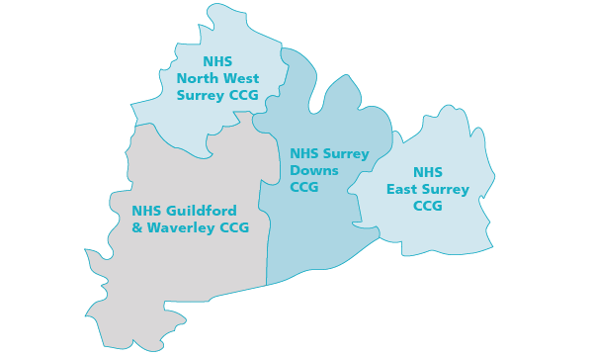

Slide 6
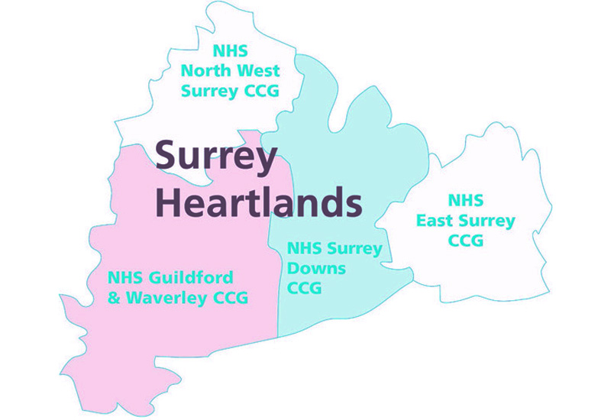

Slide 7
Children must be a priority within ICSs
ICBs will be required by primary legislation to set out how they will meet the needs of babies, children and young people
NHS England will issue statutory guidance that states that each ICB must nominate an executive children's lead
There will be bespoke guidance for ICSs on meeting the needs of babies, children and young people

Slide 8
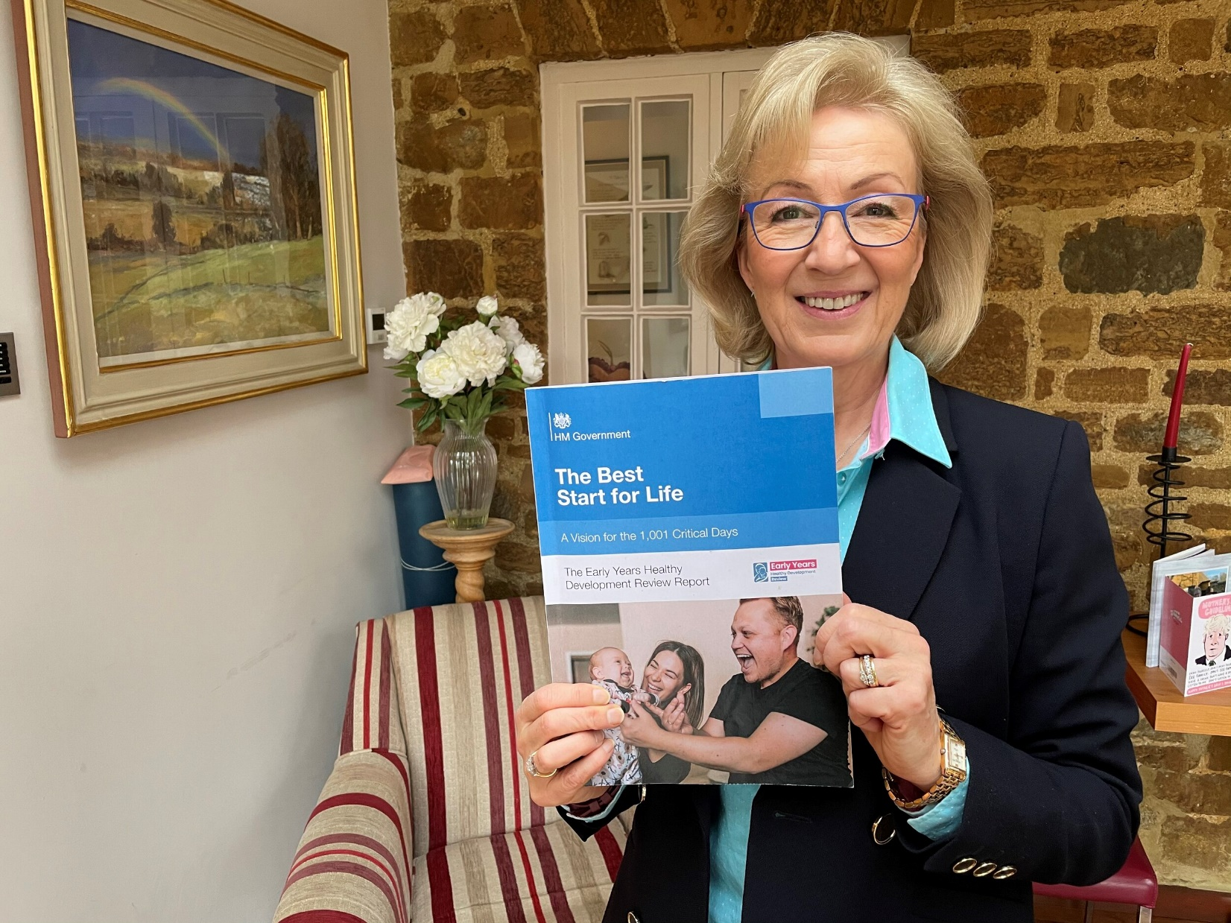
Start for Life

Slide 9
Investment and service development in:
Parent Carer Panels and a local Start for Life offer
Breast feeding support
Infant parent mental health services
Parenting programmes
Workforce pilots

Slide 10
Family Hubs

Slide 11
A good Family Hub has…
An effective multi-agency board and joint commissioning plan
Families and young people co-designing services and programmes
Pooled budgets across a range of funding sources
Start for Life as a core element of delivery
Family Hub Model Framework, DfE, 2021

Slide 12
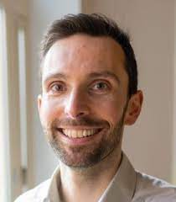
Independent Review of Children’s Social Care
Reporting Summer 2022
“There are serious shortcomings in how we support families who are struggling to parent their children in conditions of adversity”
“No situation in the current system where we will not need to spend more money”

Slide 13
2023 Spring Statement

Slide 14
General Election 2024
The NHS
Public sector workforce, including pay and conditions
Early Education and Childcare
Child poverty

