Slide 1
Using National Audit to improve Hip Fracture Care Locally
Konrad Wronka
Dr J Nicholson, Dr M Suresh, Trixie Douglas, Nikki Smith, Ann Alexander
West Suffolk Hospital, Bury St Edmunds
Hip Fracture Summit, 9 December 2022

Slide 2
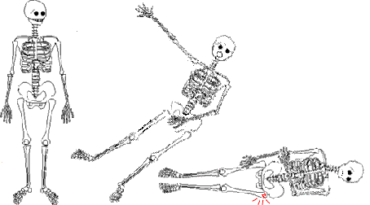

Slide 3
Aim
Meeting the NHFD Key Performance Indicators
How do you convince your board to give the highest priority to hip fracture patients?
Ensuring the sicker, older, frailer patients are at the top of the surgical list
How we have reduced delays in surgical operations as a result of avoidable
inefficiencies in preoperative planning or in the organisation of theatre lists
Impact of Covid-19: changing practice
Using audit data to monitor care and prompt change
Using RCA to investigate and understand causes of breaches
Teamwork and implementation
Evaluating the impact of service change

Slide 4
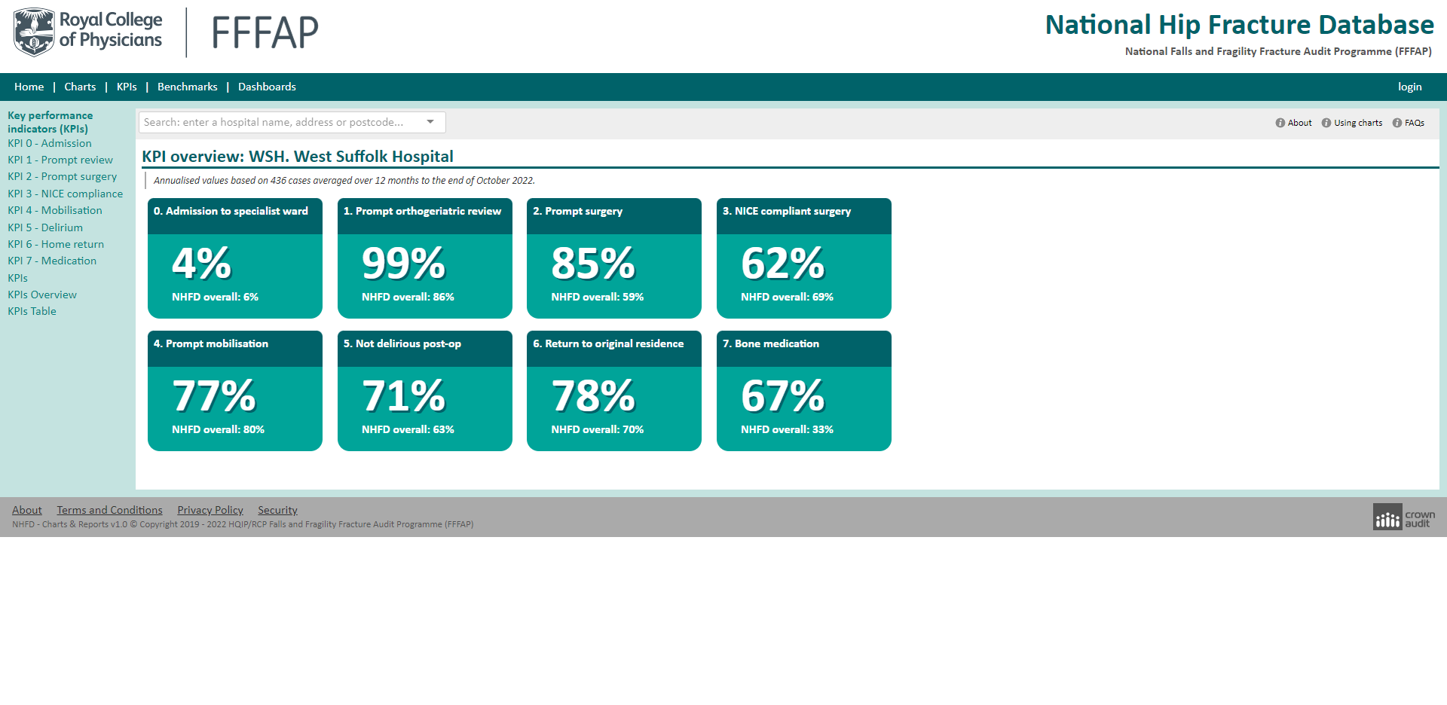

Slide 5

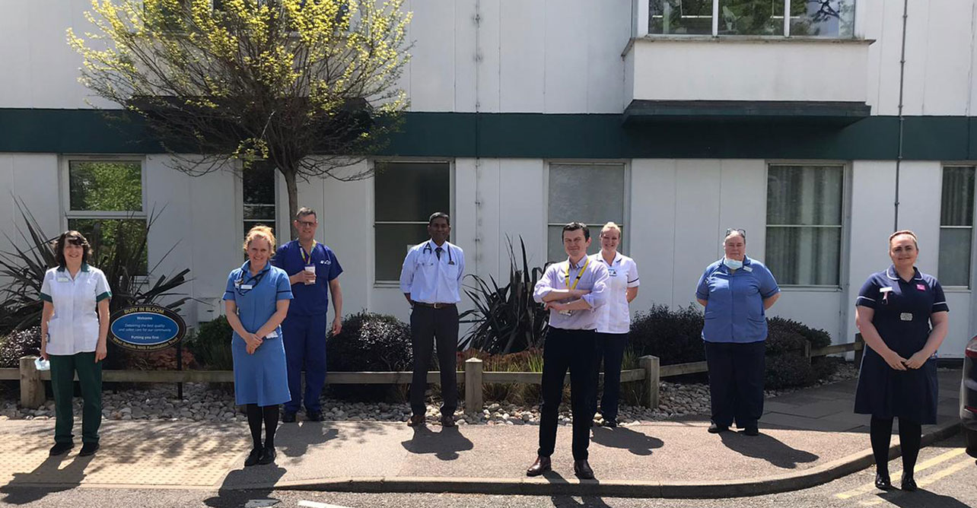
WSFT Hip Fracture Team
Notes:
Hello everyone, and thank you very much to the organisers for inviting us back to speak at this summit. We thought we’d do something a little different and take turns to present a case, in the context of the ever changing hip fracture environment, and hope that you find it inspiring, enlightenting and perhaps a little bit amusing!

Slide 6
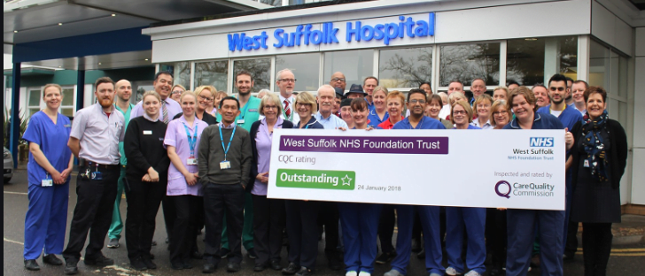
We are all Hip Fracture Team!

Slide 7
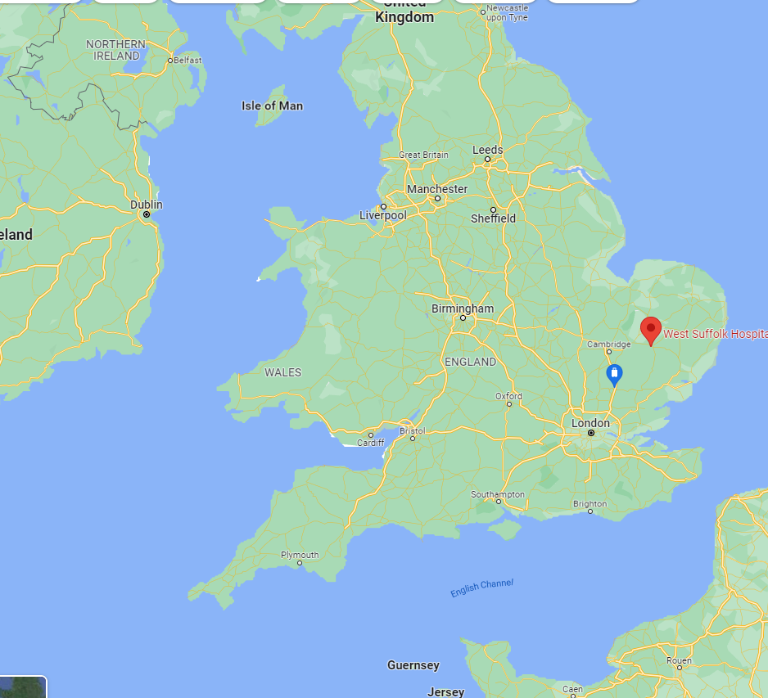
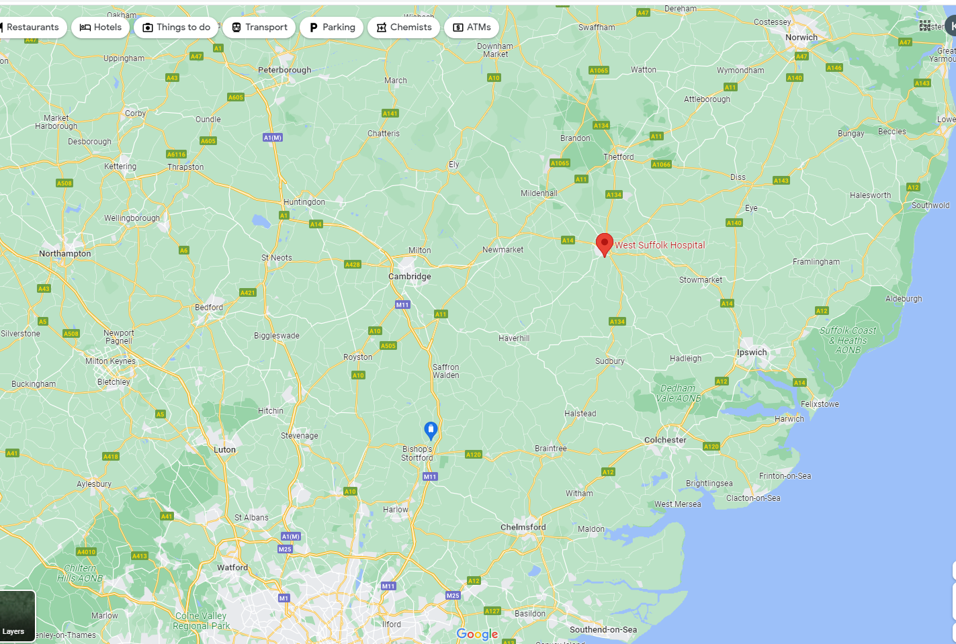
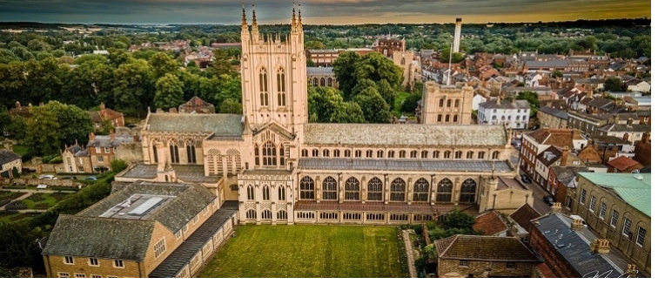
Beautiful cathedral town in East of England

Slide 8
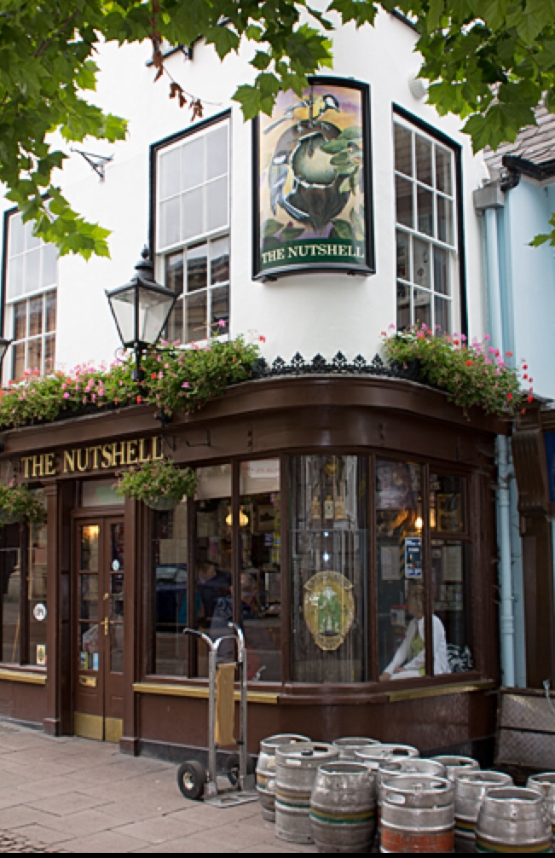
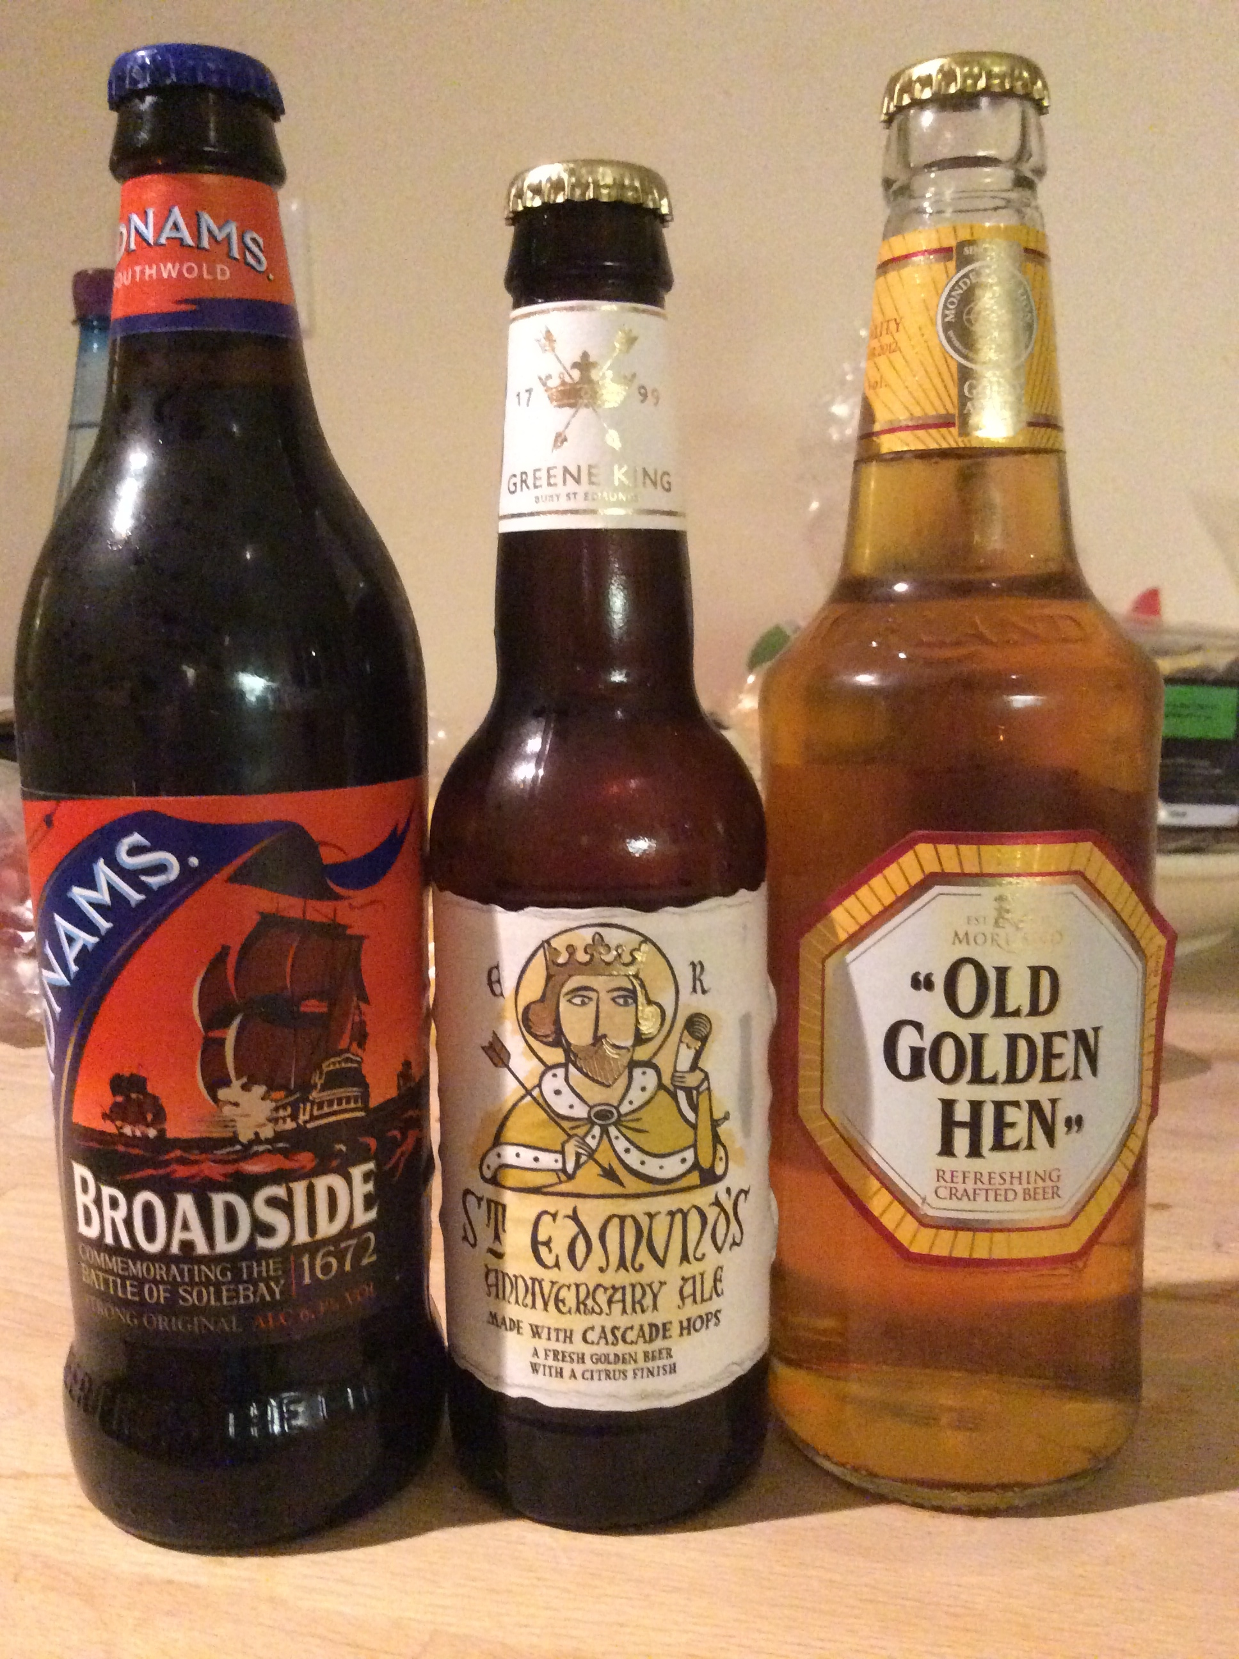
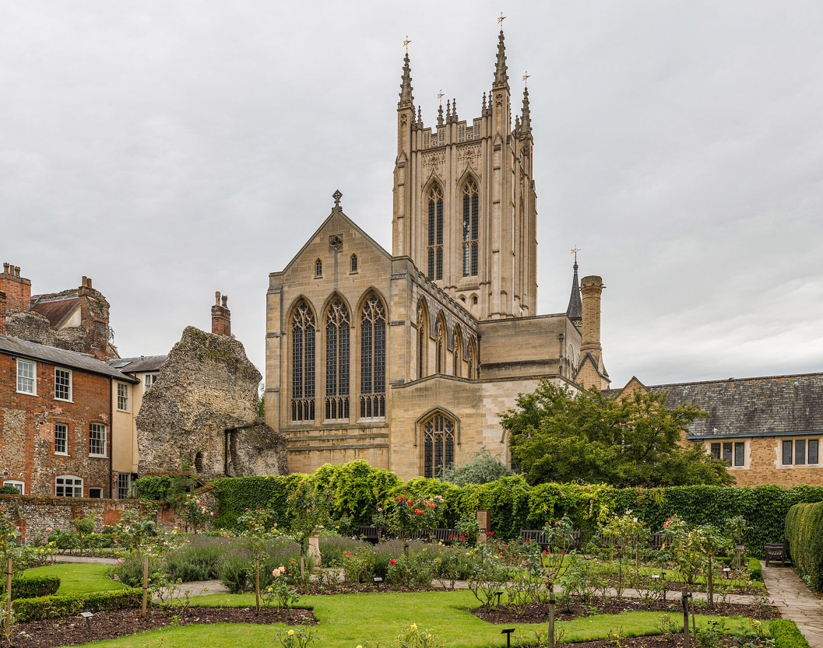
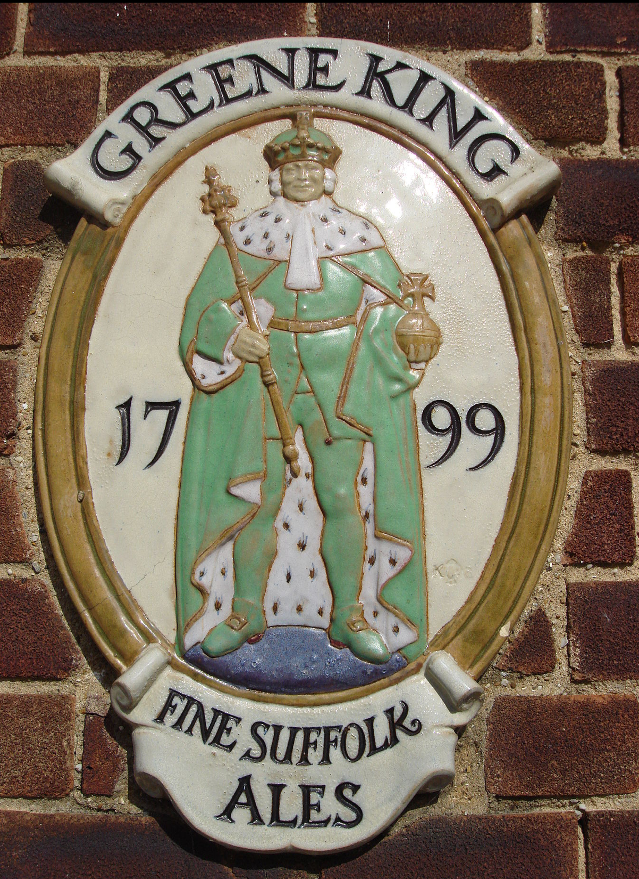
Bury St Edmunds

Slide 9
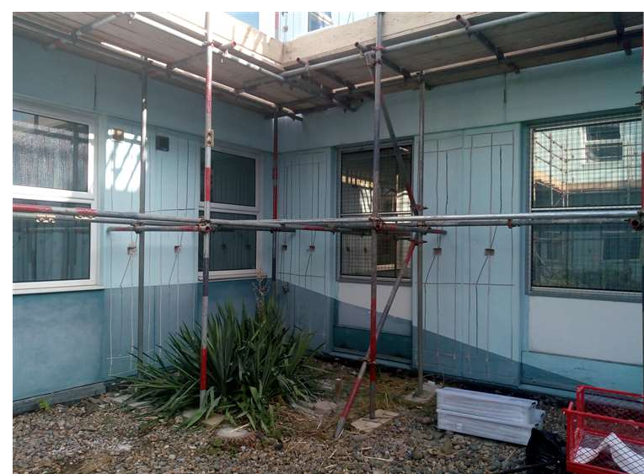
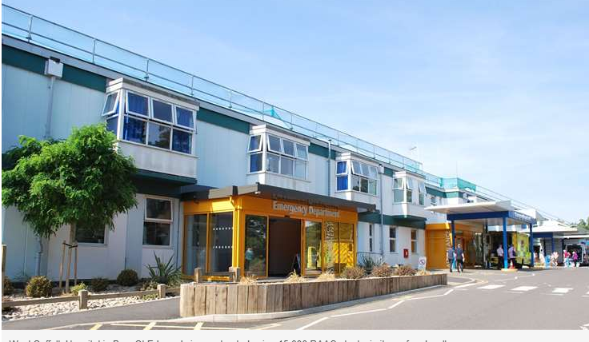
West Suffolk Hospital
Less beautiful hospital
500 beds
Too small for population
With roof that may fall any time
And usually looking like that…

Slide 10
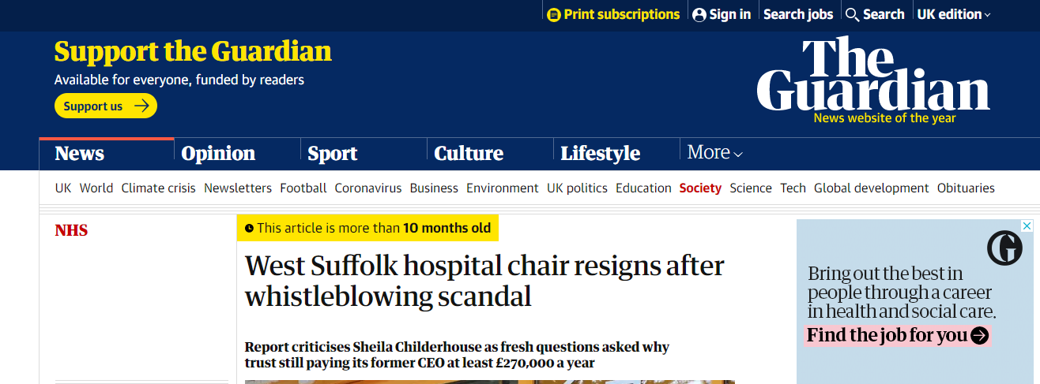
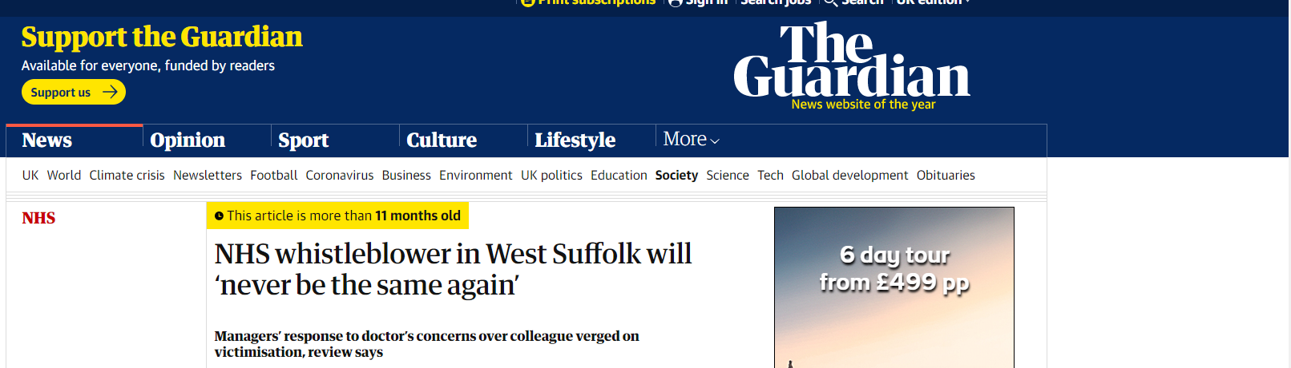
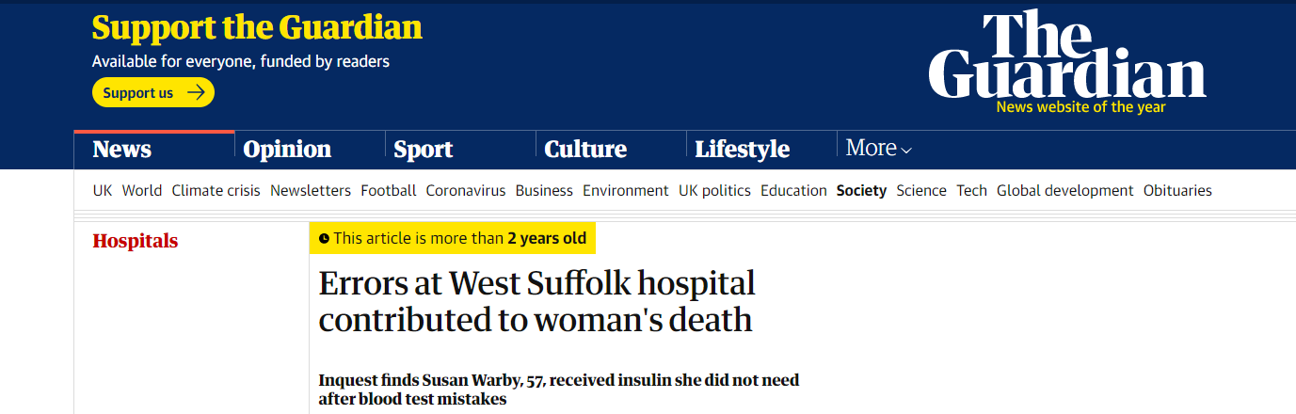
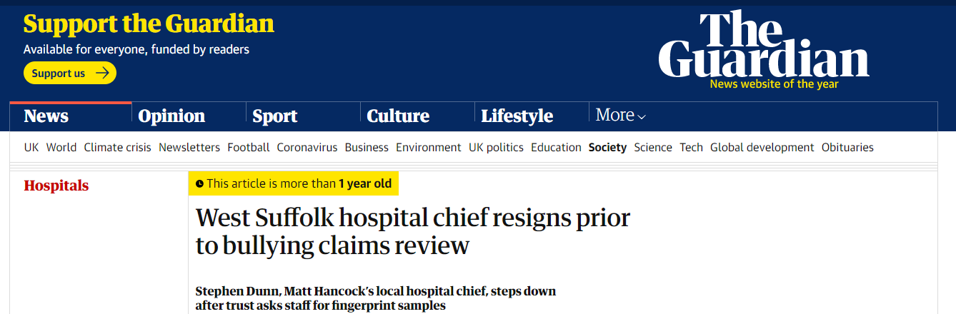
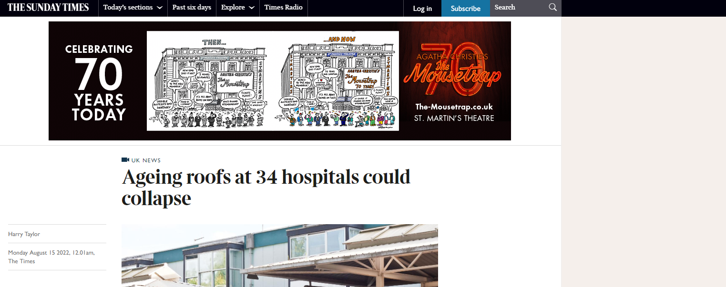

Slide 11
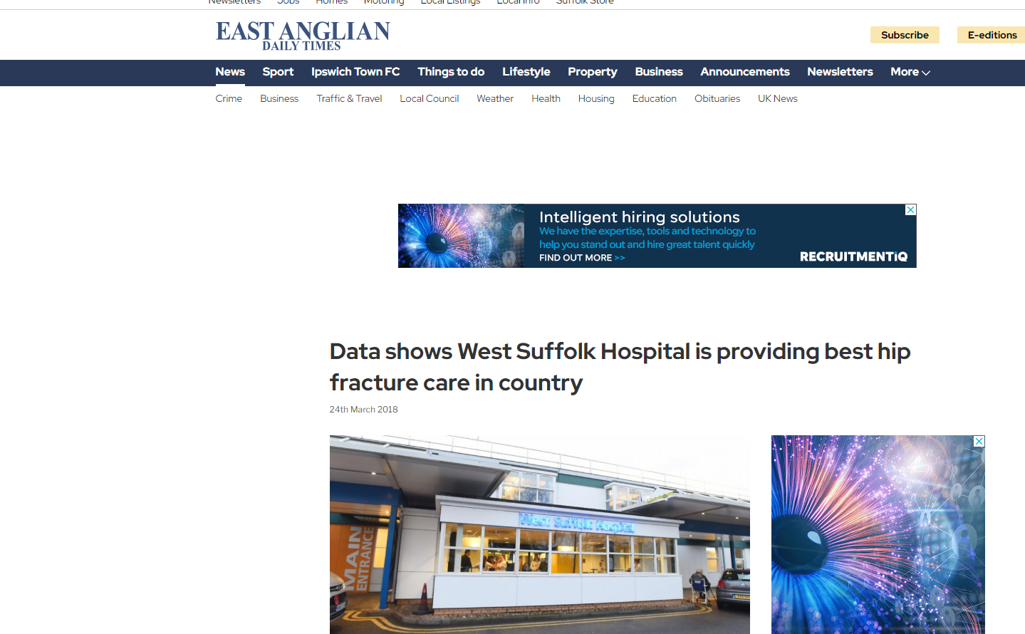
But we pride ourselves in hip fracture care…

Slide 12
Hip Fracture Team
Meet once a fortnight
(minuted)
Review Hip Fracture Service performance
All breaches and issues investigated and discussed/RCA
#NOF performance discussed at monthly CG/consultants meeting
Results disseminated
Lead by example

Slide 13
Nurse Practitioner
Currently Trixie and Helen
Trixie->>2 new posts
8-20 Mon Fri
Trauma coordination
Data input
# NOF admissions
Prioritisation
FIB
Bone Protection
Link orthogeriatritian

Slide 14
Trauma Practitioner
Hip # priority
They understand
Consultants and doctors not always…

Slide 15
Trauma Practitioner
Trixie retiring date known 2020
Raised with T&O and management since
Business plan 2022….
Approved summer
Interviews Nov 2022
2 additional recruits
  To provide 7 days service
  To provide better care

Slide 16
National Data
65900 cases in 2021
63284 cases in 2020
65600 cases 2019
30 day mortality 6.5-8.5%
30-day mortality was three times higher for patients with COVID-19
One year mortality 25-30 % – worse than many cancers!
Length of stay 15 - 20 days
Massive cost to NHS ->£1B, >1% of all NHS budget
Notes:
And we want to make it better

Slide 17
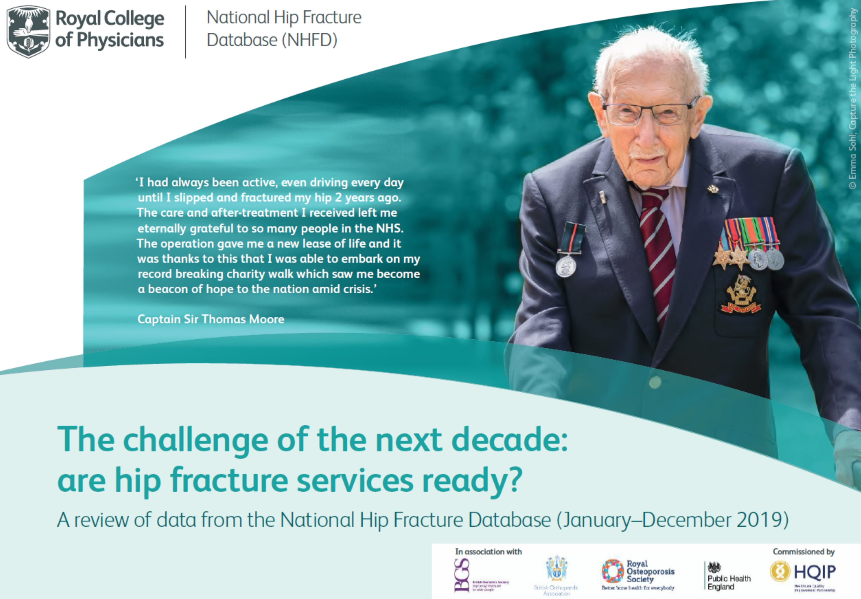
Notes:
QiP

Slide 18
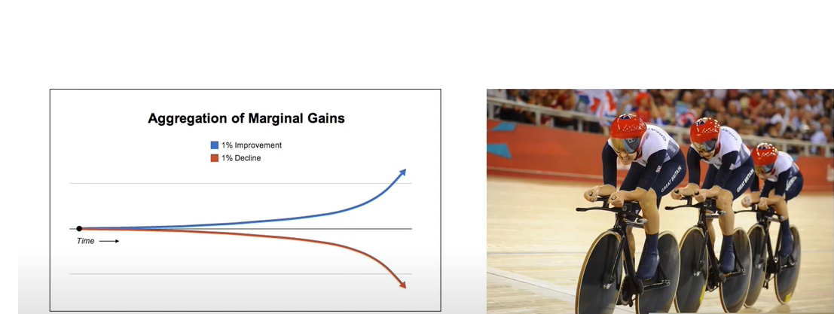

Slide 19
West Suffolk Hospital
346 cases 2019
358 cases 2020
376 cases 2021
Close to 400 in 2022 expected

Slide 20
T&O
10 consultants on call (Mon-Thur and Thur-Mon)
2x Trauma Practitioners
Since 2021 Mon-Sat all day trauma list (0800-1730)
One Trauma ward 34 beds
One geriatrician….
Under resourced but very good team punching above their weight!

Slide 21
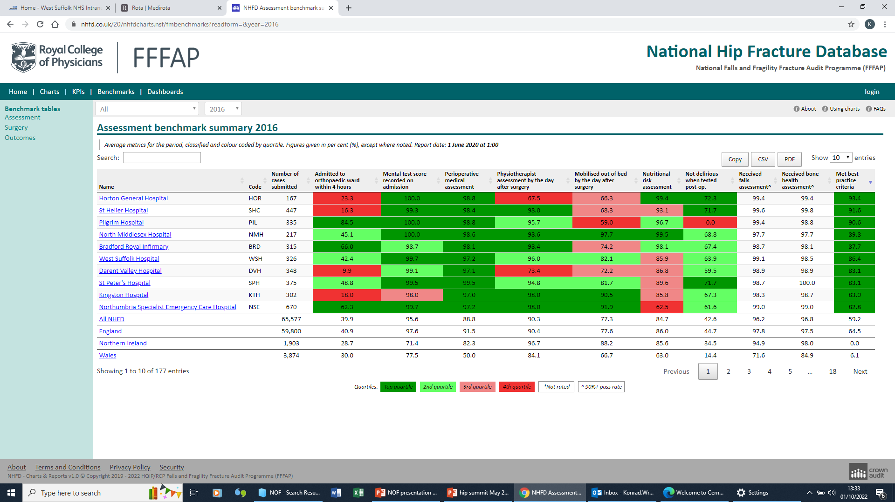
2016

Slide 22
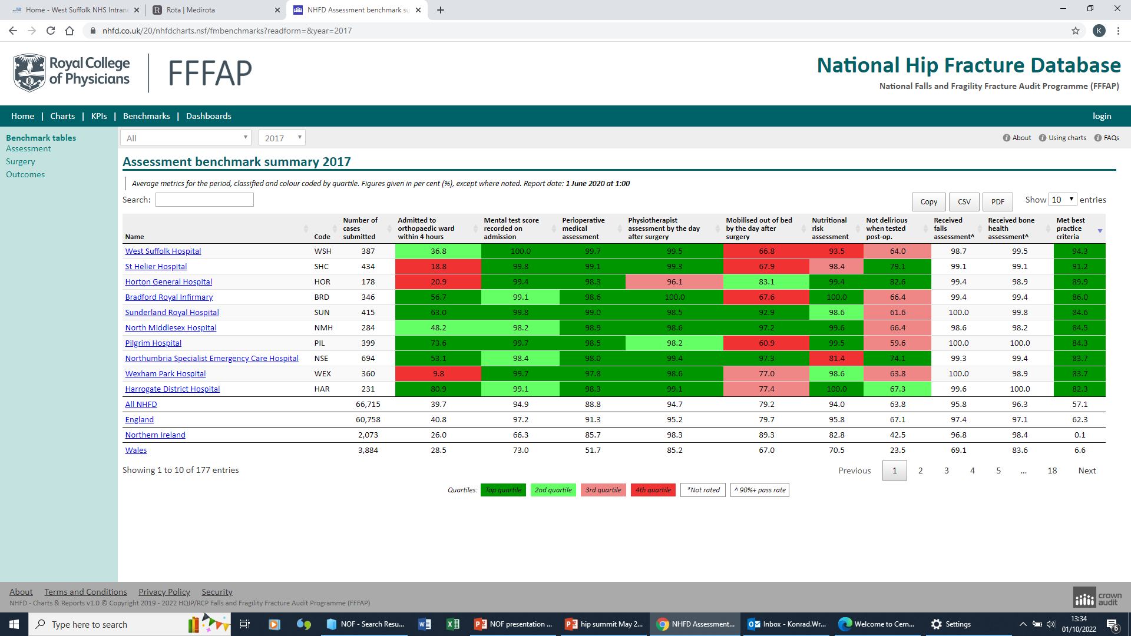
2017 – top f the league

Slide 23
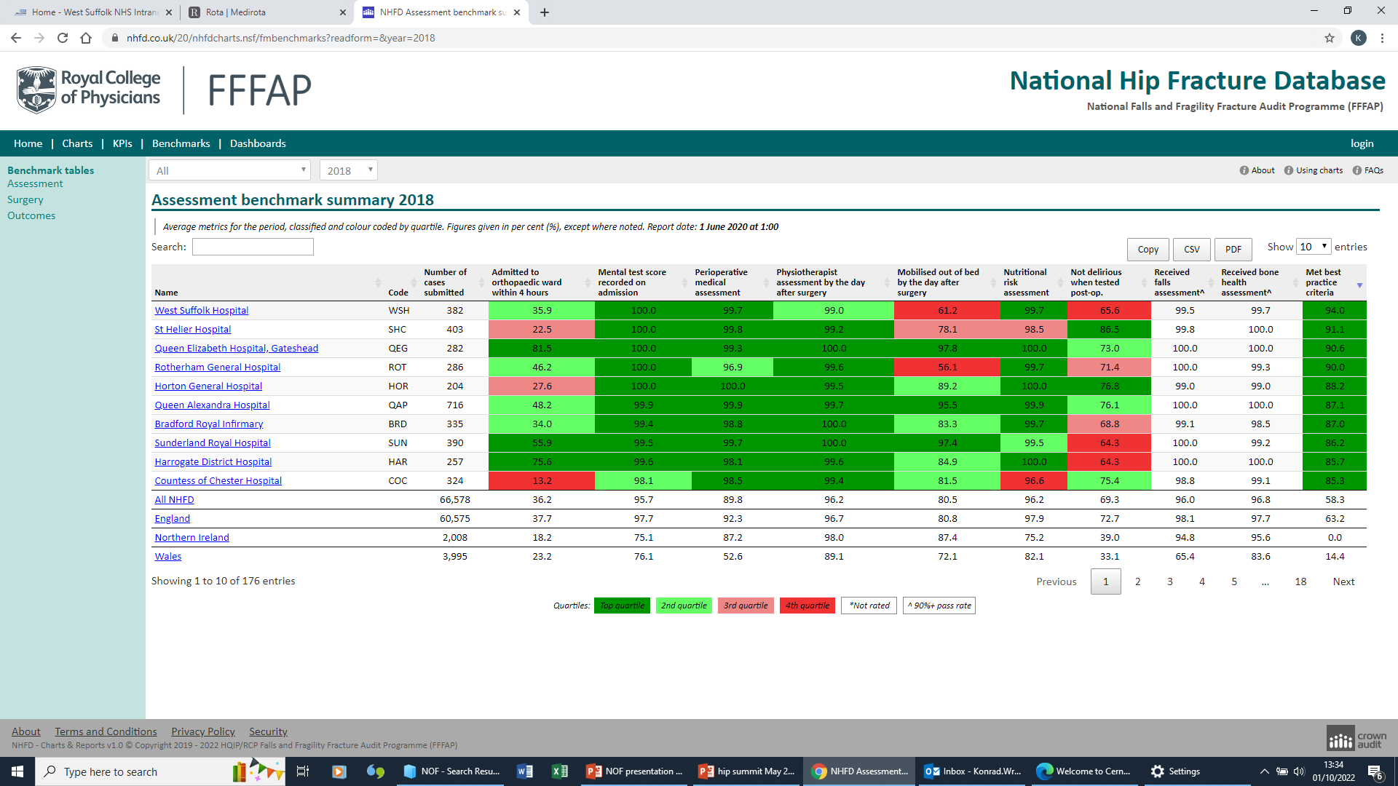
2018 again…

Slide 24
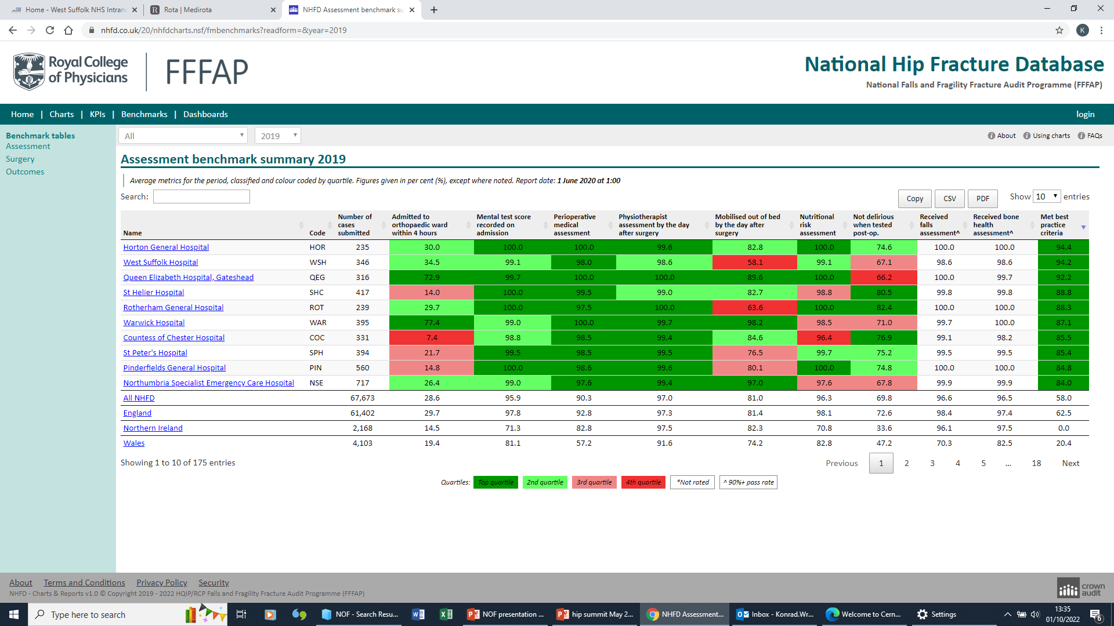
2019 – not that good…

Slide 25
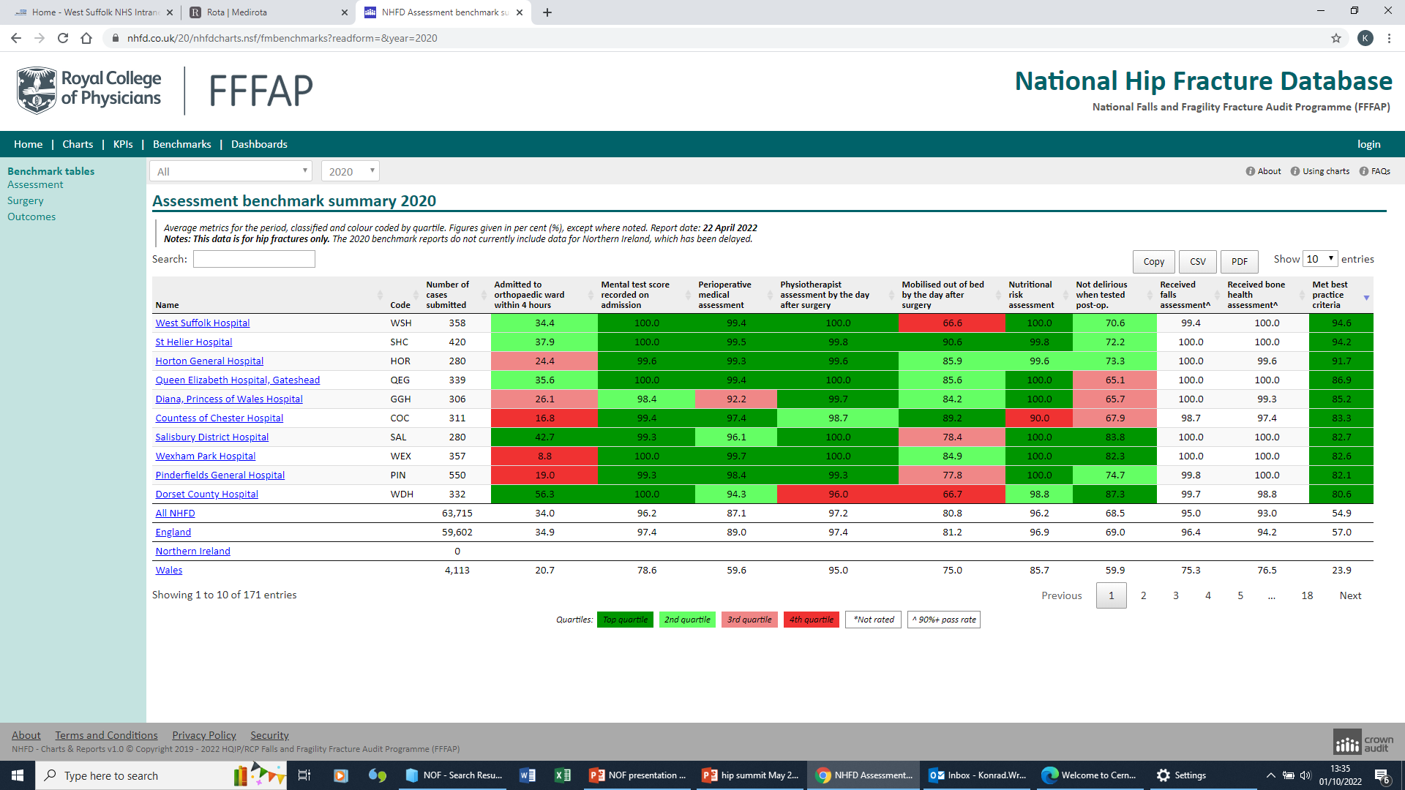
2020 top again

Slide 26
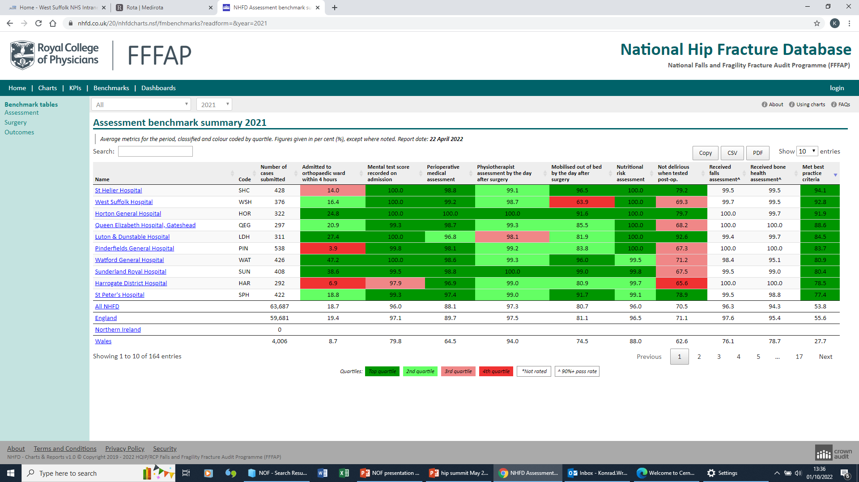
2021 sadly not..

Slide 27
Ensuring the sicker, older, frailer patients are at the top of the surgical list
Team work in T&O
Prioritisation of Geriatric trauma
Great support anaesthetic team
No patient to sick to anaesthetise
  Actually to sick to wait another night

Slide 28
How we have reduced delays
Evening before planning
Assessment by anaesthetic team evening or night of admission
Golden Patient rule
Pre operative templating and surgical planning
Theatre meeting with all day plan before list starts
Anticoagulation policy for patient having emergency hip surgery

Slide 29
Best Performing Trust?
Meeting the NHFD benchmarks
Using audit data to monitor care and prompt change
Team work
Evaluating the impact of service change
Ambition

Slide 30
Results – COVID- 19 Times
Fracture of Neck of Femur monthly report
 | 01/01/2020-30/11/2020 | Jan-20 | Feb-20 | Mar-20 | Apr-20 | May-20 | Jun-20 | Jul-20 | Aug-20 | Sep-20 | Oct-20 | Nov-20
Number of #NOFs | 332 | 26 | 29 | 26 | 34 | 25 | 23 | 28 | 28 | 40 | 44 | 29
BPT% (Best Practice Tariff achieved) | 93.37% | 92.31% | 100.00% | 100.00% | 88.24% | 88% | 91.30% | 92.86% | 92.86% | 97.50% | 90.91% | 93.10%
Number of patients lost to BPT | 22 | 2 | 0 | 0 | 4 | 3 | 2 | 2 | 2 | 1 | 4 | 2

Slide 31
Covid 19 impact
Increase in trauma numbers
Increase in # NOF
Increased frailty
Decreased staff morale
Decreased theatre efficiencies
Decrease in number of theatre porters…
Equipment issues (?Brexit?)

Slide 32
GIRFT for Trauma review Nov 2020
Excellent overall practice
Recommendations:
  Need 7 days trauma list
  Day 1 mobilisation
  7 day/week orthogeriatrician

Slide 33
Exec team
Girft helped!
Voice of all Department is loud

Slide 34
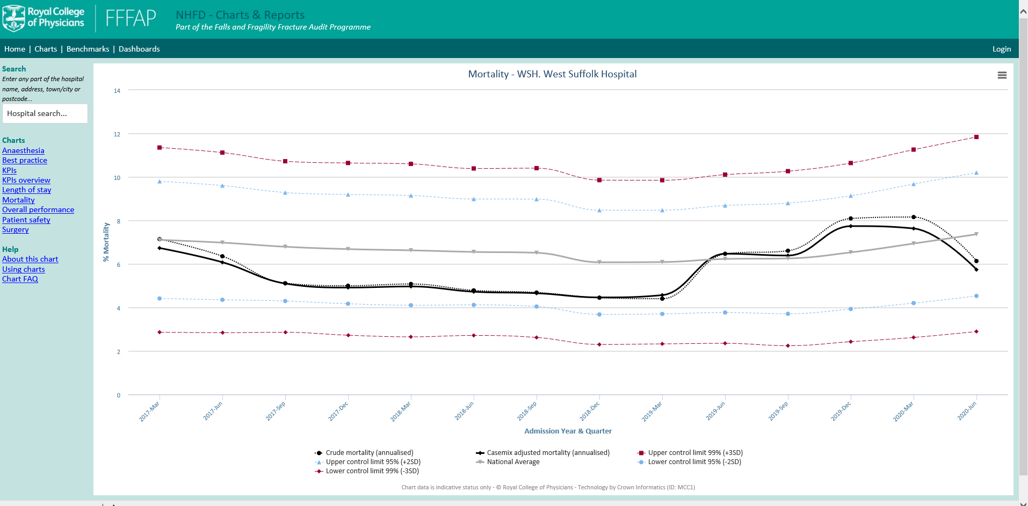
Our mortality

Slide 35
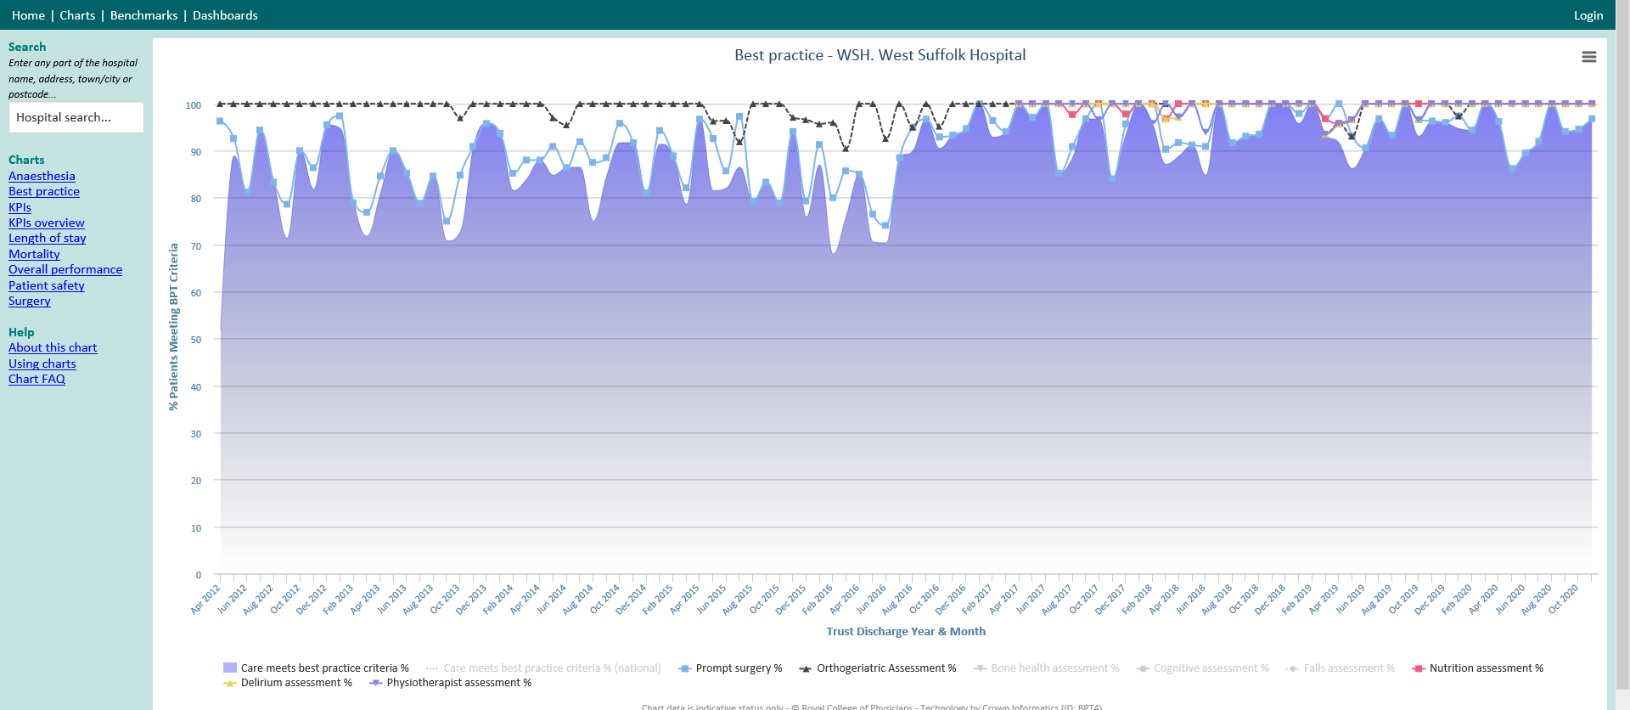
Covid-19
All day trauma list Mon- Sat

Slide 36
Covid 19
All day trauma list!!

Slide 37
Review-Risks We Identified in past
PT Cover weekends
Th Capacity M-F
7 Day working
DOAC’s
Handover Hiatus
Ward staffing/beds
Notes:
And we worked on each

Slide 38
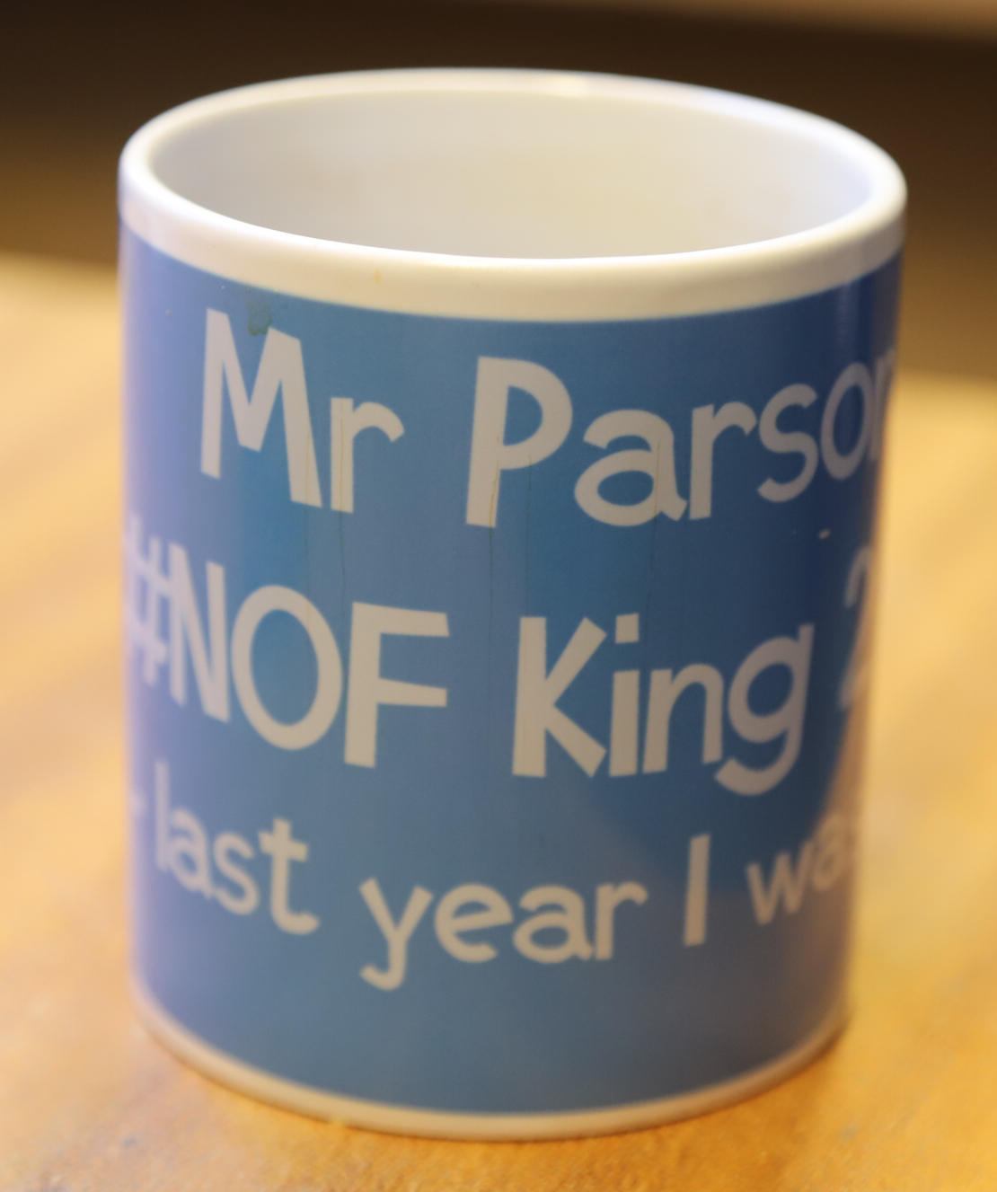
Change – Not Easy
Make it competitive no-one likes being last!
Introduce incentives
Human Factors?
Share your information

Slide 39
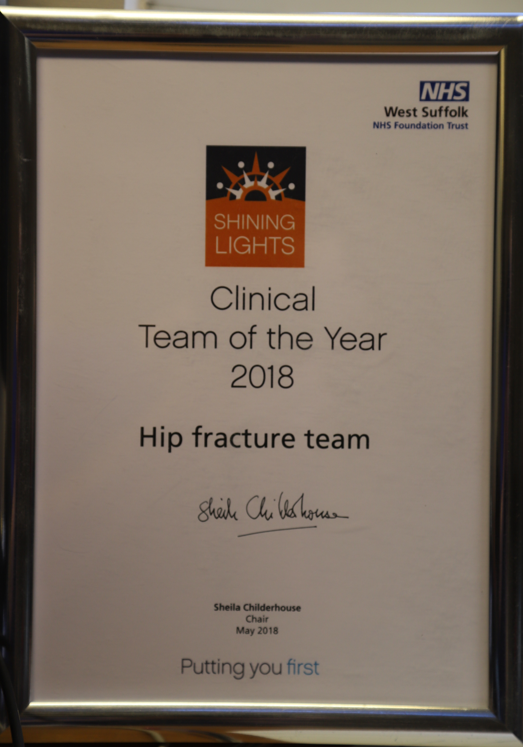
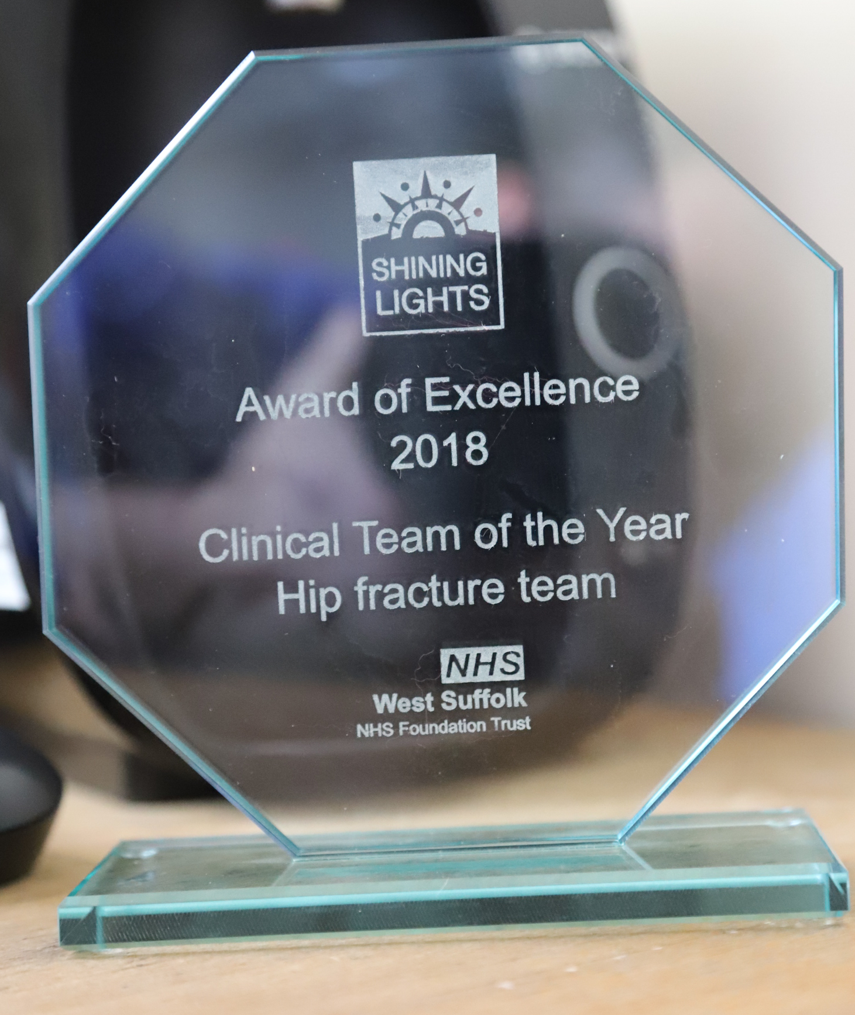
Change – Not Easy

Slide 40
Scaling up
'Golden Patient’
Early Anaesth Review
Th8: 8.15am send (wish)
Prioritization
Consultant Education
Haematology
Cardiology
Weekend Trauma Lists
Longer Trauma List

Slide 41
Marginal Gains
Dietician
Consultant lead surgery
Peri operative warming
Fascia iliaca block
Delirium Assessment and Rx
Ferrinject
Family information

Slide 42
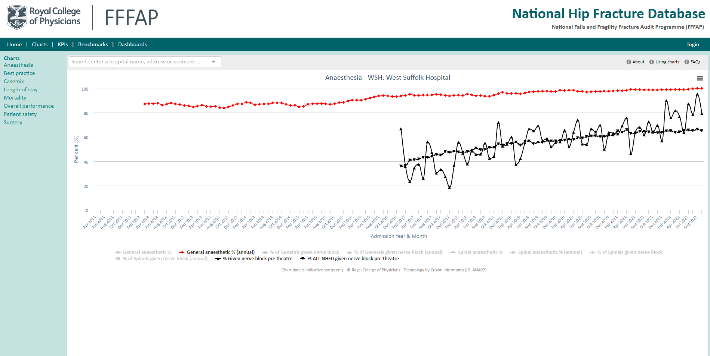

Slide 43
Ongoing audit

Slide 46
Challenges
Maintaining Standards
Revision/Reoperation Burden
Peri-prosthetic #
Only five surgeons able to do THR (3 on on call rota)
Extending trauma lists

Slide 47
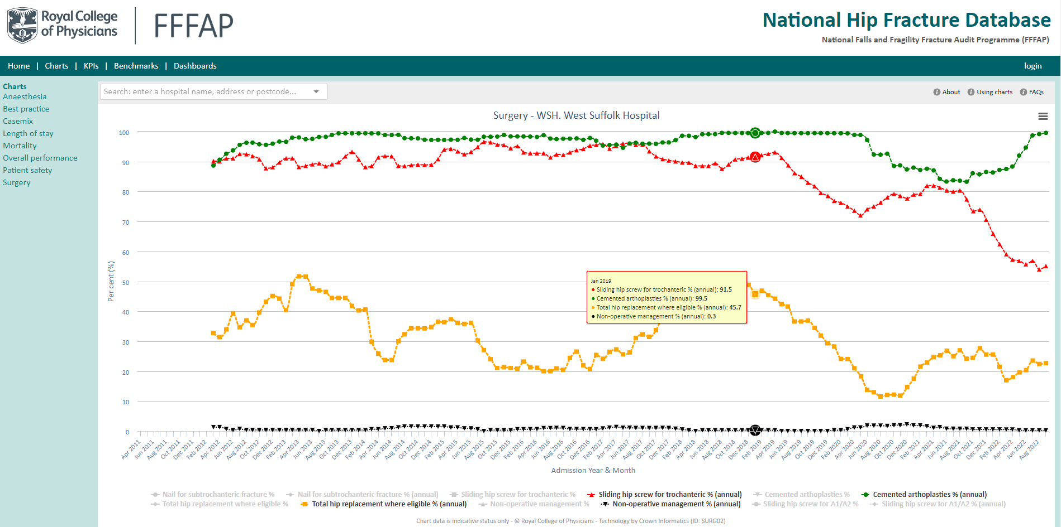

Slide 48
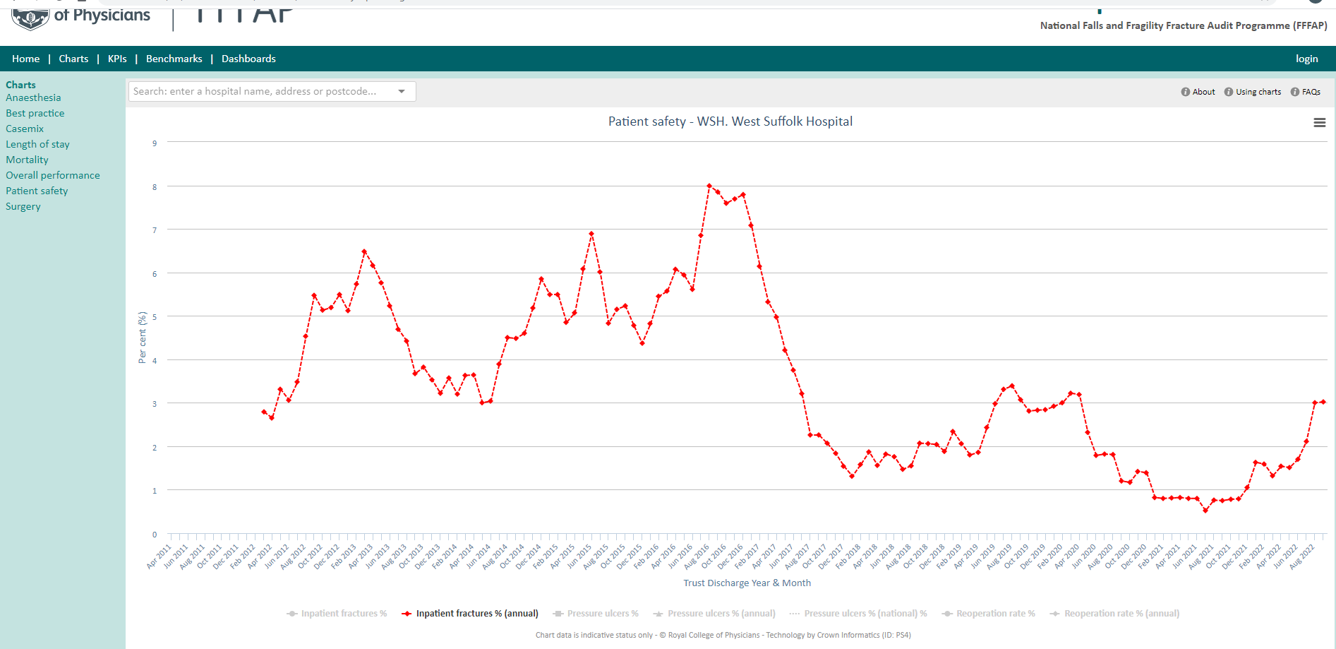

Slide 49
Continuous audit
Regular meetings
Regular review of performance

Slide 50
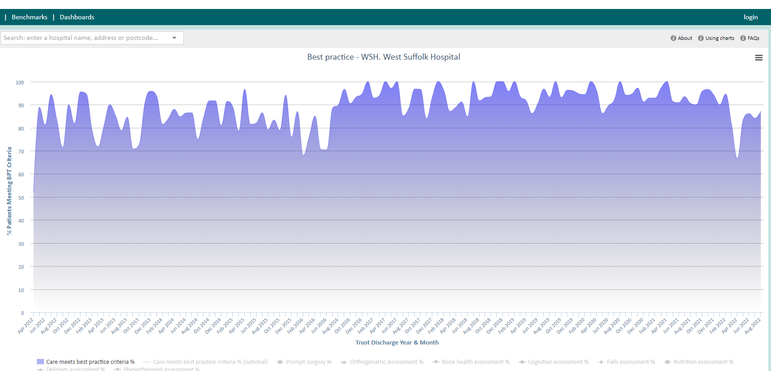
Disaster
Only 66% BPT

Slide 51
Jan – July 2022
44 patients care not met BPT criteria
  1 AMTS
  3 Physiotherapy (weekend sickness and poor communication)
  3 geriatrician assessment (1 RIP in recovery)
  36 time to theatre
    1 due to DOAC
    4 due to medical review/investigation/stabilisation

Slide 52
It matters
Better outcomes
Mortality, inpatient stay, morbidity, return to usual place residence all improved in recent years
Each BPT patient generates £1366 extra for the Trust
44 patients = £60k
Against 2021 same period- loss = £40980

Slide 53
Audit – Helen Boulton / KW
Jan-Jul 2022
36 patients waited more than 36hrs for surgery
9 of them died
25% mortality
historical mortality WSH – 6%.
First covid wave- mortality 8%

Slide 54
Big concern
Data reviewed regularly
Alert on CG meeting
Risk register and alert exec team
Inter-Departmental discussion
Remedial plan
7 day / week trauma list agreed (not yet in place)
Last month data a lot better again
Must not lower our guard

Slide 55
How do you convince your board to give the highest priority to hip fracture patients?
Data
Complications and mortality
Carrot and stick
Communication

Slide 56
Trauma list efficiency
Golden patient
  Difficult discussions
Ownership
Theatre flow
Consultants pushing patients to theatre

Slide 57
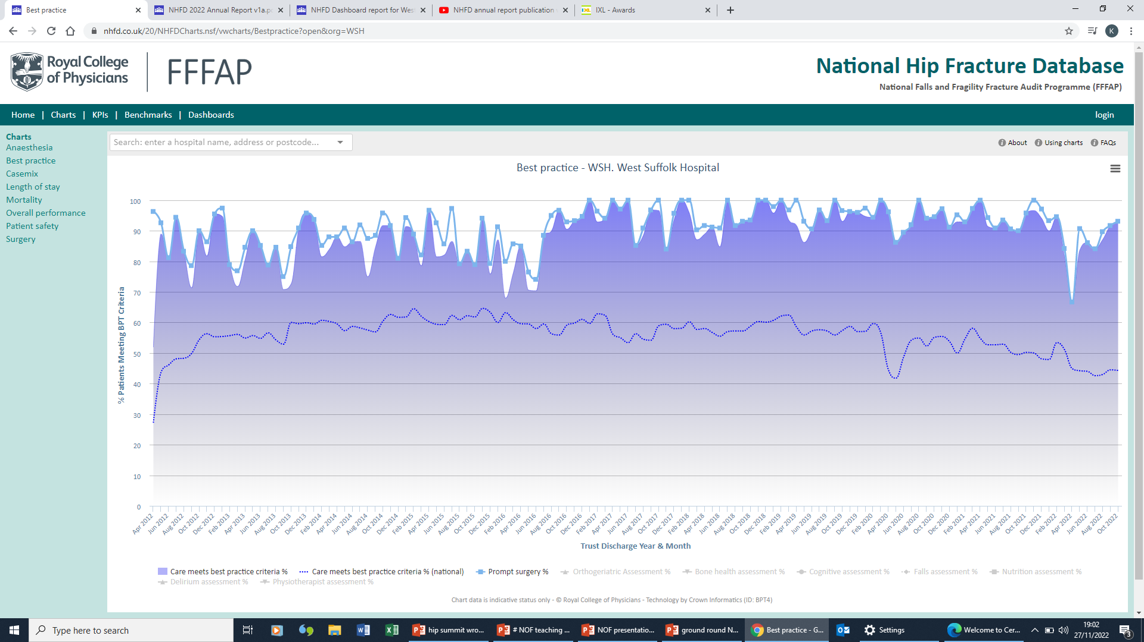

Slide 58
Together we can do more

Slide 59
Tips for Improvement
Review NHFD data regularly
Make it personal
Expect challenges
Involve Exec team
Strong Leadership and Core Team
Be clear about your plan
Involve the rest of your department

Slide 60
Questions?

