Slide 1
Developing your role as a Ward Manager
Paul Rafferty
Deputy Chief Nurse
York Teaching Hospital NHS Foundation Trust

Slide 2

The journey…

Slide 3
Know your focus
Tip number one…

Slide 4
Your focus…
Your Staff
Your organisation
Your Patients & families

Slide 5
Know your role
Tip number two…

Slide 6
The Ward Manager role…
Ensuring that staff are clear about what they are doing and why, and have the skills to do their jobs, are crucial factors for delivering high quality patient care.

Slide 7
Characteristics of a Ward Manager
Passionate
Takes pride
Challenges convention
Innovates
Has operational grip
Knows their patients
Takes ownership for their area, their team and their patients
Creates a talented, independent workforce
Honest
Straight forward and loves a challenge
Resilient and reflective

Slide 8
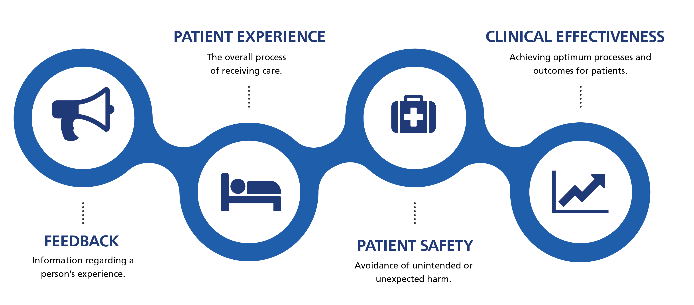
Your role…

Slide 9
Clinical variation and lack of operational standardisation results in poorer patient outcome and experience and also drives up cost.

Slide 10
Focus on quality
Tip number three…

Slide 11


Slide 12




Quality

Slide 13
People, people, people
Tip number four…

Slide 14


Slide 15
Your people…
Well-being
Attendance
Appraisals
Education
Talent management

Slide 16
Develop and support yourself
Tip number five…

Slide 17
Administrative support function
Leadership development
360 degree feedback & team insight/ personal behaviours insight
HR support and training
A ward manager development programme?
A mentor to support, guide and challenge?
Finance support
Patient safety and quality link
Chief Nursing team and NEDs
Reflection, revalidation and clinical supervision

