Slide 1

Controlled Drugs and the Use of Drugs Beyond Product License
Melinda Presland
Consultant Pharmacist, Palliative and End of Life Care

Slide 2
Content
Controlled Drugs and Non-Medical Prescribing
Practicalities and governance of prescribing Controlled Drugs
Prescribing outside of product license
Non-Medical Prescribing and the use of Syringe Pumps and Syringe Pump combinations
Case Study
  Controlled Drugs: PO and CSCI

Slide 3
Controlled Drugs
Medicines Act 1968
Misuse of Drugs Act 1971
Misuse of Drugs (safe custody) regulations 1973
Misuse of drugs (supply to addicts) regulations 1997
Misuse of Drugs Regulations 2001
Health Act 2006
Controlled Drugs (Supervision of Management of Use) Regulations 2006
Misuse of Drugs and Misuse of Drugs (Safe Custody) (Amendment) Regulations 2007
Misuse of Drugs Regulations (Amendment) 2012
Controlled Drugs (Supervision of management and use) Regulations 2013

Slide 4
Controlled Drug Schedule
CD schedule | Details | Examples of drugs
Schedule 1 (CD lic POM) | No therapeutic use/license | Hallucinogenic drugs, ecstasy-type substances,
Schedule 2 ( CD POM) | Opiates/ Stimulants | Diamorphine, morphine, methadone, oxycodone, pethidine, amfetamines, ketamine
Schedule 3 (CD No Reg POM) | Minor stimulants / drugs less likely to be misused | Buprenophrine, temazepam, tramadol, midazolam, phenobarbital, gabapentin, pregabalin
Schedule 4 ( CD Benz/ CD anabolic POM) | Split into 2 parts Part 1: Benzodiazepines Part 2: Anabolic steroids/ growth hormones | Diazepam, zopiclone, Sativex
Schedule 5 (CD Inv POM/P) | Low strength medicinal products | Codeine, pholcodine
Notes:
Independent Prescribers: are able to prescribe medicine for any medical condition within their competence, including any controlled drug in Schedule 2,3,4 or 5 as amended (except Diamorphine, Dipipanone or Cocaine for the treatment of addiction).
Supplementary prescribers: are able to prescribe medicine for any medical condition within their competence, including any controlled drug in Schedule 2,3,4 or 5 as amended (except Diamorphine, Dipipanone or Cocaine for the treatment of addiction) in accordance with patient management plan

Slide 5
Prescribing as an NMP
Notes:
Look in Drug Tariff for ACBS, SLS, appliances (cathethers/ BD microfine)

Slide 6
CD Prescriptions
May be computer generated
Must be indelible
Must be signed by an authorised prescriber
Must contain the following information:
  Name and address of patient (hospital/NHS number)
  Drug
  Formulation
  Strength
  Dose
  Frequency
  Total quantity in words and figures
  Date
  Address of the prescriber
  Valid for 28 days, 30 days supply (good practice)
  Governance – record what is supplied & ensure accurate and timely information flow

Slide 7
CD Prescription example
Patient details:
Mr James Smith (age 55), of 6 Winter Square, London, SW12 7AH
Medication details:
Morphine sulphate MR 50mg BD & morphine sulphate 15mg 2-4 hourly PRN
Please give 30 day supply

Slide 8
CD prescription example
Mr James Smith, 6 Winter Square, London, SW12 7AH
Zomorph 30mg Capsules, 1 BD, supply 60 (sixty)
Zomorph 10mg Capsules, 2 BD, supply 120 (one hundred and twenty)
Morphine sulphate liquid 10mg/5ml, 15mg (7.5ml) 2-4 hourly PRN, supply 100ml (one hundred millilitres)

Slide 9
CD prescription example
Mr James Smith, 6 Winter Square, London, SW12 7AH
Morphine sulphate MR 50mg BD:
Zomorph 30mg Capsules, supply 60 (sixty)
Zomorph 10mg Capsules, supply 120 (one hundred and twenty)
Morphine sulphate, 15mg (7.5ml) 2-4 hourly PRN, supply 100ml (one hundred millilitres) of 10mg/5ml liquid

Slide 10
Know your CD formulations…
Morphine
Modified release
  Tablets - MST, Morphgesic, Filnarine
  Capsules - Zomorph, MXL (care – OD dosing!),
Immediate release
  Tablets - Sevredol tablets
  Liquid - Oramorph (10mg/5ml & 20mg/ml) & generics

Slide 11
Know your CD formulations…
Oxycodone
Modified release tablets – OxyContin, Longtec etc…
Immediate release capsules– OxyNorm, Shortec, Lynlor
Immediate release liquid (5mg/5ml & 10mg/ml) – OxyNorm, Shortec
Notes:
MR preps - Abtard, Carexil, Ixyldone, Onexila, Oxeltra, Renocontin, Oxylan, Oxypro, Reltebon, Zomestine

Slide 12
Know your CD formulations…
Buprenorphine patches
Change every 7 days – BuTrans, Butec, Bunov, Bupramyl, Panitaz, (5, 10, 15 & 20mcg/hr) Reletrans
Change twice weekly – Buplast, Bupeaze, Relevtec,
(35, 52.5 & 70mcg/hr)
Change every 72 hours – Hapoctasin
(35, 52.5 & 70mcg/hr)
Notes:
MR preps - Abtard, Carexil, Ixyldone, Onexila, Oxeltra, Renocontin, Oxylan, Oxypro, Reltebon, Zomestine

Slide 13
Take care when prescribing…
1 – Patient titrated using Oramorph to 20mg q4h → converted to Sevredol 60mg BD with Oramorph 20mg PRN
2 – Buprenorphine patch 35mcg/hr applied weekly
3 – OxyNorm tablets 10mg PRN
What are the issues here?

Slide 14
Drug licensing
Before a medicine can be marketed in the UK, a number of licenses are essential
    Marketing authorisation (product licence)
    Manufacturer’s and wholesale dealer’s licences
    Clinical trial authorisations
These are granted by:
    MHRA (Medicines and Healthcare products regulatory agency)
    or the EMEA (European Medicines Evaluation Agency)

Slide 15
Drug licensing
For a marketing authorisation (product licence) to be granted the product must meet standards of safety, quality and efficacy. The marketing authorisation defines its terms of use.
Each product has a summary of product characteristics (SPC) which lists:
  Indications
  Recommended doses
  Methods of administration
  Contraindications
  Warnings and precautions
Liability lies with the manufacturer
A licensed medicine is accompanied by appropriate product information and labelling
Notes:
SPC details available at https://www.medicines.org.uk/emc/

Slide 16
Off-label use of Medicines
Have a marketing authorisation, but…
Different indication
Different dose
Different route
Responsibility lies with the prescriber

Slide 17
Off-label drug use in palliative care - indications
Clonazepam → Neuropathic pain
Ketamine
Lidocaine patches
Morphine → Dyspnoea
Glycopyrronium → Noisy breathing
Hyoscine butylbromide
Octreotide → Malignant bowel obstruction
Midazolam → Seizure prevention
Nifedipine → Tenesmus
Paroxetine → Pruritis
Venlafaxine → Sweats
Megestrol → Appetite

Slide 18
Off-label drug use in palliative care – routes of administration
Subcutaneous
Alfentanil
Clonazepam
Cyclizine
Furosemide
Glycopyrronium
Haloperidol
Hyoscine butylbromide
Ketamine
Metoclopramide
Midazolam
Ondansetron
Phenobarbital injections
Epidural/Intrathecal
Diamorphine
Fentanyl
Clonidine injections
Sublingual
Lorazepam tablets
Diazepam enema
Buccal
Midazolam injection
Topical
Morphine injection
Diamorphine injection

Slide 19
Unlicensed Medicines
No marketing authorisation
Include:
Specials
eg. ketamine oral liquid, tranexamic acid oral liquid
Named patient drugs
eg. glycopyrronium tablets, hydomorphone injection,
clonazepam injection
Syringe pump combinations
eg. morphine + midazolam + glycopyrronium
Responsibility lies with the prescriber

Slide 20
Prescribing off-label or unlicensed medicines
Advice for prescribers says you should:
be satisfied that an alternative, licensed medicine would not meet the patient’s needs before prescribing an unlicensed medicine
be satisfied that such use would better serve the patient’s needs than an appropriately licensed alternative before prescribing a medicine off-label
before prescribing an unlicensed medicine or using a medicine off-label you should:
  be satisfied that there is a sufficient evidence base and/or experience of using the medicine to show its safety and efficacy
  take responsibility for prescribing the medicine and for overseeing the patient’s care, including monitoring and follow-up
  record the medicine prescribed and, where common practice is not being followed, the reasons for prescribing this medicine; you may wish to record that you have discussed the issue with the patient

Slide 21
Prescribing off-label or unlicensed medicines
Best practice for communication includes:
you give patients, or those authorising treatment on their behalf, sufficient information about the proposed treatment, including known serious or common adverse reactions, to enable them to make an informed decision
where current practice supports the use of a medicine outside the terms of its licence, it may not be necessary to draw attention to the licence when seeking consent. However, it is good practice to give as much information as patients or carers require or which they may see as relevant
you explain the reasons for prescribing a medicine off-label or prescribing an unlicensed medicine where there is little evidence to support its use, or where the use of a medicine is innovative
Notes:
Sometimes helps to have a leaflet to share with people…

Slide 22
Unlicensed Medicines – Syringe Pump Combinations
Mixing two licensed medicines, where one is not a vehicle for the administration of the other, falls within the definition of manufacture and results in a new, unlicensed product being administered
  Medicines Act 1968
The palliative care practice of administering a mixture of licensed medication using a syringe driver is safe and effective
MHRA statement September 2008

Slide 23
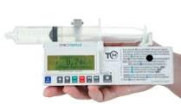
CSCI via syringe pump
Used SUBCUTANEOUSLY, therefore you do not need IV access
Gives a steady plasma concentration of drug
Can combine several drugs in 1 syringe to manage multiple symptoms
Useful in intractable pain, vomiting, severe dysphagia, patient too weak to swallow oral drugs or unconscious
Small and unobtrusive for patient and family
Review doses daily, change every 24hrs
For breakthrough symptoms, give PRN ‘rescue’ top-ups IV or via s/c line

Slide 24
Think COMPATIBILITY
Notes:
Phenytoin mixed with glucose 5% which lowers pH resulted in percipitation
Propofol mixed with lidocaine resulting in layering and coalescence
The more drugs are mixed together, the higher the risk of incompatibilities. Always consult pharmacy when mixing more than 3 drugs

Slide 26
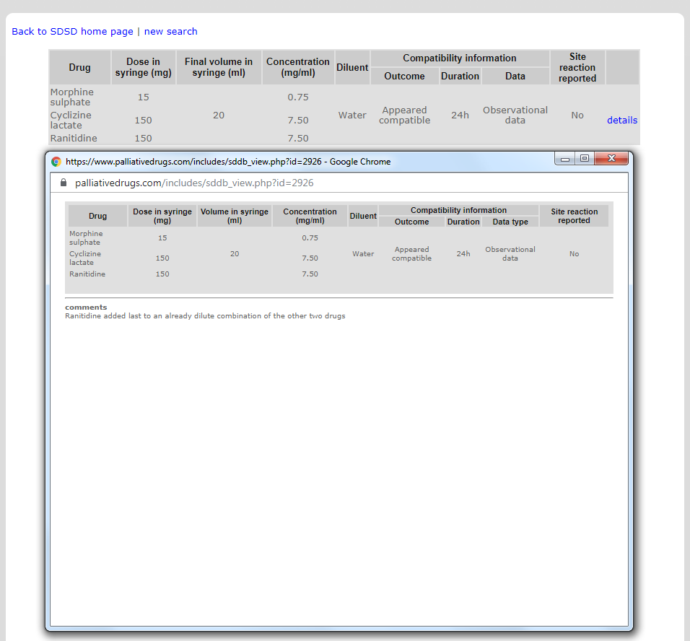

Slide 27
Case Study
A 78 year old gentleman is admitted into the hospice on PO morphine sulphate MR 30mg BD with deteriorating renal function. His Crcl 38 ml/min on admission.
The medical team want to convert him onto an equivalent dose of oxycodone. How much PO oxycodone MR should he be started on?
Notes:
a) Morphine MR 60mg daily / 2 = Oxycodone MR 30mg daily = oxycodone MR 15mg BD

Slide 28
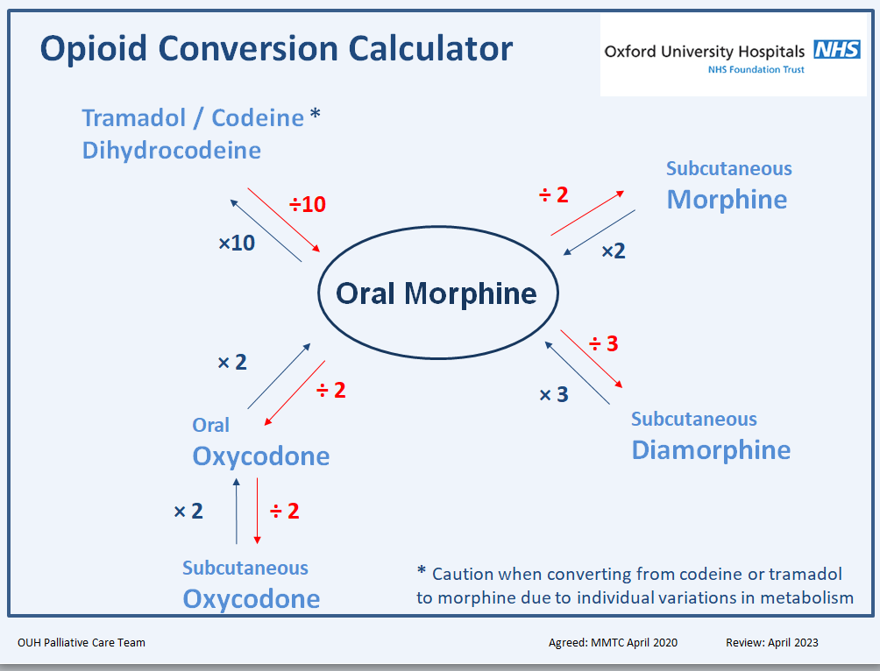
The medical team want to convert him onto an equivalent dose of oxycodone. How much PO oxycodone MR should he be started on?
PO morphine → PO oxycodone
2:1
60:30
= 30mg/24 hours, so 15mg BD

Slide 29
His condition deteriorates and he can no longer swallow. What dose of oxycodone should be added to his syringe pump (over 24 hours)?
Notes:
Oxycodone MR 30mg/ = Oxycodone sc 15mg

Slide 30
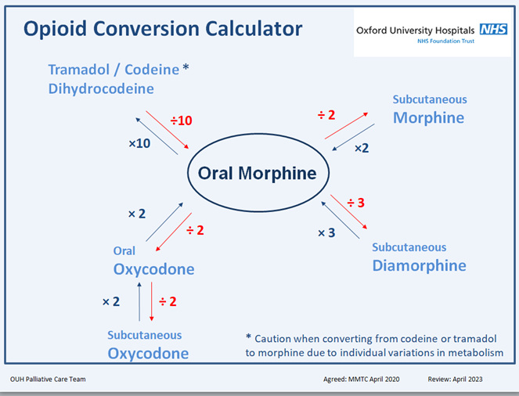
His condition deteriorates and he can no longer swallow. What dose of oxycodone should be added to his syringe pump (over 24 hours)?
oxycodone PO : oxycodone SC
2:1
30mg : 15mg
= 15mg oxycodone via syringe pump over 24 hours
Notes:
Oxycodone MR 40mg/ 1.5 = Oxycodone sc 26.667 mg equivalent to 25mg OD
Oxycodone 25mg/6 = 4mg rounded to 5mg

Slide 31
How much oxycodone SC should be prescribed as a PRN dose?
(remember convention is PRN dose is 1/6th total daily dose, but may be upto 1/10th)
Notes:
Oxycodone MR 40mg/ 1.5 = Oxycodone sc 26.667 mg equivalent to 25mg OD
Oxycodone 25mg/6 = 4mg rounded to 5mg

Slide 32
How much oxycodone SC should be prescribed as a PRN dose?
15/6 = 2.5mg

Slide 33
He’s had 4 PRN doses of oxycodone 2.5mg SC in the last 24 hours. How much shall we increase the dose of oxycodone in his syringe pump to?
Notes:
Increase by 10mg so increase oxycodone in syringe driver to 35mg OD
Oxycodone 35mg/6= 5.8mg rounded to 6mg

Slide 34
He’s had 4 PRN doses of oxycodone 2.5mg SC in the last 24 hours. How much shall we increase the dose of oxycodone in his syringe driver to?
In 24 hours that’s an additional 10mg on top of the 15mg, however, if that was all added into the pump it would be greater than a 50% increase (convention is 30 – 50% increase).
Therefore, increase oxycodone dose in the syringe driver to 20mg over 24 hours.
Notes:
Sometimes, not all of the PRN doses need to be put into the driver to obtain analgesia. If we can deliver continuously, avoiding peaks and troughs, we may be able to use a lower dose.

Slide 35
What should the PRN SC oxycodone dose be now?

Slide 36
What should the PRN SC oxycodone dose be now?
20/6= 3.3mg
Could either give 2.5mg or 5mg (or a range if that is acceptable)

Slide 37
Summary
Controlled Drugs and Non-Medical Prescribing
Practicalities and governance of prescribing Controlled Drugs
Prescribing outside of product license
Non-Medical Prescribing and the use of Syringe Drivers and Syringe Driver combinations
Case Study
  Controlled Drugs: PO and CSCI

Slide 38

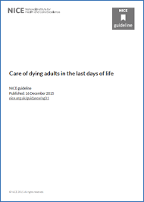
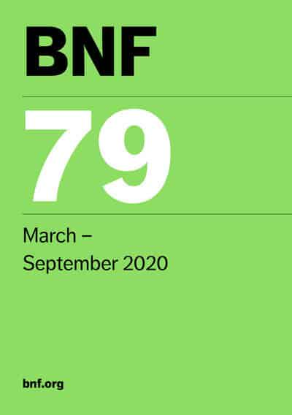

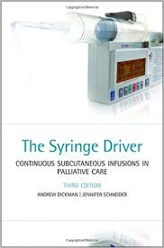
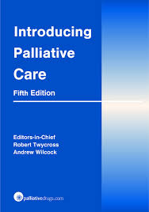

References
Notes:
Not forgetting OUH Intranet Palliative Care site

