Slide 1

Managing and supporting clinicians in difficulty
Anne Rothery, Adviser

Slide 2
NHS Resolution functions
Claims Management
Practitioner Performance Advice
Primary Care Appeals
Safety and Learning

Slide 3
Advice
Advice
Assessment and Intervention
Education
Healthcare Professional Alert Notices (HPANs)
Supporting the resolution of performance concerns of individual doctors, dentists and pharmacists
Practitioner Performance Advice
Notes:
This is more detailed although I tend to concentrate on advice and education.

Slide 4
How we support resolution of concerns
Practitioner Performance Advice Service
Advice
Education
Assessment and intervention
Healthcare Professional Alert Notices (HPANs)
Assisted mediation
Behavioural assessments
Clinical performance assessments
Professional support and remediation
Team reviews
https://resolution.nhs.uk/services/practitioner-performance-advice/
Notes:
This is just a re iteration of the previous slide but allows more mention of HPANs as I’ve found few have heard of them.

Slide 5
Advice
Free to NHS Bodies and no threshold to contacting us
Around 1000 requests a year
Adviser team are senior staff with backgrounds in clinical, human resources and legal professions
Advisers are aligned to specific healthcare organisations and NHS regions across England, Northern Ireland and Wales
https://resolution.nhs.uk/practitioner-performance-advisers/

Slide 6
When to call us
Whenever you want advice, are uncertain
If you have to – i.e. if you are considering capability proceedings under Maintaining High Professional Standards in the modern NHS (MHPS)
If you are considering exclusion
If you are requesting a Heath Professional Alert Notice (HPAN)
Notes:
Part to emphasise that we have no thresholds. Useful to push that we are objective and that in the trust can get vlinded by being too close to a problem, particularly if longstanding or others seem to have a vested interest in outcomes.

Slide 7
Bringing expertise to the resolution of concerns about professional practice
Advisers from varied backgrounds
Primarily advise and support NHS employers, commissioners and independents.
Also involved in education, research and assessment
Provide HPAN services

Slide 8
Overview
Identifying performance concerns and dealing with them effectively: early warning systems
Managing concerns: Putting into context the Department of Health (DH) guidance “Maintaining High Professional Standards in the Modern NHS” (“MHPS”)
NHS Resolution and “Employing Bodies” – Responsible officers, Medical Directors (MDs) and the General Medical Council (GMC). Interaction with Royal Colleges
Support for CD’s
Some practical examples

Slide 9
Starting out
What is a medical manager?
  Part of the role is to make judgements as to how to handle performance concerns
Notes:
Other presentations today have largely covered this . Lonely at times. Know your strengths/weaknesses. Get a helper/bagman aka succession planning. Knowing when to pass it up the chain of command and to ask for advice either internally or from us.

Slide 10

What is a performance concern?

Slide 11
Definition of a concern
“A concern about a doctor’s practice can be said to have arisen where an incident causes, or has the potential to cause, harm to a patient, staff or the organisation; or where the doctor develops a pattern of repeating mistakes, or appears to behave persistently in a manner inconsistent with the standards described in Good Medical Practice.” (GMC, 2006)
Notes:
Think this one should come out and just rely on the next slide any comments?

Slide 12
Definition of a concern(2)
Any aspect of a doctor’s performance or conduct which:
Poses a threat or potential threat to patient safety
Exposes services to financial or other substantial risk
Undermines the reputation or efficiency of services in some significant way
Is outside acceptable practices, guidelines and standards.
Involves allegations of a criminal nature and
Brings the profession or trust/organisation into disrepute.
Notes:
Note also:
Brings the profession or Trust /organisation into disrepute
Allegations of a criminal nature

Slide 13

What are the triggers for a concern?

Slide 14
Triggers for concern
Colleague concerns
Clinical incidents
Complaints
Data monitoring – mortality
Quality outcomes
Clinical audits
Compliance with national guidance
Criminal incidents
Doctor’s own concerns
Feedback
Whistleblowing
The majority of doctors provide a high standard of care.
All doctors will experience a variation in their level of practice and clinical competence during their career.
Responsible Officers (ROs) must have corporate governance systems in place to allow early detection of triggers so that concerns about a doctor can be addressed appropriately.
Notes:
Appraisal is unlikely to act as a trigger for concern, but information included in this slide is likely to be considered during an appraisal.
Ask delegates to think about other triggers for concern – what are their experiences of the most useful triggers?
GMC helpline for doctors who are considering referring their colleagues. Approx 1000 calls a year.
Ask delegates to reflect on their own understanding about triggers:
Where are triggers identified i.e how do concerns come to light?
Who manages them?
Who is responsible for overseeing them?
Draw out link with CI role – where information stored in case required as evidence
? Replace with slide from manda’s presentation.

Slide 15
Not everyone is ‘normal’
Have a high index of suspicion
A assume nothing
B believe no one
C check everything
D document everything
Notes:
I add in bit about Linda R suspecting Shipman. Sometimes we have to take a leap of imagination. We can have almost a reverse bias if we perceive people as one of us. Ask if anyone else has examples of this. Ask the room about how concerns arise in their organisation before the next slide Some of my colleagues have asked me to remove this slide as it seems to cynical but I think its just a realistic attitude. Not that your staff are lying but we all see things from our own perspectives and that’s why C is in.
In particular document why you haven’t done something. Two years on at a tribunal or enquiry will you remember the heat of the moment stuff? How you were emotionally invested in the case?

Slide 16
Role as medical manager: knowledge and skills
As a medical manager, there is a responsibility to make judgements about other doctors. This requires additional knowledge such as:
Local disciplinary policy
MHPS (Maintaining high professional standards in the NHS)
How to approach the problem, deciding whether to deal with issues formally or informally……..but informally does not mean undocumented
How to approach the decision about restriction or exclusion.
The ability to have difficult conversations without personal biases or emotions intruding
Notes:
NHS England Responding to concerns guidance for responsible officers document is useful to read as it re inforces how to manage without pushing everything down a formal disciplinary route. Also can mention the Dido Harding letter.

Slide 17
Self-management
Starts with Values
  Personal
  Professional
    Respect
    Positive regard [they’re doing the best they can]
Knowledge (guidance, policies, rules etc)
Experience (seen this / done this before)
Support (colleague, coach, mentor, supervisor)
  HR
  Other medical managers
  External (eg NCAS, MDO, legal)
Personality (self-knowledge etc)
Notes:
Take time over this slide.
See what’s in the room already: share experience etc.
Values links to Rogerian triad (Carl Rogers): empathy, warmth, unconditional positive regard – these will do [or look them up].

Slide 18
What is conflict of interest?
Conflict of interest
A situation in which someone in a position of trust has competing professional or personal duties, loyalties, obligations or interests that would either make it difficult to fulfil their duties fairly, or would create an appearance of impropriety or a loss of impartiality that could undermine public confidence.
Bias or the appearance of bias
A predisposition, prejudice or preconceived opinion that prevents impartial or objective evaluation or the appearance of such based on reasonable grounds.
Composite definition from several sources
Notes:
These definitions are not ‘official’ they are combined/pooled from a series of sources
Consider case of Makhdum vs Norfolk and Suffolk NHS Foundation Trust (October 2012) – agreed investigator was not required to be a clinician. Dr raised significant concerns that the case manager, chairman of the panel, HR adviser all lacked impartiality or the appearance of impartiality due to ongoing nature of case (Note – not upheld)
These apply to different situations:
A CoI is where the RO has 2 separate competing interests [not where 2 people have competing interests]
AoB is where an RO’s preconceived opinions could be seen by an outside observer to sway their judgement. In certain circumstances, the appearance of bias, even where there is no actual bias, if this is on reasonable grounds may allow for legal challenge. yourself:
Would a fair minded observer, having considered the relevant facts, conclude that there was a real possibility that the [CI/CM/Panel] was consciously or subconsciously biased.
Justice must not only be done, it must be seen to be done.

Slide 19
Conflict of interest or appearance of bias
Where there is or has been a personal relationship (marriage, partnership) between a responsible officer and a doctor or where the two are related in any other way
Where there is a financial or business relationship between a responsible officer and a doctor
Instances where a third party is involved for example an affair or marriage breakdown
Where there is a known and long-standing personal animosity (or friendship) between a responsible officer and a doctor
Notes:
These are the situations described in the RO Guidance (RO Guidance 2010 (refers to “RO” - think about case investigator role) but need to consider for CI/CM and anyone else involved in investigation process.
First 2 are relatively easy to define – easy thresholds but 3 and 4 are much more difficult
Will need to consider this more acutely when doctor puts in a challenge. Raise potential issues with CM as soon as you become aware and document decision.
Lawyers opinion: situations 3 and 4 could have legal consequences for the employer of an RO who refuses to participate in revalidation of a doctor for these reasons. If that refusal is based upon victimising the doctor for having rejected the RO’s sexual advances, or as a result of legitimate “whistleblowing” or discrimination allegations, then refusal by the RO to participate in revalidation of the doctor may amount to an unlawful act. In these circumstances it is important that revalidation is picked up quickly by another RO in accordance with the next slide so that the doctor concerned does not suffer materially as a result.

Slide 20
MHPS
Contents
Part I: Action when a concern arises
Part II: Restriction of practice and exclusion
Part III: Conduct hearings and disciplinary matters
Part IV: Procedures for dealing with issues of capability
Part V: Handling concerns about a doctor’s health
Notes:
Discrete sections. Often an overlap. Flag up differences in independent sector and potential for FTs to work differently. (if independent delegates expected).
The next notes are just from CI training but sometimes have been asked bits about them.
NB: Paragraphs 12 and 15 in Part 1 of MHPS regarding the role of the CI. Para 12:
“The CI is responsible for leading the investigation into any allegations or concerns about a practitioner, establishing the facts and reporting the findings. The CI:
Must formally involve a senior member of the medical or dental staff where a question of clinical judgement is raised during the investigation process
Must ensure that safeguards are in place throughout the investigation so that breaches of confidentiality are avoided as far as possible. Patient confidentiality needs to be maintained but the disciplinary panel will need to know the details of the allegations. It is the responsibility of the CI to judge what information needs to be gathered and how – within the boundaries of the law – that information should be gathered
Must ensure that there are sufficient written statements collected to establish a case prior to a decision to convene a disciplinary panel, and on aspects of the case not covered by a written statement, ensure that oral evidence is given sufficient weight in the investigation report
Must ensure that a written record is kept of the investigation, the conclusions reached and the course of action agreed by the Director or Head of HR with the Medical Director
Must assist the designated Board member in reviewing the progress of the case
The CI does not make the decision on what action should be taken nor whether the employee should be excluded from work and may not be a member of the disciplinary or appeal panel relating to the case.
Important to note that where there is both conduct and capability concerns than the capability process should (most often) be followed. This can be unhelpful where the conduct issues are the main cause for concern due to the complexity and lengthy processes involved in capability hearings. MHPS says there may be cases where it is advisable to pursue a conduct issue separately. It is also important not to classify as capability, misconduct that has lead to clinical consequences e.g. inappropriate behaviour in theatre can lead to the disruption of teamwork with increased clinical risks to patients and possible harm.

Slide 21
What to do when a concern arises – MHPS Part I
Talk to the doctor
Assess the risk to patient safety
Have a process in place - role of HR (MHPS Part I)
Be fair, open, transparent and supportive
Deal with promptly
Consider health, behaviour, clinical skills and environment
Document the process and the rationale for action taken
Notes:
Ask the audience what's the first thing you should normally do when concerns arise. ASK the Doctor. As a CD may be able to deal with within department but document rationale for any escalation upwards. You manage performance concerns at a departmental level but resist being case manager in MHPS investigation terms for doctors you manage directly.

Slide 22
Restriction of practice and exclusion – MHPS Part II
Potential risks to patients (and staff) need to be managed
Exclusion is a neutral act …..… except that it is not felt that way
If the only concern is about clinical (capability) issues, should not normally need to exclude
  Why not?
Notes:
If you are speaking at the CD meeting emphasise that this is a role for the Medical Director or RO.

Slide 23
Investigations
Is it necessary?
Is the investigation likely to obtain further relevant evidence?
Has there been some preliminary exploration of the concerns?
What sort of process is most relevant?
Which policies apply – may be more than one?
Is a formal investigation under MHPS procedures an proportionate response to the problem?
Does the organisation have clear guidance that explains the process and its links to disciplinary guidance?
Do you want to contact NHS Resolution to discuss? (NB contact details at the end of this presentation)
Notes:
This slide is more to be emphasized in the dealing with doctors in Difficulty talks when there will be case managers present rather than just CDs.
Note terminology of “preliminary” investigation before “formal” investigation – “preliminary to discuss/agree whether a full formal investigation is required”- this is an initial fact establishing exercise to rule out e.g. malicious allegations
Ask NCAS for advice
Beware of the corridor/ car park conversations

Slide 24
When an investigation may not be necessary
Where:
Reported concerns:
  Do not have a substantial basis
  Are refuted by other available evidence
  Are frivolous, malicious or vexatious
Informal action is agreed
Sufficient evidence exists to take action
An investigation has been done elsewhere and the results shared
The doctor agrees with the relevant facts
Confirmed or suspected ill-health which would make an investigation inappropriate
The case needs to be referred to the Police or NHS Protect
Concerns are being investigated by another agency.
Notes:
It is sometimes good practice to conduct an internal investigation even though other agencies are conducting an investigation. Please note that it is good practice to complete an investigation even if a doctor leaves the organisation during the process e.g. a locum. 20% of investigations are not completed when a doctor leaves an organisation! It is important to complete and pass concerns on to the next employer or tell regulator to make sure patients are safe in other places the doctor may go and practice.
DH website includes MOU between DH, NHS and Police about who takes the lead in investigations.
Lawyers comment: Particular consideration should be given where a concern has been raised which proves to be groundless. The complainant may have made a legally protected complain (often referred to as “whistleblowing”) and if they are victimised as a result (i.e. suffer any detriment) this may be actionable. But consider potential malicious/vexatious complaints
24

Slide 25
Top tips
Dealing with concerns early usually means that it is less serious than if the matter is left to fester, go in low and hard.
Legal duty upon employers to treat all employees equally and fairly
Probity is always a major concern because any lack of probity potentially taints the whole of an individual’s practice; so if there is any issue of dishonesty or being disingenuous - deal with it!
All health professionals are under a duty to raise any concerns they have - so failure to act could leave individuals open to criticism
Practitioners often react to concerns being raised by being either over-critical of themselves or over-defensive; allow for this and remember the situation is stressful for them….as well as for you!
Know the procedure you’re working to & stick to it if you want to avoid being vulnerable to later criticism or challenge
Informal does NOT mean undocumented
Notes:
For the effective CD conference I do a bit about setting your lines in the sand before you start. Make these visible to people in the department. Be absolutely clear from the start. Eg around meeting attendances, private work, booking holidays, rotas and cover etc. will you have an open door for concerns. Know everyone’s name in immediate department. Bring biscuits! ( I do a personal bit about no bitching and only stab in the front).
Be clear where all info will be stored. Some trusts now have it on ESR. Important to put negatives as well as positives eg from investigation as any investigation can affect a doctor’s subsequent behaviour.

Slide 26
Case 1 - Dr Wembley: complaint example
You are the Clinical Director in Emergency Medicine (EM) and also the Education Supervisor for Dr Wembley
The Service Manager tells you that a complaint has recently been made about Dr Wembley, an ST4 in EM
What are the key initial questions?
Next steps?
Notes:
I wonder about putting one of these higher up the order of play, perhaps even before the intro stuff about us?

Slide 27
Case 2 - Dr Canon: lateness
Dr Canon is a Specialty Doctor in Paediatrics. She is fairly frequently late for work, particularly for clinics. Colleagues have grumbled from time to time, but no patient complaints to date. Her lead consultant has spoken to her a few times, usually with temporary improvement which later slips back. The consultant has now raised the problem with you as CD for Maternity and Children’s Services.
What should happen?
What possible explanations/causes might there be?

Slide 28
Case 2 - Dr Canon: lateness intervention and follow up
Intervention – appropriate to findings
Follow up
Recorded
Appraisal

Slide 29
Case 2 - Dr Canon: lateness formal action
Agreement of doctor always makes things easier
Lack of agreement/acceptance (insight…) makes a formal process more likely e.g. Investigation under MHPS Part I
If a disciplinary sanction is considered– does the organisation have an “Agreed Sanction” process / policy?
NHS Resolution advice?
GMC – Employer Liaison Advisers (ELAs)?RO or MD would be involved at this point
Notes:
Remember most doctors even those who have concerns investigated come back to work in the same post and department so re integration is key.

Slide 30
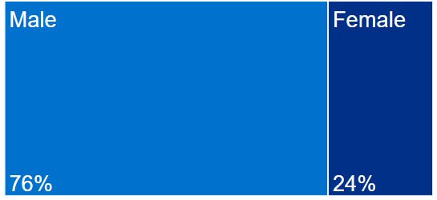
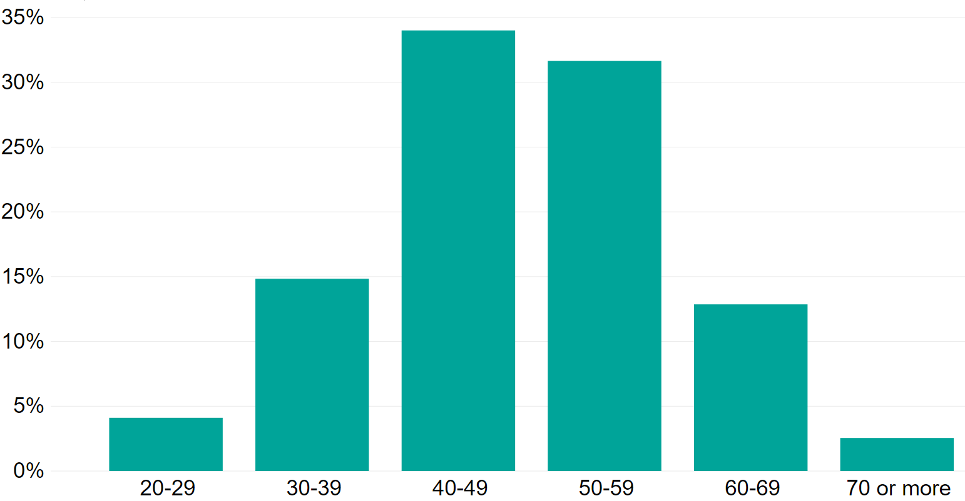
Practitioner characteristics - overview
4349
Practitioners
2015-2020
Age Group
Notes:
The statistics and graphics on this slide represent cases opened or closed from the financial years 2015/16 to 2019/20
The male and female statistics represent the practitioner’s gender, not their sex

Slide 31
Practitioner characteristics - overview
4349
Practitioners
2015-2020
Notes:
The statistics and graphics on this slide represent cases opened or closed from the financial years 2015/16 to 2019/20

Slide 32
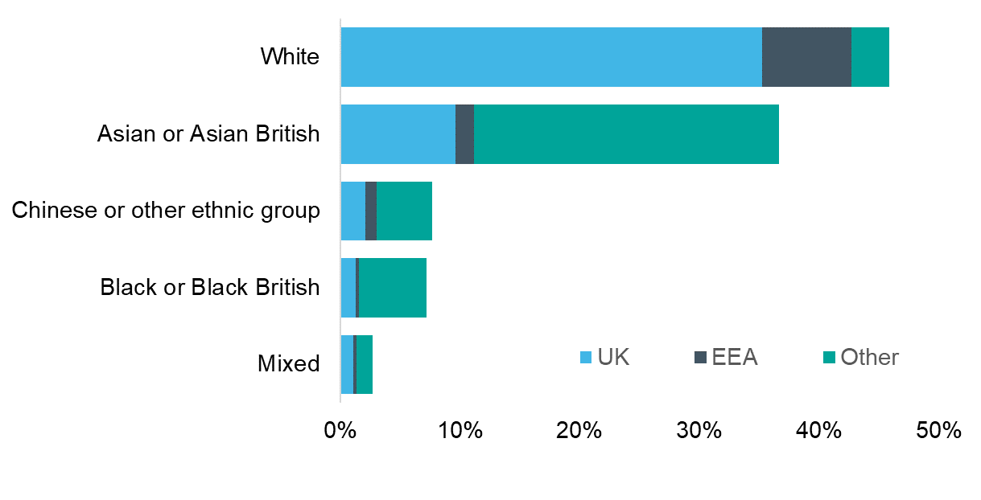
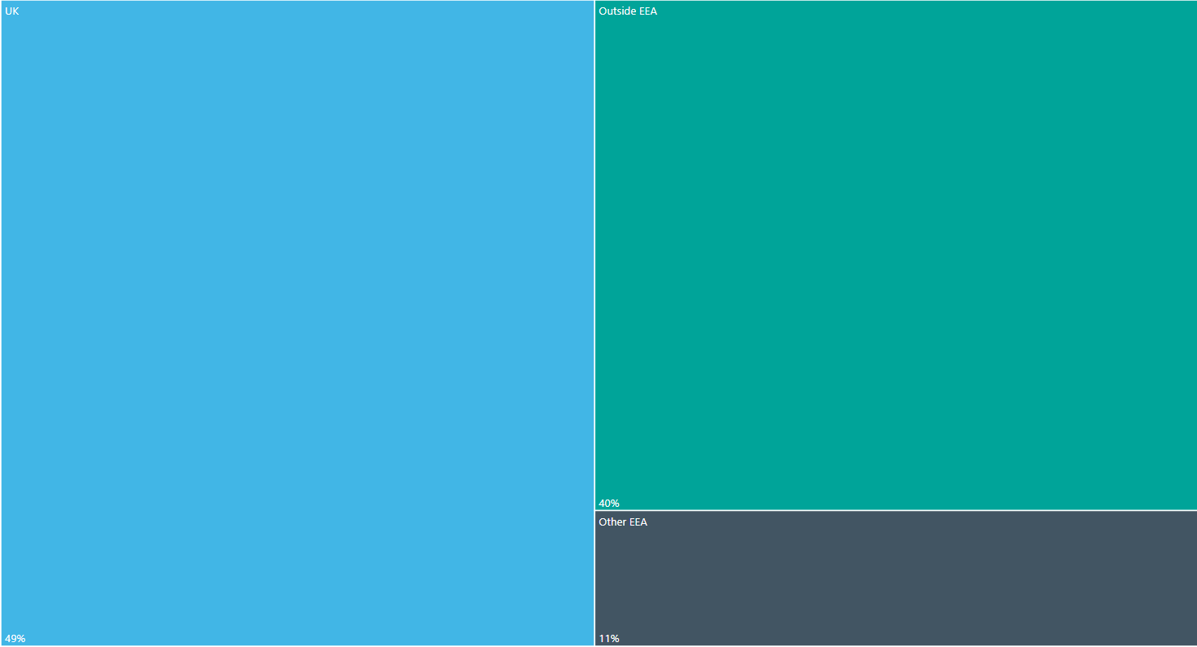
Ethnicity and place of qualification
4349
Practitioners
2015-2020
Ethnicity groups
Place of primary qualification
UK
Other
40%
49%
EEA
11%
Ethnicity group terms reflect those in use when Practitioner Performance Advice (formerly NCAS) was established in 2001. An update is being considered as part of our data quality program
Notes:
The statistics and graphics on this slide represent cases opened or closed from the financial years 2015/16 to 2019/20
Ethnicity terms reflect those from the 2001 census.
The EEA includes EU countries and also Iceland, Liechtenstein and Norway. Switzerland is not an EU or EEA member but is part of the single market. This means Swiss nationals have the same rights to live and work in the UK as other EEA nationals (source: https://www.gov.uk/eu-eea)

Slide 33
Doctors subject of cases compared with doctors on the GMC register
Gender
Age
Place of qualification
Ethnicity
GMC – General Medical Council
Notes:
The y-axis on the left refers to the % of Advice cases and doctors on the medical register. The y-axis on the right indicates the rate of Advice cases per 1000 doctors on GMC medical register
Rate per 1000 doctors represents the cases received by Advice per 1000 doctors belonging to a particular gender/age/ethnicity or place of qualification
The statistics and graphics on this slide represent cases opened or closed from the financial years 2015/16 to 2019/20
This slide only include cases of 3935 doctors and not dentists or pharmacists
Note that not all doctors on the register currently hold a licence to practise
Ethnicity group terms reflect those in use when Advice (formerly NCAS) was established in 2001. An update is being considered as part of our data quality program

Slide 34
Reported concerns - overall
4038
Cases 2015-2020
Behaviour / misconduct concerns
69%
43%
18%
22%
Clinical concerns 47%
3%
5%
4%
Health concerns 18%
6%
Notes:
Initial concerns reported by healthcare organisations
The statistics and graphics on this slide represent cases opened or closed from the financial years 2015/16 to 2019/20
Note that the number of cases is smaller than number of practitioners due to some practitioners having multiple cases
Due to significant overlap in the reported concerns, the totals add up to over 100%

Slide 35
Reported concerns 2012 compared with 2020
5634 cases from 2007 - 2013
4038 cases from 2015 - 2020
Behaviour / misconduct concerns 69%
Behaviour / misconduct concerns 58%
Clinical concerns 58%
Clinical concerns 47%
30%
43%
19%
29%
18%
22%
4%
5%
5%
3%
5%
4%
Health concerns 21%
7%
Health concerns 18%
6%
Notes:
Initial concerns reported by healthcare organisations
The statistics from 2007-2013 represent cases opened or closed from December 2007 to September 2013
The statistics from 2015-2020 represent cases opened or closed from the financial years 2015/16 to 2019/20
Note the increasing proportion of cases citing behaviour/misconduct – we are not sure if this relates to increasing awareness of these issues and willingness to deal with them or whether it relates to a real change in behaviours. It does correlate with our perception of increasing requests for behavioural interventions e.g. BA, mediation, team review
Due to significant overlap in the reported concerns, the totals add up to over 100%

Slide 36
Reported concerns by sector
Primary Care
4038
Secondary Care
Behaviour / misconduct concerns 49%
Behaviour / misconduct concerns 73%
Clinical concerns 59%
Cases 2015-2020
Clinical concerns 43%
29%
14%
46%
36%
19%
18%
2%
4%
7%
3%
5%
3%
9%
6%
Health concerns 22%
Health concerns 17%
Notes:
Initial concerns reported by healthcare organisations
The statistics and graphics on this slide represent cases opened or closed from the financial years 2015/16 to 2019/20
Note that the number of cases is smaller than number of practitioners due to some practitioners having multiple cases
All professional groups (doctors, dentists and pharmacists) are included in the appropriate primary and secondary care groupings
Due to significant overlap in the reported concerns, the totals add up to over 100%
Be careful not to speculate too much on the reasons for differences – but participants may express their views

Slide 37
Reported concerns in secondary care by grade group
3088 cases, 2015-2020
Training grade (352 cases)
Other career grade (697 cases)
Consultant or equivalent (2039 cases)
Behaviour / misconduct concerns 72%
Behaviour / misconduct concerns 72%
Behaviour / misconduct concerns 75%
Clinical concerns 38%
Clinical concerns 46%
Clinical concerns 43%
13%
16%
41%
22%
19%
48%
19%
18%
47%
5%
4%
7%
2%
3%
3%
3%
7%
5%
9%
7%
5%
Health concerns 25%
Health concerns 19%
Health concerns 16%
Notes:
Initial concerns reported by healthcare organisations
The statistics and graphics on this slide represent cases opened or closed from the financial years 2015/16 to 2019/20
Note that the number of cases is smaller than number of practitioners due to some practitioners having multiple cases
Note that there are smaller numbers in the training grade group compared to the other groups
Dentists working in secondary care are included
Due to significant overlap in the reported concerns, the totals add up to over 100%

Slide 38
Reported concerns by gender
Male
4010
Female
Behaviour / misconduct concerns 70%
Behaviour / misconduct concerns 60%
Cases 2015-2020
Clinical concerns 52%
Clinical concerns 43%
46%
33%
18%
17%
25%
21%
3%
2%
6%
6%
5%
3%
5%
10%
Health concerns 15%
Health concerns 25%
Notes:
Initial concerns reported by healthcare organisations
The statistics and graphics on this slide represent cases opened or closed from the financial years 2015/16 to 2019/20
Note that the number of cases is smaller than number of practitioners due to some practitioners having multiple cases
We do not know the reasons for the differences shown in these diagrams – we hope to be able to explore this more and potentially correlate it with other information, for example from BAs
Due to significant overlap in the reported concerns, the totals add up to over 100%

Slide 39
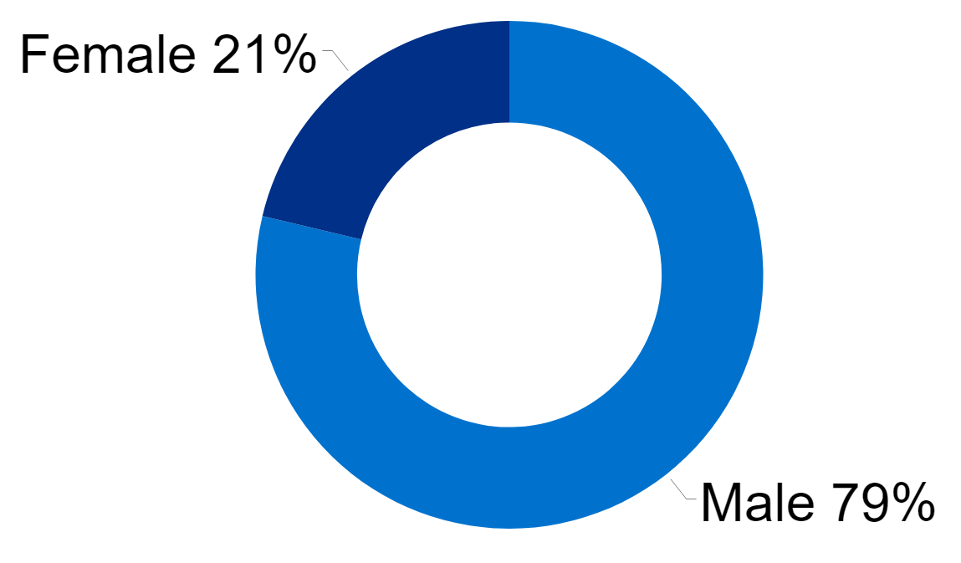
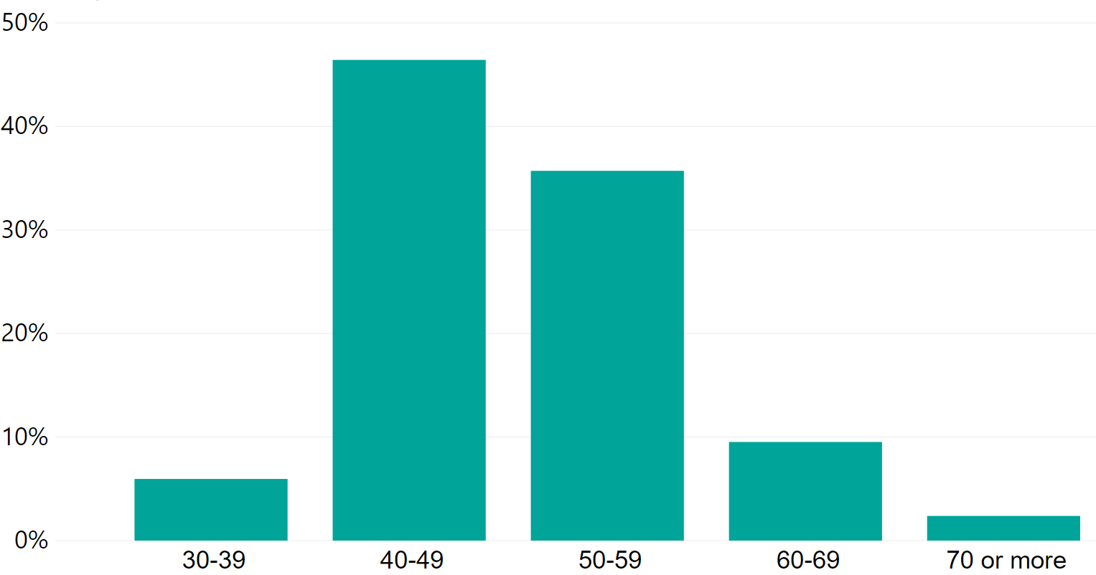
Practitioner characteristics - assessments
94
Assessments 2015-2020
Age
Notes:
These figures relate to the assessments carried out on cases which were opened in this period and do not show the totality of assessments carried out in the period
For assessments where the assessment report was issued between 2015/16 to 2019/20

Slide 40
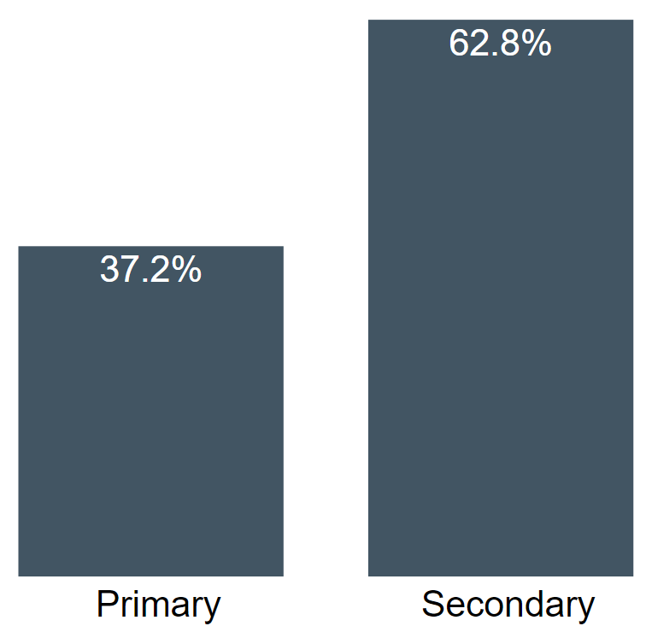
Practitioner characteristics - assessments
94
Assessments 2015-2020
Sector
Notes:
These figures relate to the assessments carried out on cases which were opened in this period and do not show the totality of assessments carried out in the period
For assessments where the assessment report was issued between 2015/16 to 2019/20

Slide 41
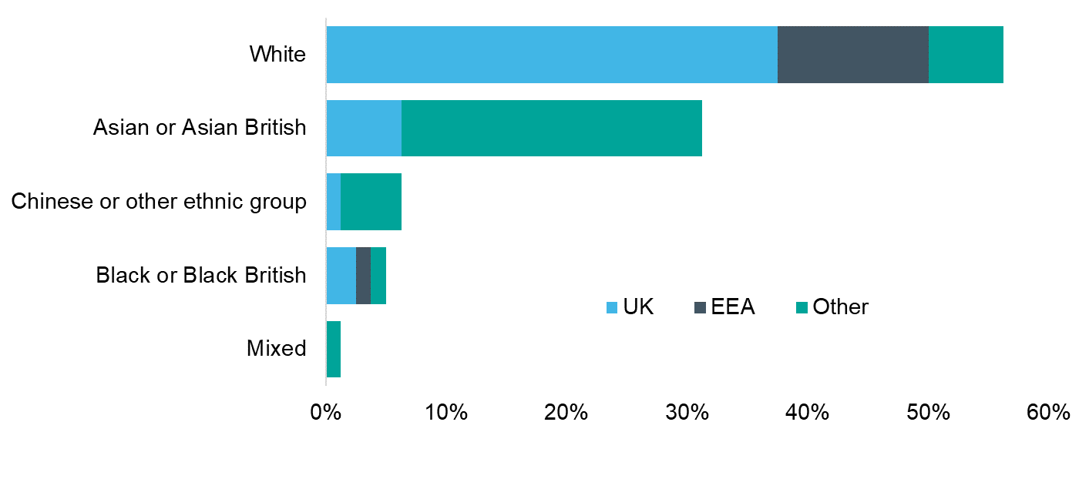
Ethnicity and place of qualification - assessments
94
Assessments 2015-2020
Ethnicity
Place of primary qualification
UK
Other
39%
48%
EEA
13%
Ethnicity group terms reflect those in use when Practitioner Performance Advice (formerly NCAS) was established in 2001. An update is being considered as part of our data quality program
Notes:
For assessments conducted in cases opened in the timeframe and where the assessment report was issued between 2015/16 to 2019/20
Ethnicity terms reflect those from the 2001 census.
The EEA includes EU countries and also Iceland, Liechtenstein and Norway. Switzerland is not an EU or EEA member but is part of the single market. This means Swiss nationals have the same rights to live and work in the UK as other EEA nationals (source: https://www.gov.uk/eu-eea)

Slide 42
Contact Practitioner Performance Advice
England (Scotland and Wales)
Tel: 020 7811 2600
Email: casesupport@resolution.nhs.uk
Northern Ireland
Tel: 028 90 690 791
Email: northernireland.team@ncas.nhs.uk

Slide 43
Any questions?

