Slide 1
My Experience as an International Junior Doctor Working in the NHS
Anna Zonato A&E Junior Doctor at the NNUH

Slide 2
Overview
Background
My journey
Definition
Numbers
Similarities and differences
Culture and patient safety
COVID-19
Closure
References

Slide 3
Background
Graduated by Universidade Federal do Paraná (UFPR) in Jan/2017
Worked with Occupational Health, A&E and primary care in Brazil
A&E post at Norfolk and Norwich University Hospital for the past 30 months

Slide 4
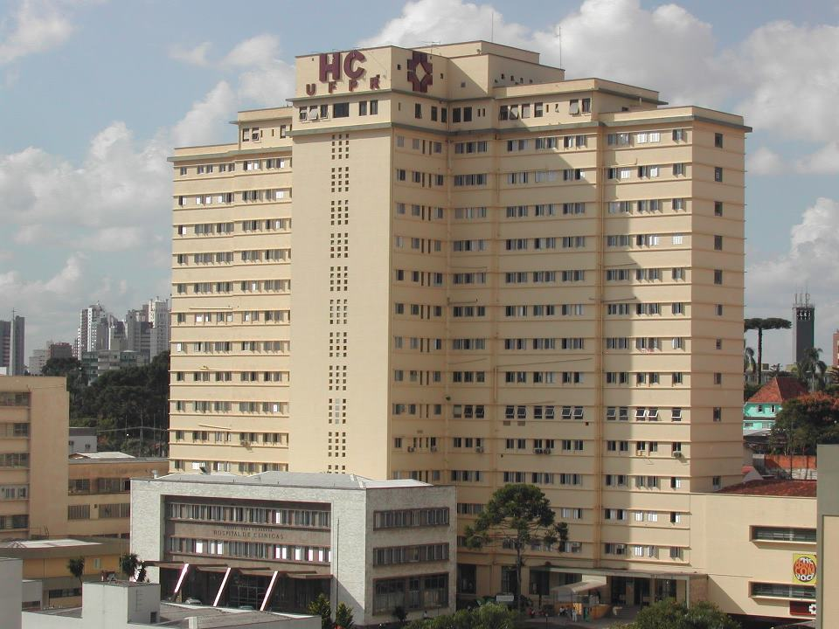

Slide 5
My Journey
2014 - Forensic Science at De Montfort University (Ciências sem Fronteiras)
Jan/2017 – Graduation by UFPR
Feb/2017 – IELTS
Jun/2017 – PLAB part 1
Oct/2017 – PLAB part 2
Dec/2017 – GMC registration
Jul/2018 – Moved to the UK
Aug/2018 – Started working in A&E

Slide 6
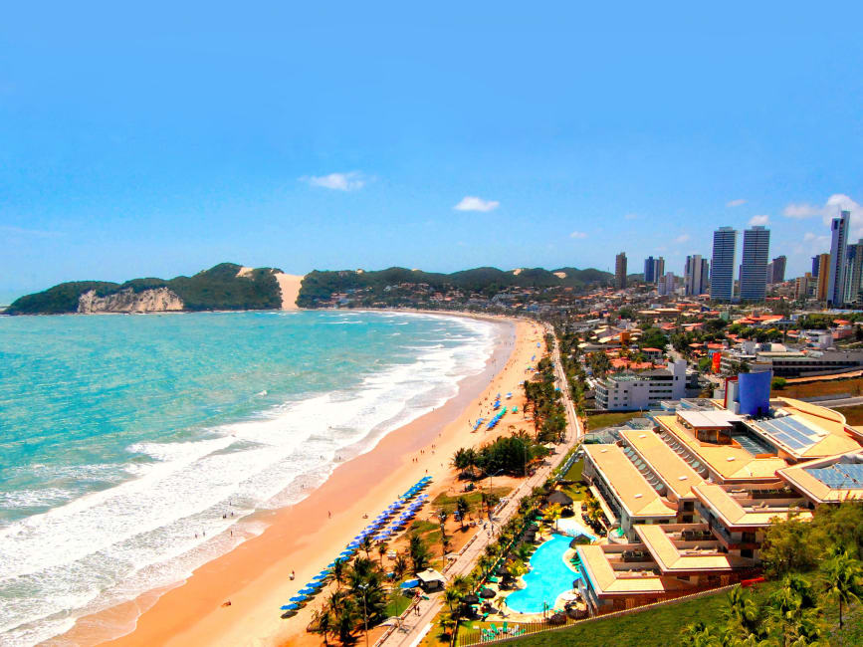

Slide 8
Why?
Emigration
Underfunding of NHS
Training costs
Career opportunities
Retention issues
Better offers elsewhere
Immigration
Higher income country
Quality of life
Better training
Job/career opportunities
Take skills back home

Slide 9
Definition
‘Overseas Doctors’
Those who have graduated outside the UK. Embraces two groups: international medical graduates (IMG) and European Economic Area (EEA) graduates.
IMGs - Professional and Linguistic Assessment Board test (PLAB) and the International English Language Test System (IELTS). EEA and Swiss nationals are exempt from PLAB.

Slide 10
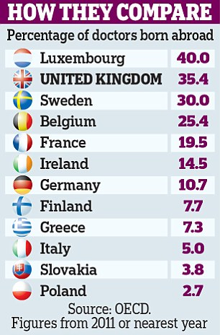
Numbers

Slide 11
“While it is encouraging that more doctors are entering training, the numbers are still nowhere near enough to meet patient need.” Dr Chaand Nagpaul, head of the British Medical Association
“We are importing doctors… from countries where they were desperately needed. We poached them in order to plug holes in the NHS workforce, now in crisis.” Surgeon Professor J Meirion Thomas

Slide 12
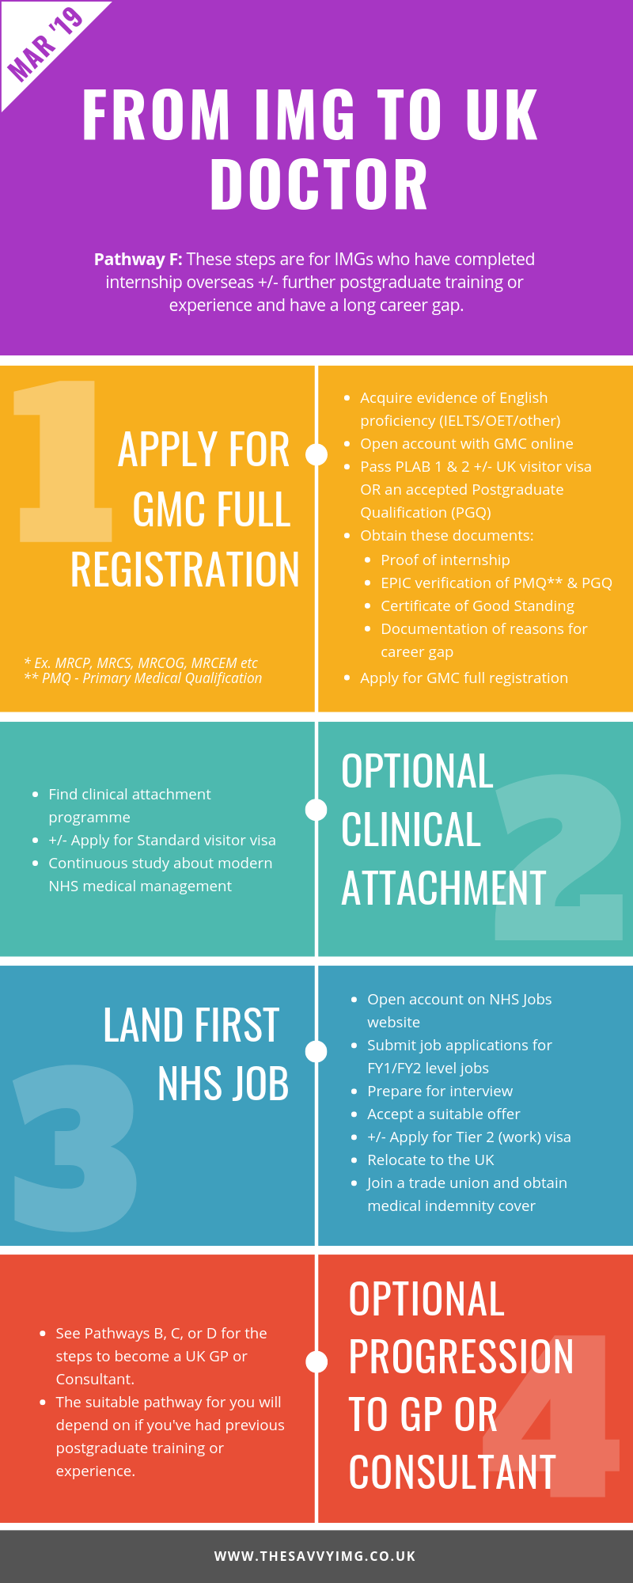

Slide 13
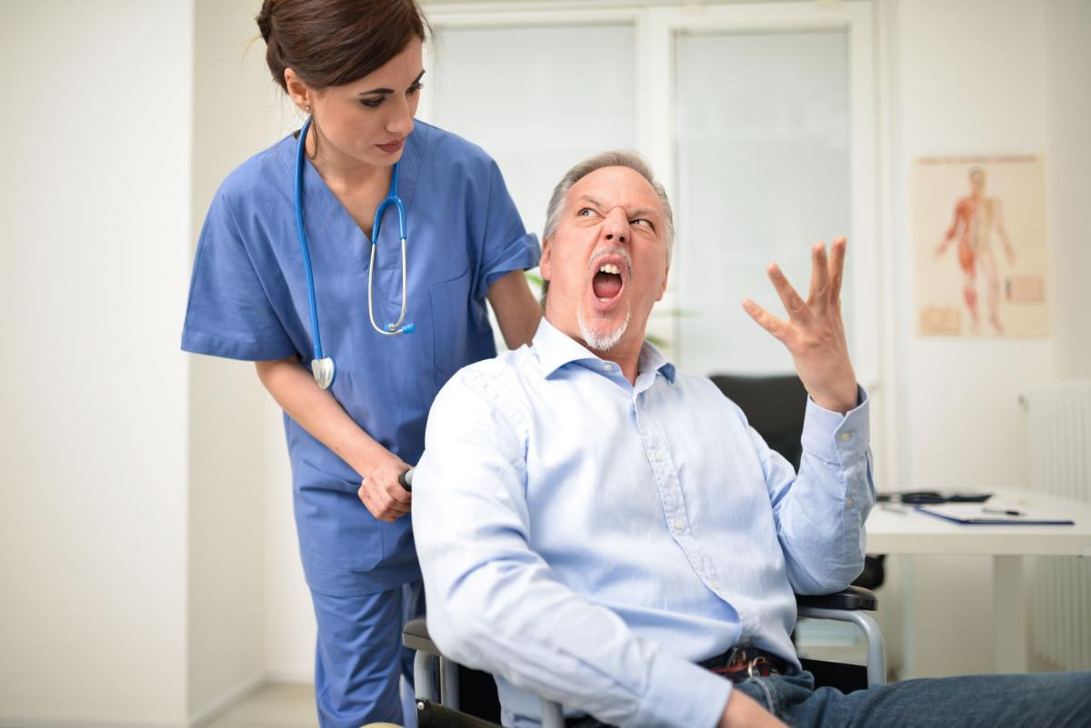
Similarities
People
Medicine in general
System structure
Hospital routine
Waiting times

Slide 14
Benefits
Support – consultants, MDU, BMJ, GMC
Infrastructure
Lesser hours
Work flexibility
Quality of life
Safety!

Slide 15
Health in the UK
“The UK spends almost 10% of its GDP on health, about one percentage point higher than the OECD average. This is projected to reach 11.4% by 2030. This level of spending buys strong access to health care, with low levels of inequality, though long-term care services are less accessible.”

Slide 16
Brazil x UK
Parameter | Brazil | UK
Life expectancy (men, years) | 72.1 | 79.5
Health spending (US dollars/capita) | 1282 | 4070
Elderly | 8.9% | 17.26%
Alcohol - Litres/capita (aged 15 and over) | 6.3 | 9.7
Smoking - % of population aged 15+ | 10.1 | 17.2

Slide 17
Brazil x UK
Parameter | Brazil | UK
Road accidents (per million) | >140? | 28.1
Firearm deaths (per 100,000) | 19.4 | 0.2
Intentional homicides (per 100,000) | 30.5 (12th) | 1.2 (124th)

Slide 18
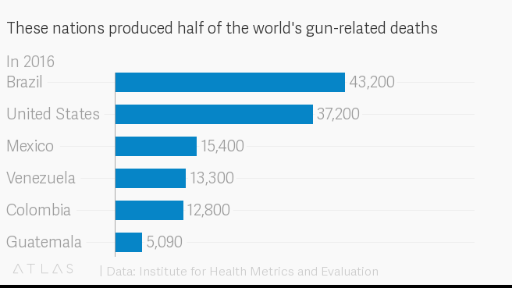

Slide 19
Challenges
Process costs
Culture
Language
Training
Routine
IT
Bureaucracy
Patient characteristics
Diseases/prevalence
Alcohol
Weather

Slide 20
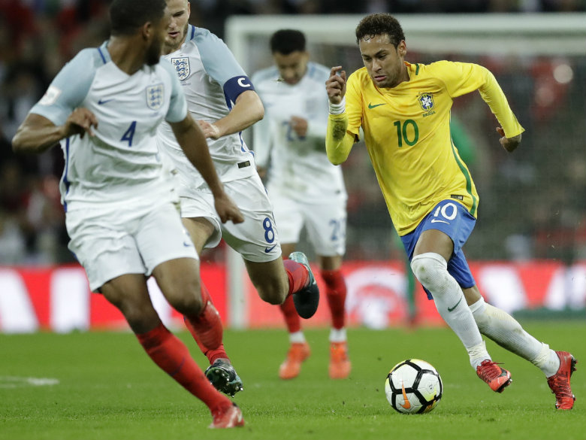
Culture

Slide 21
Language

Slide 23
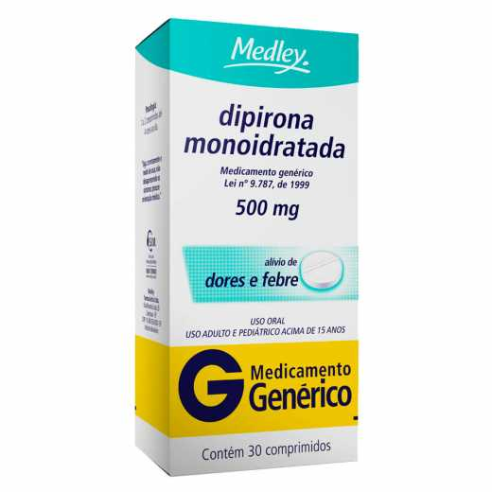
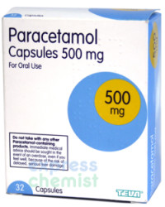
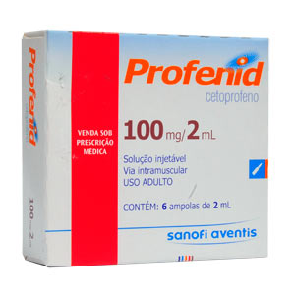

Slide 24
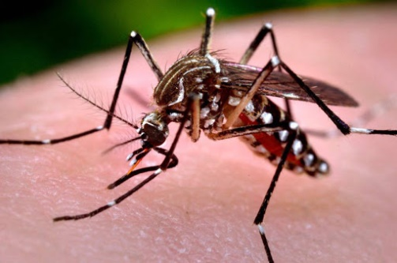
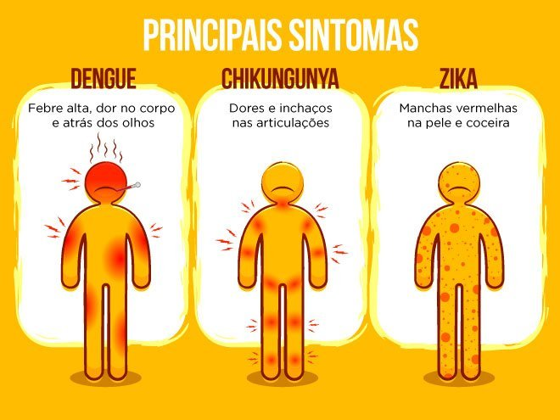

Slide 25
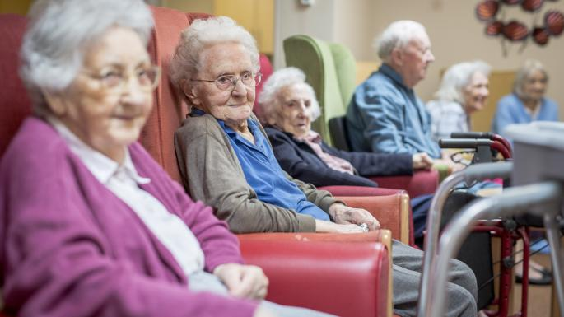

Slide 27
Patient Safety
Safeguarding concerns
Is this safe?
Are they going to be safe at home?
Safety netting

Slide 28
What should safety net advice include?
The existence of uncertainty. If the diagnosis is uncertain, that uncertainty should be communicated to the patient
What exactly to look out for. If there is a recognised risk of deterioration or complications developing then the safety-net advice should include the specific clinical features.
How exactly to seek further help (how and where).
What to expect about time course.

Slide 29
What should be recorded?
Safety-net advice should be documented in the medical notes.
There was no consensus on when and whether safety-net advice should be given in written format rather than verbally.

Slide 30
Ethnicity x COVID-19
UK - one in seven people are from Black, Asian and Minority Ethnic (BAME) backgrounds.
The first ten healthcare workers in the UK who died as a result of COVID-19 were all from BAME backgrounds.
Relationship between ethnicity and known risk factors for poor clinical outcomes in COVID-19, driven by both biological and socio-economic mechanisms.

Slide 31
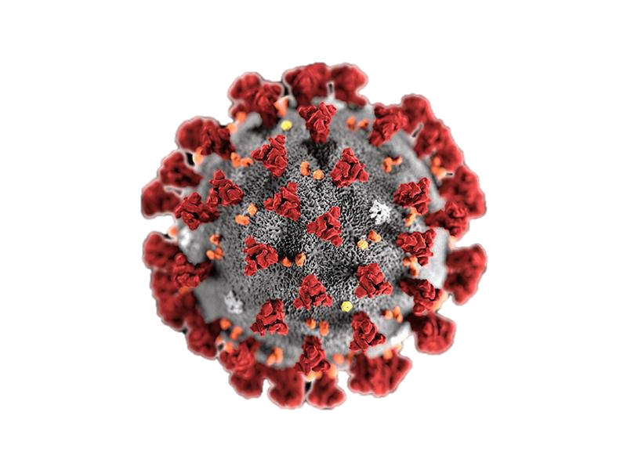
Ethnicity x COVID-19
HTN, DM, CVD
ACE2 receptors
Socio-economic
Behavioural
Vitamin D

Slide 32
Towards Solution
Making the necessary information available in advance
Bridging the culture gap
A point of contact
‘responsible officer’
A national induction
programme
Recognition of our part

Slide 33
“An awareness of historical patterns of discrimination and recognition of the fundamental part that ethnic minorities and migrants have played in the history of the NHS would seem to be key components of cultural change. In turn, such an exercise might enable migrants and ethnic minority staff to feel a greater sense of belonging in the NHS.”

Slide 34
“Immigration is a ‘central factor’ in the evolution of the country. (…) from its overseas-born Premiership footballers to, dare we whisper it, its royal family with roots on the European continent, the UK as we know it today is to a great extent the result of population movements.

Slide 35
Migrants do not just bring a colourful presence, different cultures, music and food. They shape nations by working in industry, public services and becoming involved in civil society. The history of the British National (or should that be International?) Health Service provides us with an excellent illustration of such processes at work.”

Slide 36
References
https://www.oecd.org/unitedkingdom/health-at-a-glance-uk-EN.pdf
OECD (2020), Alcohol consumption (indicator). doi: 10.1787/e6895909-en (Accessed on 26 February 2020)
OECD (2020), Daily smokers (indicator). doi: 10.1787/1ff488c2-en (Accessed on 26 February 2020)
OECD (2020), Road accidents (indicator). doi: 10.1787/2fe1b899-en (Accessed on 26 February 2020)
https://www.telegraph.co.uk/news/2019/10/24/gap-number-foreign-doctors-uk-trained-doctors-doubles-year-new/
https://www.pbs.org/newshour/health/theres-a-new-global-ranking-of-gun-deaths-heres-where-the-u-s-stands
https://www.ncbi.nlm.nih.gov/pmc/articles/PMC2765844/
https://www.ncbi.nlm.nih.gov/pmc/articles/PMC6520089/
https://www.ncbi.nlm.nih.gov/pmc/articles/PMC2951177/
https://www.ncbi.nlm.nih.gov/pmc/articles/PMC7267805/
https://www.ncbi.nlm.nih.gov/pmc/articles/PMC4563843/

