Slide 1
On a precipice The GMC’s role in supporting international doctors
Tista Chakravarty-Gannon
Head of Outreach Development and Support Operations, GMC
Notes:
Intro

Slide 2
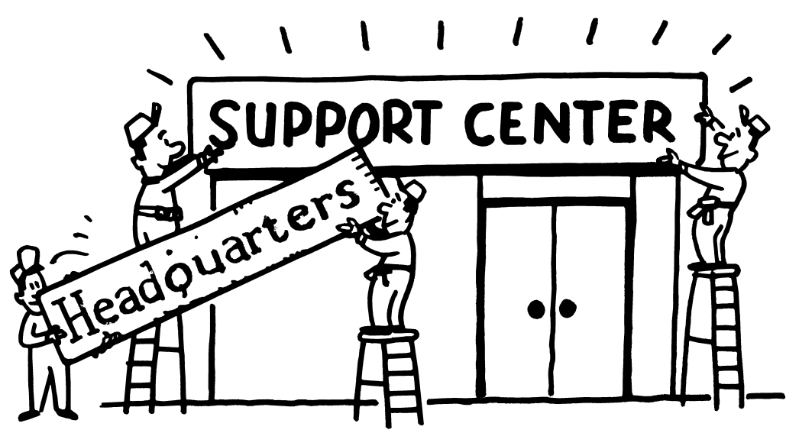
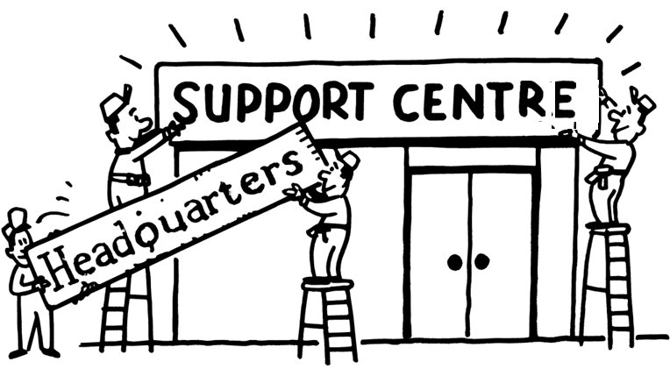
Notes:
Personal intro
2

Slide 3
Notes:
Personal intro
3

Slide 4
Notes:
Personal intro
Turning to international doctors - We have a huge responsibility to support our colleagues across all these areas
Standards is the fulcrum of what we do. If we can support colleagues to deliver good medical practice in what is, let’s face it an increasingly challenging environment, if we can support early and prevent them from getting into difficulty, then clearly that’s eminently desirable
4

Slide 5
Notes:
Managing workload in the service has increasingly felt like a Sisyphean task at times
And before we look at what the GMC can do, I want to think about the impact of workload on the workforce

Slide 6
10 seconds…
Can you find the
the mistake?
1 2 3 4 5 6 7 8 9
Notes:
And for a tangential take on that, indulge me a moment as I’m going to use a quick exercise that my team sometimes use. You have 10 seconds to find the mistake on the slide – don’t shout out – out your hand up once you find it…very frustrating when you spot it – slide designed to deflect with different colours, font sizes, etc. And my point is that it’s easy to miss things in a pressurised environment

Slide 7
The space to think…
Notes:
Which is somewhat analogous to the service - recognition that service delivery is important, but what’ the efficacy if you don’t have the space to think. What are the consequences? If you’re doing and doing and doing without the space to think…you’ll miss things and…

Slide 8
Burnout
Well over a half of trainees, and just under a half of trainers, reported that they often or always feel worn out at the end of their working day
Nearly half of trainees reported that they work beyond their rostered hours on a daily or weekly basis
Two in five trainees and two thirds of trainers rated the intensity of their work as very heavy or heavy
Almost a third of trainees said that they are often exhausted at the thought of another shift
Notes:
You’ll burnout. Now this relates to trainees and trainers, but of course, it’s much broader than that

Slide 9
International doctors
I arrived in spring and had no idea where to buy a good coat.
I was asked to get the SHO and the nurse looked fed up when I asked who/what that was.
No one told me that the local area was unsafe at night.
I got the catheter from the cupboard as instructed…
I had no one to talk to.

Slide 10
Notes:
In that context, the GMC and system partners have a moral responsibility to provide real support.
10

Slide 11
“The best way to keep patients safe is to keep doctors safe” Terence Stephenson
Four warning signs
supply of new doctors has not kept pace with demand
dependence on non-UK qualified doctors increased in some specialties
at risk of becoming a less attractive place for overseas doctors to work
strain on doctors training and being trained continues
State of Medical Education and Practice, GMC, December 2017
Notes:
We’ve been raising our concerns about this for years now in our annual SoMEP report and I would also add that keeping workforce wellbeing supported and their environments safe is ethically appropriate in and of itself

Slide 12
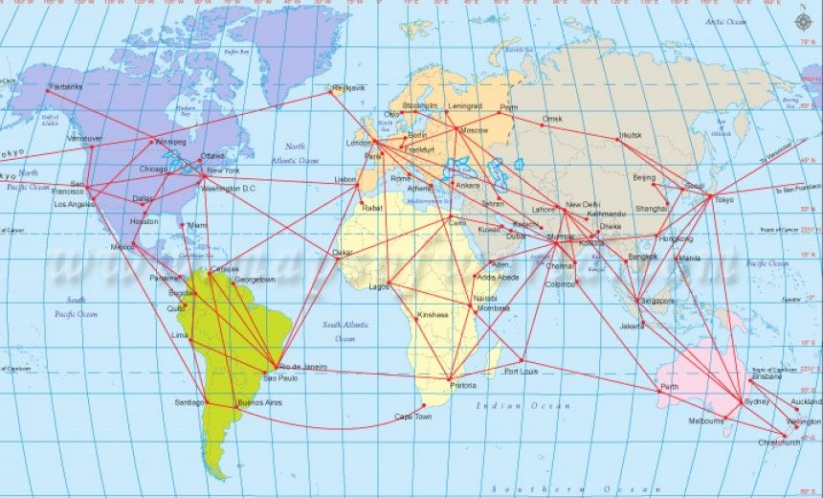
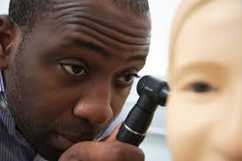
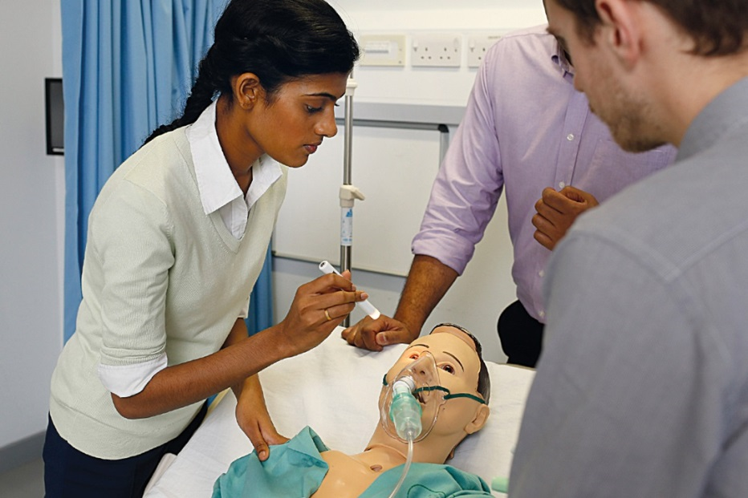
So, what can we do?
Routes to registration
Physical space for PLAB
Ethical recruitment
Increasing medical school places
Legislative change
Notes:
Some of the actions are more prosaic, but no less critically important:
Simplify routes to registration
Around 50% of IMGs come through PLAB – improve the process, but also create greater physical space – capacity from 4000 to 11000
Support ethical recruitment schemes like MTI and collaborate to develop similar
Support increased med school places –
Some of these require legislative change (e.g. where we’d like to go with CESR/CEGPR)

Slide 13
What about workforce wellbeing?
Notes:
So, as I say, those practical actions are critically important, but for me, wellbeing and support is critical to retention and recruitment and that’s my is the key focus

Slide 14
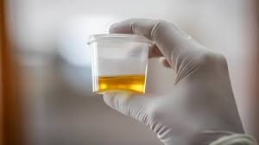
Oliguria occurs twice as frequently in junior doctors on an intensive care unit as in their patients
On an ICU over 22 days, what characteristics/ presentation were most associated with oliguria?
Notes:
Click through slide for reveal

Slide 15
I have enough time to stay adequately hydrated
Yes
No
Yes, but I sometimes fall into bad habits
Notes:
Oliguria occurs twice as frequently in junior doctors on an intensive care unit as in their patients

Slide 16
Induction?
IT skills assessment
Fire
Manual handling
Equipment
Hazardous substances
Slips, trips and falls
Infection control and PPE
Infection control and handwashing
Resus services
Information governance
Notes:
Where have I gotten this list from? Where’s the support? What about culture shock; different legislation, different patient expectation; different system?

Slide 17
Notes:
In 2012 we called for an induction programme and we developed the programme ourselves.

Slide 18
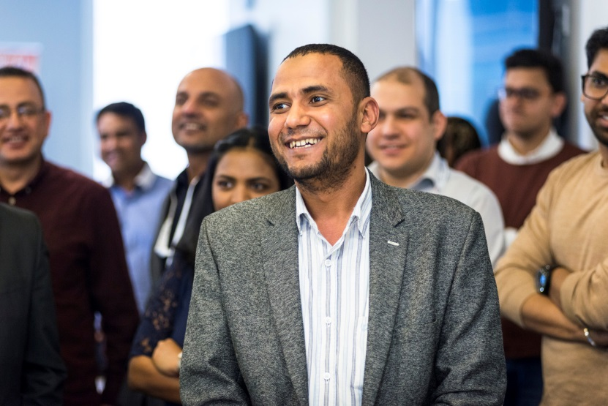
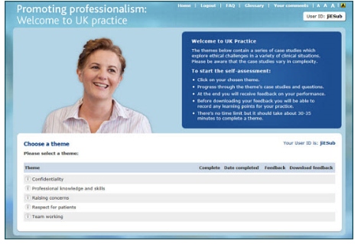
Free half-day workshops delivered by experienced GMC staff, who are experts in GMC guidance
Free online self-assessment tool helps doctors identify where they need to improve their understanding of GMC guidance

Slide 19
What percentage of attendees said they would change their practice after attending?
71%
81%
91%

Slide 20
Does it work?
98% rated the session as good or very good
97% would recommend it to a friend
91% would change their practice as a result of attending
97% improved their knowledge
95% improved their impression of the GMC
Newcastle University evaluation research since undertaken shows:
Significant improvements to understanding of GMC guidance, confidence and patient-centredness
3 month follow up showed intention to change practice resulted in actual changes
Currently working with MWRES to further influence induction & support
Notes:
2018 evaluation form stats - highlight work with Newcastle, concept of mandating and work with WRES

Slide 21
Bullying: Impact on workforce widely recognised
‘Trusts are paying the price for poor staff retention and work place culture through having to use costly locums and bank staff’
‘Regulators should focus more on staff wellbeing and culture’
Notes:
In addition to how we support doctors new to the UK, there’s another serious issues that affects the workforce – comments from Dido Harding – 21st Feb 2019 on wellbeing and culture

Slide 22
Professional behaviours and patient safety
Notes:
Some of you may recall that we ran a programme of events in 2015 to look at the most challenging issues for the workforce. And our PBPS prog has essentially emanated from that. Like WtUKP it’s academically robust, we’ve worked with Vanderbilt Uni, various Colleges, DAUK and others

Slide 23
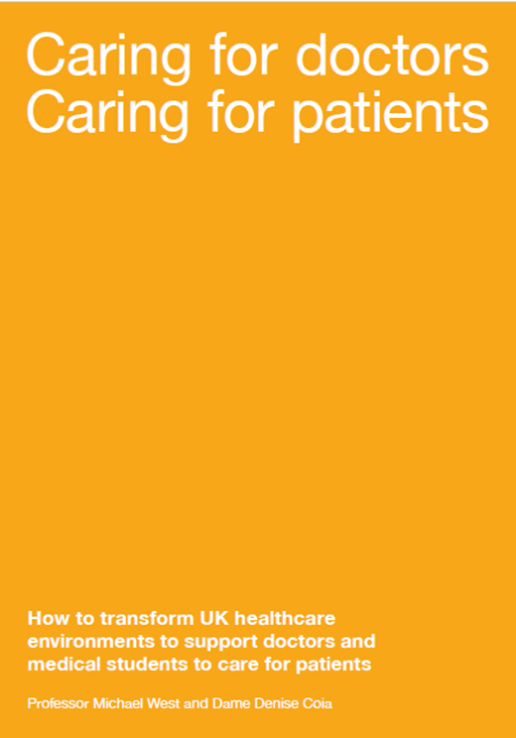
Notes:
Is likely to recommend
development, monitoring and assessment of nurturing cultures
Recruitment and retiention; reprioritisation if workload becomes too high – monitoring workload
Implementing BMA Good Rostering Guide and the BMA Fatigue and Facilities Charter
support team-working and create home-teams

Slide 24
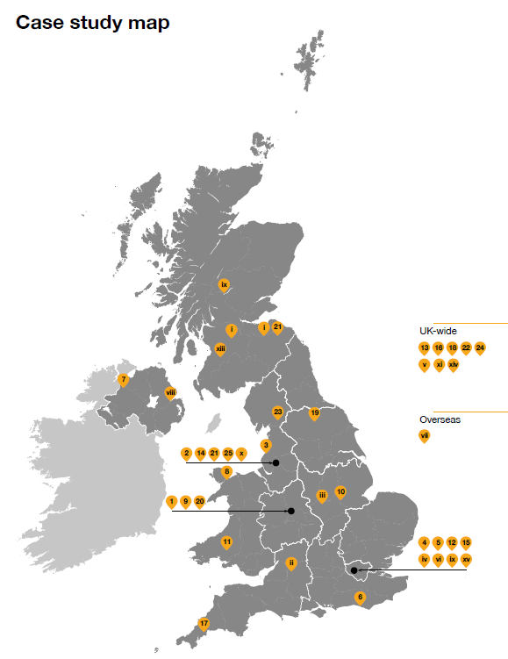
Six steps needed
Autonomy/control
Voice, influence and fairness
Belonging
Team working
Competence
Workload
Work conditions
Work schedule and rotas
Culture and leadership
Call to action
Recommendations
Case studies
Notes:
Autonomy
There are three recommendations for healthcare organisations, which aim to provide doctors with more control over their working lives. This includes giving doctors the ability to have a greater influence over their workplace cultures, providing minimum standards for basic food and rest facilities and addressing issues with rota planning.
Belonging
There are two recommendations that aim to make doctors feel part of effective and supportive teams. They aim to help healthcare bodies to develop effective multidisciplinary team working and allow doctors to feel that they have a voice within the workplace.
Competence
There are three recommendations that aim to help doctors to be more effective in the workplace, so they can deliver valued outcomes such as high-quality care. These include tackling problems with workload, making sure that doctors have affective clinical, educational and pastoral support and implementing training frameworks that suit doctors’ needs and enable them to manage their wider life circumstances.
This

Slide 25
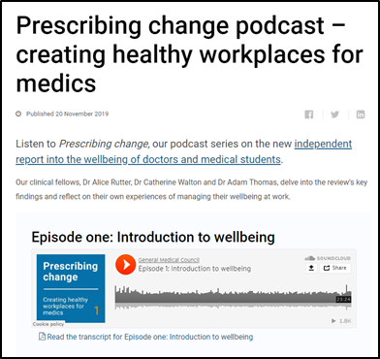
Alice – one of our clinical fellows said:
“What has struck me reading this report is that there are places all over the UK doing inspiring things to make doctors’ lives better – with equally inspiring results. What seems to unite these is that wellbeing and staff are a priority, that leaders have invested their time, and that there has been collaborative and creative thinking about ways forward.”

Slide 26
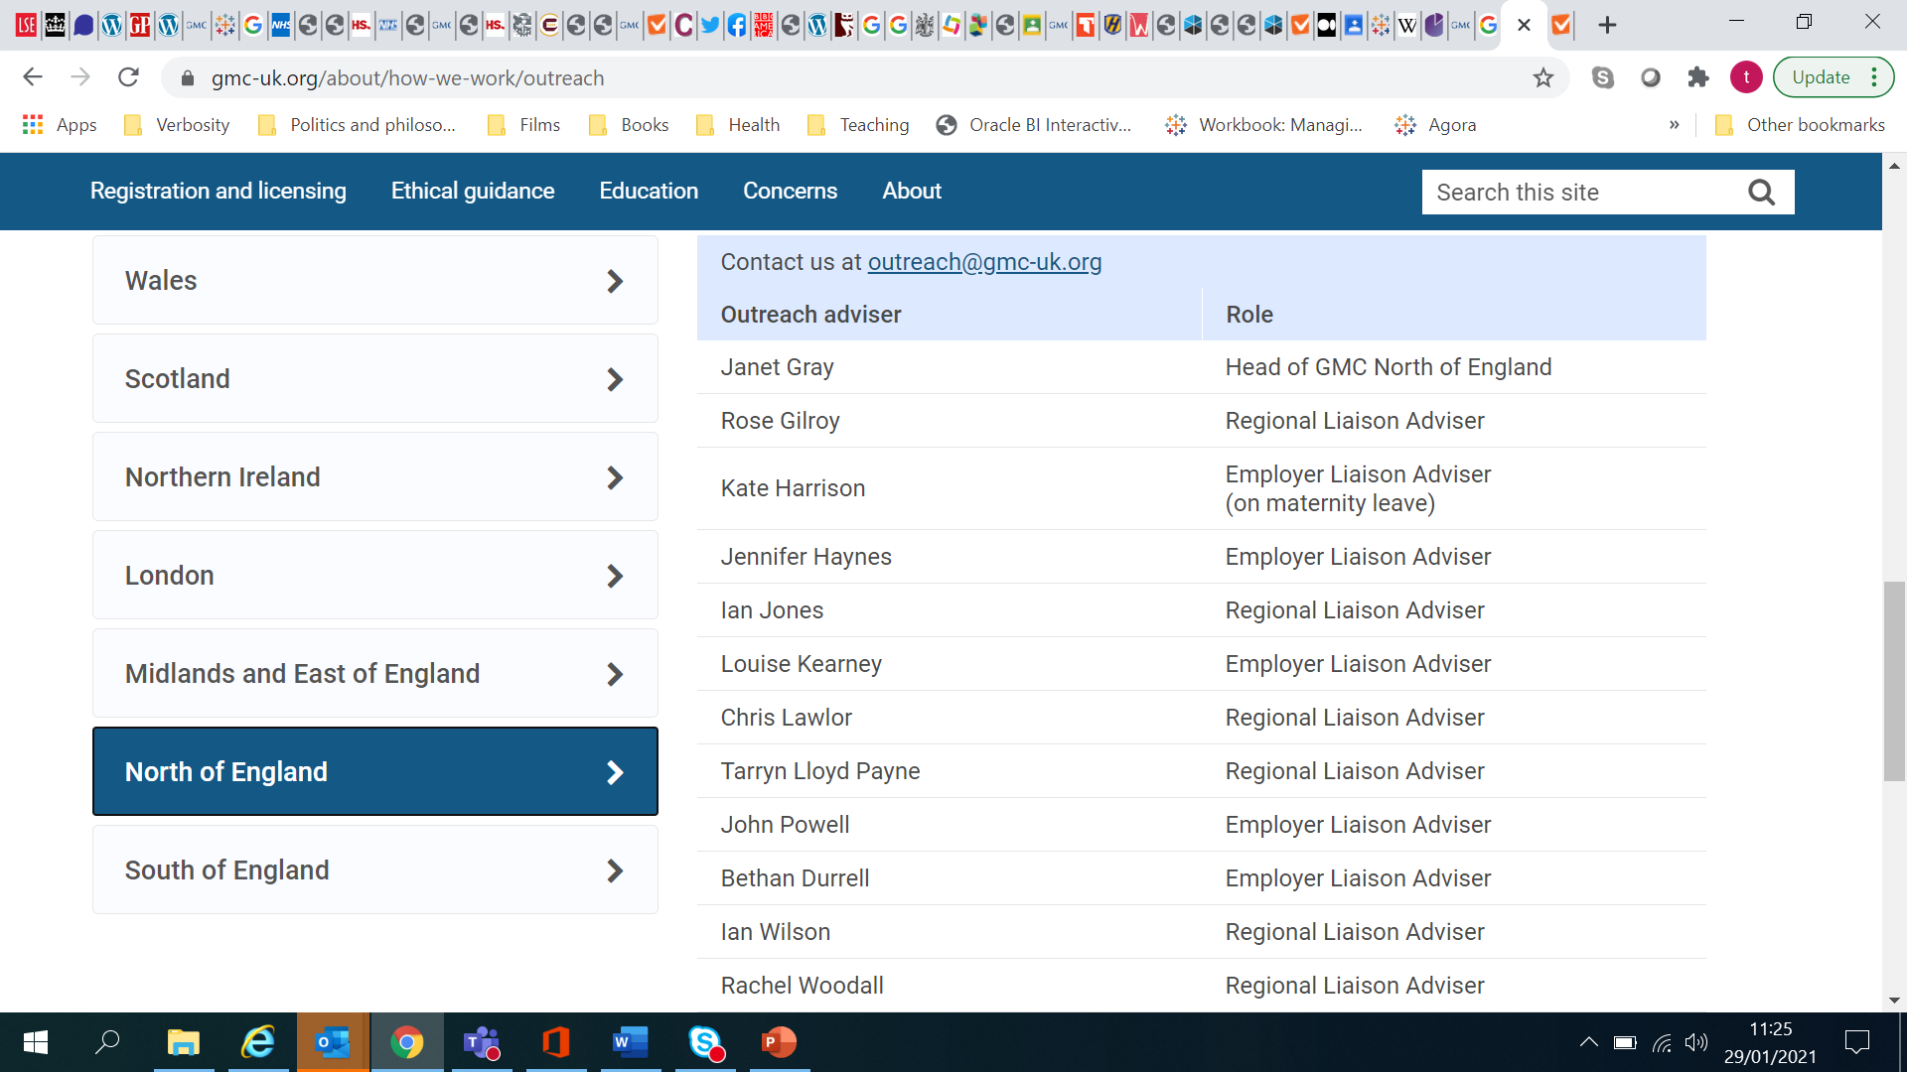
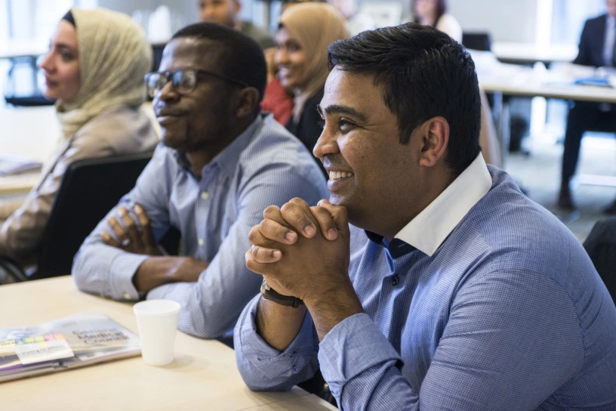
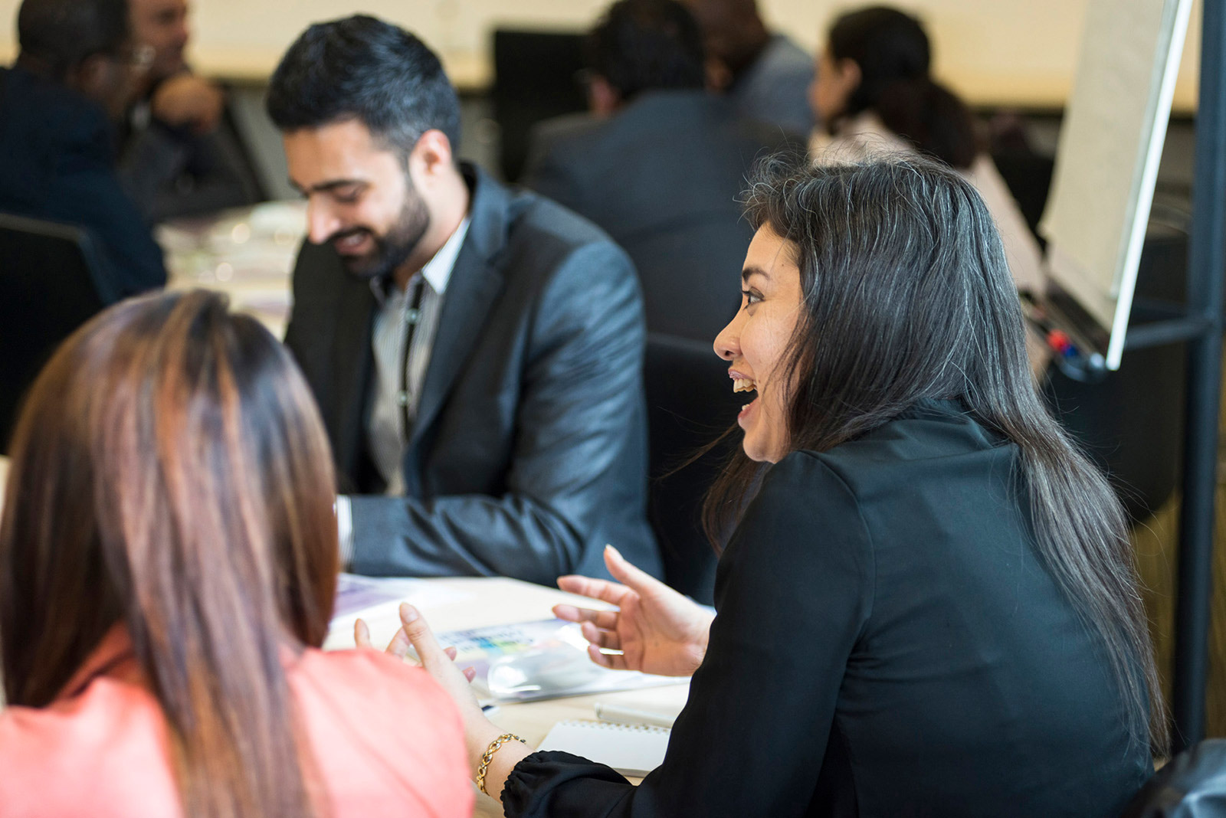
GMC Outreach
We are an ‘up stream’ preventative intervention
We offer consultancy to the provider
We provide supportive teaching interventions to doctors and medical students
We proactively listen, to inform policy, operations and our approach to providing support
Relational regulation: engage, influence, inform
Notes:
Concluding with Outreach

Slide 27
Our vision
Welcome to UK Practice is a natural step in the journey to becoming a doctor in the UK
A majority of internationally-qualified doctors new to UK practice will have taken part by the end of 2021
All doctors who register through a sponsoring organisation attend WtUKP
That we are able to work with colleagues on the ground to improve cultures and ongoing support for international doctors
That we can support the system to tackle bullying
That we can collaborate to improve wellbeing and prevent harm

Slide 28
Welcome to UK Practice is a natural step in the journey to becoming a doctor in the UK
A majority of internationally qualified doctors, new to UK practice, will have taken part by the end of 2021
All doctors who register through a sponsoring organisation attend WtUKP
That we are able to work with colleagues on the ground to improve cultures and ongoing support for international doctors
That we can support the system to tackle bullying
That we can collaborate to improve wellbeing and prevent harm
To realise this ambition we need your support. How can we collaborate on this? What do you need from us?

