Slide 1


…insights, solutions, myths
FEBRuary 2021
Dr Ron Daniels B.E.M.
CEO, UK Sepsis Trust
Executive Board, Global Sepsis Alliance
WHO Technical Expert Group
@SepsisUK

Slide 2
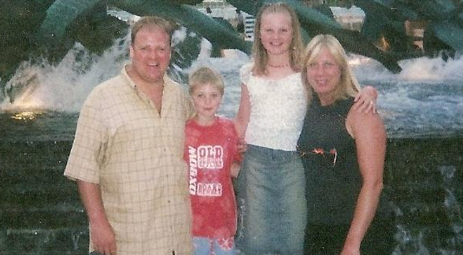

Slide 3
SEPSIS is a life-threatening condition that arises when the body’s response
to an infection injures its own tissues and organs.

Slide 4

Breast cancer
Bowel cancer
Annual UK sepsis deaths

Slide 5
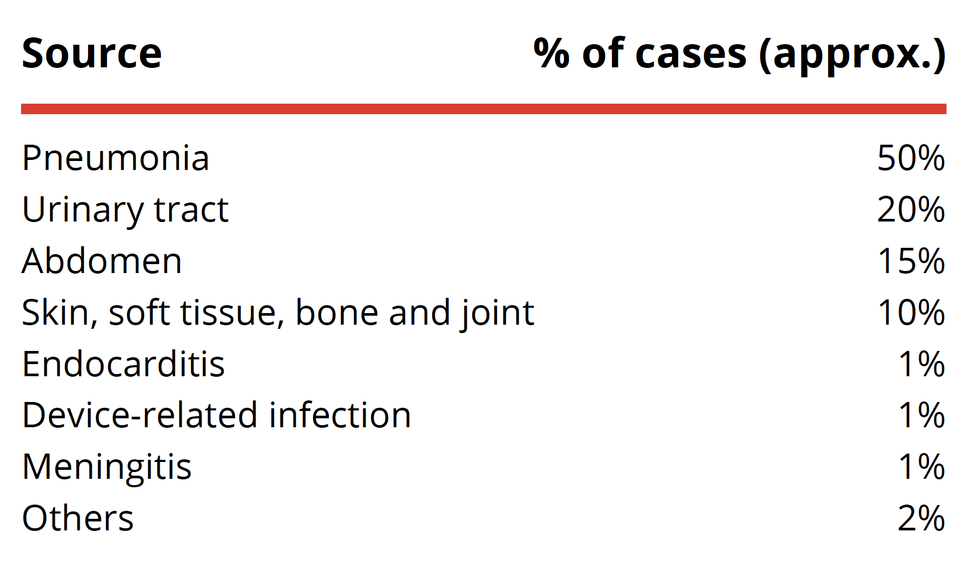
SOURCES OF INFECTION

Slide 6
‘MIGHT BE’ SEPSIS CODES
J18.0 Bronchopneumonia, unspecified organism
J18.1 Lobar pneumonia, unspecified organism
J18.9 Pneumonia, unspecified organism
K65.0 Generalised peritonitis
L03.9 Cellulitis, unspecified
L03.1 Cellulitis of limb
N39.0 Urinary tract infection

Slide 7
‘MIGHT BE’ SEPSIS CODES
J18.0
J18.1
J18.9
K65.0
L03.9
L03.1
N39.0
1,700,000
CASES
(HES data 2017)

Slide 8

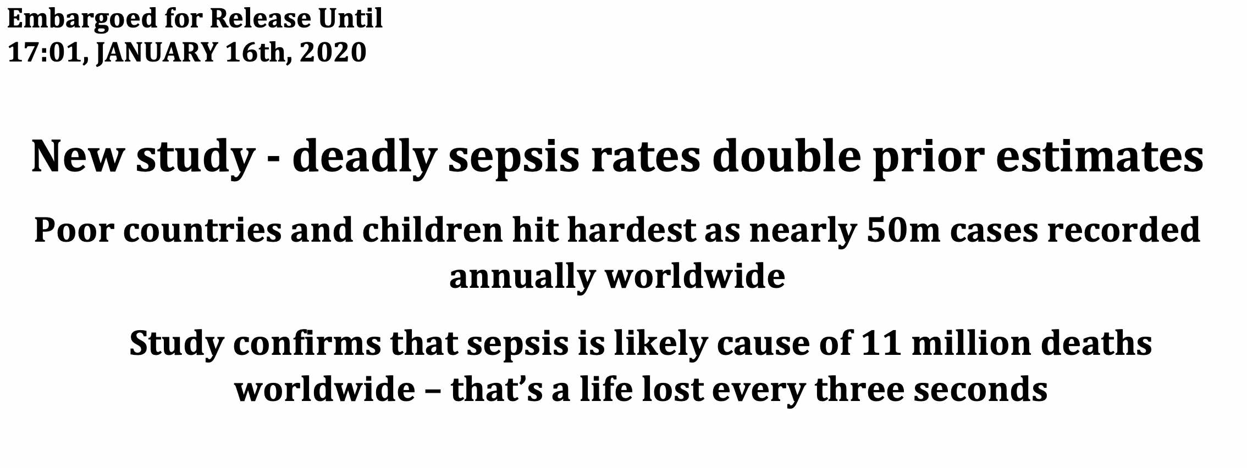

Slide 9
GLOBAL SEPSIS MORTALITY
Ischaemic Heart Disease
7.2M
(CDC 2015)
Cancer
9.6M
(WHO 2018))
Sepsis
11 M
*
Tobacco
8M
(WHO 2019)
COVID-19: 2.1M (JHU 2021)
*Rudd K, Lancet 2020

Slide 10
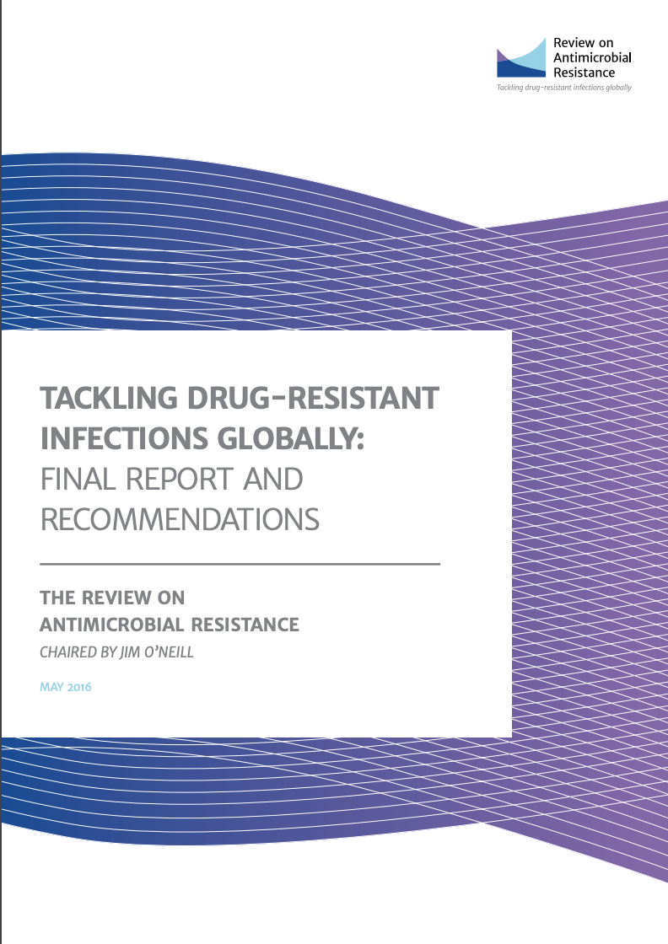
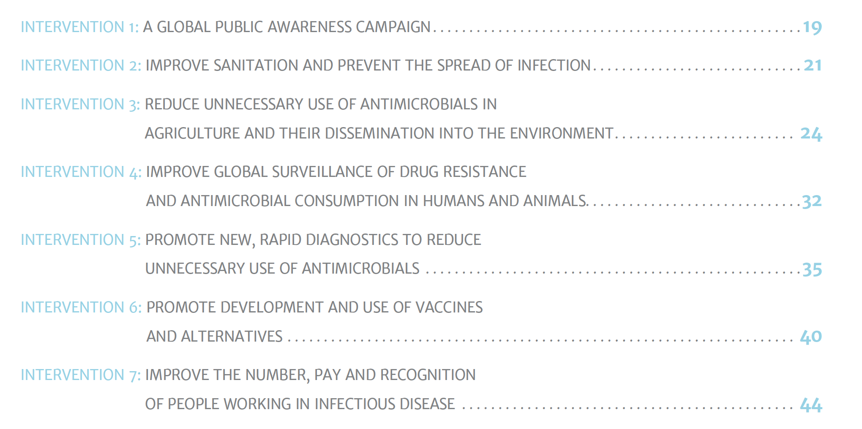

Slide 11
GLOBAL SEPSIS MORTALITY
IHD
7.2M
(CDC 2015)
Cancer
9.6M
(WHO 2018))
Sepsis
21 M
*
Tobacco
8M
(WHO 2019)
COVID-19: 2.1M (JHU 2021)
*Rudd K, Lancet 2020

Slide 12
GLOBAL SEPSIS MORTALITY
IHD
7.2M
(CDC 2015)
Cancer
9.6M
(WHO 2018))
Sepsis
49 M
*
Tobacco
8M
(WHO 2019)
COVID-19: 2.1M (JHU 2021)
*Rudd K, Lancet 2020

Slide 13
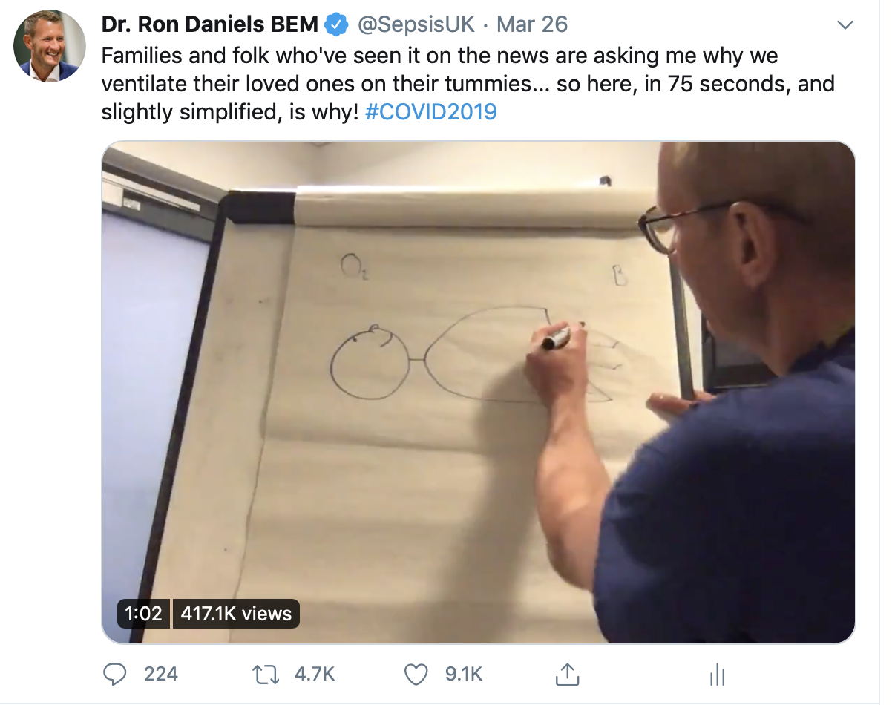

Slide 14
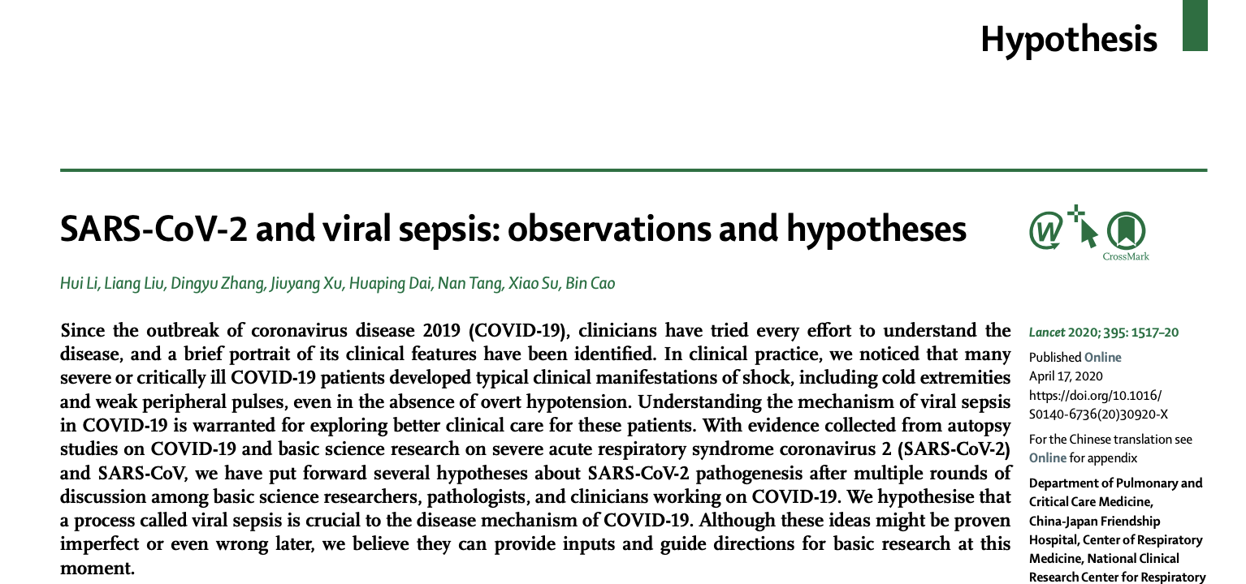

Slide 15
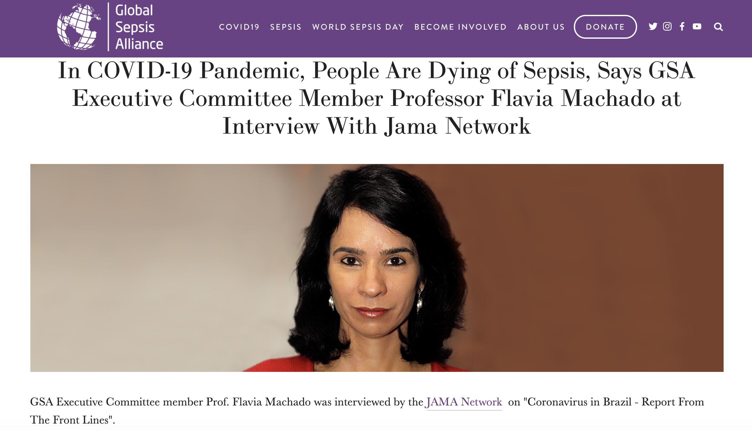

Slide 16
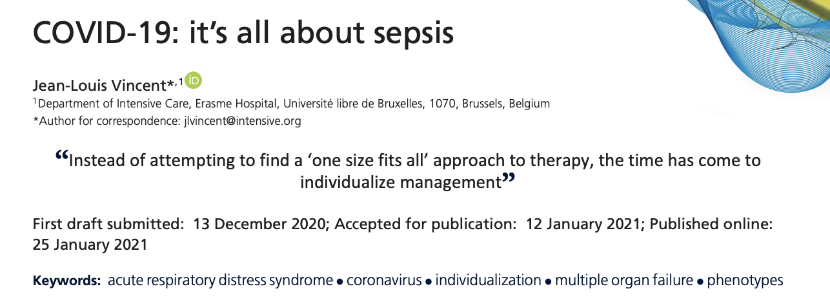

Slide 17
Is using the word sepsis for COVID-19 patients just a question of semantics? No, the implications of calling this sepsis are important. First, this dysregulated host response explains why antiviral therapies, including remdesivir, have not been found to be very effective in COVID-19 patients who have become critically ill. On the other hand, immunomodulation with corticosteroids and tocilizumab are valid therapeutic approaches in some patients, and other options will follow

Slide 18
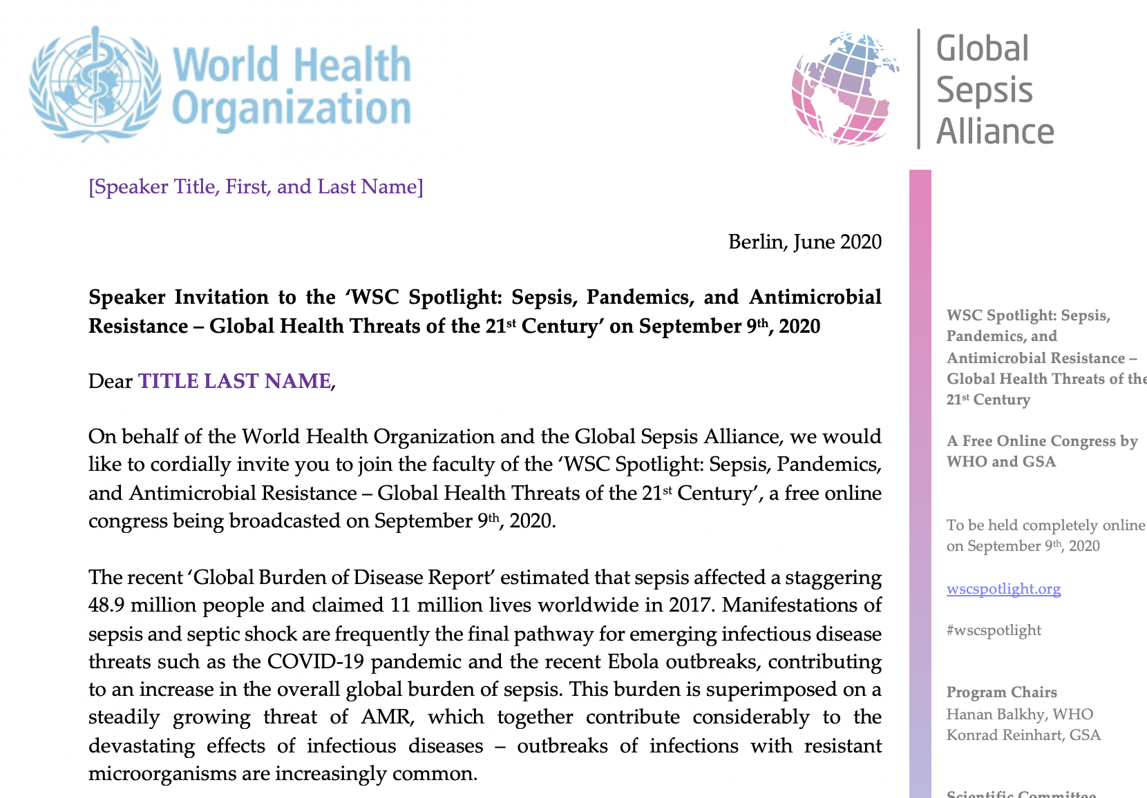

Slide 19
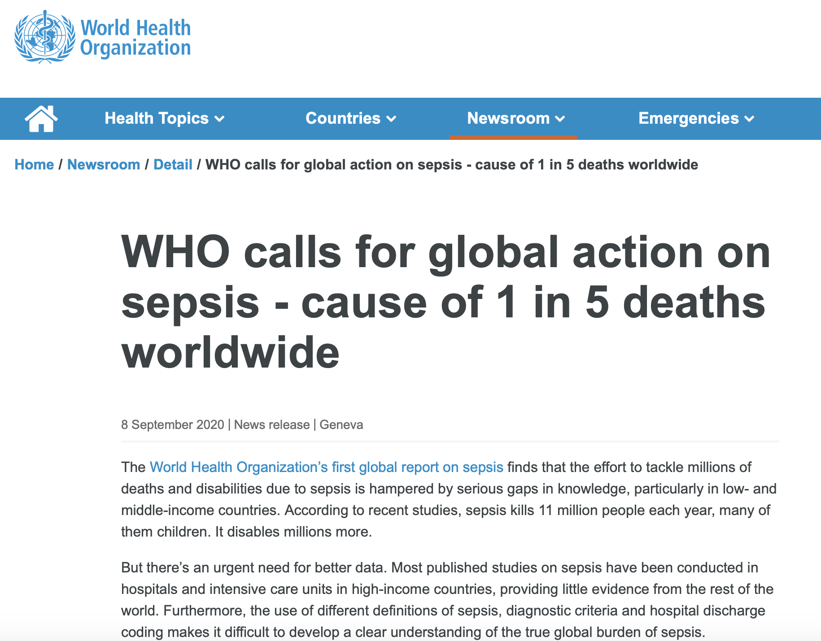

Slide 20

What about survivors?
@sepsisuk
Dr Ron Daniels B.E.M.
CEO, UK Sepsis Trust
CEO, Global Sepsis Alliance
Special Adviser (maternal sepsis) to WHO
Dr Ron Daniels B.E.M.
CEO, UK Sepsis Trust
CEO, Global Sepsis Alliance
Special Adviser (maternal sepsis) to WHO
@SepsisUK
@SepsisUK
@SepsisUK

Slide 21
Around 40% of survivors of sepsis suffer at least one of a range of physical, cognitive, and psychological sequelae.

Slide 22
43% of survivors in one study were still not back at work at one year.
Poulsen JB, M.ller K, Kehlet H, Perner A. Acta Anaesthesiol Scand. 2009;53(6):724-730

Slide 23
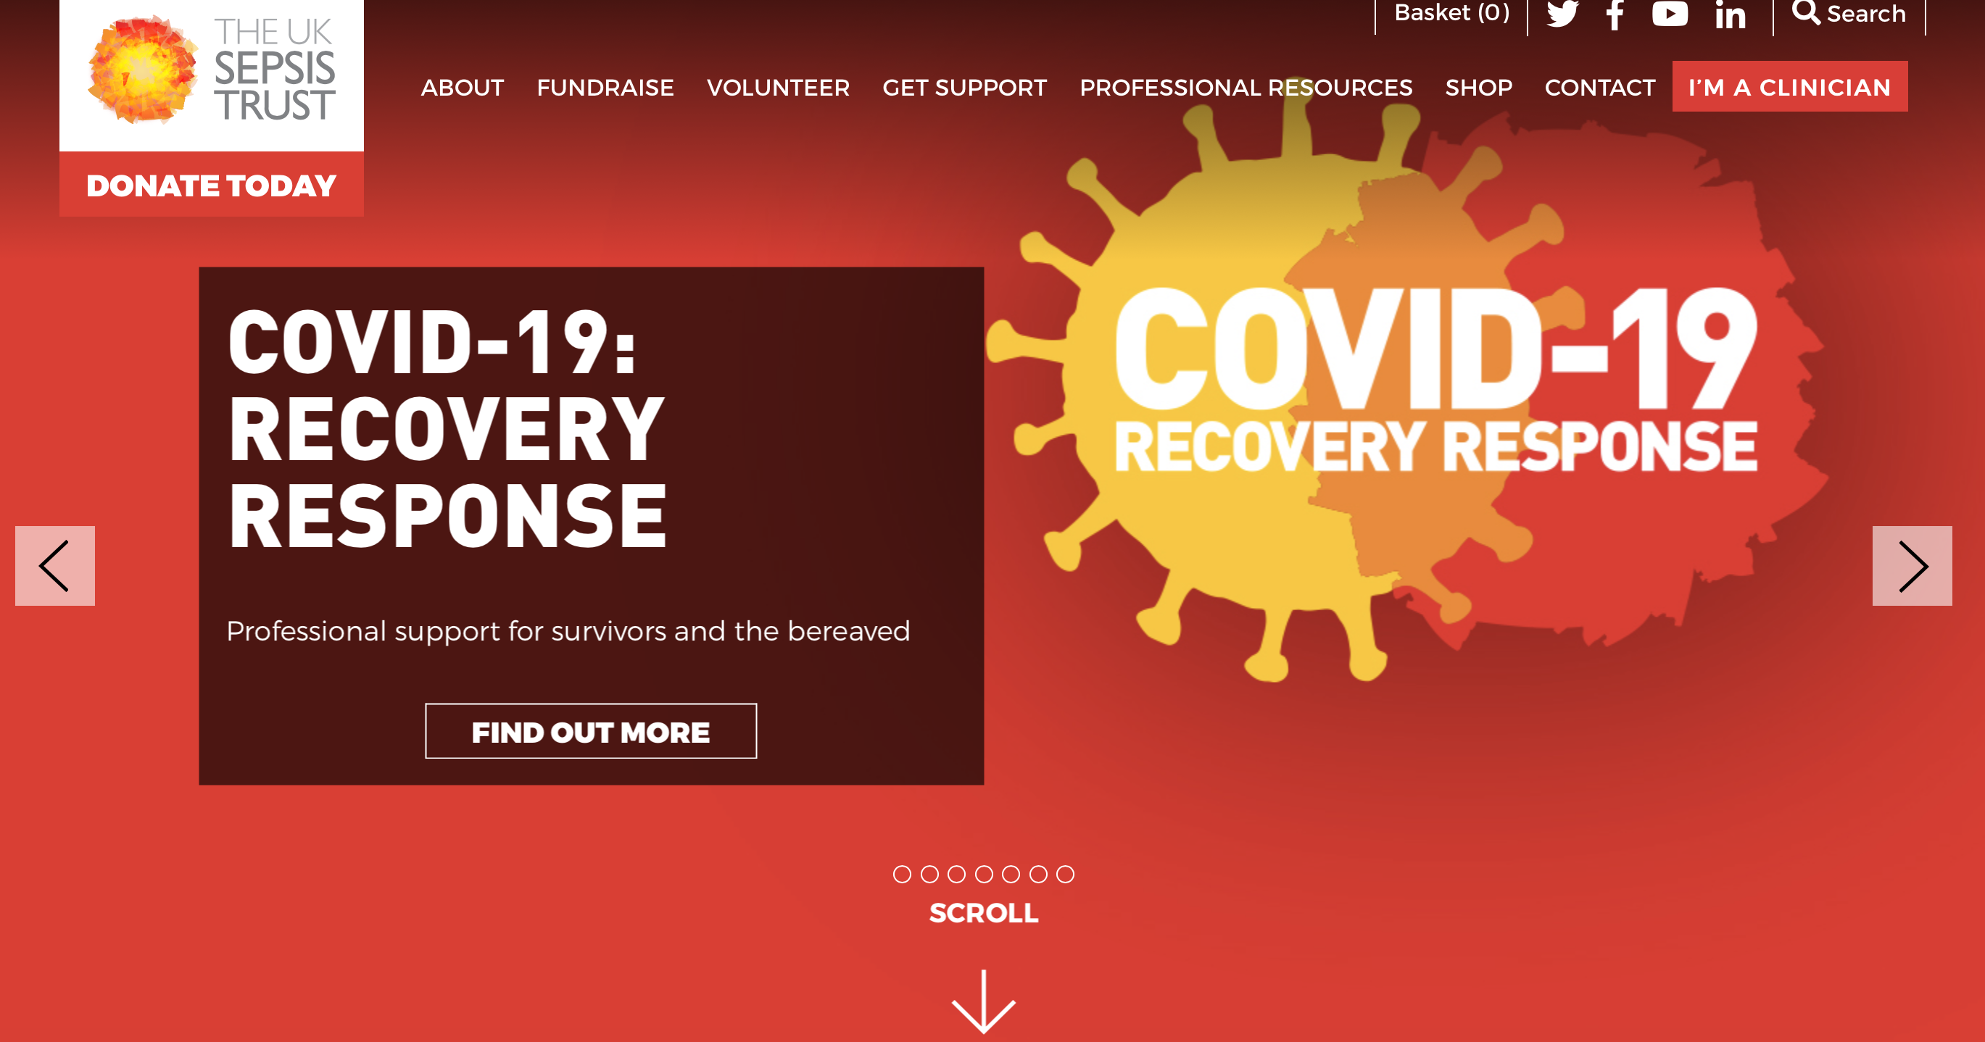

Slide 24

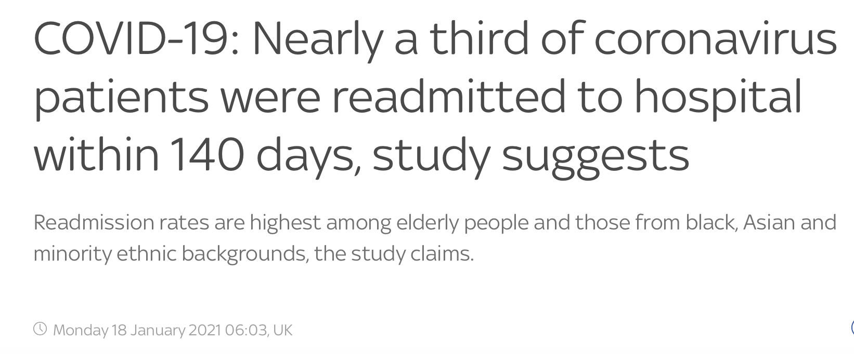

Slide 25

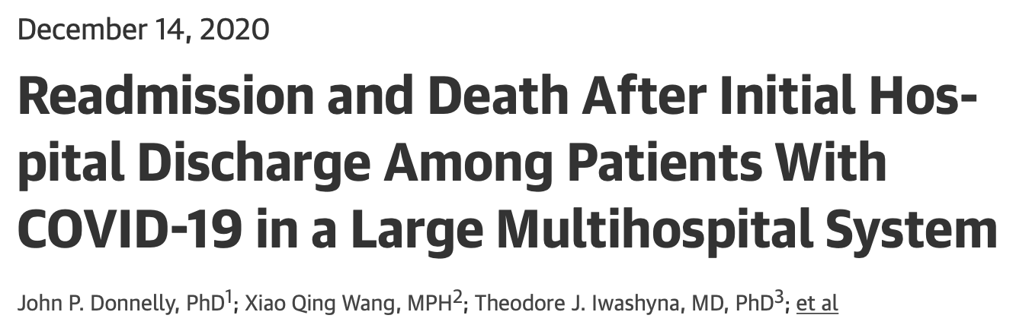
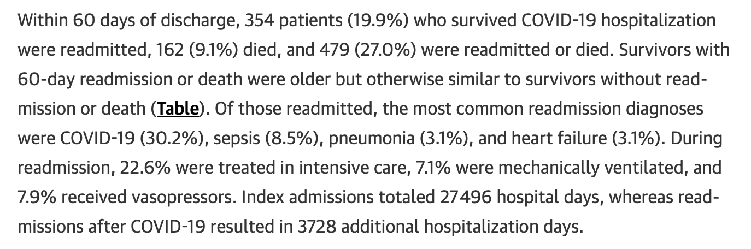

Slide 26
Preventing harm
@SepsisUK

Slide 27
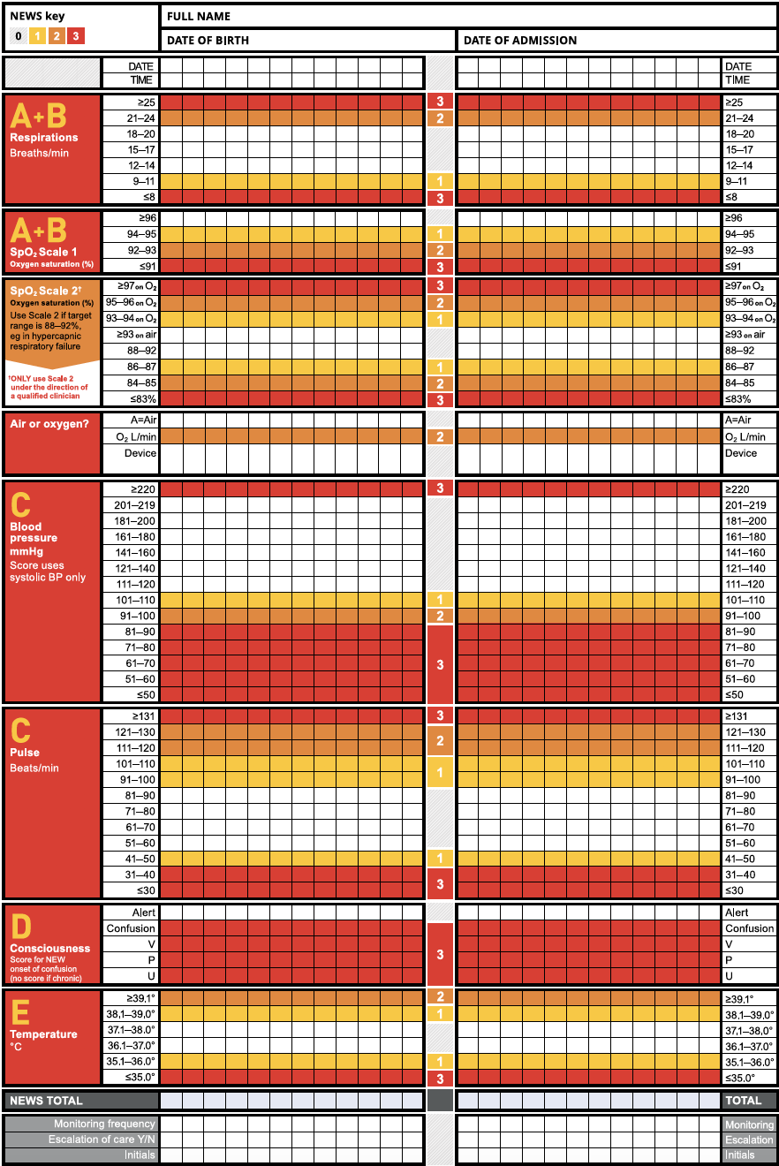
NEWS-2
Second version, created by Royal College of Physicians
NHS recommends ‘Think Sepsis’ if total NEWS-2 is 5 or above

Slide 28
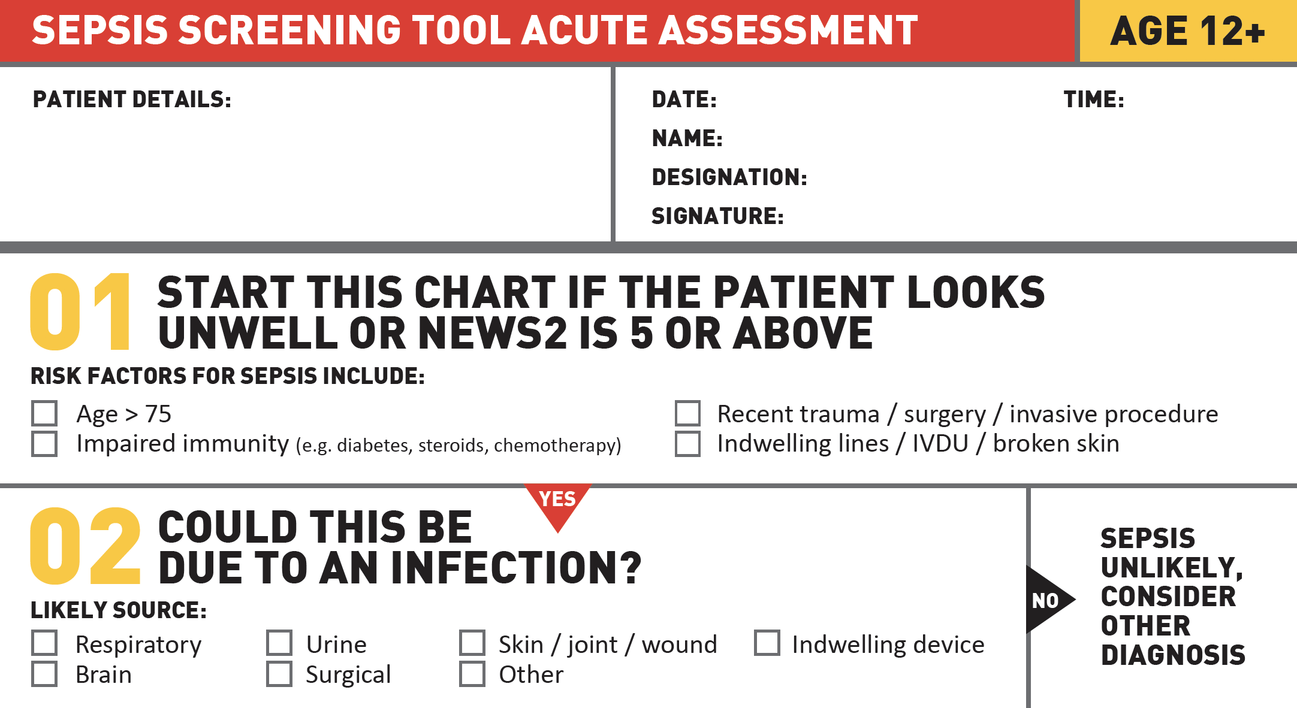

Slide 29
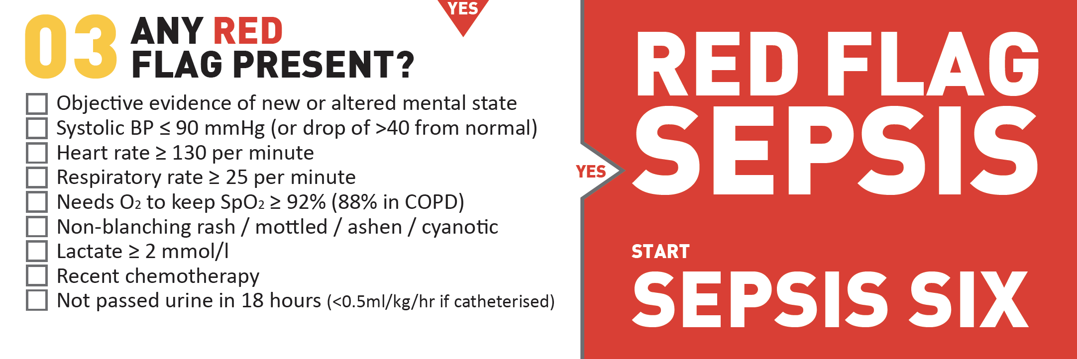

Slide 30
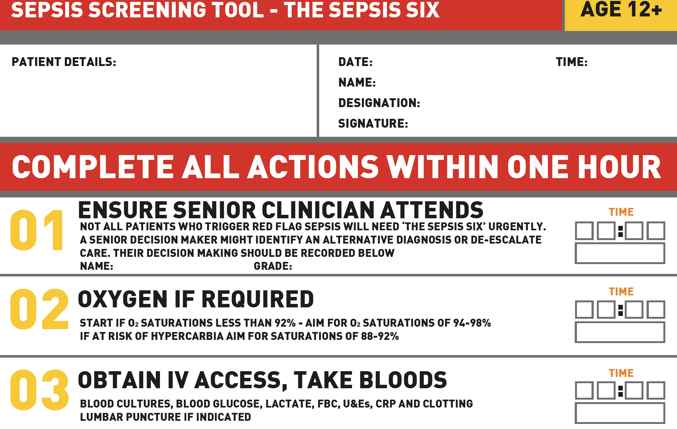

Slide 31


Slide 32

CLINICAL STANDARD 2
All emergency admissions must be seen and have a thorough clinical assessment by a suitable consultant as soon as possible but at the latest within 14 hours from the time of admission to hospital.
Seven Day Services Clinical Standards, 2017

Slide 33
CLINICAL STANDARD 2
England.nhs.uk 7 day hospital services self-assessment results, Oct 2019

Slide 34
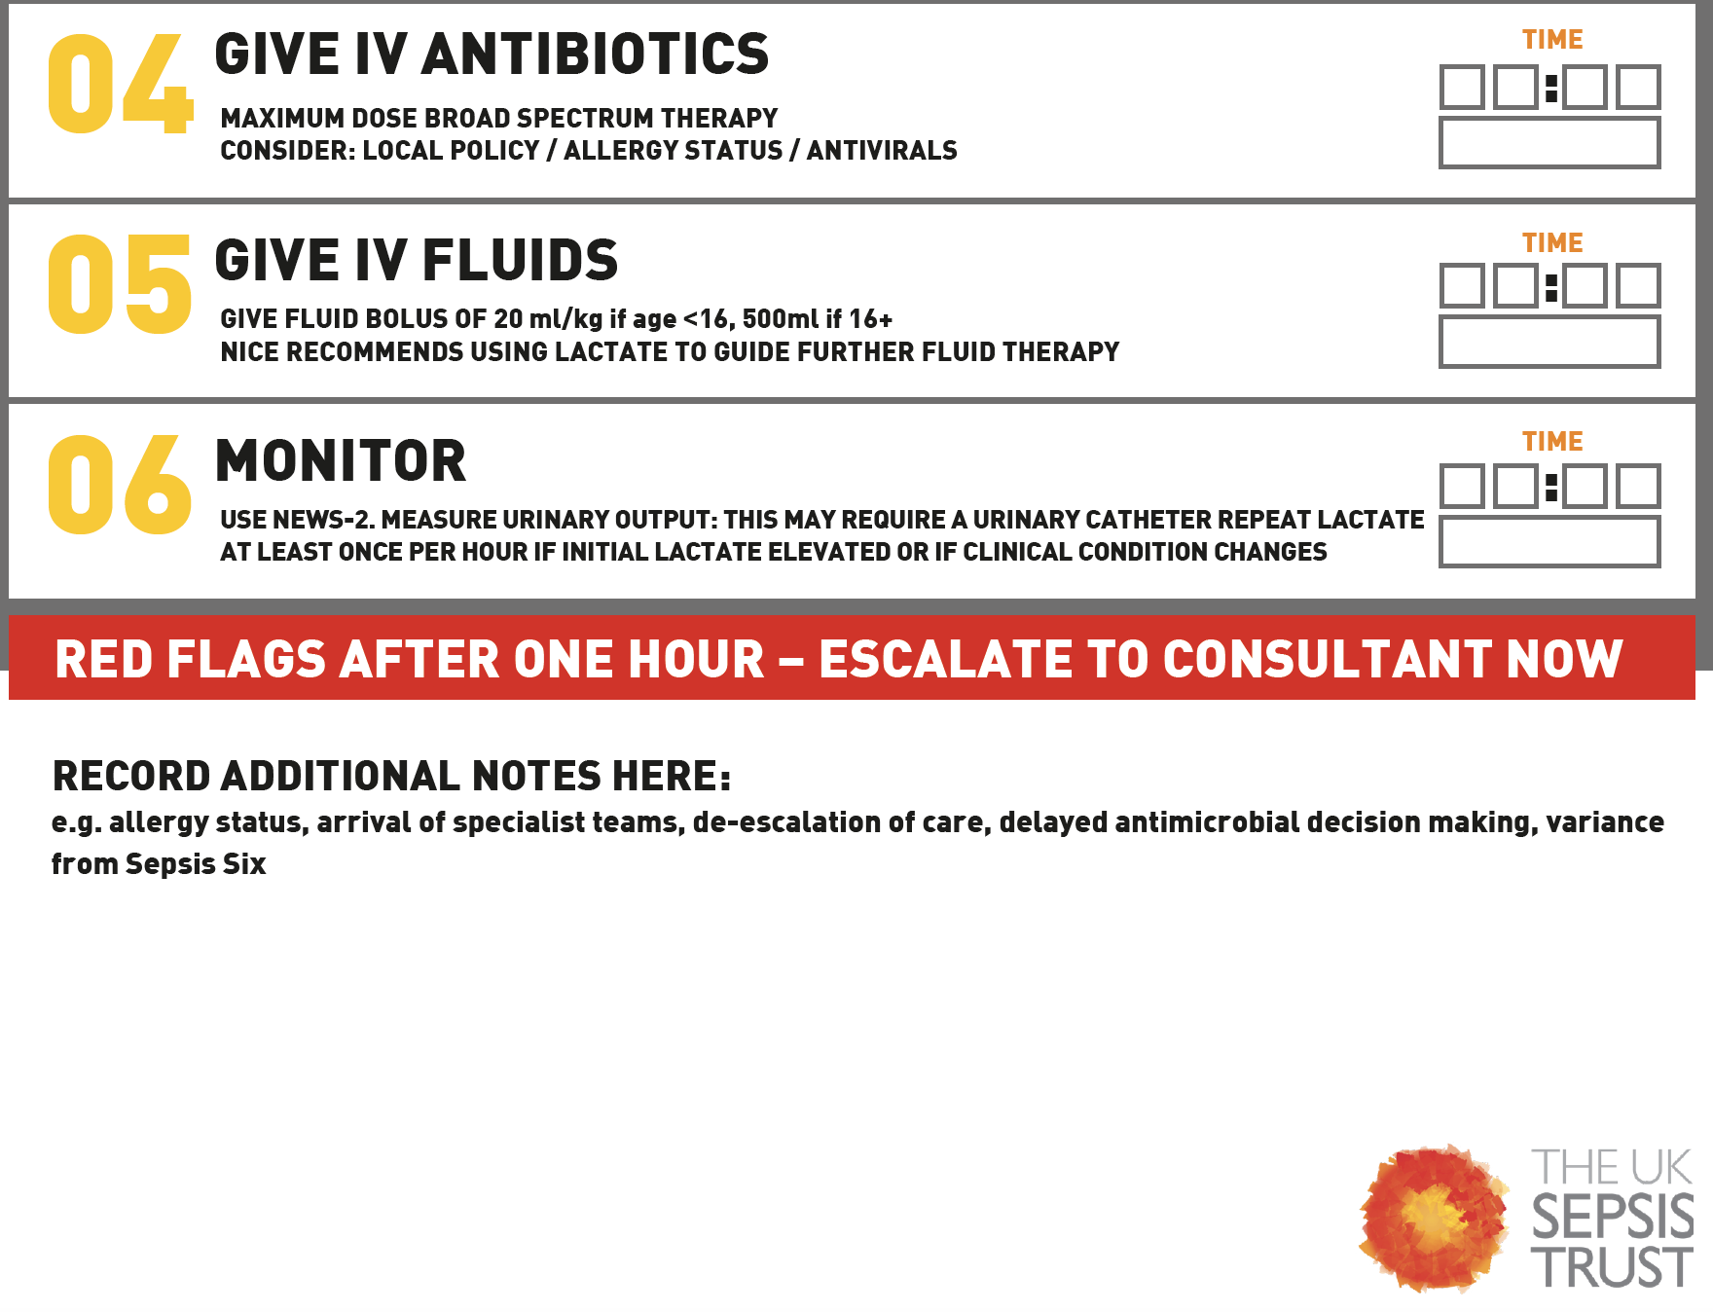

Slide 35


Slide 36
IF YOUR MUM HAD SEPSIS....
...and was receiving reasonable standard care and investigations how long would you be happy to wait before she received antibiotics?
Does it matter?

Slide 37

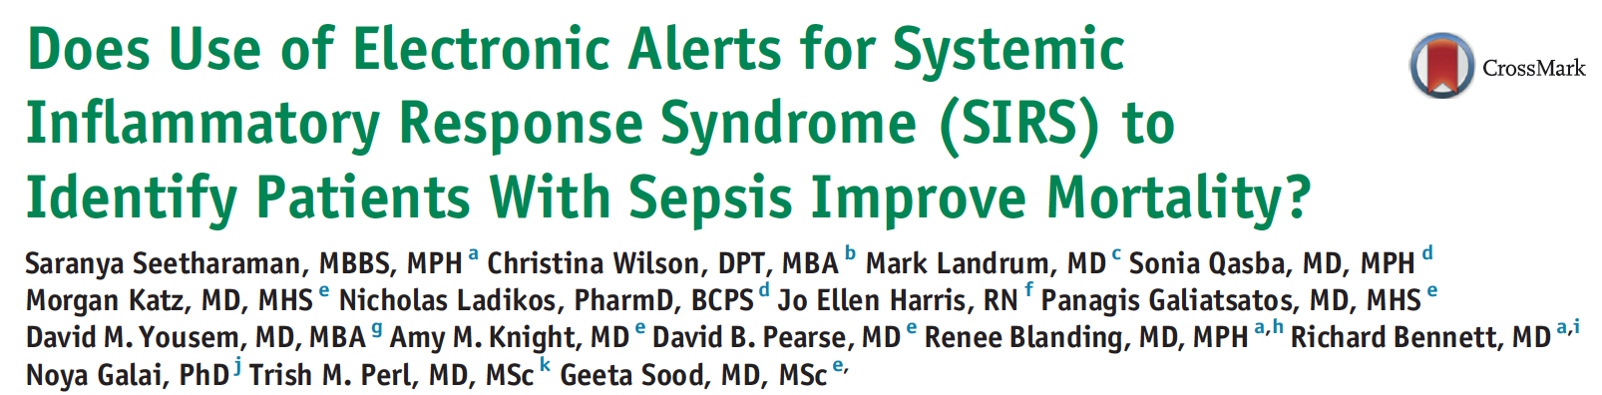

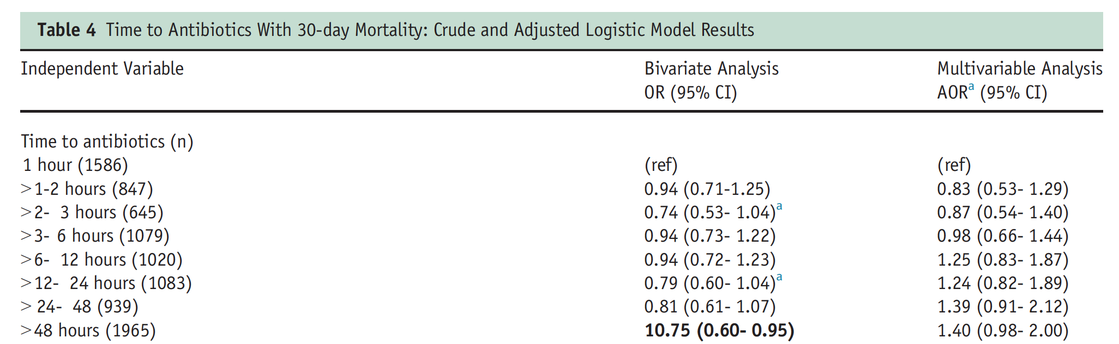


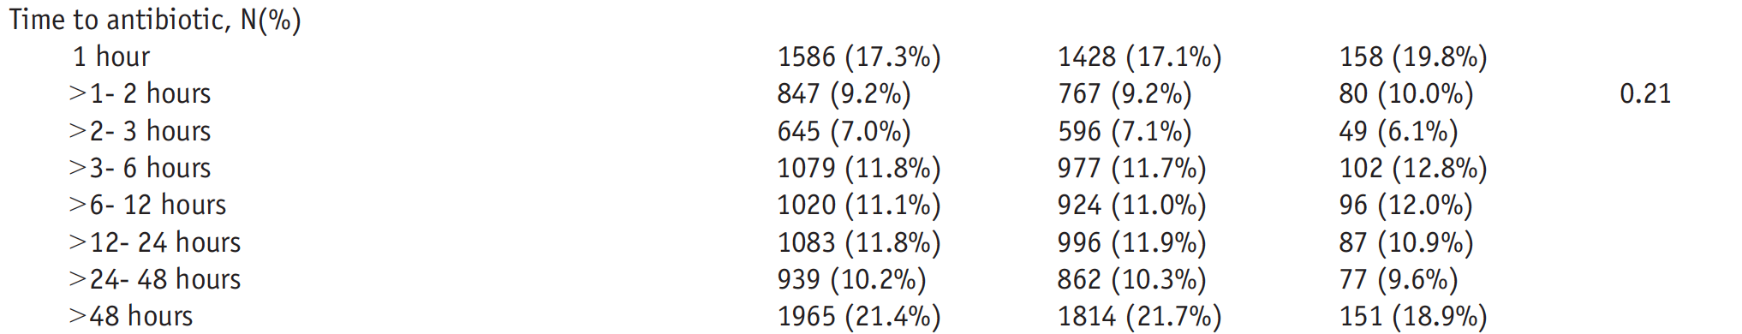
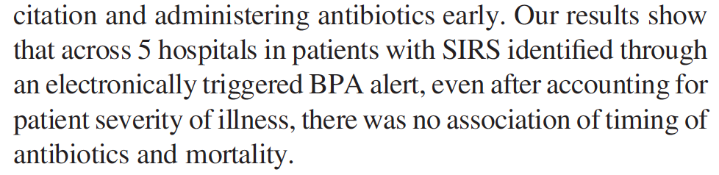


Slide 39
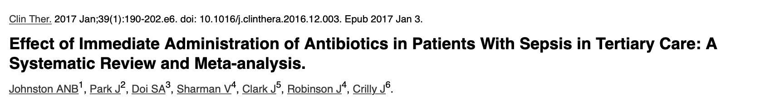
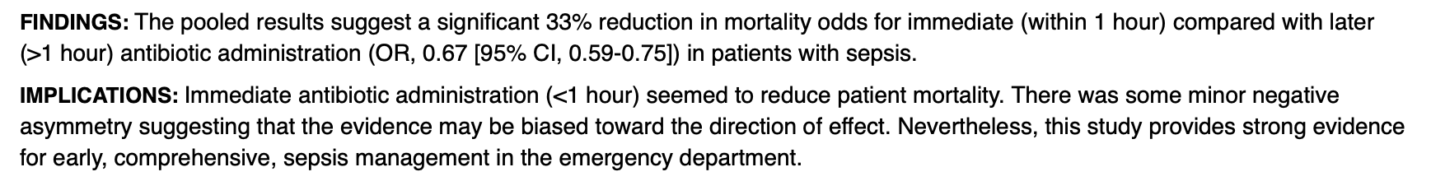

Slide 40
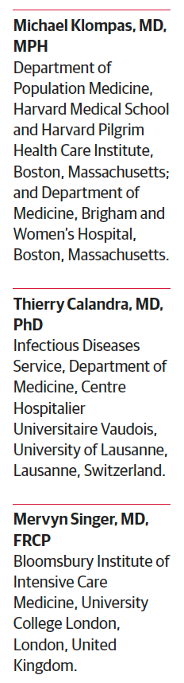

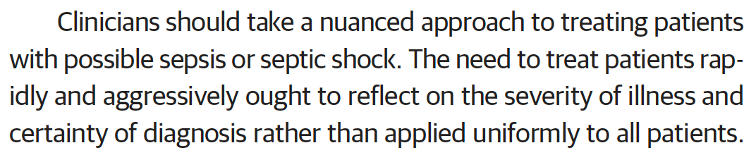
FINDING THE EQUILIBRIUM

Slide 41
NHS ENGLAND CQUIN DATA

Slide 42
OVERLAID WITH EST^{D} MORTALITY*
35
30
25
20
15
10
5
NCEPOD 2015
* NB: measurement sources vary

Slide 43
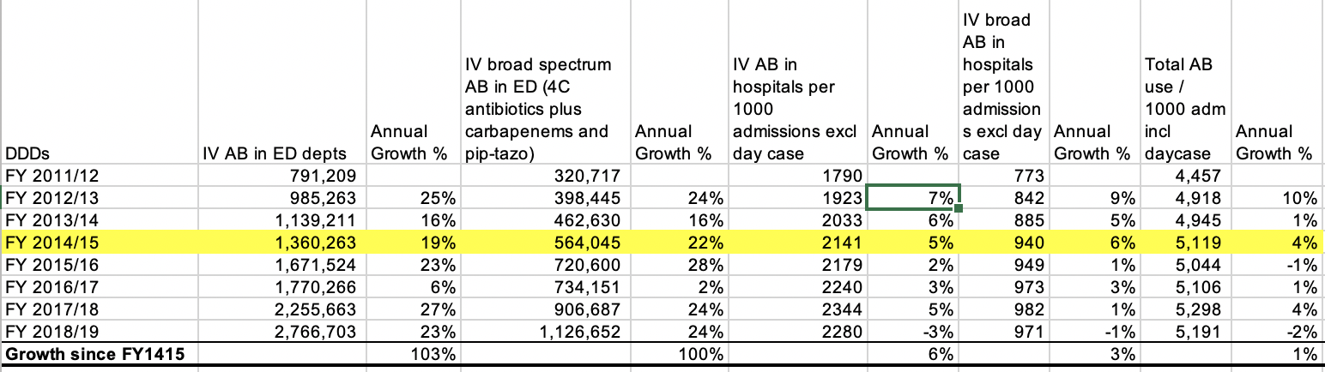

Slide 44
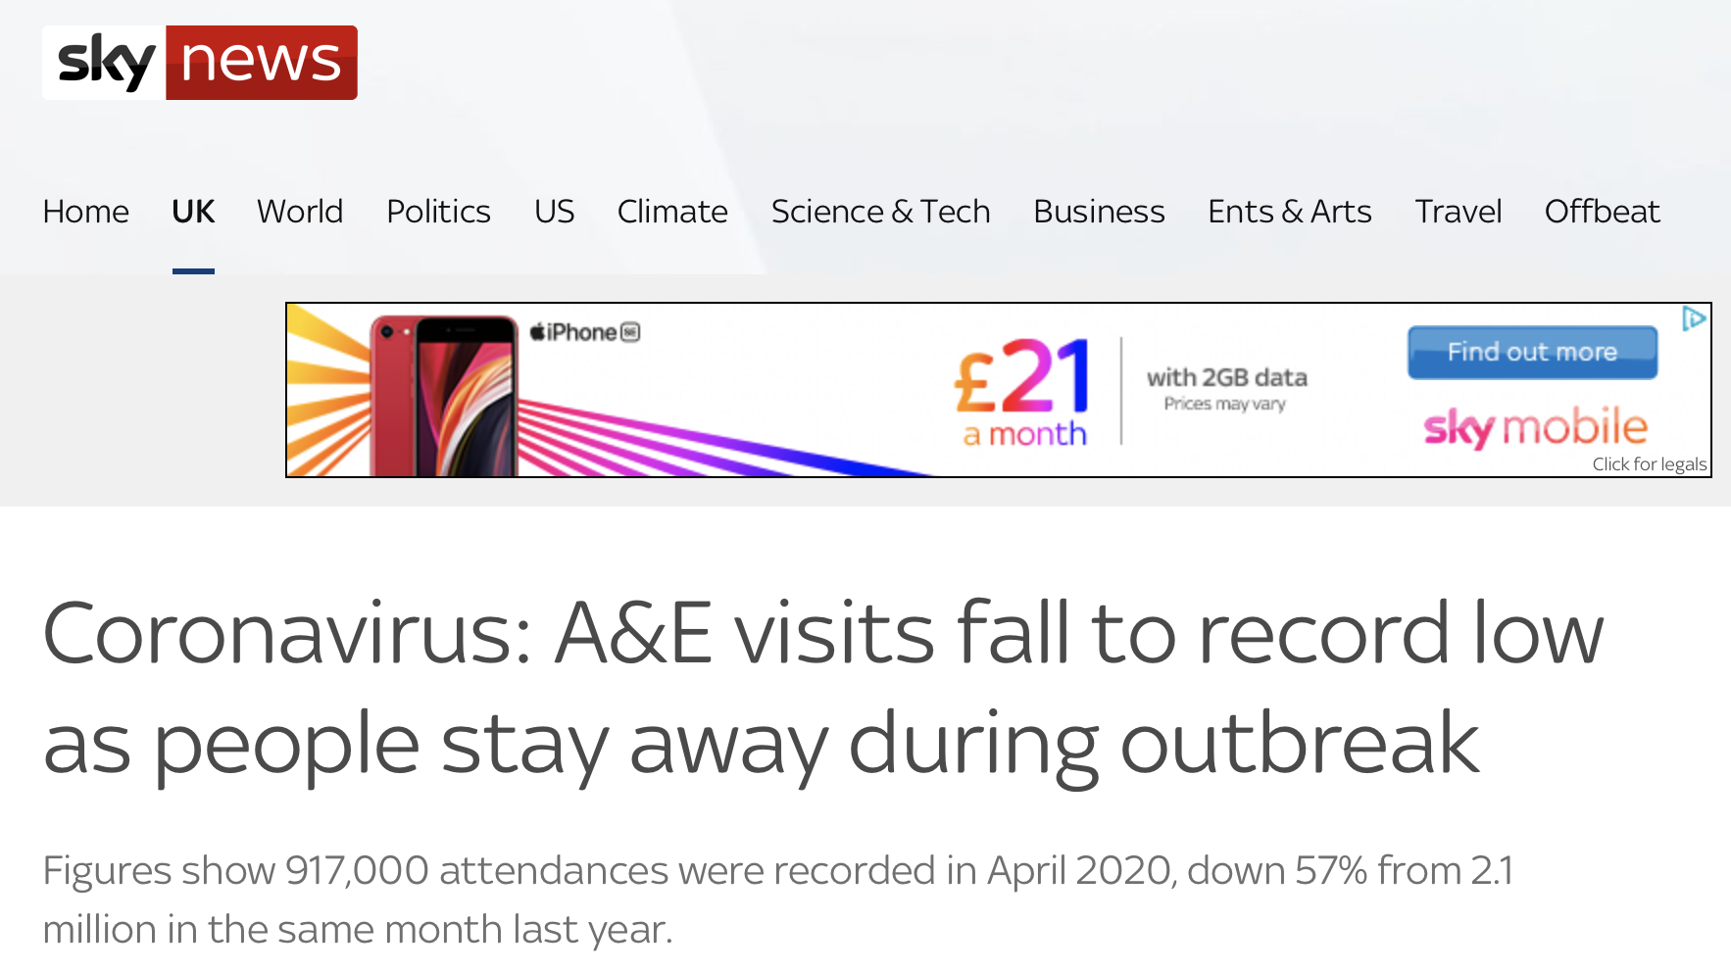

Slide 45


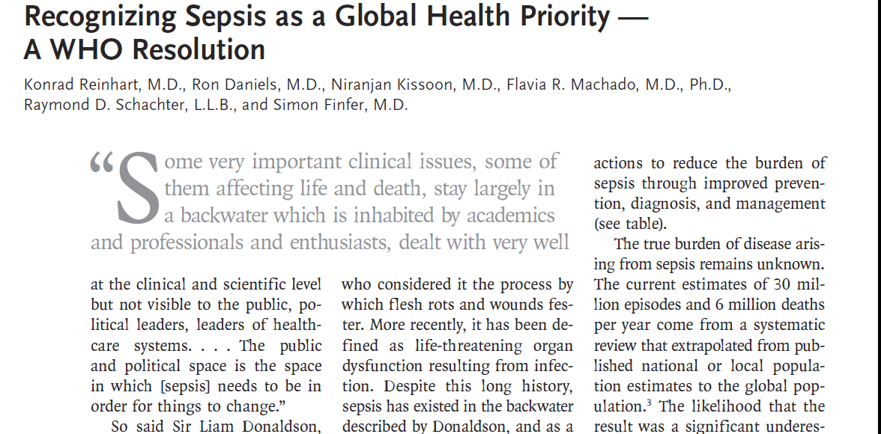

Slide 46
. . The public and political space is the space in which [sepsis] needs to be in order for things to change.”
Sir Liam Donaldson, Geneva ; May 2017

Slide 47

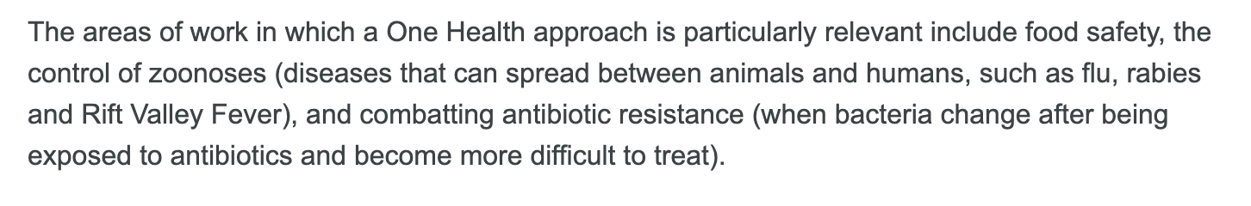

Slide 48
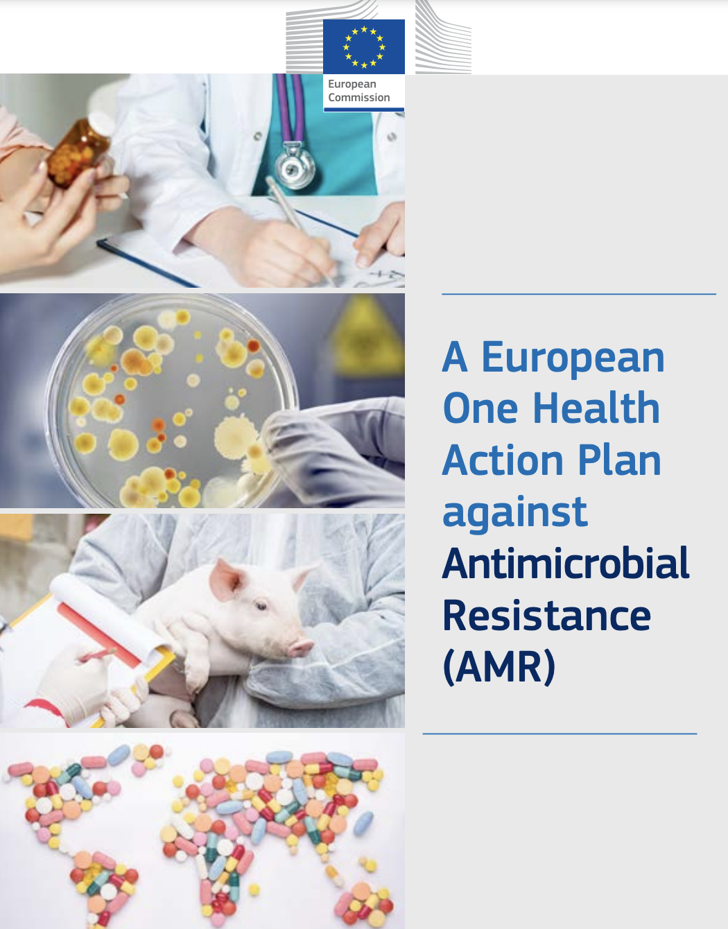
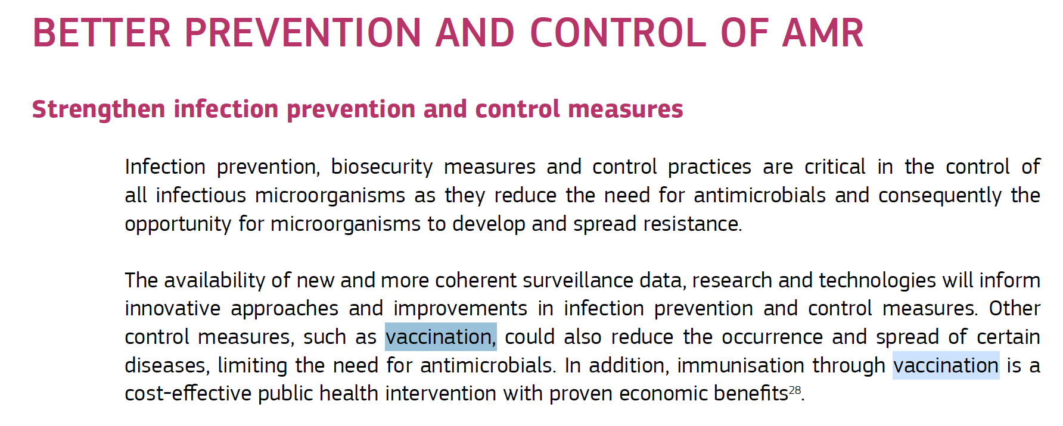
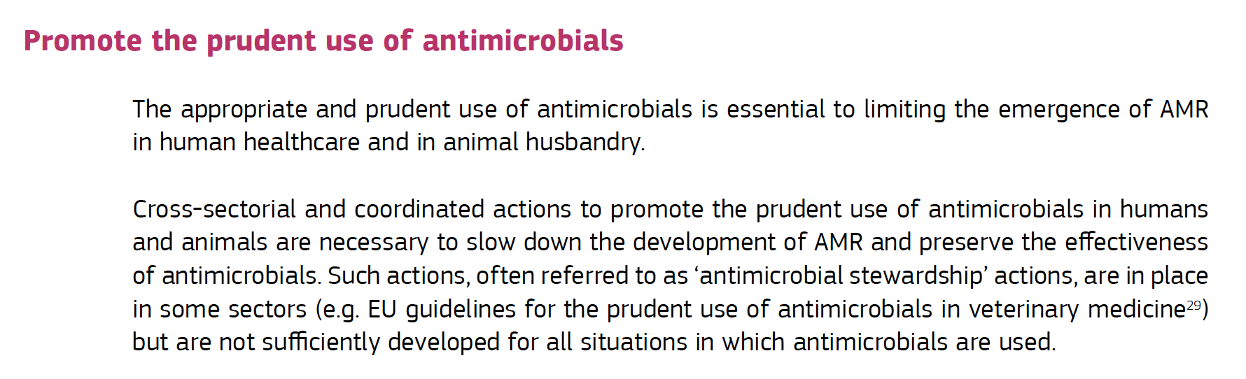

Slide 49
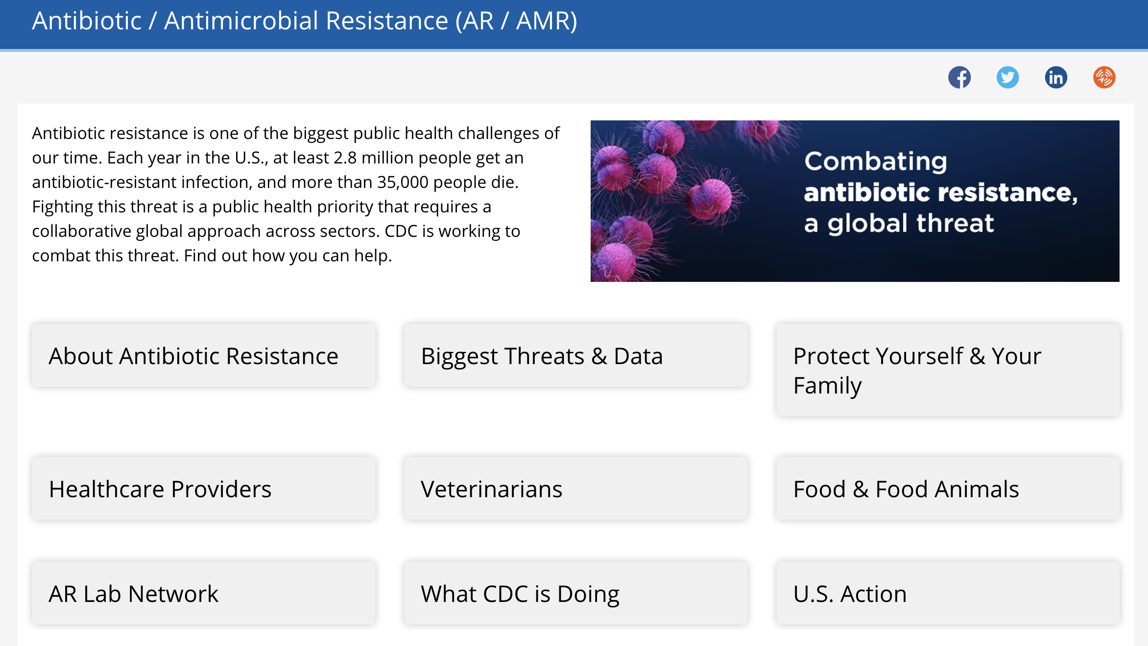

Slide 50
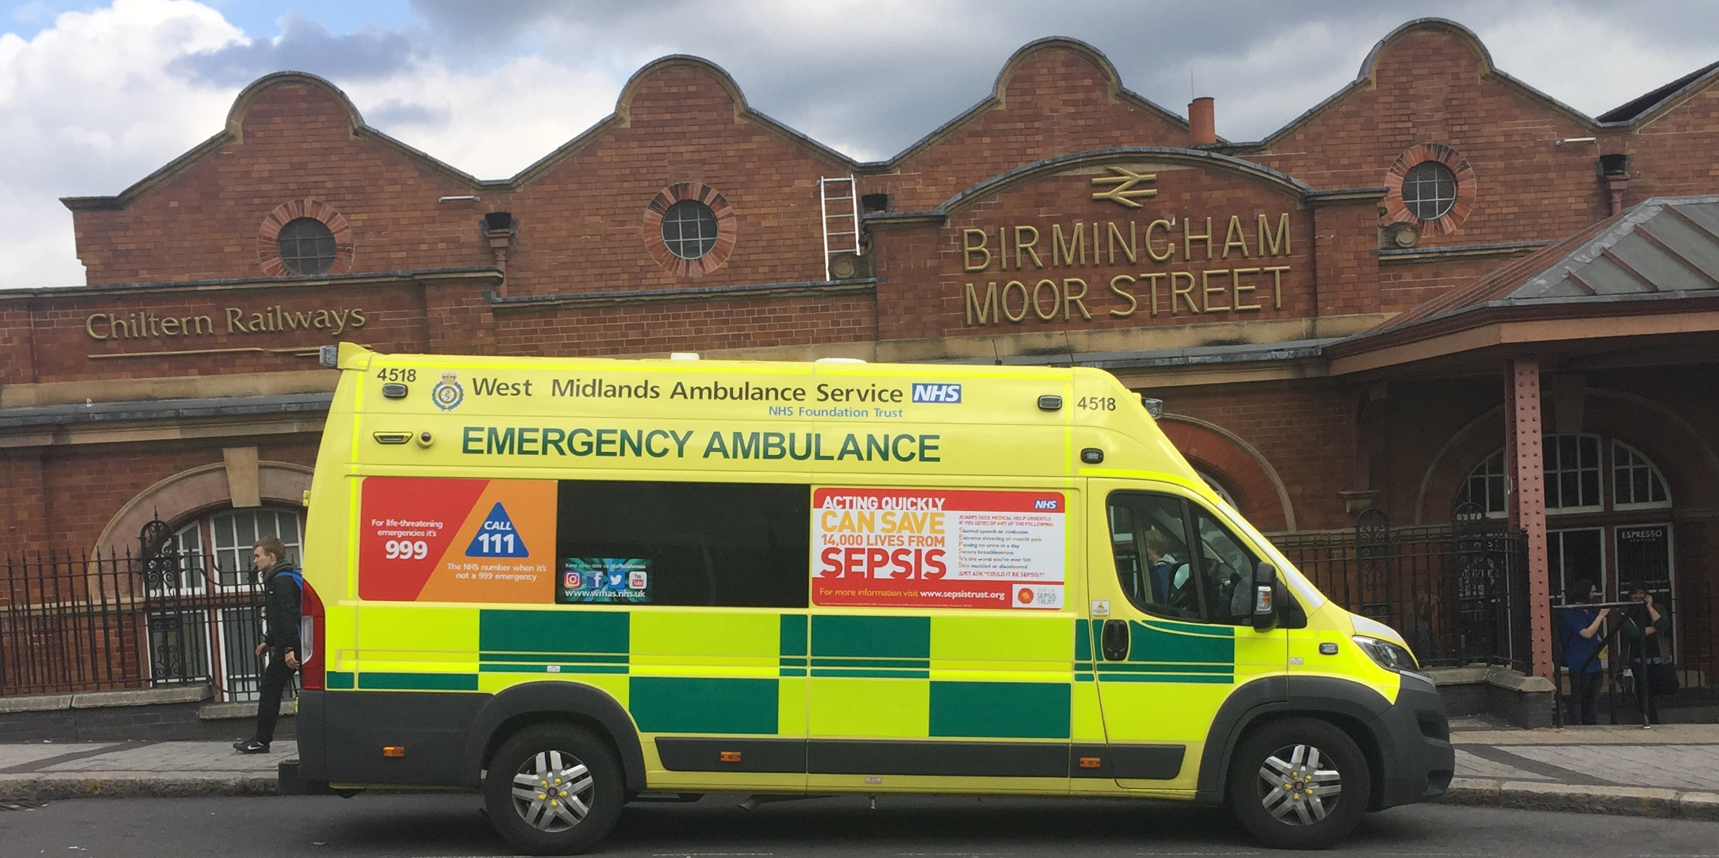

Slide 52


Slide 53
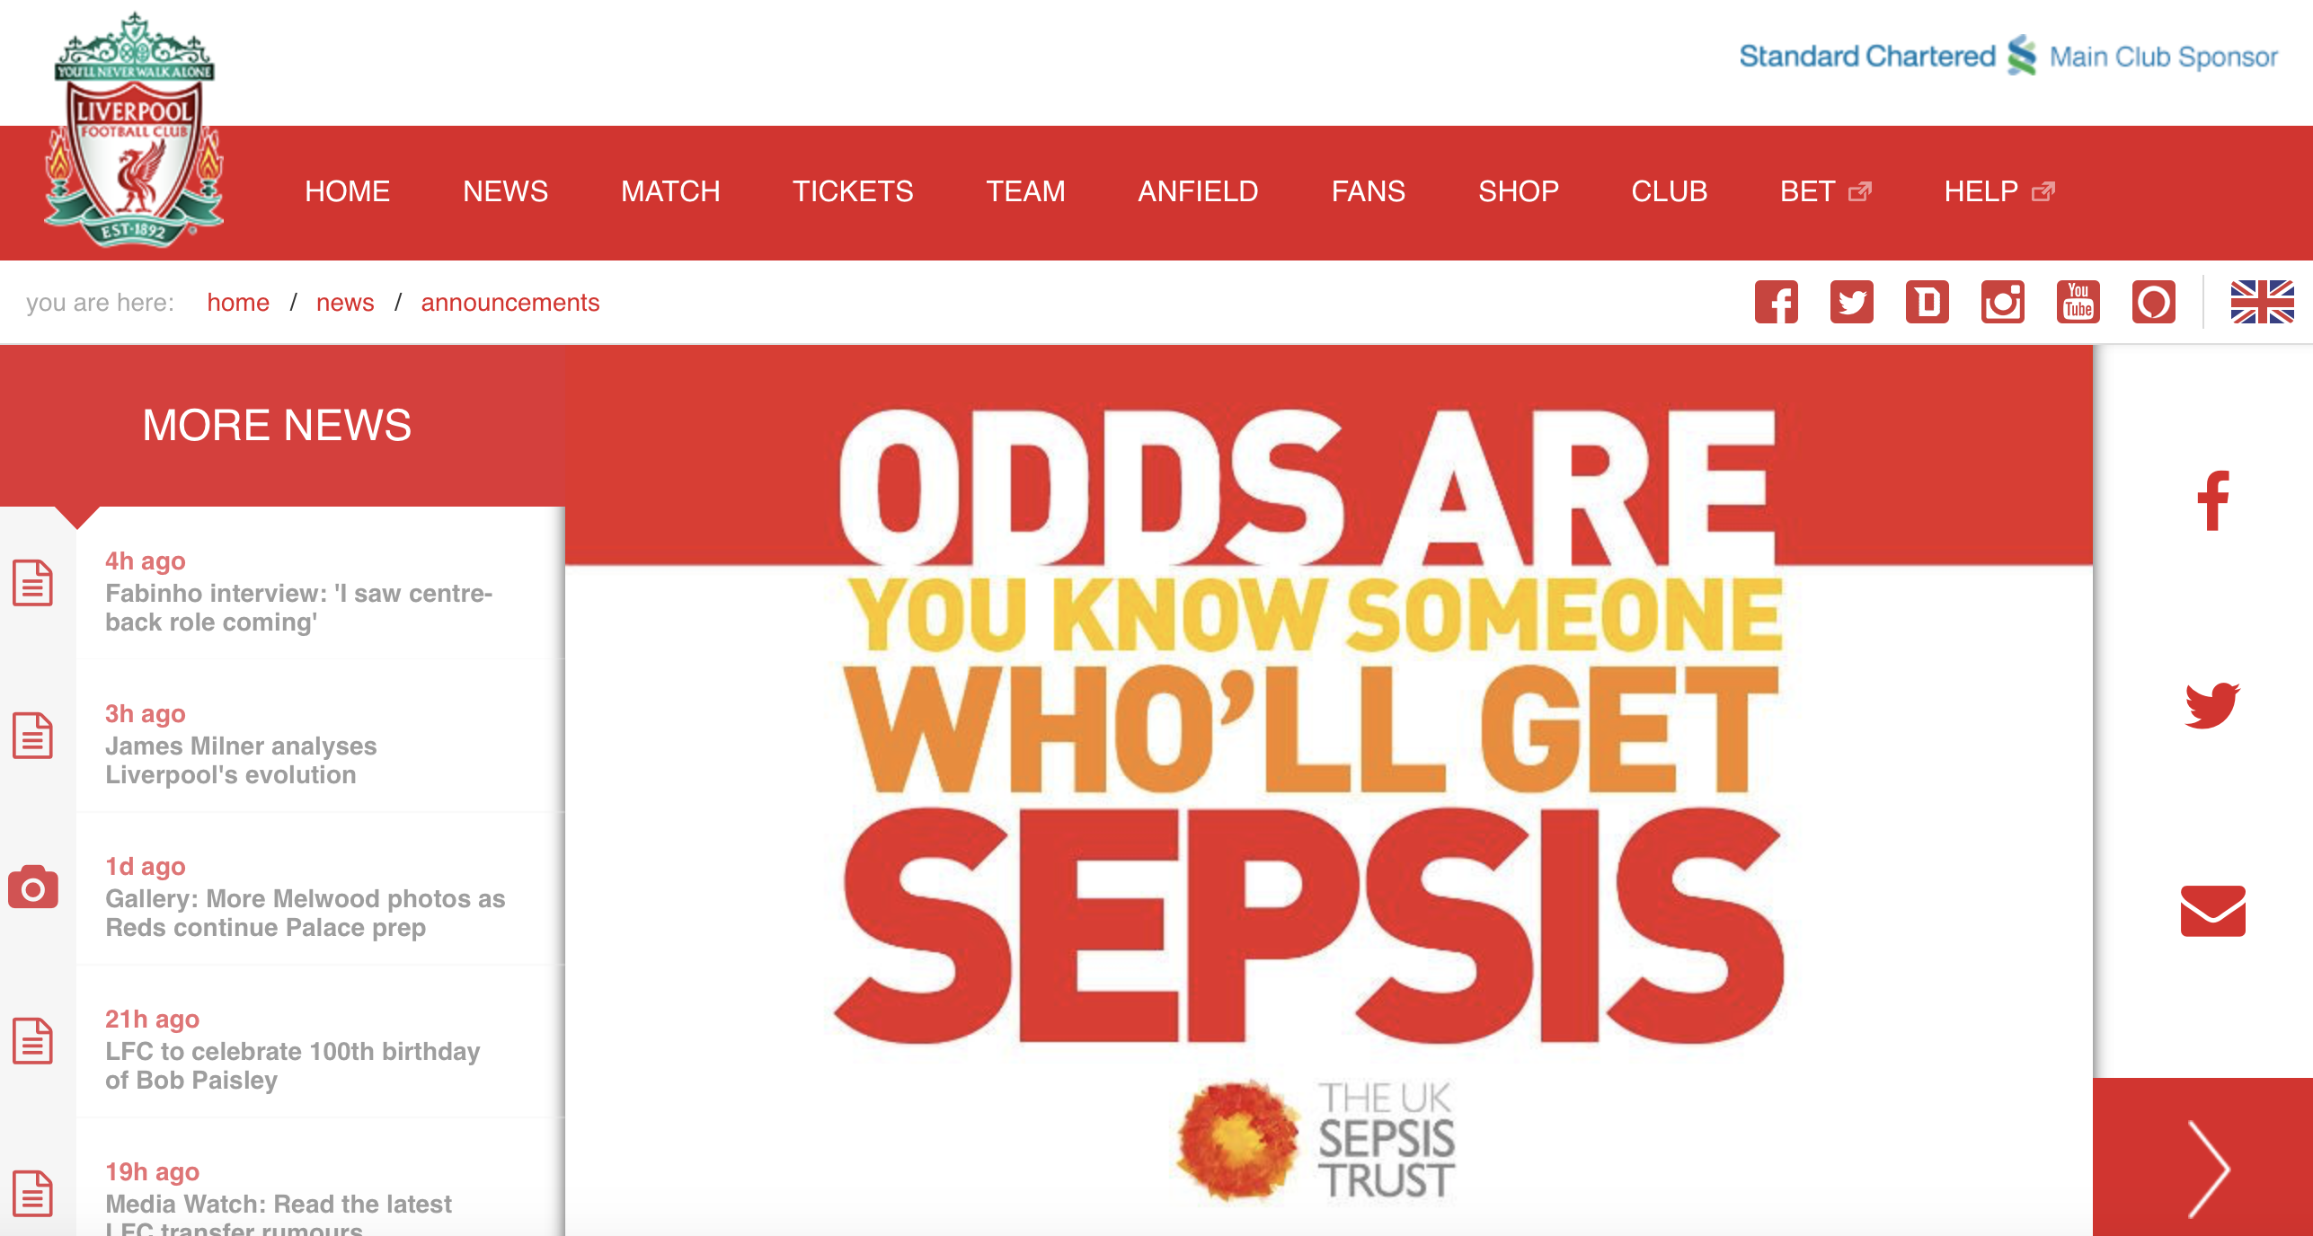

Slide 54
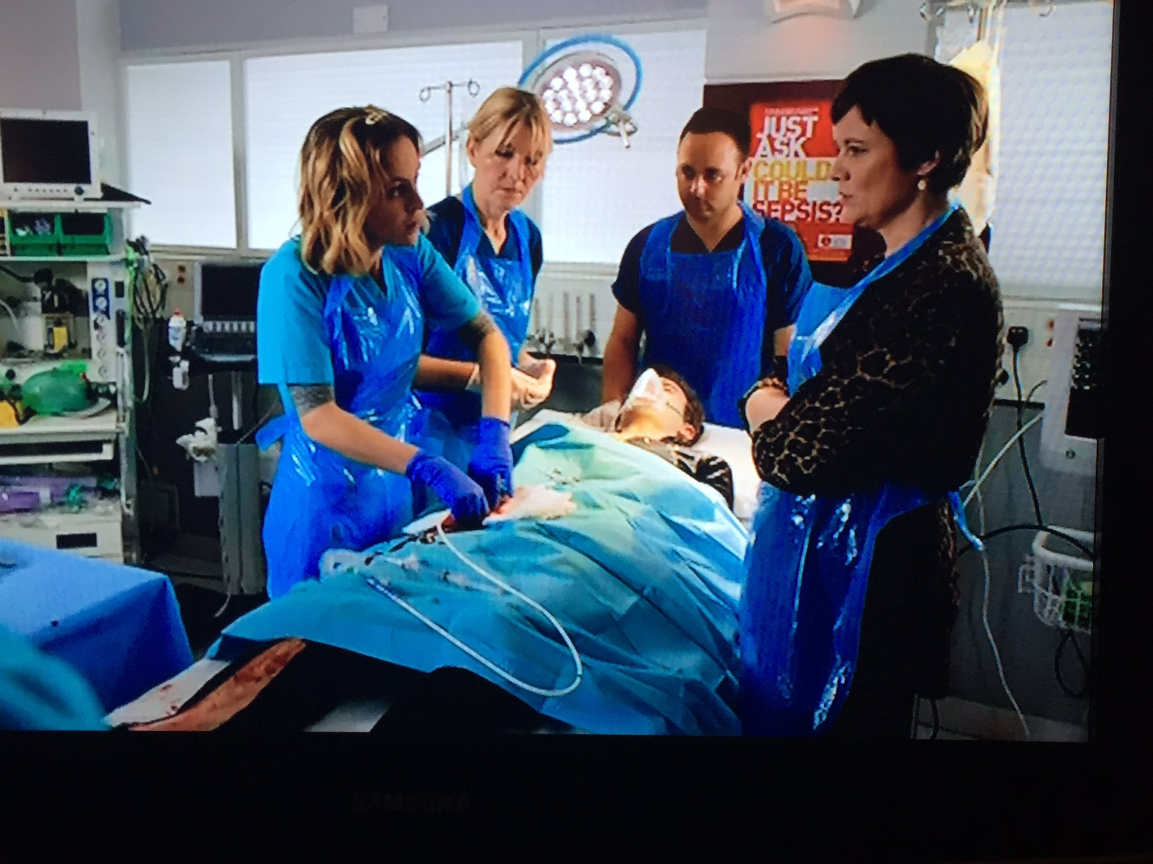

Slide 55
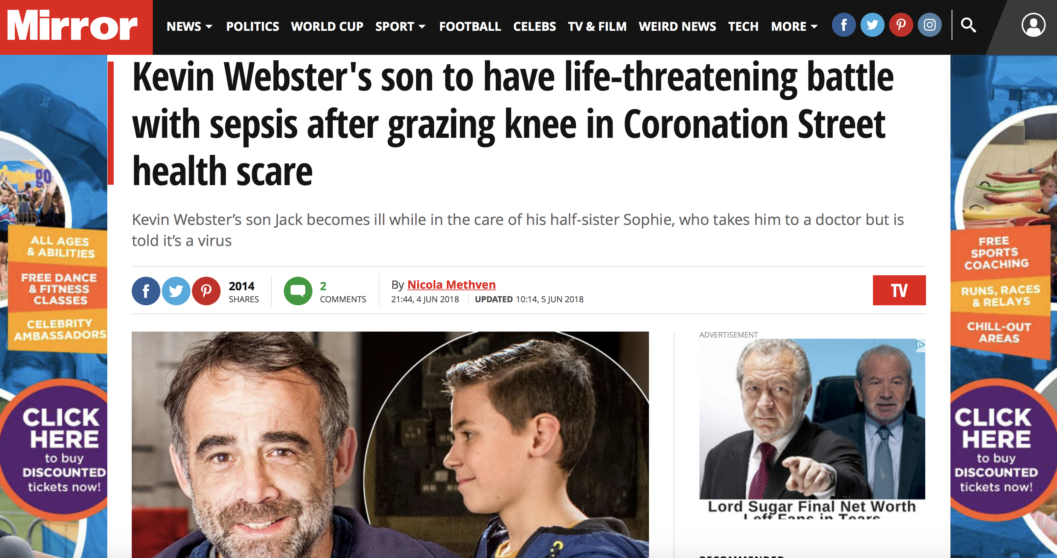

Slide 57


7,000

