Slide 1
The Patient
CHI Number 1602643466
Service user
Vascular Patient
Dermatology Patient
Rheumatology patient
Gastro Patient
Immunology Patient
Diabetic Patient
Cardiology Patient

Slide 2
Joined up care
A consultant who heads up a team to co-ordinate care for individuals for the journey through the NHS from acute care and incorporating Social care for Chronic conditions.
Looking outside of the box of conventional care for what is in the patients bests interests. Mostly due to allergies to pain Medication
Alternative Therapy’s.

Slide 3
Self Help
Looking for alternative help by advocating for others as a patient Ambassador.
Super doctor, Introduction to Dr Keith Grimes on a whatsapp group By Helen Shaw A mutual aquaintence.
Suggestion of trying VR.
No idea what VR was apart from an advert on TV with dinosaurs chasing school children wearing headsets.
Delivery of a VR Kit via Helen Shaw.

Slide 4
Trying Vr for the first Time
After a few phone calls where my conditions and any contra-indications were discussed fully. Dr Grimes explained how to set up and utilise my VR Headset.
His suggestion of 5-10 minutes was noted.
Signed up for oculus
Typed in my interest, Scuba Diving.
Hundreds of videos appeared and loads I clicked to watch later.
Sat down relaxed and started.

Slide 5
The first time
Within minutes I was submerged in an underwater world, doing what I had done for years in actual dive sites I had dived previously.
Time was ignored as I heard my breathing and could see my bubbles, all my memories triggered. I was diving again.
45 minutes later the streaming stopped. I stood up it was without pain or effort.
I stood crying into my headset with disbelief and elation.

Slide 6
The outcome
The effect of that first session lasted 2-3 hours, where I felt so high with being pain free for the 1st time in 3 years.
I continued to use VR about 3-4 times daily.
Not only did it relieve my pain it became pain management.
This allowed me to do things id only dreamed of for years.
I started to fulfil my bucket list.

Slide 7
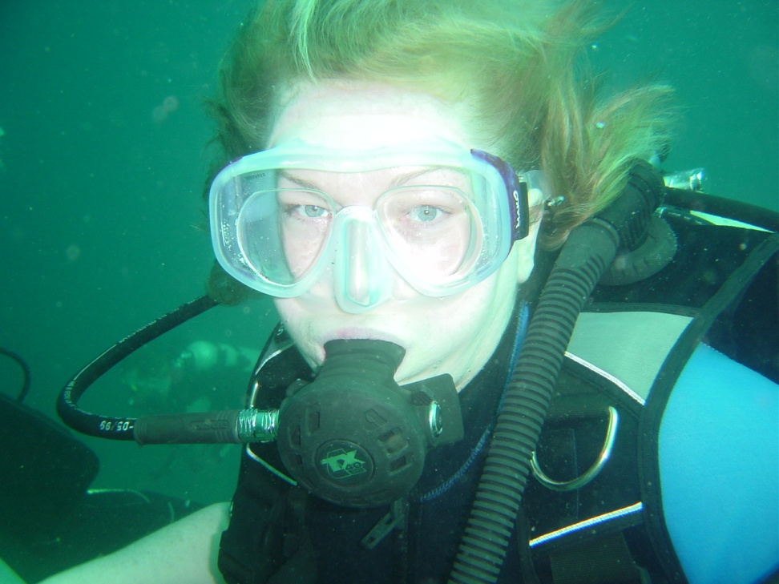
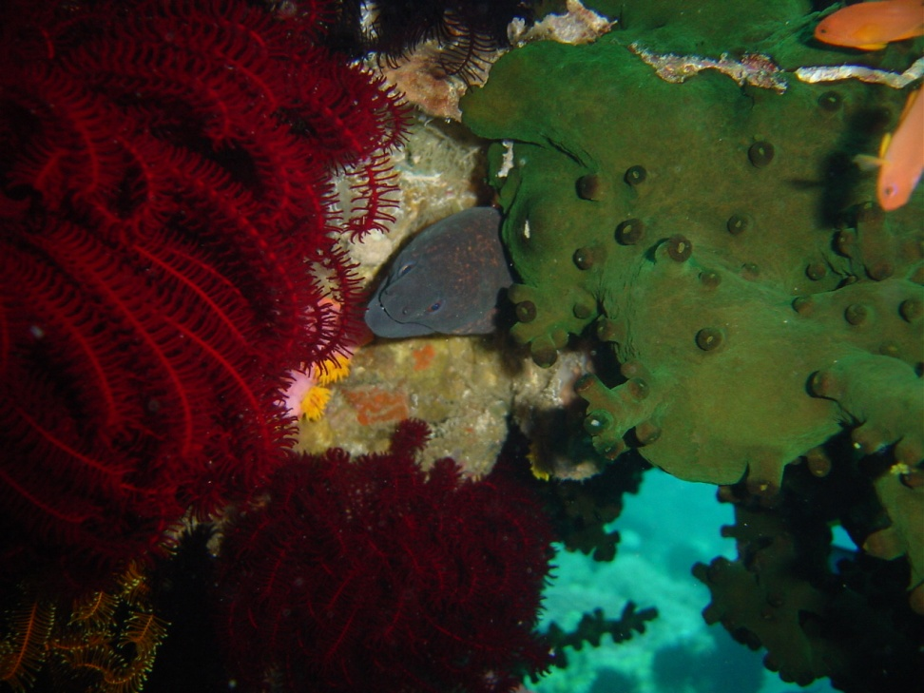
Me scuba diving in the phillapines

Slide 8
Finally
I have used VR now for 3 years.
I've used it for Mental health during Shielding
Coping as my condition deteriorated.
After the trauma of acute kidney failure
After a Heart attack
Mostly I use it for pain, every day.
I've used it during minor surgery as I'm allergic to local anaesthetic.
Now its used for end of life care, till my last breath, But as Keith has told me often......
“NOT TODAY”

