Slide 1
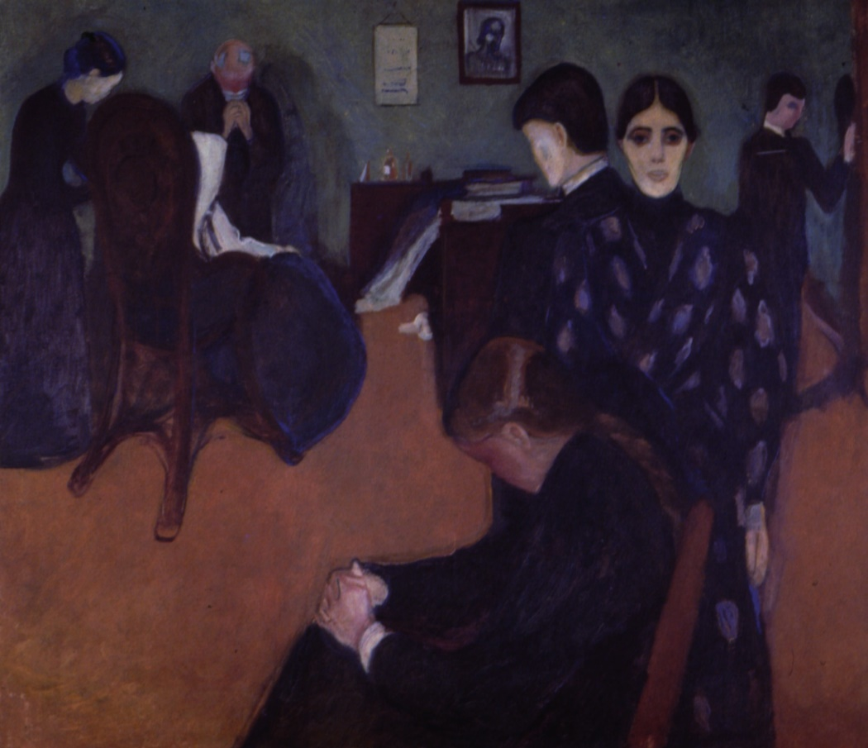
Covid-19 and Dementia
Supporting people and improving care through Covid-19
Sarah Russell RN
Professional and Practice Development Facilitator, Dementia UK
Family Carer
Visiting Clinical Reader, University of Surrey Visiting Fellow, University of Southampton
Florence Nightingale Foundation Alumni Non Executive Director, End of Life Integrator
sarah.russell@dementiauk.org @LearnAdmirNurse or @WeEOLC

Slide 2
What do we
mean by end
of life?
What matters?
Impact?
How can we better support?
Take home messages

Slide 3
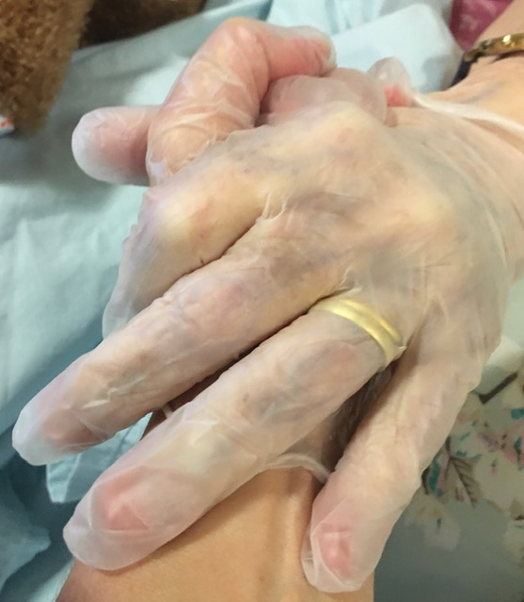
Transparency
1

Slide 4
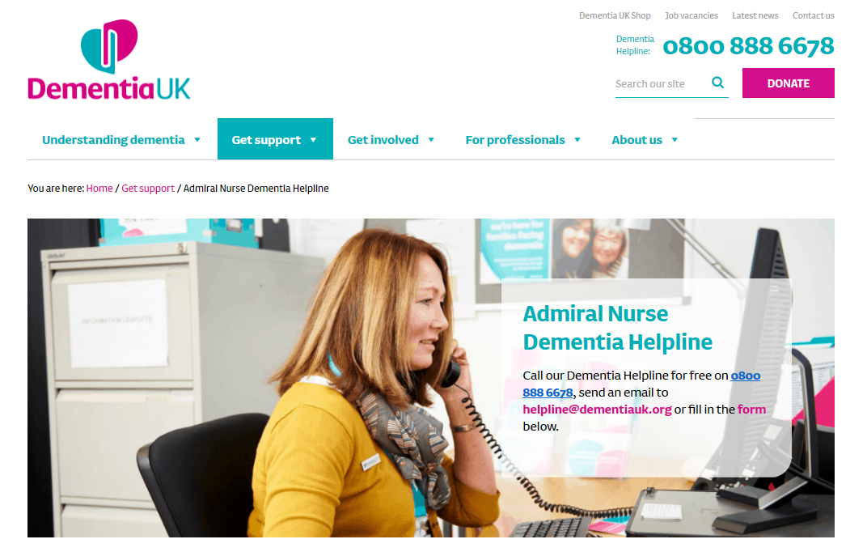

Slide 5
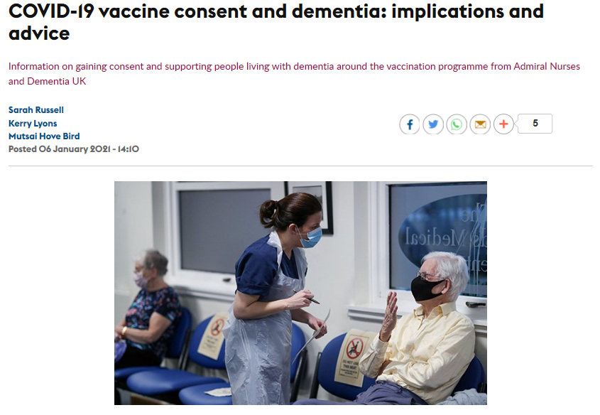
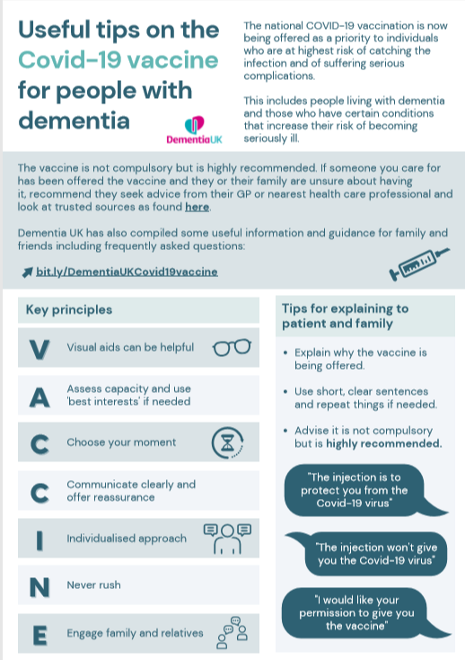
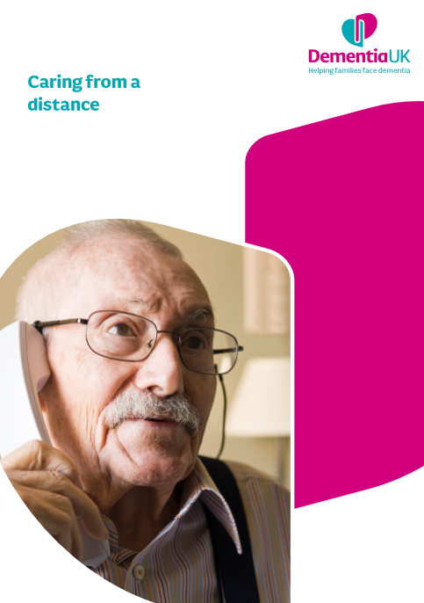
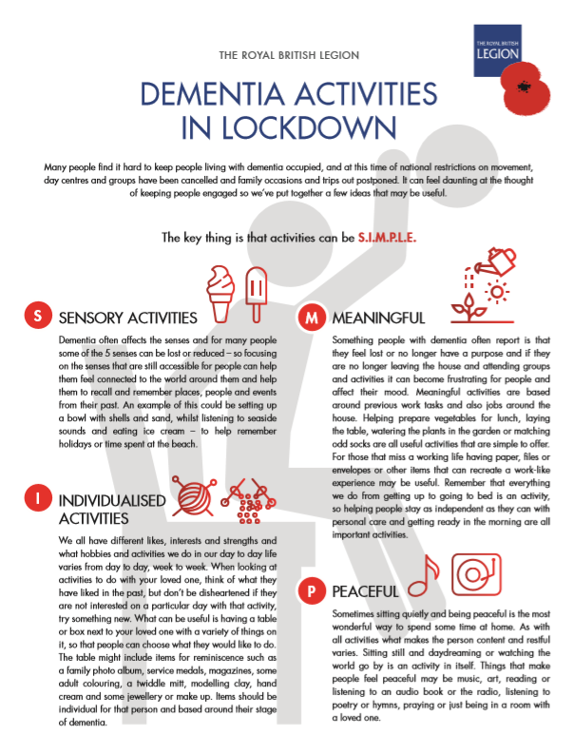
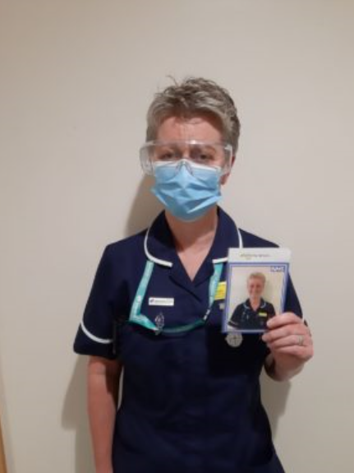
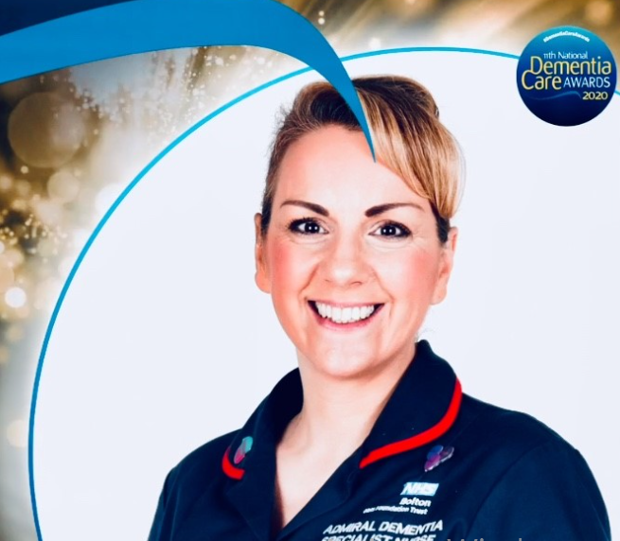
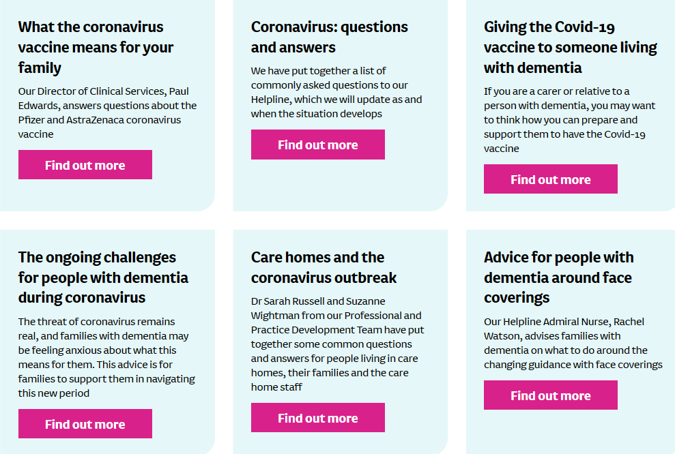
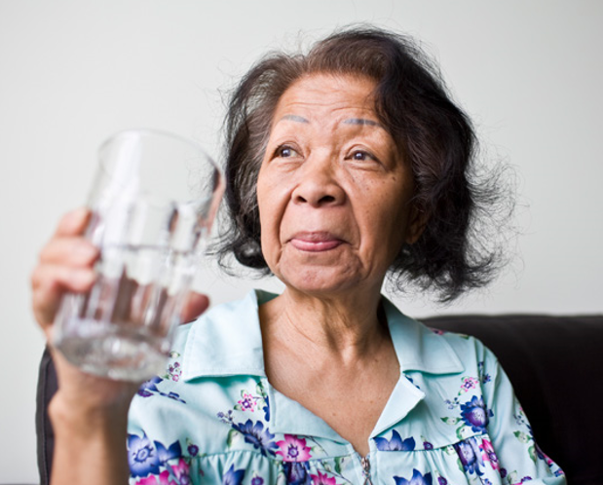
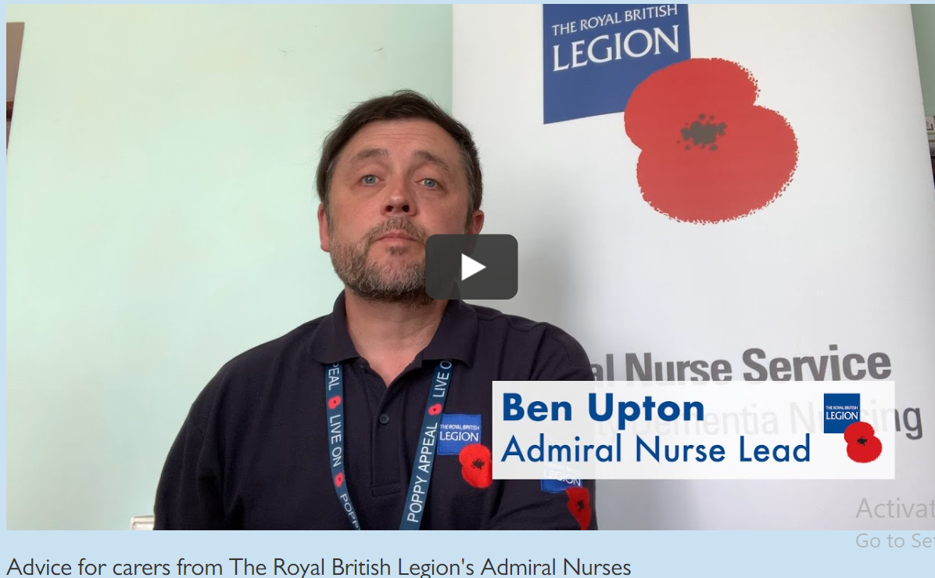

Slide 6
What do we mean by ‘end of life’ ?

Slide 7
”You matter because you’re you, and you matter to the end of your life.
We will do all we can not only to help you to die peacefully,
but also to live until you die.”
(Dame Cicely Saunders)
After Death?
Last days?
Last hours?
Last weeks?
Last month?
Last year?
Palliative care: treatment, care and support for people with a life-limiting illness, and their family and friends
Hospice care: helps people live as fully and as well as they can to the end of their lives, however long that may be.
End of life care: treatment, care and support for people who are nearing the end of their life

Slide 8
What matters?

Slide 9
Palliative Care and Dementia
Goals & advance care planning
Person centred, shared decision making
Continuity of care
Recognising dying**
Timely referral
Psychosocial, spiritual support
Family care
Grief, bereavement and loss
Avoid futile treatment
Symptom control
Amador, S., Sampson, E.L., Goodman, C., Robinson, L. and SEED Research Team, 2019. A systematic review and critical appraisal of quality indicators to assess optimal palliative care for older people with dementia. Palliative medicine, 33(4), pp.415-429.

Slide 10
Impact
People with dementia
Family carers

Slide 11
Impact
Care Homes
Workforce

Slide 12
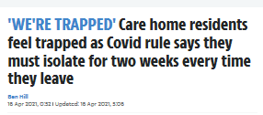
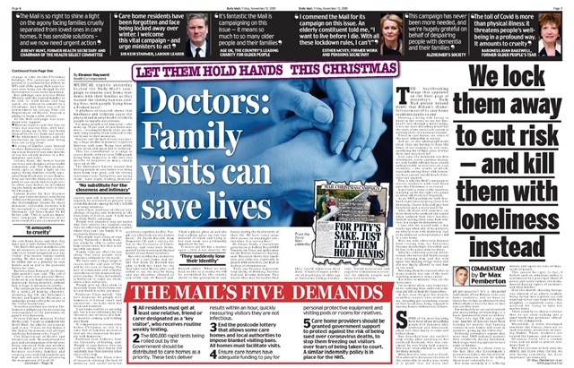
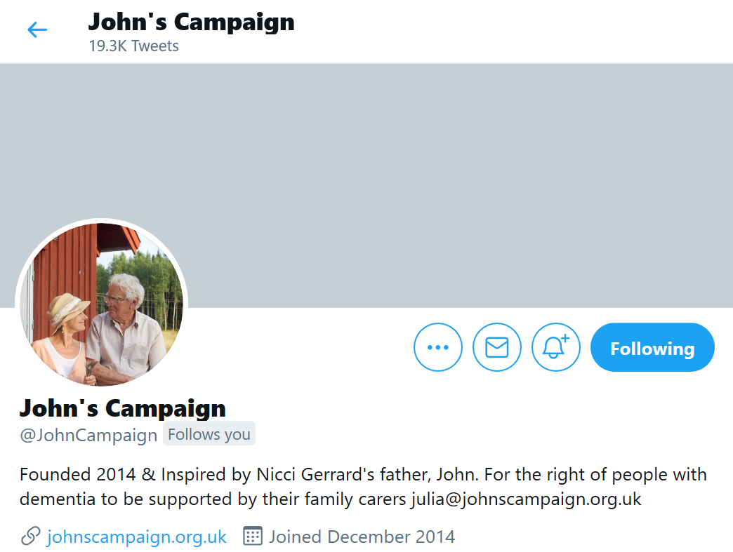
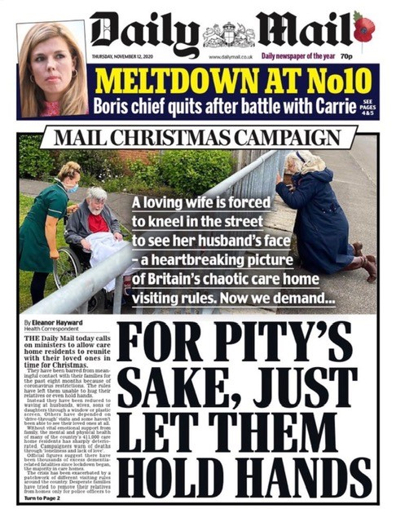
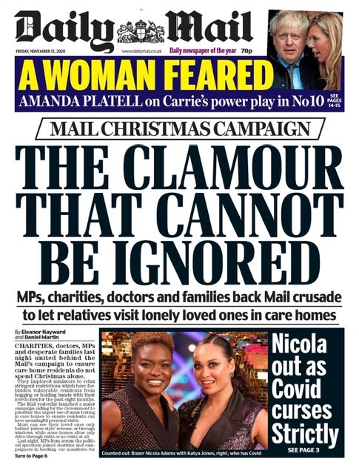
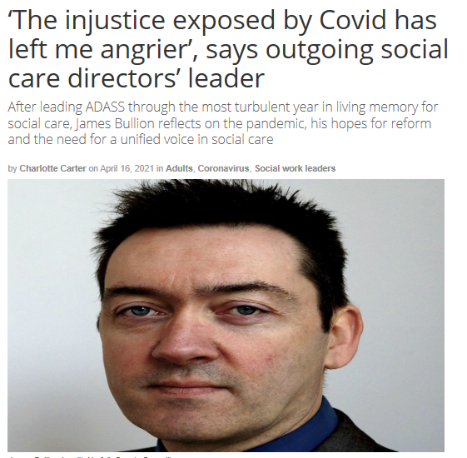
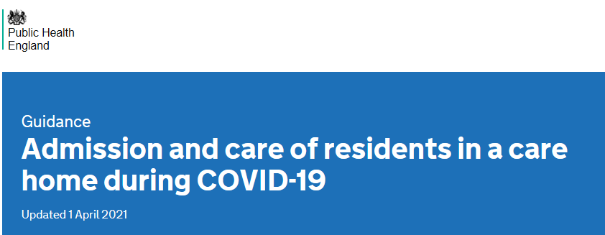
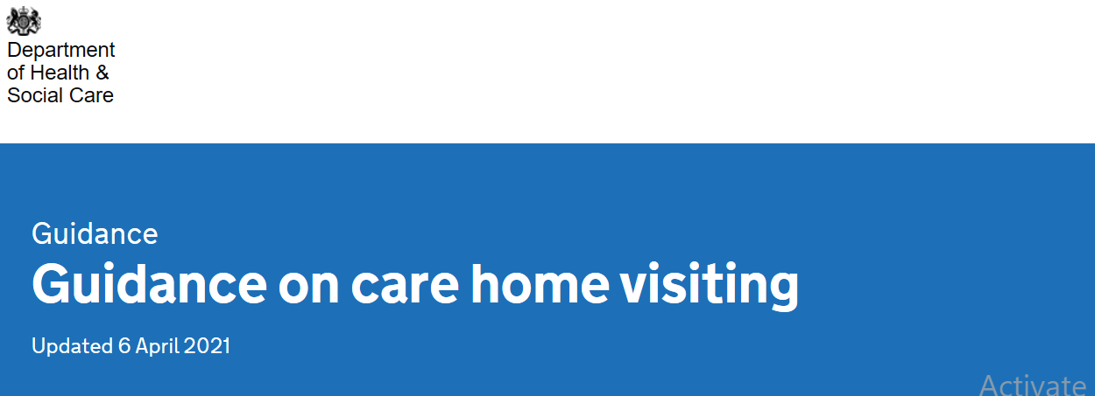

Slide 13
Moral Injury (Risk)
“The profound psychological distress which results from actions, or the lack of them, which violate one’s moral or ethical code”
(Litz et al 2009)
“Potentially Morally Injurious Events (PMIE) can include acts of perpetration, acts of omission or experiences of betrayal from leaders or trusted others”
(Williamson et al 2020)
“the challenge of simultaneously knowing what care patients need but being unable to provide it due to constraints that are beyond our control” (Dean & Talbot, 2019).
Risk factors applicable during COVID-19 include:
If there is a loss of life
If leaders are perceived to not take responsibility and are unsupportive
If staff feel unaware or unprepared for emotional/psychological consequences of decisions
Occurs at the same time as other traumatic events (e.g. death of a loved one)
If there is a lack of social support following the PMIE
(Williamson et al 2020)

Slide 14
Grief and COVID-19
Grief is an ongoing and important factor of the COVID-19 pandemic that affects patients, families, and medical providers.
Some grief processes are novel related to social distancing/isolation, uncertainty/self-blame related to infection, and inability to implement usual burials/funerals
Others are typically experienced near end of life but are occurring on an unprecedented scale that has the potential to have devastating individual/societal effects in the short and long term.
Wallace, C.L., Wladkowski, S.P., Gibson, A. and White, P., 2020. Grief during the COVID-19 pandemic: considerations for palliative care providers. Journal of Pain and Symptom Management

Slide 15
Anticipatory Grief
The normal mourning that occurs for a patient or family when death is expected
Disenfranchised Grief
Grief that persons experience when they incur a loss that is not or cannot be openly acknowledged, socially sanctioned or publicly mourned
Complicated grief
People feel unable to bounce back. There is usually something about the experience that leaves the person who has been bereaved feeling stuck and in a struggle to cope with the emotional impact of their grieving
Traumatic Bereavement
A loss that is sudden and unexpected, and often results from horrific or frightening circumstances
Results from uncertainty as well as trying to make sense of what is coming.
Doka, (1999)
Wallace, et al (2020)
Shock, disbelief, sadness, guilt, anger, fear, insomnia, fatigue, appetite, tummy upsets,
aches, pains, lack of concentration, mood swings, tearfulness, apathy
Types of Grief
https://www.cruse.org.uk/get-help/traumatic-bereavement
https://www.cruse.org.uk/complicated-grief

Slide 16
Support

Slide 17
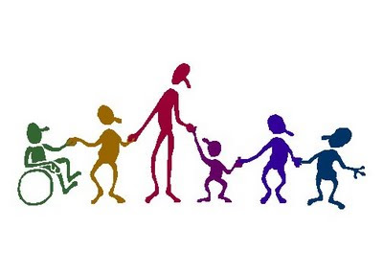
The Context of Care
The Practice Environment
Workforce
Development
and
Support
The Context of Care
The Policy Environment
Person centred Practice
Values, behaviour, attitudes

Slide 18
Take home messages

Slide 19
Covid-19 and Dementia
Supporting people and improving care through Covid-19
Sarah Russell RN
Professional and Practice Development Facilitator, Dementia UK
Family Carer
Visiting Clinical Reader, University of Surrey Visiting Fellow, University of Southampton
Florence Nightingale Foundation Alumni Non Executive Director, End of Life Integrator
sarah.russell@dementiauk.org @LearnAdmirNurse or @WeEOLC

Slide 20
References:
Borges, L.M., Barnes, S.M., Farnsworth, J.K., Bahraini, N.H. and Brenner, L.A., 2020. A commentary on moral injury among health care providers during the COVID-19 pandemic. Psychological Trauma: Theory, Research, Practice, and Policy.
Dean, W. and Simon Talbot, A.D., 2019. Reframing clinician distress: moral injury not burnout. Federal Practitioner, 36(9), p.400.
Doka, K.J., 1999. Disenfranchised grief. Bereavement care, 18(3), pp.37-39.
Dubey, S, Biswas, P, Ghosh, R, et al. Psychosocial impact of COVID-19. Diabetes Metab Syndr. 2020;14(5):779–788. doi:10.1016/j.dsx.2020.05.03
Giebel, C., Cannon, J., Hanna, K., Butchard, S., Eley, R., Gaughan, A., Komuravelli, A., Shenton, J., Callaghan, S., Tetlow, H. and Limbert, S., 2020. Impact of COVID-19 related social support service closures on people with dementia and unpaid carers: a qualitative study. Aging & Mental Health, pp.1-8.
Grimm, F.; Hodgson, K.; Brine, R.; Deeny, S.R. Hospital Admissions From Care Homes in England During the COVID-19 Pandemic: A Retrospective, Cross-Sectional Analysis Using Linked Administrative Data. Preprints 2021, 2021020593 (doi: 10.20944/preprints202102.0593.v1)
Litz, B.T., Stein, N., Delaney, E., Lebowitz, L., Nash, W.P., Silva, C. and Maguen, S., 2009. Moral injury and moral repair in war veterans: A preliminary model and intervention strategy. Clinical psychology review, 29(8), pp.695-706.
Lorenz-Dant, K. and Comas-Herrera, A., 2021. The impacts of COVID-19 on unpaid carers of adults with long-term care needs and measures to address these impacts: A rapid review of the available evidence.
Wallace, C.L., Wladkowski, S.P., Gibson, A. and White, P., 2020. Grief during the COVID-19 pandemic: considerations for palliative care providers. Journal of Pain and Symptom Management.
Williamson V, Murphy D, Greenberg N. COVID-19 and experiences of moral injury in frontline key workers. Occupational Medicine. 2020 Jul 1;70(5).

