Slide 1
West Herts experience of virtual medicine in a pandemic
Mike van der Watt

Slide 2
What changed re OPD/ED?
Consultant triage all OPD referrals, including F2F v virtual
Review of all patients already booked for clinic, decide who still to see, who to discharge back to GP
Hotline advice and guideline
Hot clinics available to ED consultants / ward patients to facilitate early discharge
Cardiology and Respiratory consultants embedded in ED (SMART)
vSMART evolution

Slide 3
West Herts Virtual Wards
C-19 advancing digital transformation
Dr Matthew J Knight MBE FRCP
Consultant Respiratory Physician
West Hertfordshire Hospitals NHS Trust

Slide 4
WHHT Virtual Hospitals
Covid VH - >4500 patients to date
COPD VH
Heart Failure VH

Slide 5
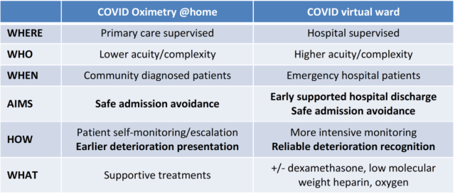

Slide 6
Wave 1
900 patients- average age 54 (18-97)
~50% with 2 comorbidities or more
8.9% had a post discharge complication
6.8% required hospital admission(8.6% if high risk group)
3% mortality in high risk group following subsequent readmission (0.05% low risk)
No apps in this cohort (just ‘phone and oximeter)

Slide 7
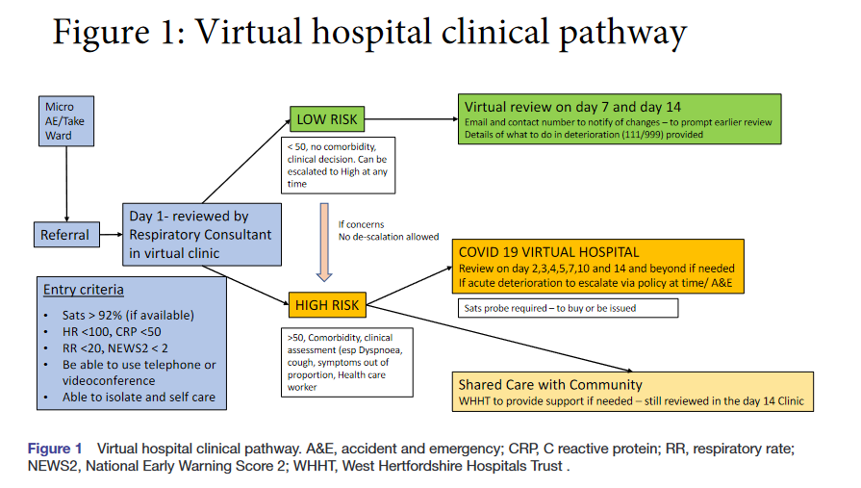

Slide 8
Impact of a patient app
Team at peak pandemic wave 1 – > 1 hour of clinical time per patient (over 14 days)
  400 patients managed simultaneously
  Consultants – 3 FT, 3 PT – providing a 7/7 9-7 service
  Respiratory physiologists – 3
    Direct patient care
    Data gathering
  Physiotherapists – 5 (from ortho) – half a day 7/7
  Admin support 1.5 providing 5/7 9-5 and Sat/Sun am
  2 FY1 (shielding)
  Interface with community team, palliative care, district nursing and primary care teams

Slide 9
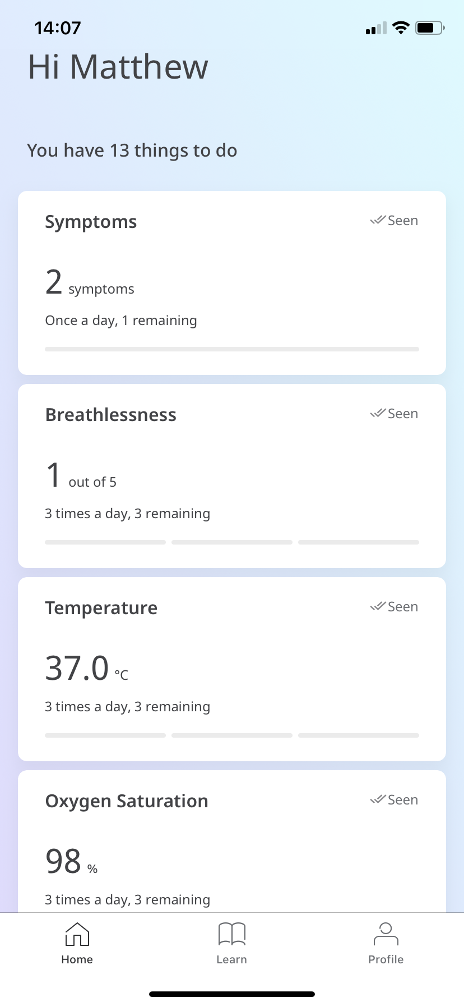
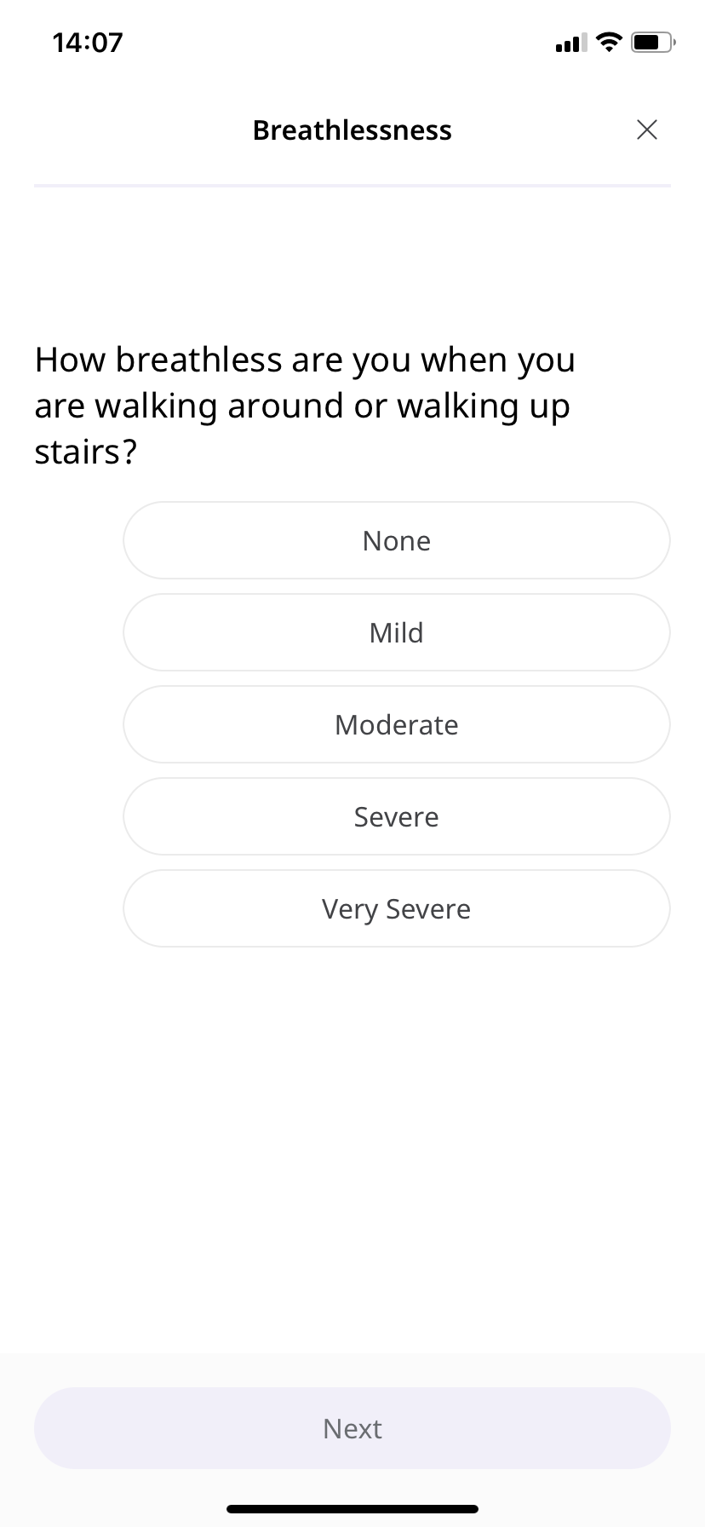
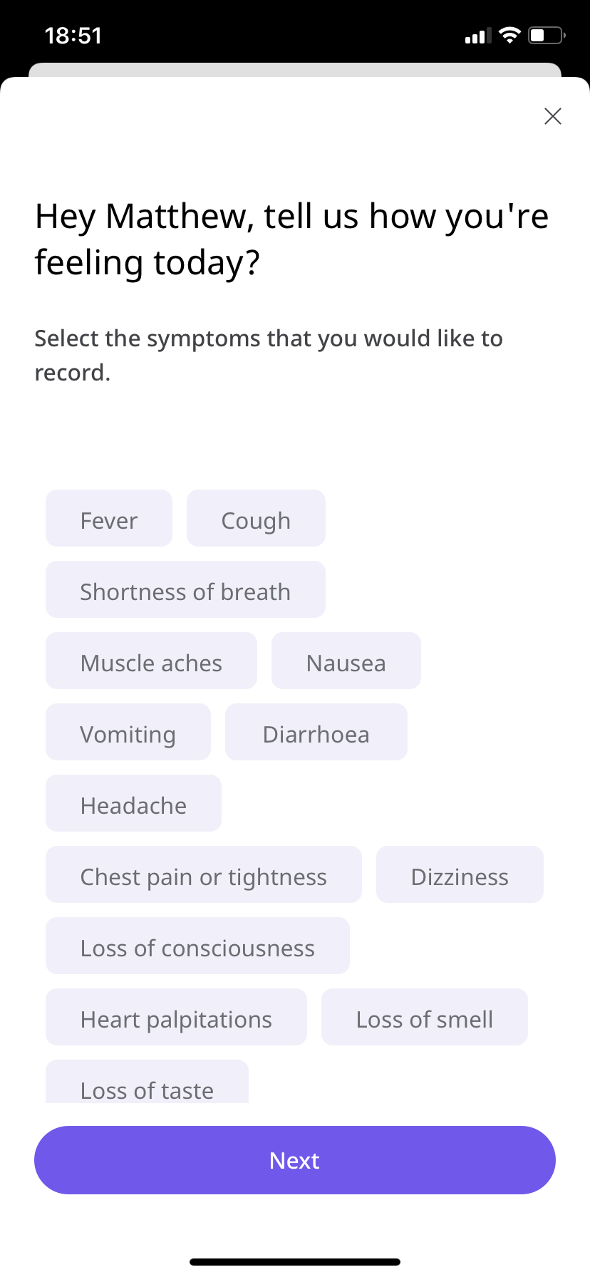
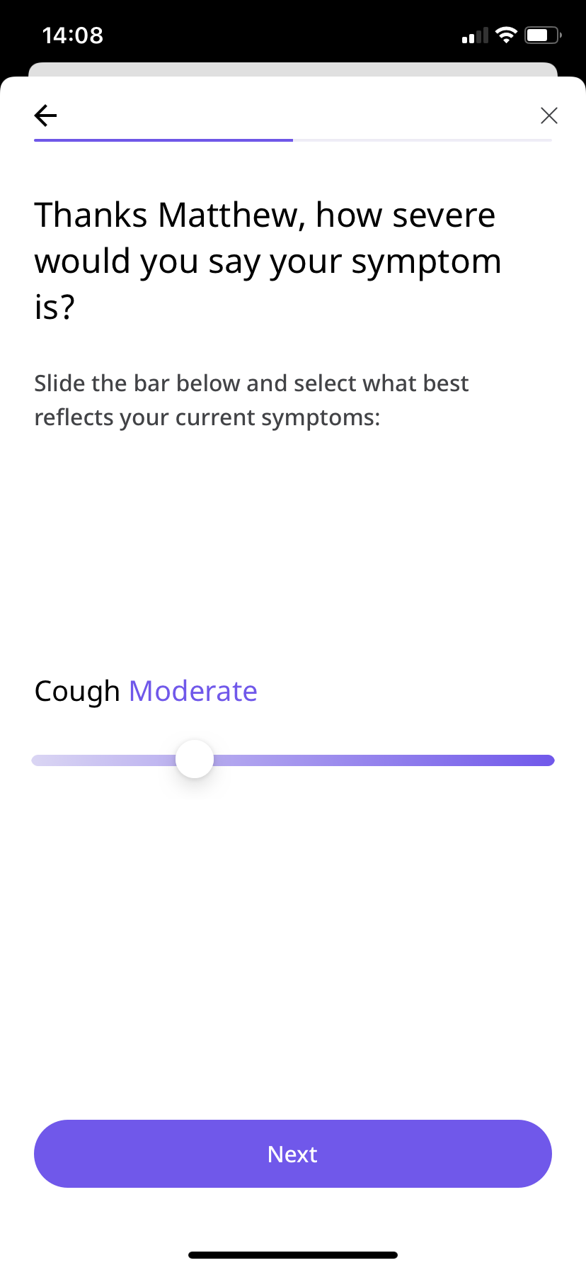
Patient’s view
Mid May 2020 rolled out an IT platform and app’ to facilitate patients uploading symptoms and observations

Slide 10
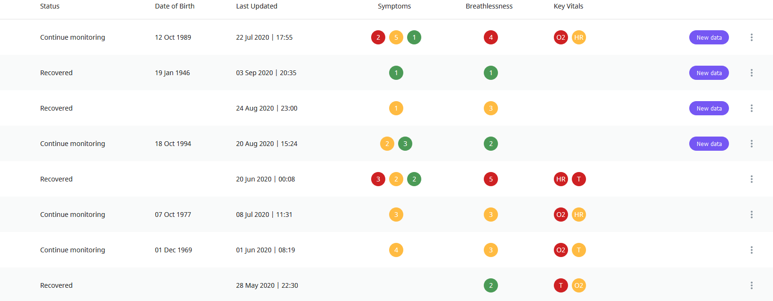
Clinician’s view

Slide 11
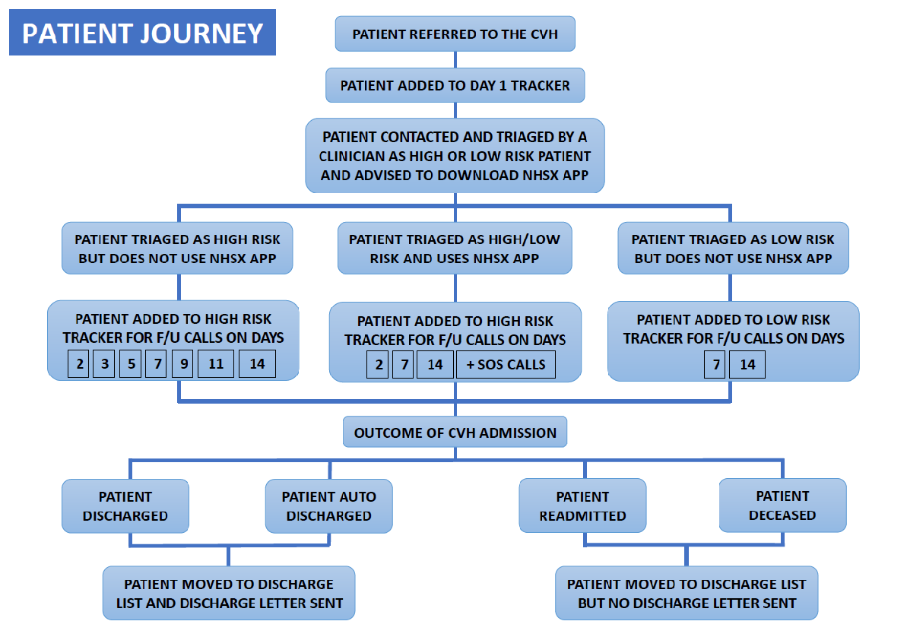
Patient pathway wave 2

Slide 12
Wave 2
> 3000 patients (1/3 low risk 2/3 higher risk)
329 used app – the rest on telephone
Monitoring
  Low risk – standard calls and any saturation probe
  Higher risk – Masimo/Nonin/Clinical grade probes
Readmission rate <10% mortality <1%
Patient selection

Slide 13
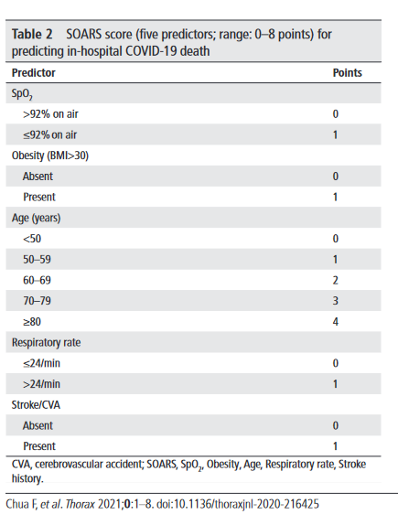
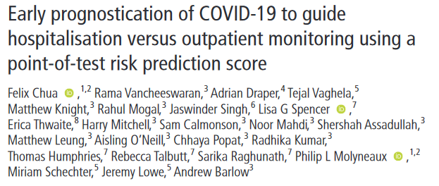
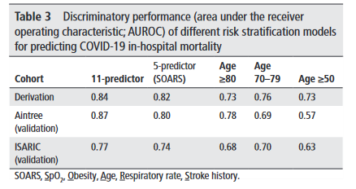
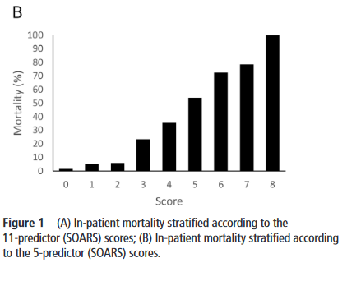
SOARS Score – selecting the correct patients for safe remote care

Slide 14
The future
COPD – 1500 admissions per year av LOS 8 days – potential bed day saving 3000-4500 bed days per year
CCF- potential early enhanced supported discharge – 600 patients per year (approx. 1000 bed days potential).
Post operative (eg appendicitis)
Other conditions (eg pneumonia, PE, arrythmia, diabetic foot) with community support (eg for IV abx or diuretics).

Slide 15
Masimo patient safety net
Integrated system providing remote high quality measurements on
  Heart rate
  Oxygen saturation
  Respiratory rate
  Temperature
  Perfusion index and pleth variability
  BP
  Single lead ECG rhythm strip
Potential to transmit real time Hb (eg post op monitoring) CarboxyHb (eg smokers)

Slide 16
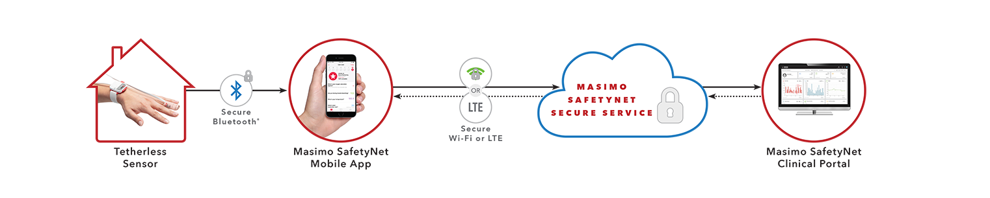
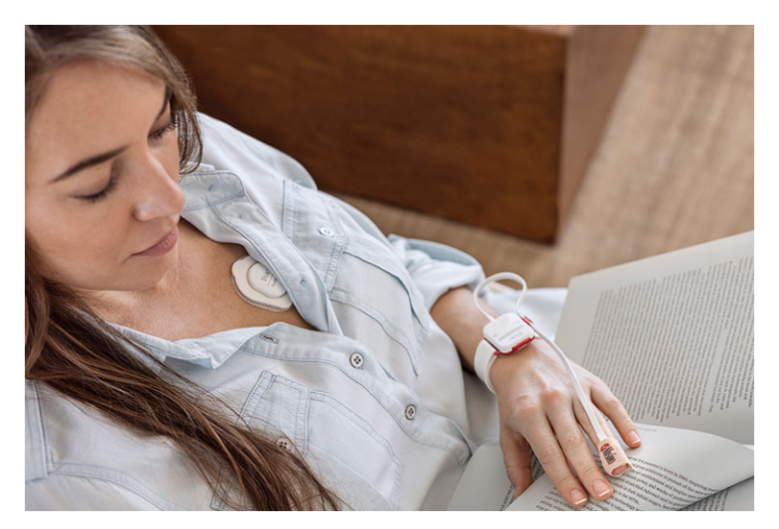
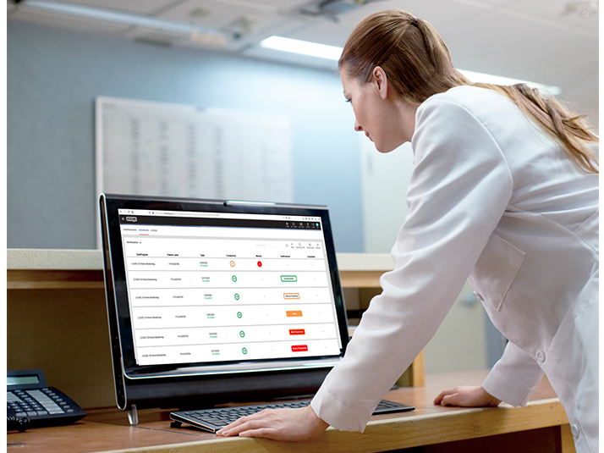
Masimo patient safety net
Transmits from the patient wearable at home to a secure web based dashboard for reactive monitoring

Slide 17
Referral pathway eg COPD as example
Inclusion criteria
Exclusion criteria
Confirmed diagnosis of COPD
Current COPD exacerbation
Consents to using form of remote monitoring (saturation probe or wearable device)
< 80 years old
Reviewed either by (V)SMART or ABC MDT
pH below 7.3
DECAF score > 2
NEWS2 ≥ 3
Oxygen saturation ≤ 92% (88% if previously confirmed hypoxic baseline)
Unable to mobilise or self care (unless support in place)
Unstable co-existent diagnosis (eg arrythmia, CCF, etc)

Slide 18
Referral Pathway – risk stratification
LOW RISK
HIGHER RISK
DECAF score 0
NEWS score < 2
No social care and support at home
Not on LTOT or home NIV
1 or less admissions in last year
2 or less courses of steroids in last year
DECAF score 1 – 2 (3 only resp con)
NEWS Score 3 or less
Lives alone
Mobility concerns or care package
LTOT, Acute Oxygen wean or home NIV
Multiple admissions in last year
3 or more course of steroids in last year

Slide 19
Referral Pathway – AE / AAU/Wards
Inform community COPD team and confirm receipt
VH referral form
Set up on Masimo patient safety net
Ensure all medications prescribed and issued and that patient can use them
HIGH RISK
Review by VSMART or ABC MDT
Referral to COPD VH
VH referral form
Supply oxygen saturation probe
Ensure all medications prescribed and issued and that patient can use them
LOW RISK

Slide 20
LOW RISK PATHWAY (COPD)
DECAF score 0
NEWS score < 2
No social care and support at home
Not on LTOT, Acute oxygen (for wean) or home NIV
1 or less admissions in last year
2 or less courses of steroids in last year
Can be escalated at any time
< 24 hours of admission
MDT review of patients not improving
Day 1
VH call and clinical assessment
Observations logged
Observations collected only during contacts. Safety netting in-between
Day ~7
CLCH team review and onward care
Referral as needed to
  Rehabilitation
  Clinic
  Dietician
  Psychological support
Day 2
CLCH team review
CLCH assessment PRN
Nebs weaning
Steroids
H@H

Slide 21
HIGHER RISK PATHWAY
DECAF score 1 – 2 (3 only resp con)
NEWS Score 3 or less
Lives alone
Mobility concerns or care package
LTOT, Acute Oxygen wean or home NIV
Multiple admissions in last year
3 or more course of steroids in last year
Day 1
VH call
Day 2
VH call
Day 3
VH call
Day 4
VH call
Day 5
VH call
Day 6
VH call
Day 7
VH call
MDT review of progress
Daily monitoring of physiological observations (Patient Safety net)
Day 1
CLCH visit
Day 7
CLCH team review and onward care
Referral as needed to
  Rehabilitation
  Clinic
  Dietician
  Psychological support
Complex H@H COPD pathway
Nebs and Oxygen weaning

Slide 22
Escalation
8am to 9pm CLCH and WHHT resp contact
9pm-9am – A and E /999

Slide 23

Fracture Pathway Redesign
Virtual Fracture Clinic
Mr Krisztian Deierl
Consultant Orthopaedic Surgeon, Trauma Lead

Slide 24
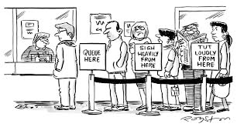
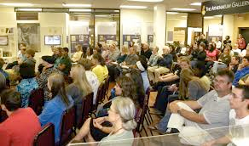
Out dated
Inefficient
Needless consultations
Poor patient experience
Unacceptable delay for first appointment

Slide 25
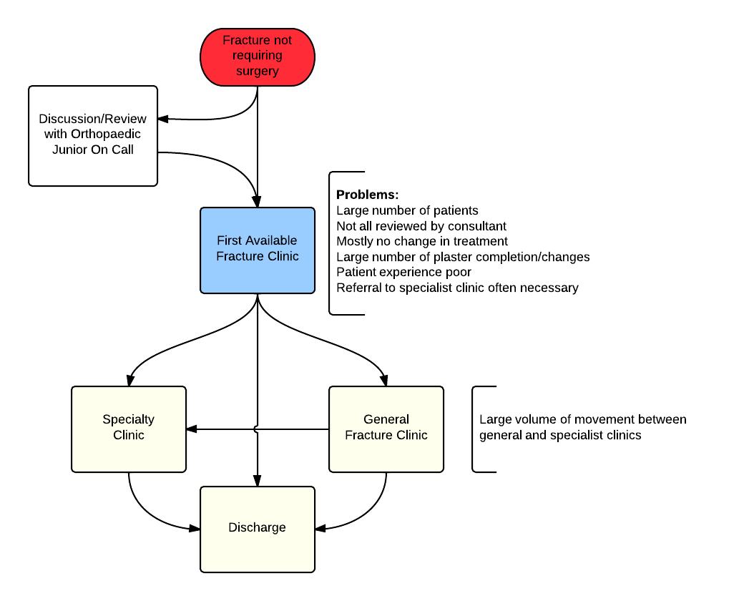
Old ‘traditional’ pathway- NO CONTROL

Slide 26
Protocols

Slide 27
Use of modern splintage avoids need for unnecessary further appointments to change/remove casts + allows functional rehab
Removable velcro splints rather than plaster of Paris
Patients have ownership of their injury - they can contact us if recovery not proceeding as expected
Advice in A+E is reinforced by Information Leaflet explaining injury, treatment and expected recovery
Backed up by Orthopaedic Department Fracture telephone helpline during working hours

Slide 28
Patient Information Leaflets
Another tool to help A+E meet 4 hour target
Torus #‘s
Radial head/neck #’s (fat pad signs)
Neck of 5th metacarpal #‘s
Mallet fingers
5th metatarsal #‘s
Child’s clavicle #‘s
Standardised info provided
No ortho follow up required

Slide 29
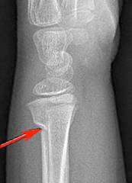
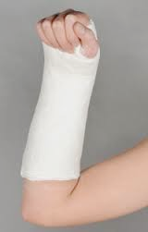
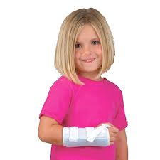
further fracture clinic visits for removal
no further visits
remove splint at home as per guidance instructions

Slide 30
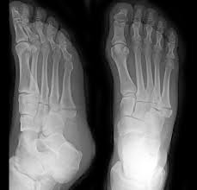
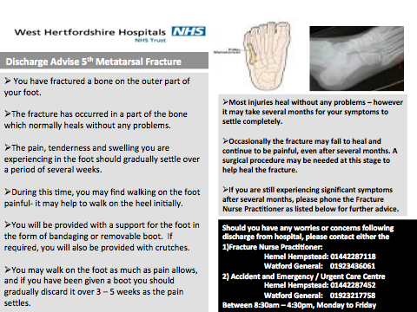
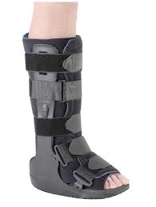
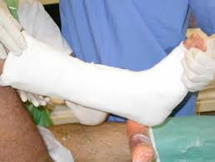
Metatarsal fracture
£12.50 + VAT
2 staff to apply
Time consuming, 4 hour target

Slide 31
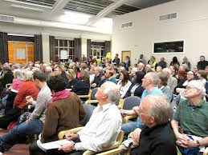
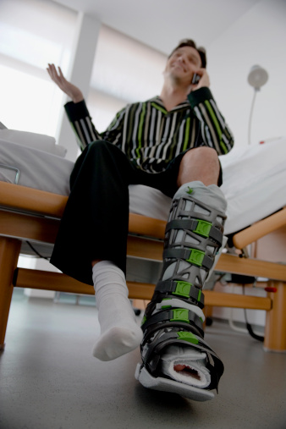


Utilising modern tools
Virtual Clinic
Already available
Electronic Radiology systems - PACS
Mobile phones, email
ED documentation of contact numbers essential

Slide 32
The new pathway
ED Discharge
with Advice Leaflet
Fracture/ Injury
Acute admission for surgery via on call team
Telephone helpline for enquiry / concern
Virtual Fracture Clinic
Helpline used and Practitioner discussion with Virtual Clinic Consultant
Discharge
No Follow up
Fracture Clinic Practitioner telephones Patient same day
Letter sent to patient and GP
Helpline if needed
Standard Fracture Clinic Appointment within 72 hours
Or
Sub-specialist clinic
Face to face consultation
Plaster room appointment

Slide 33
Consultant Triage
"Virtual Clinic"
Consultant review - A+E notes and x-rays
Diagnosis and plan recorded and outcome decided
Discharge, plaster room, standard fracture clinic/sub-specialised, TCI for surgery
Senior Nurse - telephone patient same day, letter with copy to GP, agreed plan entered to database

Slide 34
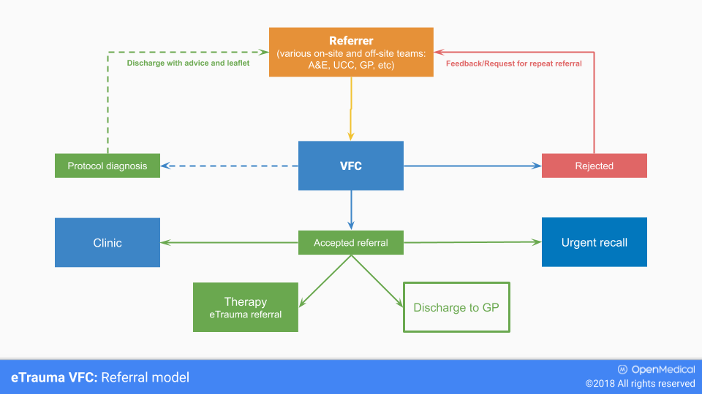
eVFC referral model

Slide 35
94%
Reviewed by Consultant within 72 hours

Slide 36
-1402
F2F appointments per year

Slide 37
-2687
Follow-ups per year

Slide 38
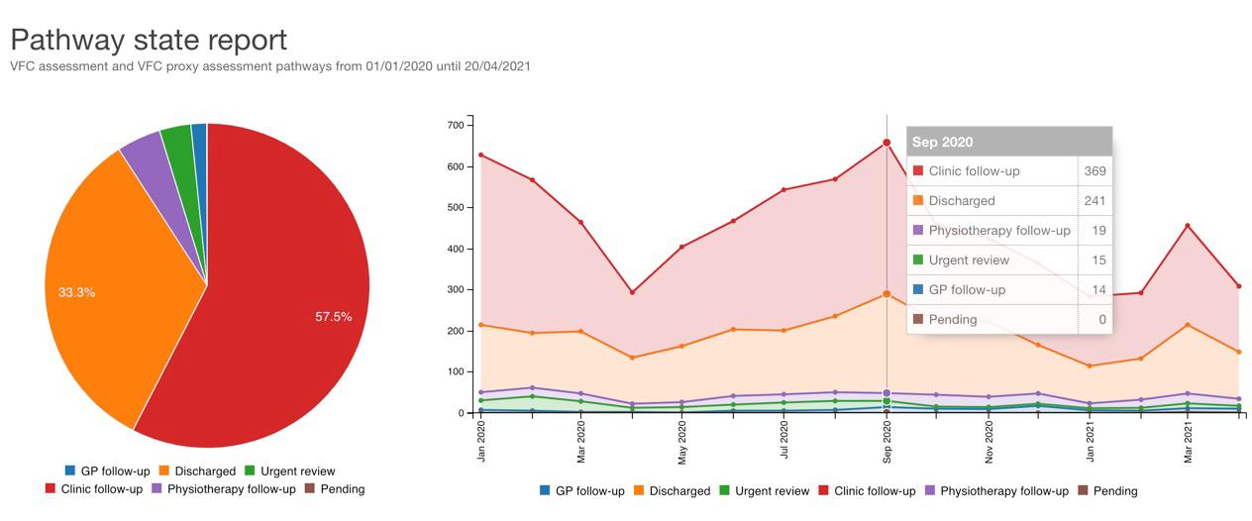
Covid data

