Slide 1
Supporting Ward Managers to lead through Covid-19
David Melia
Director of Nursing and Quality/Deputy Chief Executive
The Mid Yorkshire Hospitals NHS Trust

Slide 2
It’s all about the virus isn’t it?
Reflections
Context
How do you show accountability for your service?
How do you manage your staff?
What does support look like?

Slide 3
Context
What was it like before 2020?
What were your challenges and your successes?
How did you know how good your ward was?
Governance
People
Relationship
Visibility
What did the pandemic show us that we should have already been doing?
“Unprecedented”
Longevity
Sustainability
Changing platforms
Uncertainty
Personal cost
Grief

Slide 4
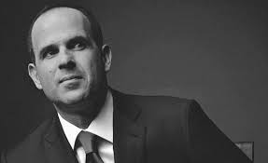
How do you show accountability for your service?
Why do need to do it?
Who is it for?
Do we know what ‘good’ looks like?
How did the pandemic change it?
Do you know what is expected of you?
Who is it that you’re accountable to?
“If you don’t know your numbers, you don’t know your business”
Marcus Lemonis

Slide 5
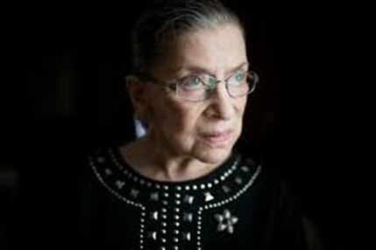
How do you manage your staff?
Direction
Conviction
Compassion
Tolerance
Values & behaviours
Best/worst of times
Challenge & congratulate
Kindness
“Fight for the things you care about, but do it in a way that will lead others to join you”
Ruth Bader Ginsburg

Slide 6
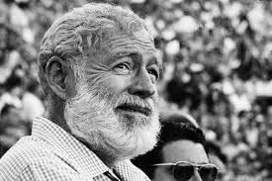
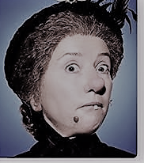
What does support look like?
“If something is wrong, fix it now. But train yourself not to worry, worry fixes nothing”
Earnest Hemingway

Slide 7
Ask yourself……….
Does what you’re doing feel right?
If it’s not right – can it be changed or made better?
Who can help you influence it?
Have you spoken out or accepted it?
Don’t beat yourselves up
These aren’t normal times
You can’t do everything – nobody is a superhero
This too shall pass.

Slide 8
Thank you!
Please ask me a question – it’ll make me feel liked ☺

