Slide 1
Leah Callighan
Matron, Bradford Teaching Hospitals NHS Foundation Trust
Notes:
Hello my name is Leah and I am a very New and young ward manager from Bradford Teaching Hospitals.

Slide 2
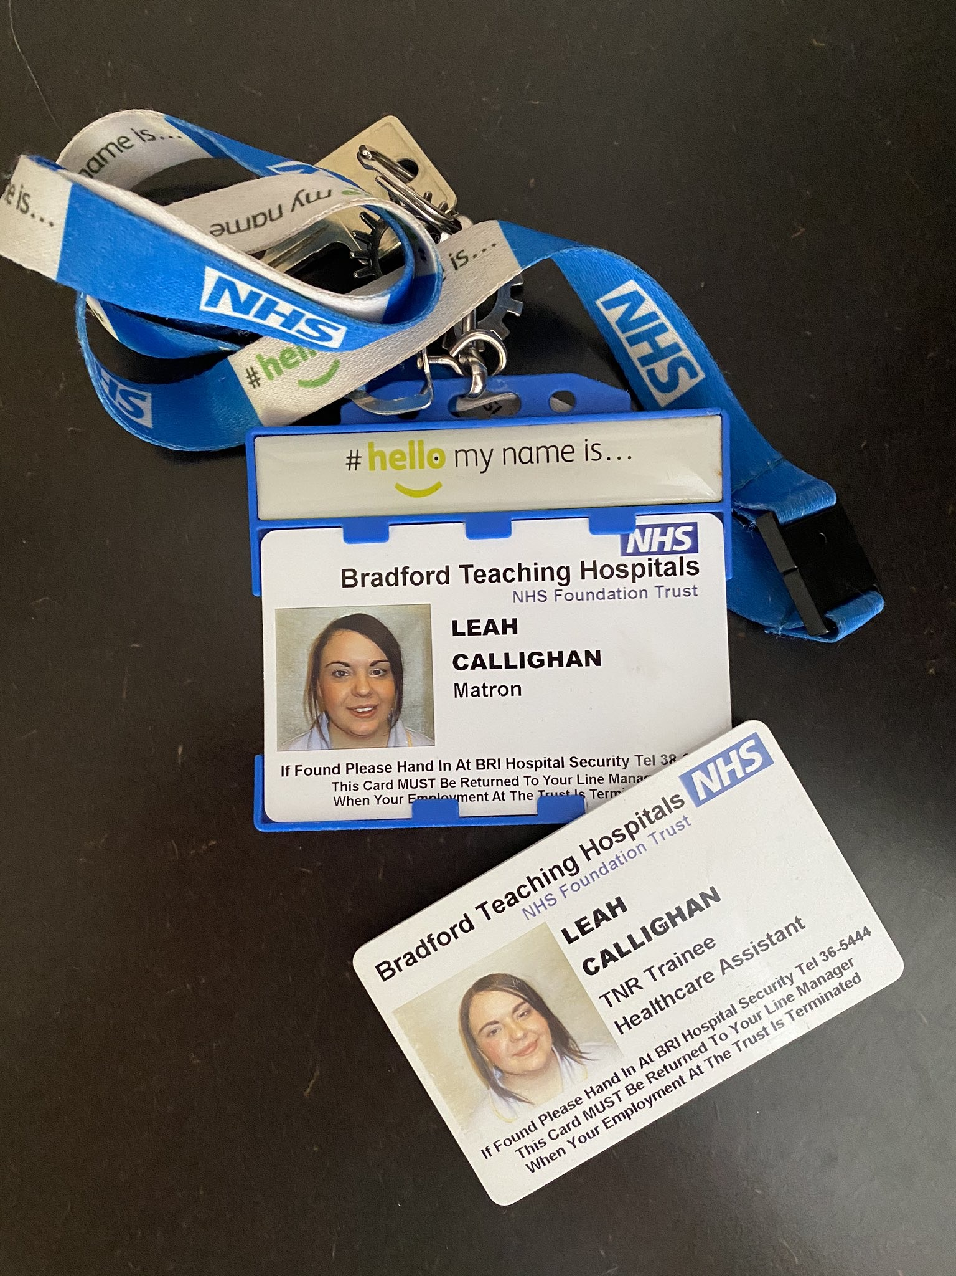
Developing my skills in leadership
Notes:
During this presentation I will talk to you about how I have developed my skills as a ward manager as it is a role I have only been doing a year but I have faced some difficult yet rewarding challenges.
I joined Bradford Teaching Hospitals as an apprentice receptionist in the staff training department as a school leaver. I did this for 2 years but felt a bit wasted working in a hospital so I joined the staff bank to work as a trainee HCA which I found my calling as I loved meeting patients. A few years down the line I found myself a newly qualified nurse working on a plastic surgery ward. I was always looking for new opportunities so when a secondment came up for a junior sister I was quick to apply! I remember been so nervous in my interview but i soon received a phone call, just 15 months into been a qualified nurse that I had got the job!

Slide 3
What I learened going from Junior Ward Sister to Ward Manager
Notes:
The hardest jump I made was going from a band 5 to a 6. This was due to new responsiblities and not really knowing what to do.
It soon became clear everything what I did had to relate back to improve 4 key elements – patient flow, patient care, patient experience and patient safety.
I soon became into the habit of reflecting on a regular basis to look at how I could improve myself going forward. I did make mistakes and probably will make more in the future but I learned from these to better myself and post importantly patient care.
My main goal was to lead my team to do their best each shift to have a better outcome on patient care. I feel really lucky and proud ro be a ward manager as not only can i transform patient care, but create happier working environment for my team. Happy staff always results in happy patients
I look at my team with the view that person is a leader and, my biggest challenge is trying to get people to see this in themselves!

Slide 4
What I wish I’d have know when I first became a Junior Sister
Managing people
Self belief
It is not perosnal
Be open to feedback
Acknoweldge problems
Don’t be afraid to ask for help
Notes:
The things I wish I would have know when I moved from staff nurse to sister are that
Managing people is hard! I have learned now to try and find things out why have happened instead of just telling people what they have done wrong
Believing in yourself is really important - this really helped with my confidence
Things are not personal - We need to remember we are there to improve patient care, experience, safety and flow and some of the decisions we have to do to support this are not always popular with everyone
We need to acknowledge problems. I used to be defensive over my areas but learned I need to be open for feedback. again It is not personal!
I used to think I could do it all when I first started and hated asking for help, but a big realisation I had over the past year is I need to be less of a control freak and learned to delegate.

Slide 5
What characteristics have I learned to be an effective Ward Manager?
Lead by example
One team, many talents
Mentor and support
Create clarity
Delegate & organise
Be human
Challenge yourself & be open to change
Notes:
Reflecting on all all my previous roles, I think characteristics I have had to learn to be effective as a ward manager are:
We need Lead by example, by implementing the 6 C’s daily and working at the standard we expect from our team
We are one team with many talents. Learn from each others experiences and knowledge within your team
We need to act as a mentor and support all of our colleagues.
I need to create clarity. Be clear with roles, responsibilities and over all goals for myself and team
Don’t be afraid to delegate. Organise each day and it will run so much smoother !
We need to be human. Whilst as a ward manager I do see my ward more of a business but I cannot forget that I am a nurse. Compassion is key and can never be lost! Take time for yourself and don’t be scared to ask for help
I need to challegne myself by trying new things. I am a sugical nurse but at the beginging of the year I was seconded to medicine to set a short stay medical ward up which was a brilliant experience
We need to be open to change and most importantly involve staff

Slide 6
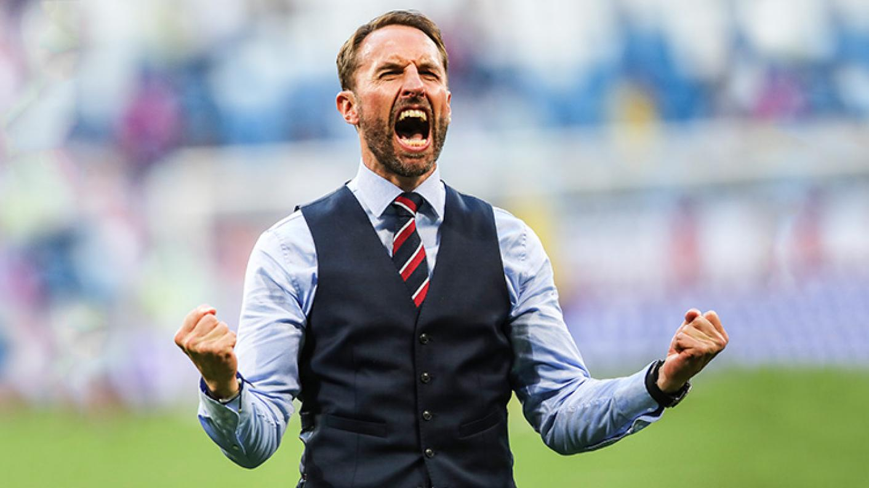
What did I learn from Gareth Southgate as a leader in the World Cup 2018?
Notes:
I included this slide when I did my first presentation back in 2018 – and it is still relevant now!
We need to have the confidence to challenge performance if it is effecting how the team is functioning all together. Establish why, how we can fix it and support them to get back to standards
We need to learn from previous mistakes and show empathy.
We need to be approachable to our team and not be judgemental when mistakes happen.
We need to keep positive whatever is thrown at us.
Spread joy at the workplace! Smile even when things are not going according to plan
We need to treat staff and patients as people instead of numbers and performers
I think the most important thing to have about your job is passion! If we shown how much we care we are bound to be successful leaders

Slide 7
Visible leadership – never “too posh to wash!”

Slide 8
Value & Praise – you do it enough!
Ward 18 ‘Employee of the Month’
Notes:
Valuing and praising members off your team is absolutely vital.
I recently launched employee of the month It has really motivated the team to go the extra mile
Staff can nominate each other or they can be nominated by a family and friends test – this has helped us reach a 100% response rate for the first month!
It doesn’t have to be anything as formal as this, but a simple thank you, acknowldge tough shifts, talk to staff, take an interest, make sure people have breaks, comfortable places to rest and take breaks etc

Slide 9
What have your teams achieved?
Notes:
This is one of my wards – acute oncology have gone 12 months without a hospital acquired pressure ulcer!
Talk to your teams – no matter how big or small, what has your ward / department achieved and how can you acknowledge this?

Slide 10
Ward Rounds have to be key
Patient Flow
Patient Experience
Patient Safety
Patient Care
Notes:
Ward rounds have to be key and when done right will improve patient flow, safety, care and experience we should all be striving to achieve.
Some changes I have made to my ward round to make them more effective include
Don’t stick to routine, ask patients to be seen in different orders – see unwell patients and those eligible for discharge first
Do simple tasks there and then such as give patients a family and friend test, remove cannulas, repeat obs
Set criteria led discharges to avoid medical reviews later on in the day as well as giving nursing staff more conifedence as they are workin automously
Chase clinicians directly if patients have not been reviewed, escalating any barriers as appropriate
Escalate concerns such as safegaurding, pressure ulcer and falls risk as MDT working will have a better outcome for the patient
Summarise each patients plan after ward round and liaise with junior medical staff the priorities. Share the information with nursing team and delegate tasks as appropriate

Slide 11
Organise and Develop your team
Notes:
I am aware of my job discription but in hnesty it doesn’t really tell me what I need to do each day.
My way of remembering things are written on this whiteboard in my office. It gives my prompts as to what I should be doing and when, as well as giving guidance to my band 6’s. It includes daily, weekly, monthly and as and when jobs but the most important part is what is written in blue - be happy, kind, positive and an an excellent role model.
I also have regular chats with my Matron, inform her of what I am doing to make sure there is no other priorties and I share work between my band 6s to help with their own development

Slide 12
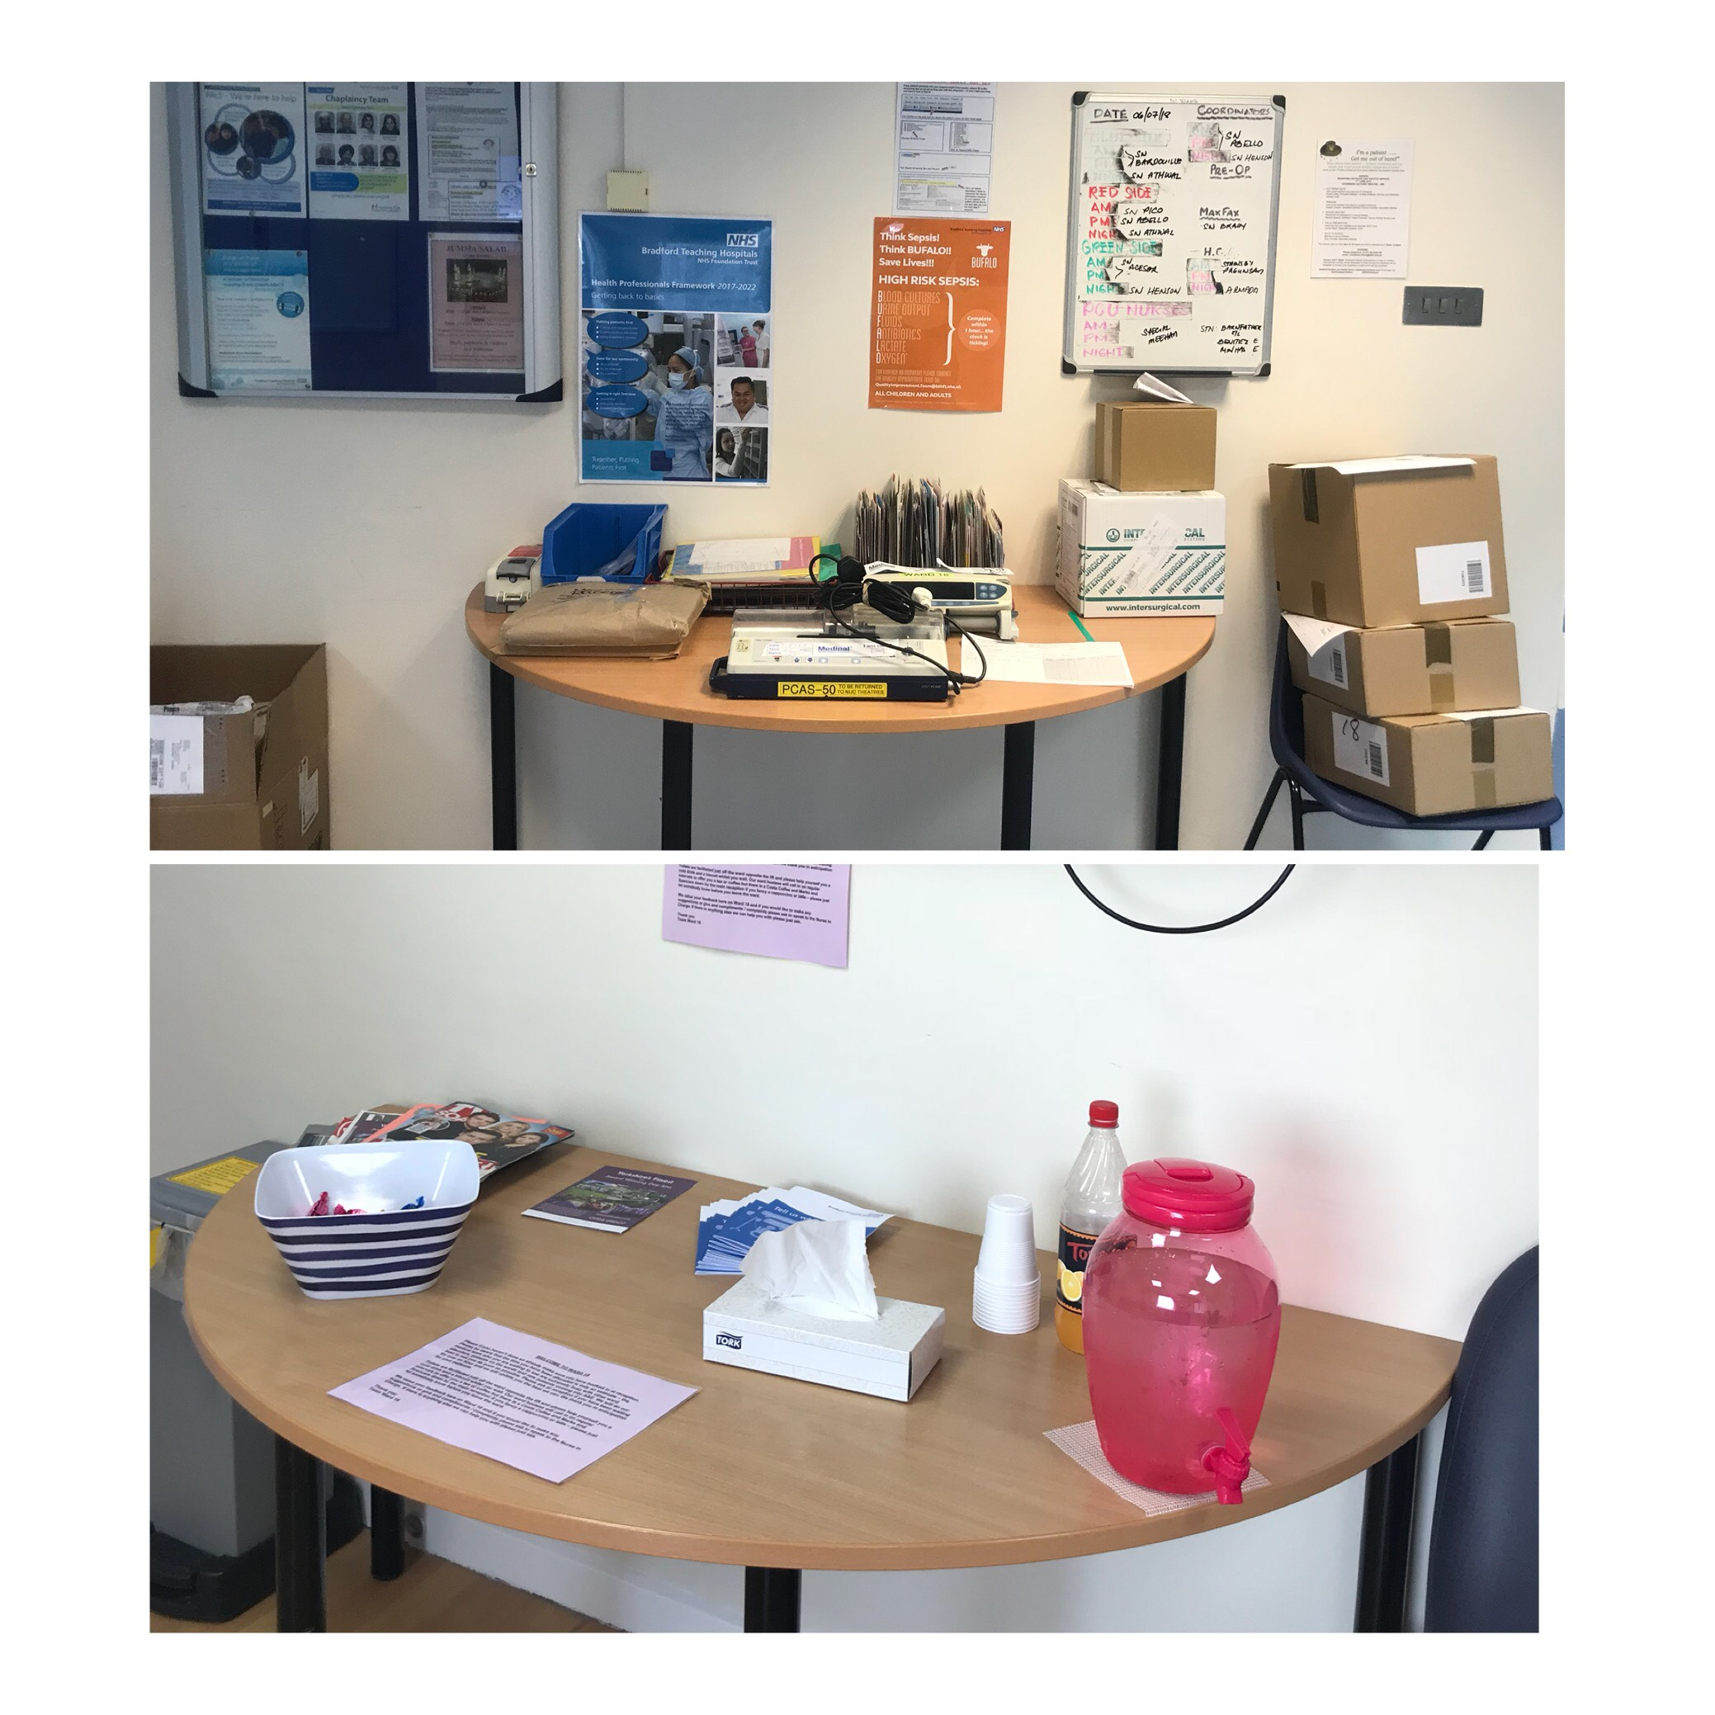
Look at your ward through a newcomers eyes
Notes:
15 step challegne – how does it feel walking onto a ward? What did it look like, feel like, how were you spoken to
I made a few changes to a previous ward in the pictures above - It made the hole ward much more inviting! I thought staff may have been reluctant to change but most embraced it as it has created a much nicer working environment
I would really recommend having good sort out through your own wards and departments – you will be surprised what you will find and do a 15 step challenge with a nearby ward!

Slide 13
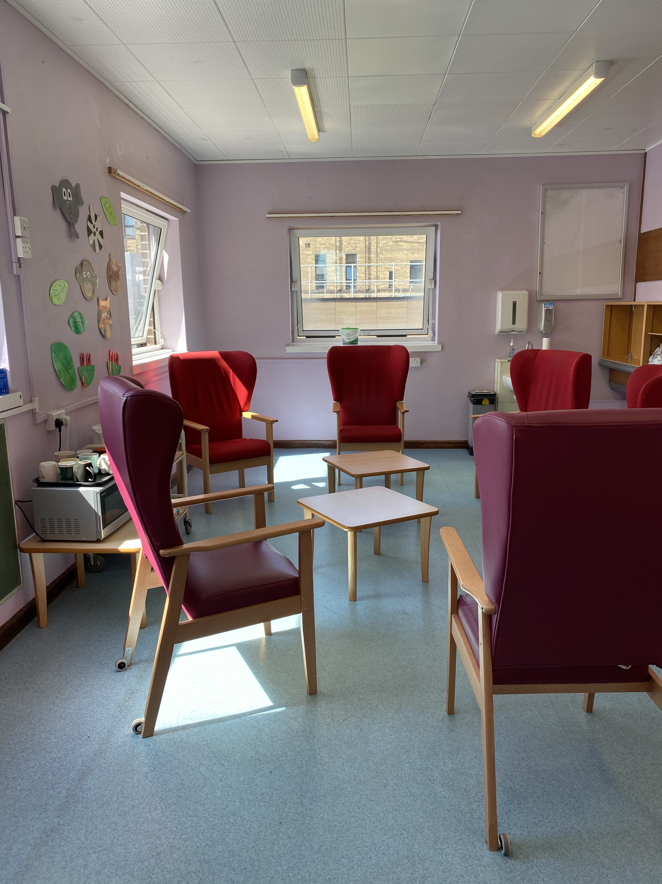
Including staff break areas

Slide 14
Lessons I’ve learned about my own work life balance
Who am I? What do I want?
Get 8 hours sleep each night
Noticing my stress and fatigue
Time management
Asking for help
Again…… I’m only one person
Notes:
It is so important to get the work life balance right. Unfortunately it is hard too!
I have learned to realise who I am. I am not just a Matron. I am a partner, a daughter, a sister, and a friend. I have thought what I want to achieve in life – I give myself things to look forward to like holidays and nights out with the girls
I try to keep active to help me get a good nights rest. I also feel that I perform better at work when I have slept for 8 hours– I am more switched on, passionate, enthusiastic and overall I have a lot more energy.
Time management is incredibly important to me. I look at what needs to be done at home and work and focus on what my priorities are
I personally become really narky and short when I am tired and stressed, if I don’t notice I am like this then my partner lets me know!
It also comes back to what I spoke about earlier that we need to realise we are only one person, cannot do everything and we cannot be afraid to ask for help.

Slide 15
The things that reduced me to tears
Abusive relatives
No support from colleagues
Colleagues not speaking to me
Lack of belief
Frustration
Exhaustion
Notes:
Unfortunately I am sure that all of us have cried in our careers at some point. The following things have upset me over the years but I do believe they have made me a stronger and kinder person
Abusive patients and relatives have made me cry in the past. I have also supported staff who have had to suffer this. We are the NHS and it is totally unacceptable we should ever be made to feel like this at work
I have had days where I have felt under supported by my team - no matter what happens it is so important to be united as a team and professional even if people have had disagreements
The lack of belief by my peers shown in me hurt me. I got my first juniors sisters post after been qualified 15 months. I was talked about by past and present colleagues for the decision to give me the job was ridiculous as I lacked experience.

Slide 16
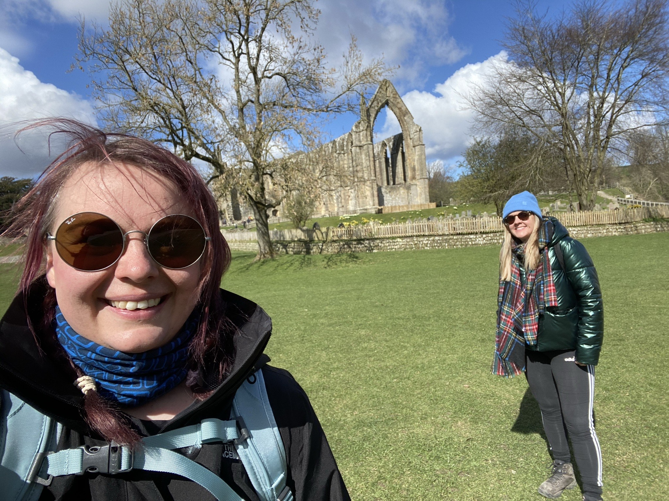
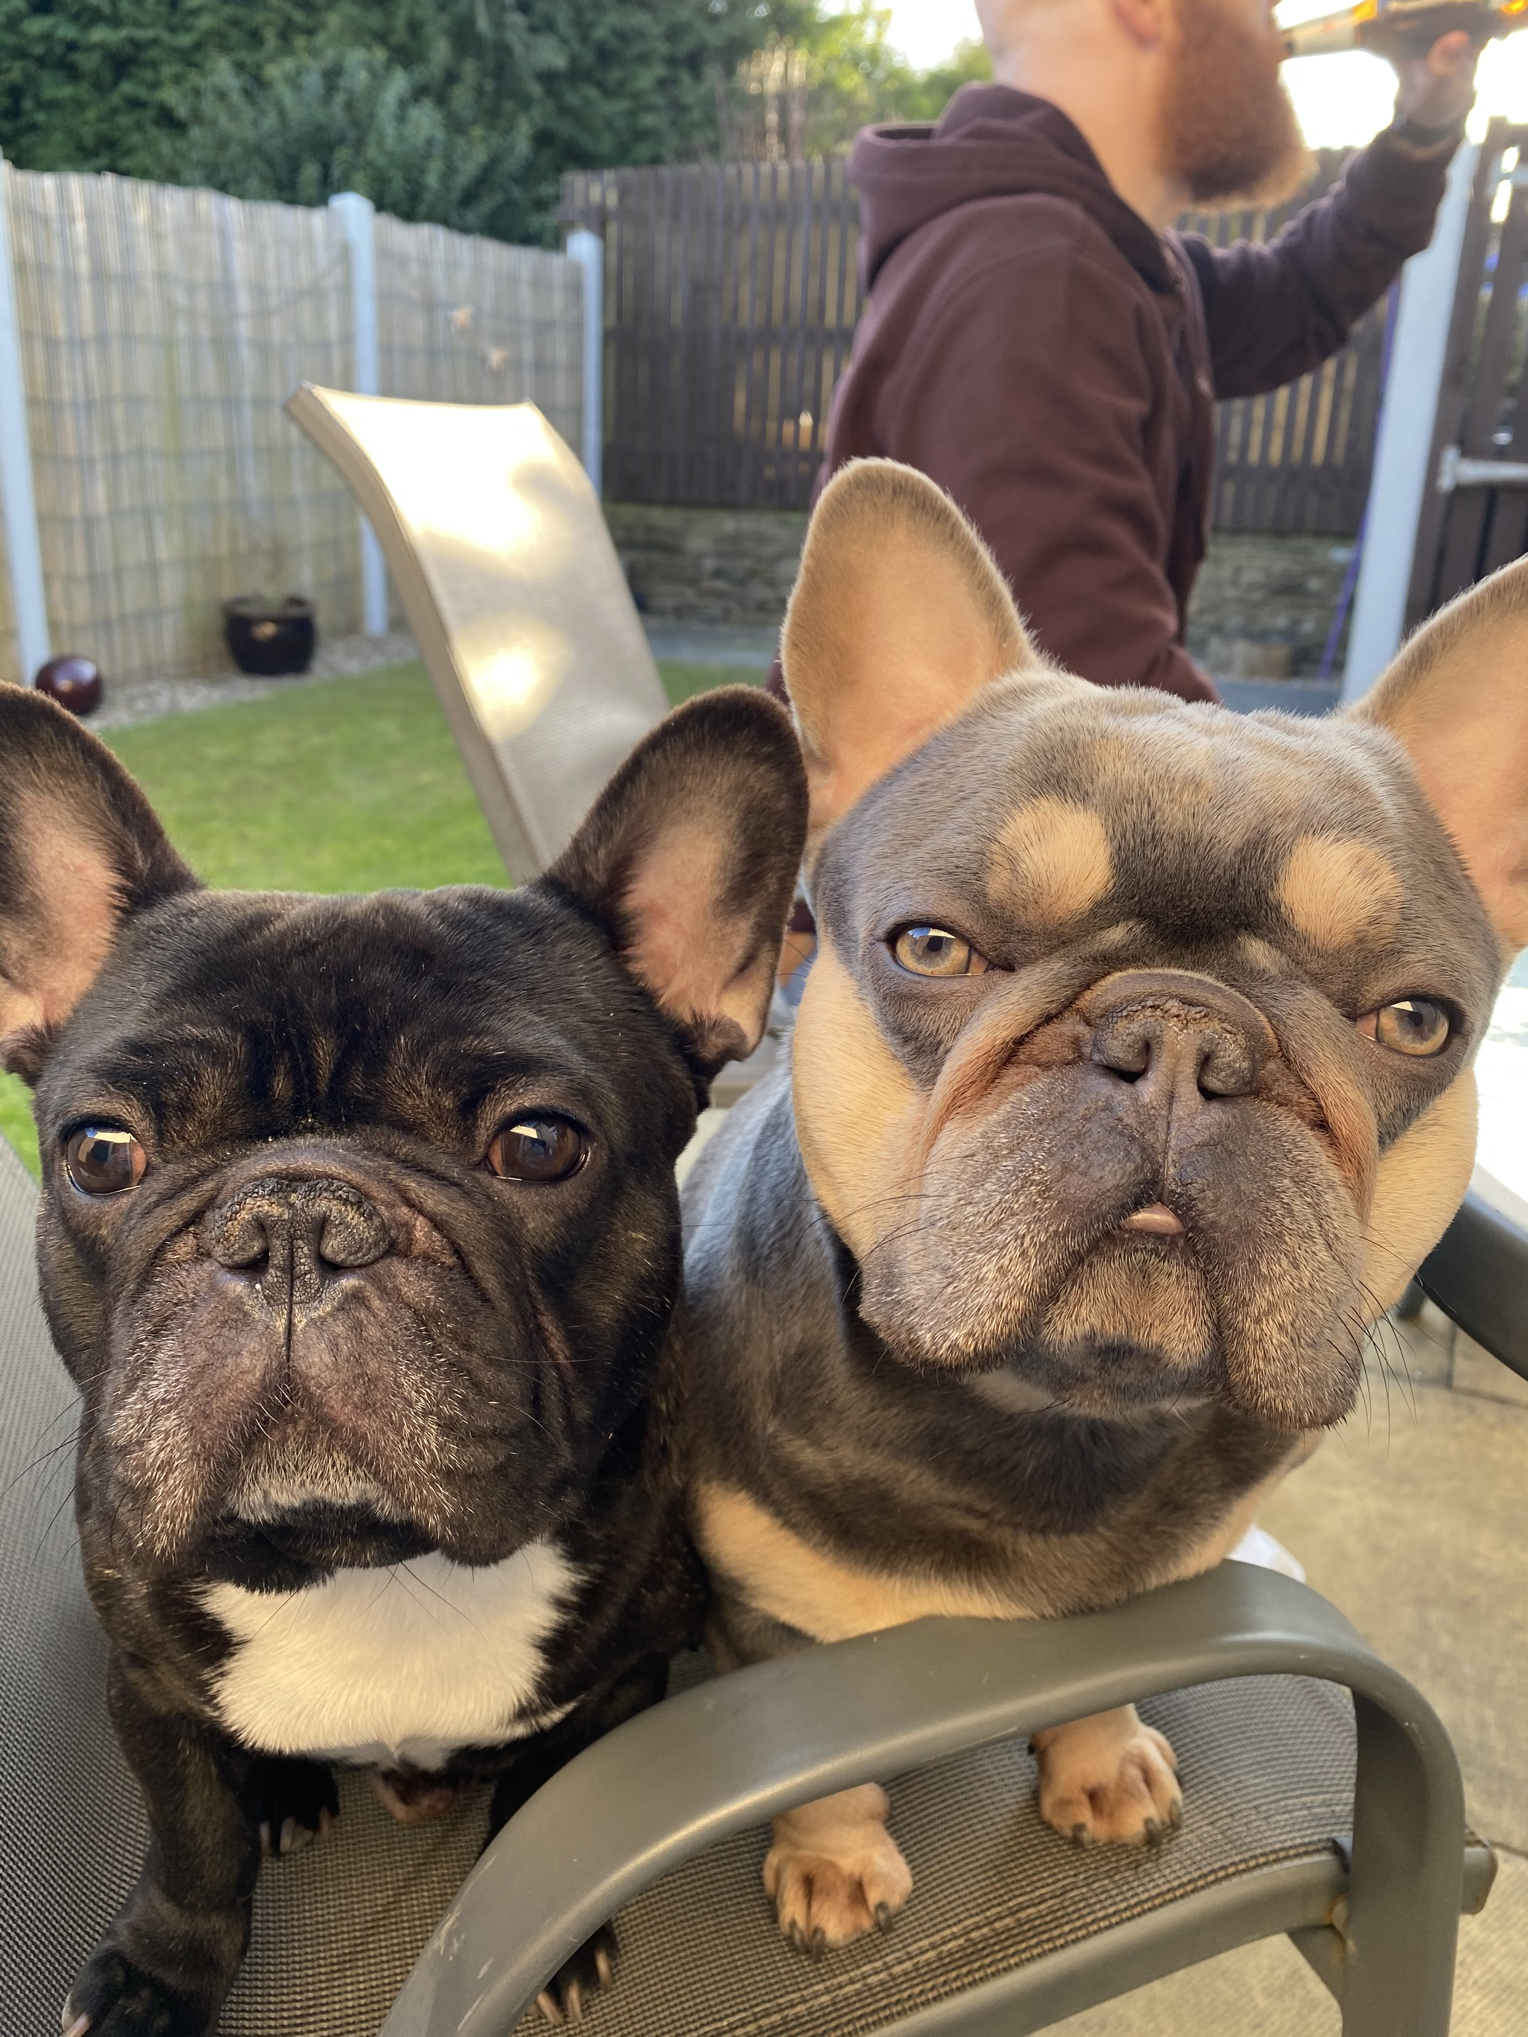
To unwind and relax I love the great Yorkshire outdoors with my dogs!
What will you do?
Notes:
And when I am feeling down and need a good de-stress I love getting out in the fresh air and taking a llama for a walk (or my dog when I can’t get to the lake district!)
I love doing this because it is in a beautiful location, relaxing, lots of fresh air and fun
I was chatting to the host most recently and she told me that the llama in the picture with me even went to some nursing homes! If only infection control would let me bring them onto my ward!
Think about what you will do when things build up - and no a bottle of wine every night does not count!

Slide 17
What support did I need during my first year as a Ward Manager?
Informal 1:1’s and shareing knowledge and expeirences with my peers
Realise the job does not start and end at a patient
Regular 1:1’s and have an effective appraisal
Clear expectations – when things aren’t clear, I asked
Corporate news
My Trusts agenda
Notes:
My first year as a ward manager has been hard but overall I have absolutely loved it. I think this has been because of the support I received in various ways such as:
Informal one to ones with my colleagues who were both band 7s, we meet up around once a month and talk about what is going on in our areas. This is really helpful as it made me realise we are all in the same boat, we share our experiences and help each through good and bad times
I realised my job role does not just start and end at a patient. Everything we do is about improving patient care and experience - today none of us have seen any patients but we are all here to learn and make positive changes to ourselves and our wards
I asked regular feedback from my managers from appraisals to having catch ups as I need clarity about my own performance and willingness to take feedback, when not always positive
I needed to know what is expected of me and my area , what are the current trust issues for a corporate perspective. Do you know what your trusts initiative is? What are the main focuses? Sure a lot will be the same - recruitment and retention, patient flow, supporting A&E and cost improvement plans

Slide 18
Transferable skills
Notes:
I am now Matron for Radiology – I have been here for 2 years, when I started this is how I felt my knowledge was about CT / MRI scans etc
I was too focused on what I didn’t know then what I did know. I don’t need to know how to do a scan, but I do know how to ensure patients feel comfortable and are safe in our care. I have experience quality, safety, people management, leadership culture and this is what I can contribute

Slide 19
Final thought……
MAGIC HAPPENS WHEN YOU STEP OUT OF YOUR COMFORT ZONE
@leah_callighan
Notes:
I was going to include a slide on covid and our year – but thought we are all a bit burned out from it. This has always been my motto and I am sure each and everyone one of has gone out of our comfort zone the past year. Be proud of what you have achieved and be kind to yourself.

