Slide 1
The Coroner’s Role
- the investigatory duty
5th May 2021
HealthCareUK Conference
Andrew Harris
Senior Coroner, London Inner South
Professor of Coronial Law, William Harvey Research Institute,
Queen Mary’s University of London

Slide 2
Role of Coroner
1971
Determine cause of death
  In inquests 4 questions – who where when how died
Allay rumours/ suspicion
Alert circumstances to prevent further deaths
To advance knowledge
To preserve legal interests of family and all IPs
2014
Greater responsiveness and accountabilities

Slide 3
Judges’ determinations
Criminal
  Guilty or Not Guilty
Civil
  Whether specific law broken or duty breached
Coroner
  What has caused death
  What has contributed more than minimally or trivially

Slide 4
Procedures
Criminal
  Adversarial, questioning led by counsel
  Standard of proof: beyond all reasonable doubt
Civil
  Adversarial, questioning led by counsel
  Standard of proof: on the balance of probabilities
Coroner
  Inquisitorial, questioning led by coroner
  Standard of proof: on the balance of probabilities

Slide 5
Powers
Criminal
  Sentencing
  May→ victim support, imprisonment
Civil
  Breach, Declaration, Order, Mandamus
  May→ compensation, new action, reputation damage
Coroner
  Record of Inquest
  May lead to Preventing Future Death Report

Slide 6
Coronial Investigation
Coroners and Justice Act 2009 (CJA)
A senior coroner who is made aware that the body of a deceased person is within that coroners area ….. if the coroner has reason to suspect that…
the cause is death is unknown or
the deceased died a violent or unnatural death or
the deceased died while in … state detention (s1(2)
must as soon as practicable conduct an investigation into the person’s death (s1(1))
Preliminary enquiries (s1(7))
Notes:
CJA 1 Duty to investigate certain deaths
A senior coroner who is made aware that the body of a deceased person is within that coroner's area must as soon as practicable conduct an investigation into the person's death if subsection (2) applies.
(2) This subsection applies if the coroner has reason to suspect that—
(a) the deceased died a violent or unnatural death, (no longer sudden)
(b) the cause of death is unknown, or
(c) the deceased died while in custody or otherwise in state detention.
(3) Subsection (1) is subject to sections 2 to 4.
(4) A senior coroner who has reason to believe that—
(a) a death has occurred in or near the coroner's area,
(b) the circumstances of the death are such that there should be an investigation into it, and (c) the duty to conduct an investigation into the death under subsection (1) does not arise because of the destruction, loss or absence of the body,
may report the matter to the Chief Coroner.
Reason it suspect has LOW THRESHOLD
Preliminary enquiries (s1(7))
Request to transfer s2
Rarely by direction of Chief Coroner (s3)

Slide 7
Deaths in England and Wales (MoJ 2019)
500,000 deaths in England & Wales
Doctor issues MCCD for Registrar
40% reported to coroners: 210,900 falling
14% of reported to inquest: 30,000 rising
39% of reported have autopsies: 82,1000 stable
Coroner enquires, investigates, issues

Slide 8
DEATH
Cause of death
natural and known
Cause of death
not known or unnatural
Clinician issues MCCD
Refer to Coroner: enquiries
Autopsy
Open investigation
Form A
Form B
Discontinue investigation
Consented
autopsy
Open inquest
Family take MCCD to
Registrar of Deaths
Record of Inquest sent to Registrar
Cremation
form
Body can be collected, buried, cremated or repatriated
Notes:
Reporting deaths (ONS)
Deaths that may be due to:
Industrial disease
During prison/police custody or shortly after
Violence and Suicide
During operation/anaesthetic
Neglect (including self)
Adverse effects of treatment, or of standards of care, or about which complaint (advisable in England, compulsory in Scotland)
Accident
Cause not known/no Dr attended
Certifying Dr not seen in 14/7 or after death

Slide 9
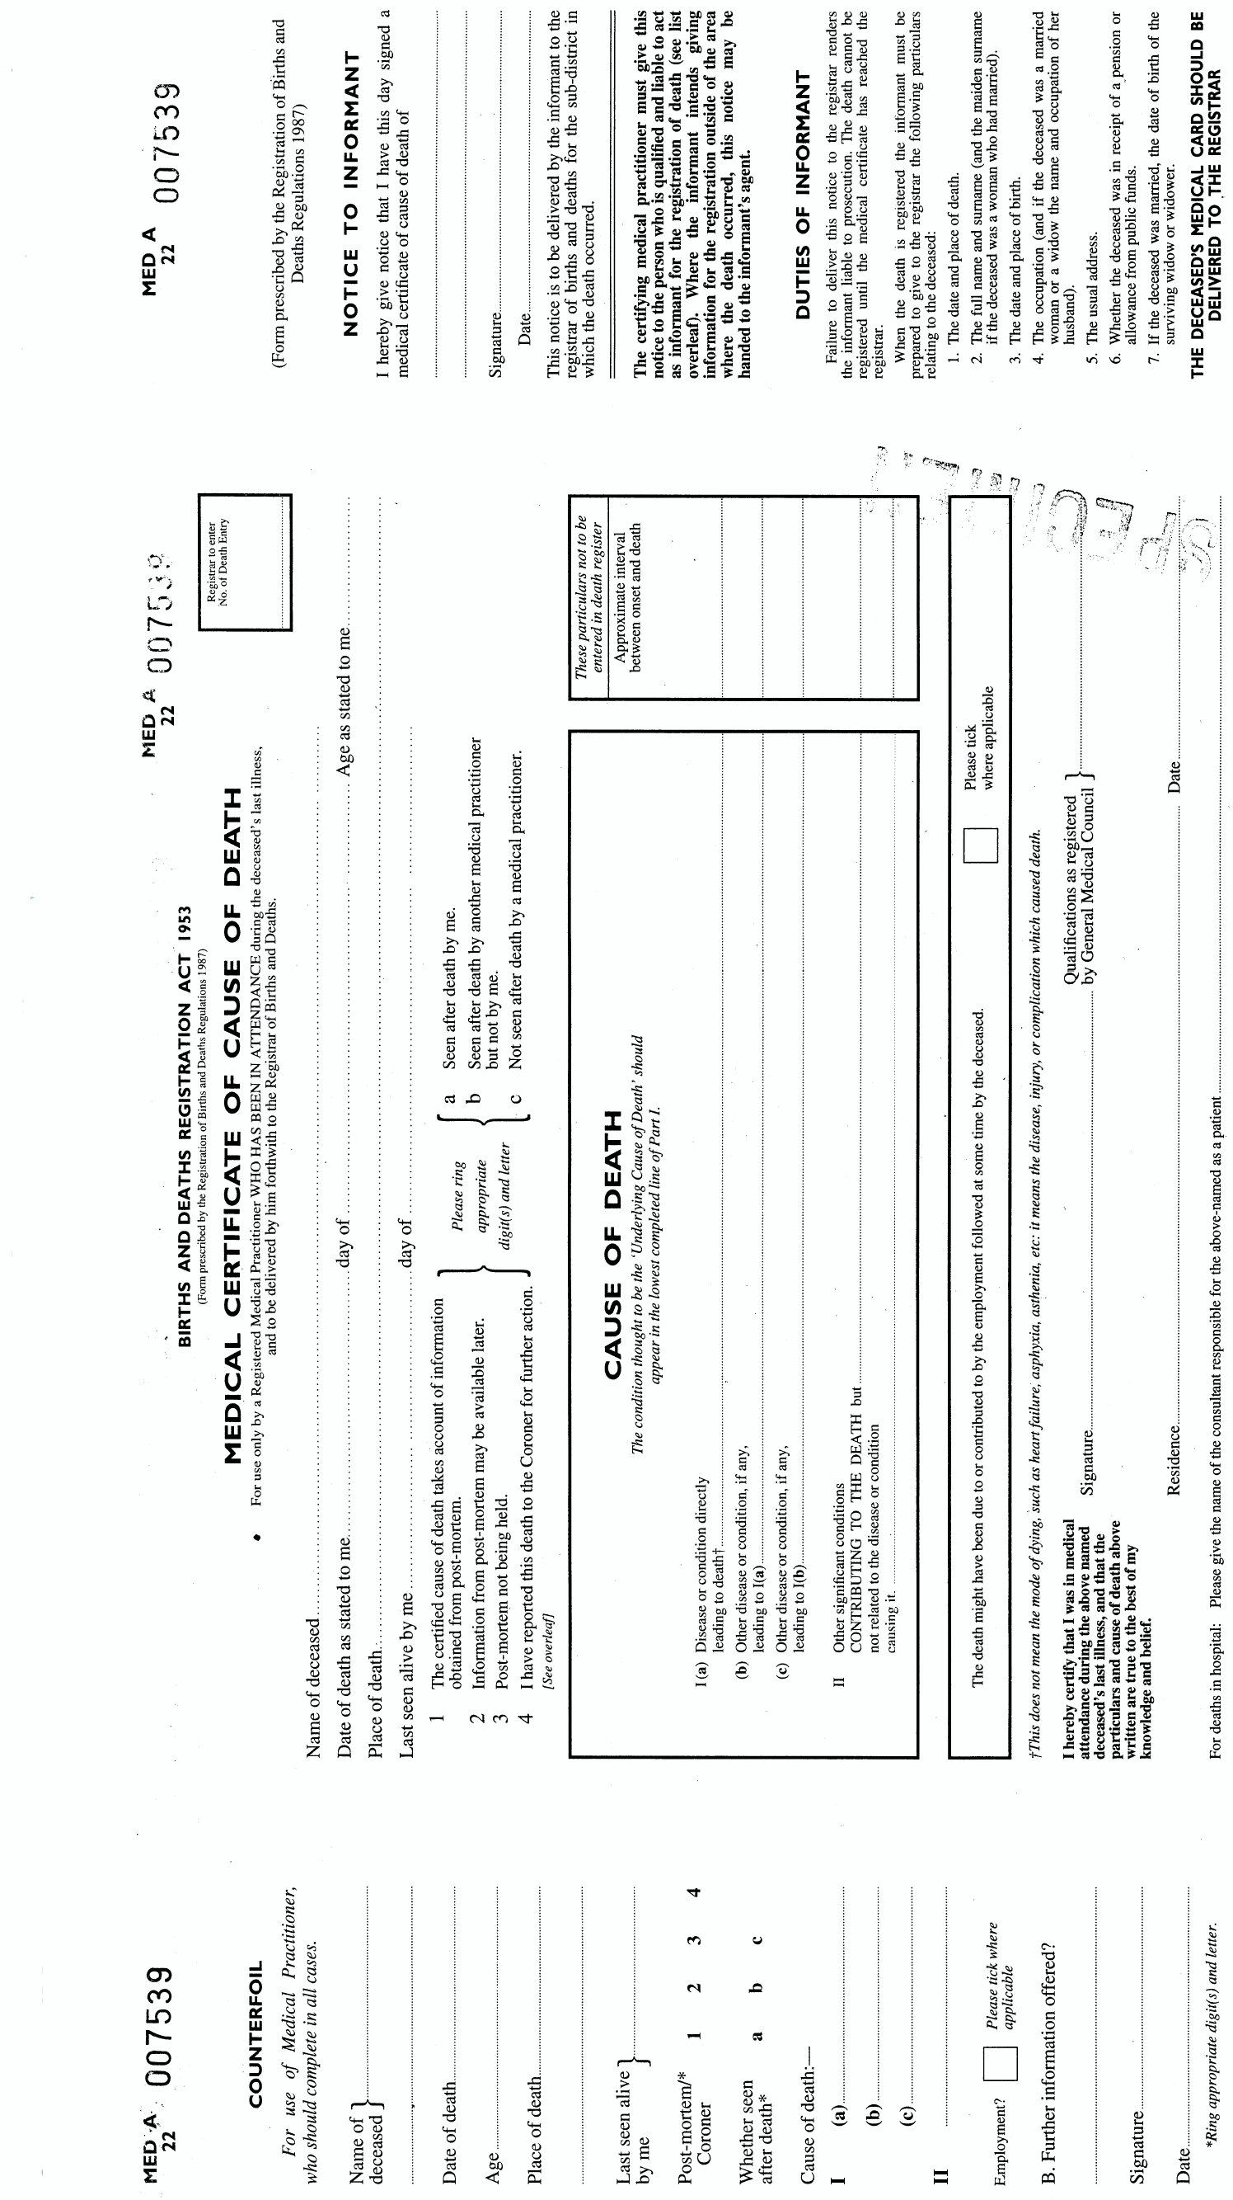
Notes:
Doctors can issue MCCD if provided care in last illness and seen deceased within 14 days of death Or after death. If doubt seek senior advice or HMC.
Death within 24 hrs admission or related to surgery report to HMC - cause unknown.
Consider hospital PM if definitely natural cause, but not precisely known. If cause known such as terminally ill then try to find doctor to sign.
~30% of medical certificates clinical cause of death is significantly wrong or incomplete
Discrepancy rate unrelated to length of stay in hospital or time on GP’s list
Potential loss of reliable clinical audit and public health data
Poor standard of certification. Note 1a 1b 1c sequence of causation
Note II factors that are contributory to death but not related to 1
Don’t hide operation or anaesthetic if clearly causative
If reported to HMC can cover with A or investigate further. Request consultant.

Slide 10
Medical Cause of Death
Dr should state MCD whether or not going to coroner/pathologist, mentioning contributory causes
1c underlying caused 1b caused immediate cause 1a
Antecedent cause needed: “Aspiration” insufficient
Entries in II contribute to death, on balance of probability, but do not (directly) relate to disease in 1
To best of knowledge and belief: lower than probable
Seek advice of Medical Examiner*

Slide 11
Source of Referrals to Coroner
Hospital Doctors - apply death Notification regulations advised by MEs
Police refer deaths in community, mostly unknown cause, declaration as to non suspicious
A small number from other sources -
Registrars, Hospices, GPs, or members of public
Transfers from other coroners
Directions from Chief Coroner

Slide 12
Notification of Death Regulations 2019*
Exposure/ contact with toxic substance – acute not chronic but all industrial. Implications of Kissi-Debra?
Use medicinal product, CD, psychoactive substance
Violence, trauma, injury, self harm – any time eg old RTA
Neglect/ self neglect (lack of care ? contributed)
Unexpected, mistake, procedure ? contributed
Otherwise unnatural (not entirely from disease)
In State Detention – under MHA section
MCD not known, after consultation (not with coroner)

Slide 13
Coronavirus Act 2020
Notify if either attending Dr nor other can sign or Dr can sign but not in reasonable time*
Don’t notify Covid to C just because notifiable for health protection; you can certify Covid if clinically diag and no test /result unavailable£
No attendance in 28/7 notify C who may tell Registrar to accept MCCD from Dr (NFA) £

Slide 14
Ordering PME where non suspicious
    Cor should direct as soon as reasonably practicable (Reg 11);
    but need to know MCCD not possible and consult family
    Can specify kind of examination (CJA s14 (2)) ?non-invasive
    Unnatural death - Dr should give C MCCD if attended (BDRA 1953)
    ? View and tox or none eg non contact RTA, suspension
No cause of death
  Can consultant issue? NFA or secure report and cover with A?
  Do family object? – PIRH, scan, Can override (Manch C ex p Worch 1988 CA)
  To see if duty to investigate (CJA s14 (1b))
  Despite Dr willing to issue MCCD (R v Westmr C ex p Rainer 1968)
Autopsy pathologists independently accountable to Coroner
Families decide disposal of tissues (HTA). Body release after autopsy but then may have to wait for histology or toxicology

Slide 15
Coronial Investigation
PME natural, no reason to investigate – B;
If not (or if interim certificate) – open investigation
Coroner has powers to require statements and discloses these to interested persons: how death occurred – in direct line of causation
Evidence may later enable an investigation to be discontinued (if autopsy done) – Form B
If not an inquest is opened in public in court

Slide 16
Stigma and whose right to know?
Drug misuse; HIV; being gay; criminal record
Requests not to disclose
Consider relevance
Disclosure rights and Data Protection
Coroner can redact statements
You can be directed that a certain matter may not be disclosed or referred to

Slide 17
Cultural aspects of death
16th century attitudes and beliefs
Different religious customs
Dominant western denial
  Less prepared
  Family disputes
  Blame
  Affects attitude to and need for forensics

Slide 18
“Unnatural” death
Medical and Legal Definitions are different:
Scientific literature and opinion Natural: Death related to an internal bodily event not influenced by external occurrences
Legal: considerations
i) Statutory requirements to investigate (industrial, detention)
ii) Statutory interpretation unnatural (rules): “Not in accordance with physical nature; or at variance with what is usual or expected”
iii) Case law: C investigates if per se unnatural (RTA /error in surgery); if prima facie natural MCD apply case law

Slide 19
How case law over time changes triggers for investigation
17 yr status asthmaticus died whilst waiting for ambulance - natural death even though earlier ambulance would have saved his life. Now unnatural. R v Poplar Coroner ex p Thomas 1992
Coroner could not investigate removal from ITU and drug causing pneumonia. Now can
R v HM Coroner Birmingham and Solihull, exp Cptton QBD (1996) 160 JP 123; [1995] COD 245

Slide 20
Unnatural in law is contextual- Touche
“Little more than unexpected.. Not exclusively in terms of causation. Look at combination of circumstances”
LJ Robert Walker, p61-62 in Touche
Wholly unexpected deaths from natural causes which would not have occurred but for culpable human failure (Failure to monitor BP post partum) R v Inner North London Coroner ex p Touche [2001] EWCA Civ 383; Thomas abandoned
Where there is a possibility of “neglect”, even of contributory cause, investigate if unnatural (not negligence)
Only possibility of alternative cause of death needed to investigate (delay in diagnosis of septicaemia)
Bloom v ADC North London v Whipps Cross Hospital [2004] EWHC 3071 (Admin)
Medically natural MCD but legally unnatural death

Slide 21
Potentially fatal conditions
Where a medical intervention fails to prevent death from the underlying fatal cause, even if treatment was wrong, or negligent failure to treat, death is natural
R v Birmingham Coroner ex p Benton (1997)
Most deaths following emergency treatments are referred, but coroner usually finds natural
Medical error unnatural MCD: in law natural
Critical to tell coroner whether intervention was an emergency or elective

Slide 22
The elderly
Resident Nursing Home
Altzheimers, manic depression
1a Bronchopneumonia, II Dementia
Should there be an investigation?
Notes:
5

Slide 23
What triggers investigation?
Wife says he was clammy day before death
Possible failure to give antibiotics
Inadequate medical records
Antipsychotic drug given in unacceptable doses making susceptible to pneumonia
Left immobile in bucket chair
Excessive focus of coroner on perceived requirement to demonstrate link between death and improper treatment. Goes further than “reasonable cause to suspect”. Bicknell v HMC Birmingham [2007] EWHC 2547 (Admin)

Slide 24
Cause of falls and ♯NOF
81y, MI, dementia, diabetes; Fall ♯NOF
Hypotensive post op, death Day 2
1a Pulm oedema 1b ♯NOF (operated) from fall
  Unnatural. Inquest
1a Pulm oedema 1b IHD ♯NOF (operated) from fall
1c Old Age Frailty
  - Natural. If NOK no concerns, no further investigation
Evidence for frailty may depend on expert evidence on osteoporosis, muscle weakness
Notes:
00132-15 Fernandes

Slide 25
Cause when immunosuppressed
14y AML BM transplant, post op problems
1a Sepsis, 1b AML (GvH disease)
Family - wrong treatment and CoD, transfers.
CC. Inquest: BM - own WCs completely obliterated.
1a MOF 1b Candida sepsis 1c Immunosuppression from stem cell transplant II GvH, relapse AML
“Unintended conseq nec medical treatment”
Expert evidence on bone marrow crucial
Notes:
Leanne Peace 00261-12

Slide 26
Sudden death of unknown cause
Presumption natural syndromes
SIDS – but SUDI with virus/ co-sleeping?
SUDEP usually natural - underlying cause?
SACD – exclude drugs, Genetics
In schizophrenia –
Has antipsychotic caused arrhythmia?
Case specific contexts. Rule out underlying conditions with expert investigations
Notes:
Sudden death in epilepsy
Sudden cardiac death in young people with negative autopsy
In Markham v W London Coroner 2013 High court ordered new inquest after verdict of unknown natural causes before genetic diagnosis was returned.
Sudden death in schizophrenia where excited delirium or medication related cause excluded. Coroner needs to understand to what extent capacity to choose/ best interests and to what extent opportunities for professional intervention missed
Sudden infant deaths UK survey pathologists 2010:
SIDS unexplained in sleep up to one year
SUDI preceding illness, co-sleeping or minor histo changes
UNASCERTAINED WHERE SUSPICION OF NON NATURAL CAUSE, including where parents consumed alcohol or dugs in last 24 hours.
Consensus definition, but variation.
Should coroner consider SUDI unnatural as co-sleeping is contributory cause or rely on pathologist advice? Automatically get police report. Operation Indigo. What investigation beyond PM? IP submissions but acutely distressing.

Slide 27
Epidemics
World since 70s: HIV 75.7m cases, 32.7m died CFR start 100%. UK: 2016 ?all cause mort 0.4%
Pre-exposure Prophylaxis trials. R double cost
Flu: 400,000 annual deaths in epidemic; PHE: 17,000 annually. 0.1% seasonal mortality
Covid: 4.41m cases UK, 128,000 died; 2.9% CFR (2.1% world).
12/20 Age Std Mort (rate/100,000 pop) 234 (flu 25; 51 av)
M>60 Mortality 10/1000; Kent variant 13/1000

Slide 28
Covid ? Coronial investigations
Many not reported. Initially not autopsied. Now PCRs
MCD natural Is there culpable human failure?
Wave 1: NHS inappropriate PPE, varying awareness, inadequate procedural protection, lack of testing
Wave 2: Care Home Care Home deaths ?Not tested on discharge from hospital, no PPE
Wave 3: Transport and service sector exposure
Causation problems. Legal Q about remoteness
Work Related Deaths Need HSE referral and require Coroner jury
Coroner not Q gov policy/ Public Inquiries

