Slide 1
Tony Bonser
tbonser@aol.com
Vice-chair of trustees – St Catherine’s Hospice
Fund-raiser for Macmillan Cancer Support
Member GM Health and Social Care Board
Member National Patient/Carer experience workstream
Notes:
What I do. Status with a group of professionals.

Slide 2
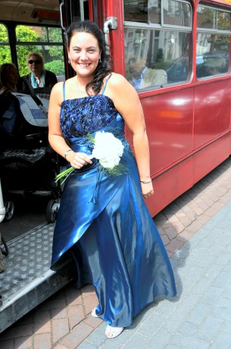
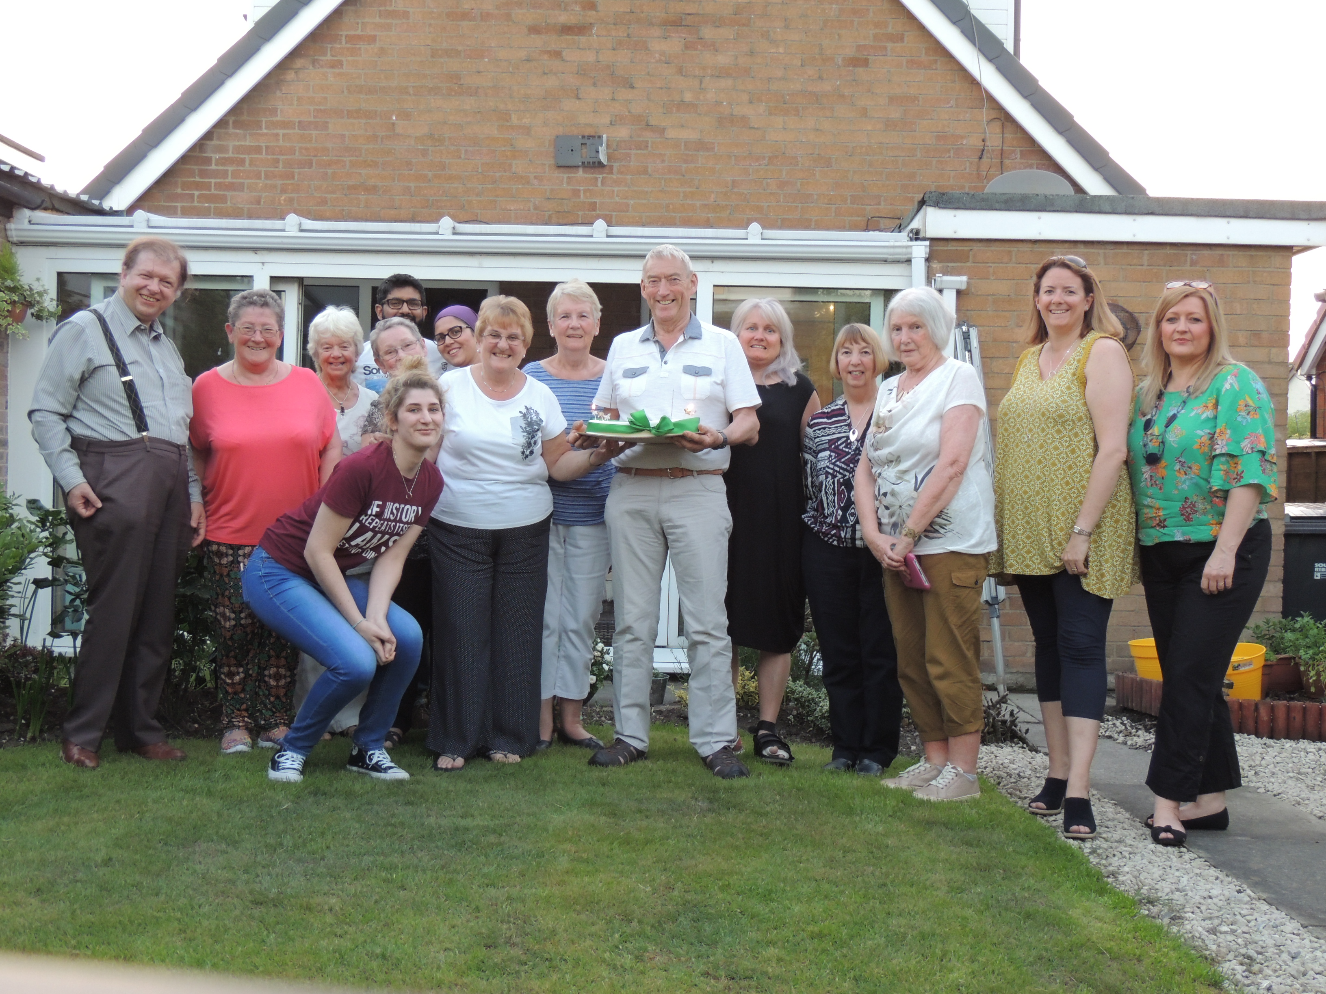
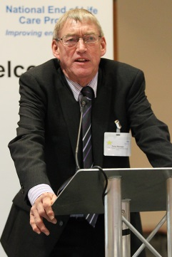
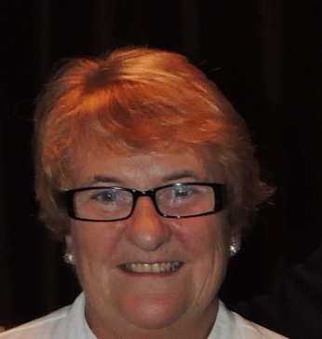
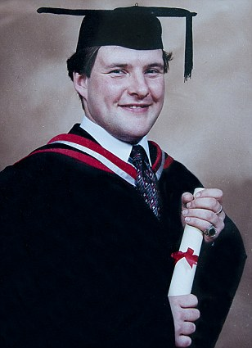
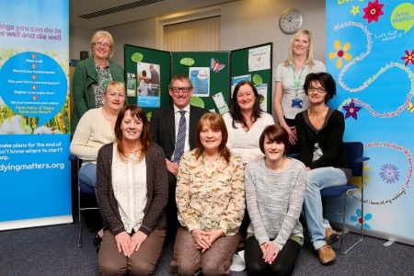
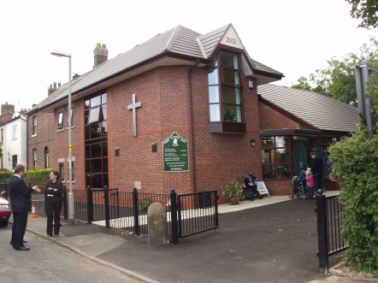
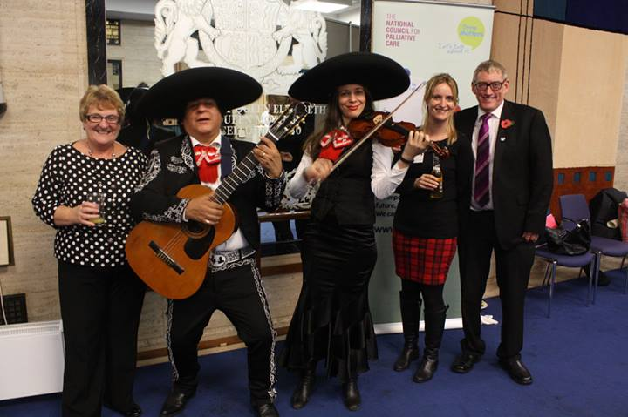
But this is who I am…..
Notes:
Connected to range of networks. Common factor, my late son Neil. What happened to him affects me, and thus everyone in all the networks – and always will, for good or bad. You are never dealing with just the patient.

Slide 3
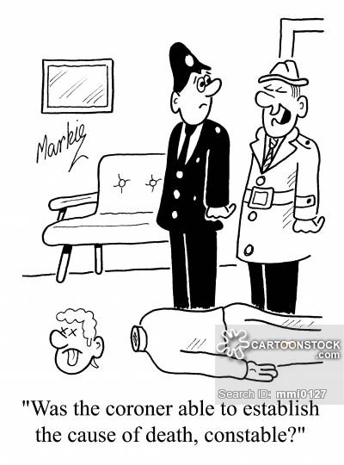

Slide 4
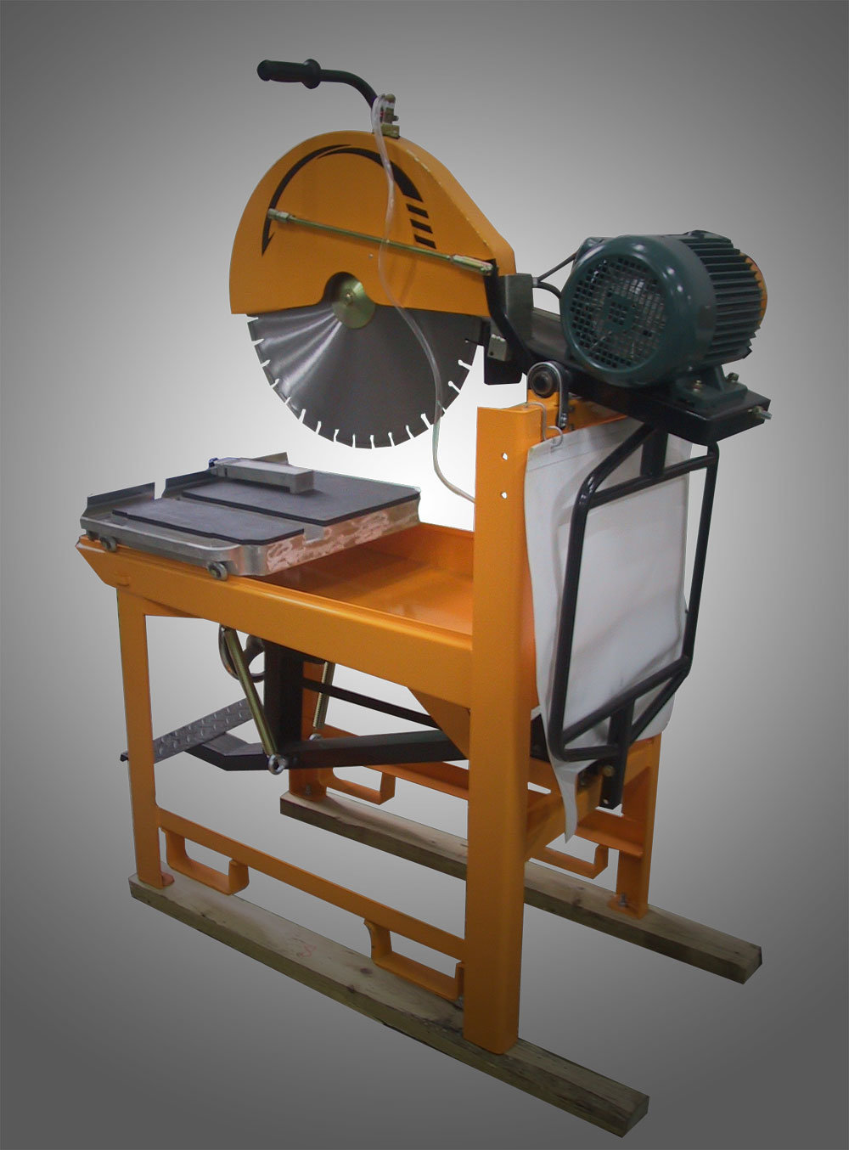
Why do you need an inquest?
We need to know what killed him!

Slide 5
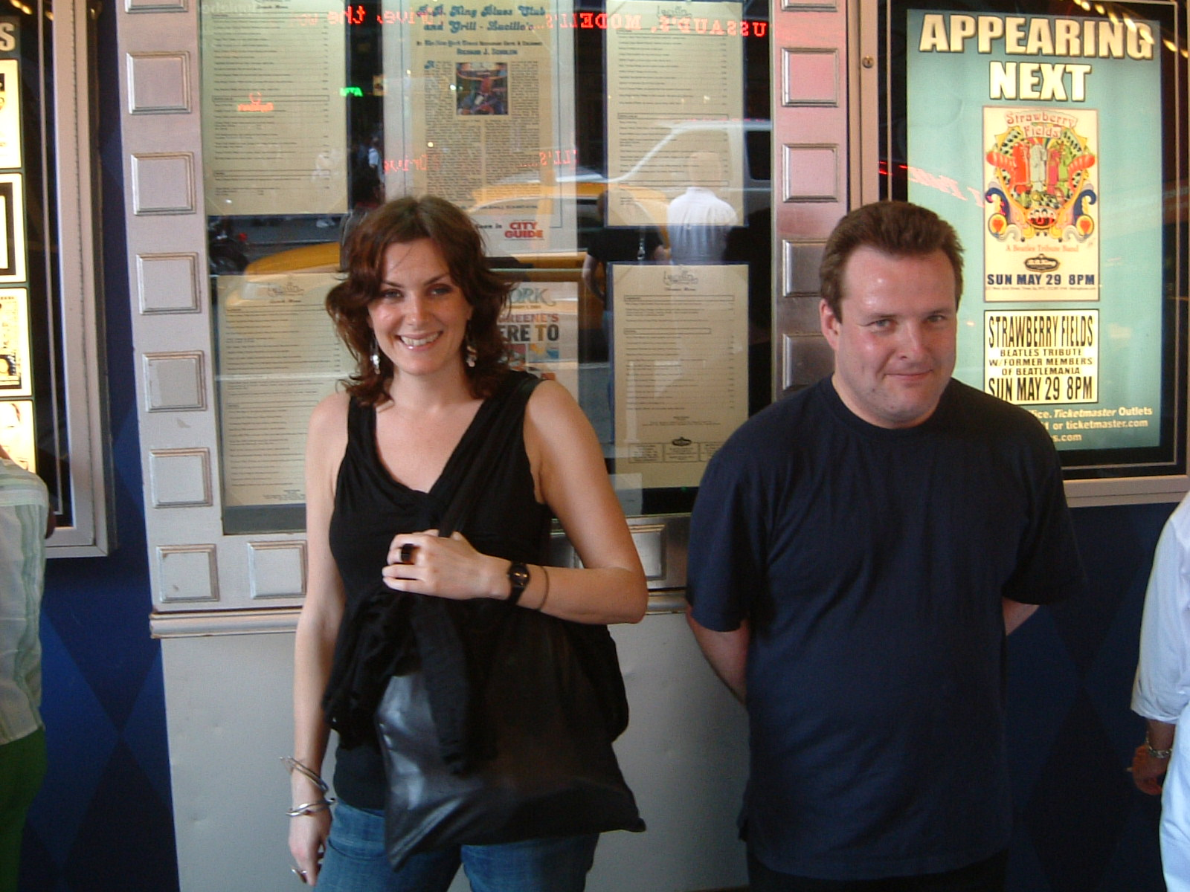
What do you want?
Notes:
Our son Neil – 1973-2009. Diagnosed with a Sarcoma in 2004. Operated on We though it was all over. Asked, “What do you want?” To go to New York. He met a friend, Alison. Enjoyed themselves.Good memories for us as we fulfilled his dream.
Our son, Neil, 1973-2009. Diagnosed with a Sarcoma in 2004. Operated on. We asked, “What do you want?” “To go to New York.” We took him. Met Alison, a friend. They enjoyed themselves. We have good memories. Asked what he wanted and made it happen. Heart of Patient-centred philosophy.

Slide 6
What matters to carers and relatives?

Slide 7
bereave (v.) Middle English bireven, from Old English bereafian "to deprive of, take away by violence, seize, rob," from be- + reafian "rob, plunder," from Proto-Germanic *raubōjanan, from PIE *runp- "to break"

Slide 8
Communication

Slide 9
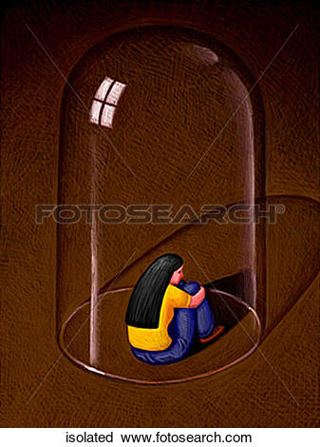
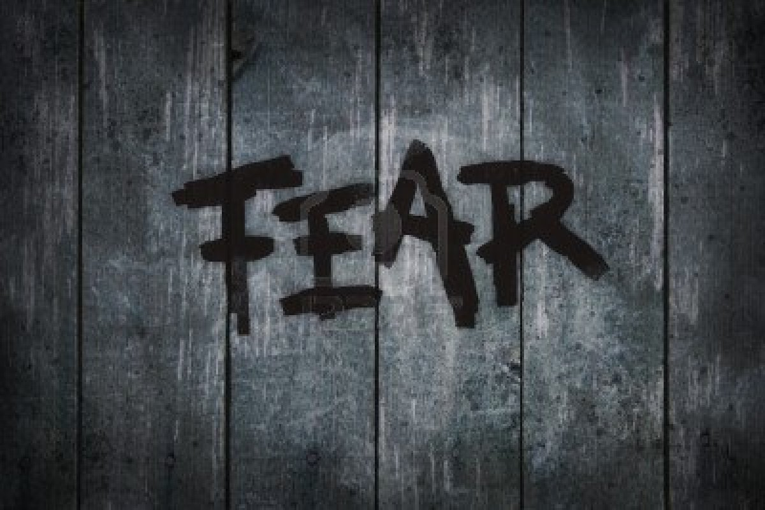
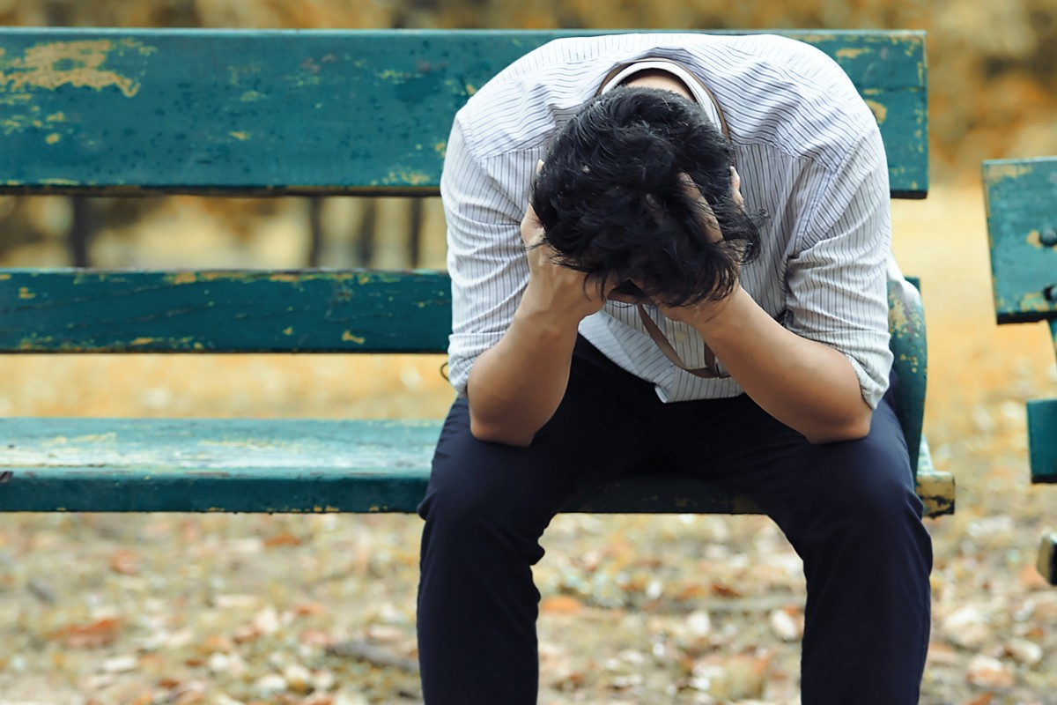
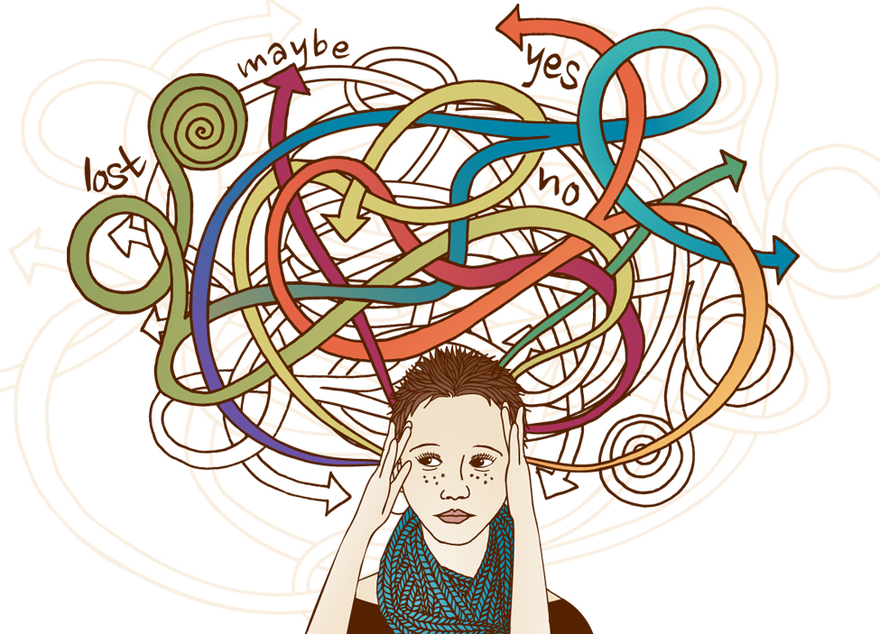
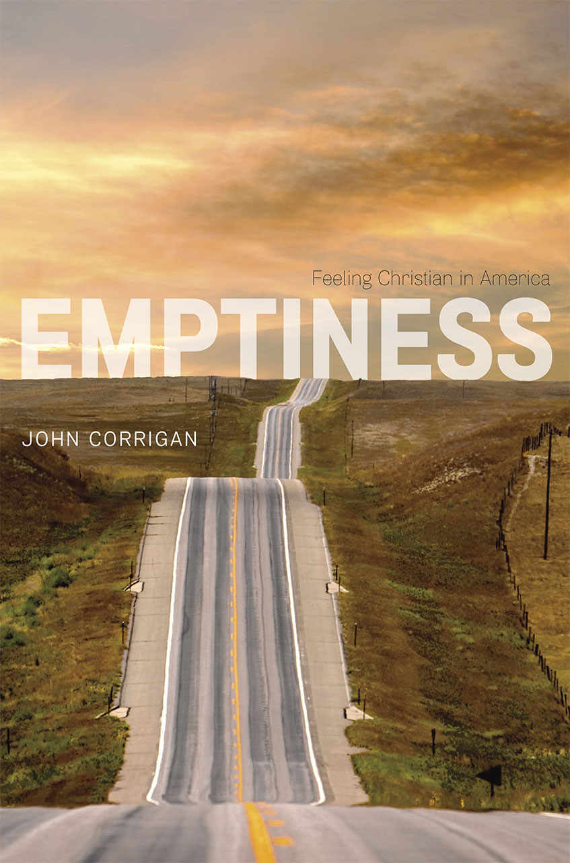
This can lead to:
Isolation
Despair
Confusion
Guilt

Slide 11
You know what you’ve said
But not what I’ve heard
When people are emotional, they don't listen to or remember everything, and they edit their memories.

Slide 12
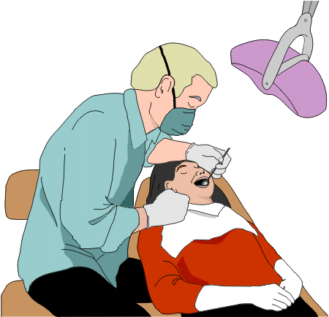
Am I going mad?

Slide 13
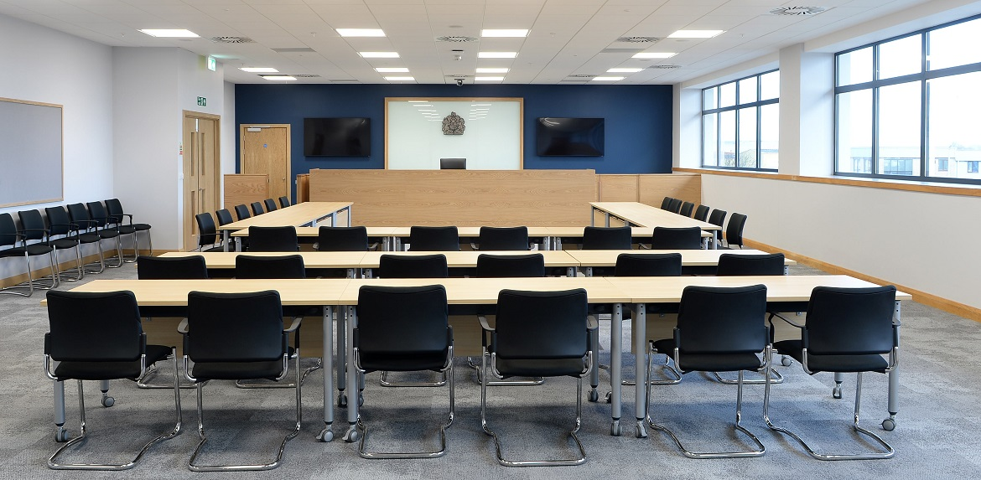

Slide 15
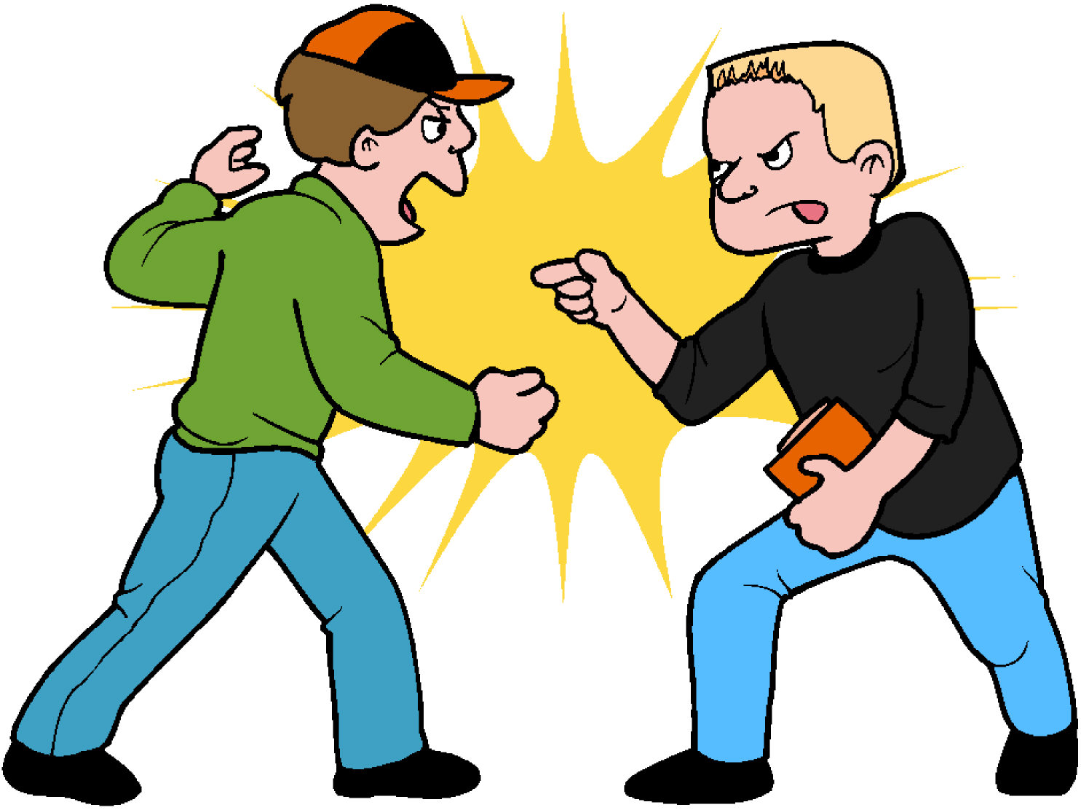

Slide 17
Authority

Slide 18
At the end, they got what they wanted

Slide 19
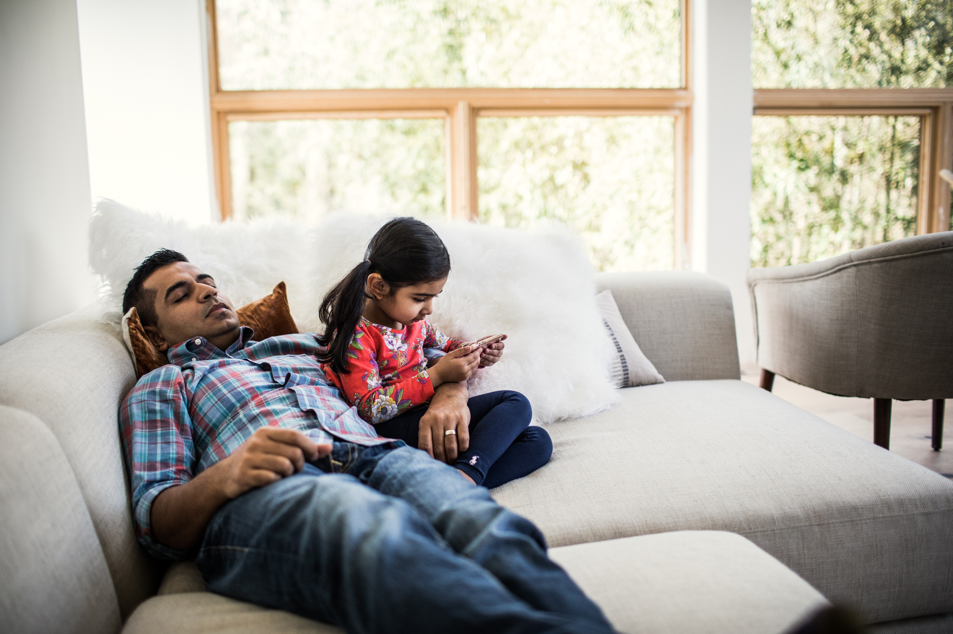
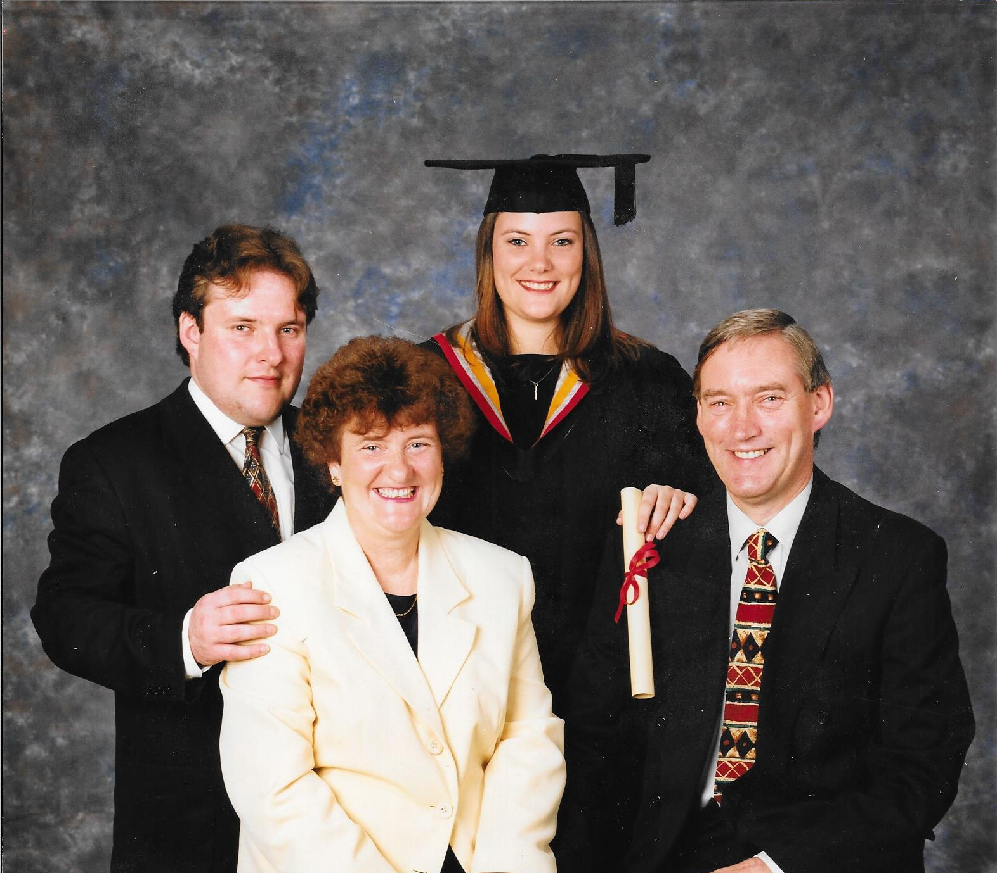
What matters?
That in the end the right things happened.

