Slide 1
Developing your role as a Designated Prescribing Practitioner Merina Michael Non-Medical Prescriber Education Lead (Trust Wide) Barts Health NHS Trust 19th May 2021

Slide 2
• The role of the Designated Prescribing Practitioner • Integrating the role into day to day practice

Slide 3
What's in the Name ?
Designated Medical Practitioner
Designated Prescribing Practitioner
Practice Assessor (plus a named practice supervisor)
Practice Educator

Slide 4
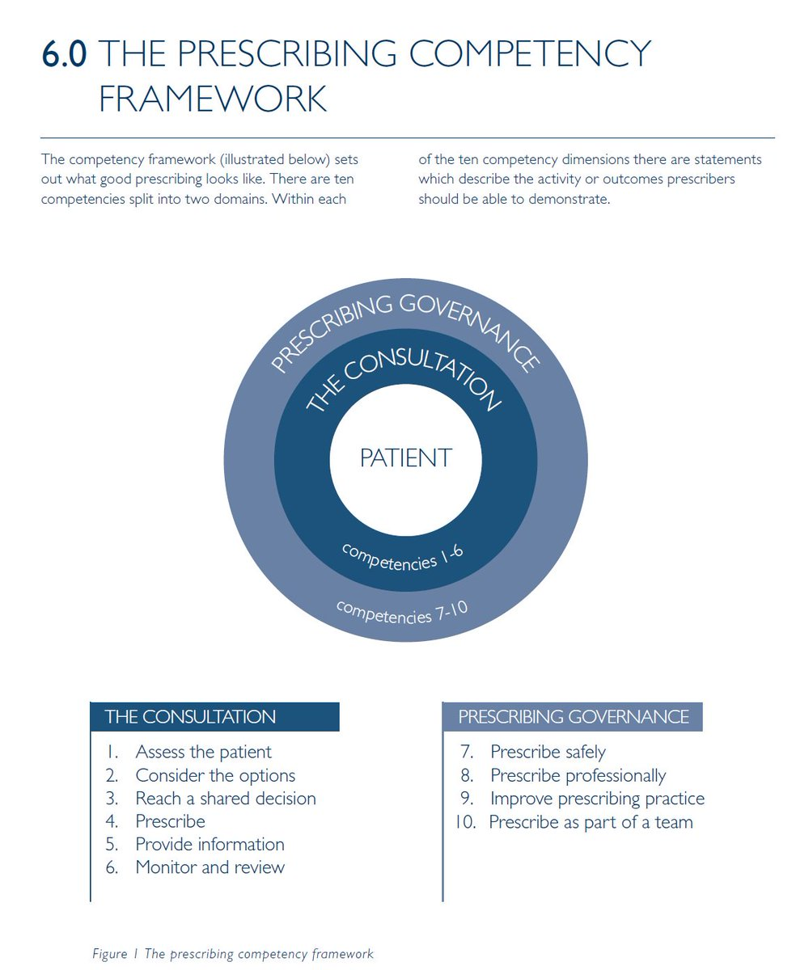
Underpinning the Competencies

Slide 6
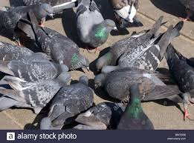
2nd NON-MEDICAL PRESCRIBER CONFERENCE Setting the vision for NMP
“Supporting prescribers to reach full potential “ Education Academy, Barts Health NHS Trust

Slide 7
Implementation of role as
Designated Prescribing Practitioner
Programme providers
DPPs
NMP Trainees
Employers / Organisations

Slide 8
1.Programme Providers
Assess competence of DPPs
Inform the development of training for DPPs
Support provision of feedback to DPPs
Academic Assessors

Slide 9
Arrangements for Practice Supervision
Appropriate arrangements for Practice Supervision are in place.
Assure that NMP Trainee will be fully supported in development as a prescriber.
Establish Practice Supervisor and Practice Assessor,
Responsible for period of Supervised Practice. If one person will undertake both roles, please ask them to complete the Practice Assessor section only. Please note that, in such circumstances,
A nominated signatory within your employing organisation must provide reasons for this situation.
Applicants undertaking the programme on an individual or self-employed basis, statement of support from a senior manager governance arrangements , statement of support.

Slide 10
University Application Form
PLEASE NOTE: We are not able to accept your Health CPD application form for the non-medical prescribing courses
without this Supporting Admission Form. A partially completed Supporting Admissions Form will lead to the rejection of
your application.

Slide 11
Support for PA/PS/DPP/PEs
Information Handbook
Initial communication to discuss the role and responsibilities
Telephone and email contacts provided
Communication between Academic Assessor and Practice Assessor at midway point and summative point, to be documented by the Academic Assessor.

Slide 12
2. PA/PS/DPP/PEs
Self assessment
Demonstrate meet required competencies
Identify areas for development
CPD and revalidation

Slide 13
The four broad competency areas
The ability to create an environment for learning
• Personal characteristics
• Teaching knowledge
• Teaching skills

Slide 14
PA/PS/DPP/PEs
Have a minimum of 3 years’ experience as an independent prescriber.
Is registered with the relevant regulatory body (NMC, GPhC or HCPC)
Is currently prescribing in their clinical role, we recommend at least once a week
Has some experience or training in teaching and/or supervision in clinical practice
Is able to support the student over 6 months and commit to a minimum of 30 hours of direct observation of the student

Slide 15
Practice Supervisors
Requirements for :
• Provide evidence of current knowledge and experience of the student’s intended field of prescribing practice
• Understand the competencies and programme outcomes they are supporting students to achieve
• Receive ongoing support to prepare, reflect and develop for effective supervision and contribution to, student learning and assessment
• Appropriately raise and respond to any concerns about student conduct and competence and be supported in
doing so

Slide 16
The Practice Assessor
• Normally be a registered medical practitioner or be registered on the same part of the NMC register as the student they are assessing
• Provide evidence of current experience of the student’s intended field of prescribing practice
• Understand the student’s learning and achievement in theory and the competencies and programme outcomes the student is aiming to achieve
• Undertake preparation or evidence prior learning and experience that enables them to demonstrate achievement of the following minimum outcomes:
Interpersonal communication skills, relevant to student learning and assessment.
the conduct of objective, evidence-based assessments of students,
the provision of constructive feedback to facilitate professional development in others
knowledge of the assessment process and their role within it
Receive ongoing support and training to reflect and develop in their role
• Demonstrate the proactive development of their professional practice and knowledge to fulfil their role

Slide 17
3. NMP trainees
Identify suitable DPP
Understand the role of the DPP
Demonstrate and document their professional development as a prescriber in a clinical practice learning log.
Document meetings with their Practice Supervisors and ensure this is available to the Practice Assessor at the designated meetings.
Be aware of the systems in place to provide feedback and support

Slide 18
University entry criteria For NMPs
• Current registration, Experience, Evidence of the ability to study at the academic level.
• Applicants must also provide:
•Written confirmation of support from their employer
Time to attend University,
Access to learning opportunities and protected time with Practice Supervisor and Practice Assessor.
The applicant can demonstrate safe and effective practice in relation to:
• Clinical/health assessment
• Diagnostics/care management
• Planning and evaluation of care
If self-employed
a comprehensive professional reference
arrangements made for practice supervision and assessment.
Written confirmation from the Practice Supervisor and Practice Assessor

Slide 19
Confirmation from Supporting organisation
The identified Practice Supervisor and Practice Assessor have
Skills and experience in a practice learning role
Demonstrate the required regulatory body and University criteria to support and assess students
Have been qualified as prescribers for a minimum of three years
Prescribe regularly
Fully supported by the service organisation .
Exceptional circumstances
Insufficient nurse prescribers with the relevant skills, knowledge or experience to Staffing challenges

Slide 20
4. Employers/ Organisations
Support governance processes around period of learning in practice
Assist prospective NMPs to identify DPP

Slide 21
The aims of practice experience:
To develop an analytical and critical approach which will promote creative and innovative practice
To enable students to develop the ability to identify their own individual learning needs and to develop the skills of reflection in order to appraise learning outcomes
To enable students to work with the PA/DPP/PE that promotes a shared approach to practice experience in order that identified learning needs can be met

Slide 22
The Designated Prescribing Practitioner
Personal Characteristics
Professional Skills and Knowledge
Teaching and Training Skills
Competencies DPPs should have prior to taking on role
General competencies- not specific to role
Support HEIs in assessing suitability to take on role

Slide 23
Learning Process
At the beginning
Mid-way
Summative points

Slide 24
Learning Agreement
The learning agreement should include statements about:
Learning needs / targets in relation to past experience and the learning outcomes
Strategies to be employed by the student to achieve the performance criteria required for each domain
The resources needed to achieve the performance criteria
The ways in which the student will monitor and evaluate

Slide 25
Examples of evidence of development:
Observe how the PA conducts
Consultation with the patient.
Development of the subsequent management plan.
Following this, observation and assessment of student’s ability to carry out patient consultations, suggested clinical management and prescribing options, which can then be discussed with the PA.
Allow in depth discussion and analysis of management plans using random case analysis approach, when patient care and prescribing behaviour can be examined further.
Reflect on consultations, encouraging critical thinking and reflection

Slide 26
Case studies-PS/ PA
The NMP Trainee can have multiple PSs /PA
Discussion
While the NMP Trainee can work with one PS / PA on multiple occasions,
Discussion

Slide 27
Case studies PS/PA
PS/PA is/ NOT Obliged to work with students for full 6 months.
Discussion
Practice Supervisors will have the opportunity to collaborate with PA/DPP/PE and have contact with Academic Assessors.
Discussion

Slide 28
Structure of NMP training
1. Consultation and decision-making
2. Assessment of the patient across the systems
3. Basic and Applied Therapeutics
4. Principles and methods of monitoring medicines
5. Evidence-based practice and clinical governance in relation to prescribing
6. Legal, policy, professional and ethical aspects
7. Prescribing in the public health context

Slide 29
Learning Outcomes
Knowledge and Understanding: Patient management
Intellectual Skills: safe and competent Prescribing
Practical Skills: prescribing decisions
Transferable Skills: Ethical and legal responsibilities

Slide 30
Factors Promoting the Implementation of NMP
1) Clinical supervision
2) Continuing professional development
3) Good inter professional relationships
4) learning culture
5) Seen as enhancing service efficiency rather
than altering the structural organization of care.

Slide 31
Q & A
“Supporting prescribers to reach full potential “ Education Academy, Barts Health NHS Trust

