Slide 1
A Practical Guide to Effective Prescribing in Cardiology For Current & Aspiring Non Medical Prescribers
14th May 2021
Virtual Conference
Jan Keenan
Consultant Nurse Cardiology
NMP Lead, Oxford University Hospitals NHS Foundation Trust
Jan.keenan@ouh.nhs.uk

Slide 2
Objectives
Developing, demonstrating and maintaining competence in Prescribing in cardiology
Developing confidence in prescribing practice
Ensuring your practice is evidence based: guidelines and evidence
Keeping your prescribing knowledge up-to-date: accessing education, training and resources
Assessing and evaluating prescribing competence
Ensuring you have the history-taking, clinical assessment and diagnosis skills to prescribe appropriately and effectively
Measuring the impact of prescribing on practice: audit and evaluation
My experience of nurse prescribing within cardiology nurse led clinics
Involving patients to improve adherence and outcome

Slide 3
From Novice…..
Developing, demonstrating and maintaining competence in Prescribing in cardiology
Developing confidence in prescribing practice
Ensuring your practice is evidence based: guidelines and evidence
Keeping your prescribing knowledge up-to-date: accessing education, training and resources
Assessing and evaluating prescribing competence
Ensuring you have the history-taking, clinical assessment and diagnosis skills to prescribe appropriately and effectively
Measuring the impact of prescribing on practice: audit and evaluation
My experience of nurse prescribing within cardiology nurse led clinics
Involving patients to improve adherence and outcome

Slide 4
To Advanced Beginner…
Developing, demonstrating and maintaining competence in Prescribing in cardiology
Developing confidence in prescribing practice
Ensuring your practice is evidence based: guidelines and evidence
Keeping your prescribing knowledge up-to-date: accessing education, training and resources
Assessing and evaluating prescribing competence
Ensuring you have the history-taking, clinical assessment and diagnosis skills to prescribe appropriately and effectively
Measuring the impact of prescribing on practice: audit and evaluation
My experience of nurse prescribing within cardiology nurse led clinics
Involving patients to improve adherence and outcome

Slide 5
To Proficient…
Developing, demonstrating and maintaining competence in Prescribing in cardiology
Developing confidence in prescribing practice
Ensuring your practice is evidence based: guidelines and evidence
Keeping your prescribing knowledge up-to-date: accessing education, training and resources
Assessing and evaluating prescribing competence
Ensuring you have the history-taking, clinical assessment and diagnosis skills to prescribe appropriately and effectively
Measuring the impact of prescribing on practice: audit and evaluation
My experience of nurse prescribing within cardiology nurse led clinics
Involving patients to improve adherence and outcome

Slide 6
Novice
Developing, demonstrating and maintaining competence in Prescribing in cardiology
Assessing and evaluating prescribing competence
Ensuring you have the history-taking, clinical assessment and diagnosis skills to prescribe appropriately and effectively

Slide 7
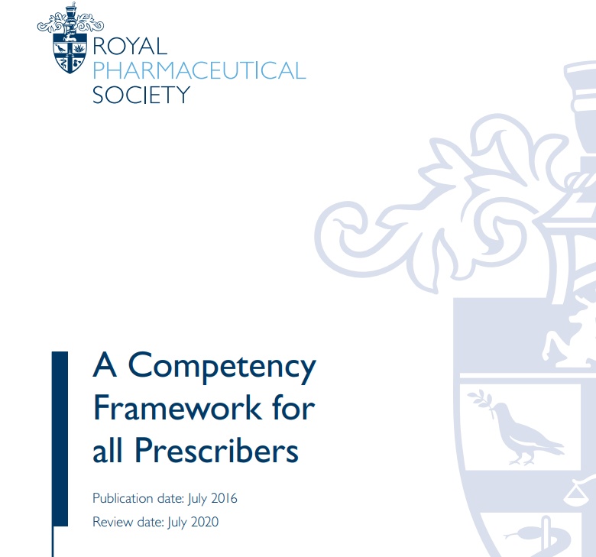
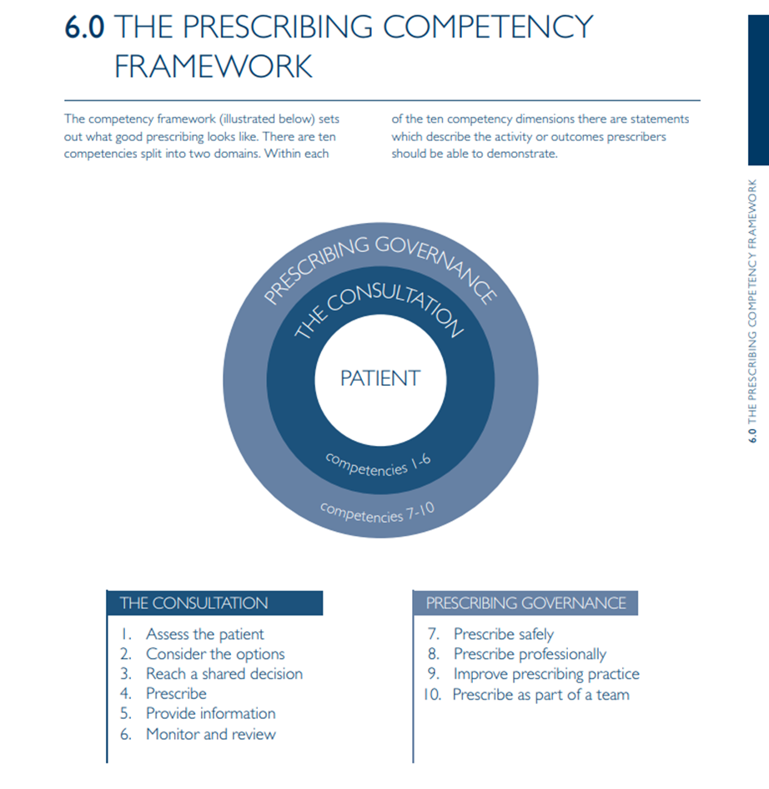
https://www.rpharms.com/Portals/0/RPS%20document%20library/Open%20access/Professional%20standards/Prescribing%20competency%20framework/prescribing-competency-framework.pdf?ver=2019-02-13-163215-030

Slide 8
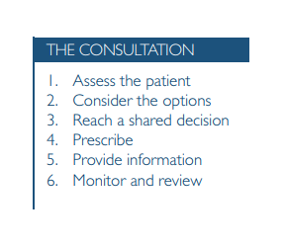
Who is your clinical supervisor?
Peer supervision
How do you use the competency framework?
How do you use your prescribing colleagues?
Is prescribing embedded into your appraisal?
Does your revalidation include reflection on your prescribing?
Do you keep a log or portfolio?

Slide 9
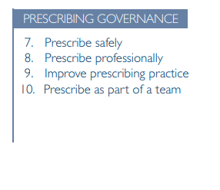
What does your non-medical prescribing policy look like?
Safely – decision-making, consent, shared decision making, person centred care, access to information; monitoring, follow up, referral, sharing information
Professionally - Professional guidance
https://www.nmc.org.uk/standards/standards-for-post-registration/standards-for-prescribers/
https://www.pharmacyregulation.org/news/gphc-launches-new-guidance-pharmacist-prescribers
https://www.hcpc-uk.org/standards/standards-relevant-to-education-and-training/standards-for-prescribing/
Clinical, national and local guidance
Improvement
What resources do you use or access?
What local resources do you have access to
https://www.sps.nhs.uk/
Teamwork
Consider Trust and National resources
Use your colleagues

Slide 10
Advanced Beginner
Developing confidence in prescribing practice
Ensuring your practice is evidence based: guidelines and evidence
Keeping your prescribing knowledge up-to-date: accessing education, training and resources

Slide 11
‘Confidence means feeling sure of yourself and your abilities — not in an arrogant way, but in a realistic, secure way. . . . . It's a quiet inner knowledge that you're capable. ... feel secure . . . .’

Slide 12
Guidelines and Evidence….?

Slide 13
Proficient
Measuring the impact of prescribing on practice: audit and evaluation
My experience of nurse prescribing within cardiology nurse led clinics
Involving patients to improve adherence and outcome

Slide 14
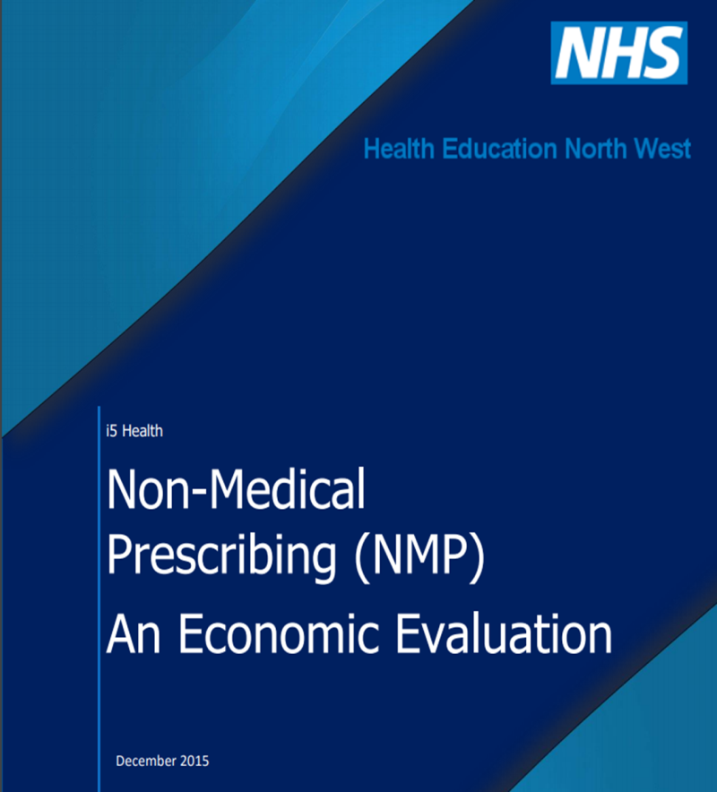
Audit and Evaluation
Define prescribing
‘to lay down, in writing or otherwise, as a rule or a course of action to be followed’
Record keeping, log book
Consider all your medication decisions
that means not just initiating a medication – it can mean NOT using a medication; it can mean stopping a medication (de-prescribing); changing or titrating a medication

Slide 15
Involving patients to improve adherence and outcome
Safe prescribing
Shared decision making
It’s OK to deviate
Listen!
‘How do you feel you are getting on with the medication’
Is there anything that concerns you about your medication?
Beliefs about Medication
Measuring Medication Adherence
Robert Horne, John Weinman & Matthew Hankins (1999) The beliefs about medicines questionnaire: The development and evaluation of a new method for assessing the cognitive representation of medication, Psychology & Health, 14:1, 1-24, DOI: 10.1080/08870449908407311

Slide 16
Objectives
Developing, demonstrating and maintaining competence in Prescribing in cardiology
Developing confidence in prescribing practice
Ensuring your practice is evidence based: guidelines and evidence
Keeping your prescribing knowledge up-to-date: accessing education, training and resources
Assessing and evaluating prescribing competence
Ensuring you have the history-taking, clinical assessment and diagnosis skills to prescribe appropriately and effectively
Measuring the impact of prescribing on practice: audit and evaluation
My experience of nurse prescribing within cardiology nurse led clinics
Involving patients to improve adherence and outcome

