Slide 1
Clinical cases for discussion
Jan.keenan@ouh.nhs.uk

Slide 2
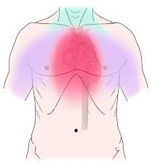
RACPC
The patient: 59 year old man; new onset stable angina with rapidly deteriorating symptoms
Previously fit and well
ECG normal at GP, Anterior TWI in clinic
To admit, or not to admit?
Will you prescribe?
What are your priorities?

Slide 3
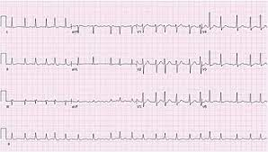
Cardiology Pre-admission
73 year old lady awaiting a left atrial circumferential ablation in AF at the time of preadmission clinic (PAC), poor rate control. Ankle oedema, increasing SOB on minimal exertion – rate related – and deteriorating gradually
PAC is outpatients –it’s Friday afternoon, she is due her procedure on Wednesday next week
What other information do you need?
Will you prescribe?
What is your priority?

Slide 4
Cardiac rehabilitation / follow up after MI
63 year old lady; anterior STEMI 3 months earlier; single vessel PCI, good LV, no bystander disease
Fed up. She’s tired, c/o poor effort tolerance, lethargy, poor concentration, can’t be bothered, vivid dreams, waking with central chest pain about once a week
On aspirin 75mg od; bisoprolol 2.5mg od; ramipril 2.5mg od; atorvastatin 80mg od; ticagrelor 90mg bd
ECG reduced amplitude anterior R wave, SR 52, no HF; BP 156/85
Would you change anything?
Would you initiate any other medication?

