Slide 1
The Effective Nurse Director A personal practical guide
Virtual presentation
Friday, 14th May 2021
JACQUELINE FILKINS, Professor
****************************************
Notes:
Prof. Nancy Fontaine

Slide 2
Dreams are allowed but a bumpy road can be expected
Notes:
Personal account of my professional journey, bumps and all.

Slide 3
My Dream – it is postponed for 5 years....
My dream was to become a nurse
Not in my home country but in Africa!
… there was a problem: “Business studies come first!”
Notes:
Business Studies 3 yrs f/t then off to England to start work at the SNTO, YHA--- future husband, back to CH to start nursing

Slide 4
Motivation is a want – it is what gets you started
Determination is a need – it is what helps you to finish what you started
From “Executive Coach” by Jamie Douraghy
https://www.lifeworkintegration.com
Notes:
From: Hanging on to the motivation and shaping it towards determination is not always easy….
I will now present my talk in THREE sections: 1Learning experiences in Malawi, then short 2 years in York followed by Madagascar, back to UK (Leeds, Brighton, Carlisle) 3 1992 ENDA, Links and summary of Reflections.

Slide 5
The long journey of my professional life begins…
From Switzerland to England
From Southampton via
Senegal,
Ascension,
St. Helena to
South Africa (Capetown)
through the Kalahari to
Bulawayo and on to
our destination:
MALAWI
By train and ferry
By boat
(Studying an old textbook on Tropical medicine on deck of the ship during the voyage)
By train and car to:
Notes:
5 years later I am a qualified nurse! (2yrs in SNTO, UK & 3 yrs Red Cross Hospital, Berne) Long journey starts with somewhat starry eyes and somewhat ill prepared ….

Slide 6
1 From Europe to Central Africa (Malawi) and back
We were ill prepared and had not asked the right questions!
Dozens of little wood fires under a corrugated roof next to the new hospital
Patients laying on the floor on mats…
No time to waste: out comes typewriter to write situational reports and begging letters.
The lesson:
DO NOT ASSUME!
A new hospital without beds, no running water, only intermittent electricity, empty shelves, a few glass syringes
Medical assistants who really know more than you and…
it’s hotter than you think!
Notes:
I was told that I would work in a newly built hospital …..My image of a hospital was not what I found! And my husband was to establish a farm. Our tour duration was 3 years. ---Back to the UK for 2 years to York. (The work has carried on: Teaching hospital, Farm with fishponds ….)

Slide 7
2 From England to Northern Tip of Madagascar and back
Amending the dream….
2 yrs in York, psychiatric hospital (p/t night staff nurse).
Then it was time to pack our belongings to start our 2nd tour:
A new journey starts from England to Tananarive MADAGASCAR to
Diego Suarez (Northern tip of Madagascar)
Lessons learnt:
TAKE OPPORTUNITIES (decimalization!)
BE PREPARED and CONFIDENT
Being prepared attracts local mothers to clinic held on veranda (my mother’s circle of friends made garments for children…)
Notes:
We are better prepared: have made contact with the right people in Madagascar (Antanarive) prior to the journey (Rotary, Clergymen) and got help from family and friends at home

Slide 8
EXAMPLES from experiences which shaped my work
Leeds: An appraisal whilst on night duty leaves an impression
Brighton :
a) I don’t like multiple choice questions - but later it leads to promotion: SCN
b) Primary nursing: NOT for the night staff! Only 12-hour care? Out comes the typewriter and it has unexpected repercussions.
c) A two-week trip to Canada: a nightmare or pleasure? But help is at hand…
d) The big NHS reorganisation of the NHS: from Administrators to Managers. “what if’s…” emerge and have surprising outcomes.
e) I am no longer Senior Clinical Nurse but Hospital Manager and Senior Clinical Nurse. Nurses are not the only angels….
Notes:
LEEDS: Reflection, Learning; BRIGHTON: Night Sister a) Re-group and remain motivated; b) Get into Action and Speak up! c) Accept Help (Director of Education, from Canadian host & Prof Charlotte Kratz) d) Imagine the “what if” and Act & take the Opportunity (Outline a job description for a job which does not yet exist) e) Mr Foster From Finance helps, RCN gives support with media training whilst nurses close doors (not for long). OPPORTUNITIES taken to develop new ways of working (interprofessional working, budget sharing)

Slide 9
Four years later…CARLISLE!
1988 Manager, Patient Care Services/Deputy UGM
1992 Executive NHS Trust Nurse Director
1997 The big change: Dean, Faculty of Health (later: …and Social Sciences)
Focus on improvement, innovations, involvement locally, nationally and within the EU, change management, leadership and education.
LISTEN, be INSPIRED and INSPIRE
Notes:
From 1988 – 1992: I don’t assume to know what staff know or don’t know and find an ally (Dir. of Education) and Clinical Grading also helped!) Nurture the “good bits” (staff and practices) let them Inspire others (Champions), make tough Decisions (meringues, Aberdeen) Involvement RCN (International Committee), IHM (member), University College of St.Martin’s (Governor) Further Studies Birmingham University 2yrs p/t
From 1992 – 1997 Same Boardroom, same faces but different responsibilities; building on good relationships.

Slide 10
1992: Creation of ENDA
3
Need for action was decided: An association for Nurse Directors is planned. 1st President is chosen.
We can achieve more together and learn from each other
Initial step: undertake a SWOT analysis of the job of Nurse Directors from the countries represented in ENDA
Bi-annual congresses are established
A Proto-code of Ethics for ND is created!
Notes:
JF 1st President, Alliances are being formed, EU working parties, Presentations in French, German, English. External Expertise from members, ANP, Nurse Prescribing, Membership not just for ND but Nurse Leaders-INFLUENCING POLICIES WITHIN THE EU +++ Nurse ENTREPRENEUR: ENGLISH FOR NURSES

Slide 11
Instead of networking think of making LINKS
Links must be strong for the creation of a network
Intuition, Innovation, Inspiring, Involvement are good ingredients
Nurture
Knowledge

Slide 12
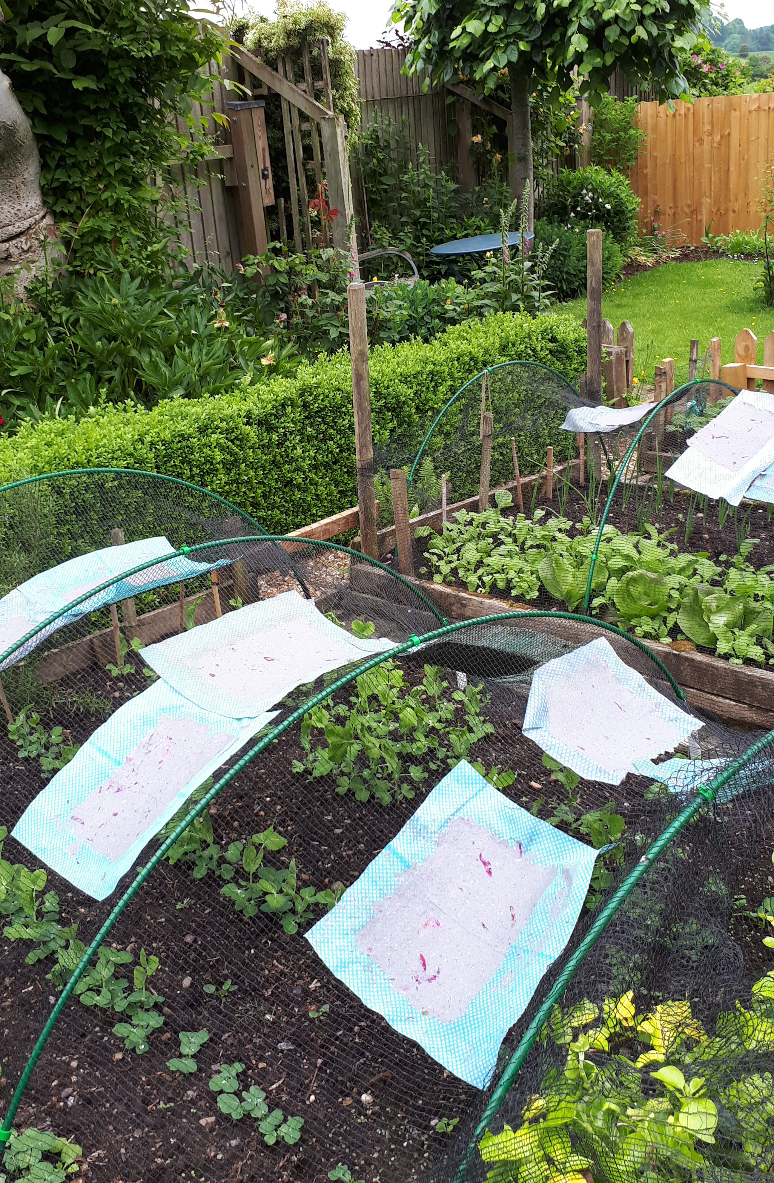
Reflections on elements which shaped my career
COMMUNICATION: Listen to tone, expression, body language. Ask the right questions.
OPPORTUNTIES: They may be big or small but take them, be brave!
GET INVOLVED! See where you can make a difference.
PROBLEM SOLVING: Analyse it, seek solutions, identify possible support, prepare to be flexible and surprised - but do know your inner self.
INSPIRE AND KEEP LEARNING: Make it happen for patients, staff and yourself.
DELEGATE: Be clear about what, who, when and level of delegated authority.
…………GET A HOBBY!!!!

