Slide 1
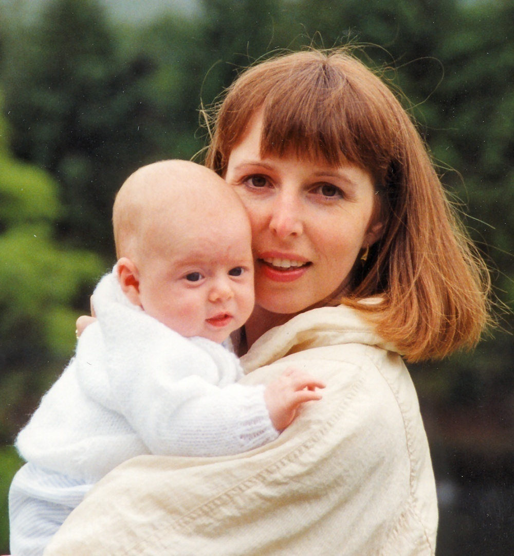
Perinatal Mental Health Crisis…what does a crisis feel like?

Slide 2
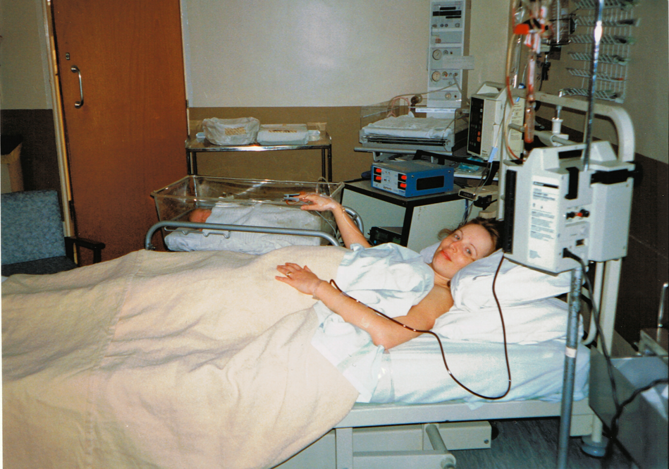

Slide 3
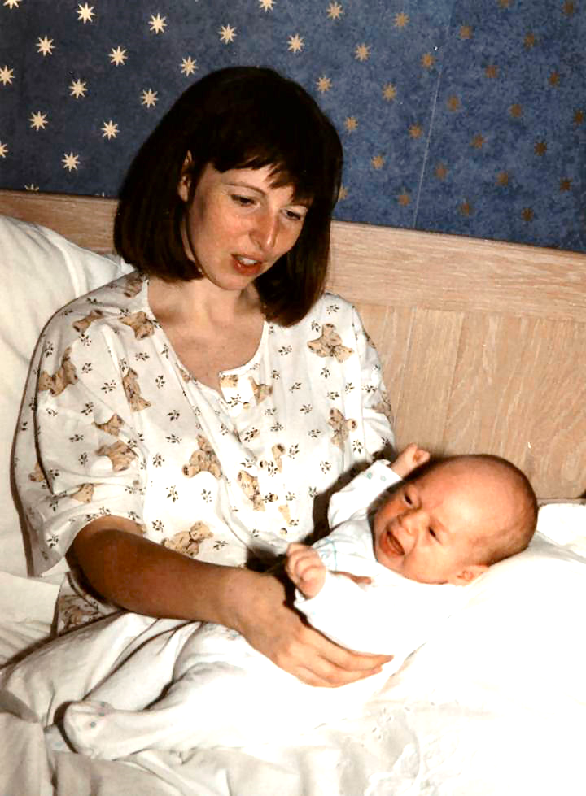
Exhausted
Lonely
Aggressive
Irrational
Nervous energy
Emotional
Notes:
Enjoyment?

Slide 4
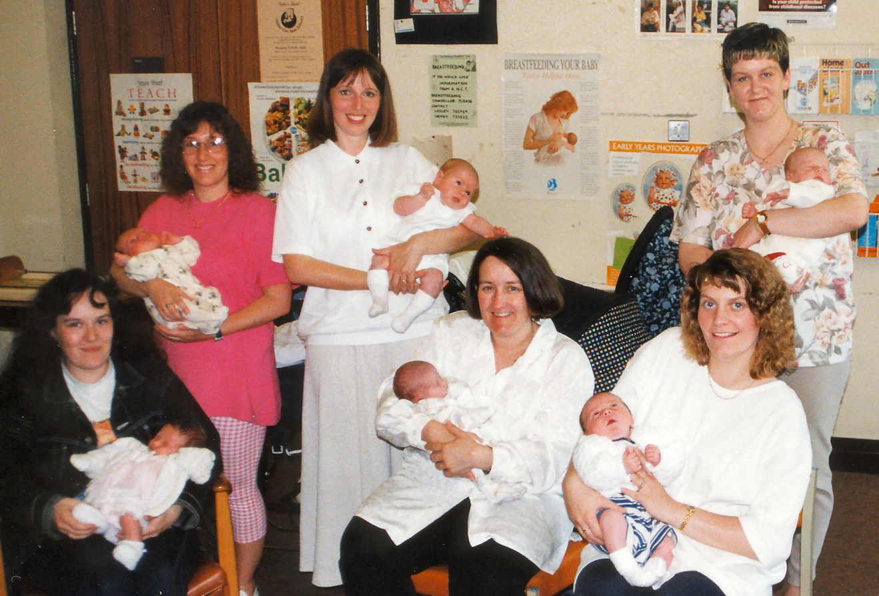
Why does everyone else seem to cope?

Slide 5
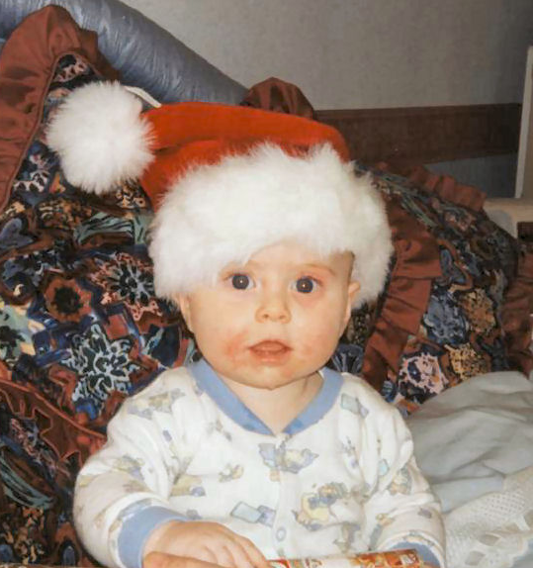
Where’s my Mum?

Slide 6
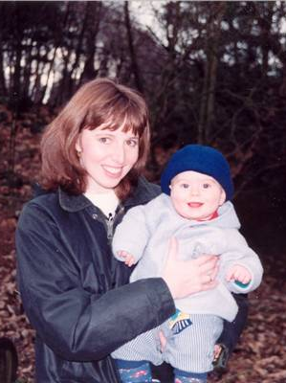
An in-patient!

Slide 7
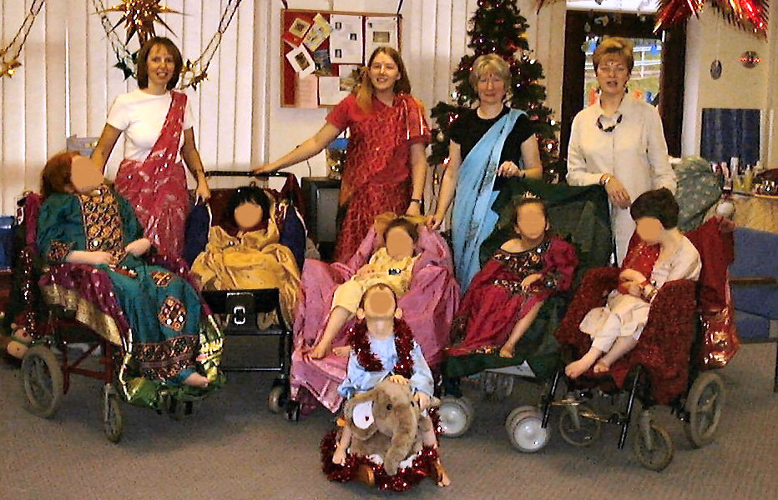
Back to life ….

Slide 8
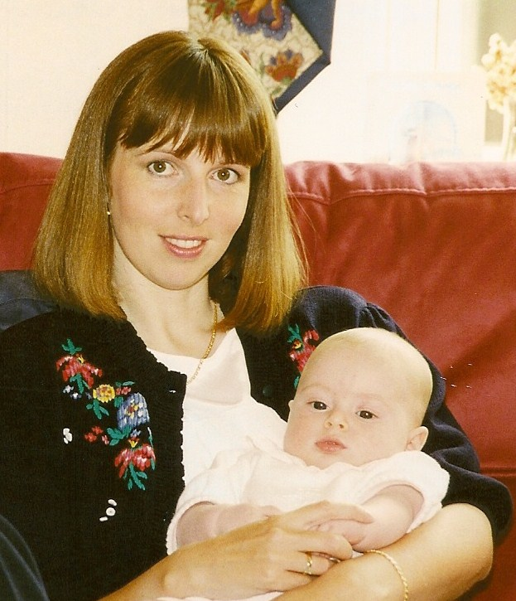
Empathetic HCPs
Time & patience
ECT
Family and friends
Being in hospital
Occupational Health
My son
Exercise
What helped?

Slide 9
Non-empathetic HCPs
Communication
Sleep deprivation
Financial pressure
My ‘dishonesty’
Ignorance
My
personality
Stigma
What hindered?

Slide 10
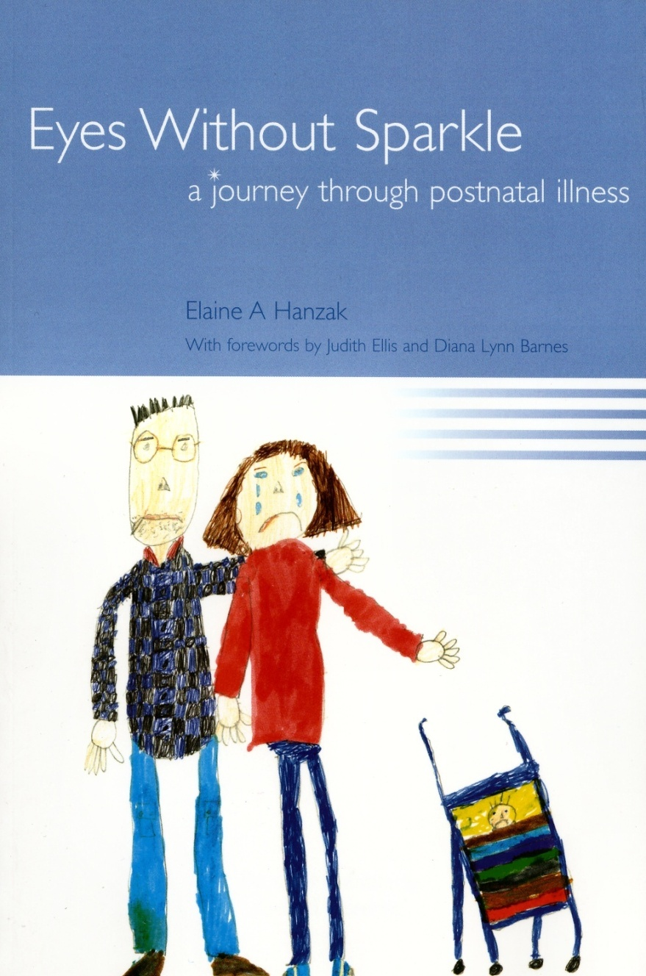
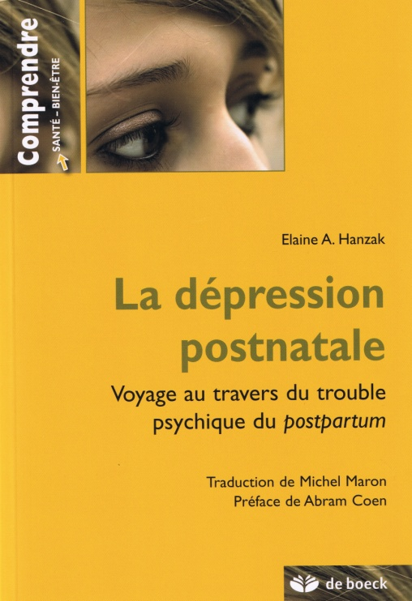

Slide 11
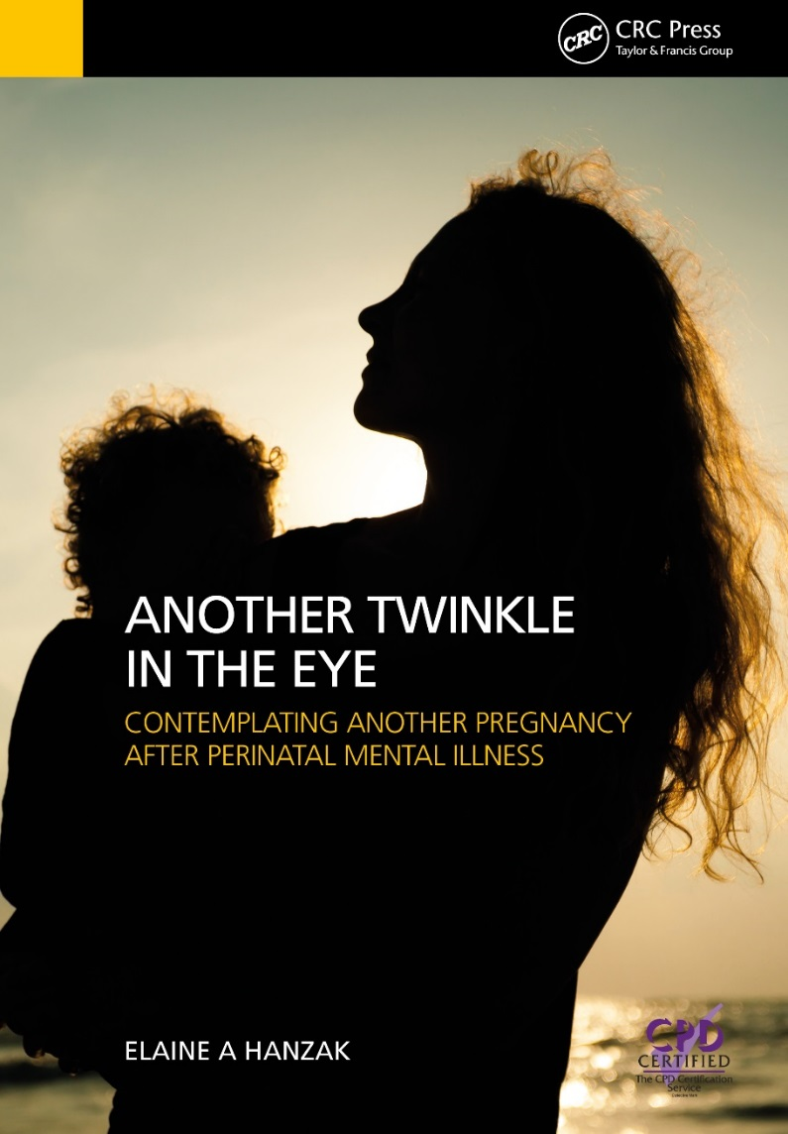
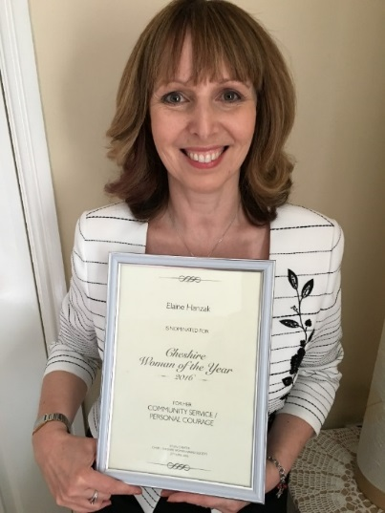

Slide 12
Suicide is a leading cause of death for women during pregnancy and in the year after giving birth

Slide 13
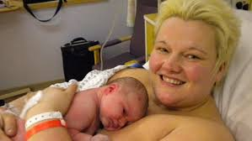
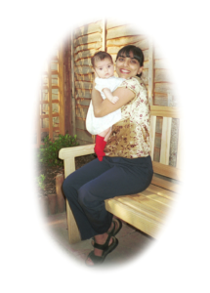
Let’s enable their silent screams to be finally heard!
Notes:
Claire Peake, 39 – school teacher – hung herself like scene from Officer & Gentlemen
Joe Bingley, nurse – jumped in front of a train
Charlotte Bevan + daughter – jumped off Avon Gorge in Bristol
Dr Daksha Emson & Freya – stabbed and set fire
In the words of Daksha Emson’s husband on what would have been his daughter’s 18th Birthday – ‘Let’s enable their silent screams to be finally heard’.

Slide 14
COVID-19
Covid-19 & Long Covid

Slide 15
During and after pregnancy, women have faced a greater likelihood of poor mental health during the pandemic, including anxiety, depression, loneliness and suicidal thoughts, according to a new report commissioned by the Maternal Mental Health Alliance

Slide 16
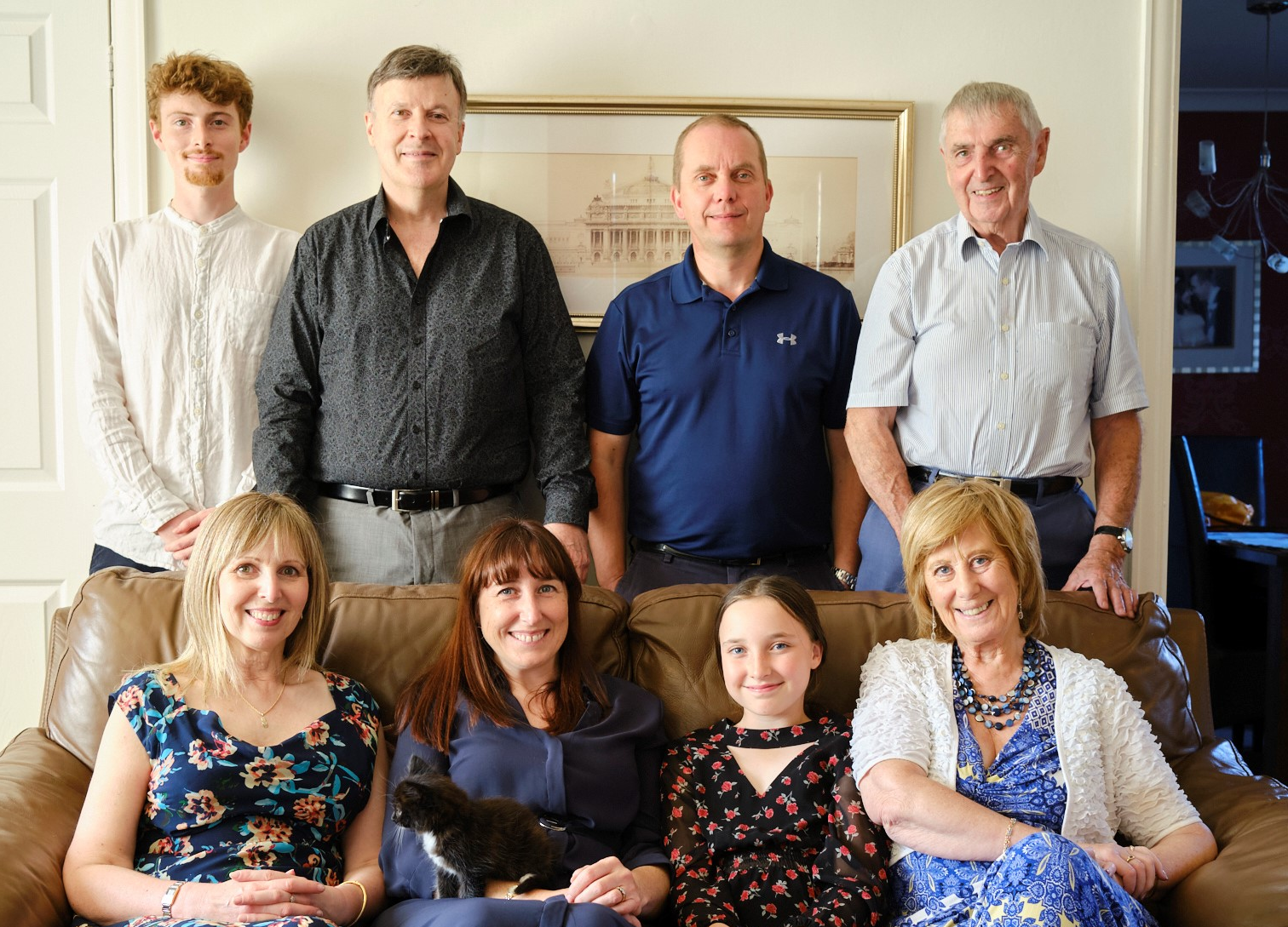
Gratitude

