Slide 1
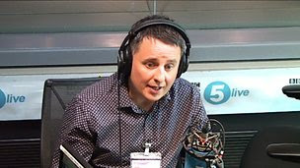
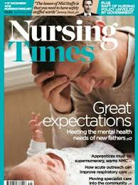
Mark Williams
Founder of International Fathers Mental Health Day
A father
Author & campaigner
Public speaker
Notes:
A well known UK advocate for supporting fathers in their Perinatal Mental Health. He has been active in support work and media awareness, helping his wife through her postnatal recovery after a trauma birth and getting through his own journey

Slide 2
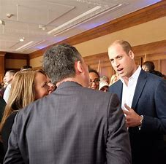
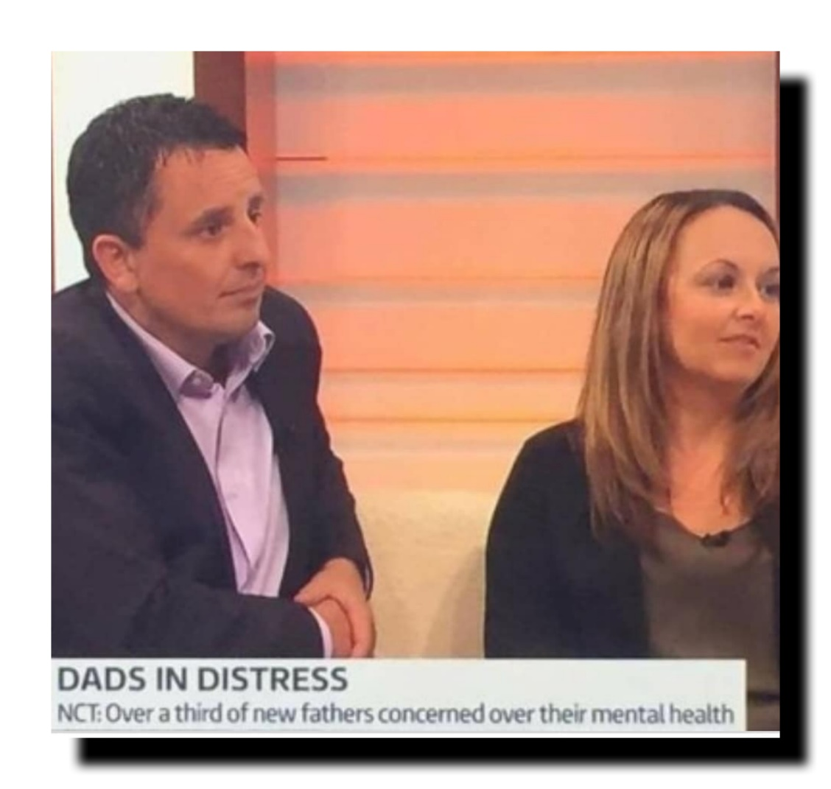
Awareness and Education

Slide 4
June 21st

Slide 9
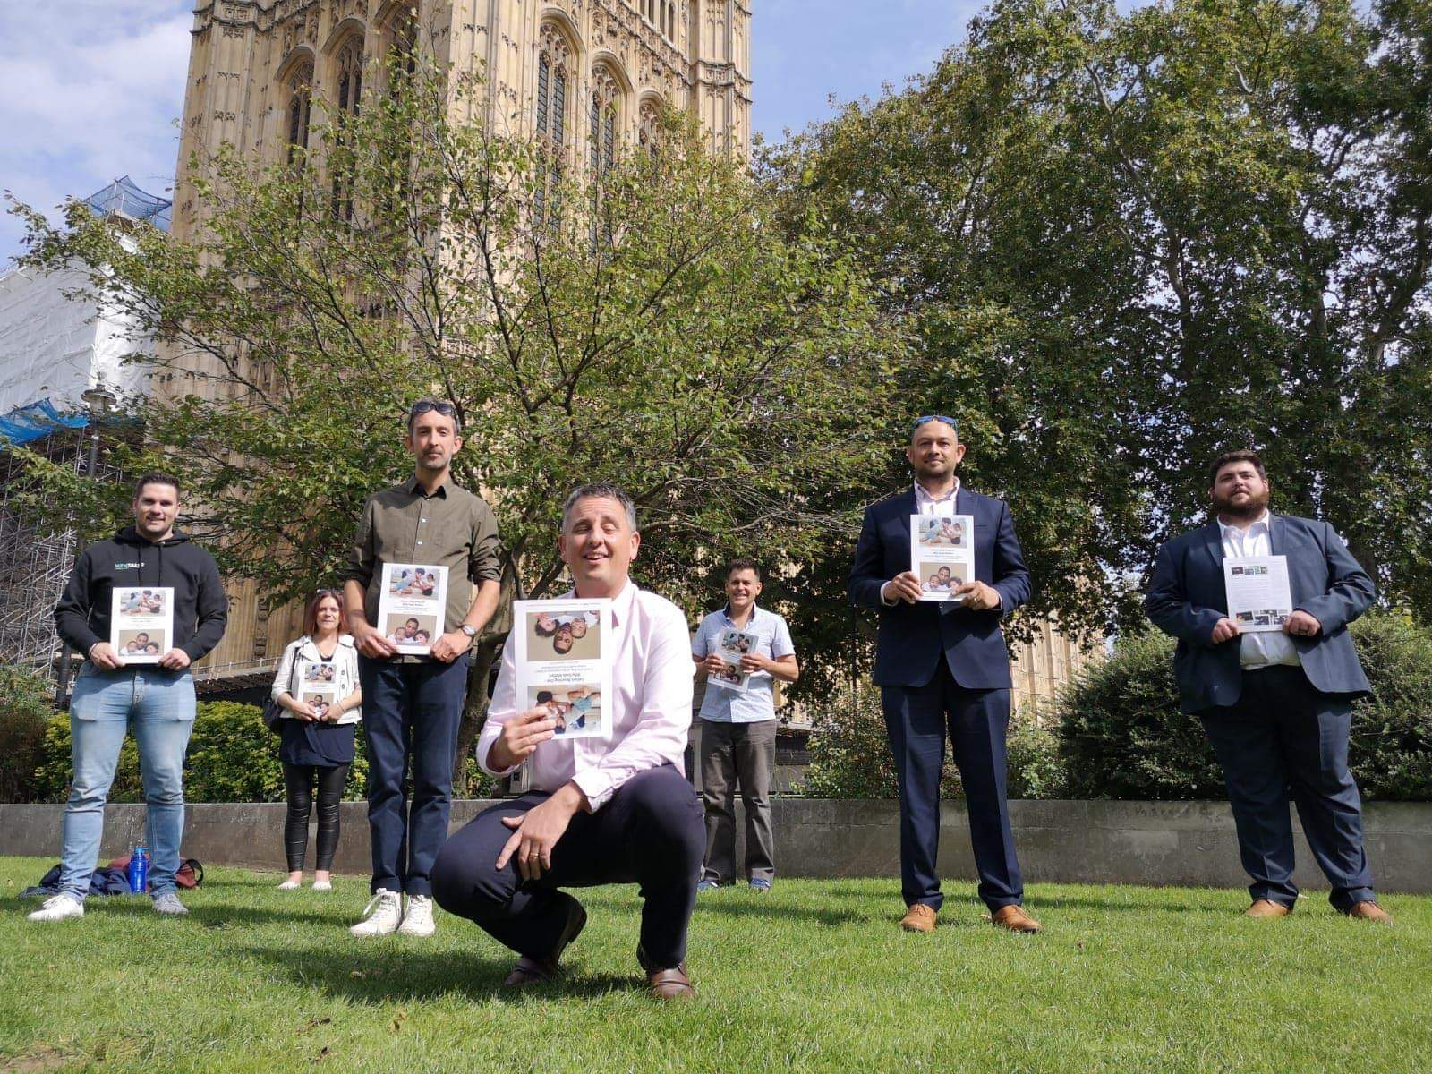
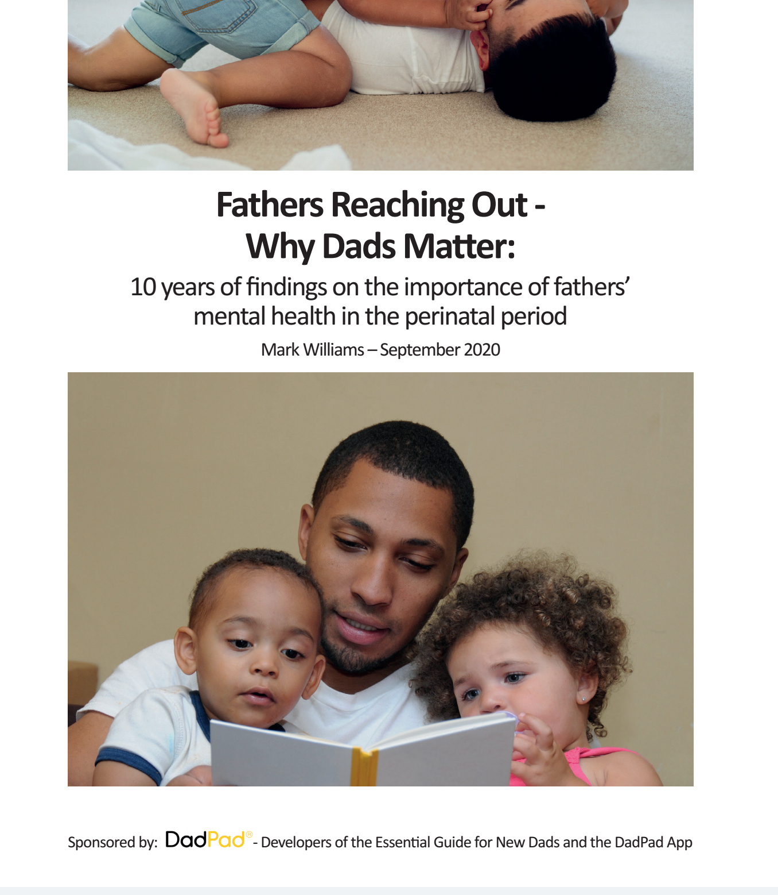

Slide 10
Questions
&
Answers
Notes:
Ask how we do feel?

