Slide 1
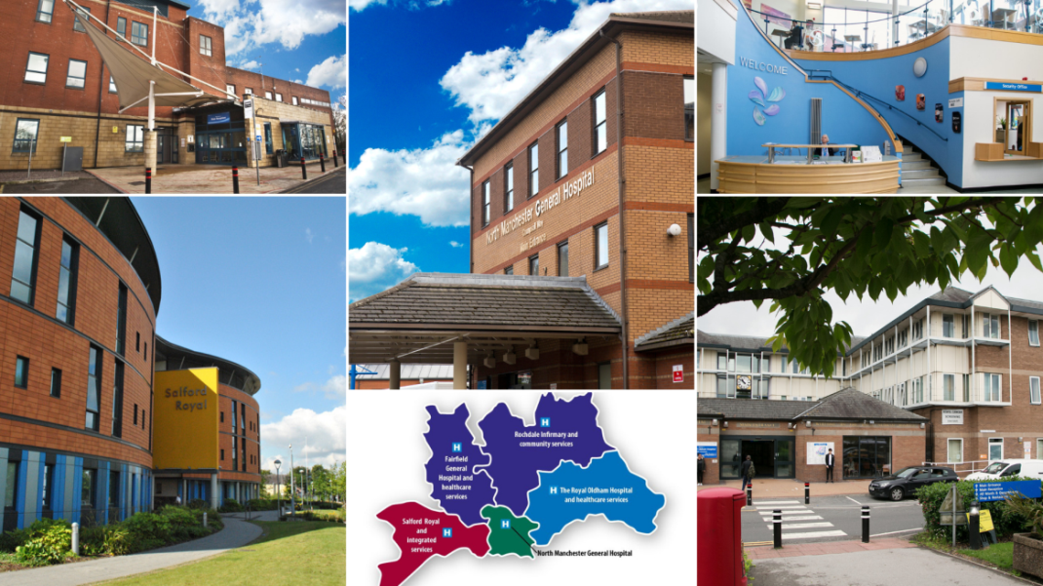
Nursing Assessment & Accreditation System (NAAS)
May 2021
Notes:
Now very much a national focus on accreditation.

Slide 2
Simon Featherstone
Director of Nursing
Salford Care Organisation (Northern Care Alliance)
Helen Carter
Associate Director for Assurance and Quality
Northern Care Alliance

Slide 3
Aims of the presentation
Our Accreditation story – Salford, Pennine, Northern Care Alliance
The last 12 months……
What does an accredited ward look like – ‘SCAPE’ wards
Governance – Reducing variation across wards on 4 sites
Celebrating Success and supporting wards who are not meeting the standards

Slide 4
The Northern Care Alliance

Slide 5
Salford
In 2008 SRFT launched its Quality Improvement Strategy which aimed to reduce harm and mortality as well as be the safest hospital in the country. No standardised method to formally measure the quality of care being delivered across the organisation at this time.
Context in 2008 – 49 wards at Salford – ad hoc assurance. No recognition for best practice or good leadership. Ward staff had little involvement in assurance. Key elements missing including; personal ownership, structure and framework, standardisation of documentation and responsibility and accountability of staff/teams.
September 2008 NAAS launched. 13 key standards derived from key performance indicators including; Organisation & Management of the ward, Safeguarding, Pain, Patient Safety, Environmental Safety, Nutrition and Hydration, End of Life, Medicine Management, Person centred care, Pressure Ulcers, Elimination, Communication and Infection Prevention and Control. (Now 14 standards, new People Standard)
Each standard is RAG rated individually to provide an overall score. 3 elements in each; Environment, Care and Leadership

Slide 6
The Assessment Process
Reassessment
Unannounced visit
2 assessors spend full early shift on the ward (including handover)
Verbal feedback given on the day
Full report sent to the Manager
2 weeks to complete an Action Plan
Engagement of the team in order to meet actions
Desk top preparation prior to assessment
Notes:
Moving forward the NAAS process will now be standardised across all Care Organisations as we come together as the NCA
The assessment day is really a time to shine and showcase good practice and any improvements which have been made in your area and highlight the positive impact they have had on providing patient care which is safe clean and personal
Unannounced visit by 2 assessors
Desktop preparation prior to assessment
Full morning shift (inc handover & huddle)
Assessment – incorporates the wider multidisciplinary team, patients and families
Observation through data, inspection and patient feedback
Immediate feedback to teams
Detailed report provided following assessment
Action for improvement through support

Slide 7
NAAS Reassessment
Red | 5 or more red standards in total | Level 0 | Reassess in 2 months
Amber | 3-4 red standards in total | Level 1 | Reassess in 4 months
Green | 1-2 red standards in total 8 green standards | Level 2 | Reassess in 8 months
Blue | SCAPE Wards | Level 3 | Annual Review

Slide 8
Pennine( North East Sector) Journey
February 2016 CQC inspected services at PAHT overall rating “inadequate”
Several key areas for improvement were identified:
Patient safety Systems of assurance Governance arrangements Leadership Quality of care.
Staff subsequently seconded from SRFT in August 2016 as part of the Trust Improvement Plan
NAAS initially piloted in 9 clinical areas across sites
Final document and process agreed with the Directors of Nursing/Chief Nurse
November 2016 and full roll-out of adult inpatient areas commenced

Slide 10
NAAS Matron Role
Background:
Introduced in May 2017 at Pennine in response to the significant number of red rated wards
Key role in providing targeted visible support in between formal NAAS assessments
One matron initially based on each site within the North East Sector
March 2021 - NAAS matron commenced at Salford as part of standardisation of the accreditation team as an NCA service

Slide 11
Notes:
1 Red, 9 Amber, 47 Green & 41 SCAPE

Slide 12
NAAS
SRFT - 2008
Summary
CAAS
SRFT - 2013
NAAS
PAHT 2016
Paediatric NAAS
PAHT 2018
NES CAAS pilot 2020
NCA NAAS
Restart using a standardised tool across the NES
Notes:
NAAS as been in place at Salford for 13 years now and CAAS 8 years. NAAS was implemented in the NES as part of the Quality Improvement Plan, following the CQC inspection in 2016 which rated the Trust as inadequate. In 2018 a Paediatrics tool was developed and implemented. With the creation of the Northern Care alliance we have now created a standardised NAAS to be used across all sites. The Accrediation system will continue to develop and expand in to other areas such as Theatres, Maternity services and outpatients.

Slide 13
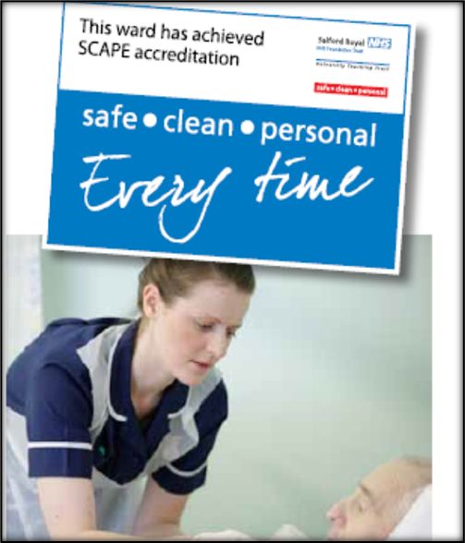
SCAPE - Accreditation
Safe Clean and Personal Every Time
3 consecutive green assessments
Application and Portfolio of evidence required
SCAPE panel, executive and non executive board
Panel visit to the team
Presentation and Q&A session
Panel recommendation to CIC for Trust Board to decide
Not all teams are accredited with SCAPE status.
Outcome of panel can be to accept, decline or defer accreditation.

Slide 14
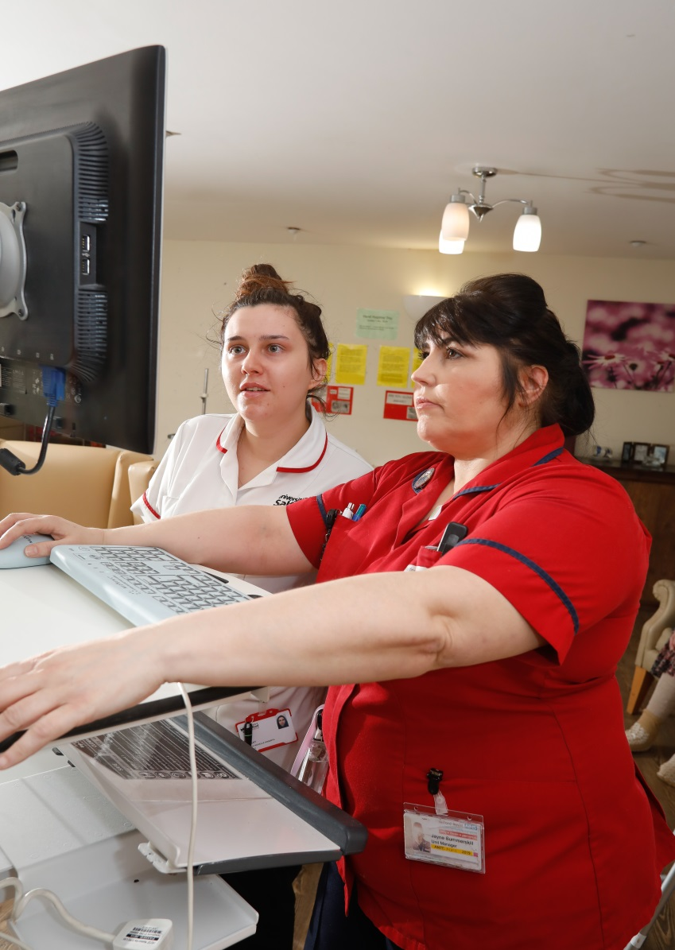
SCAPE Wards
Expanding Ward
Managers role to ward
Matron
Recognition for all the ward
team
Patients benefit from safe, clean
and personal care every time

Slide 15
The Last 12 Months:
The team were redeployed in March 2020
Supported various roles including Infection Prevention and Control Teams on all sites.
Implemented a ‘mini-audit’ process in May 2020. This continued in various forms until January 2021.
Team then supported the vaccination programme.
Restart formal assessment process in May 2021

Slide 16
Current Issues:
Lack of assurance around quality of care currently being delivered by ward teams and community teams
The restart needs to be a supportive process recognising the experiences of many teams.
Decision made to freeze pre-pandemic scores for the next 12 months until all inpatient areas have been assessed. Approximately 80 teams.
Opportunity to restructure the team/tool/process across the NCA.

Slide 17
Governance
NAAS team sit within the Corporate Nursing structure with close links to each of the Care Organisations senior nursing teams
Responsibility for improvement is with the ward manager and supported and monitored by the care organisation nursing structure
The content of the standards are reviewed annually in conjunction with the expert specialist nursing teams
Team KPIs are the maintenance of the assessment schedule
Monthly reports of NAAS results produced by each site NAAS matron and presented at site QPE/Nursing and Midwifery Board. Themes identified and shared
NAAS results shared at NCA Board
A bi-annual report produced for all sites and presented to Audit Committee to identify NCA position

Slide 18
Centrally
operated
Sustainability
Locally
owned
High
purpose
Reward/recognition
Leadership
identification
Target
QI
Accountability/
Gap
analysis
Consequence
Skills
Standards

Slide 19
Summary
Northern Care Alliance NHS Group continues on its quality improvement journey
‘Back to basics’ – no new developments.
Despite the same pressures, wards feel calmer, more organised, staff more in control.
Need to triangulate data and see a reduction in harms and an increase in positive patient experiences and outcomes.
From April 2021 the NAAS process will be standardised across the NCA.
Main focus now for the next 12 months is that the process is reintroduced as a supportive process to aid recovery of both team, individuals and the Organisation post Covid-19

Slide 20
Thank you

